Slide 1
802.24 Vertical Applications TAG
802.24.2 IoT TG
What is the Internet of Things
November 10, 2021

Slide 2
What is the Internet of Things
• The network of physical objects that contain embedded technology to communicate and sense or interact with their internal states or the external environment. (Gartner)
• A global infrastructure for the information society, enabling advanced services by interconnecting (physical and virtual) things based on existing and evolving interoperable information and communication technologies. (IoT-GSI)
• IoT describes a world where just about anything can be connected and communicate in an intelligent fashion. In other words, with the Internet of Things, the physical world is becoming one big information system. (Techopedia)
• It’s a concept of everyday objects – from industrial machines to wearable devices - using built-in sensors to gather data and take action on that data across a network. (SAS Institute)

Slide 3
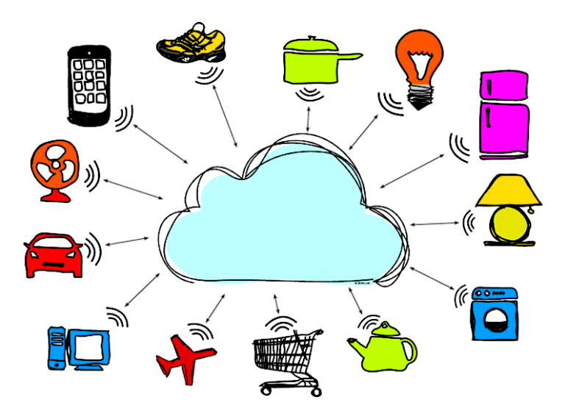
IoT Sensors
Sensors collect data from the environment or object under measurement and turns it into useful data.

Slide 4
Sensors and Actuators
A sensor is a device that responds to any change in physical phenomena or environmental variables like heat, pressure, humidity, movement etc. and turns that into to a more usable form.
Sensors contain a transducer is a device that converts energy from one form to another
An actuator is a device that is responsible for moving or controlling a mechanism or system. It is operated by a source of energy, which can be mechanical force, electrical current, hydraulic fluid pressure, or pneumatic pressure, and converts that energy into motion.

Slide 5
ISO/IEC 20924 - Internet of things (IoT) – Vocabulary
3.2.4
IoT device
entity of an IoT system that interacts and communicates with the physical world through sensing or actuating
Note 1 to entry: An IoT device can be a sensor or an actuator
3.2.1
Internet of Things - IoT
infrastructure of interconnected entities, people, systems and information resources together with services which processes and reacts to information from the physical world and virtual world
3.2.6
IoT gateway
entity of an IoT system that connects one or more proximity networks and the IoT devices on those networks to each other and to one or more access networks

Slide 6
ISO/IEC 20924 - Internet of things (IoT) – Vocabulary (cont)
3.2.3
IoT conceptual model
common structure and definitions for describing the concepts, relationships, and behavior within an IoT system
3.2.7
IoT system
system providing functionalities of Internet of Things
Note 1 to entry: IoT system is inclusive of IoT devices, IoT gateways, sensors, and actuators.
3.2.5
IoT domain
major functional group of an IoT system
Note 1 to entry: Every entity in an IoT system participates in one or more IoT domains and is said to be included or contained by that domain.
Note 2 to entry: The IoT domain consists of six domains: user domain, operation & management domain, application & service domain, resource access & interchange domain, sensing & controlling domain, physical entity domain.

Slide 7
IEEE P2413/D0.4.6, March 2019
Draft Standard for An Architectural Framework for the Internet of Things (IoT)
It is important to understand what the Internet of Things is and what the difference is between the IoT environment and an IoT system. A simple definition of an Internet of Things system is “a system of entities (including cyber-physical devices, information resources, and people) that exchange information and interact with the physical world by sensing, processing information, and actuating.”
The set of IoT components available to be composed into IoT systems, the networks connecting the components, and any associated services that provide the mechanisms for discovery, composition, and orchestration can be called an IoT environment.
Core to the idea of IoT is this interaction with physical entities. An entity of interest is a physical entity that is of interest to a human or organization for the completion of a goal. A physical entity is a discrete, identifiable part of the physical environment. Physical entities can be any physical object: humans; animals; cars; store or logistics-chain items; mechanical devices; computing devices; etc.

Slide 8
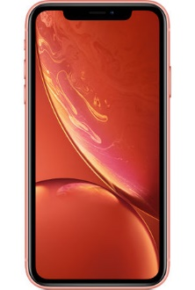
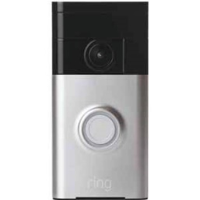

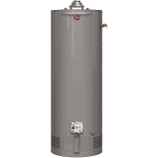
Not the Internet of Things – Smart Devices
Wi-Fi IoT Device Specific Apps
Wi-Fi

Slide 9
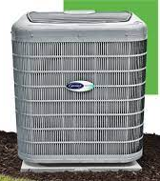
Approaching IoT
Local Power Company
Lower power consumption during energy rush hour
Switches to away mode when you leave the house
Wi-Fi IoT Device Specific App
Controls a system of devices
Wi-Fi

Slide 10
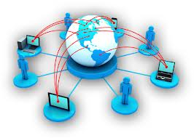

Internet of Things (IoT) IBM Vision
More Things Connected than People
Intelligent “System of Systems” Connecting the Planet
Generating enormous amounts of Data
Determine patterns in the Data for greater efficiencies
IDC revealed its prediction that the global IoT market would hit $7.1 trillion by 2020
Wisdom
Intelligence
& Analytics
Knowledge
People make better Decisions
Information
Data

Slide 11
Vertical Markets
Smart Home – smart speakers, virtual assistants, camera doorbells, lighting control, thermostats
Smart Cities - smart parking, mass transit, traffic, public safety, energy management
Smart Buildings – control lighting and energy usage
Connected Cars – self driving, safer for passengers and other road users, infotainment, navigation
Connected Retail - supply chain, customer experience, and new channels & revenue streams
Wearables - smart bands, smart watches and other wearable devices capable of collecting, sending and processing data over mobile applications
Health Care – patient monitoring
Industrial - sensors to gather data for analyzing and optimizing manufacturing processes
Agriculture – “the connected cow”
Transportation and Logistics - operation processes are automated for solutions such as fleet management, asset tracking and predictive maintenance
Telecom - device certification and monitoring can deliver predictive failure insights, usage pricing

Slide 12
Internet of Things - Maintenance Use Case
IoT-based predictive maintenance allows you to systematically schedule the optimal maintenance and inspection routine to avoid unplanned downtime and unnecessary effort. Avoidable costs can be greatly reduced, and you can also reduce the amount of time the machinery or equipment is down for maintenance.
Gartner estimates that through 2022, decision automation in the form of predictive maintenance will generate the highest business value for organizations with heavy assets. Businesses in asset-intensive industries struggle to maintain a balance between keeping costs down and asset availability up. Effective asset management and maintenance play a key role in ensuring that this balance is maintained – enabling these businesses to comply with regulations, avoid the costs associated with unnecessary maintenance, and avoid unplanned downtime.
According to a report by PwC, on average, predictive maintenance in factories could:
Reduce costs by 12%
Improve uptime by 9%
Reduce safety, health, environment, and quality risks by 14%
Extend the lifetime of an aging asset by 20%

Slide 13
Internet of Things – Devices?
Are Personal Computers, Mobiles Phones, Printers or Smart TVs IoT devices?

