Slide 1
802.24 Vertical Applications TAG Closing Report
November 2019
Waikoloa, Hawaii

Slide 2
802.24 Overview
Officers
TAG Chair: Tim Godfrey
Secretary & TAG Vice Chair: Ben Rolfe
Task Groups
802.24.1 Smart Grid TG Tim Godfrey
802.24.2 IoT TG Chris DiMinico
31 Voting Members
Agenda: 24-19-0031-00
Meetings for the Week
Tuesday PM2 24.1
Tuesday 18:00 Joint session with 802.1
Wednesday PM2 24.2
Thursday PM1 24
Manual attendance tracking for 802.1 & 802.3 members

Slide 3
802.24 Agenda - November 2019, Waikoloa, Hawaii |  | 24-19-0031-02-0000
1 | Tuesday PM2
1.1 | Call session to order, present “Guidelines for IEEE SA meetings”, Quorum | Godfrey | 5 | 4:00 PM
1.2 | Review of Agenda / Approval of Agenda | Godfrey | 5 | 4:05 PM
1.3 | Approve minutes from prior TAG meeting | Godfrey | 5 | 4:10 PM
1.4 | Introduction/meeting objectives / Review action items from previous meeting | Godfrey | 5 | 4:15 PM
1.5 | 802.24.1 Smart Grid Task Group | Godfrey | 0 | 4:20 PM
1.6 | ITU and regulatory items | Godfrey/Holcomb | 10 | 4:20 PM
1.7 | Liaison Review - ATIS IoT | Godfrey | 15 | 4:30 PM
1.8 | 802.16t PAR and CSD Review and discussion | Godfrey | 60 | 4:45 PM
1.9 | SGIP/SEPA Wireless Characteristics Matrix | Godfrey | 15 | 5:45 PM
 | Joint Session with 802.1 on Low Latency | Godfrey / Farkas | 30 | 6:00 PM | Fixed Time
2 | Wednesday PM2
2.1 | Call to Order 802.24.1 Smart Grid TG | Godfrey | 0 | 4:00 PM
2.2 | 802.16t PAR and CSD Comment Responses | Godfrey | 60 | 4:00 PM
2.3 | Call to Order 802.24.2 TG | DiMinico | 0 | 5:00 PM
2.4 | 802.24.2 Liaison Coordinator's Report and Update | DiMinico | 10 | 5:00 PM
2.5 | Review of IoT white paper development, expanding scope and participation | DiMinico | 15 | 5:10 PM
2.6 | P2413 Liaison report / Update | Winkel | 15 | 5:25 PM
2.7 | Recess | Godfrey | 0 | 5:40 PM
3 | Thursday PM1
3.1 | Call to Order 802.24 TAG | Godfrey | 0 | 1:30 PM
3.2 | Low Latency White Paper | Holland / Seo | 60 | 1:30 PM
3.3 | "IEEE 802 Solutions for Vertical Applications" White Paper | Godfrey | 40 | 2:30 PM
3.4 | Whitepaper/document for application-specific use cases of Sub 1GHz standards 802.15.4g and 802.11ah | Godfrey/Rolfe | 10 | 3:10 PM
3.5 | 802.24 New Action Items, New Activities, AOB | Godfrey | 10 | 3:20 PM
3.6 | Adjourn | Godfrey | 0 | 3:30 PM

Slide 4
802.24 TAG
Approve September TAG minutes
802.24-19-27r0
Teleconference Minutes
802.24-19-0028r0 Minutes of October 1 Teleconference
Approved with unanimous consent
TAG Action Items from September:
none

Slide 5
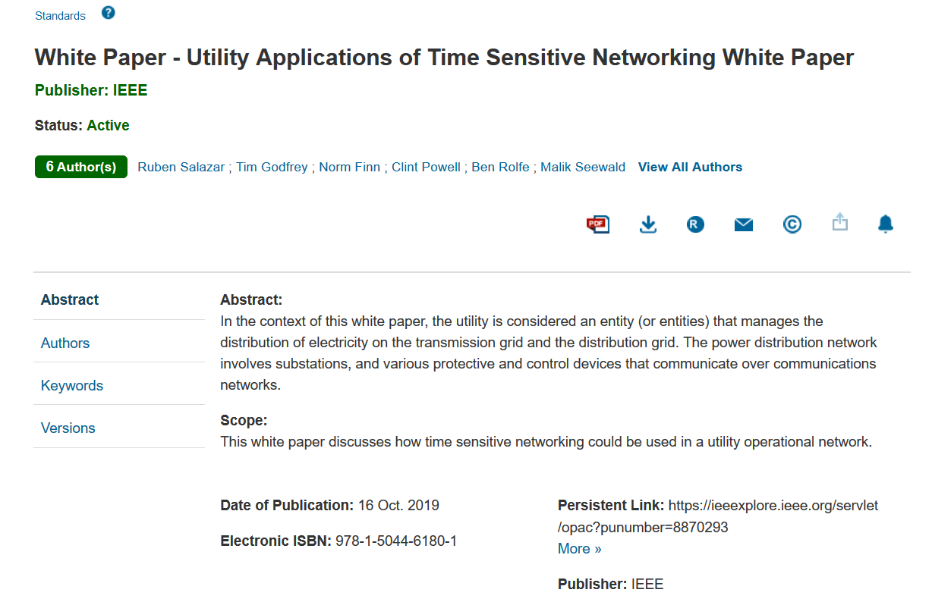
TSN White Paper - https://ieeexplore.ieee.org/abstract/document/8870295
Published October 16

Slide 6
Liaison Review
P2413 Ludwig Winkel
ATIS TOPS Farrokh Khatibi
Wi-Fi Alliance (Informal) Alan Berkema
IEC SEG8 Patrick Wetterwald (concluding)
IEEE PSCC TF S6 Marc Lacroix
IEEE P2030.5 Bob Heile
Industrial Internet Consortium Wael Diab (status?) assign to Chris D

Slide 7
ATIS Liaison – IoT
802.24 contributed to this document
ATIS welcomes comments and feedback on the final https://access.atis.org/apps/group_public/download.php/49200/ATIS-I-0000075.pdf
Initial observations
Almost entirely 3GPP focused – not surprising given that ATIS is an organizational partner of 3GPP
The terms “IEEE” and “802” do not appear anywhere in the document
Wi-Fi is mentioned. Wi-SUN is not.
Note the final title:
IOT Categorization: Exploring the Need for Standardizing Additional Network Slices

Slide 8
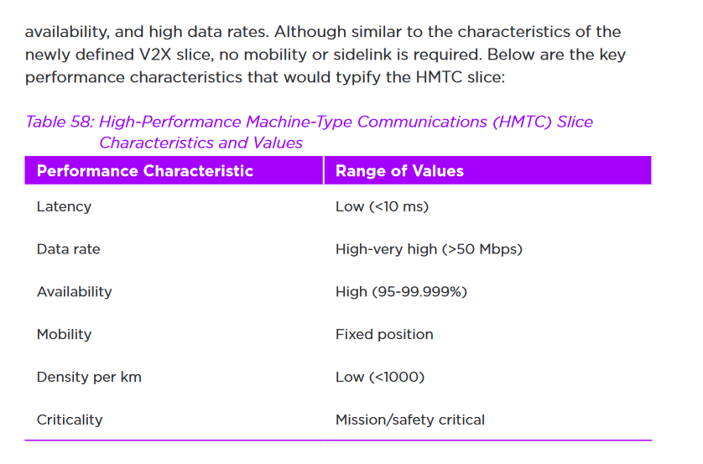
ATIS: IOT Categorization
New Slice Proposed:
Sounds like 802.1 TSN?

Slide 9
Licensed Narrowband Amendment 802.16t
Discussion on comments received from 802.11
Document 802.24-19-0035r0

Slide 10
SEPA request for update to Wireless Matrix
Document started as SGIP PAP2 resource 6 years ago
Last version provided by 802.24:
24-18-0028-00-sgtg-wireless-characteristics-matrix-update-2018-08-29-Draft-dot24edits.xlsx
Updated version posted as 802.24-19-0037r0
Further contributions needed to update 802.15.4x details

Slide 11
Licensed Narrowband Amendment 802.16t
Wednesday Discussion
Completed discussion of comments from 802.3
Complete comments and responses in Document 802.24-19-0035r0

Slide 12
802.24 Motion to approve PAR Comment Responses
Move to approve the PAR and CSD comment responses in document 802.24-19-0035r0, and the resulting changes to the P802.16t PAR and CSD (as updated in 802.24-19-0029r6 and 802.24-19-0030r1 respectively)
Moved: Ben Rolfe
Second: Allan Jones
Vote: 7 / 0 / 1

Slide 13
802.24 Motion to recommend 802.15 approve PAR/CSD Comment Responses
Move to recommend that 802.15 approve the PAR and CSD comment responses in document 802.24-19-0035r0, and the resulting changes to the P802.16t PAR and CSD (as updated in 802.24-19-0029r6 and 802.24-19-0030r1 respectively).
Moved: Ann Krieger
Second: Allan Jones
Vote: 7 / 0 / 1

Slide 14
802.24 Motion to approve P802.16t PAR and CSD
Approve the PAR and CSD contained in 802.24-19-0029r6 and 802.24-19-0030r1, respectively, and request the EC to forward the PAR to NesCom.
Moved: Ben Rolfe
Second: Allan Jones
Vote: 7 / 0 / 1

Slide 15
802.24 Motion to recommend 802.15 approval of P802.16t PAR and CSD
Recommend that the PAR and CSD contained in 802.24-19-0029r6 and 802.24-19-0030r1, respectively, be approved by the IEEE 802.15 WG, and that the EC be requested to forward the PAR to NesCom.
Moved: Ben Rolfe
Second: Ann Krieger
Vote: 7 / 0 / 1

Slide 16
January Meeting Planning for 802.16t Project
Assuming PAR approval, the Task Group will begin at January Interim.
Basic Agenda
TG Startup – TG leadership, project plan, timeline
Discuss development process, and key documents (System Requirements Document, System Description Document, Spec Framework evolving into Draft)
Call for contributions?
I will need to provide meeting slot requiresments and room sizes to the 802.15 chair
4 or 5 slots. Prefer Tuesday - Thursday slots that do not overlap with 802.24 or 802.18.
Ask for room for 30 – other stakeholders may show up

Slide 17
802.24.2 IoT TG: Single Pair Ethernet white paper
Chris DiMinico presented tutorial on Power over Single Pair Ethernet.
Draft was returned from IEEE editors for TAG Review
Chris DiMinico will provide edits and respond back to IEEE Editor and include materials on PODL

Slide 18
“Low latency” White Paper
Achieving low latency with IEEE 802 standards
Including wired and wireless communications
An alternative (or complement) to 5G URLLC
A set of vertical applications enabled by low latency
The challenges of reliable low latency in unlicensed spectrum.
Adapting TSN’s “FRER” feature
Adapting 802 wireless to licensed spectrum?
Operating over multiple bands or channels?
Special cases for high data rates for immersive video

Slide 19
“Low latency” White Paper
Joint meeting was held with 802.1 TSN. Provided overview of white paper and goals.
Joint Meetings will be scheduled at Plenary meetings.
From September version is 802.24-19-0003r5.
Progress between meetings
Allen Jones worked on section 6 from RTA TIG.
Document was sent as link to a private Sharepoint – TAG could not access
Oliver Holland led TAG on cleaning up document structure
Output from this meeting is 802.24-19-0003r6.
Still seeking text contributions and other input based on comments in draft

Slide 20
"IEEE 802 Solutions for Vertical Applications"
Previously called “Network Integration”
Draft White Paper From September
Output of this meeting has been posted as IEEE802-24/19-0017r3
Input from Max Riegel
802.24-19-0034r0 “802.1CF introduction to solutios for vertical applications”
Updated to r1 during discussion and review
Discussion
802.11 AANI, report talking about using 802.1CF model for how an 802 radio technology could be integrated with 5G Core.
Review for applicability to this white paper, and invite the author(s) to attend next session.

Slide 21
2020 Future TAG Activity Planning
A whitepaper/document for application-specific use cases of Sub 1GHz standards 802.15.4g and 802.11ah. Identifying where each standard is most suitable, and how to make best use of mechanisms proposed in 802.19.3 TG.
Can this also include applying 802.15.4s in sub-1GHz spectrum?
1H 2020 for starting, depending on 802.19.3 progress
19.3 draft for informal review at end of 2019. LB following January 2020 meeting. SA Ballot before July.
Contributors to 19.3 would be interested in contributing to this work.
Plan of action:
Ramp up work during 2020 as balloting on 19.3 completes.

Slide 22
802.24 TAG closing
Action Items from this meeting
None
Any New Business?
Next Meeting 12-17 January 2020 - Wireless Interim
Hotel Irvine, Irvine, CA.
Adjourn

