Slide 1
802.24 Vertical Applications TAG
November 2019
Waikoloa, Hawaii

Slide 2
802.24 Overview
Officers
  TAG Chair: Tim Godfrey
  Secretary & TAG Vice Chair: Ben Rolfe
Task Groups
  802.24.1 Smart Grid TG Tim Godfrey
  802.24.2 IoT TG Chris DiMinico
31 Voting Members
  Agenda: 24-19-0031-00
Meetings for the Week
  Tuesday PM2 24.1
  Wednesday PM2 24.2
  Thursday PM1 24
Manual attendance tracking for 802.1 & 802.3 members

Slide 3
802.24 Agenda - November 2019, Waikoloa, Hawaii |  | 24-19-0031-01-0000
1 | Tuesday PM2
1.1 | Call session to order, present “Guidelines for IEEE SA meetings”, Quorum | Godfrey | 5 | 4:00 PM
1.2 | Review of Agenda / Approval of Agenda | Godfrey | 5 | 4:05 PM
1.3 | Approve minutes from prior TAG meeting | Godfrey | 5 | 4:10 PM
1.4 | Introduction/meeting objectives / Review action items from previous meeting | Godfrey | 5 | 4:15 PM
1.5 | 802.24.1 Smart Grid Task Group | Godfrey | 0 | 4:20 PM
1.6 | ITU and regulatory items | Godfrey/Holcomb | 15 | 4:20 PM
1.7 | Liaison Review - ATIS IoT | Godfrey | 15 | 4:35 PM
1.8 | 802.16t PAR and CSD Review and discussion | Godfrey | 60 | 4:50 PM
1.9 | Recess | Godfrey | 0 | 5:50 PM
2 | Wednesday PM2
2.1 | Call to Order 802.24.1 Smart Grid TG | Godfrey | 0 | 4:00 PM
2.2 | 802.16t PAR and CSD Comment Responses | Godfrey | 60 | 4:00 PM
2.3 | Call to Order 802.24.2 TG | DiMinico | 0 | 5:00 PM
2.4 | 802.24.2 Liaison Coordinator's Report and Update | DiMinico | 10 | 5:00 PM
2.5 | Review of IoT white paper development, expanding scope and participation | DiMinico | 15 | 5:10 PM
2.6 | P2413 Liaison report / Update | Winkel | 15 | 5:25 PM
2.7 | Recess | Godfrey | 0 | 5:40 PM
3 | Thursday PM1
3.1 | Call to Order 802.24 TAG | Godfrey | 0 | 1:30 PM
3.2 | Low Latency White Paper | Holland / Seo | 60 | 1:30 PM
3.3 | "IEEE 802 Solutions for Vertical Applications" White Paper | Godfrey/Reigel | 40 | 2:30 PM
3.4 | Whitepaper/document for application-specific use cases of Sub 1GHz standards 802.15.4g and 802.11ah | Godfrey/Rolfe | 10 | 3:10 PM
3.5 | 802.24 New Action Items, New Activities, AOB | Godfrey | 10 | 3:20 PM
3.6 | Adjourn | Godfrey | 0 | 3:30 PM

Slide 4
Guidelines for IEEE-SA Meetings
All IEEE-SA standards meetings shall be conducted in compliance with all applicable laws, including antitrust and competition laws.
Don’t discuss the interpretation, validity, or essentiality of patents/patent claims.
Don’t discuss specific license rates, terms, or conditions.
  Relative costs, including licensing costs of essential patent claims, of different technical approaches may be discussed in standards development meetings.
    Technical considerations remain primary focus
Don’t discuss or engage in the fixing of product prices, allocation of customers, or division of sales markets.
Don’t discuss the status or substance of ongoing or threatened litigation.
Don’t be silent if inappropriate topics are discussed… do formally object.
---------------------------------------------------------------
If you have questions, contact the IEEE-SA Standards Board Patent Committee Administrator at patcom@ieee.org or visit http://standards.ieee.org/about/sasb/patcom/index.html
See IEEE-SA Standards Board Operations Manual, clause 5.3.10 and “Promoting Competition and Innovation: What You Need to Know about the IEEE Standards Association's Antitrust and Competition Policy” for more details.
This slide set is available
at https://development.standards.ieee.org/myproject/Public/mytools/mob/preparslides.ppt
IEEE 802 Executive Committee

Slide 5
Participation in IEEE 802 Meetings
Participation in any IEEE 802 meeting (Sponsor, Sponsor subgroup, Working Group, Working Group subgroup, etc.) is on an individual basis
• Participants in the IEEE standards development individual process shall act based on their qualifications and experience. (https://standards.ieee.org/develop/policies/bylaws/sb_bylaws.pdf section 5.2.1)
• IEEE 802 Working Group membership is by individual; “Working Group members shall participate in the consensus process in a manner consistent with their professional expert opinion as individuals, and not as organizational representatives”. (subclause 4.2.1 “Establishment”, of the IEEE 802 LMSC Working Group Policies and Procedures)
• Participants have an obligation to act and vote as an individual and not under the direction of any other individual or group. A Participant’s obligation to act and vote as an individual applies in all cases, regardless of any external commitments, agreements, contracts, or orders.
• Participants shall not direct the actions or votes of any other member of an IEEE 802 Working Group or retaliate against any other member for their actions or votes within IEEE 802 Working Group meetings, see https://standards.ieee.org/develop/policies/bylaws/sb_bylaws.pdf section 5.2.1.3 and the IEEE 802 LMSC Working Group Policies and Procedures, subclause 3.4.1 “Chair”, list item x.
By participating in IEEE 802 meetings, you accept these requirements. If you do not agree to these policies then you shall not participate.
(Latest revision of IEEE 802 LMSC Working Group Policies and Procedures: http://www.ieee802.org/devdocs.shtml )
Slide 5
IEEE 802 Executive Committee
Notes:
doc.: ec-16-0149-00-00EC
November 2016
Dorothy Stanley, HP Enterprise
Page 5

Slide 6
Administration
Attendance take on IMAT
  Reciprocal rights for most WGs
Web page
  http://www.ieee802.org/24
Mailing list
  stds-802-24@listserv.ieee.org
  802-24-voters@listserv.ieee.org (voters list)
Document archive
  http://mentor.ieee.org/802.24/documents
IEEE 802 announcement reflector, stds-802-all@listserv.ieee.org
  Send email to listserv@listserv.ieee.org with no subject and with the
  following 2 lines appearing first in the body of the message
Subscribe stds-802-all
end

Slide 7
802.24 TAG
Approve September TAG minutes
  802.24-19-237r0
  Teleconference Minutes
    802.24-19-0028r0 Minutes of October 1 Teleconference
TAG Action Items from September:
  none

Slide 8
Radio Regulatory Items
Update from 802.18 – Jay Holcomb
  Anything from WRC-19 for critical infrastructure

Slide 9
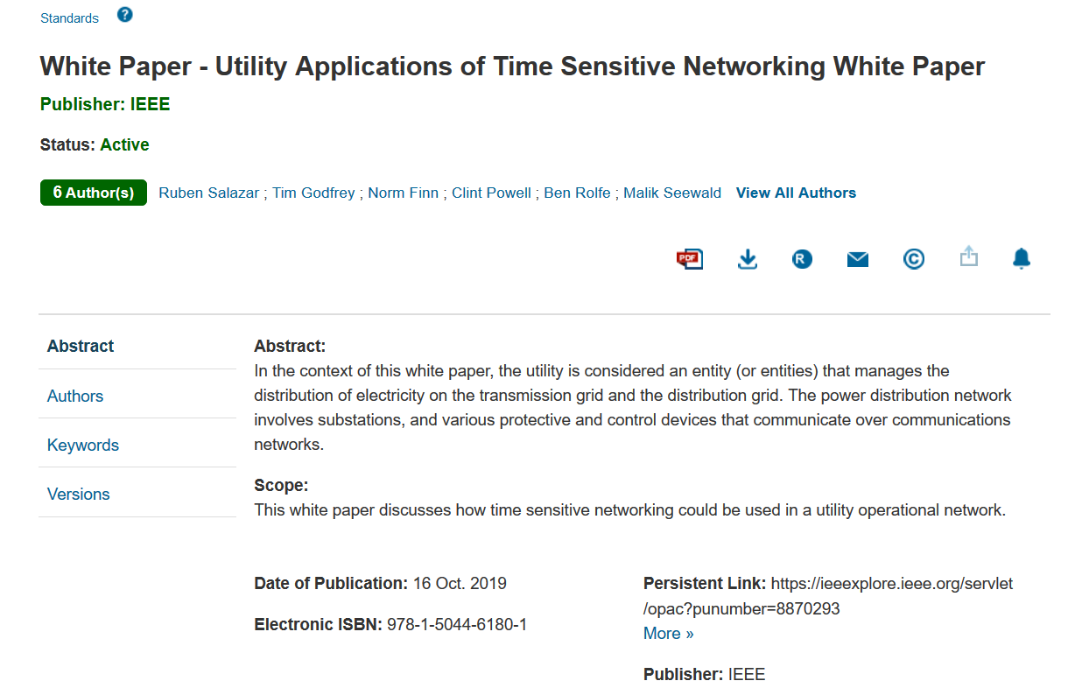
TSN White Paper - https://ieeexplore.ieee.org/abstract/document/8870295
Published
October 16

Slide 10
Liaison Review
P2413 Ludwig Winkel
ATIS TOPS Farrokh Khatibi
Wi-Fi Alliance (Informal) Alan Berkema
IEC SEG8 Patrick Wetterwald (concluding)
IEEE PSCC TF S6 Marc Lacroix
IEEE P2030.5 Bob Heile
Industrial Internet Consortium Wael Diab (status?) assign to Chris D

Slide 11
ATIS Liaison – IoT
802.24 contributed to this document
ATIS welcomes comments and feedback on the final https://access.atis.org/apps/group_public/download.php/49200/ATIS-I-0000075.pdf
Initial observations
  Almost entirely 3GPP focused – not surprising given that ATIS is an organizational partner of 3GPP
  The terms “IEEE” and “802” do not appear anywhere in the document
  Wi-Fi is mentioned. Wi-SUN is not.
Note the final title:
  IOT Categorization: Exploring the Need for Standardizing Additional Network Slices

Slide 12
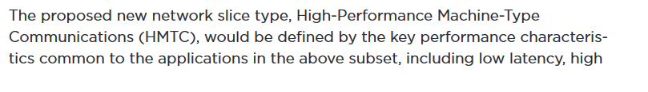
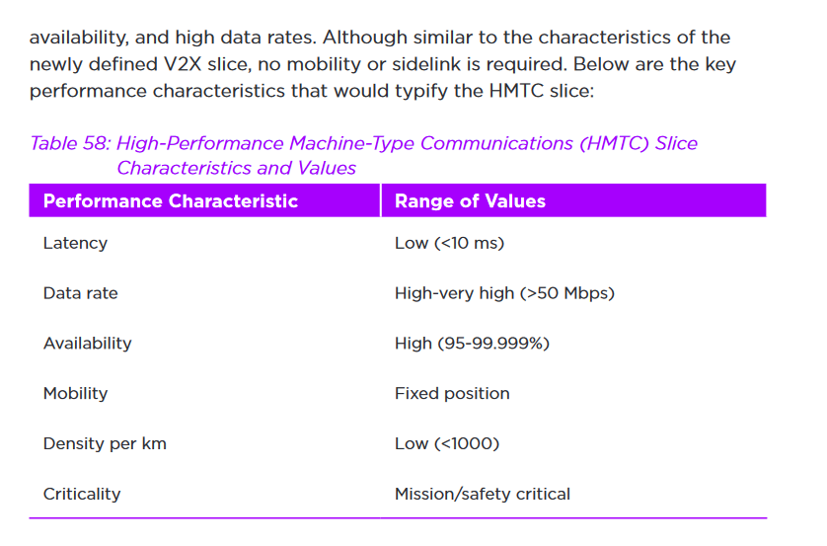
ATIS: IOT Categorization
New Slice Proposed:
  Sounds like 802.1 TSN?

Slide 13
Licensed Narrowband Amendment 802.16t
802.24 has conducted teleconferences to develop this PAR and CSD
PAR: 802.24-19-0029r4
CSD: 802.24-19-0030r0
PAR Presentation Document with EC Motion
  802.24-19-0033r0

Slide 14
Ad-Hoc working session for PAR Comments
Volunteers may meet for an ad-hoc session Wednesday AM1 or PM1 to start developing responses to any PAR comments

Slide 15
Wednesday 802.24
TAG

Slide 16
802.16t PAR Comment Response
Other Working Groups submit comments on PARs by Tuesday 6:30pm.
  WGs, other than the proposing WG, shall express concerns to the proposing WG as soon as possible and shall submit comments to the proposing WG and the Sponsor by e-mail not later than 6:30 p.m. on Tuesday of the plenary session.
Proposing WG provides responses to PAR comments by Wednesday 6:30pm
  The proposing WG shall post a response to commenting WG and to the Sponsor together with a Final PAR on a public website and circulate the relevant URL on the Sponsor reflector not later than 6:30 p.m. on Wednesday of the plenary session. It will be assumed that insufficient coordination and/or inter-WG consideration had occurred prior to the submission of the PAR if this deadline is not met, and the proposed PAR will not be considered by the Sponsor at the closing Sponsor meeting.

Slide 17
Discussion
Written responses to comments
  Send by email
Any Updates to PAR or CSD
  Post new URL to EC reflector

Slide 18
Wednesday 802.24.2
IoT TG

Slide 19
802.24.2 White Paper
Status and development of IoT White paper
  802.24-17-0036r2
  Ludwig is developing some related materials.
  Can we pull new developments from P2413 into this white paper?
Ludwig will provide an update on P2413 and IEC topics
  We will continue to re-structure and advance with more wireless WG materials.

Slide 20
Building engagement in TG2 IoT
Discussion on plan and new activities for IoT task group and broader engagement
What are the IoT activities in IEEE 802?
  802.15.4 – Wi-SUN is going after IoT in addition to Smart Grid
  802.15.4w – LPWA another IoT focus
  802.11ah (Halow), 802.11ba (WUR)
Can we find volunteers to contribute to IoT white paper?

Slide 21
Single Pair Ethernet white paper
Draft was returned from IEEE editors for TAG Review
Chris DiMinico was not available, but will provide edits and respond back to IEEE Editor

Slide 22
Thursday 802.24
TAG

Slide 23
“Low latency” White Paper
Achieving low latency with IEEE 802 standards
  Including wired and wireless communications
  An alternative (or complement) to 5G URLLC
A set of vertical applications enabled by low latency
The challenges of reliable low latency in unlicensed spectrum.
  Adapting TSN’s “FRER” feature
  Adapting 802 wireless to licensed spectrum?
  Operating over multiple bands or channels?
Special cases for high data rates for immersive video

Slide 24
Next Steps
Individuals from 802.21 interested in AR/VR to provide text contributions
Need volunteers to pare down AR/VR section to limit scope to Low Latency networking concepts.
A topic to explore is the relationship between high throughput and low latency. Can you have low latency without high bandwidth?
Can we follow the example of 5G URLLC?
This can be seen as alternative to 5G approaches, but standards-based and lower cost to use.
  Show how Wi-Fi technology can provide an equally good or better result and performance (bandwidth and low jitter and low latency)
Map identified uses cases on to various IEEE 802 standards.
Tie low latency to 802.1 TSN – how can 802.1 TSN functionality be carried into other MAC/PHY standards.
  Follow collaboration of 802.11be with 802.1 TSN – there are gaps in expectations from 802.11 and TSN.
  Discuss how FRER could compensate for lack of reliability/predictability of unlicensed spectrum
Trim down section 6 from RTA TIG. – action Allen.
Max could review section on relation of TSN to 802.11
Output from this meeting is 802.24-19-0003r5.
  Still seeking text contributions and other input from actions above.

Slide 25
"IEEE 802 Solutions for Vertical Applications"
Previously called “Network Integration”
Draft White Paper From July
    IEEE802-24/19-0017r1
    Output of this meeting has been posted as IEEE802-24/19-0017r3
Volunteers requested provide text contributions

Slide 26
2020 Future TAG Activity Planning
A whitepaper/document for application-specific use cases of Sub 1GHz standards 802.15.4g and 802.11ah. Identifying where each standard is most suitable, and how to make best use of mechanisms proposed in 802.19.3 TG.
  Can this also include applying 802.15.4s in sub-1GHz spectrum?
  1H 2020 for starting, depending on 802.19.3 progress
TBD
  802.24 white paper on IoT and P2413
  Update of first Smart Grid white paper to address latest amendments of 802.15.4 u, v, w, x, y, Revmd

Slide 27
802.24 TAG closing
Action Items from this meeting
Any New Business?

