Slide 1
802.24 Vertical Applications TAG
January 2018 Meeting
Irvine, CA, USA

Slide 2
802.24 Overview
Officers
  TAG Chair: Tim Godfrey
  Secretary & TAG Vice Chair: Ben Rolfe
Task Groups
  802.24.1 Smart Grid TG Tim Godfrey
  802.24.2 IoT TG Chris DiMinico
28 Voting Members
  Agenda: 24-18-0001-00-0000
Meetings for the Week
  Tuesday PM2 24.1
  Wednesday PM2 24.1
Manual attendance tracking for 802.1 & 802.3 members

Slide 3
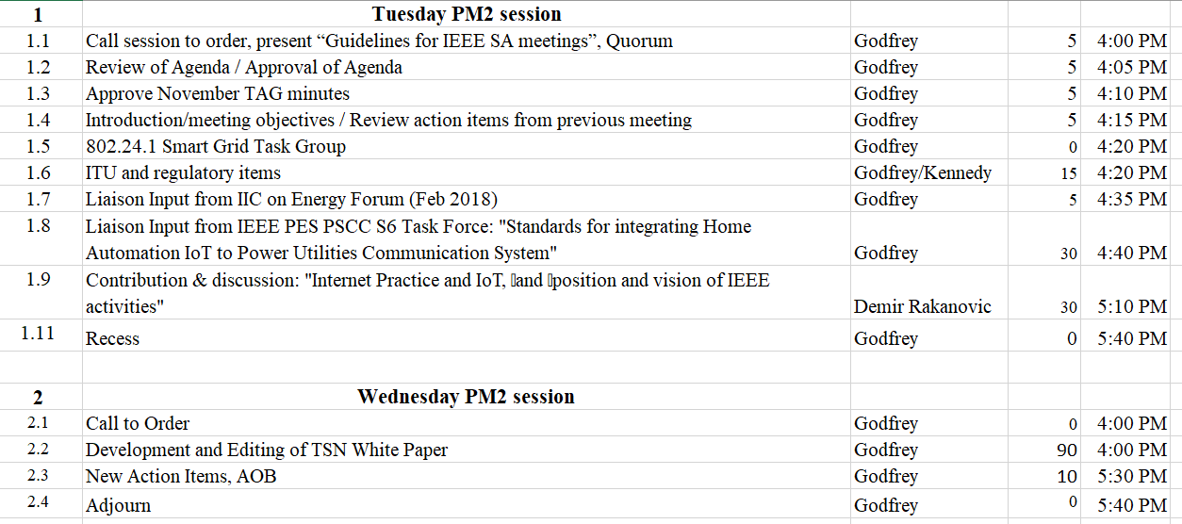
Agenda – 802.24-18-001r0

Slide 4
Guidelines for IEEE-SA Meetings
All IEEE-SA standards meetings shall be conducted in compliance with all applicable laws, including antitrust and competition laws.
Don’t discuss the interpretation, validity, or essentiality of patents/patent claims.
Don’t discuss specific license rates, terms, or conditions.
  Relative costs, including licensing costs of essential patent claims, of different technical approaches may be discussed in standards development meetings.
    Technical considerations remain primary focus
Don’t discuss or engage in the fixing of product prices, allocation of customers, or division of sales markets.
Don’t discuss the status or substance of ongoing or threatened litigation.
Don’t be silent if inappropriate topics are discussed… do formally object.
---------------------------------------------------------------
If you have questions, contact the IEEE-SA Standards Board Patent Committee Administrator at patcom@ieee.org or visit http://standards.ieee.org/about/sasb/patcom/index.html
See IEEE-SA Standards Board Operations Manual, clause 5.3.10 and “Promoting Competition and Innovation: What You Need to Know about the IEEE Standards Association's Antitrust and Competition Policy” for more details.
This slide set is available
at https://development.standards.ieee.org/myproject/Public/mytools/mob/preparslides.ppt

Slide 5
Participation in IEEE 802 Meetings
All participation in IEEE 802 Working Group meetings is on an individual basis
• Participants in the IEEE standards development individual process shall act based on their qualifications and experience. (https://standards.ieee.org/develop/policies/bylaws/sb_bylaws.pdf section 5.2.1)
• IEEE 802 Working Group membership is by individual; “Working Group members shall participate in the consensus process in a manner consistent with their professional expert opinion as individuals, and not as organizational representatives”. (http://ieee802.org/PNP/approved/IEEE_802_WG_PandP_v19.pdf section 4.2.1)
You have an obligation to act and vote as an individual and not under the direction of any other individual or group. Your obligation to act and vote as an individual applies in all cases, regardless of any external commitments, agreements, contracts, or orders.
You shall not direct the actions or votes of any other member of an IEEE 802 Working Group or retaliate against any other member for their actions or votes within IEEE 802 Working Group meetings, see https://standards.ieee.org/develop/policies/bylaws/sb_bylaws.pdf section 5.2.1.3 and http://ieee802.org/PNP/approved/IEEE_802_WG_PandP_v19.pdf section 3.4.1, list item x
By participating in IEEE 802 meetings, you accept these requirements. If you do not agree to these policies then you shall not participate.

Slide 6
Administration
Attendance take on IMAT
  Reciprocal rights for most WGs
Web page
  http://www.ieee802.org/24
Mailing list
  stds-802-24@listserv.ieee.org
  802-24-voters@listserv.ieee.org (voters list)
Document archive
  http://mentor.ieee.org/802.24/documents
IEEE 802 announcement reflector, stds-802-all@listserv.ieee.org
  Send email to listserv@listserv.ieee.org with no subject and with the
  following 2 lines appearing first in the body of the message
Subscribe stds-802-all
end

Slide 7
Monday: 802.24 TAG
Approve November minutes
  24-17-0027r0
TAG Action Items from November:

Slide 8
Tuesday 802.24.1
Smart Grid TG

Slide 9
ITU and Radio Regulatory Items
<TBD>
Any follow-up action for 802.24?

Slide 10
Liaison Input from IIC on Energy Forum
IIoT ENERGY FORUM
  http://www.iiconsortium.org/reston-forum-2018/index.htm
  WHEN: Friday, February 9th - 9:00am to 5:00pm
  WHERE: MITRE 4 Building, 7596 Colshire Drive, McLean, VA 22102
  PARTNER:NIST – National Institute of Standards and Technology
  HOST: The MITRE Company
  COST: Complimentary. PRE-REGISTRATION IS REQUIRED
  CONTACT: info@iiconsortium.org

Slide 11
New Liaison – IEEE PES
IEEE PSCC TF S6
January 2018 Study Report – IoT for Connected Home – Communication and Cybersecurity Requirements
Available in 802.24 private area
Discussion and comments

Slide 12
Contribution
24-18-00340
dr_presentation_Internet Practice and IoT.pptx
  Demir Rakanovic
Discussion

Slide 13
Wednesday 802.24.1
Smart Grid TG

Slide 14
TSN Utility Use Cases
Further editing of first section describing utility use cases

Slide 15
Next Steps developing white paper
Continue merging and condensing content from Norm Finn
  Merge content related to time synchronization
Other text contributions from 802.1 TSN?
Review IETF DetNet use cases – incorporate others as appropriate
Teleconference in January
  January Interim not all-802.
  Another updating cycle before March plenary?
  802.1 interim is Jan 22-26.
  Plan on call week of Jan 29 (follow up and announce on reflect)
  Avoid Tuesday and Thursday mid-day EST

Slide 16
802.24 TAG closing
Action Items from this meeting
  Plan TSN teleconference
  Forward reviewed Sub-1GHz white paper for publishing
Any New Business?

