Slide 1
802.24 Vertical Applications TAG
November 2017 Meeting
Orlando, FL, USA

Slide 2
802.24 Overview
Officers
TAG Chair: Tim Godfrey
Secretary & TAG Vice Chair: Ben Rolfe
Task Groups
802.24.1 Smart Grid TG Tim Godfrey
802.24.2 IoT TG Chris DiMinico
34 Voting Members
Agenda: 24-17-0024-01-0000
Meetings for the Week
Monday PM2 24.1
Tuesday PM2 24.2
Wednesday PM2 24.1 at 4:30 move to 802.1 TSN
Manual attendance tracking for 802.1 & 802.3 members

Slide 3
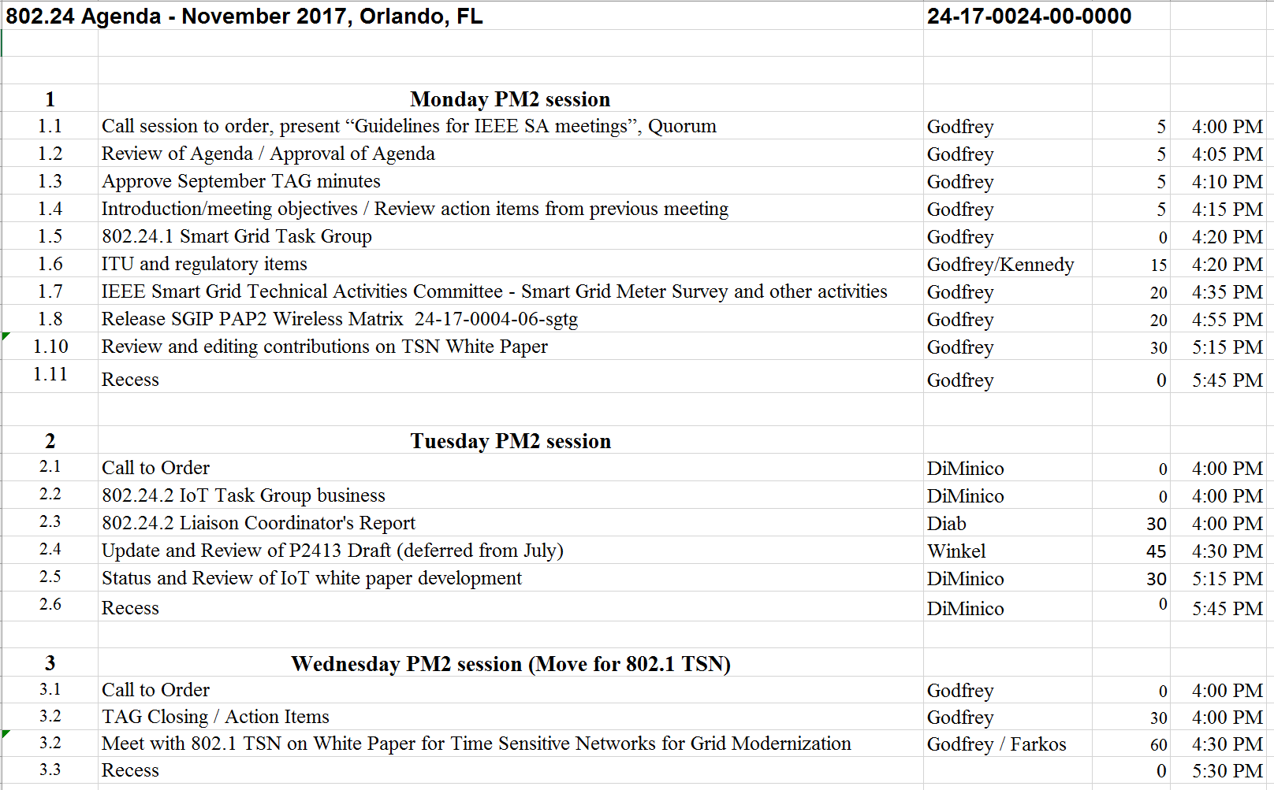
Agenda – 802.24-17-0024r0

Slide 4
Other Guidelines for IEEE WG Meetings
All IEEE-SA standards meetings shall be conducted in compliance with all applicable laws, including antitrust and competition laws.
Don’t discuss the interpretation, validity, or essentiality of patents/patent claims.
Don’t discuss specific license rates, terms, or conditions.
Relative costs, including licensing costs of essential patent claims, of different technical approaches may be discussed in standards development meetings.
Technical considerations remain primary focus
Don’t discuss or engage in the fixing of product prices, allocation of customers, or division of sales markets.
Don’t discuss the status or substance of ongoing or threatened litigation.
Don’t be silent if inappropriate topics are discussed … do formally object.
---------------------------------------------------------------
See IEEE-SA Standards Board Operations Manual, clause 5.3.10 and “Promoting Competition and Innovation: What You Need to Know about the IEEE Standards Association's Antitrust and Competition Policy” for more details.
Notes:
4

Slide 5
Participation in IEEE 802 Meetings
All participation in IEEE 802 Working Group meetings is on an individual basis
• Participants in the IEEE standards development individual process shall act based on their qualifications and experience. (https://standards.ieee.org/develop/policies/bylaws/sb_bylaws.pdf section 5.2.1)
• IEEE 802 Working Group membership is by individual; “Working Group members shall participate in the consensus process in a manner consistent with their professional expert opinion as individuals, and not as organizational representatives”. (http://ieee802.org/PNP/approved/IEEE_802_WG_PandP_v19.pdf section 4.2.1)
You have an obligation to act and vote as an individual and not under the direction of any other individual or group. Your obligation to act and vote as an individual applies in all cases, regardless of any external commitments, agreements, contracts, or orders.
You shall not direct the actions or votes of any other member of an IEEE 802 Working Group or retaliate against any other member for their actions or votes within IEEE 802 Working Group meetings, see https://standards.ieee.org/develop/policies/bylaws/sb_bylaws.pdf section 5.2.1.3 and http://ieee802.org/PNP/approved/IEEE_802_WG_PandP_v19.pdf section 3.4.1, list item x
By participating in IEEE 802 meetings, you accept these requirements. If you do not agree to these policies then you shall not participate.

Slide 6
Administration
Attendance take on IMAT
Reciprocal rights for most WGs
Web page
http://www.ieee802.org/24
Mailing list
stds-802-24@listserv.ieee.org
802-24-voters@listserv.ieee.org (voters list)
Document archive
http://mentor.ieee.org/802.24/documents
IEEE 802 announcement reflector, stds-802-all@listserv.ieee.org
Send email to listserv@listserv.ieee.org with no subject and with the
following 2 lines appearing first in the body of the message
Subscribe stds-802-all
end

Slide 7
Monday: 802.24 TAG
Approve September minutes
24-17-0027r0
TAG Action Items from July / September:
Plan TSN teleconference (October)
Did not happen – pick up at this meeting
Coordinate with Wael on Wi-Fi Alliance Liaison
Review IoT MSGT Use Case Document (Henry Chiarelli)
Set up Private Area for exchanging documents under Liaison

Slide 8
Coordination with Industry Connections:
Regularly examine (or liaison with) IC Committee to determine if we want to be involved with any existing IC activities.
Plan of action: Check in by email regularly (before plenary meetings) on status with the IC Committee
Ongoing Activity: IEEE 802 Network Enhancements Industry Connections Activity
Tuesday 7:30pm
New IC Activity in Orlando:
None known

Slide 9
Publicizing White Paper Releases
Procedure for back end of white papers established in July:
Share white papers directly with Jonathan.
Request IEEE-SA Marketing, social media, Newsletters,
In process – releasing of Sub-1GHz White Paper

Slide 10
Monday 802.24.1
Smart Grid TG

Slide 11
ITU and Radio Regulatory Items
From September: FCC NOI 17-104.
FCC stated goal is to promote flexible use of spectrum
Part of subject bands may be in use by utilities for smart grid applications now
Input requested: participate in 802.18 to shape 802 response
Any update or new action?

Slide 12
IEEE Smart Grid Technical Activities Committee
Purpose:
“Within the IEEE Smart Grid Technical Activities Committee, we are writing a White paper on smart metering. The focus of this white paper will be on the deployed comms standards, from power line, to wireless cellular to meshed networking to whatever…”
Ongoing calls series on two activities:
Smart Meter Survey
White Paper
New chair: Satish Saini
Program Manager at Hydro One
Opportunities for TAG to engage?
Contribute to survey?
Contribute to White Paper?

Slide 13
Finalize PAP2 Wireless Matrix
Current Status:
Latest version 802.24-17-0004r6
Pinged 802.11 last week for spectrum efficiency values
SEPA/SGIP Study Group has been formed for Matrix update
802.24 output will provide update for 802 standards
Other standards’ contributors may provide additional updates

Slide 14
SEPA/SGIP update WG
Membership (established by SEPA)
Tim Godfrey EPRI
Ron Cunningham AEP
Doug Gray TCS
Bill Godwin Duke Energy
Matt Gilmore Itron
Gerald Gray EPRI
Planning first call next week, Nov 13

Slide 15
TSN white paper
Version after initial merge of Norm Finn contribution
802.24-17-0006r9
Norm’s text in purple
Challenge is reducing excellent content to more manageable size for this white paper.
Volunteer for document Editor?

Slide 16
TSN Utility Use Cases
Preparation for Wednesday Joint Meeting with 802.1
Further editing of first section describing utility use cases

Slide 17
Future Opportunities Tracking
At plenary meetings – review upcoming needs and opportunities for 802.24 projects.

Slide 18
Future Opportunities Tracking (.1)
Are there any new utility industry activities or organizations that could benefit from a liaison to 802.24?

Slide 19
Future Opportunities Tracking (.2)
802.24 white paper on IoT and P2413?
Maybe more towards completion of P2413?
Agnostic to underlying communications, but applicable to all 802 standards.
Highlight the relationship between P2413 and 802 standards.
Discuss in Tuesday session of 802.24.2

Slide 20
Future Opportunities Tracking
802.15.12 ULI
Incorporating features from 802.15.9 RP which are currently used in utility networking into ULI standard
Some other areas of potential interest
Still in proposal phase
802.15.4s SMR – spectrum management resources
Can 802.24 provide an input with respect to Smart Grid or IoT?
IEC 65C WG 17 dealing with coexistence management and spectrum policy
ETSI TCRRS reconfigurable radio systems
ETSI TCERM WG 41 – defining a central coordination point to handle spectrum.
Sharing and increasing coexistence and providing better QoS
September Notes:
Currently in sponsor ballot
May be useful for dynamic radio management identified by utilities as import for future network deployments
4s resource management is defined, but now how they are used
White paper could cover how adaptation and resource management are accomplished.
Including use of metrics for management.

Slide 21
Other Future Opportunities
Monitor the LPWAN IG in 802.15 to see where it goes (and links to IETF)
See where IG-DEP goes.
Many use cases presented already covered by 802 standards
Potential application in utility networks for extremely hard to reach endpoints
Extremely low power use cases may be of interest to utility applications
Participation required to steer to useful work
Applying new bands and channel plans
802.15.4u and 802.15.4v completed. Add bands in various regions for existing 802.15.4 PHYs commonly used in smart grid.

Slide 22
Tuesday 802.24.2 IoT TG

Slide 23
Tuesday: 802.24.2
802.24.2 Liaison Coordinator's Report
Wael Diab
IIC Liaison Report
Any new liaison requests
Request to explore liaison with Wi-Fi Alliance IoT Group.
802.24 will initiate the liaison request
Action Wael – draft a formal liaison statement with areas of collaboration and exchange.
Suggested: IoT Market Segment Task Group
Challenges – information exchange will need to be cleared of default confidentiality of WFA documents.

Slide 24
802.24.2
P2413 Liaison Report and Draft Review
Ludwig Winkel
Relationship to 24.2 IoT White Paper
Can be use to explain to the 802 community how 802 fits into the overall IoT architecture

Slide 25
802.24.2
Review and plan IoT white paper development
Chris DiMinico
Discussion on IoT White Paper Draft
Contributions towards IoT White Paper
Wi-Fi Alliance IoT Use Case Document Review

Slide 26
Wednesday 802.24.1 Smart Grid TG 802.1 TSN Joint Working Session

Slide 27
Content for TSN white paper
Version after initial merge of Norm Finn contribution
802.24-17-0006r9
Norm’s text in purple
Challenge is reducing excellent content to more manageable size for this white paper.
Document contribution from Rodney Cummings
TBD

Slide 28
Next Steps
Continue merging and condensing content from Norm Finn
Merge content related to time synchronization
Other text contributions from 802.1 TSN?
Review IETF DetNet use cases – incorporate others as appropriate

Slide 29
802.24 TAG closing
Action Items from this meeting
Any New Business?

