Slide 1
802.24.1 Smart Grid TAG
Consolidated White Paper Presentation
Date: 2014-11-04
Authors:

Slide 2
Note – this is a draft: work in progress…

Slide 3
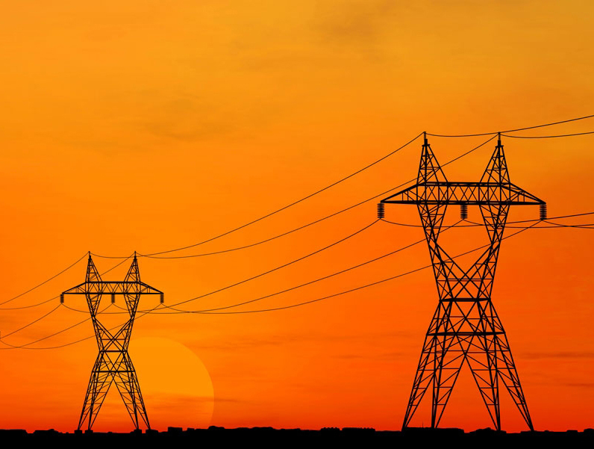

IEEE-SA Smart Grid

Slide 4
Smart Grid
Smart Grid is defined as:
  Providing bidirectional communication of power quality, supply, and demand across the power grid to utilize electricity more dynamically resulting in increased energy efficiency and power grid reliability. This change is necessary to manage the increased variability caused by renewable resources, the increased peak demand created by energy intensive consumers such as electric vehicles, and to minimize the environmental impact of ever increasing aggregate demand for electrical power.
Notes:
Split into two.

Slide 5
IEEE 802 and Smart Grid
IEEE 802 networking technologies bring the following advantages to Smart Grid communications:
  Enterprise grade security compatibility
  Huge ecosystem (billions of products, hundreds of manufacturers)
  Long-term (20 year), battery-powered operation
  Continued operation during line fault events when using wireless media
  Wide choice of products across the spectrum of power versus performance
  Ability to be implemented in resource-constrained devices
  Ongoing development of standards to address changing environment and technology
  Wireless standards that operate in a licensed and license-exempt spectrum
  Offers a rich set of data rate/range/latency tradeoffs
  Common upper layer interface to seamlessly integrate into existing IT systems

Slide 6
The Smart Grid = Electric Grid + Intelligence
Notes:
Clarify the meaning of “intelligence” with a new bullet
Remove or clean-up figure. Larger text.

Slide 7
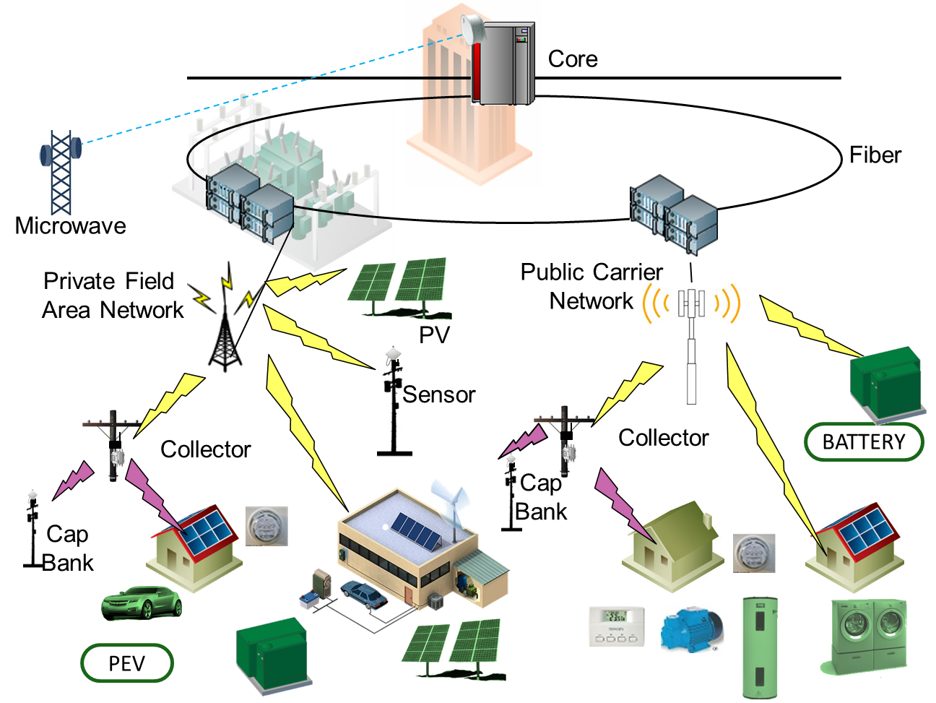
Key Standards for Integrated Grid Communications Networks
LAN
IEEE 802.3
IEEE 802.11
WAN
IEEE 802.3 1000BASE-X
IEEE 802.22
IEEE 802.16
IEEE 802.11
(Mesh Topology)
FAN
IEEE 802.15.4:
(SUN, LECIM, TVWS)
IEEE 802.11ah, 802.11af
NAN
IEEE 802.11
IEEE 802.15.4
Devices
Notes:
PEV to “PHEV”
Fix background/master page
Merge FAN and NAN into FAN/NAN

Slide 8








Examples of utility communications protocols
Application
Layer
Other Applications
Metering
IEC 61968 CIM, ANSI C12.22,
DLMS/COSEM,…
SCADA
IEC 61850, 60870
DNP3/IP, Modbus/TCP,…
DNS, NTP, IPfix/Netflow, SSH
RADIUS, AAA, LDAP, SNMP,…
(RFC 6272 IP in Smart Grid)
Session
Layer
Web Services, EXI, SOAP,
RestFul,HTTPS/CoAP
Transport
Layer
UDP/TCP
Security (DTLS/TLS)
Network
Layer
IPv6/IPv4
Addressing, Routing, Multicast, QoS, Security
IPv6 RPL
Data
Link
Layer
802.1X / EAP-TLS & IEEE 802.11i based Access Control
IPv6 over PPP
(RFC 5072)
LLC`
802.15.9 KMP
IPv6 over Ethernet (RFC 2464)
IP or Ethernet
Convergence SubL.
6LoWPAN (RFC 6282)
M
A
C
IEEE 802.15.4e MAC enhancements
IEEE 802.11
Wi-Fi
IEEE 802.3
Ethernet
IEEE 802.16
WiMAX
IEEE 802.22
WRAN
2G, 3G, LTE
Cellular
IEEE 802.15.4
including FHSS
IEEE 1901.2
802.15.4 frame
format
Physical
Layer
IEEE 802.15.4g
2.4GHz, 915, 868MHz
DSSS, FSK, OFDM
IEEE 1901.2
NB-PLC
OFDM
IEEE 802.11
Wi-Fi
2.4, 5 GHz, Sub-GHz
IEEE 802.3
Ethernet
UTP, FO
IEEE 802.16
WiMAX
1.x - 3.x GHz
IEEE 802.22
TV White
Space
2G, 3G, LTE
Cellular
Notes:
Remove UDP from TCP/UDP layer
Change IIEEE to IEEE.
Add 802.22
EXI/ HTTPS/ CoAP are not app layer themselves. Move App layer up and put these in below
Is EAP-TLS above IP? Move 2G/3G/Cellular out to right, and bypass 802.1x layer.
Split 6lowpan to show 802.15.9
Move Network Functionality bottom line at bottom of IP layer

Slide 9

SG Network Architecture
High level example of an AMI system
Detailed View:
Notes:
Put detailed diagram into a backup section – only used by those who are have the background.

Slide 10
Something on cyber security and IEEE 802
Notes:
References to FIPS, 2006 version, and later versions.
We would like to show how IEEE 802 fits into a comprehensive security architecture.
Generally 802 provides layer 2 authentication and encryption. Show key management interfaces and mechanisms. Cypher suites
NISTIR (Phil Beecher to provide this. Describe PKI, EAPOL, KMP, )
X – Y chart showing NISTIR requirements in rows, and 802 protocols in columns

Slide 11
Example applications that take advantage of low power operation, (water, oil/gas, line sensors)
Example of “constrained” types of devices
Notes:
Ben Rolfe will create this

Slide 12
Comparison with PLC – advantage of operation even if power line is damaged
Notes:
Jeritt Kent will provide

Slide 13
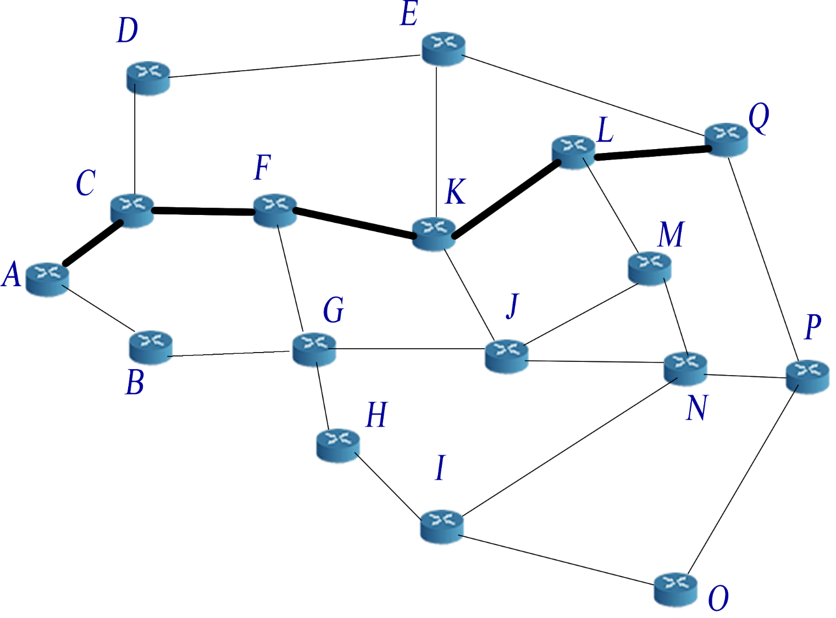
Example of Mesh Network
http://upload.wikimedia.org/wikipedia/commons/c/c5/17_node_mesh_network.png
Notes:
Look in L2R contributions.

Slide 14
IEEE 802.11 standards hierarchy
IEEE
802.3
802.11
802.15
802.16
802.21
802.22
802.11a through 802.11z: Completed
Completed
Active: More Grid relevant
11ac
Higher rate in 5GHz band
11ad
Higher rate in 60GHz band
Active: Less Grid relevant
11ae
Prioritization of management frames
11af
TV White Space
11ah
915MHz Band operation (sub 1GHz)
11ai
Fast Initial Association
11aj
China Millimeter Wave Task Group
11ak
General Link (full bridging over WLAN) joint with 802.1
11aq
Pre-Association Discovery Task Group
11ax
High Efficiency WLAN (HEW)

Slide 15
802.11 – Spectrum / Rate view
.11ad
500MHz
1GHz
2GHz
5GHz
10GHz
60GHz
802.11ac
500Mbps
802.11n
802.11n
100Mbps
.11af
.11ah
802.11g
.11y
.11j
802.11a
.11p
10Mbps
802.11
802.11b
1Mbps

Slide 16
IEEE 802.15 standards hierarchy
IEEE
802.3
802.11
802.15
802.16
802.21
802.22
802.15.4
ZigBee
Completed
4e
Smart Utility Networks (WiSUN) AMI
4g
Active – More Grid relevant
4k
LECIM
Active – Less Grid relevant
4m
AMI for TV White Space
4n
4q
4r
Layer 2 Routing Task Group
Key Management
Protocol Task Group
802.15.9
802.15.10

Slide 17
802.15.4 PHY Overview (data rate vs frequency)
10Kbps
100Kbps
1Mbps
5GHz
O-QPSK
CSS
CSS
2GHz
4g 2FSK
4g 2FSK
4g 4FSK
4g O-QPSK
4g ODFM
4g 2FSK
4g 2FSK
4g 4FSK
1GHz
4g ODFM
BPSK DSSS
4g 2FSK
GFSK
4g 2FSK
O-QPSK, ASK
920
4g 4FSK
915
4g ODFM
BPSK DSSS
O-QPSK
868
4g O-QPSK
BPSK DSSS
O-QPSK, ASK
863
4g ODFM
780
O-QPSK, ASK
MPSK
500MHz
4g O-QPSK
4g 2FSK
4g 2FSK
4g 4FSK
4g 2FSK
4g ODFM

Slide 18
IEEE 802.16 standards hierarchy
IEEE
802.3
802.11
802.15
802.16
802.21
802.22
802.16-2012
WiMAX
16n
Completed – Grid Relevant
16p
Small Cell Backhaul
Completed – Less Relevant
16r
Multi-Tier Networks
WiMAX 2
16q
Active – Limited grid relevance
High Reliability
802.16.1
Machine to Machine
1a
1b
Performance Metrics
802.16.3

