Slide 1
IEEE 802 Smart Grid Adhoc

Slide 2
SGIP
SGIP formed in 2009 by NIST
  Provide support to meet requirements of Energy Independence and Security Act of 2007 (EISA)
4 primary functions
  Gaps in standards concerning interoperability
  Testing and certification
  Oversee implementation compliance
  Accelerate smart grid proliferation
Currently administrator fully funded by government and will be significantly reduced in Jan 2013

Slide 3
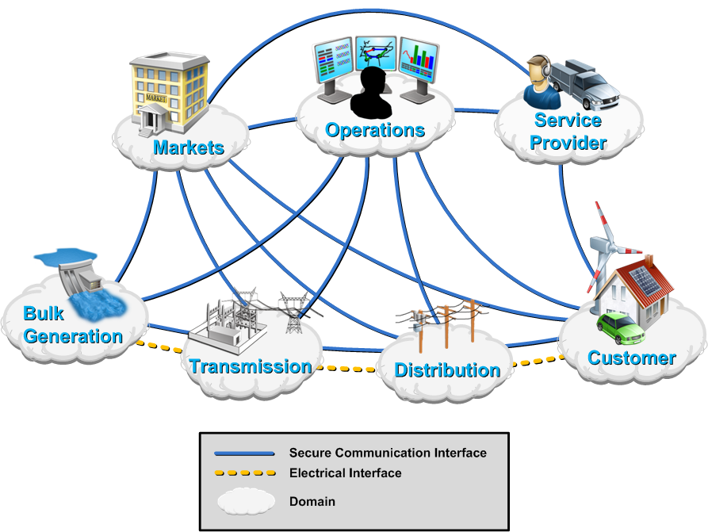
NIST Conceptual Model
NIST role is to coordinate development of a framework that includes,
    Identification of Standards
    High-level architecture reference model
    Testing/ certification framework

Slide 4
SGIP PAP02 – IEEE related activities
Recognition of IEEE 802 wireless standards in NIST Catalog of Standards (COS)
Acceptance of wireless standards as viable in Smart Grid deployments
IEEE 802 SG standards also been considered for the calculation of wireless matrix

Slide 5
PAP02 Status
Published: Version 1
  NISTIR 7761: NIST Priority Action Plan 2
    Guidelines for Assessing Wireless Standards for Smart Grid Applications
  Wireless Capability Matrix
  Application Communication Requirements Matrix
Update of the Guidelines with goal of completing Version 2 by early 2013
  Modifications to
    Sect 4 Wireless Technology
    Sect 5 Modeling & Evaluation Approach
    Sect 6 Factors to Consider
    Annex – Technology specific, entry for 802.11, but not 802.15 or 802.16, SDOs are responsible to update
http://collaborate.nist.gov/twiki-sggrid/bin/view/SmartGrid/PAP02Wireless

Slide 6
IEEE 802.15.4g - SUN
Scope
This Standard defines an amendment to IEEE 802.15.4. It addresses principally outdoor Low Data Rate Wireless Smart Metering Utility Network requirements. It defines an alternate PHY and only those MAC modifications needed to support its implementation.
Specifically, the amendment supports all of the following:
Operation in any of the regionally available license exempt frequency bands, such as 700MHz to 1GHz, and the 2.4 GHz band.
Data rate of at least 40 kbits per second but not more than 1000 kbits per second
Achieve the optimal energy efficient link margin given the environmental conditions encountered in Smart Metering deployments.
Principally outdoor communications
PHY frame sizes up to a minimum of 1500 octets
Simultaneous operation for at least 3 co-located orthogonal networks
Connectivity to at least one thousand direct neighbors characteristic of dense urban deployment
Provides mechanisms that enable coexistence with other systems in the same band(s) including IEEE 802.11, 802.15 and 802.16 systems

Slide 7
TG4g Timeline
Task | Start Date
EC Approve Sponsor Ballot | July 2011
Sponsor Ballot | Aug 2011
Comment Resolution | Sep 2011
Recirculation 1 | Oct 2011
Recirc1 Comment Resolution | Nov 2011
EC conditional approval for RevCom | Nov 2011
Recirculation 2 | Nov / Dec 2011
Recirc 2 CR | Dec 2011 / Jan 2012
RevCom approval | March 2012
Standard Published | April 2012

Slide 8
IEEE 802.15.4e
Scope
The intention of this amendment is to enhance and add functionality to the 802.15.4-2006 MAC to a) better support the industrial markets and b) permit compatibility with modifications being proposed within the Chinese WPAN.
Specifically, the MAC enhancements are limited to:
TDMA: to provide a) determinism, b) enhanced utilization of bandwidth
Channel Hopping: to provide additional robustness in high interfering environments and enhance coexistence with other wireless networks
GTS: to increase its flexibility such as a) supporting peer to peer, b) the length of the slot, and c) number of slots
CSMA: to improve throughput and reduce energy consumption
Security: to add support for additional options such as asymmetrical keys
Low latency: to reduce end to end delivery time such as needed for control applications

Slide 9
TG4e Timeline
Task | Start Date
Letter Ballot Start (30-day) | 8 Oct 2010
Letter Ballot Close | 7 Nov 2010
Resolve comments | 20 Jan 2011
Recirculation (15-day) | 25 Feb 2011
Resolve comments | 17 Mar 2011
Recirculation II (15-day) | 21 Apr 2011
Resolve comments | 8 May 2011
Recirculation III (15-day) | 7 Jun 2011
Sponsor Ballot (30-day) | 5 Aug 2011
Recirc-1 (10-day) | 14 Oct 2011
Recirc-2 (10-day) | 28 Oct 2011
EC approval to go to RevCom | 11 Nov 2011
IEEE RevCom approval | Mar 2012
Standard Published | April 2012

Slide 10
ECSG Next Steps
PAP02 discussion on the wireless characteristics matrix
  Provide input regarding “Range Estimator Matrix” (see next slide)
  Update Annex and review chapters 4, 5, 6. Use chapter 4 as a template for the Annex, answering the questions regarding the system.
    802.11 – Bruce Kraemer
    802.15 – Phil Beecher
    802.16 – Tim Godfrey
    802.22 – Apurva Mody

Slide 11
Range estimator matrix
SDO subcommittee (every Monday, noon EDT, 1.5 hours), identify members attending
Spreadsheet change
  Emphasize the preferred model to use for WLAN.
  Add note to descriptive text that spreadsheet is not appropriate for mesh: Kunal Shah
Update inputs (end of July Plenary for approval by WGs)
  802.11 (802.11ah): Bruce Kraemer
  802.15.4g/e: Phil Beecher
  802.16: Tim Godfrey
  802.22: Apurva Mody

Slide 12
Items for call
Effective DL and UL BW should not be enforced, rather effect of TDD should be accounted for on the data rate side. Bruce Kraemer to communicate. Phil Beecher will join as well.
Mention that an effort is ongoing in 802 to update the Range spreadsheet with typical numbers for each of the relevant 802 standards.

