Slide 1
IEEE P802.22.3: Spectrum Characterization and Occupancy Sensing (SCOS)
Apurva N. Mody (WhiteSpace Alliance)
Oliver Holland (Advanced Wireless Technology Group, Ltd.)
Roger Hislop (Internet Solutions)
Mike Cotton (National Telecommunications and Information Administration)
Gianfranco Miele (University of Cassino)
IEEE 802 Wireless Interim Meeting, May 15, 2019
Atlanta, Georgia, USA

Slide 2
Outline
Background and Need for the Standard
IEEE P802.22.3
  PAR
  Current Status
IEEE P802.22.3 Draft Standard
  Reference Applications
  Requirements
  Architecture
  Services
  Information Model
  Applications and Modes of Operation
Why IEEE 802.15?
Conclusion and Request

Slide 3
Background and Need for the Standard

Slide 4
Spectrum Sharing Today
TV White Space (TVWS)
  US, UK, Canada, Singapore, South Africa, Colombia, numerous other countries worldwide
Citizens Broadband Radio Service (CBRS)
  US; possible solution in other countries, e.g., 1800 MHz, 2.3 GHz, and 3.8-4.2 GHz in UK
FCC 6 GHz NPRM
  Requires sharing with many different types of Primary Users
Licensed-Shared Access (LSA)
  EU—France, Finland, Italy, Netherlands
Others, e.g., light licensing, collective use of spectrum and concurrent spectrum access, and of course, sharing in unlicensed spectrum

Slide 5
Spectrum Sharing Today—Spectrum Sensing
Still is (or can be) used in some cases
  Environmental Sensing Capability (ESC) –
    Note – NTIA is heavily involved in the 802.22.3 Activities. They are already working on the 802.22.3 implementation and plan to deploy their sensor network for CBRS (3.5 GHz)
  Very low-power white space devices in US
  Coordination among license-exempt devices
  5 GHz
Of course, can greatly assist regulatory processes
  E.g., interference potential/interferer detection, spectrum forensics
  Understanding of the spectral situation, e.g., to assess potential for sharing gains

Slide 6
Flexible Spectrum Access
Demand on spectrum. Example:
  Vast increase in the performance requirements of systems (e.g., “5G”/IMT-2020, 20 Gbps peak); a lot of this achieved by access to more spectrum
  Higher frequencies (e.g., mm-wave, and 3 GHz+) problematic in many scenarios. Coverage, need for density of access points, reliability/availability, etc.
  Spectrum sharing is a prime means to achieve increase in accessible spectrum at lower frequencies. See, e.g.,
    PCAST, “Report to the President: Realizing the Full Potential of Government-Held Spectrum to Spur Economic Growth,” July 2012.
    Ofcom, “Enabling Opportunities for Innovation”, Consultation, December 2018.
Leads to increasing range of devices spatially (perhaps also temporally) sharing a range of bands
Notes:
6

Slide 7
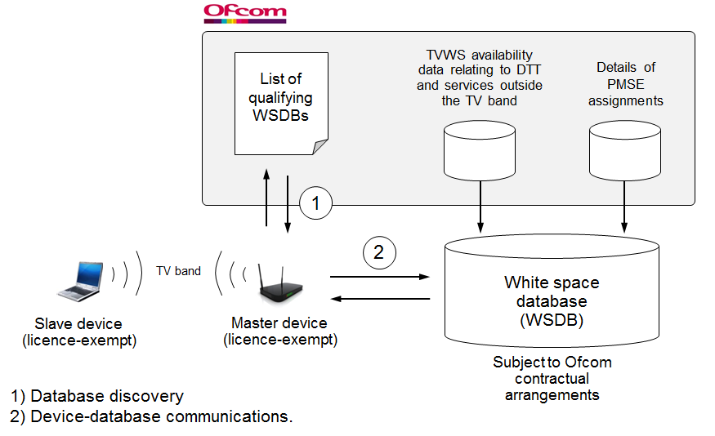
Flexible Spectrum Access
Sharing strongly supported/promoted by some regulators and becoming inherent in regulatory frameworks.
  TV White Space
  (TVWS)
  example:
Source: Ofcom, “Implementing TV White Spaces”, statement, February 2015.
Notes:
7

Slide 8
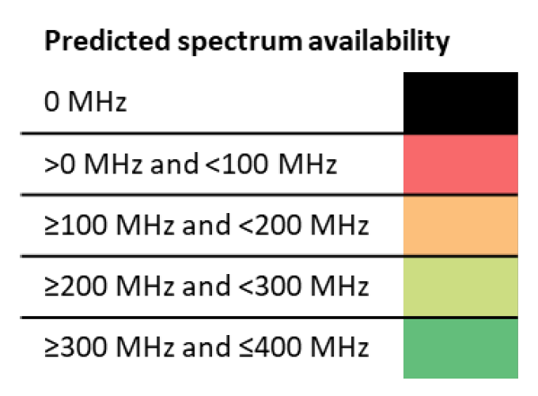
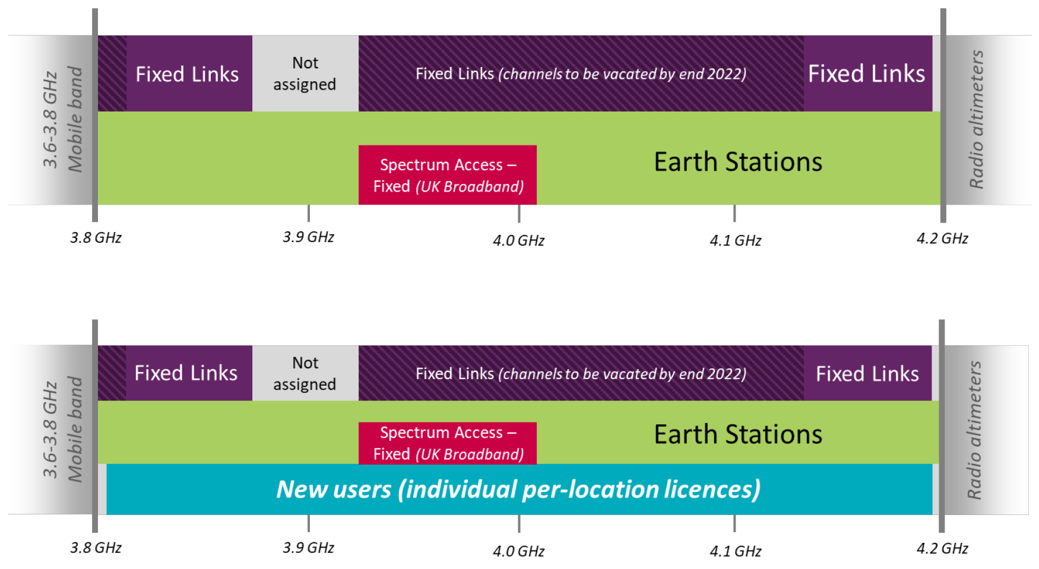
Flexible Spectrum Access
Regulatory Frameworks (continued)
  Novel/local licensing concepts
  example (note, also proposes local licenses for all mobile bands!):
Source: Ofcom, “Enabling Opportunities for Innovation”, consultation, December 2018.
Notes:
8

Slide 9
Flexible Spectrum Access
Regulatory Frameworks (continued)
  CBRS example
NTIA Rpt. 15-517
Jun 2015
(Exclusion Zone
Analyses & Methodology):
Highlights impact
of Model
Assumptions !

Slide 10
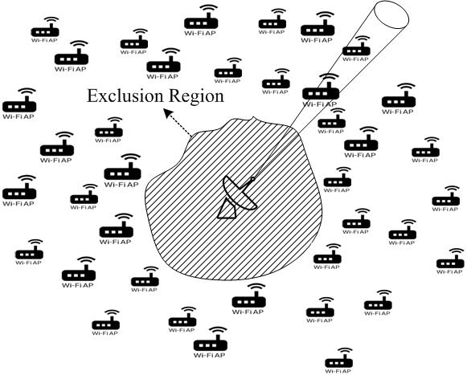
Flexible Spectrum Access
Regulatory Frameworks (continued)
  CBRS example (continued)
Exclusion Zone: A region around the primary
with no co-channel active secondary txmission
Protection Zone: A region with active
secondary txmitters, but with constraints so as
stay within `acceptable interference’ limits
Design Objective: minimize exclusion region subject to protection of primary.
Exclusion Region depends on multiple factors: sensitivity of victim receiver, interference margin, secondary txmit power, path loss model
Incumbent Licensee: ‘primary’ (to be protected from interference)
New User: `secondary’ (no interference protection)
Effective Sharing can be Staged to be Successful

Slide 11
Flexible Spectrum Access—Implications and Need for SCOS
Sensing is part of some spectrum sharing frameworks (e.g., CBRS, TV White Space in US case, etc.).
Sensing can assist the frameworks in other ways (e.g., help to measure and better optimise propagation and the utilised propagation model, help to monitor for possible interference being caused, help to detect malfunctioning or malicious devices, etc).
In general:
  Need to sense for interference; localise interference, due to greater range/use of flexible spectrum access devices being used.
  Also greater range and number of devices using the spectrum.
  Spectrum analysis (e.g., efficiency, many other uses).
Notes:
11

Slide 12
Background and Need for the Standard
Standards are needed
  to get consistent results
  allowing correlation of result amongst many devices
  which ultimately will be the strength of SCOS
  allowing the vast amount of fallow spectrum
  to become available for opportunistic use
  and allow everyone to view, in quasi real time
  Store vast amount of data in a standardized format
  the actual spectrum use and the fallow spectrum that can be shared by other users
Notes:
12

Slide 13
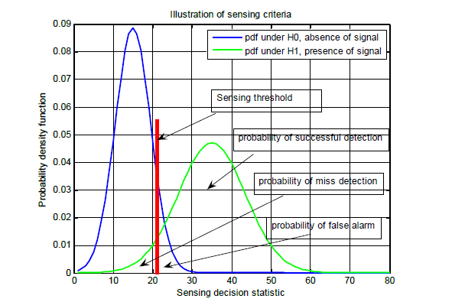
Spectrum Sharing Today—Spectrum Sensing
Energy detection
Feature detection, e.g.,
  Cyclic prefix
  Autocorrelation
  Cyclostationary
Partially adapted from content presented in O. Holland, M. Nekovee, “Spectrum Awareness”, ICT-ACROPOLIS Summer School 2011, Florence, Italy, June 2011

Slide 14
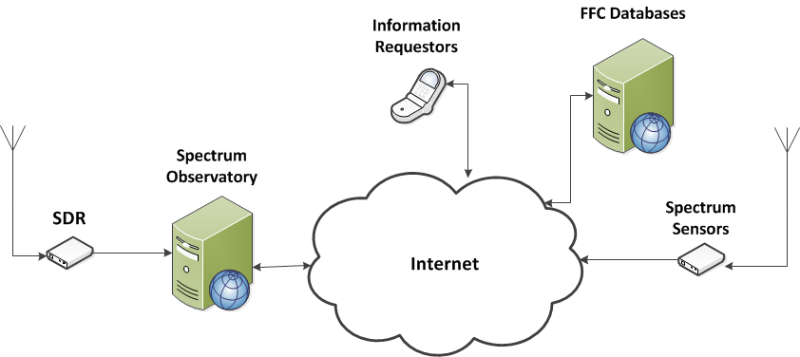
UW Spectrum Observatory (SpecObs) Database
FCC Database
http://specobs.ee.washington.edu/

Slide 15
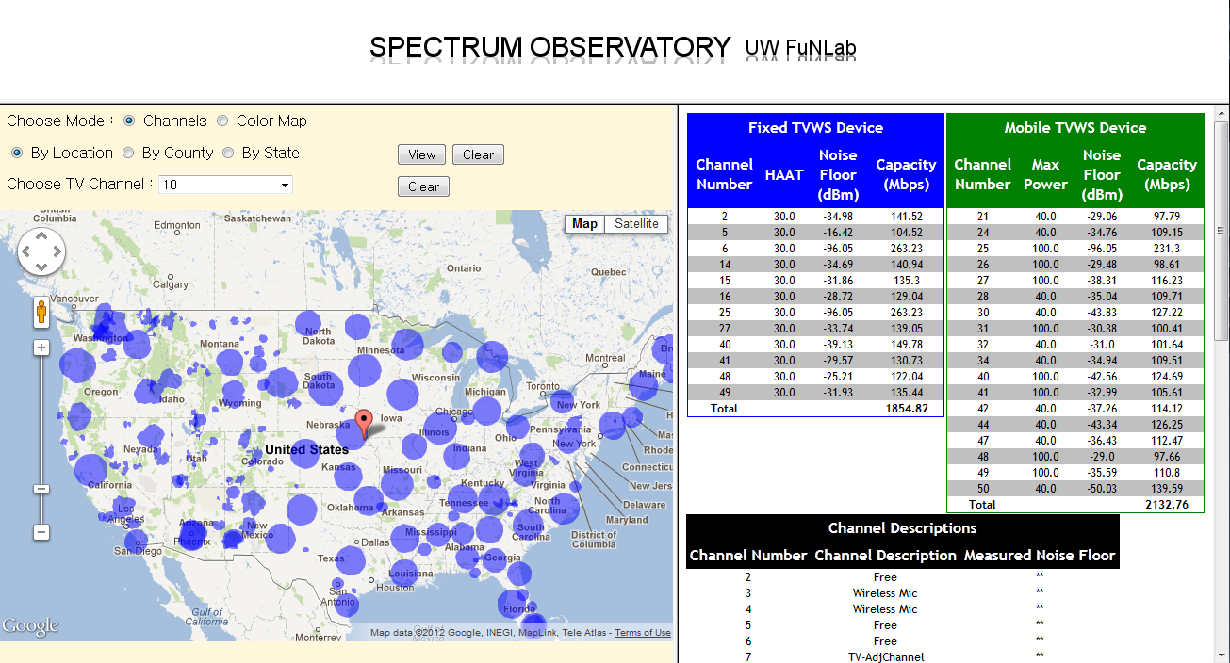
Show TV White Space Data
(Example Data for
latitude : 40.3832, longitude : -96.0511)
Query data by various options
Protection region of each TV channel

Slide 16
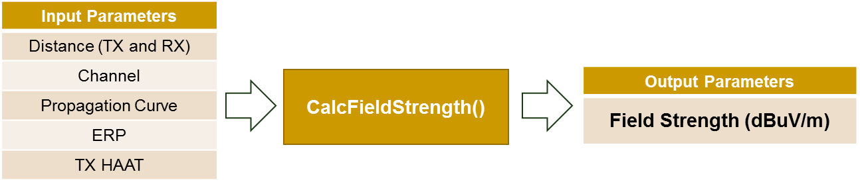
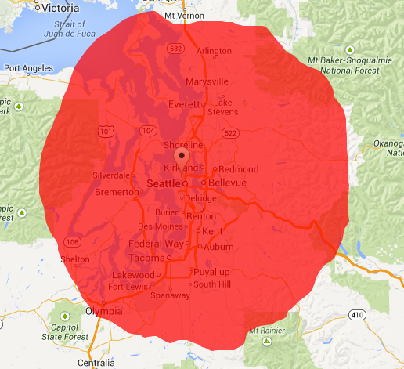
Scenario 1: FCC Defined Coverage Area for Single TV Channel
  Geographic area within the TV station’s noise-limited contour
→ Defined with F-Curve and Field Strength Threshold
Coverage Area computed by F-Curve (KIRO-TV in Seattle)
TV Type | Channel 2- 6 | Channel 7 – 13 | Channel 14 - 51
Analog | 47 | 56 | 64
Digital | 28 | 36 | 41
Table 1. Field Strength (dBuV/m) Threshold to define TV coverage

Slide 17
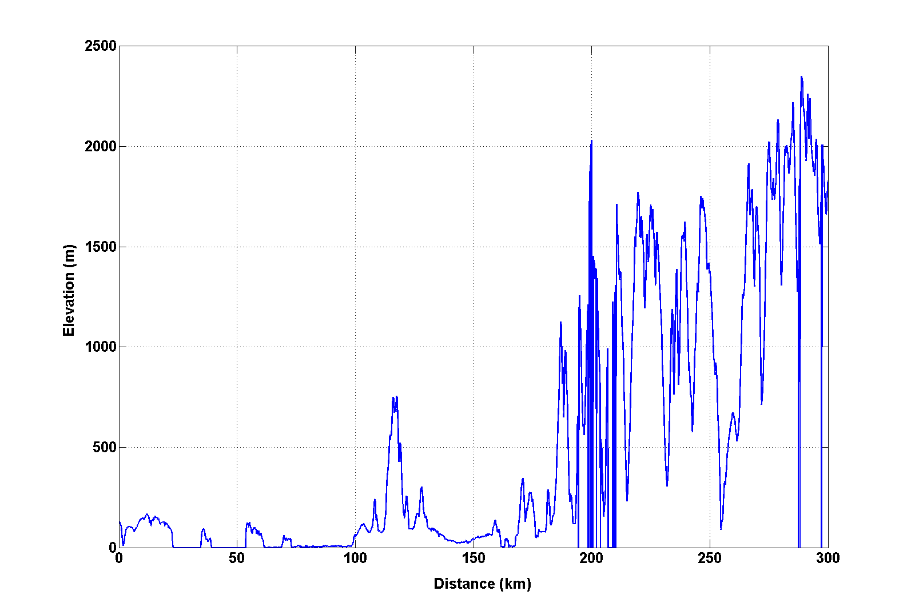
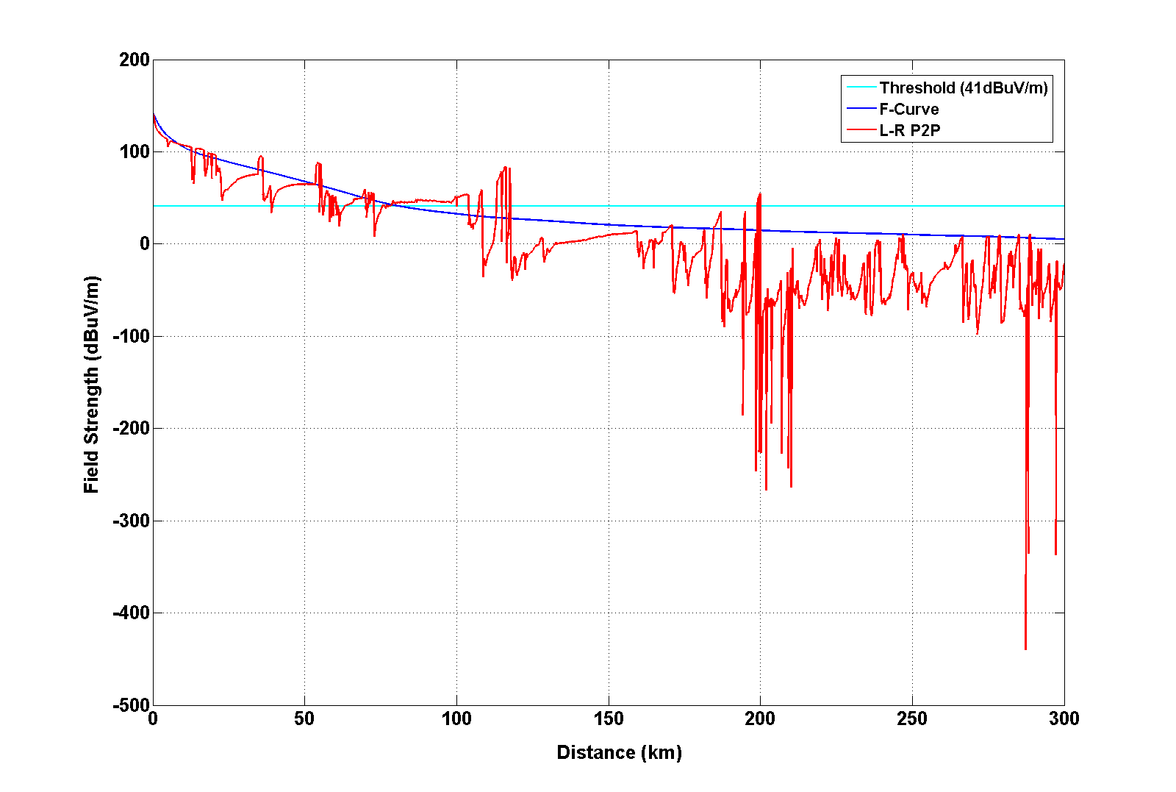
Longley-Rice Model
L-R P2P mode
  Input – All elevation value (every 100 m) and distance between TX and RX
  Output – Field Strength (dBuV/m)
  Takes account for LOS, diffraction, scatter effect with terrain data
  The below figures show L-R P2P mode is sensitive to terrain elevation
Elevation of azimuth 0 degree (KIRO-TV)
Field strength of azimuth 0 degree (KIRO-TV)

Slide 18
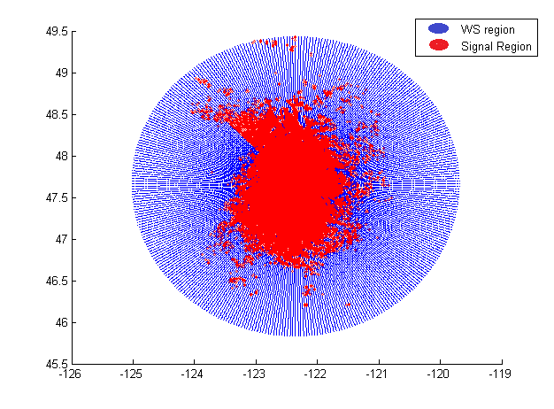
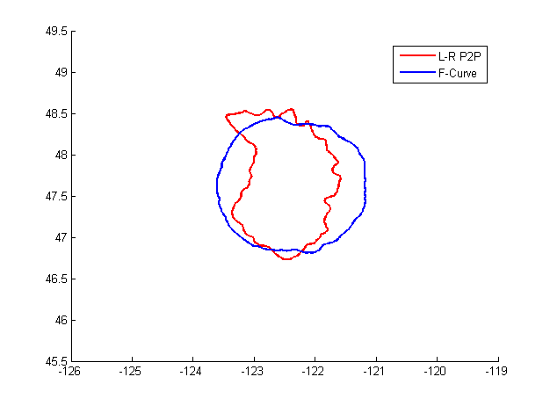
SpecObs Coverage using L-R P2P
Method using classification algorithm
  Calculate field strength at all dense points around transmitters with L-R P2P mode
  Run K- NN algorithm to classify points as WS or service regions
Estimation of L-R field strength
(KIRO-TV)
Comparison of coverage (KIRO-TV)
L-R P2P Vs F-Curve

Slide 19
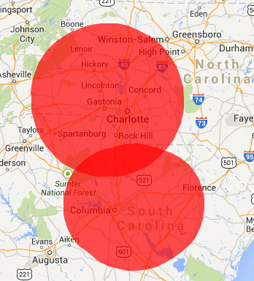
Scenario 2 : Two Co-channel TV stations
  Two nearby DTV stations operating co-channel (channel 39)
  - coverage regions partially overlap per F-curve
  High possibility of co-channel interference
Coverage area for WMYT-TV and WKTC (F-Curve)
Desired Station
Channel: 39
Call sign: WMYT-TV
Service type: DT
ERP: 225.0 kW
HAAT: 571.0 m
Antenna Type: ND
Coordinate:
35.36222,-81.15528
Undesired Station
Channel: 39
Call sign: WKTC
Service type: DT
ERP: 500.0 kW
HAAT: 391.0 m
Antenna Type: DA
Coordinate:
34.11611,-80.76417

Slide 20
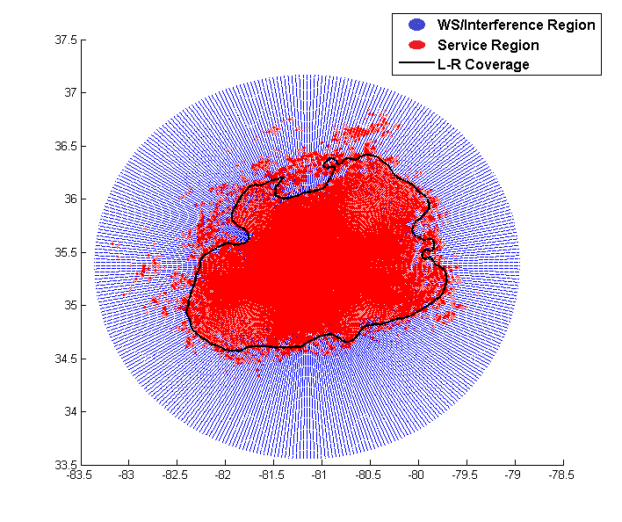
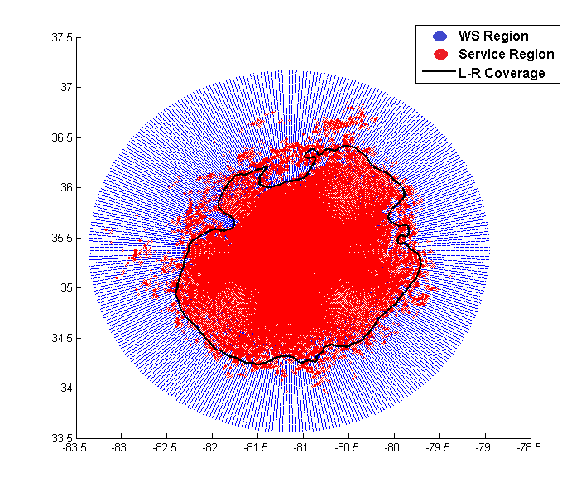
SpecObs Results
Result of TV Coverage (WMYT-TV)
  Calculates SNR-based coverage and SINR-based coverage
  Run KNN algorithm to compute a closed-loop coverage
  SINR-based coverage are lost some service regions of WMYT-TV due to interference from WKTC
WMYT-TV service region and coverage based on SNR threshold (16 dB) and K = 250
Total error rate = 15.376 %
Type 1 (8.218 %) + Type 2 (7.158 %)
WMYT-TV service region and coverage based on SINR threshold (15.16 dB) and K = 250
Total error rate = 13.916 %
Type 1 (6.491 %) + Type 2 (7.425 %)

Slide 21
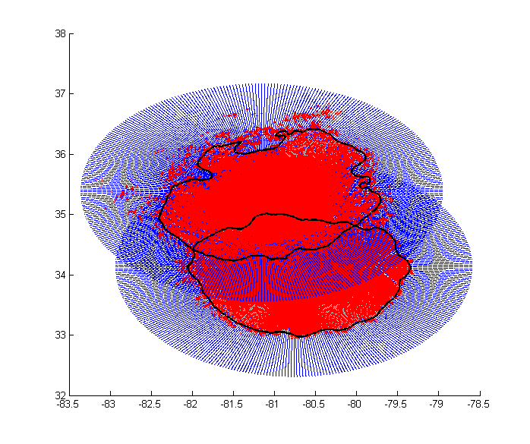
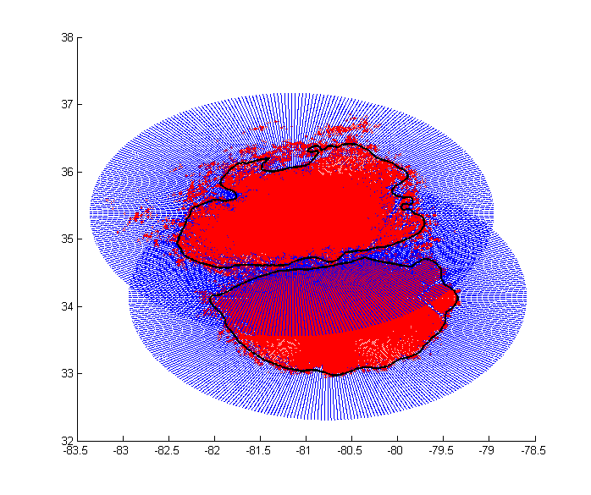
SpecObs Results Comparison
Comparison of TV Coverage
  SINR-based coverage of two stations are distinct
  Our approach shows better estimation of coverage
SNR-based Coverage comparison
for WMYT-TV and WKTC
SINR-based Coverage comparison
for WMYT-TV and WKTC

Slide 22
TV White Space Capacity
  Need to go beyond just WS listing, need to answer
  “How much white space capacity is available to secondary users at a location ? ”
  → max rate a single secondary user may reliably
  transmit at a point

Slide 23
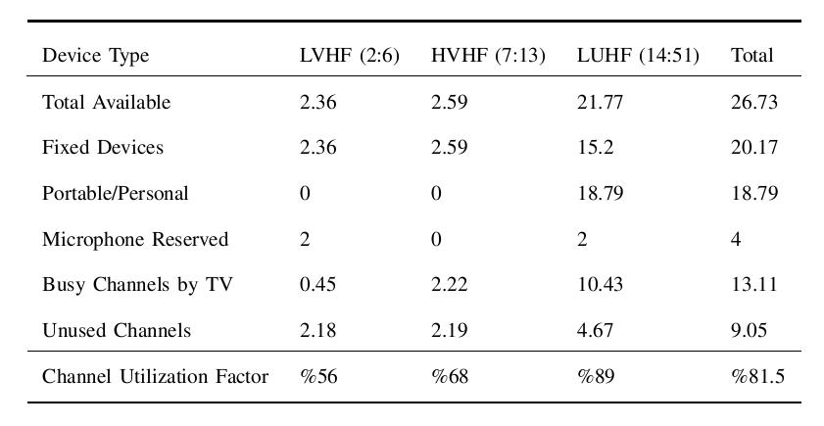
Channel Availability Statistics

Slide 24
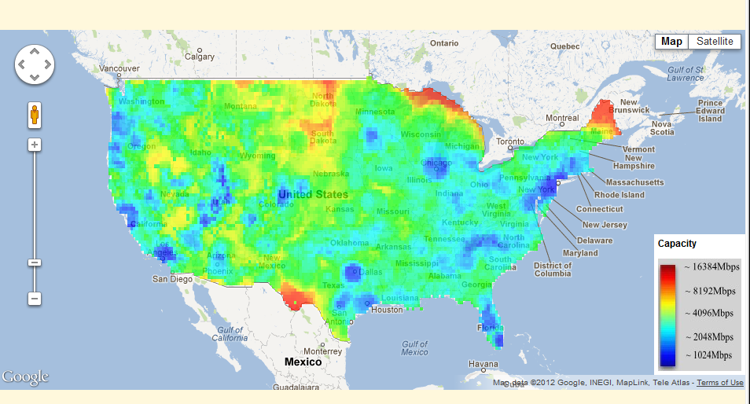
Advantage of Combining SOS with Current Database Architecture
Shows available sum capacity
over the U.S graphically

Slide 25
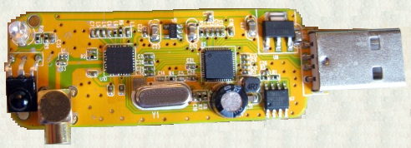
Example of SCOS-IoT
Spectrum sensing can fit in a USB dongle
USB3 I/Q 2.5Ms/s A/D
Acarsd
Tuner
6/7/8 MHz BW
24-1766 MHz
Antenna
Port
Notes:
25

Slide 26
Spectrum Sensing Implementation
Why standards are needed
Current market has a plethora of implementations
This is mainly due to
  market is developing faster than standards
  in a vacuum of standards
    inconsistent performance amongst manufacturers rules
Every manufacturer goes their way, making their own devices
Notes:
26

Slide 27
Spectrum Sensing Implementation
Broad Market potential – currently, we have a jungle of SOS SDR candidates & tools
The current maverick expansion scenario in a standards vacuum
Microsoft
Modesdeco
acars_ng
WxtoIMG
SoftFM
GNU Radio
PDW
NWRA
BAE Systems
SeeDeR
ec3k
Orbitron
DStar
HDSDR
GR-AIS
Studio1
Acarsd
Linrad
SDR-J
NRF905 Decoder
PowerSDR
cuSDR
AISMon
Redhawk
ADS-B Decoder and Radar
RTL-SDR
GR-Phosphor
OpenCPN
Nutaq
GQRX
DREAM
QtRadio
SDR-RADIO.COM V2
SDR_Lab
LibRadio
rtlamr
LTE-Scanner
Virtuel Radar Server
DAB_Player
Trunk88
Unitrunker
GR-Elster
WebRadio
GlobeS
ViewRF
Sdrangelove
AmeriSys
Multimode
PlanePlotter
FunCube
SRD#
ShipPlotter
ShinySDR
Radio Receiver for Chrome
SDRWeather
Acarsdec
GNSS
SDR Touch
ADSB
coca1090
adsbSCOPE
GR-RDS
RDS_Spy
NRF24-BTLE Decode
Ettus
TVSharp
Sodira
gr-air-modes
Wavesink Plus
Airprobe
RTL_433
SondeMonitor
dl-fldigi
Panorama
Notes:
27

Slide 28
Spectrum Sensing Implementation
What standards need to do
Standards are needed to define classes of devices by specifying
  the PHY layer abilities for each class of device
  the client-server communication protocols
For the best results, servers standards should specify vendor independent
  basic behaviours for each class of device
  means to communicate abilities, limitations and observation results
Notes:
28

Slide 29
IEEE P802.22.3
Spectrum Characterization and Occupancy Sensing

Slide 30
PAR
2.1 Title: Standard for Spectrum Characterization and Occupancy Sensing
5.2 Scope: This Standard defines a Spectrum Characterization and Occupancy Sensing (SCOS) System. It defines the formats for system configuration and spectrum measurement parameters. It includes protocols for reporting measurement information that allow the coalescing of results from multiple systems. The standard leverages interfaces and primitives that are derived from IEEE Std. 802.22-2011. It uses any available transport mechanism to control and manage the system, and to share sensing data. The standard provides means for conveying value added sensing information to various spectrum database services.

Slide 31
PAR
5.4 Purpose: The purpose is to specify operating characteristics of the components of the Spectrum Characterization and Occupancy Sensing System.
5.5 Need for the Project: Recently, Federal Communications Commission (FCC), National Telecommunications and Information Administration (NTIA) in the United States and other regulators such as OfCom UK, have broadened their horizons for cooperative spectrum sharing approaches in order to optimize spectrum utilization. For example see the PCAST Report (See §8.1). FCC/ NTIA are in the process of opening new spectrum bands which specifically require multi-levels of regulated users (e. g. primary, opportunistic etc.) to share the spectrum.

Slide 32
PAR
5.5 Need for the Project (continued): There is emphasis on greater spectrum efficiencies, spectrum sharing and spectrum utilization, which requires not only database driven configuration of the radios, but systems that can provide spectrum occupancy at a particular location and at a particular time.
This standard will help fulfil this need by creating a Spectrum Characterization and Occupancy Sensing System. This will enable improved spectrum utilization and support for other shared spectrum applications, hence benefitting the regulators and users alike.

Slide 33
IEEE P802.22.3 Draft Standard

Slide 34
Spectrum Characterization and Occupancy Sensing (SCOS) Applications
Quantification of the available spectrum through spectrum observatories
On-demand spectrum survey and report
Collaborative spectrum measurement and calibration
Labeling of systems utilizing the spectrum
Spectrum planning
Spectrum mapping
Coverage analysis for wireless deployment
Terrain and topology - shadowing and fading analysis
Complement the database access for spectrum sharing by adding in-situ awareness and faster decision making.
Space-Time-Frequency spectrum hole identification and prediction where non-time-sensitive tasks can be performed at certain times and at certain locations, when the spectrum use is sparse or non-existent
Identification and geo-location of interference sources.

Slide 35
Spectrum Characterization and Occupancy Sensing (SCOS) Applications
Shared spectrum device radio operation.
  Sensing-based or supported spectrum access.
National spectrum regulation.
  As part of flexible access/sharing frameworks.
  Numerous other cases.
Research programs.
Law enforcement and public order.
Network operator applications.
  Resource usage optimisation, monitoring, etc.

Slide 36
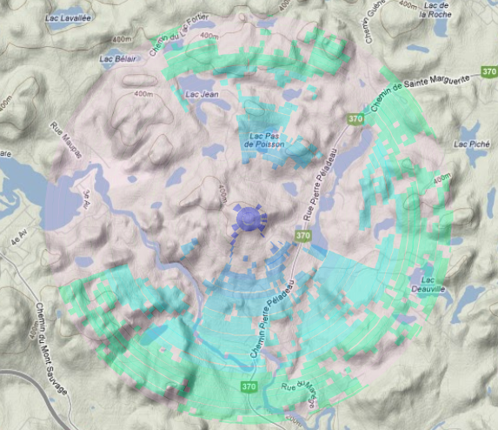

SCOS observed Spectrum Occupation
vs coverage area
Blue – dashed line: Coverage based on No terrain information
Shaded: Coverage based on SOS and terrain combination
Tx Site
Notes:
36

Slide 37
Current Status
Has held 5 internal Letter Ballots, on 5 drafts of the standard.
Most recent Letter Ballot 5 on Draft 5.0 has met return requirements, and achieved 100% approval.
Considering whether would wish to go to Sponsor Ballot based on this, or to have further internal Letter Ballot to facilitate very strong/prominent contributor/developer participating more who has extensive extra development resource imminently coming online.

Slide 38
IEEE P802.22.3 Spectrum Characterization and Occupancy Working Group Letter Ballot
IEEE WG Letter Ballot | Launch Date | # of Comments Received | Comment Resolution Status | Response Ratio | Approval Ratio | Draft Status
WG LB #1 (P802.22.3 Draft v1.0) | February 12th 2017 to March 13th 2017 | 153 | Comments were addressed and Resolved | 76% | 17% | P802.22 Draft v2.0 Prepared
WG LB #2 (P802.22.3 Draft v2.0) | October1st to October 30th 2017 | 95 | Comments were addressed and Resolved | 77% | 50% | P802.22 Draft v3.0 Prepared
WG LB #3 (P802.22.3 Draft 3.0) | February21st 2018 to March 4th 2018 | 60 | Comments were addressed and Resolved | 61.54% | 60% | P802.22 Draft v4.0 prepared
WG LB #4 (P802.22.3 Draft 4.0) | October 2nd 2018 to October 31st 2018 | 72 | Comments are being addressed and resolved | 73% | 71% | P802.22 Draft v5.0 prepared
WG LB #5 (P802.22.3 Draft 5.0) | Feb 2019 – March 2019 | 55 | Comments are being addressed and resolved | 58% | 100% | P802.22 Draft v6.0 being prepared

Slide 39
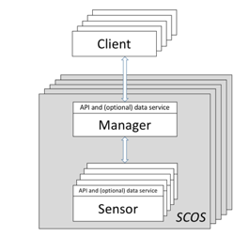
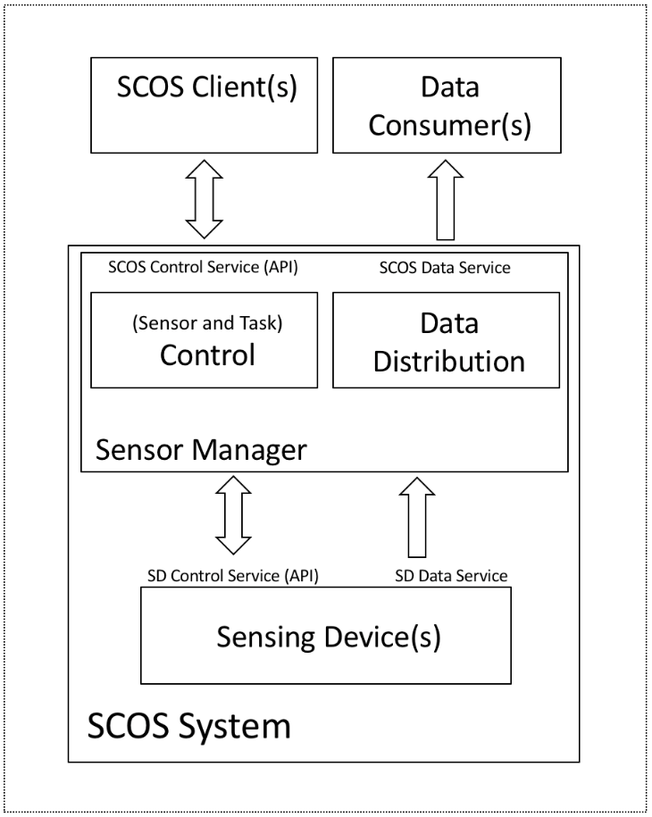
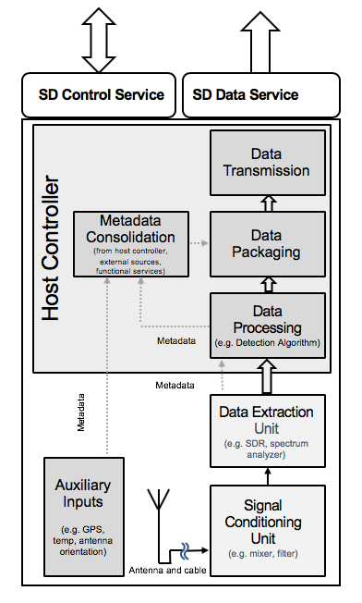
Architecture
Notes:
39

Slide 40
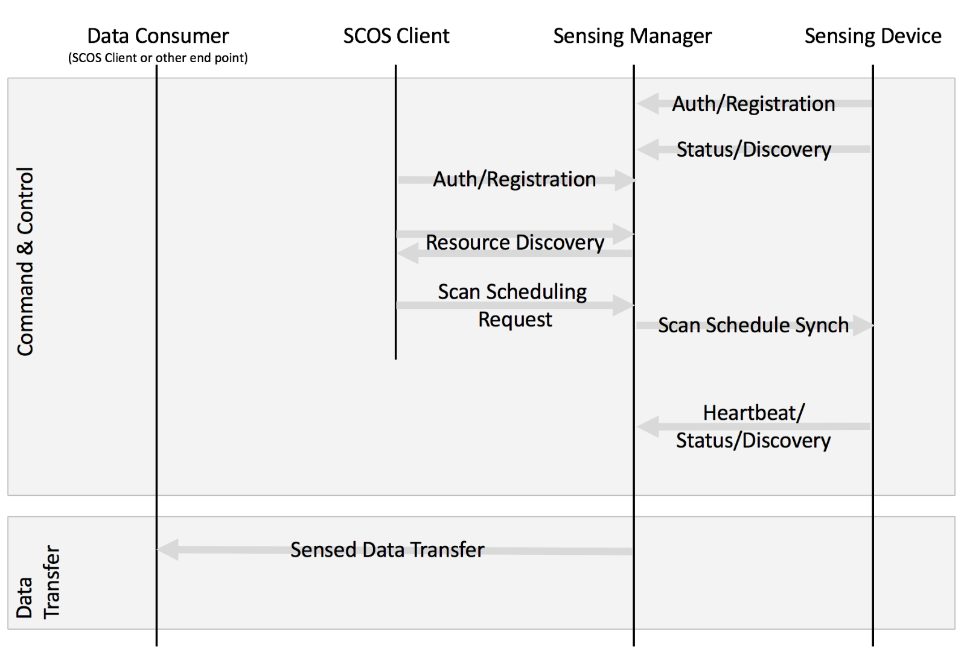
Simplified Interactions Model
Notes:
40

Slide 41
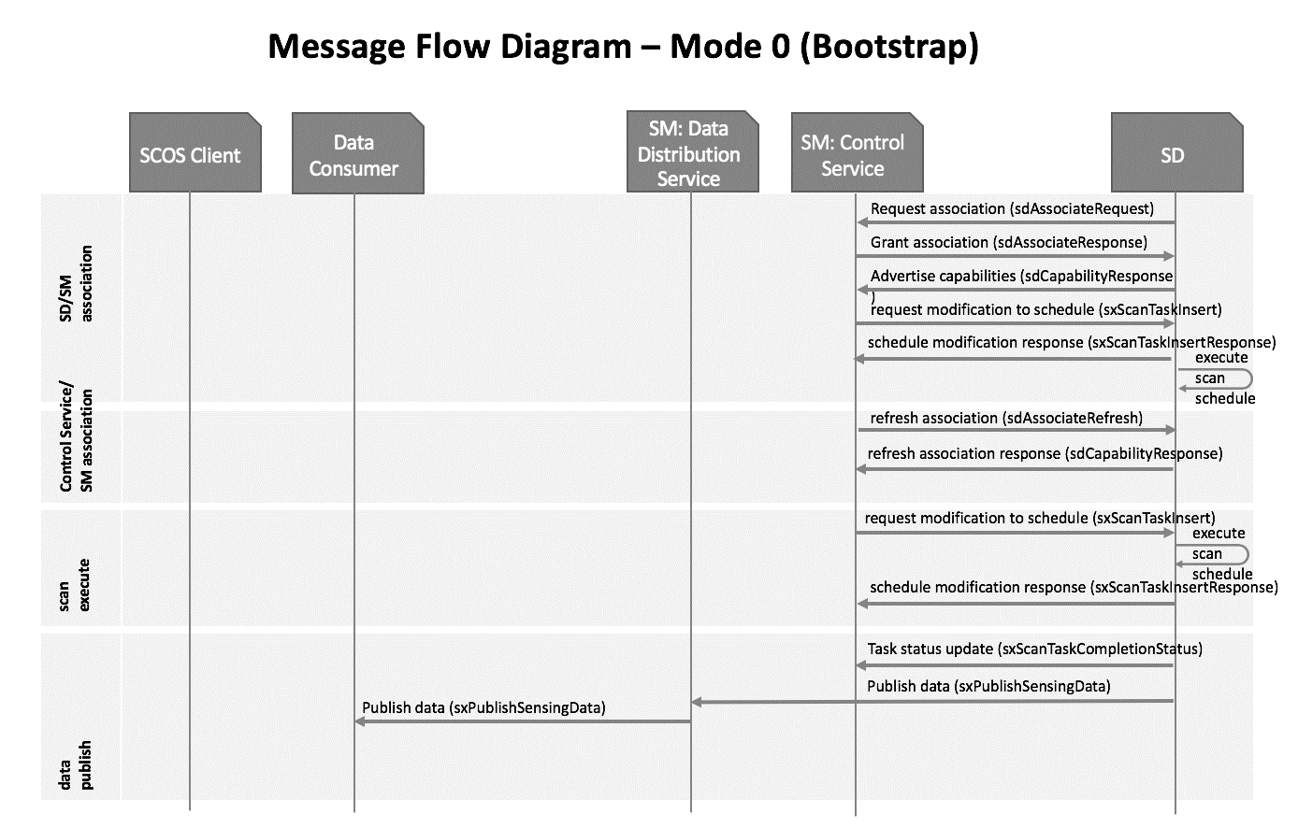
Modes of Operation
Mode 0 (Bootstrapping Mode).
Notes:
41

Slide 42
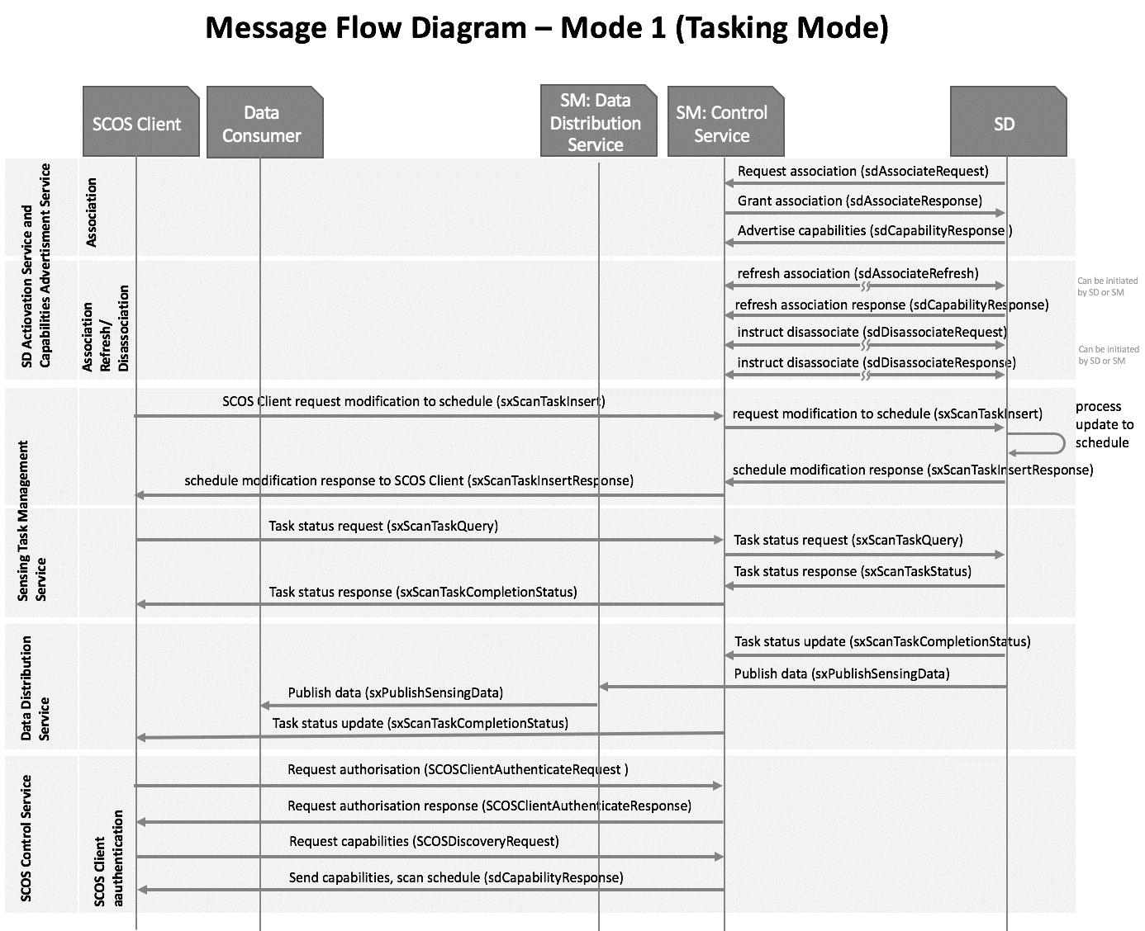
Modes of Operation
Mode 1 (Tasking Mode).
Notes:
42

Slide 43
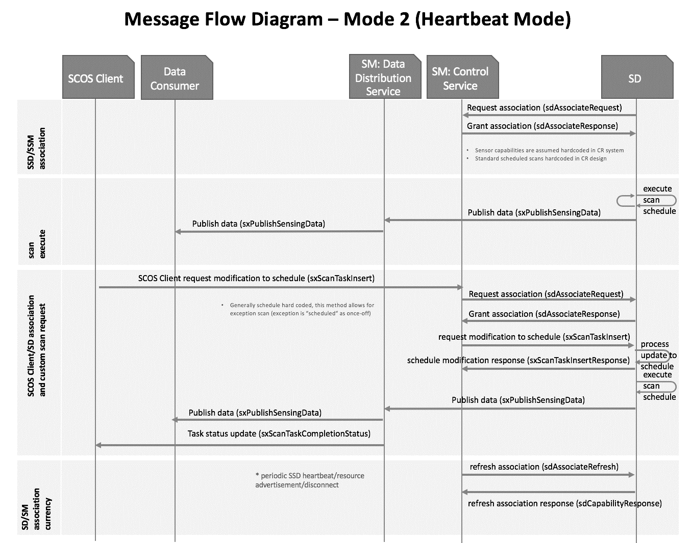
Modes of Operation
Mode 2 (Heartbeat Mode).
Notes:
43

Slide 44
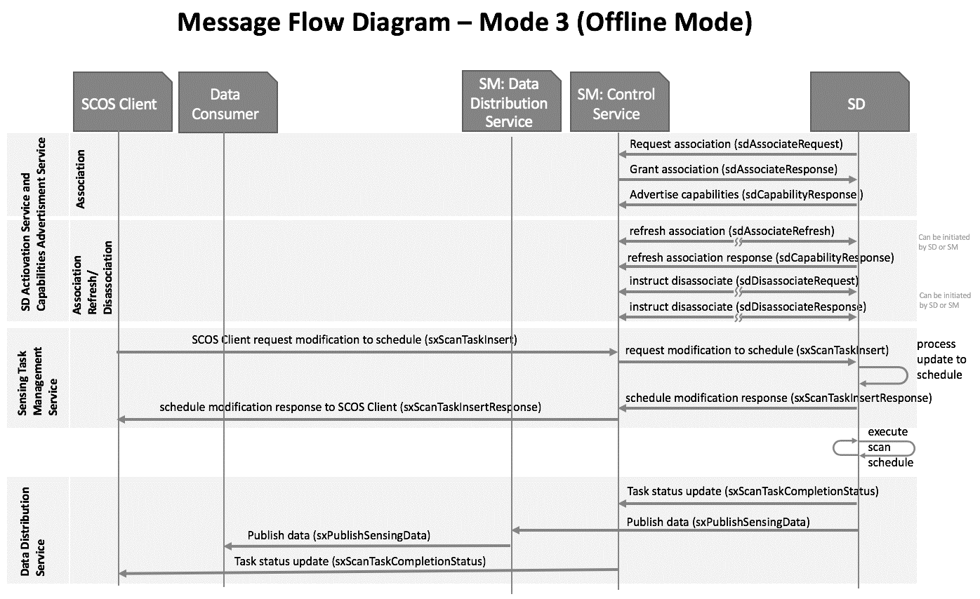
Modes of Operation
Mode 3 (Offline Mode).
Notes:
44

Slide 45
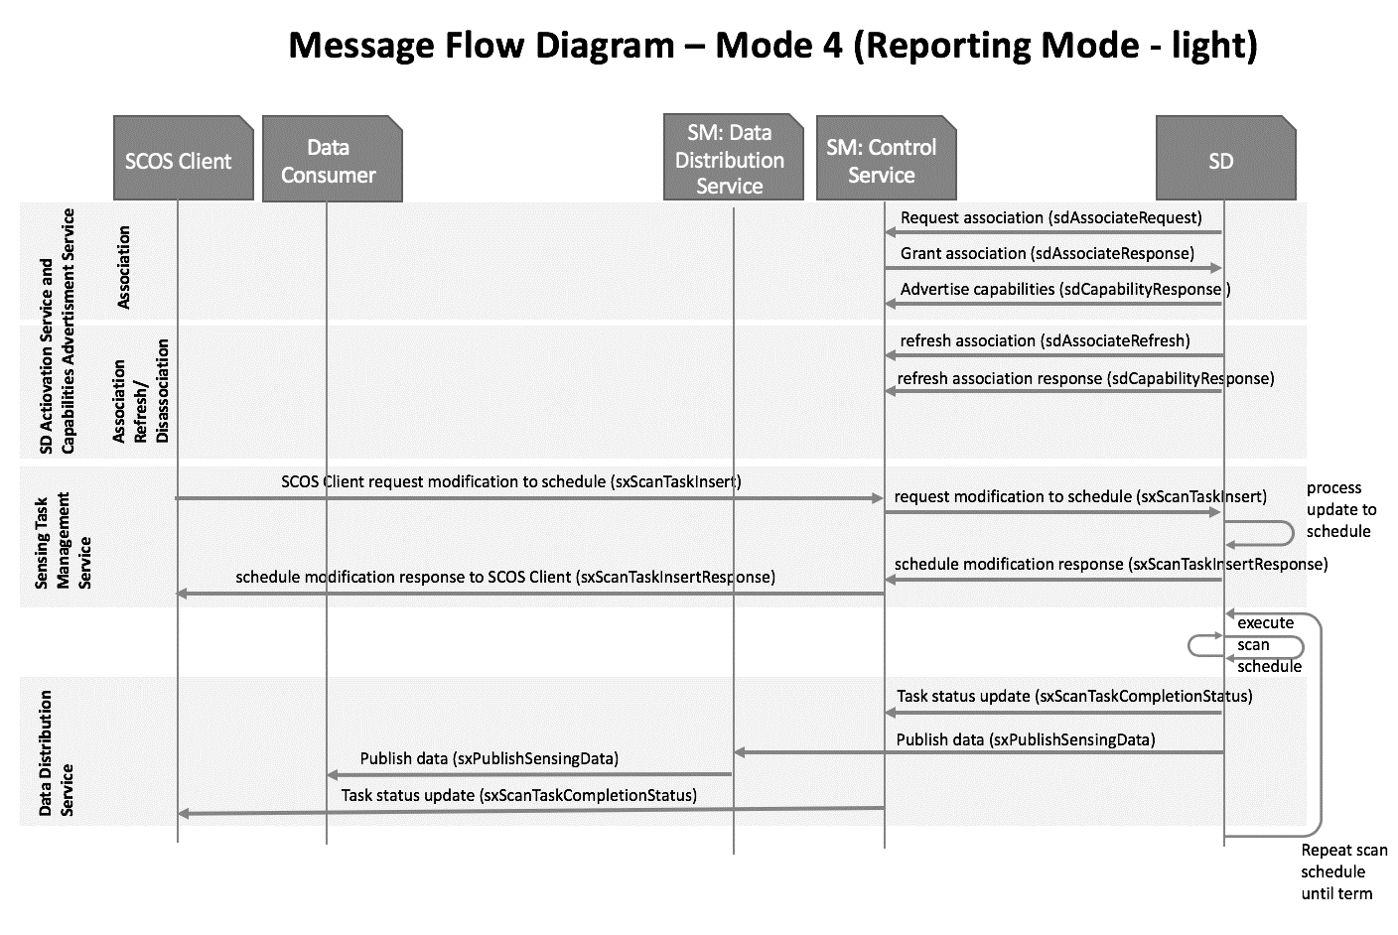
Modes of Operation
Mode 4 (Reporting Mode).
Notes:
45

Slide 46
IEEE P802.22.3 Spectrum Characterization and Occupancy Sensing Telecon Schedule
Johannesburg | Tokyo | Boston | Denver
Thu 15:00 | Thu 22:00 | Thu 09:00 * | Thu 07:00 *
Thu 16:00 | Thu 23:00 | Thu 10:00 * | Thu 08:00 *
Teleconference every other Thursday at 9 am ET which is 2 pm UTC

Slide 47
Why IEEE 802.15?

Slide 48
Why IEEE 802.15
IEEE P802.22.3 started its work concentrating very heavily on spectrum sensing to support spectrum opportunity detection for opportunistic spectrum access—so suited to IEEE 802.22 at the time.
Applications and entities involved have expanded far more to broader areas, e.g.,
  Spectrum forensics.
  Interference localisation.
  Regulatory framework/process optimisation.
  Network deployment optimisation (e.g., resource reuse).
802.22.3 is essentially an IoT sensor network.
It would be ideal to combine the Spectrum Sharing Expertise within 802.22 with the Wireless Sensor Networks expertise in 802.15,
Individuals/involvements therein would also greatly benefit the 802.22.3 work.
Notes:
48

Slide 49
Conclusion and Request

Slide 50
Conclusion and Request
Strong need for such a standard, for many different types of stakeholders and uses of it.
Good state of progress so far.
802.22 Working Group has already done the hard work. 802.15 can benefit from this.
Standard will greatly benefit by joining forces between the expertise contained in the 802.22 Working Group with the presence of many IoT stakeholders in the 802.15 Working Group
802.22.3 would greatly benefit from the greater involvement/visibility and participation of IEEE 802.15 members.
Request your kind consideration of move of this activity to be under IEEE 802.15.
Notes:
50

