Slide 1

Spectrum ........
…...............................Be Prepared for Sharing

Slide 2
Contributors
Apurva N. Mody, CTO, National Spectrum Consortium (NSC)
Julie Knapp, Chief, Office of Engineering Technology, Federal Communications Commission (FCC)
Sumit Roy, University of Washington, NSC
Jeff Evans, Georgia Tech Research Institute, NSC
Oliver Holland, Advanced Wireless Technology Group
Jay Holcomb, Itron, Chair, IEEE 802.18 Task Group

Slide 3
Overview
Apurva N. Mody, National Spectrum Consortium
apurva.mody@ieee.org, apurva.mody@WhiteSpaceAlliance.org

Slide 4
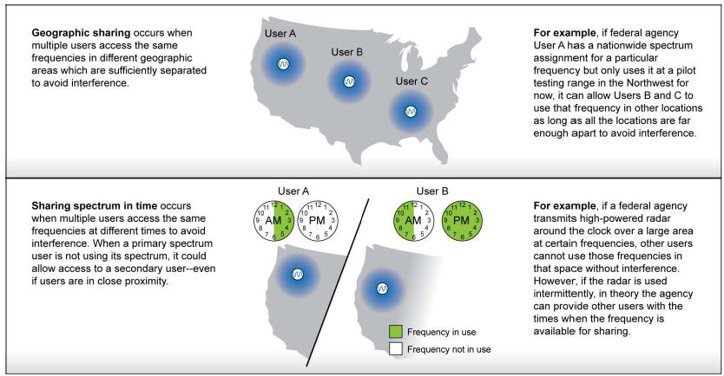
What is Bi-directional Spectrum Sharing
https://www.gao.gov/assets/650/648206.pdf
Sharing of the Same Spectrum based on Location or Time to avoid interference to a Primary User

Slide 5
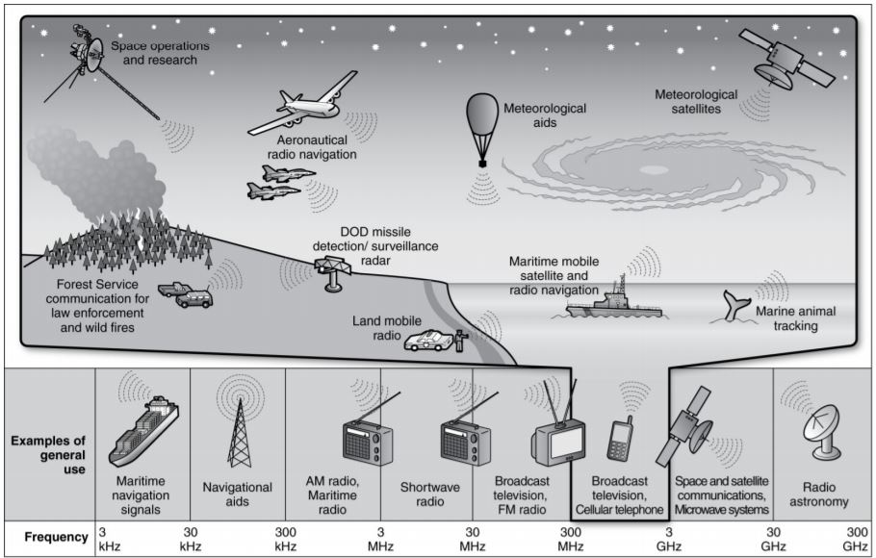

Federal to Commercial Bi-directional Spectrum Sharing
Federal
Commercial

Slide 6

Commercial to Commercial Bi-directional Spectrum Sharing
Commercial 1
Commercial 2

Slide 7
Spectrum Bands being Considered for Commercial Use
Presenter
Apurva N. Mody, National Spectrum Consortium
On behalf of
Julie Knapp, Chief of Office of Engineering and Technology, FCC
Jay Holcomb, Itron, Chair, IEEE 802.18 Radio Regulatory TAG

Slide 8


Mobile Now Act and Spectrum Bands Being Considered for Release
Julius Knapp, Chief
Office of Engineering and Technology
Federal Communications Commission
Presented to the
National Spectrum Consortium
November 1, 2018
Note: The views expressed in this presentation are those of the author and may not necessarily represent the views of the Federal Communications Commission

Slide 9
Key FCC Spectrum
Initiatives & Proceedings
Low Frequency Spectrum:
  TV Broadcast Incentive Auction (600 MHz band)
Mid Frequency Spectrum:
  3.5 GHz (3550-3700 MHz)
  Proposal for 3700 – 4200 MHz
  Draft proposal for 5925 – 7125 MHz
High Frequency Spectrum:
  Spectrum Frontiers (above 24 GHz)
  Spectrum Horizons (above 95 GHz)
All these bands require mechanisms for spectrum sharing

Slide 10
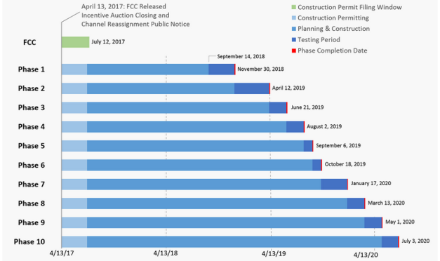
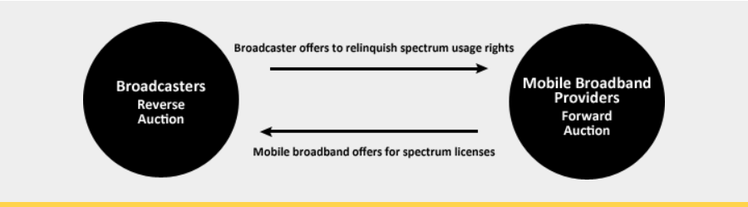
Low Band: TV Incentive Auction (600 MHz) band)
How it Works
Ten Phase Transition Plan
Reverse Auction
  Ended January 13, 2017 – Stage 4; 84 megahertz clearing target
Forward Auction Ended 2/10/17
39 month transition period began 4/13/17
First licenses were issued 6/15/17
Post-Incentive Auction Special Displacement
Window 4/10/18 – 6/1/18
Paired Spectrum
Blocks Repurposed
Licensed
Mics
Unlicensed
Microphones
1 MHz buffer
Downlink
6 megahertz
WSD
Uplink
11 Megahertz
“Duplex Gap”

Slide 11

Mid Band
Citizen’s Broadband Radio Service (3.5 GHz)
Problem: How to share spectrum (3550 – 3700 MHz)
with navy radars other incumbent users
Incumbent
Access
Priority Access
Spectrum Access System (SAS)
protects against interference and
manages access to spectrum
General Authorized Access
Spectrum sharing
across three tiers
Dynamic Spectrum Access
Where We Are In The Process
Multi-stakeholder process - WinnForum developing implementation
Conditionally approved first Spectrum Access Administrators: Amdocs; Comsearch, CTIA, Federated Wireless, Google; Key Bridge; and Sony
SAS testing by NTIA Institute for Telecommunications Science
Initial commercial deployments – Applications under review by FCC
FCC planning to open 3.4 GHz to 4.2 GHz in the near future.

Slide 12
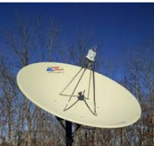
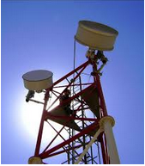
Mid Band
3.7 & 6 GHz
Proposed to make spectrum available for licensed wireless service the in the
3.7 – 4.2 GHz C-band satellite DL band
Proposed to make spectrum available for unlicensed access in the
5.925 – 7.125 GHz (6 GHz) band
Significance:
  3.7 GHz is adjacent to 3.5 GHz band - region is focus for 5G internationally
  6 GHz is close to 5 GHz unlicensed bands
Two Areas of Focus:
3.7 – 4.2 GHz – Proposed licensed access to C-band satellite DL spectrum
5.925 – 7.125 GHz – Proposed unlicensed sharing with Pt-2-Pt microwave & satellite uplinks
3.7 GHz to 4.2 GHz will require sharing with Fixed Satellite Receivers

Slide 13
6 GHz Spectrum Sharing Requirements
Interested parties, in or adjacent to the 6 GHz band:
Auto Makers, Broadcast, Microwave users in general, Public Safety, RLANs, Satellite, Utilities, UWB
The 6 GHz band is exclusive non-federal spectrum and is host to several incumbent services operating on a primary basis, including fixed point-to-point services, Fixed-Satellite Service (FSS), Broadcast Auxiliary Service, and Cable Television Relay Service. A query of FCC databases shows 47,695 unique call signs between 5.925 and 7.125 GHz.
NPRM band segments:
Band (GHz) Primary Allocations Reference used NPRM Devices
5.925-6.425 Fixed Service, FSS U-NII-5 Standard-Power Access Point
6.425-6.525 Mobile Service, FSS U-NII-6 Low-Power Access Point
6.525-6.875 Fixed Service, FSS U-NII-7 Standard-Power Access Point
6.875-7.125 Fixed Service, Mobile Service, U-NII-8 Low-Power FSS Access Point
6 GHz requires spectrum sharing with Microwave Links, Broadcast Auxiliary Services, Fixed Satellite Receiver Stations etc.

Slide 14
6 GHz Spectrum Sharing Requirements
Sharing is focusing on AFC – Automated Frequency Coordination
In the 5.925-6.425 GHz and 6.525-6.875 GHz sub-bands, unlicensed devices would only be allowed to transmit under the control of an automated frequency control (AFC) system.
  These frequencies are heavily used by point-to-point microwave links and some fixed satellite systems.
  The AFC system would identify frequencies on which unlicensed devices could operate without causing harmful interference to fixed point-to-point microwave receivers.
In the 6.425-6.525 GHz and 6.875-7.125 GHz sub-bands, unlicensed devices would be restricted to indoor use and would operate at lower power, without an AFC system.
  These frequencies are used for mobile services, such as the Broadcast Auxiliary Service and Cable Television Relay Service, as well as fixed and fixed satellite services. The itinerant nature of the mobile services makes the use of an AFC system impractical.
  The combination of lower power and indoor operations would protect licensed services operating on these frequencies from harmful interference.
6 GHz requires spectrum sharing with Microwave Links, Broadcast Auxiliary Services, Fixed Satellite Receiver Stations etc.

Slide 15
High Band
Spectrum Frontiers
Spectrum Allocations
Service Rules
12.55 GHz of Spectrum added for mobile
Licensed Bands (Total 3.85 GHz):
24.25-24.45 GHz and 24.75-25.25 GHz; 47.2-48.2 GHz; 27.5-28.35 GHz; 37-38.6 GHz; 38.6-40 GHz;
Unlicensed Bands (Total 7 GHz):
64-71 GHz (added to 57 – 64 GHz)
Part 30: Upper Microwave Flexible Use Service (UMFUS)
Geographic Area Licensing, Area Size, Band Plan, License Term, Overlay Auctions
Technical rules
Performance Requirements
Often Associated with “5G”

Slide 16
Overview of
First Report and Order Bands
 | 28 GHz | 37 GHz | 39 GHz | 64-71 GHz
Frequency | 27.5-28.35 GHz | 37-38.6 GHz | 38.6-40 GHz | 64-71 GHz
Bandwidth | 850 MHz | 1600 MHz | 1400 MHz | 7000 MHz
Terrestrial Allocation | Licensed for fixed operations, with about 75% of the population covered by existing licenses; remaining licenses in inventory | Yes (no current use) | Licensed for fixed operations, with about 50% of the population covered by existing licenses; the remaining licenses are in inventory. | Yes (no current use)
Federal Allocation | No | Radio Astronomy / Space Research in 37-38 GHz @ 3 sites; Federal Fixed/Mobile in 37-38.6 GHz @ 14 locations | Fixed Satellite Service / Mobile Satellite Service in 39.5-40 (military use only) | Earth Exploration Satellite Fixed/Mobile/Satellite
Satellite Allocation | Yes | Yes (no current use) | Yes (no current use) | Yes (no current use)
Licensing Scheme | Licensed | Licensed | Licensed | Unlicensed
Satellite/terrestrial sharing accomplished by well defined protections & rights
Lower 600 MHz identified for
sharing between Federal
Government and Private
Sector - - invited comment on
sharing method

Slide 17
Overview of Second R&O Bands
 | 24 GHz | 47 GHz
Frequency | 24.25-24.45 GHz and 24.75-25.25 GHz | 47.2-48.2 GHz
Bandwidth | 700 MHz | 1000 MHz
Terrestrial Allocation | Lower segment is licensed for two types of fixed operations: 24 GHz service and Digital Electronic Messaging Service (DEMS). 5 active 24 GHz licenses, and 38 active DEMS licenses; remaining licenses in inventory | Yes (no current use)
Federal Allocation | No | No
Satellite Allocation | Yes, 24.75-25.25 GHz band segment is non-Federal allocated for FSS (Earth-to-space) | Yes (no current use and the Commission designated this band for terrestrial use)
Licensing Scheme | Licensed | Licensed

Slide 18
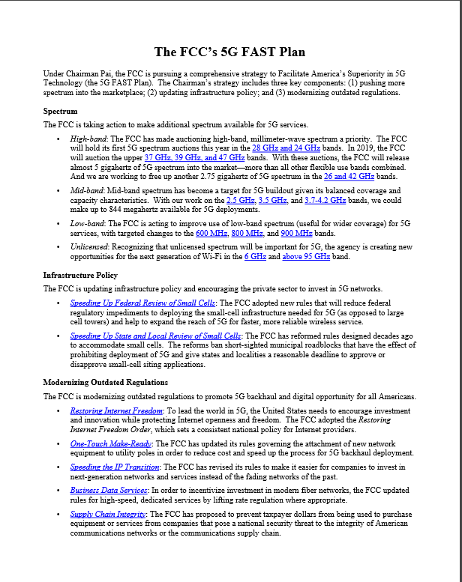
Roll-out of MMW Bands & 5G
Already happening - - granted flexibility for incumbent fixed services to offer mobile
Auctions planned this year for 28 GHz, then 24 GHz;
upper 37 GHz, 39 GHz
& 47 GHz next year
Third Notice invited comment on 25.25-27.5 GHz (26 GHz) and 42.0 – 42.5 GHz
https://docs.fcc.gov/public/attachments/DOC-354326A1.pdf

Slide 19
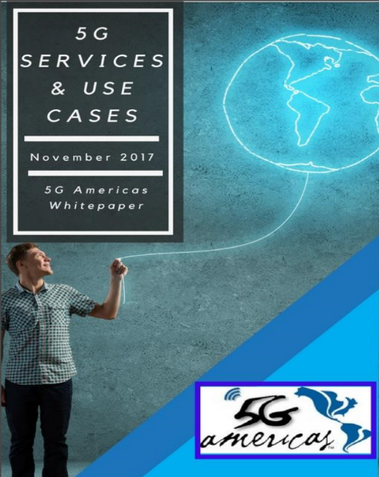
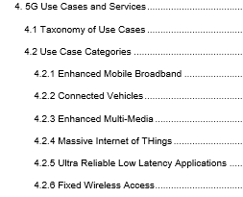
Five Things to Know About 5G
5G is not band-specific – (heterogenous networks)
Much greater bandwidth &
reduced latency
Enables many new applications
Important to support IoT growth
Many predictions - - time will tell
http://www.5gamericas.org/en/resources/white-papers/

Slide 20
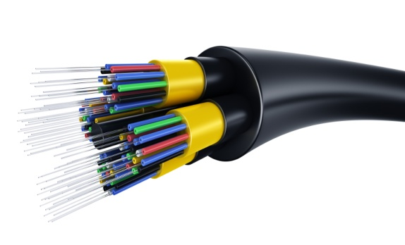
Spectrum Horizons
Proposed to expand access
above 95 GHz
  Total of 102.2 GHz to for licensed
  point-to-point services
    95100 GHz, 102-109.5 GHz, 111.8-114.25 GHz,
    122.25-123 GHz, 130-134 GHz, 141-148.5 GHz,
    151.5158.5 GHz, 174.5-174.8 GHz, 231.5-232 GHz,
    and 240-241 GHz band
    Similar to 70/80/90 GHz rules
    Licensed nationwide, non-exclusive basis
    Register links with database manager
    Seek comment on mobile use
  Total of 15.2 GHz for unlicensed use
    122-123 GHz, 244-246 GHz, 174.8-182 GHz and
    185-190 GHz bands
    Similar to 60 GHz rules
    Selected high absorption bands
  New type of experimental licenses > 95 GHz
    Longer license terms
    Ability to sell devices
Much of the spectrum above 95 GHz is allocated for passive services
Achieve Fiber Capacity
Innovations

Slide 21
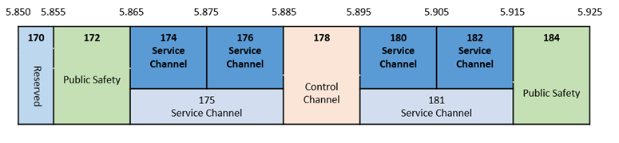
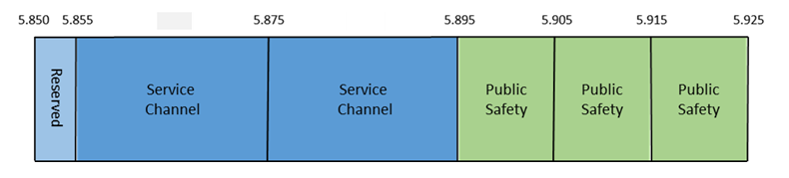
IEEE 802.11 Sharing With DSRC at 5.9 GHz
Dedicated Short Range Communications (DSRC) Channel Plan
Option 1 Detect and avoid (Cisco): Unlicensed devices monitor the
10 megahertz-wide DSRC channels and vacate entire band if signal detected
Option 2 Rechannelization (Qualcomm) : safety channels to top of the band, widen lower channels & share only lower channels with IEEE 802.11

Slide 22
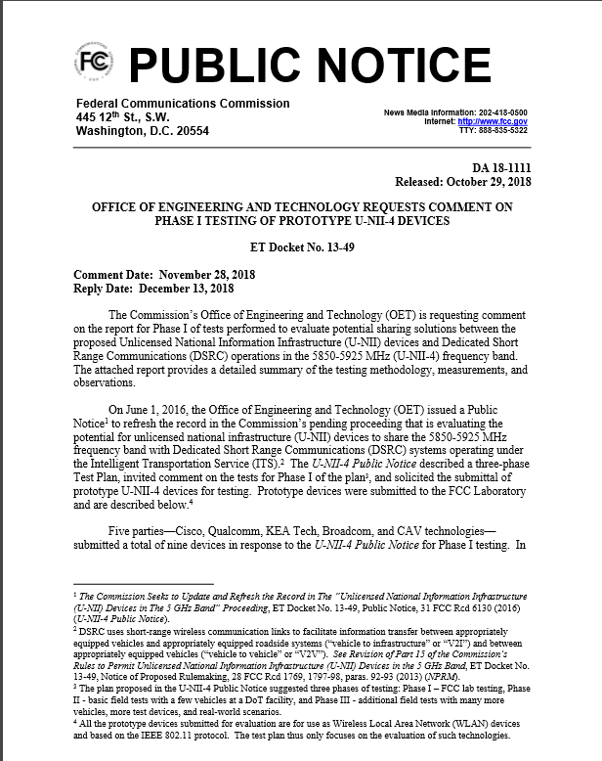
Status of 5.9 GHz Proceeding
FCC Public Notice
(June 2016):
  Refresh the record
  Invited comment on
  Tiger Team options
  Invited submittal of
  prototype devices
  Three phase test plan
  (FCC/DOT/NTIA):
    I - FCC Lab
    II – DoT Basic field test
    III – Real-world testing
FCC Public Notice
(October 2018):
  Phase 1 test report released for public comment
https://docs.fcc.gov/public/attachments/DA-18-1111A1.pdf

Slide 23
Other Spectrum Topics
4.9 GHz
(Public Safety at
4940 – 4990 MHz)
900 MHz
Re-banding Private Land Mobile
Broadband Satellites
Licensing Multiple Systems
WRC
Many Issues
on the Agenda
TV White Space
Continued Interest
for Rural Broadband
Unmanned
Aerial Systems
What spectrum may
be needed?

Slide 24
Omnibus Appropriations Act
Public Law 115‐141 (Enacted 3.23.2018)
AKA Ray Baum Act
(Repack Airwaves Yielding Better Access for Users of Modern Services Act of 2018)
Contains numerous provisions for actions and reports by FCC, NTIA, et al re spectrum:
  Identify at least 255 MHz of spectrum for mobile and fixed wireless BB use (100 MHz below 8 GHz for unlicensed use; 100 MHz below 6 GHz for flexible licensed use; 55 MHz below 8 GHz for licensed/unlicensed or both use) by 12/31/2022
  NTIA feasibility report on commercial wireless use in 3100 ‐ 3550 MHz band by 3/23/20
  FCC feasibility report on commercial wireless use in 3700‐4200 MHz band by 9/23/19
  Publish NPRM to authorize mobile or fixed use in 42‐42.5 GHz band.
  NTIA report on recommendations to incentivize Federal entities to give up or share spectrum
  Collaborate w/ NTIA to conduct bidirectional sharing study by 9/23/19
  Develop national plan by 9/23/19 to make add’l spectrum available for unlicensed or licensed use
  Adopt rules to permit unlicensed use in guard bands (including duplex gaps)
  Ensure FCC efforts related to unlicensed use policies are reasonable and in the public interest

Slide 25
President’ s Space Policy Directive-2 (SPD-2) on May 24, 2018
Its focus is reforming commercial space regulations and creating a “one-stop shop” for the commercial space sector at the Department of Commerce
Sec. 5. Radio Frequency Spectrum. (a) The Secretary of Commerce, in coordination with the Director of the Office of Science and Technology Policy, shall work with the Federal Communications Commission to ensure that Federal Government activities related to radio frequency spectrum are, to the extent permitted by law, consistent with the policy set forth in section 1 of this memorandum.
(b) Within 120 days of the date of this memorandum, the Secretary of Commerce and the Director of the Office of Science and Technology Policy, in consultation with the Chairman of the Federal Communications Commission, and in coordination with the members of the National Space Council, shall provide to the President, through the Executive Secretary of the National Space Council, a report on improving the global competitiveness of the United States space sector through radio frequency spectrum policies, regulation, and United States activities at the International Telecommunication Union and other multilateral forums.

Slide 26
PRESIDENTIAL MEMORANDA
Presidential Memorandum on Developing a Sustainable Spectrum Strategy for America’s Future INFRASTRUCTURE & TECHNOLOGY
Issued on: October 25, 2018
Within 180 days agencies report anticipated future spectrum requirements
The Director of the Office of Science and Technology Policy (OSTP) shall report on emerging technologies and their expected impact on non-Federal spectrum demand
The Director of OSTP shall report on recommendations for research and development priorities that advance spectrum access and efficiency
Within 270 days submit a long-term National Spectrum Strategy that includes legislative, regulatory, or other policy recommendations
The Chief Technology Officer and the Director of the National Economic Council, or their designees, shall co-chair a Spectrum Strategy Task Force

Slide 27
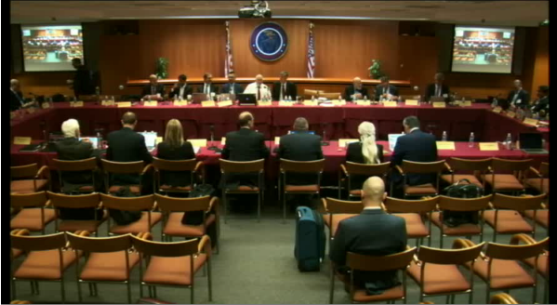
FCC Technological Advisory Council
The FCC’s Technological Advisory Council (TAC) provides technical advice to the FCC.
Topics for 2018
5G and IoT
Mobile Device Theft Prevention
Antenna Technology
Communication Strategy for Drones
Computational Power and Stress on the Networks

Slide 28
Spectrum Sharing Today
Oliver Holland, Advanced Wireless Technology Group, Ltd., UK
oliver.Holland@ieee.org

Slide 29
Spectrum Sharing Today
TV White Space (TVWS)
  US, UK, Canada, Singapore, South Africa, Colombia, numerous other countries worldwide
Citizens Broadband Radio Service (CBRS)
  US; possible solution in other countries, e.g., 1800 MHz, 2.3 GHz, and 3.8-4.2 GHz in UK
Licensed-Shared Access (LSA)
  EU—France, Finland, Italy, Netherlands
Others, e.g., light licensing, collective use of spectrum and concurrent spectrum access, and of course, sharing in unlicensed spectrum

Slide 30
Spectrum Sharing Today—Spectrum Databases
Why (Geolocation/spectrum) “databases”?
  High level of dependability/reliability/certainty required when users access another service’s/incumbent’s spectrum
  Allows regulator to keep overall direct/indirect control at all times (e.g., in case of change needed, error or malicious operation, even suspension of framework, etc.)
Spectrum sensing
  Best way to obtain in-situ awareness of the environment
  Device agnostic.
  New sensing techniques have detection and characterization built in
Geolocation Database (e. g. Spectrum Access System) and Spectrum Sensing are two tried and trusted mechanisms for sharing

Slide 31
Spectrum Sharing Today—Spectrum Databases
(Geolocation/spectrum) “database” driven – generic approach
  Device registers with “database” (applicable in some cases)
  Device checks with “database of approved databases”, and chooses a database to query (applicable in some cases)
  Device sends its information to database (location, height, technical characteristics if applicable, e.g., spectrum mask, etc.)
  “Database” responds with available resources (and allowed powers, in some cases) for opportunistic access
  Device chooses resources (powers) and confirms with “database”; can start using the resources once “database” acks back
  Device has to reconfirm with database and change chosen resources if necessary, every X minutes
  “Slave”/“Mode1” option for non-internet-connected devices

Slide 32
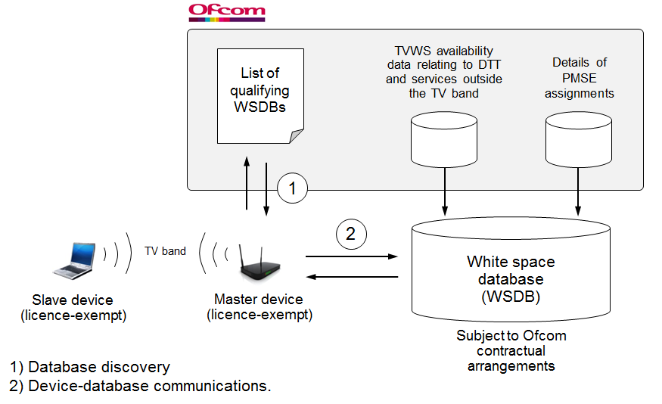
Spectrum Sharing Today—Spectrum Databases
TVWS example (Ofcom, UK)

Slide 33
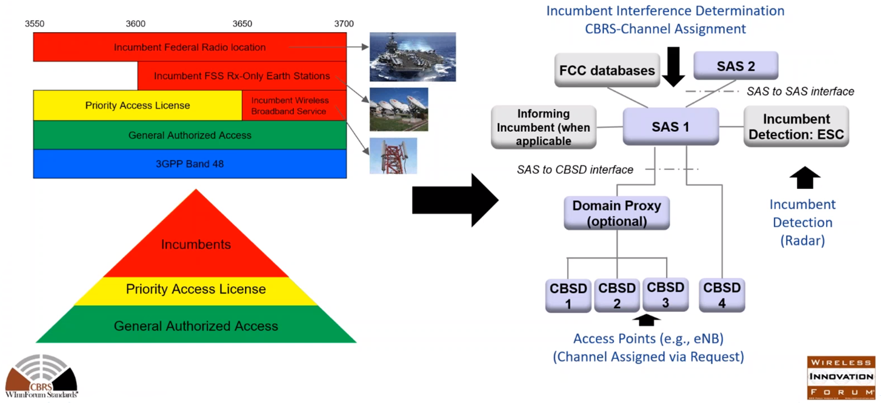
Spectrum Sharing Today—Spectrum Databases
CBRS (Wireless Innovation Forum, US)

Slide 34
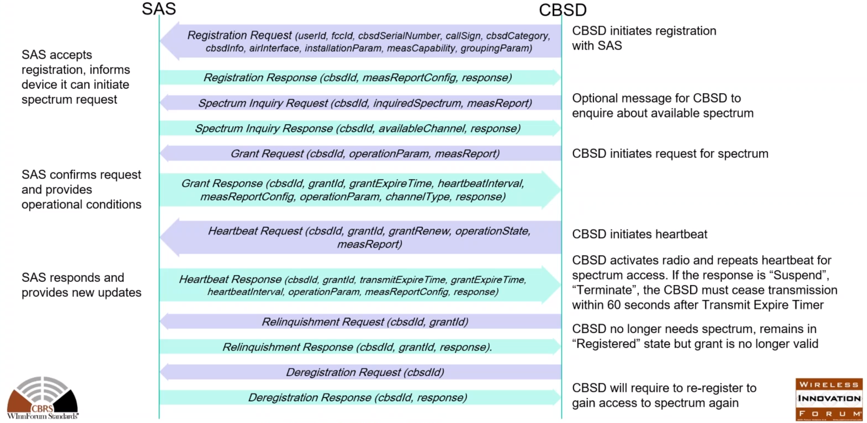
Spectrum Sharing Today—Spectrum Databases
CBRS (Wireless Innovation Forum, US)

Slide 35
Spectrum Sharing Today—Spectrum Databases
Can be:
  License-exempt, e.g., if device entirely automated, integrated GPS (TVWS—UK, CBRS—GAA)
  Licensed, e.g., if manual configuration of device required (TVWS—UK), local priority-licensed (CBRS—US)
  Primary-secondary (or even -tertiary) sharing (TVWS, CBRS)
  Sharing among operators, new entrants, e.g., by agreement of those operators, e.g., with financial compensation (LSA—EU, France, Finland, Italy, Netherlands)
  Device (TVWS, CBRS) or network (LSA, CBRS) interacting with the database
  Manual (“Enabling Opportunities for Innovation”—UK, various light licensing approaches, etc.), or automated
Various Regulatory Regimes for Spectrum Sharing

Slide 36
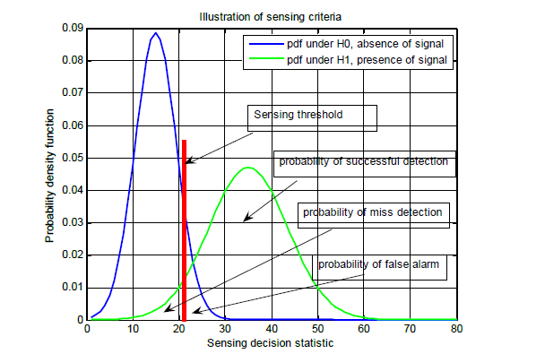
Spectrum Sharing Today—Spectrum Sensing
Energy detection
Feature detection, e.g.,
  Cyclic prefix
  Autocorrelation
  Cyclostationary
Partially adapted from content presented in O. Holland, M. Nekovee, “Spectrum Awareness”, ICT-ACROPOLIS Summer School 2011, Florence, Italy, June 2011

Slide 37
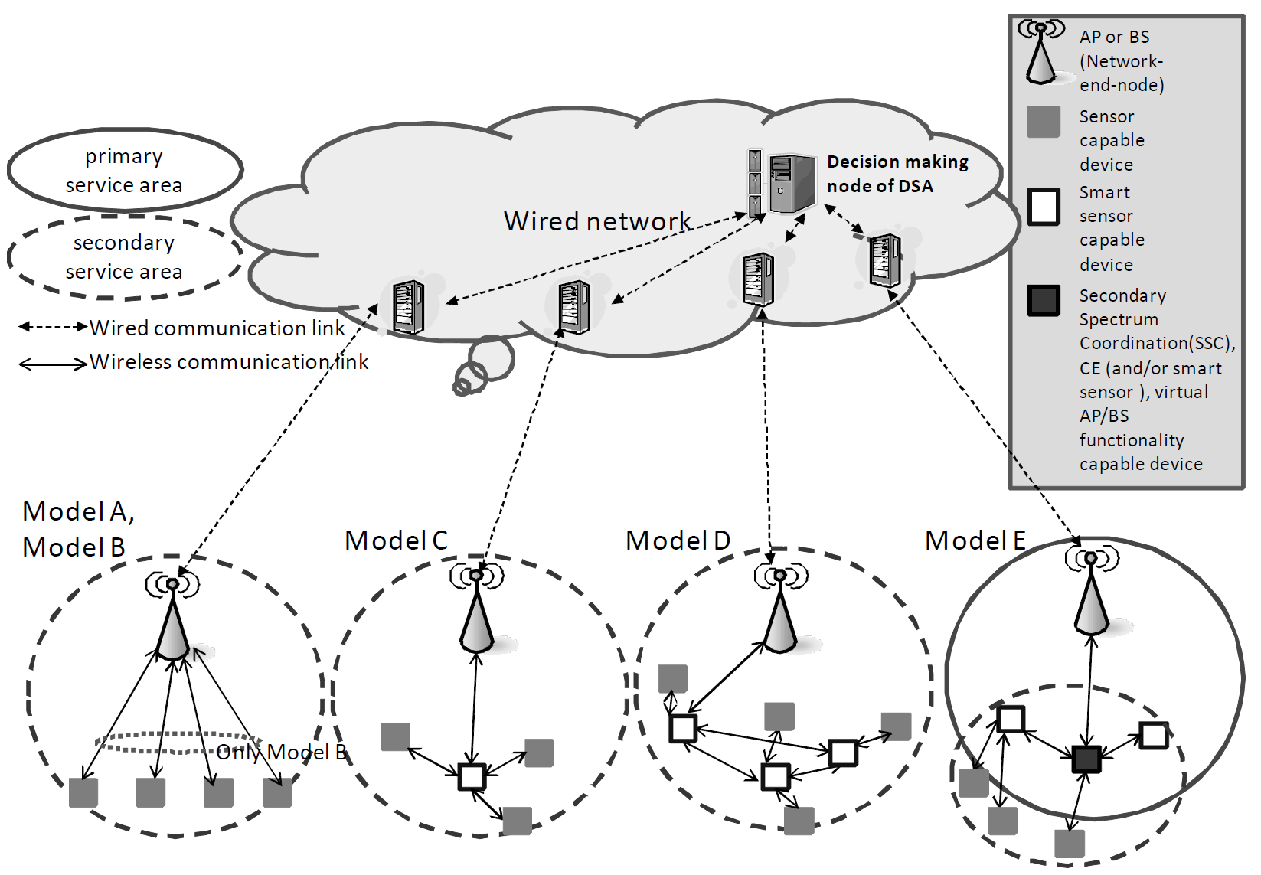
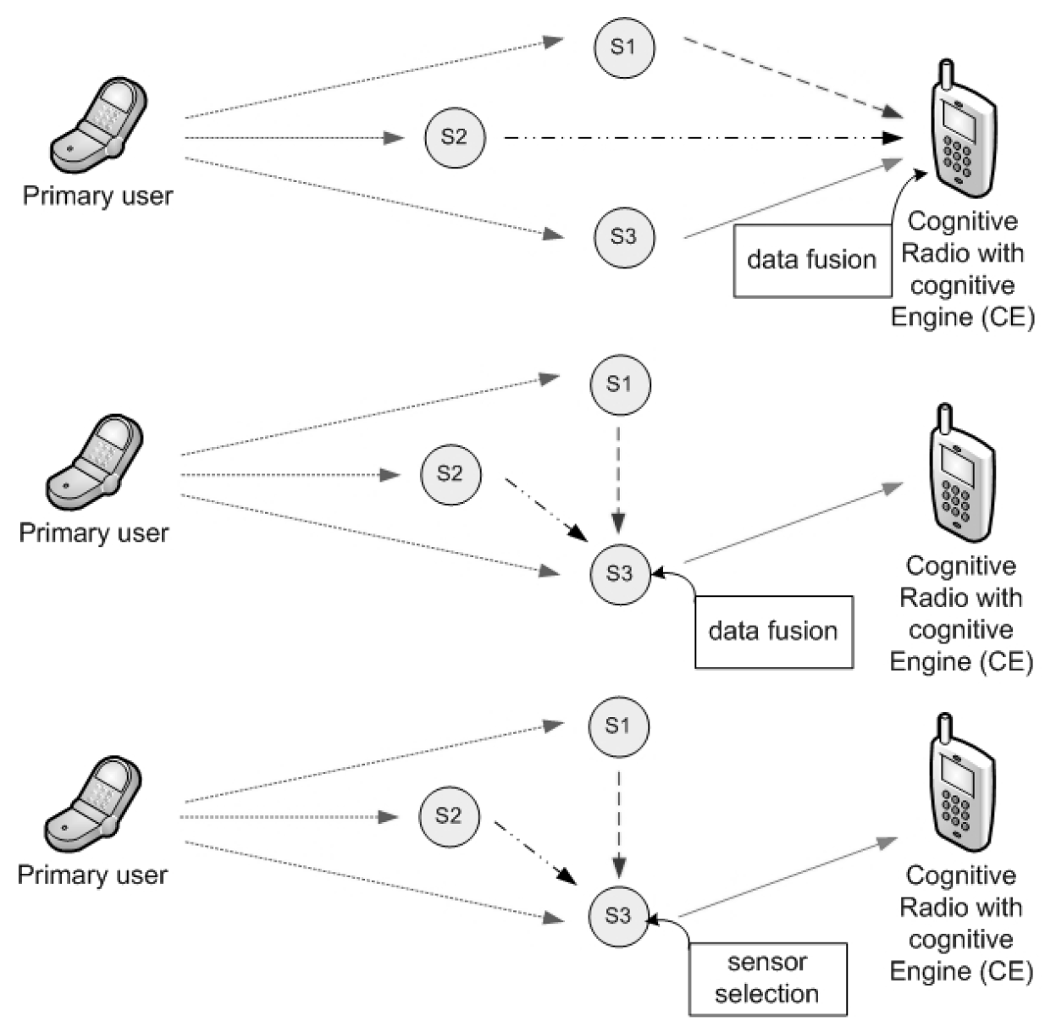
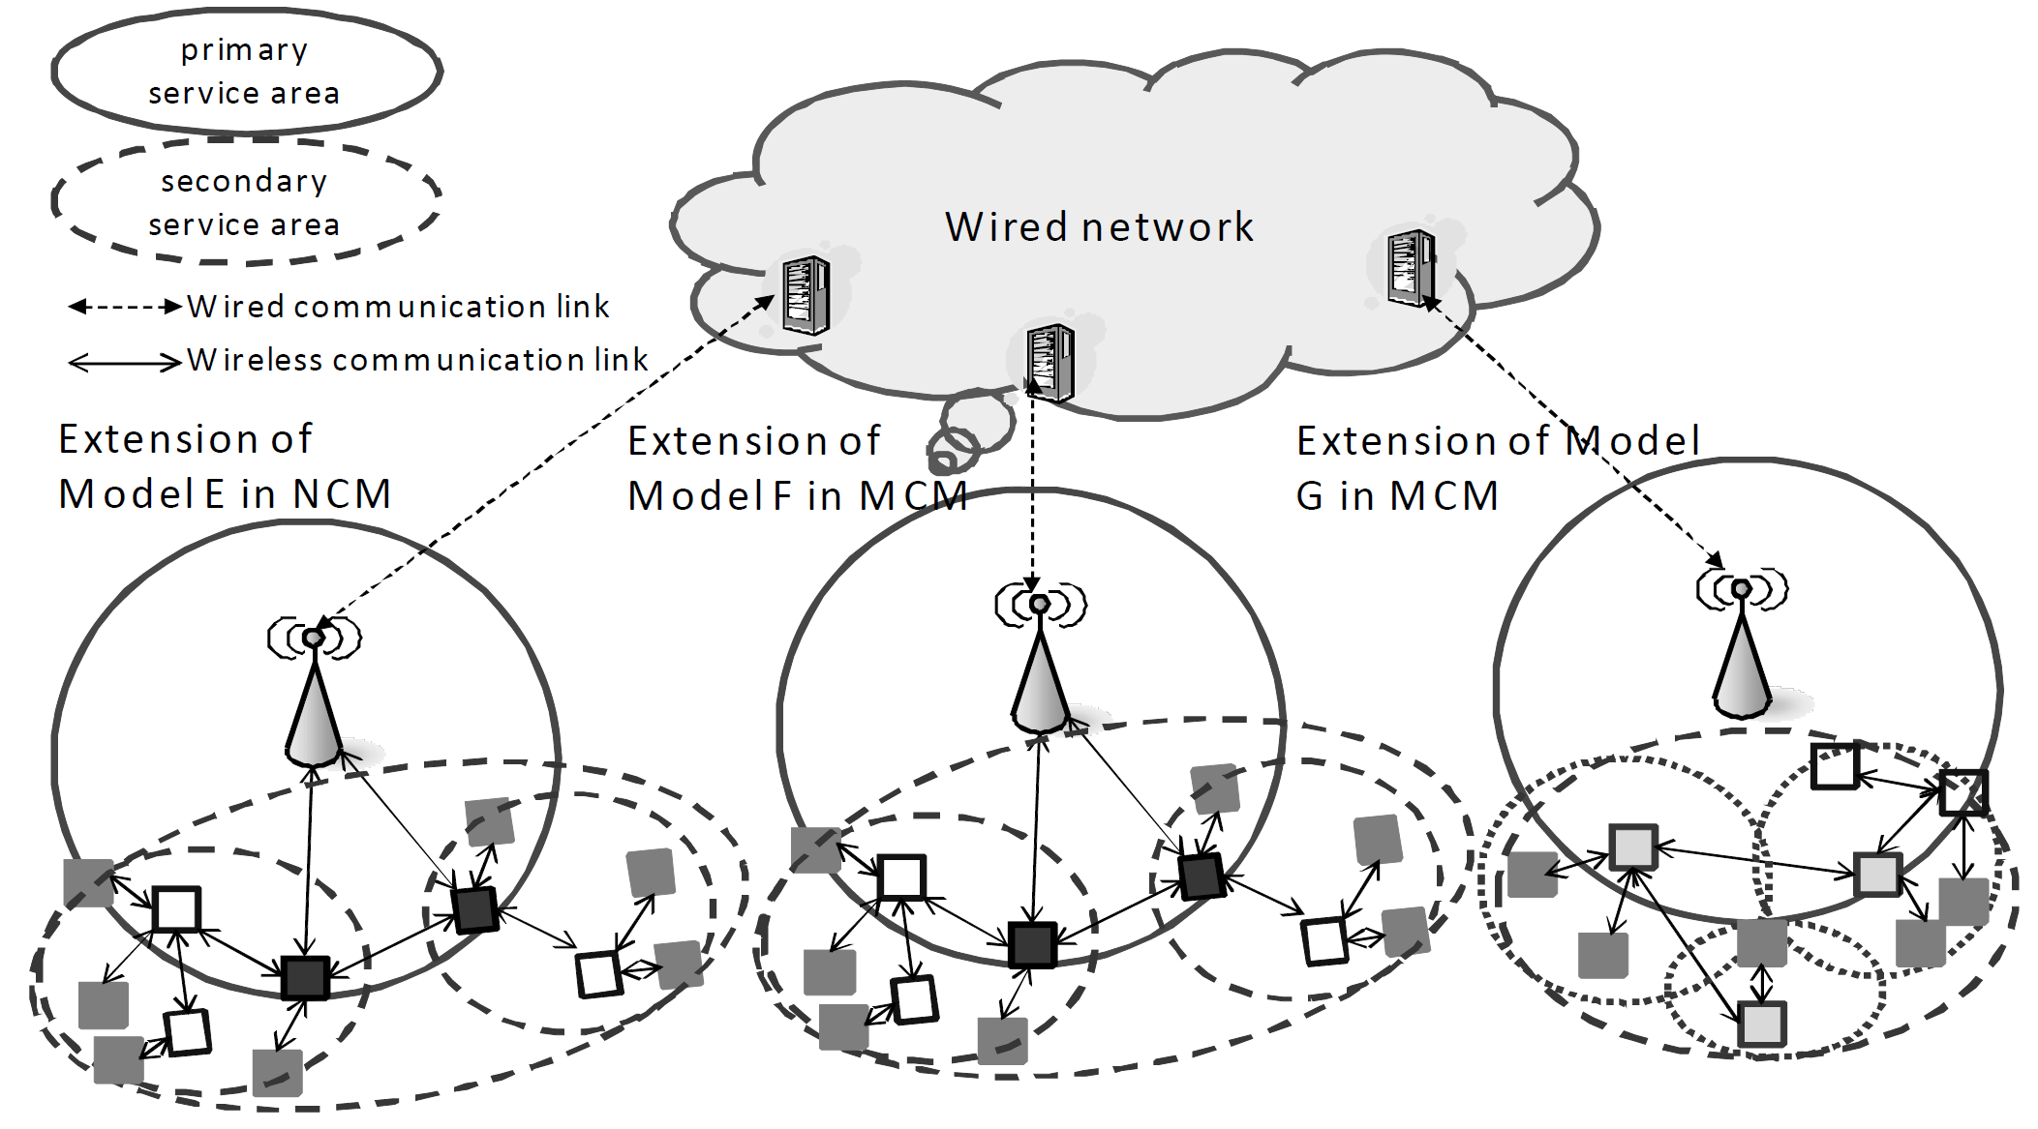
Spectrum Sharing Today—Spectrum Sensing
Hidden terminal problem
Exposed terminal problem
→ Distributed sensing
Source: IEEE-Std-1900.6TM2011

Slide 38
Spectrum Sharing Today—Spectrum Sensing
Still is (or can be) used in some cases
  Environmental Sensing Capability (ESC)
  Very low-power white space devices in US
  Coordination among license-exempt devices
  5 GHz
Of course, can greatly assist regulatory processes
  E.g., interference potential/interferer detection, spectrum forensics
  Understanding of the spectral situation, e.g., to assess potential for sharing gains
Sensing as in Environmental Sensing Capability (ESC) has been already adopted in the 3.5 GHz Band. 5G Eco-system is involved in adopting it.

Slide 39
Spectrum Sharing Today—Spectrum Sensing
Cons (w.r.t. spectrum databases alternative) already covered under “spectrum databases” content
Pros
  An understanding of the real, local situation → able to take advantage of more spatial opportunities
    Database, e.g., propagation modelling, can always be wrong. Removes need for ultra-conservative assumptions in incumbent protection
  Can be a lot more reactive to changes in the spectrum situation; → able to take advantage of more temporal opportunities
  Far more agreeable with grand visions – e.g., “Cognitive Radio”

Slide 40
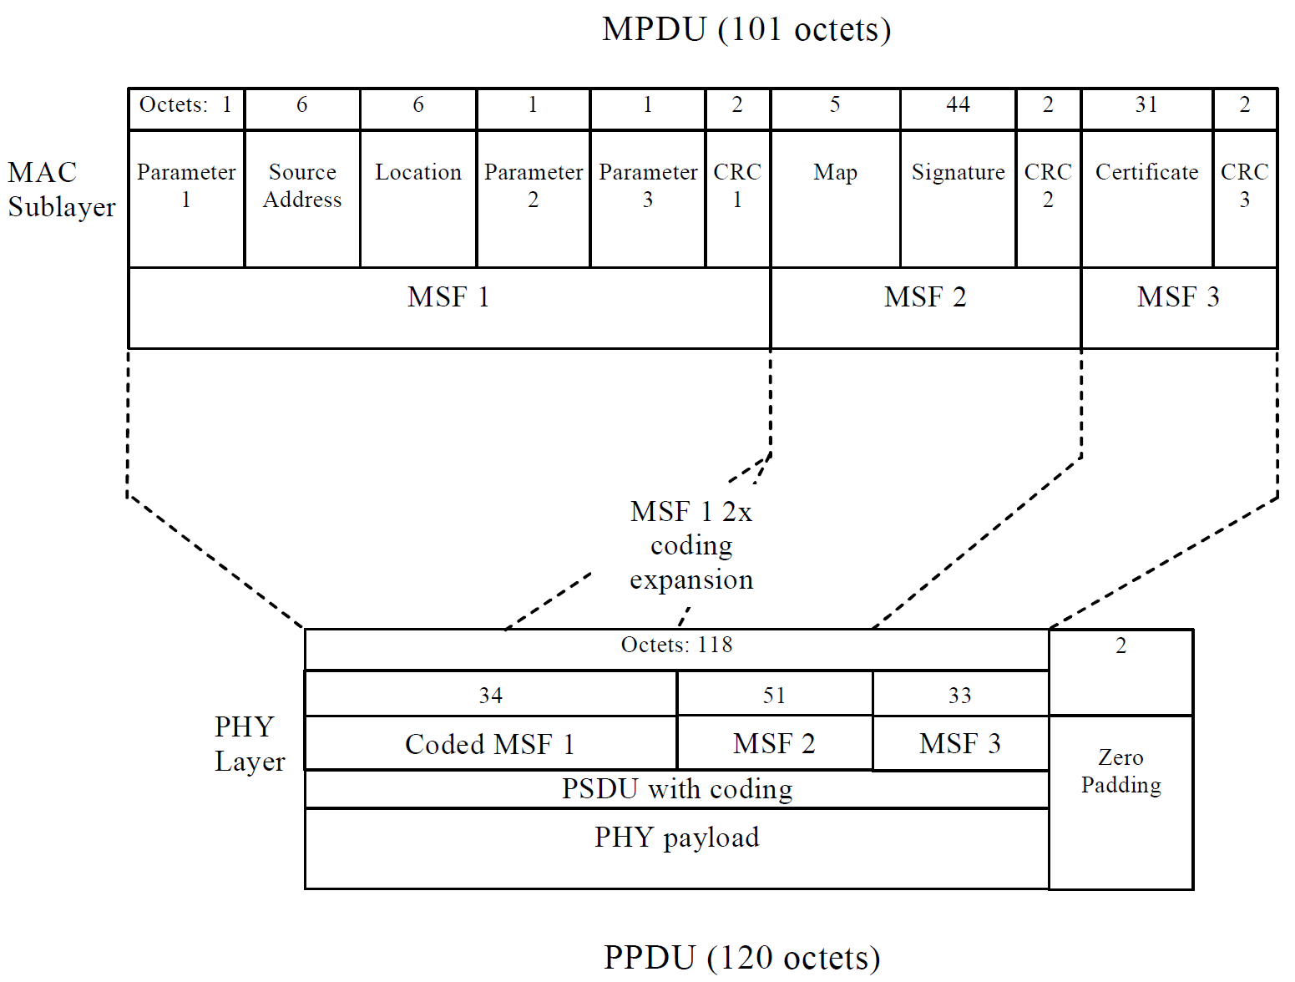
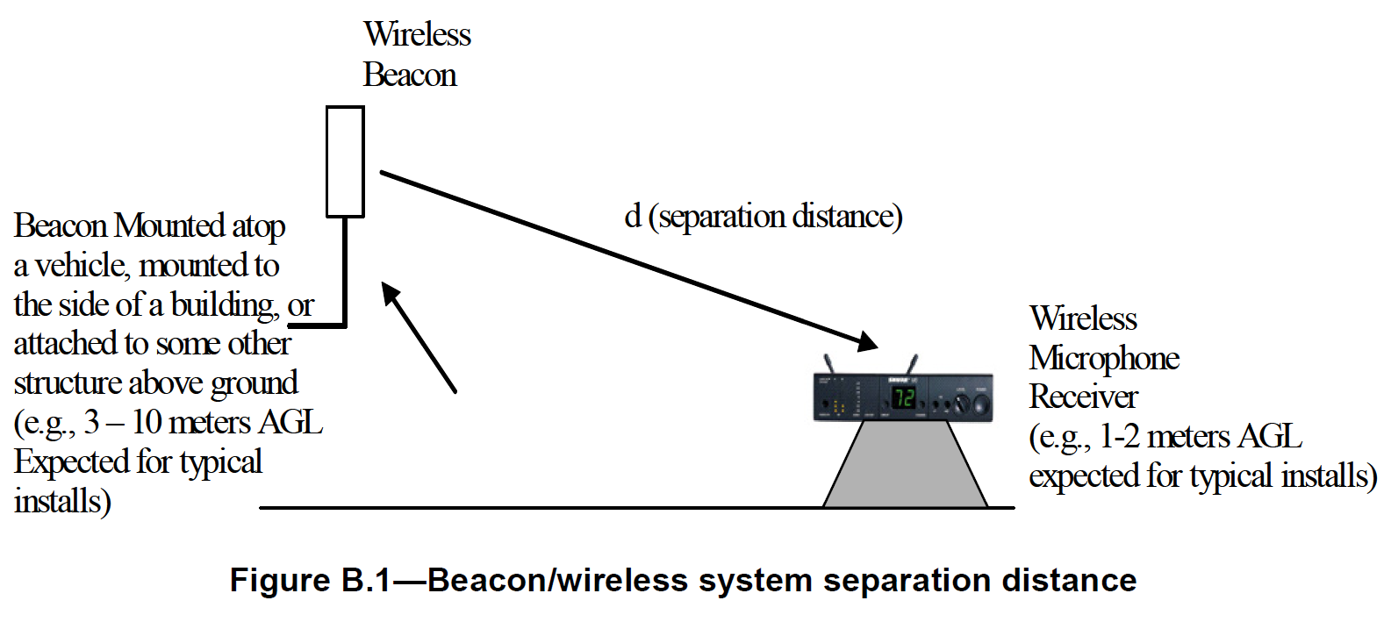
Spectrum Sharing Today—Beacons
One of the best techniques for avoiding the hidden node issue
Beacons is one of the few options to protect Primary User that is Passive (e. g. Satellite Receiver Stations)
Beacons are also very good for Dynamic Coordinated Spectrum Sharing
Beacons can be designed for robustness or for fast information transfer depending on the use-case.
Beacons is one of the few options to protect Primary User that is Passive (e. g. Satellite Receiver Stations)

Slide 41
Spectrum Sharing Insights
Sumit Roy
Integrated Systems Professor
U. of Washington, Seattle
sroy@uw.edu

Slide 42
Federal / Non-Federal Sharing
Presidential Jun 2010 Memorandum (calling on FCC & NTIA) to make 500 MHz of Federal & Non-Federal Spectrum available for commercial wireless by 2020.
NTIA Fast Track Rpt. 2010 identifying 1st set of Federal Spectrum to be re-purposed
AWS-3 SPECTRUM AUCTION (1695-1710, 1755-1780, 2155-2180 MHz)
3.5 GHz CBRS (3550-3700 MHz)
Primary System to be protected: Federal licensed incumbent
Secondary System: New (either un-licensed or licensed with lower priority than incumbent)

Slide 43
US SHARED SPECTRUM MANAGEMENT SYSTEM
COMMUNICATIONS ACT OF 1934
NTIA
FCC
- Commercial Business
- State/Local
- Entertainment
All Federal Agencies-
Commerce, Justice,
DoD, DHS
COORDINATION
- National Security
- Law Enforcement
Private Sector Market Requirements
Federal Agency Mission Requirements
Spectrum Requirements

Slide 44
AWS-3 (1695-1710, 1755-1780)
38+ systems/capabilities affected by the AWS-3 transition → must relocate to another DoD band, compress into, or stay & retrofit (share spectrum)
US Govt. will modify selected systems to operate at both 1780- 1850 MHz and
2025-2110 MHz
  Small Unmanned Aerial Systems - Tactical Radio Relay
  Tactical Targeting Network Technology - High Resolution Video
US Govt. systems will remain in the 1755-1780 MHz band and share spectrum with commercial users as follows
  Satellite Operations at 25 locations - Air Combat Training System
  Electronic Warfare - Joint Tactical Radio System (6 sites)
US Govt. will compress the remaining 1755-1780 MHz operations into 1780 - 1850 MHz
  Air Combat Training System - Precision Guided Munitions
  Joint Tactical Radio System at all other sites - Aeronautical Mobile Telemetry
3GPP Eco-system is heavily involved in enabling spectrum sharing in these bands

Slide 45
Operational Approaches to Spectrum Sharing
Non-collaborative (no information exchanged at operational time)
  Easier (retro-fitting, particularly on secondary with no requirements on primary (Federal system)
Collaborative (side channel for info exchange at operation time/scale)
  Knowledge of incumbent parameters (pulse duration/burst length, beam pattern, angular rotation speed) can potentially reduce exclusion regions
  Encourage new interference tolerance approaches for primary
There are regulatory use-cases for both Non-collaborative and Collaborative Sharing

Slide 46
System Concept Elements for Sharing
Potential Techniques
  Sensing: obtain current channel state information, to determine whether any protected service is present
  Geo-location database: secondaries to define their location and consult a geolocation database to determine available frequencies (and associated condition) at their location
  Beacons: signals to indicate that particular channels are either in use by protected services or vacant
- or other coordination mechanisms/side-channels to share
information between primary & secondary networks

Slide 47
EXCLUSION REGION (3.5 GHz): Ship Borne Radar
NTIA Rpt. 15-517
Jun 2015
(Exclusion Zone
Analyses & Methodology:
Highlights impact
of Model
Assumptions !

Slide 48
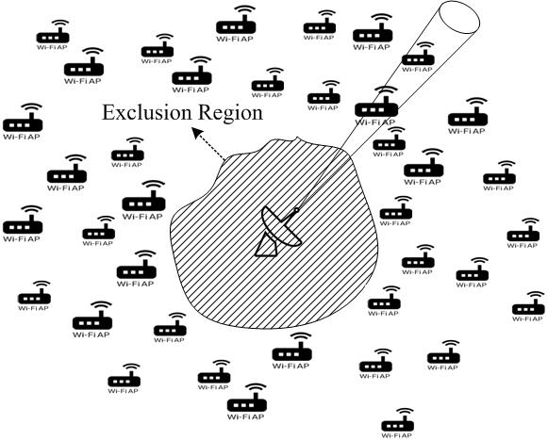
Incumbent Protection
EXCLUSION & PROTECTION REGIONS
Exclusion Zone: A region around the primary
with no co-channel active secondary txmission
Protection Zone: A region with active
secondary txmitters, but with constraints so as
stay within `acceptable interference’ limits
Design Objective: minimize exclusion region
subject to protection of primary.
Exclusion Region depends on multiple factors: sensitivity of victim receiver, interference margin, secondary txmit power, path loss model
Incumbent Licensee: ‘primary’ (to be protected from interference)
New User: `secondary’ (no interference protection)
Effective Sharing can be Staged to be Successful

Slide 49
Spectrum Sharing Tomorrow
Sumit Roy
Integrated Systems Professor
U. of Washington, Seattle
sroy@uw.edu
Jeff Evans, GTRI,
jeff.evans@gtri.gatech.edu

Slide 50

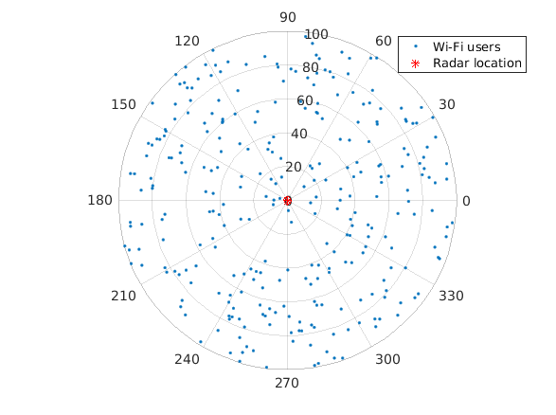
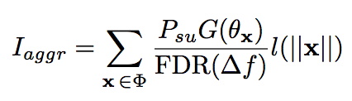

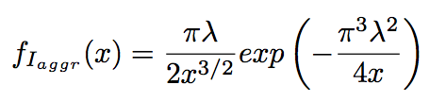
Example: Radar-IEEE 802.11 Coexistence
Homogeneous Poisson Process Deployment
α = 4 → closed form expression
Levy distribution
Aggregate interference presented by the incumbent is often Non-Gaussian – Hence requires new methods

Slide 51
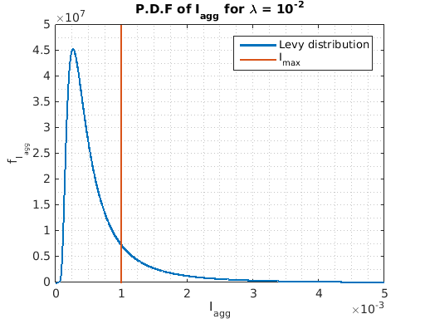

Probability of Outage
Tail probability
P_{out,max} = 0.1
Aggregate interference presented by the incumbent is often Non-Gaussian – Hence requires new methods

Slide 52
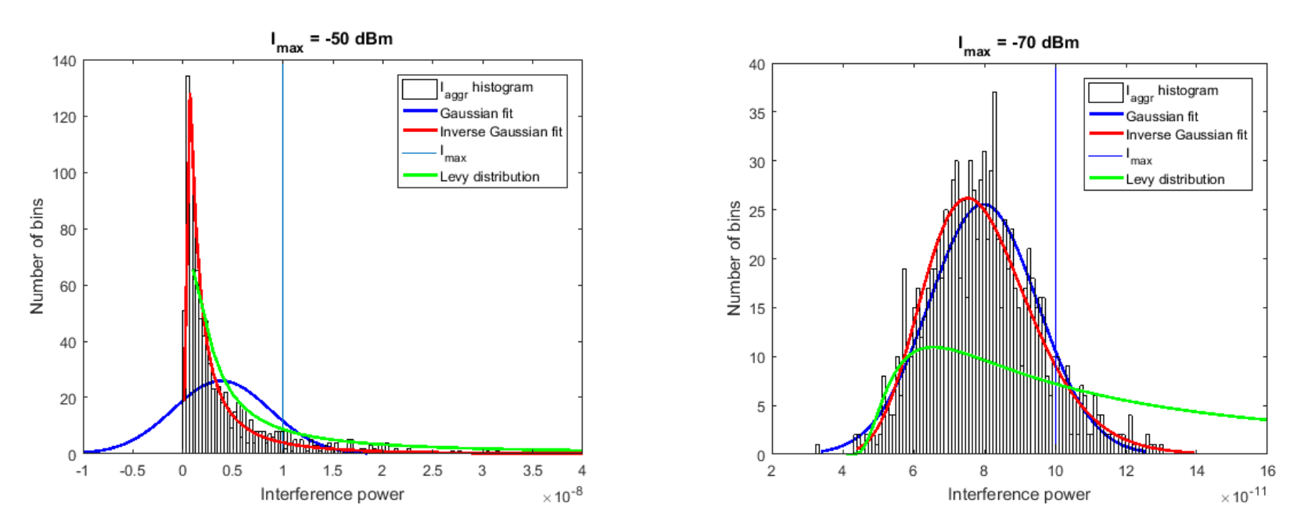
Distribution of I_{aggr} with Protection region
Gaussian Approximation – works lower aggregate Interference (large protection regions)
Otherwise significantly Non-Gaussian
Aggregate interference presented by the incumbent is often Non-Gaussian – Hence requires new methods

Slide 53
Incumbent Protection vs Incentivizing Secondary
Radar protection from IEEE 802.11:
  → sensing by IEEE 802.11 nodes + Dynamic Frequency Selection (DFS)
  sensing by IEEE 802.11 for radar incurs some cost (IEEE 802.11 throughput degradation) !
  e.g. insert quiet periods in IEEE 802.11 to listen/detect radar
Good Design → Acceptable Trade-offs
satisfy radar protection requirements while minimizing
IEEE 802.11 throughput loss (latter has been often neglected)

Slide 54
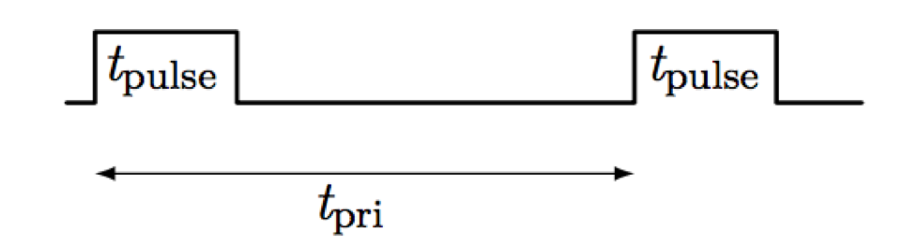

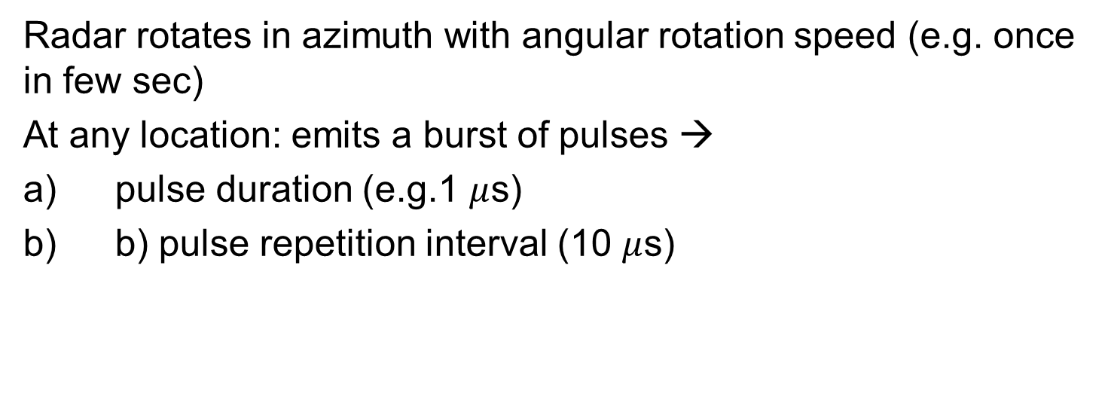
Detection – Search Radar
Spatio-temporally varying use of Spectrum Resources
Radar rotates in azimuth with angular rotation speed (e.g. once in few sec)
At any location: emits a burst of pulses →
pulse duration (e.g.1 $μ$s)
b) pulse repetition interval (10 $μ$s)
A pulse burst
Example of balancing incumbent protection with secondary enablement

Slide 55
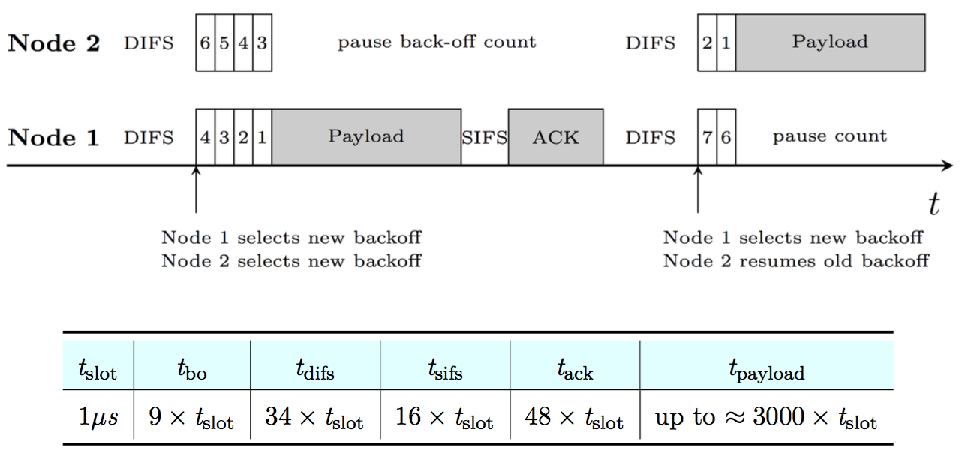
IEEE 802.11 MAC: CSMA/CA
Nodes use Carrier Sensing
Followed by Random Back-Off
Quiet Periods in IEEE 802.11 (all nodes backed off)

Slide 56
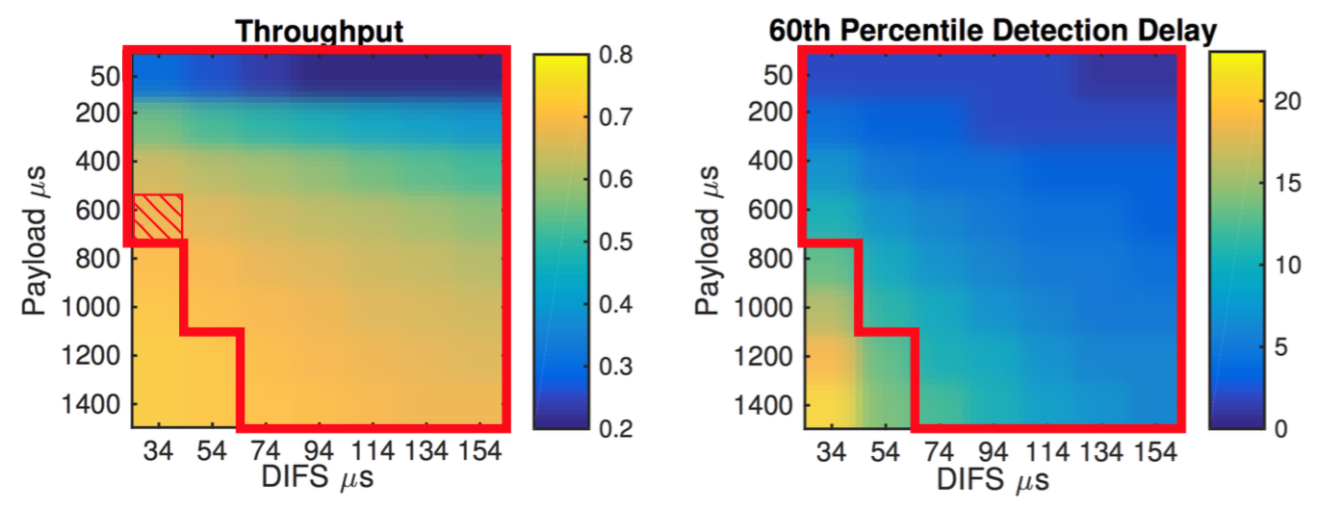
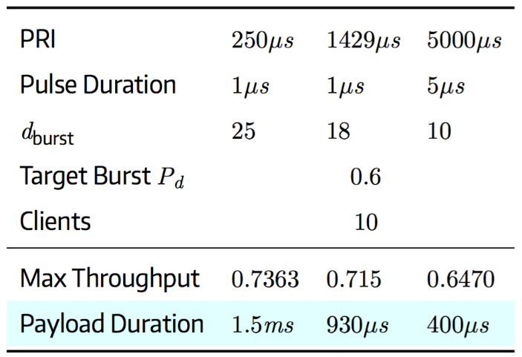
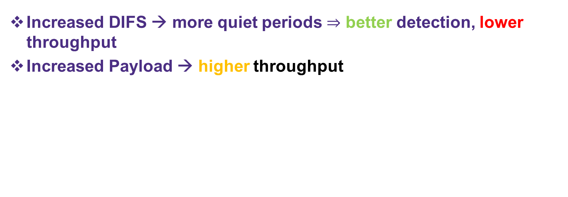
Throughput vs Detection Trade Off
IEEE 802.11 Knobs: Payload Size & DIFS duration
Increased DIFS → more quiet periods better detection, lower throughput
Increased Payload → higher throughput
Example of balancing incumbent protection with secondary enablement

Slide 57
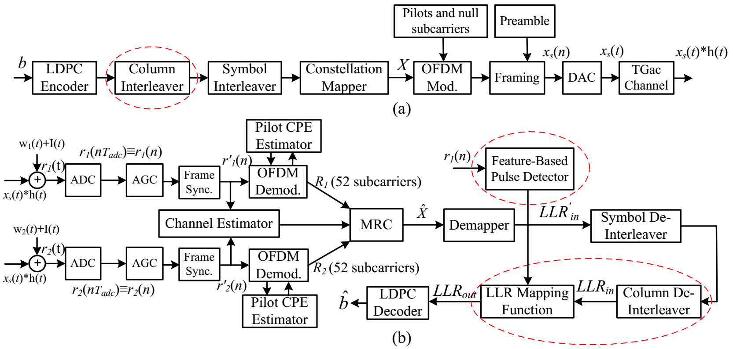

Robustifying IEEE 802.11 to Pulsed Radar
The circle boxes illustrate the elements added to the modified IEEE 802.11 system.

Slide 58
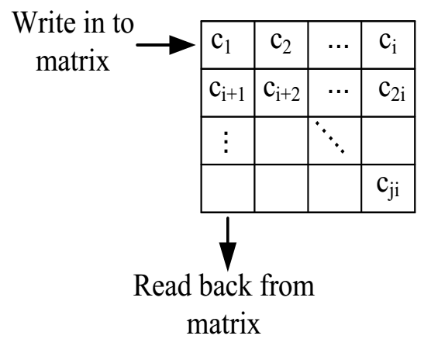
IEEE 802.11 System Modification for Interference Mitigation
Radar interference causes burst errors at the IEEE 802.11 receiver
→ need a long interleaver/de-interleaver.
The symbol interleaver in generic system is not long enough to remove the burst effect
Two types: CodeWord and Frame interleavers
The coded data bits are written row by row into a matrix at the transmitter and read back column by column from the matrix.
For de-interleaving the same process is performed at the receiver.

Slide 59
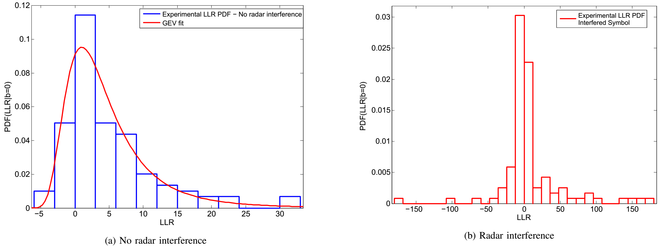
Histogram at decoder input
No radar interference histogram follows a Generalized Exponential distribution
Radar interference histogram has a very large magnitude with zero mean and large variance.

Slide 60

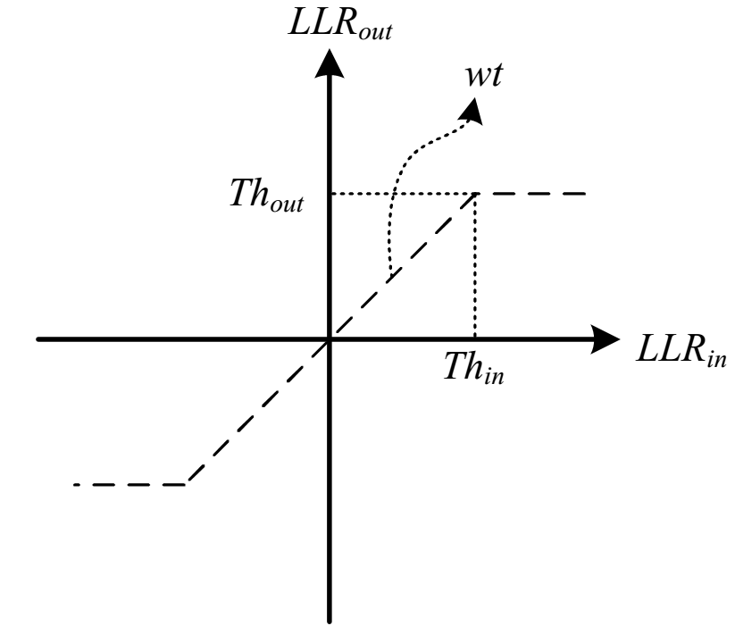
LLR Mapping
The soft-input LDPC decoder cannot correct the incorrect LLR with large magnitude
An LLR mapping function is required: threshold the LLRs with large magnitude and weight appropriately
The LLRs which are affected by the radar interference are passed through the LLR mapping function as:
The output of the LLR mapping function is
passed to the LDPC decoder

Slide 61
Radar Pulse Detection for Interference Mitigation
Generic detection approach: energy detector or other feature based detector
For detection in 802.11 OFDM – use embedded pilot symbols or other properties
Specific detectors for radar pulse:
a) cyclic prefix auto-correlation detector (CP detector)
b) frequency domain data subcarrier detector (DS detector)

Slide 62
Fair Spectrum Sharing
Should define a criterion that takes as input a given instance of spectrum usage pattern of the systems or users in the shared spectrum and delivers as output a measure of fairness for this instance of spectrum sharing (802.19-14)
f
Fairness Criterion
How fair?
B
spectrum usage pattern
in frequency and time
Spectrum usage is highly impacted by the access protocol used by each system
  The fairness criterion should be defined in terms of accepted network
  QoS parameters (throughput, time share, access…)
t
In a Fair frame-work, everyone brings out their best techniques

Slide 63


Example: LTE-LAA/IEEE 802.11 Fair Sharing 3GPP
120 m
4 co-channel cells
per operator (eNB
or IEEE 802.11 AP)
Non-mobile indoor
scenario (IEEE
propagation loss
model)
50 m
5 UEs/STAs per cell
per operator
(20 UEs or STAs per
operator) randomly
dropped
Downlink on
shared channel;
LTE has separate
licensed uplink
Step 1: Both operators A and B are IEEE 802.11 co-channel on separate SSID
Step 2: Replace operator A network with
LTE LAA
Performance metrics:
File transfer throughput
File transfer latency
Voice flow latency
Idealized
backhaul
network

Slide 64
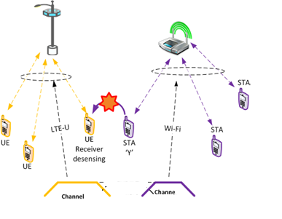
LTE-LAA /IEEE 802.11 Fair Coexistence: Comments
Multiple categories (Cat 1-4) of
LTE-LAA, behave very diff. with IEEE 802.11
Even for Cat 4 (most DCF like LTE-
LAA )
Impact of LTE-LAA → IEEE 802.11 and
IEEE 802.11 → LTE-LAA asymmetric
By tuning of resp. ED thresholds
(IEEE 802.11 and LTE-LAA), TXOP (LTE
-LAA), per-user t’put of the resp.
networks can be changed favorably!
Time Fairness does not
equal Throughput Fairness!
M. Mehrnoush et al ``On Fairness of IEEE 802.11 & LTE-LAA Coexistence”

Slide 65
Near term Technologies wireless/5G Spectrum Sharing
Numerous technologies across wireless (and fixed) exist to support future spectrums Sharing:
  Advances in RAN capabilities
  Multi-user MIMO
  Beamforming
  Network controllers
  Software Defined Networking
  Network Functions Virtualization
  Location Data Base for Unlicensed/Shared spectrum
  Geo-location specific Devices
Many of these are already being used to some degree in today’s networks and initial 5G NR deployments -- In the future low latency, efficiency, and SLAs for a range of end-user requirements, will matter as much as bandwidth
Technology primitives underlying new deployments

Slide 66
Advancing Spectrum Sharing Techniques
Dynamic Spectrum at the RAN in coordination with Slicing requirements
  New Radio Access techniques
  Massive MIMO with spatial awareness/adaptive beamforming
  Device to Device (D2D) control with high mobility – eMBB
And Network Slicing, supported at the core/RAN by:
  a wireless software-defined network,
  network function virtualization,
  Separate of control/data planes and new orchestration functions
Supporting Maximum Efficient use of Spectrum Sharing for:
  network ultra-densification,
  Edge Computing
  big data and mobile cloud computing,
  scalable Internet of Things
Looking forward to 5G Release 17

Slide 67
Emerging Technologies Must Support Disparate Needs
Enhanced
Mobile Broadband (EMBB)
High peak throughput
High spectral efficiency
High capacity
Mobility
Throughput
3D HD
Video
Immersion
Massive Machine-Type Communication (mMTC)
Smart City
Wearable
Ultra-Reliable Low Latency Communication (URLLC)
Augmented
Reality
Gaming
Utility
Metering
Network and device energy efficiency
Massive number of connections
Very large coverage
Transportation
Asset Tracking
eHealth
Autonomous
Driving
Massive Machine-Type Communication (mMTC)
Latency | Reliability
Ultra-high reliability
Ultra-low latency
Sensor Network
Smart Factory
Smart Grid
Cost Savings | Power Savings
From: Dark As Dark Can, The Untold Keynote – May 2015, Sabine Roessel, Intel Corporation
mMTC and URLLC are the new kids on the block in 5G

Slide 68
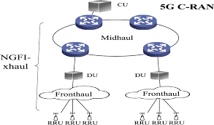
New requirements for the RAN architecture
Radio Front-end
Scalable OFDM – use “sub slots to enhance flexibility and latency which supports:
Shortened TTI – reduces latency
Massive MIMO – large numbers of bearers (hundreds) to increase bandwidth in sub-6GHz bands integrated with:
Spatial Adaptive Beam Forming – extends range/cell size
RAN innovations/new complexities
vRAN – Virtualizing the BBU
Versus C-RAN (cloud/centralized RAN – with “Front Hauling” to BBU
CoMP – coordinate muUE attached to multiple cells to provide greater reliability (Qualcomm)
Deployment: Dense cell
Decoupling traditional management functions (i.e., seesion-mobility)
Peer to Peer (Device to Device – D2D) provisioning
Edge/End-point slicing/computing – SWAP and complexity trade-offs
Cross Domain management
Reconfiguration of the Core vs the Edge
Semanticscholars.org
Source inpart: Samsung 5G

Slide 69
Multi-access Edge control – The Best of Both Worlds
Edge Computing (akin to FOG – a superset) allows different parts of the system to maximize their strengths
Cloud
    Massive storage
    Heavy computation
    Global coordination
    Wide-area connectivity
Edge/Fog
    Real-time processing
    Rapid innovation
    Client-centric
    Edge resource pooling
Issues
    More complex and power-hungry edge devices
    Parsing of data – efficiency vs. loss of context
RAN to the Mobile Edge and back to the Core

Slide 70
End-to-End Dynamic Network Slicing
Aligning with Network functions and multiple end user requirements to optimize end-to-end Service Level Agreements (SLA) from Core to RAN and End Device
  Core Leverages: NFV (Network Functions Virtualization & SDN (Software Defined Networking) techniques, Cross Domain Orchestration, and related “Awareness” concepts
  RAN: Use hardware radio resources and spectrum, with technologies/concepts to include: Edge computing, Flexible NR front-end, massive MIMO, low-latency (sub frame for <1ms), etc
Key End-User requirements:
  low latency and high reliability
  massive connection
  high spectrum efficiency
  high data rate
  Distributed & wide coverage
Networked Virtualization needs to happen end to end – Core as well as RAN

Slide 71






Dynamic Network Slicing Vertically/Horizontally
  Resulting in:
  Each SP can support array of services that have extremely different requirements for bandwidth, latency, reliability, etc.
  Virtualized through single network with multiple Network Slice Instances (NSI)
  End to End network slicing that supports creation of multiple logical networks sharing a common network infrastructure while meeting the specified service levels for each of the services
  Automated configuration of a slice during the instantiation, configuration, and real-time reconfigurations based on conditions.
VERTICAL SLICE
HORIZONTAL SLICE
FACTORY #1
Wireless Broadband
Cell #1
Cell #2
Real-Time Control
Tracking Area #1
IoT Sensors
Registration Area #1
Video Streaming
Source - https://wiki.onap.org/download/attachments/10784151/ONAPNetworkSlicingv3_25Jan2018.pptx?api=v2

Slide 72
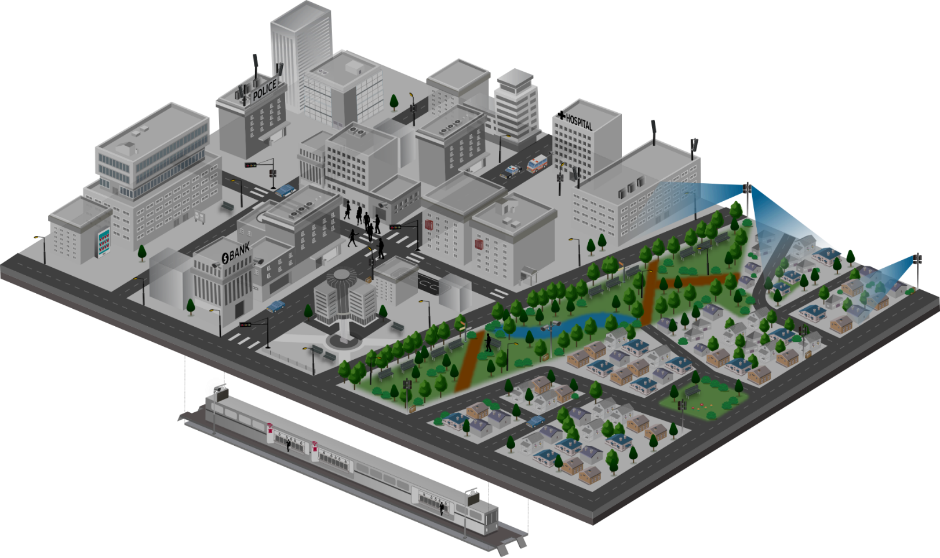












Network Slicing and 5G Success:
Optimize end-to-end
1
Mission Critical Service
4
Fixed Broadband
· Full reliability & high availability
· Real-time responsiveness
· On-the-fly coverage scalability
for disaster situations
· Next-generation broadband
· Multi-Gbps peak throughputs
· Alternative to costly fibre
· New VAS possibilities for
fresh revenue generation
Ambulance
Autonomous driving
Vending machine
CCTV
CCTV
2
Massive IoT
3
Mobile Broadband
· Connectivity for a new wave of device types
· High density deployments
· Networks-as-a-Service to meet
each service provider’s needs
· Robust QoE / QoS management
· New revenue opportunities
CCTV
· Multi-Gbps peak throughputs
· Universal gigabit connectivity
· Unparalleled mobility support
· New service / application enablement
· Advanced big data analytics
Source- Samsung- https://www.w3.org/2018/Talks/web5g/dan-web5g.pptx

Slide 73
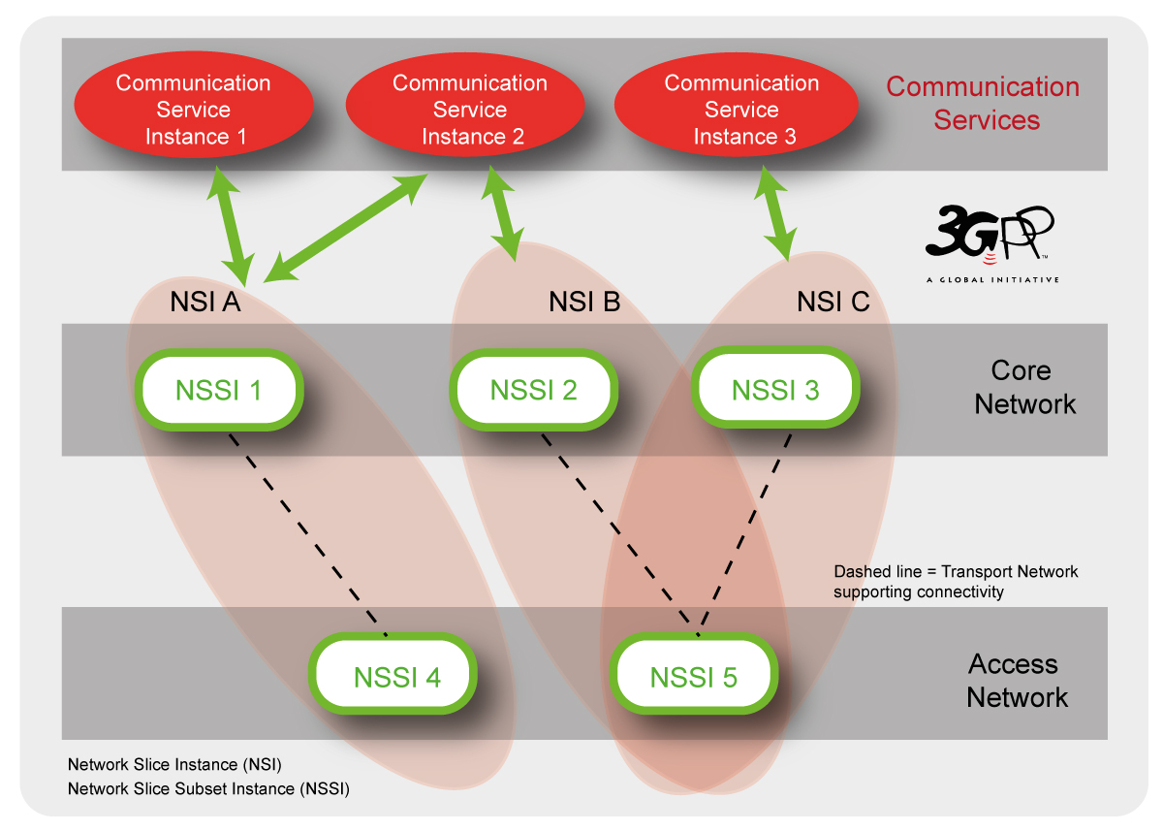
Multiple Level Slice -- Deploying Sub-slice Instances
Integrate slice instances and control at key points across the network
3 Key Components to Network Slice Architecture:
    Comm Services
    Core Network
    Access Network
Each Role can be operated by different organizations
Numerous Standards exist and are being further developed (List a few)
Source - http://www.3gpp.org/NEWS-EVENTS/3GPP-NEWS/1951-SA5_5G

Slide 74
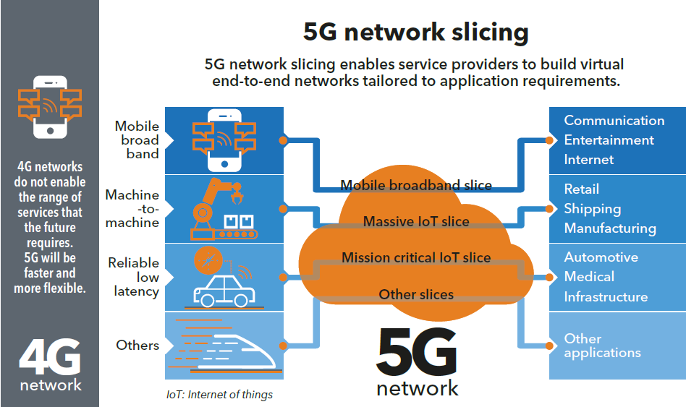
5G Slicing – Multiple Use Cases
Source: https://news.itu.int/why-end-to-end-network-slicing-will-be-important-for-5g

Slide 75
Questions & Opportunities for End-to-End Network Slicing
Implement so that the network control is agnostic to each vertical use (i.e. V2I – V2V, massive IoT, VR, etc
Initial RAN slicing has been show to improve performance and resource allocations for the user – can base stations handle the added complexity
Spectrum re-use, especially at the higher bands, is a big opportunity
Service Provider (SP) spectrum slices: how many & customer control?
Slice hand-offs: how to connect to other SPs slices? How to connect to a Multiple System Operator Slice? (i.e., integrate with cable providers and for MEACs)
Policy concern on Slicing QoS: Potential legal avenue around Net Neutrality?
User management options – addressing complexity and autonomous of multiple varying Slices with AI implementation?
Slicing standards and final definition are still ongoing (scheduled for Rel 17 2020)
What is IEEE 802’ s Approach to Network Virtualization?
These are the hard problems at the core of 5G Utopia …

Slide 76
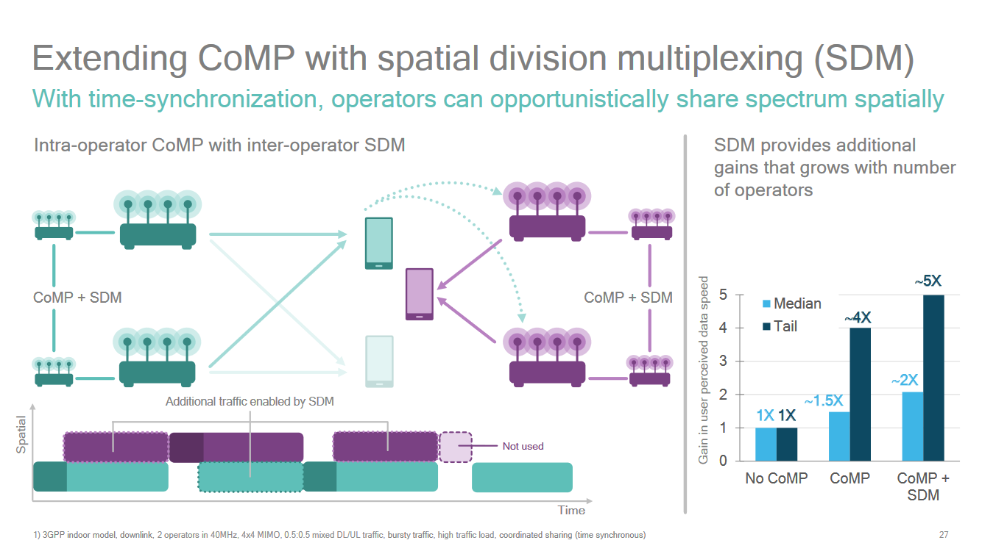
Coordinated multipoint (CoMP) communications
Coordinated multipoint (CoMP) communications allow multiple basestations in different networks transmit and receive information collaboratively.
https://www.qualcomm.com/media/documents/files/new-3gpp-effort-on-nr-in-unlicensed-spectrum-expands-5g-to-new-areas.pdf, slide 27

Slide 77
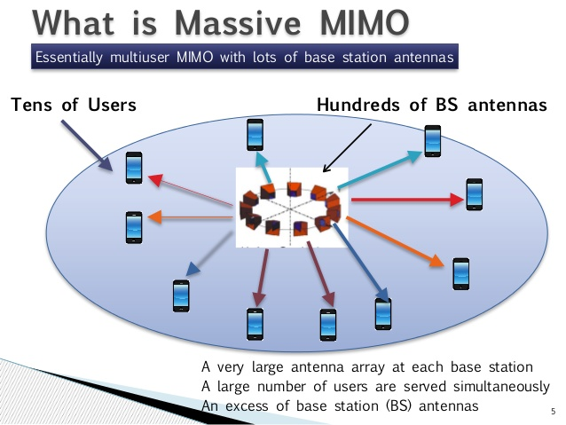
Source - https://www.indiatechonline.com/special-feature.php?id=408 ; original image courtesy IEEE

Slide 78
Massive MIMO – More than multiuser-MIMO
Utilize large antenna arrays (hundreds T/R) to serve end users (tens). Basically, the number of antennas exceed the number of end terminals.
Initially proposed for sub 6 GHz bands with TDD (exploits channel reciprocity)
can increase the capacity 10 times or more and simultaneously, improve the radiated energy-efficiency in the order of 100 times with multiple end users generating simultaneous downlink traffic
can be built with inexpensive, low-power consumption
enables a significant reduction of latency on the air interface (due to robustness against fading)
simplifies the multiple-access layer
increases the robustness both to unintended man-made interference and to intentional jamming
Source: https://massivemimo.eu/index.php

Slide 79
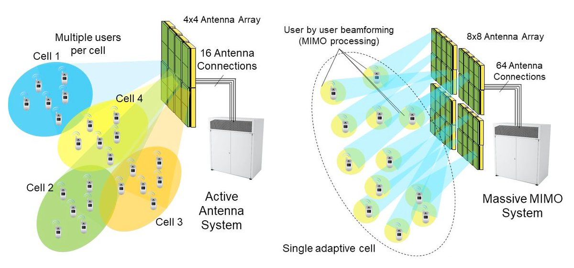
Massive MIMO Concept and Needs
mmW – above 10 GHz, reflection/scattering will be the key for NLOS propagation
Basestations at this frequency and higher would need to be inbuilding
Antenna in array exceeds users; adding high gain adaptive beamforming toc increase coverage and minimize interference; Use with Spatial and Time Domain controls to maximize Spectral Reuse
Evolving research with AI/ML techniques to add/enhance blind source identification, direction finding, etc.
Spatial Adaptive Beamforming with Massive MIMO is corner-stone of the 5G Spectrum Re-use …. One of the Utopia
https://www.edn.com/electronics-blogs/5g-waves/4459761/Realizing-5G-New-Radio-massive-MIMO-systems; January 8, 2018

Slide 80
Adaptive Beam Forming – Integrated with MIMO/TDD
L1/L2 procedures to acquire and maintain a set of network-device beam pair links (TRP ↔ UE)
  CSI-RS (known from LTE) are used for measurements in beam management procedures.
  Beam reporting is configured by higher-layer signalling with respect to periodicity, CSI-RS configurations, and RSRP and CSI report content.
  UE can trigger mechanism for beam failure recovery.
  New Radio supports using different beams for control and data channels.
  New Radio supports using multiple beam pair links for PDCCH monitoring.
Implement Massive MIMO with Time Division Duplex
SU-MIMO
CoMP

Slide 81



Agnostic but Smart MEC
Low and high latency zones based on use case
IEEE 802.11 / LAA
LTE
5G
5G
URLLC
Characteristics
LTE WAN baseline
5G low & mid band WAN
5G mmWave Hot Spots
URLLC Hotter Spots
Creating a seamless user experience will be important
…in throughput & latency
Multiple connectivity
Edge computing is feasible (required) for high bandwidth, connectivity afforded by 5G and App demands.
Spans the enterprise data enter, the WAN, the cloud, and the Edge
SWAP constraints – need hybrid with functions at the edge
Smart Edge Computing is Increasingly Necessary for ALL Networked Systems
* Contribution from Nokia

Slide 82
New Technologies that are Needed
Apurva N. Mody, National Spectrum Consortium
apurva.mody@ieee.org, apurva.mody@WhiteSpaceAlliance.org
Jeff Evans, GTRI, NSC
jeff.evans@gtri.gatech.edu
Sumit Roy, U. of Washington, NSC
sroy@uw.edu
Oliver Holland, King’ s College London
oliver.Holland@ieee.org

Slide 83


Emerging Technology: Beyond the Networks
“DATA is the new OIL” (Kyle Conner, Cisco)
Integration of AI for dense, dynamic end user requirements
Machine Learning (Can machines teach machines functions?)
Mobility as a Service will be a feature
Virtualized devices
Atomic clock chips – geo-location
Connections and Service Level Agreements (SLA’s) automated with SDN/NFV, Context Aware = AI
3D-Ultra-Massive MIMO at Terra Hz……
Smart Edge Computing is Increasingly Necessary for ALL Networked Systems

Slide 84
New Technologies and Standards to make this happen
Technologies that assist in improved electromagnetic spectrum awareness, sharing and use
Spectrally efficient communications technologies
New bi-directional spectrum sharing policies
Spectrum Sharing Tools – Spectrum Access Systems, Sensing and Beaconing Techniques
Understanding Federal Systems – e. g. Radars, SATCOM that need protection
New interference mitigation technologies
Optical links that can off-load high-capacity point to point traffic
Networked Slicing
Security, trusted micro-electronics and computing
Co-existence analysis, Interference Assessment and Monitoring
Full-Duplex and Simultaneous Transmit and Receive,
Spectrum sharing in new frontiers – mmWave and Terra Hz

Slide 85
Why IEEE 802 Community Needs to be Involved and Follow-on Actions
Apurva N. Mody, National Spectrum Consortium
apurva.mody@ieee.org, apurva.mody@WhiteSpaceAlliance.org

Slide 86
Why IEEE 802 should look into this and Next Steps
Licensed eco-system is already looking into this. AWS-1 and AWS-3 spectrum will result in bi-directional spectrum sharing between LTE networks and Federal systems
IEEE 802 has always thrived on disruption.
We need a new disruptive paradigm and policy whose time has come …
Next Steps
Set up an Executive Committee Study Group to look at Spectrum Sharing needs arising from various regulations for various spectrum bands.
Identify the mechanisms that will be needed (e. g. Spectrum Database, Sensing, Beaconing etc.)
Socialize the adoption of these techniques with various working groups OR start a new project on Spectrum Access System (Spectrum Database)
Establish liaison relationships with organizations like the National Spectrum Consortium.
IEEE 802 Needs to Act Now to be Relevant to New Spectrum Bands

