Slide 1
[Comment Resolution related to Multi-channel operation (CID 120) ]
IEEE P802.22b Wireless RANs Date: 2014-3-18
Authors:
Notice: This document has been prepared to assist IEEE 802.22. It is offered as a basis for discussion and is not binding on the contributing individual(s) or organization(s). The material in this document is subject to change in form and content after further study. The contributor(s) reserve(s) the right to add, amend or withdraw material contained herein.
Release: The contributor grants a free, irrevocable license to the IEEE to incorporate material contained in this contribution, and any modifications thereof, in the creation of an IEEE Standards publication; to copyright in the IEEE’s name any IEEE Standards publication even though it may include portions of this contribution; and at the IEEE’s sole discretion to permit others to reproduce in whole or in part the resulting IEEE Standards publication. The contributor also acknowledges and accepts that this contribution may be made public by IEEE 802.22.
Patent Policy and Procedures: The contributor is familiar with the IEEE 802 Patent Policy and Procedures http://standards.ieee.org/guides/bylaws/sb-bylaws.pdf including the statement "IEEE standards may include the known use of patent(s), including patent applications, provided the IEEE receives assurance from the patent holder or applicant with respect to patents essential for compliance with both mandatory and optional portions of the standard." Early disclosure to the Working Group of patent information that might be relevant to the standard is essential to reduce the possibility for delays in the development process and increase the likelihood that the draft publication will be approved for publication. Please notify the Chair
Apurva Mody <apurva.mody@ieee.org> as early as possible, in written or electronic form, if patented technology (or technology under patent application) might be incorporated into a draft standard being developed within the IEEE 802.22 Working Group. If you have questions, contact the IEEE Patent Committee Administrator at patcom@iee.org.

Slide 2
Abstract
This contribution presents the comment resolution related to Multi-channel operation for CID #120.

Slide 3
Comment Resolution related to CID #120
ID | Comment | Suggested Remedy
120 | This multilchannel operation is described for PHY mode 1 only. Eor example 7.24.1.1.9 "BS-CHU broadcasts SCH" | Add multi-channel operation for PHY mode 2
Proposed Remedy: Accepted
Modify description text in each sub-clause and figure that
related to the multi-channel operation for PHY mode 2.

Slide 4
Modify the description text in the sub-clause 7.24.1.1 as shown in the proposed text
(original text) BS-CHU broadcasts SCH.
(proposed text) BS-CHU broadcasts SCH on PHY Mode 1 or FCH on PHY Mode 2.

Slide 5
Modify the description text in the sub-clause 7.24.1.1.9 as shown in the proposed text
(original text) BS-CHU broadcasts SCH.
The BS-CHU shall periodically broadcast a radio frame which included the SCH information.
(proposed text) BS-CHU broadcasts SCH on PHY Mode 1 or FCH on PHY Mode 2.
The BS-CHU shall periodically broadcast a radio frame which included the SCH information on PHY Mode 1 or FCH information on PHY Mode 2.

Slide 6
Modify the description text in the sub-clause 7.24.1.1.13 as shown in the proposed text
(original text) The CPE-CHU shall perform the BS search command by attempting to detect the radio signal (preamble and SCH) from BS at the target frequency of BS search command.
(proposed text) The CPE-CHU shall perform the BS search command by attempting to detect the radio signal (preamble and SCH on PHY Mode 1 or preamble and FCH on PHY Mode 2) from BS at the target frequency of BS search command.

Slide 7
Modify the description text in the sub-clause 7.24.1.1.14 as shown in the proposed text
(original text) The BS detected notification shall include the BSID which is obtained by decoding the SCH information.
(proposed text) The BS detected notification shall include the BSID which is obtained by decoding the SCH information on PHY Mode 1 or FCH information on PHY Mode 2.

Slide 8
Modify the description text in the sub-clause 7.24.1.1.19 as shown in the proposed text
(original text) The CPE-CHU shall continue with the synchronization procedure with the frequency which is detected in SCH.
(proposed text) The CPE-CHU shall continue with the synchronization procedure with the frequency which is detected in SCH on PHY Mode 1 or FCH on PHY Mode 2.

Slide 9
Modify the description text in the sub-clause 7.24.1.2 as shown in the proposed text
(original text) BS-CHU2 broadcasts SCH.
(proposed text) BS-CHU2 broadcasts SCH on PHY Mode 1 or FCH on PHY Mode 2.

Slide 10
Modify the description text in the sub-clause 7.24.1.2.12 as shown in the proposed text
(original text) BS-CHU2 broadcasts SCH.
The BS-CHU shall periodically broadcast a radio frame which included the SCH information.
(proposed text) BS-CHU2 broadcasts SCH on PHY Mode 1 or FCH on PHY Mode 2.
The BS-CHU2 shall periodically broadcast a radio frame which included the SCH information on PHY Mode 1 or FCH information on PHY Mode 2.

Slide 11
Modify the description text in the sub-clause 7.24.1.2.16 as shown in the proposed text
(original text) The CPE-CHU shall perform the BS search command by attempting to detect the radio signal (preamble and SCH) from BS at the target frequency of BS search command.
(proposed text) The CPE-CHU shall perform the BS search command by attempting to detect the radio signal (preamble and SCH on PHY Mode 1 or preamble and FCH on PHY Mode 2) from BS at the target frequency of BS search command.

Slide 12
Modify the description text in the sub-clause 7.24.1.2.17 as shown in the proposed text
(original text) The BS detected notification shall include the BSID which is obtained by decoding the SCH information.
(proposed text) The BS detected notification shall include the BSID which is obtained by decoding the SCH information on PHY Mode 1 or FCH information on PHY Mode 2.

Slide 13
Modify the description text in the sub-clause 7.24.1.2.22 as shown in the proposed text
(original text) The CPE-CHU shall continue with the synchronization procedure with the frequency which is detected in SCH.
(proposed text) The CPE-CHU shall continue with the synchronization procedure with the frequency which is detected in SCH on PHY Mode 1 or FCH on PHY Mode 2.

Slide 14
Modify the description text in the sub-clause 7.24.1.4 as shown in the proposed text
(original text) BS-CHU broadcasts SCH.
(proposed text) BS-CHU broadcasts SCH on PHY Mode 1 or FCH on PHY Mode 2.

Slide 15
Modify the description text in the sub-clause 7.24.1.4.12 as shown in the proposed text
(original text) BS-CHU broadcasts SCH.
The BS-CHU shall periodically broadcast a radio frame which included the SCH information.
(proposed text) BS-CHU broadcasts SCH on PHY Mode 1 or FCH on PHY Mode 2.
The BS-CHU shall periodically broadcast a radio frame which included the SCH information on PHY Mode 1 or FCH information on PHY Mode 2.

Slide 16
Modify the description text in the sub-clause 7.24.1.4.14 as shown in the proposed text
(original text) The CPE-CHU shall send the channel switch completed notification to CPE-CAM when the frame containing SCH, etc. is received correctly.
(proposed text) The CPE-CHU shall send the channel switch completed notification to CPE-CAM when the frame containing SCH on PHY Mode 1 or FCH on PHY Mode 2, etc. is received correctly.

Slide 17
Modify the description text in the Operation flow for adding new operating channel in Figure AQ1 as shown in the proposed text
(original text) SCH.
(proposed text) SCH or FCH.

Slide 18
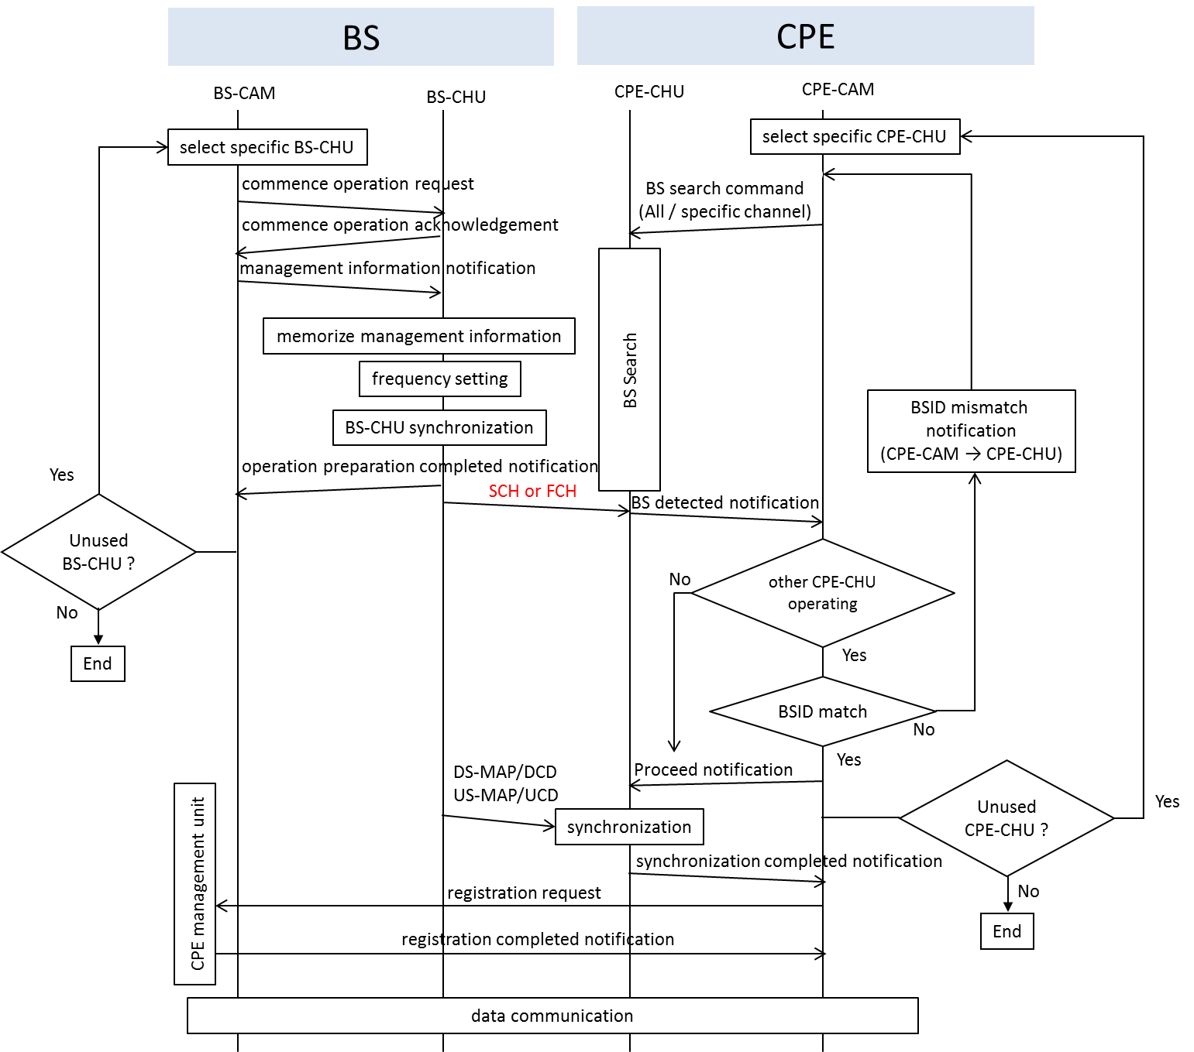
Figure AQ1—Operation flow for adding new operating channel

Slide 19
Modify the description text in the Operation flow for adding new operating channel by using BS search command (specific channel) in Figure AR1 as shown in the proposed text
(original text) SCH.
(proposed text) SCH or FCH.

Slide 20
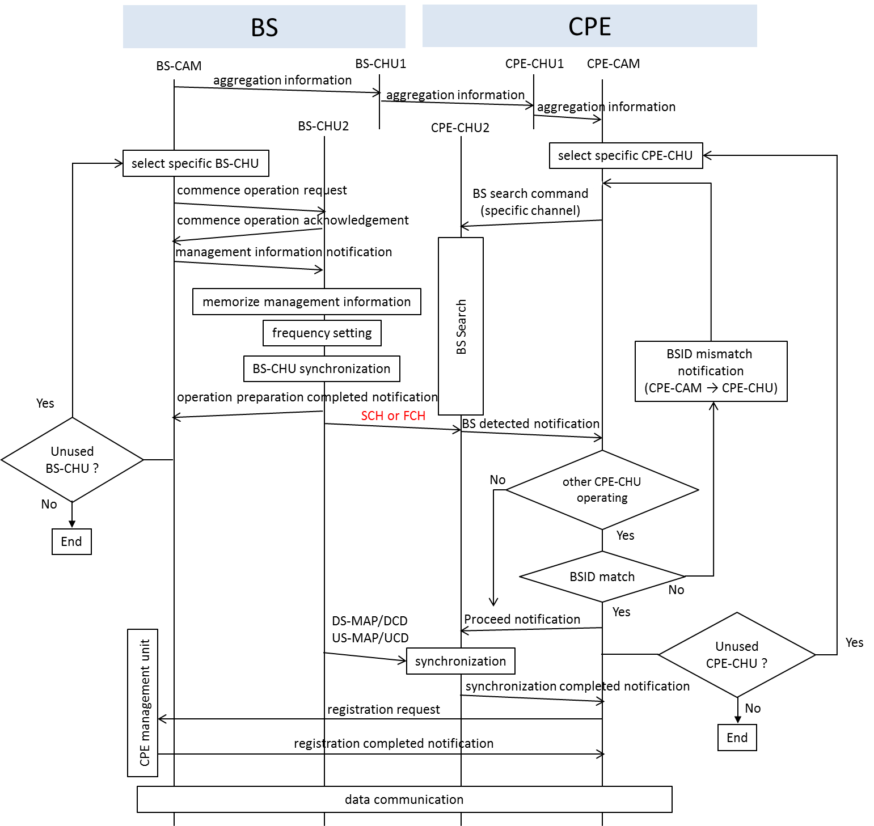
Figure AR1—Operation flow for adding new operating channel by using BS search command (specific channel)

Slide 21
Modify the description text in the Operation flow for switching operating channel in Figure AT1 as shown in the proposed text
(original text) SCH.
(proposed text) SCH or FCH.

Slide 22
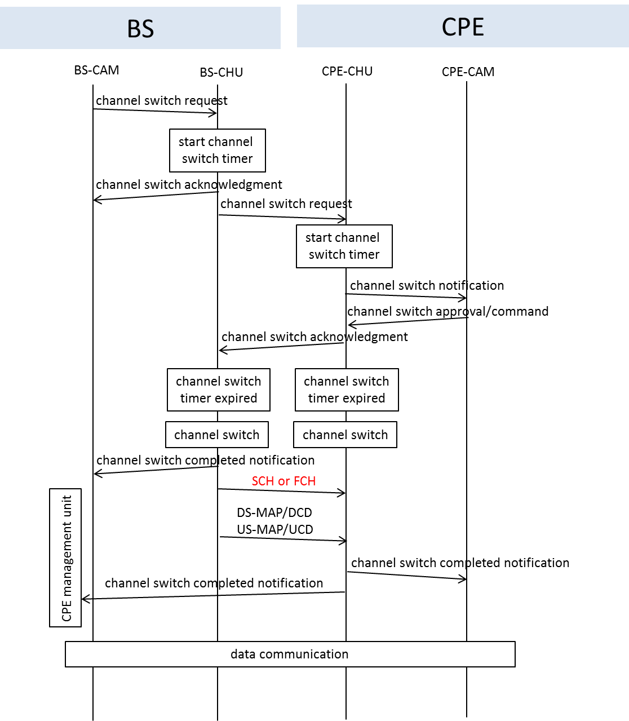
Figure AT1—Operation flow for switching operating channel

