Slide 1
Overview of the IEEE 802.22 Working Group Activities and the IEEE 802.22 (Wi-FAR) Standard for Wireless Regional Area Networks
Dr. Apurva N. Mody,
Chair, IEEE 802.22 Working Group
Chairman, WhiteSpace Alliance™
www.ieee802.org/22
apurva.mody@ieee.org,
+1-404-819-0314

Slide 2
Disclaimer…
“At lectures, symposia, seminars, or educational courses, an individual presenting information on IEEE standards shall make it clear that his or her views should be considered the personal views of that individual rather than the formal position, explanation, or interpretation of the IEEE.”
http://standards.ieee.org/ipr/disclaimers.html

Slide 3
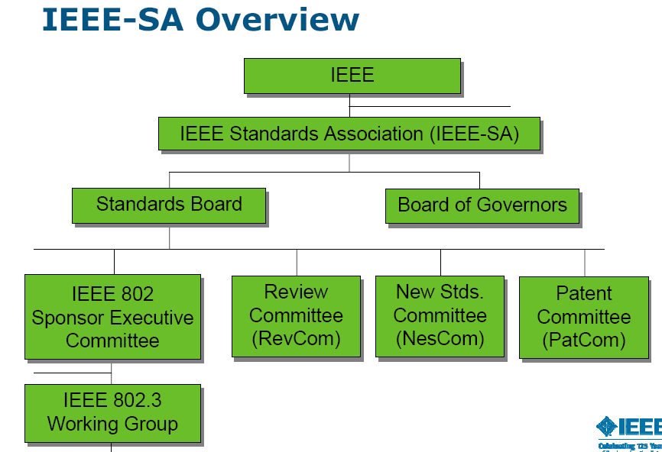
IEEE Standards Association Hierarchy
IEEE is world’ s largest professional organization with a mission of Advancing Technology for the Humanity.
IEEE SA has more than 350 standards working groups
Courtesy, Paul Nikolich, Chair, IEEE 802
802.11
WLAN
802.15
WPAN
802.22
WRAN
Wi-Fi™
ZigBee™
Wi-FAR™

Slide 4

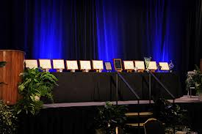
IEEE 802.22 WG on Cognitive Radio Based Spectrum Sharing and Wireless Regional Area Networks
IEEE 802.22 WG is the recipient of the IEEE SA Emerging Technology Award
IEEE 802.22 Standard – Wireless Regional Area Networks: Cognitive Radio based Access in TVWS
(Published, July 2011)
IEEE SA awards ceremony
802.22.1 – Std for Enhanced Interference Protection using beaconing
(Published Nov 2010)
802.22.2 – Std for Recommended Practice for Deployment of 802.22 Systems
(Published Sep 2012)
802.22a – Enhanced Management Information Base and Management Plane Procedures
(To be Published March 2014)
802.22b Enhancement for Broadband Services and Monitoring Applications
802.22.1a – Advanced Beaconing
NEW!! Spectrum Occupancy Sensing (SOS) Study Group
www.ieee802.org/22

Slide 5
Providing cost-effective RURAL broadband is a significant opportunity
Today, 70% of the people in the world (5.1 Billion people) do not have access to high speed (> 1Mbps) internet. More than half the population in the world live in rural areas with hardly any access to broadband.
It is expensive to lay fiber / cable in rural and remote areas with low population density. Wireless is the only solution. Backhaul / backbone internet access for rural areas is very expensive (50% of the cost)
Traditional wireless carriers have focused on urban areas with high populations density (faster Return on Investment) using licensed spectrum
This has created a DIGITAL DIVIDE / OPPORTUNITY

Slide 6
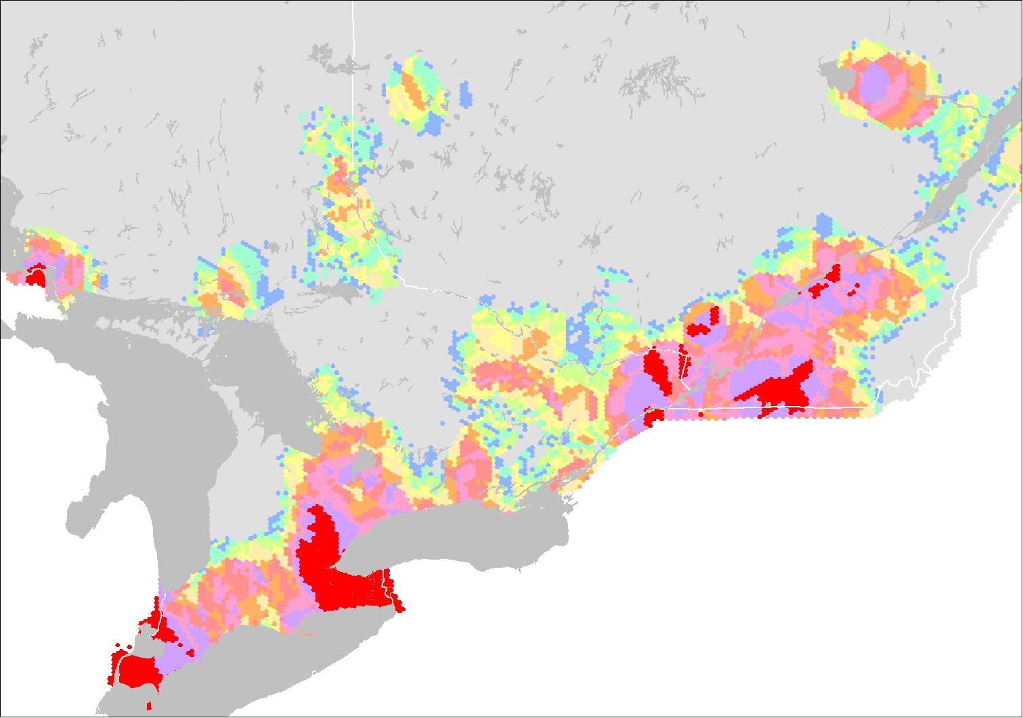

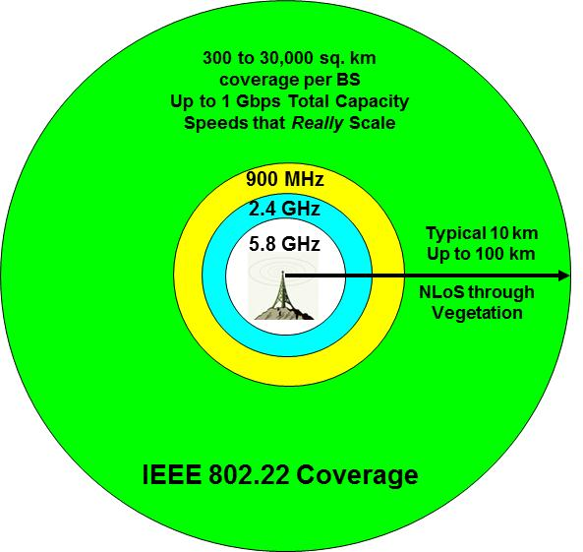
TV Band WhiteSpaces: Can help Alleviate Digital Divide
Southern Ontario and Quebec, Canada
Legend
Available TV channels
None
1
2
3
4
5
6
7
8
9
10 and +
Many Channels Available in Rural Areas
Rural Areas
Urban Areas
TV Channel Availability for Broadband
Source: Gerald Chouinard, CRC and Industry Canada
VHF / UHF bands traditionally have highly favorable propagation characteristics. Penetrating through foliage and structures, they reach far and wide
Rural areas and developing countries have significant available TV Band White Spaces.

Slide 7
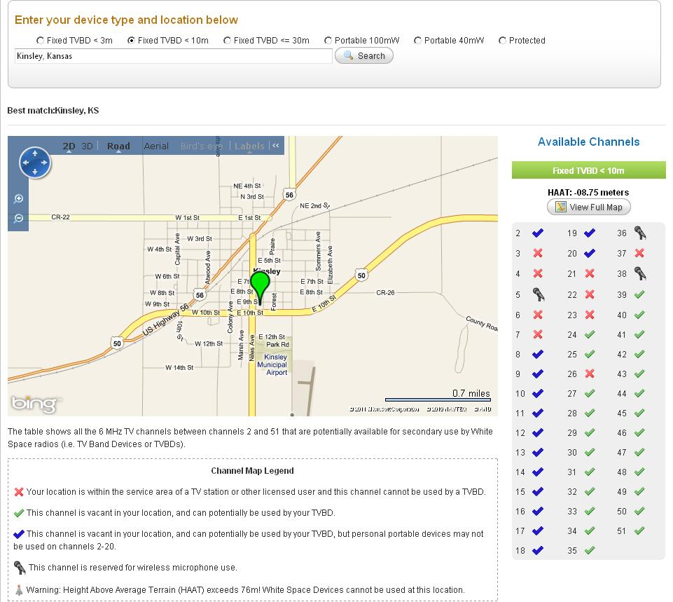
Kinsley, Kansas, USA
TV Channel Availability
Rural Town, Moderate Density
Many TV Channels are available in Rural Areas. IEEE 802.22 is Designed for Rural Areas and Developing Countries
Courtesy: Spectrum Bridge: http://spectrumbridge.com/whitespaces.aspx

Slide 8
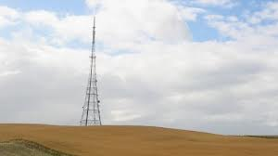
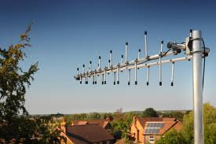

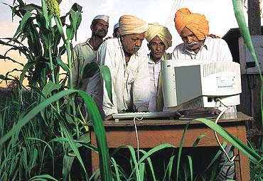
IEEE 802.22 (Wi-FAR™) Applications
BEFORE
Now
Rural Broadband and Backhaul

Slide 9
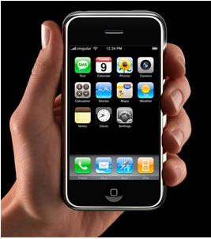
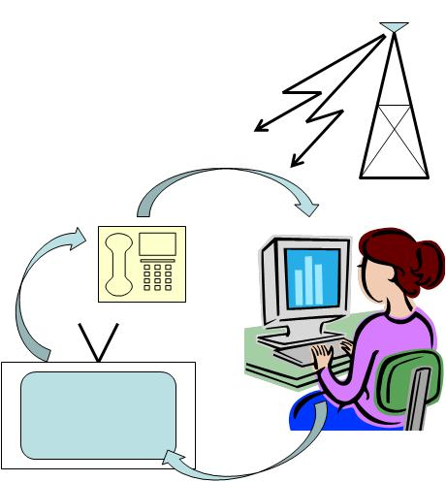

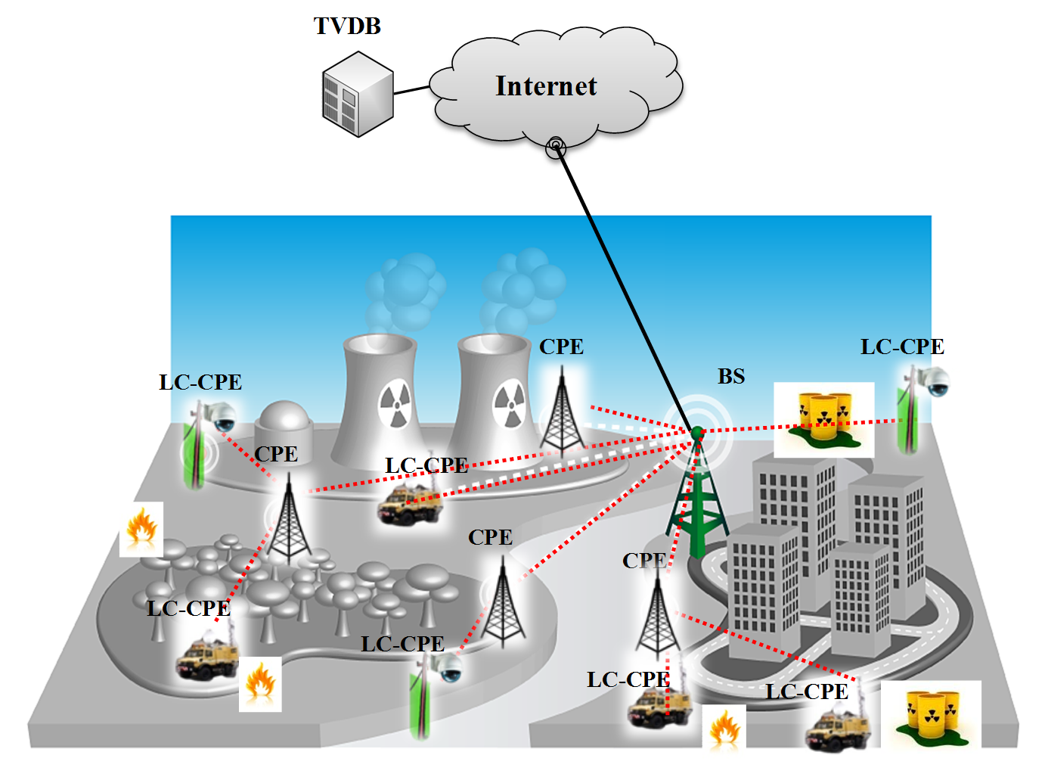

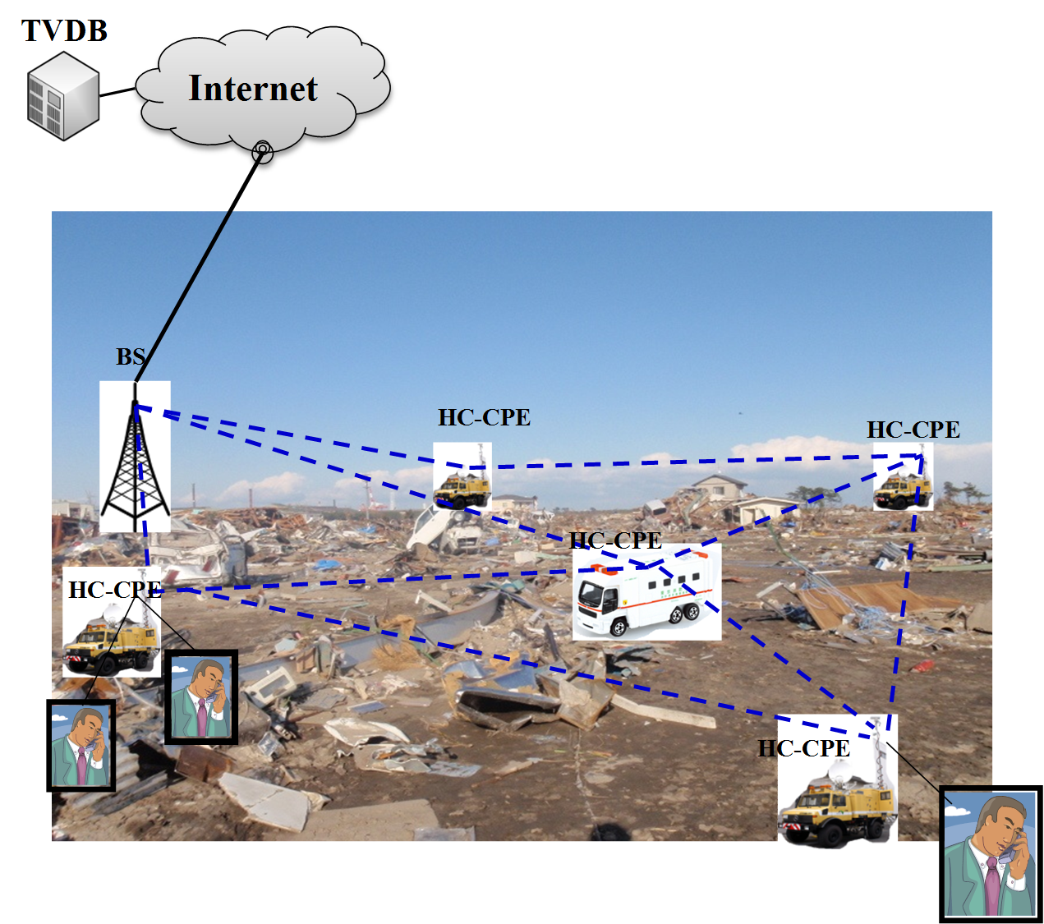
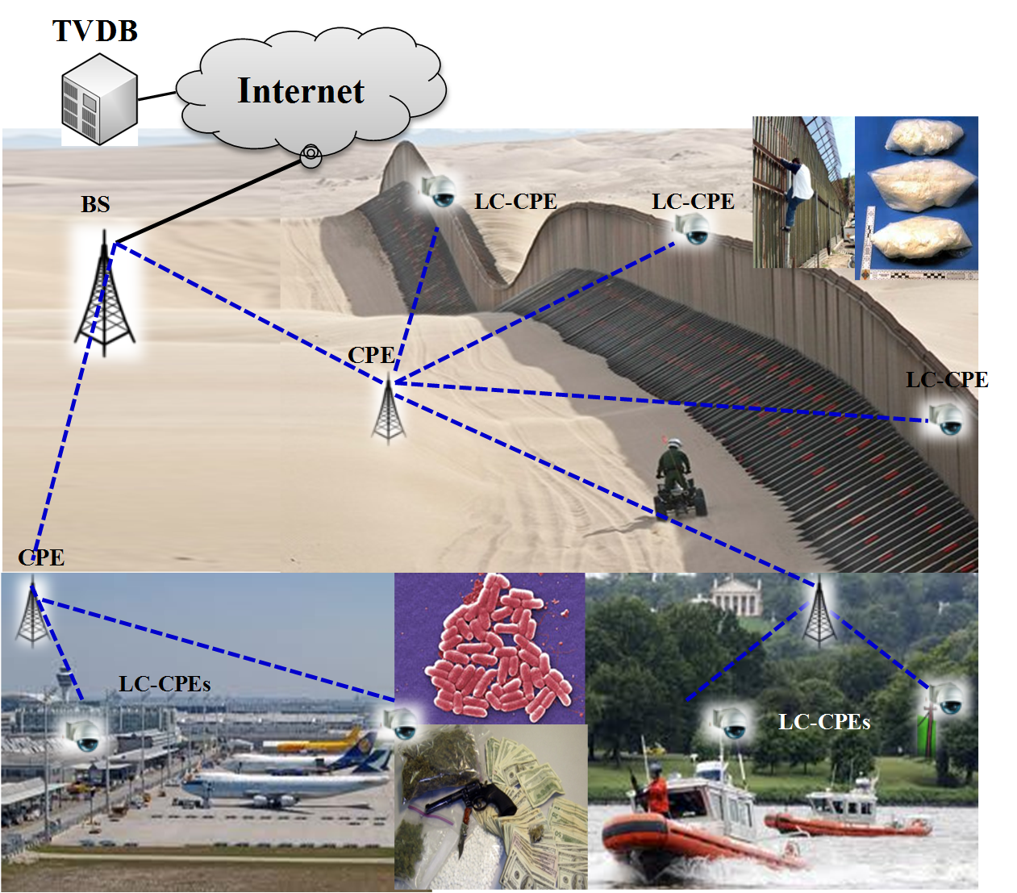
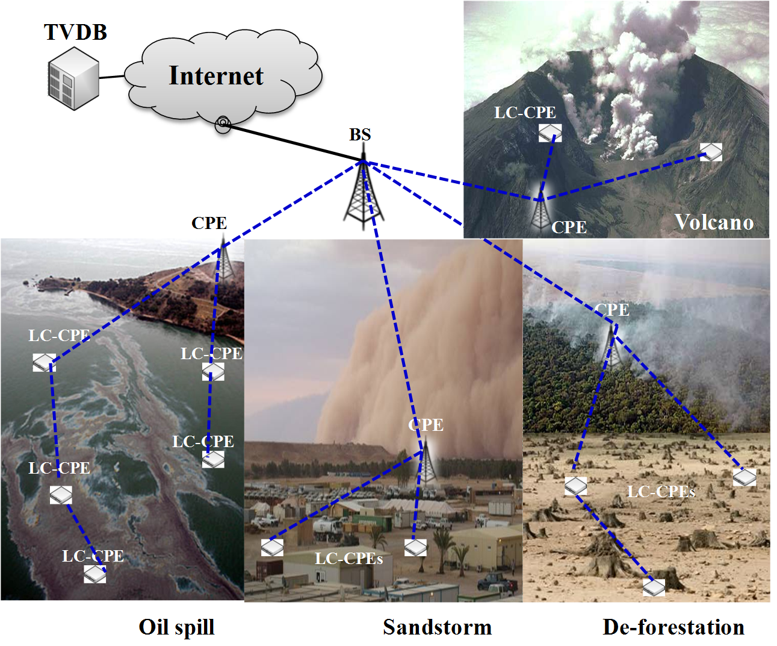
IEEE 802.22 Applications
Triple play
Cellular offload
Critical infrastructure monitoring
Border protection
Environment monitoring
Emergency broadband infrastructure

Slide 10
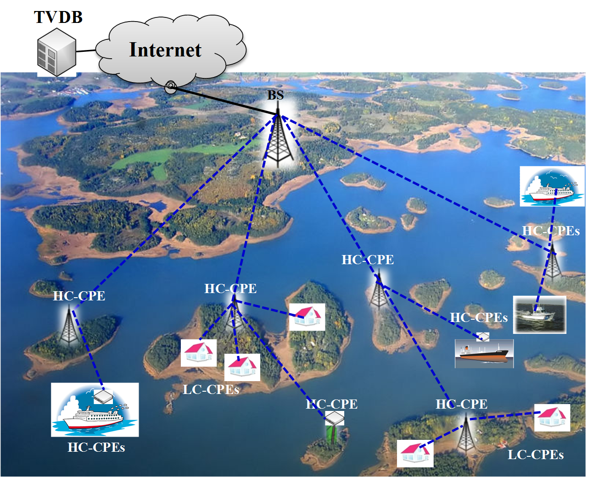
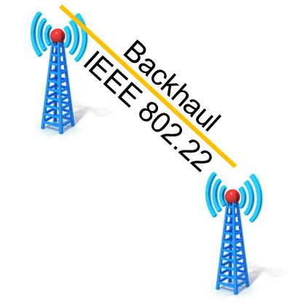
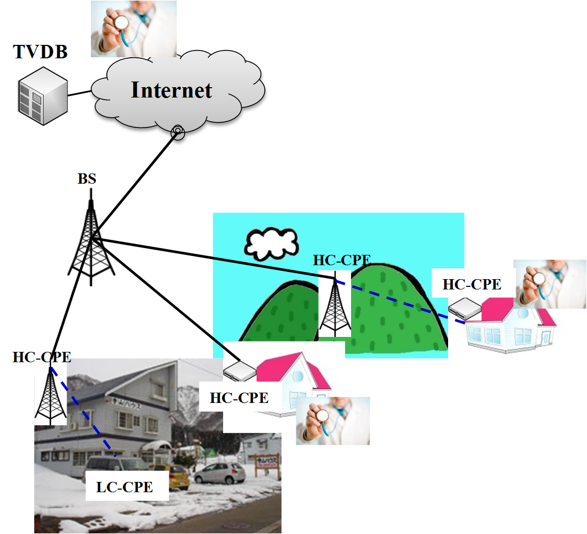
IEEE 802.22 Applications
Archipelago and marine broadband service. Servicing oil rigs
TVDB = (TV Database)
LC- CPE = Low Capability CPE
Remote medical service
C. W. Pyo, Use Cases for IEEE 802.22 (Wi-FAR(TM)) Smart Grid and Critical Infrastructure Monitoring

Slide 11

IEEE 802.22 Enables Cognitive Machine to Machine Communications
IEEE 802.22 is applicable to Smart Grid Applications

Slide 12
IEEE 802.22 (Wi-FAR™) Summary
First IEEE Standard for operation in Television Whitespaces
First IEEE Standard that is specifically designed for rural and regional area broadband access aimed at removing the digital divide
First IEEE Standard that has all the Cognitive Radio features
IEEE 802.22 (Wi-FAR™) provides Broadband Wireless Access to Regional, Rural and Remote Areas Under Line of Sight (LoS) and Non Line of Sight (NLoS) Conditions using Cognitive Radio Technology (without causing harmful interference to the incumbents).
Cognitive Radio technology added to a simple and optimized OFDMA waveform (similar to the OFDMA technology used in other broadband standards
Meets all the regulatory requirements such as protection of incumbents, access to the database, accurate geolocation, spectrum mask, control of the EIRP etc.
Large regional area foot print can allow placement of the Base Station closer to the area with cheaper internet backhaul / backbone.

Slide 13
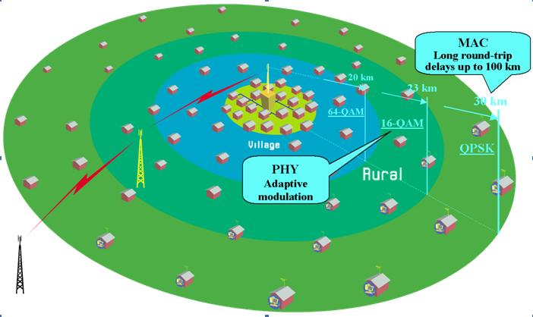
Overview of the IEEE 802.22 (Wi-FAR™) Standard
Core Technology - Cognitive radio technology used to co-exist with and protect the primary users (incumbents).
Representation – Commercial industry, Broadcasters, DoD, Regulators, and Academia
Membership – 30 on an average (over 5 years)
CONOPS - VHF and UHF band operation allows long range propagation and cell radius of 10 – 30 km, exceptionally extensible to 100 km in favorable conditions.
PHY - Optimized for long signal propagation distances and highly frequency selective fading channels (multipath with large excess delays).
MAC – Provides compensation for long round trip delays to provide service to up to 100 km.
Unique features introduced for Cognitive Radio based operation: database access, spectrum sensing, spectrum management, incumbent protection, coexistence, geo-location and security
Cognitive radio based un-licensed usage, ideally suited for rural broadband wireless access
MAC provides compensation for long round trip delays
PHY optimized to tolerate long channel response and frequency selective fading
Portability – IEEE 802.22 (Wi-FAR(TM)) allows portability (nomadic use). In case the rules do change, IEEE 802.22 (Wi-FAR(TM)) PHY is designed to support mobility of up to 114 km/h (no hand-off is included in the current version).

Slide 14
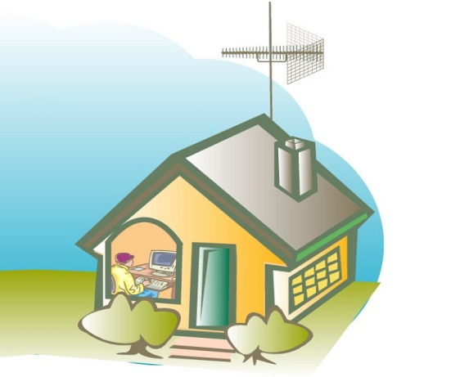
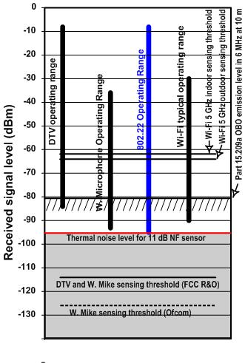
IEEE 802.22 CONOPS
Sensing and GPS Antennas
Directional Tx / Rx Antenna at the Subscriber
Operation in the VHF / UHF Whitespaces.
Network Topology – Point-to-Multipoint (PMP)
Max EIRP and Cell Radius – Fixed BS and Fixed Subscribers using 4W EIRP, Cell Radius 10 – 30 km, exceptionally extensible to 100 km under favorable conditions. 802.22 protocol has been Optimized for long signal propagation distances. (Higher power BS allowed in countries outside the USA)
Portable Subscribers Supported.
Tx / Rx antenna – BS uses sectorized or omni-directional antenna. At the subscriber Tx /Rx antenna is directional with 14 dB of front-to-back lobe suppression,
Sensing antenna requires horizontal and vertical polarization sensitivities to sense TV and microphone signals, and omni-directional pattern.
Geo-location - GPS based geo-location is mandatory, and high resolution terrestrial geo-location (triangulation) is embedded in the standard

Slide 15
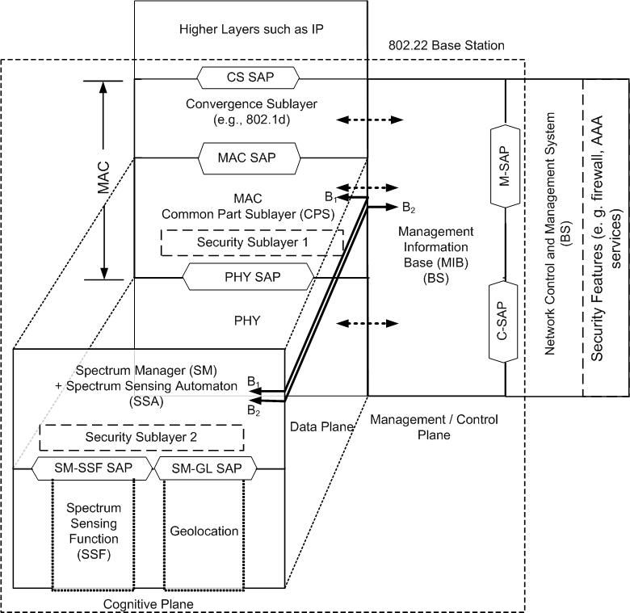
IEEE 802.22 Cognitive Node: Reference Architecture (Clause 5)
IEEE 802.22 Provides Three Mechanisms for Incumbent Protection
Sensing
Database Access
Specially Designed Beacon
Security Sub-layers are introduced to protect non-cognitive as well as cognitive functions
Cognitive Plane is used to control the Cognitive Radio Operation. Security Sublayer 2 is introduced for protection against Cognitive Threats

Slide 16
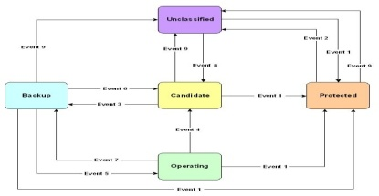
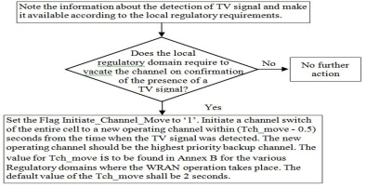
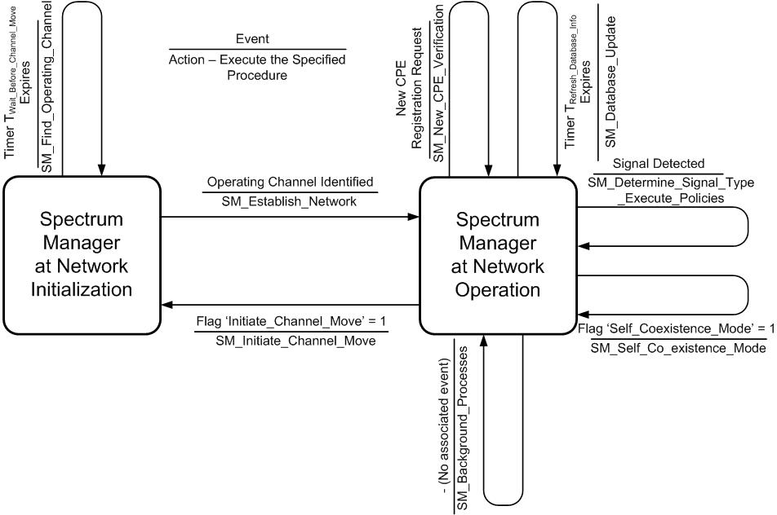
IEEE 802.22 – Cognitive Radio Capability (Clause 10)
Channel Set Management
Subscriber Station Registration and Tracking
Policies
Spectrum Manager
Geo-location
Self Co-existence
Incumbent Database Service
Spectrum Sensing
Incumbent
Database

Slide 17
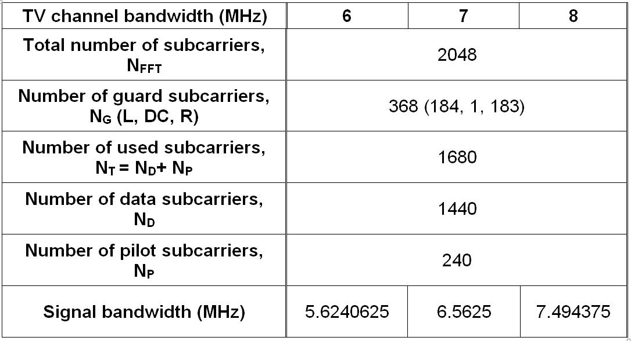
IEEE 802.22 – PHY Features (Clause 9)
PHY Transport - 802.22 uses Orthogonal Frequency Division Multiplexing (OFDM) as transport mechanism. Orthogonal Frequency Division Multiple Access (OFDMA) is used in the Upstream
Modulation - QPSK, 16-QAM and 64-QAM supported
Coding – Convolutional Code is mandatory. Either Turbo, LDPC or Shortened Block Turbo Code can be used for advanced coding.
Pilot Pattern - Each OFDM / OFDMA symbol is divided into sub-channels of 28 subcarriers of which 4 are pilots. Pilot carriers are inserted once every 7 sub-carriers. Pilots cycle through all 7 sub-carriers over 7 symbol duration. No frequency domain interpolation is required because of low Doppler spread in TV bands.
Net Spectral Efficiency - 0.624 bits/s/Hz – 3.12 bits/s/Hz
Spectral Mask - IEEE 802.22 (Wi-FAR(TM)) PHY flexible to meet Spectral Mask requirements in various countries
Data Rates in NLOS Conditions
PHY capacity |  | Mbit/s | bit/(s*Hz) |  | PHY performance: SNR (dB)
Mod. | Rate | CP= 1/8 |  |  | Mod. | Rate | SNR
QPSK | 1/2 | 3.74 | 0.624 |  | QPSK | 1/2 | 4.3
 | 2/3 | 4.99 | 0.832 |  |  | 2/3 | 6.1
 | 3/4 | 5.62 | 0.936 |  |  | 3/4 | 7.1
 | 5/6 | 6.24 | 1.04 |  |  | 5/6 | 8.1
16QAM | 1/2 | 7.49 | 1.248 |  | 16QAM | 1/2 | 10.2
 | 2/3 | 9.98 | 1.664 |  |  | 2/3 | 12.4
 | 3/4 | 11.23 | 1.872 |  |  | 3/4 | 13.5
 | 5/6 | 12.48 | 2.08 |  |  | 5/6 | 14.8
64QAM | 1/2 | 11.23 | 1.872 |  | 64QAM | 1/2 | 15.6
 | 2/3 | 14.98 | 2.496 |  |  | 2/3 | 18.3
 | 3/4 | 16.85 | 2.808 |  |  | 3/4 | 19.7
 | 5/6 | 18.72 | 3.12 |  |  | 5/6 | 20.9
 |  |  |  |  | Note: includes phase noise: -80dBc/Hz at 1 kHz and 10 kHz and -105 dBc/Hz at 100 kHz

Slide 18
TV Channel Modeling – IEEE 802.22 Supports Large Multi-Path Delay Absorption for Long Distance Communications (Clauses 7 and 9)
Long distance communication in the VHF/ UHF Band needs to deal with severe multipath and delay spread conditions
Frequency selective with large excessive delay
  Excessive delay (measurements in US, Germany, France*)
    Longest delay: >60 μsec
    85% test location with delay spread ~35 μsec
  Low frequency (54~862 MHz)
  Long range (up to 100 km)
  Slow fading
    Small Doppler spread
    (up to a few Hz)
* WRAN Channel Modeling, IEEE802.22-05/0055r7, Aug 05
Information provided by TV Broadcasters

Slide 19
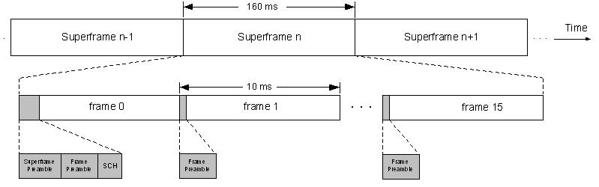
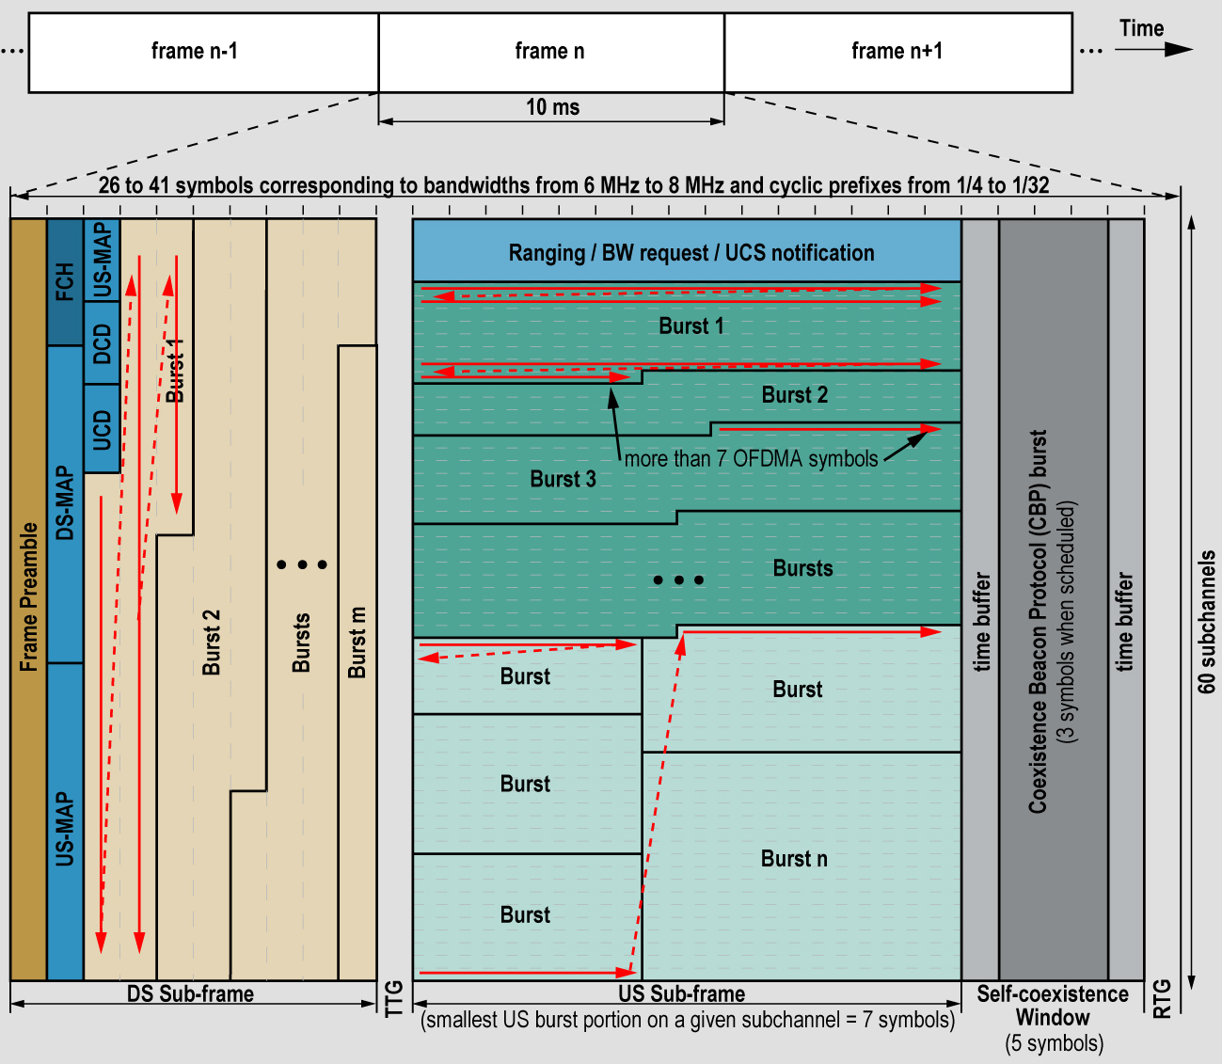
IEEE 802.22 – Frame Structure (Clause 7)
Time Division Duplex (TDD) frame structure Super-frame: 160 ms, Frame: 10 ms
OFDM/ OFDMA Transport
QPSK up to 64 QAM modulation supported
Convolutional codes and other advanced codes supported
Throughput: 22-29 Mbps per TV channel WITH NO MIMO. MIMO and channel bonding increase the throughput
Spectral Efficiency: 0.624 – 3.12 bits / sec / Hz
Distance: 10 km minimum. Upto 30 km and even 100 kms
MAC supports Cognitive Radio features
Self-coexistence Window (SCW): BS commands subscribers to send out CBPs for 802.22
Co-existence Beacon Protocol (CBP) burst used for 802.22 self co-existence and terrestrial geo-location

Slide 20
Concept of IEEE 802.22 Frame Operation (Clause 7)
The allocation of burst could be based on distance of CPE from BS in order to compensate the propagation delay under overlapping cells
Contention for all CBP transmitters
IEEE 802.22 systems are designed to accommodate propagation delays and channel delay spreads of up to 100 km.
The propagation time for CPEs beyond 30km will be accommodated by scheduling of late upstream bursts

Slide 21
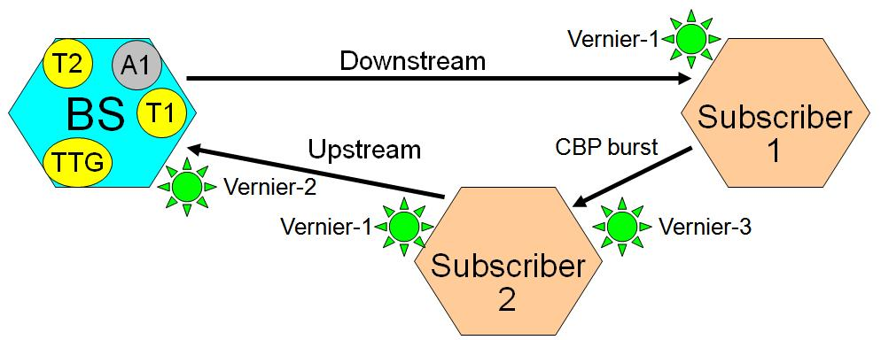
IEEE 802.22 – Geo-location (Clause 10)
Satellite-based geo-location
Requires GPS antenna at each terminal
NMEA 0183 data string used to report to BS
Terrestrially-based geo-location:
Normal BS-CPE ranging process: provides coarse ranging to an accuracy of 147.8 ns (44.3 m)
Extended ranging process: augments the accuracy of the ranging process to 1 ns (0.3 m) by a more accurate scheme using the complex channel impulse response
Off-line geo-location calculation: All the information acquired at the CPEs is transmitted to the BS which can delegate the calculation of the CPE geo-location to a server.
Signal Processing Flow for the Terrestrial Geo-location

Slide 22
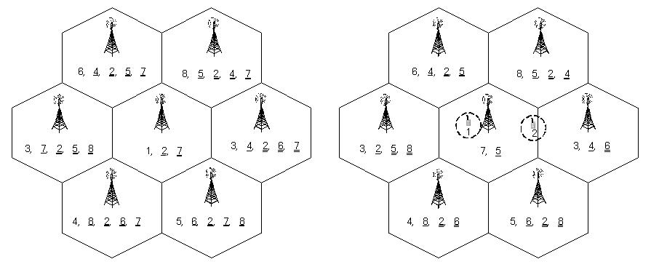
IEEE 802.22 – Self Co-existence (Clause 7)
Spectrum Etiquette
(Enough channels available)
Requires that information on operating, backup and candidate channels of each cell is shared amongst WRAN cells: exchanged by CBP bursts.
On Demand Frame Contention
(Two or more cells need to co-exist on the same channel)
Primary user appears
Number x – represents operating channel
Number y – represents backup channel
Number z (double underline) – represents candidate channel
Self-coexistence window (SCW) does not have to be allocated at each frame.

Slide 23
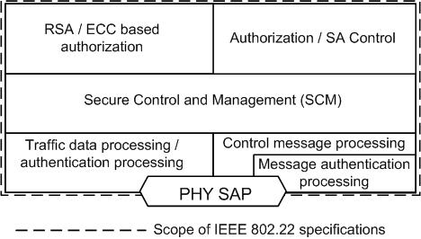
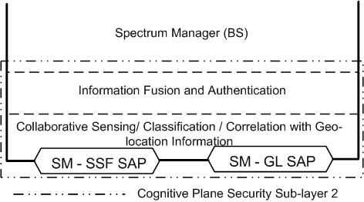
IEEE 802.22 Security Sub-layer Architecture (Clause 8)
Security Sub-layer 1 Architecture for Data / Control and Management Plane
Provides traditional security – PHY / MAC Layer Security
Security Sub-layer 2 Architecture for Cognitive Functions

Slide 24
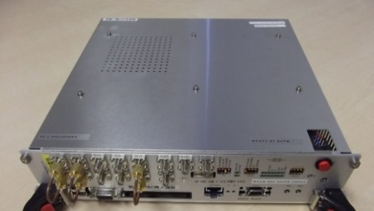

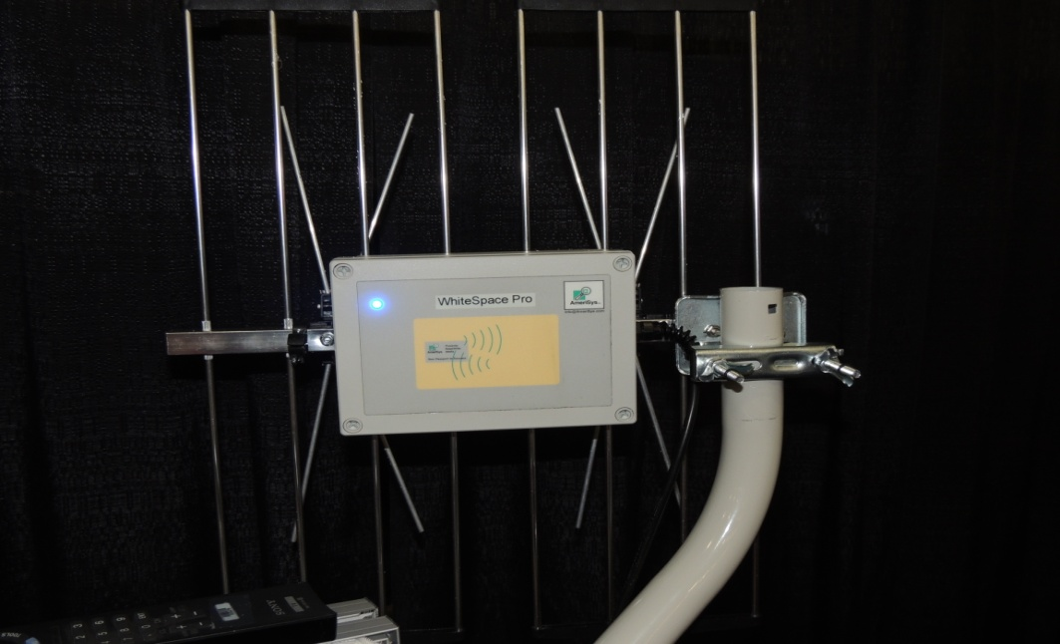
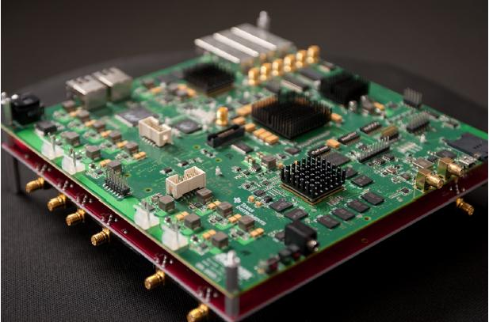
WhiteSpace Alliance Working on Commercializing the IEEE 802.22 (Wi-FAR™) Standard
NICT IEEE 802.22 Prototype
TI / Azcom 802.22 and LTE Solution
AmeriSys 802.22 SDR

Slide 25
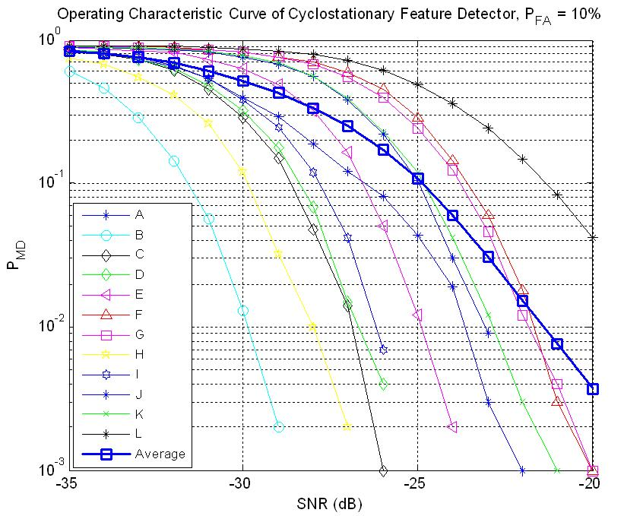
IEEE 802.22 Spectrum Sensing – New Spectrum Occupancy Sensing Study Group (SOS) Formed
Primary user protection through spectrum sensing
Current TV Band White Space regulations do not require spectrum sensing support. However, many developing countries do not have a clear database of incumbent transmitters. So setting up a database is difficult.
Several blind and signal specific feature-based sensing schemes have been proposed and thoroughly evaluated using TV Broadcaster supplied over-the-air collected signals.
Reliable sensing at SNR = -20 dB
Techniques Used:
Energy Detection,
Higher-order Stats,
Covariance
Eigen value,
Cyclostationary
DTV pilot and preamble correlation
Pd = >99%, Pfa = 10%, SNR = -20dB
DTV Detection Results based Cyclostationary Feature Detection

Slide 26
IEEE 802.22.1 Advanced Wireless Beaconing – Applies to Other Bands to Enable Spectrum Sharing with Radars
Advanced Beaconing for Spectrum Sharing
IEEE 802.22.1 defines a beacon signal for primary user protection
Security features are provided for beacon authentication
Such beacons can be used for spectrum sharing with primary users when fast response times are desired or hidden node detection is an issue
IEEE 802.22.1 Revision Project will explore
-114 dBm
Primary user contour
Protection beacon contour
Wireless Microphone Beacon Sensing Results

Slide 27
Conclusions
IEEE 802.22 Working Group has created Cognitive Radio and Spectrum Sharing Technologies that are applicable to Television Band White Spaces as well as Other (e. g. Radar) Bands
IEEE 802.22 defines the First IEEE Cognitive Radio Standard for operation in Television Whitespaces
IEEE 802.22 is the First IEEE Standard that is specifically designed for rural and regional area broadband access aimed at removing the digital divide
IEEE 802.22 (Wi-FAR™) provides Broadband Wireless Access to Regional, Rural and Remote Areas Under Line of Sight (LoS) and Non Line of Sight (NLoS) conditions without causing harmful interference to the incumbents.
Other IEEE 802.22 supporting technologies such as the IEEE 802.22.1 Advanced Beaconing and new Spectrum Occupancy Sensing (SOS) Study Group will create enabling technologies for spectrum sharing.
We intend to submit to submit IEEE 802.22 Standards through the PSDO process in the future for ISO recognition

Slide 28
References
IEEE 802.22 Working Group Website – www.ieee802.org/22
Apurva Mody, Gerald Chouinard, “Overview of the IEEE 802.22 Standard on Wireless Regional Area Networks (WRAN) and Core Technologies” http://www.ieee802.org/22/Technology/22-10-0073-03-0000-802-22-overview-and-core-technologies.pdf
WhiteSpace Alliance: www.WhiteSpaceAlliance.org
Get Completed IEEE 802.22 Standards Here: http://standards.ieee.org/about/get/802/802.22.html

