Slide 1
Comment Resolution related to Frame Configuration
IEEE P802.22 Wireless RANs Date: 2013-11-21
Authors:
Notice: This document has been prepared to assist IEEE 802.22. It is offered as a basis for discussion and is not binding on the contributing individual(s) or organization(s). The material in this document is subject to change in form and content after further study. The contributor(s) reserve(s) the right to add, amend or withdraw material contained herein.
Release: The contributor grants a free, irrevocable license to the IEEE to incorporate material contained in this contribution, and any modifications thereof, in the creation of an IEEE Standards publication; to copyright in the IEEE’s name any IEEE Standards publication even though it may include portions of this contribution; and at the IEEE’s sole discretion to permit others to reproduce in whole or in part the resulting IEEE Standards publication. The contributor also acknowledges and accepts that this contribution may be made public by IEEE 802.22.
Patent Policy and Procedures: The contributor is familiar with the IEEE 802 Patent Policy and Procedures
<http://standards.ieee.org/guides/bylaws/sb-bylaws.pdf>, including the statement "IEEE standards may include the known use of patent(s), including patent applications, provided the IEEE receives assurance from the patent holder or applicant with respect to patents essential for compliance with both mandatory and optional portions of the standard." Early disclosure to the Working Group of patent information that might be relevant to the standard is essential to reduce the possibility for delays in the development process and increase the likelihood that the draft publication will be approved for publication. Please notify the Chair Apurva Mody <apurva.mody@ieee.org> as early as possible, in written or electronic form, if patented technology (or technology under patent application) might be incorporated into a draft standard being developed within the IEEE 802.22 Working Group. If you have questions, contact the IEEE Patent Committee Administrator at <patcom@ieee.org>.

Slide 2
Comment Resolution related to CID #2
ID | Comment | Suggested Remedy
2 | In those figures, there are unnecessary time gap exist for example, TDD, RRTG, etc. remove those unnecessary time gap in mode 2 frame structures | Remedy was suggested in contribution 22-13-0141/r2

Slide 3
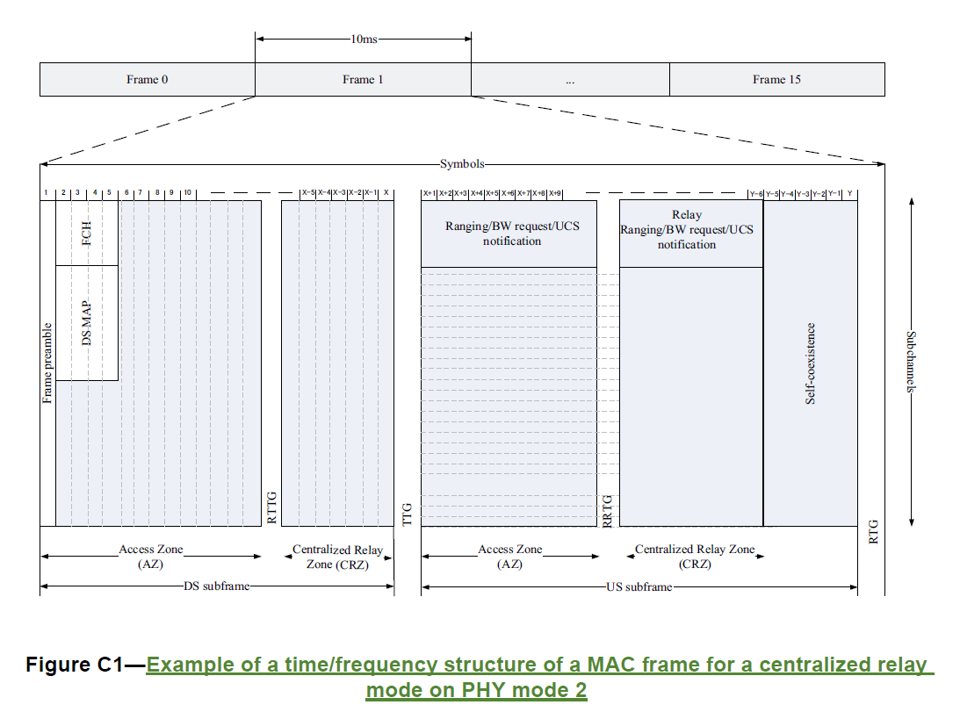
22b Frame Configuration for Relay

Slide 4
22b Frame Configuration for Relay
Centralized Scheduling Mode
Downstream
AZ (DS-AZ)
GAP (RTTG)
CRZ (DS-CRZ)
GAP (TTG)
Upstream
AZ (US-AZ)
GAP (RRTG)
CRZ (US-CRZ)
GAP (RTG)

Slide 5
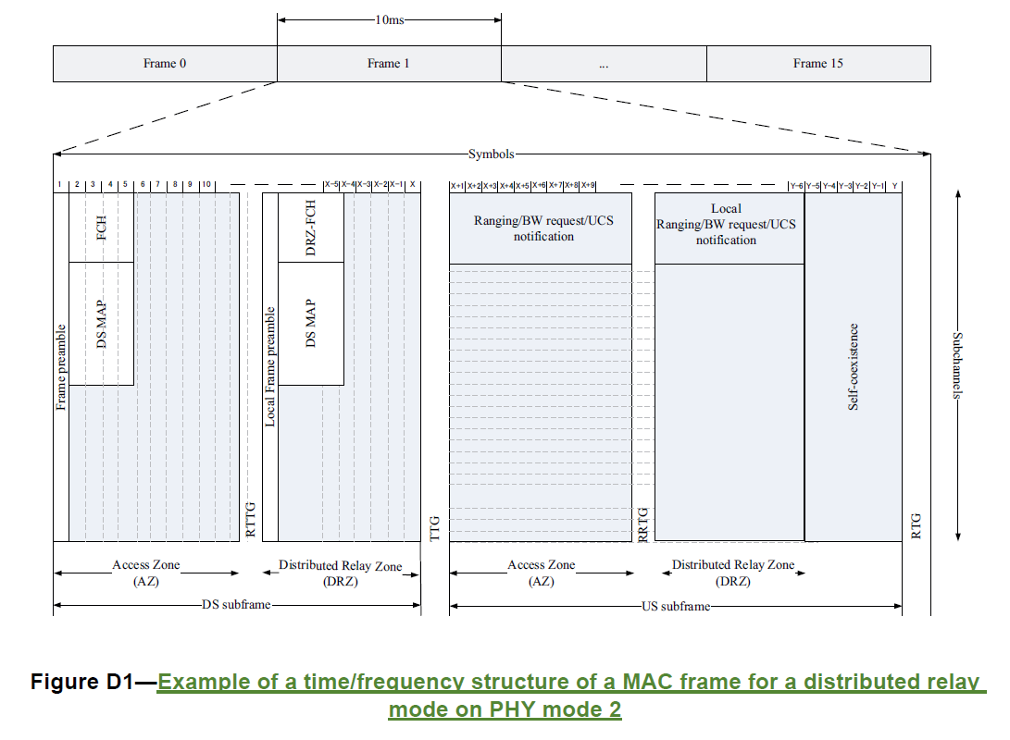
22b Frame Configuration for Relay

Slide 6
22b Frame Configuration for Relay
Distributed Scheduling Mode
Downstream
AZ (DS-AZ)
GAP (RTTG)
DRZ (DS-DRZ)
GAP (RTG)
Upstream
AZ (US-AZ)
GAP (RRTG)
DRZ (US-DRZ)
GAP (RTG)

Slide 7
Combinations of Frame Configuration 1
Centralized Scheduling Mode
DS-AZ shall appear at the First in every frame
Possible Combinations
Comb#1: DS-AZ + DS-CRZ + US-AZ + US-CRZ
Comb#2: DS-AZ + DS-CRZ + US-CRZ + US-AZ
Comb#3: DS-AZ + US-AZ + US-CRZ + DS-CRZ
Comb#4: DS-AZ + US-AZ + DS-CRZ + US-CRZ
Comb#5: DS-AZ + US-CRZ + DS-CRZ + US-AZ
Comb#6: DS-AZ + US-CRZ + US-AZ + DS-CRZ

Slide 8
Comb#1: DS-AZ + DS-CRZ + US-AZ + US-CRZ
Frame Configuration for Comb#1
 | MR-BS | R-CPE | S-CPE
DS-AZ | TX | RX | RX
DS-CRZ |  | TX | RX
US-AZ | RX | TX
US-CRZ |  | RX | TX
RRTG
RTTG
DS-AZ | RRTG | DS-CRZ | US-AZ | RTTG | US-CRZ | SC | RTG
RRTG : receive-to-transmit turnaround gap in R-CPE
RTTG : transmit-to-receive turnaround gap in R-CPE
SC : Self-coexistence

Slide 9
Comb#2: DS-AZ + DS-CRZ + US-CRZ + US-AZ
Frame Configuration for Comb#2
 | MR-BS | R-CPE | S-CPE
DS-AZ | TX | RX | RX
DS-CRZ |  | TX | RX
US-CRZ |  | RX | TX
US-AZ | RX | TX
RRTG
RTTG
RTG
RRTG
DS-AZ | RRTG | DS-CRZ | RTTG | US-CRZ | RRTG/RTG | US-AZ | SC | RTG

Slide 10
Comb#3: DS-AZ + US-AZ + US-CRZ + DS-CRZ
Frame Configuration for Comb#3
 | MR-BS | R-CPE | S-CPE
DS-AZ | TX | RX | RX
US-AZ | RX | TX
US-CRZ |  | RX | TX
DS-CRZ |  | TX | RX
TTG
RRTG
RTTG
RRTG
TTG
DS-AZ | TTG/ RRTG | US-AZ | RTTG | US-CRZ | RRTG/TTG | DS-CRZ | SC | RTG

Slide 11
Comb#4: DS-AZ + US-AZ + DS-CRZ + US-CRZ
Frame Configuration for Comb#4
 | MR-BS | R-CPE | S-CPE
DS-AZ | TX | RX | RX
US-AZ | RX | TX
DS-CRZ |  | TX | RX
US-CRZ |  | RX | TX
TTG
RRTG
RTTG
RTG
DS-AZ | TTG/RRTG | US-AZ | DS-CRZ | RRTG/RTG | US-CRZ | SC | RTG

Slide 12
Comb#5: DS-AZ + US-CRZ + DS-CRZ + US-AZ
Frame Configuration for Comb#5
 | MR-BS | R-CPE | S-CPE
DS-AZ | TX | RX | RX
US-CRZ |  | RX | TX
DS-CRZ |  | TX | RX
US-AZ | RX | TX
RTG
RRTG
DS-AZ | RTG | US-CRZ | RRTG/ TTG | DS-CRZ | US-AZ | SC | RTG

Slide 13
Comb#6: DS-AZ + US-CRZ + US-AZ + DS-CRZ
Frame Configuration for Comb#6
 | MR-BS | R-CPE | S-CPE
DS-AZ | TX | RX | RX
US-CRZ |  | RX | TX
US-AZ | RX | TX
DS-CRZ |  | TX | RX
RTG
RRTG
DS-AZ | RTG | US-CRZ | RRTG | US-AZ | DS-CRZ | SC | RTG

Slide 14
Comb#1, #4, #5 and #6 are recommendable frame configuration in Centralized Scheduling Mode, which are used the lowest number of Time Gap

Slide 15
Combinations of Frame Configuration 2
Distributed Scheduling Mode
DS-AZ shall appear at the First in every frame
DS-DRZ shall appear earlier than US-DRZ since DS-DRZ contains MAP information for US-DRZ
Possible Combinations
Comb#1: DS-AZ + DS-DRZ + US-AZ + US-DRZ
Comb#2: DS-AZ + DS-DRZ + US-DRZ + US-AZ
Comb#3: DS-AZ + US-AZ + US-DRZ + DS-DRZ
Comb#4: DS-AZ + US-AZ + DS-DRZ + US-DRZ
Comb#5: DS-AZ + US-DRZ + DS-DRZ + US-AZ
Comb#6: DS-AZ + US-DRZ + US-AZ + DS-DRZ

Slide 16
Comb#1: DS-AZ + DS-DRZ + US-AZ + US-DRZ
Frame Configuration for Comb#1
 | MR-BS | R-CPE | S-CPE
DS-AZ | TX | RX
DS-DRZ |  | TX | RX
US-AZ | RX | TX
US-DRZ |  | RX | TX
RRTG
RTTG
DS-AZ | RRTG | DS-DRZ | US-AZ | RTTG | US-DRZ | SC | RTG

Slide 17
Comb#2: DS-AZ + DS-DRZ + US-DRZ + US-AZ
Frame Configuration for Comb#2
 | MR-BS | R-CPE | S-CPE
DS-AZ | TX | RX
DS-DRZ |  | TX | RZ
US-DRZ |  | RX | TX
US-AZ | RX | TX
RRTG
RTTG
RTG
RTTG
DS-AZ | RRTG | DS-DRZ | RTTG/ RTG | US-AZ | RTTG | US-DRZ | SC | RTG

Slide 18
Comb#4: DS-AZ + US-AZ + DS-DRZ + US-DRZ
Frame Configuration for Comb#4
 | MR-BS | R-CPE | S-CPE
DS-AZ | TX | RX
US-AZ | RX | TX
DS-DRZ |  | TX | RX
US-DRZ |  | RX | TX
TTG
RRTG
RTTG
DS-AZ | TTG/ RRTG | DS-DRZ | US-AZ | RTTG | US-DRZ | SC | RTG

Slide 19
Comb#1 and Comb#4 are recommendable frame configuration in Distributed Scheduling Mode because the lowest number of Time Gap is used

Slide 20
Transmission & Retransmission

Slide 21
Comb#1: DS-AZ + DS-CRZ + US-AZ + US-CRZ
MR-BS
R-CPE
S-CPE
Frame
Frame
22b Frame #X
Ack
22b Frame #X+1
Ack
Re-Frame
Re-Frame
22b Frame #X+2

Slide 22
Comb#2: DS-AZ + DS-CRZ + US-CRZ + US-AZ
MR-BS
R-CPE
S-CPE
Frame
Frame
22b Frame #X
Ack
Ack
Re-Frame
Re-Frame
22b Frame #X+1

Slide 23
Comb#3: DS-AZ + US-AZ + US-CRZ + DS-CRZ
MR-BS
R-CPE
S-CPE
Frame
22b Frame #X
Frame
22b Frame #X+1
Ack
Ack
22b Frame #X+2

Slide 24
Comb#4: DS-AZ + US-AZ + DS-CRZ + US-CRZ
MR-BS
R-CPE
S-CPE
Frame
22b Frame #X
Frame
Ack
Ack
22b Frame #X+1
Re-Frame
22b Frame #X+2
Re-Frame

Slide 25
Comb#5: DS-AZ + US-CRZ + DS-CRZ + US-AZ
MR-BS
R-CPE
S-CPE
Frame
22b Frame #X
Frame
Ack
22b Frame #X+1
Ack
Re-Frame
22b Frame #X+2
Re-Frame

Slide 26
Comb#6: DS-AZ + US-CRZ + US-AZ + DS-CRZ
MR-BS
R-CPE
S-CPE
Frame
22b Frame #X
Frame
Ack
22b Frame #X+1
Ack
Re-Frame
22b Frame #X+2
Re-Frame

Slide 27
Comb#2 is recommendable frame configuration because it has the lowest time of retransmission

Slide 28
Discussion
The required frame configuration in each centralized and distributed scheduling mode is different
The required frame configuration is different in the viewpoint of used time gap and frame transmission
The required frame configuration is different in the different viewpoints

Slide 29
Proposed Comment Resolution
Flexible frame configuration shall be allowed
For example,
Comb#1, #4, #5 and #6 is used for the case of lower time gap in centralized scheduling mode
Comb#1 and #4 is used for the case of lower time gap in distributed scheduling mode
Comb#2 is used for the case of lower transmission time
Then, 802.22b shall not define the specific frame configuration except for the following rules
“DS-AZ shall appear at the first within the every frame.”
“DS-DRZ shall appear earlier than US-DRZ in the distributed scheduling mode since DS-DRZ may contain MAP information for US-DRZ.”
802.22b defines both “RRTG” and “RTTG” to allow flexible frame configuration

Slide 30
RRTG
The minimum receive-to-transmit turnaround gap required at an R-CPE. RRTG is measured from the time of the last sample of the received burst to the first sample of the transmitted burst at the antenna port of the R-CPE
RTTG
The minimum transmit-to-receive turnaround gap required at an R-CPE. RTTG is measured from the time of the last sample of the transmitted burst to the first sample of the received burst at the antenna port of the R-CPE

Slide 31
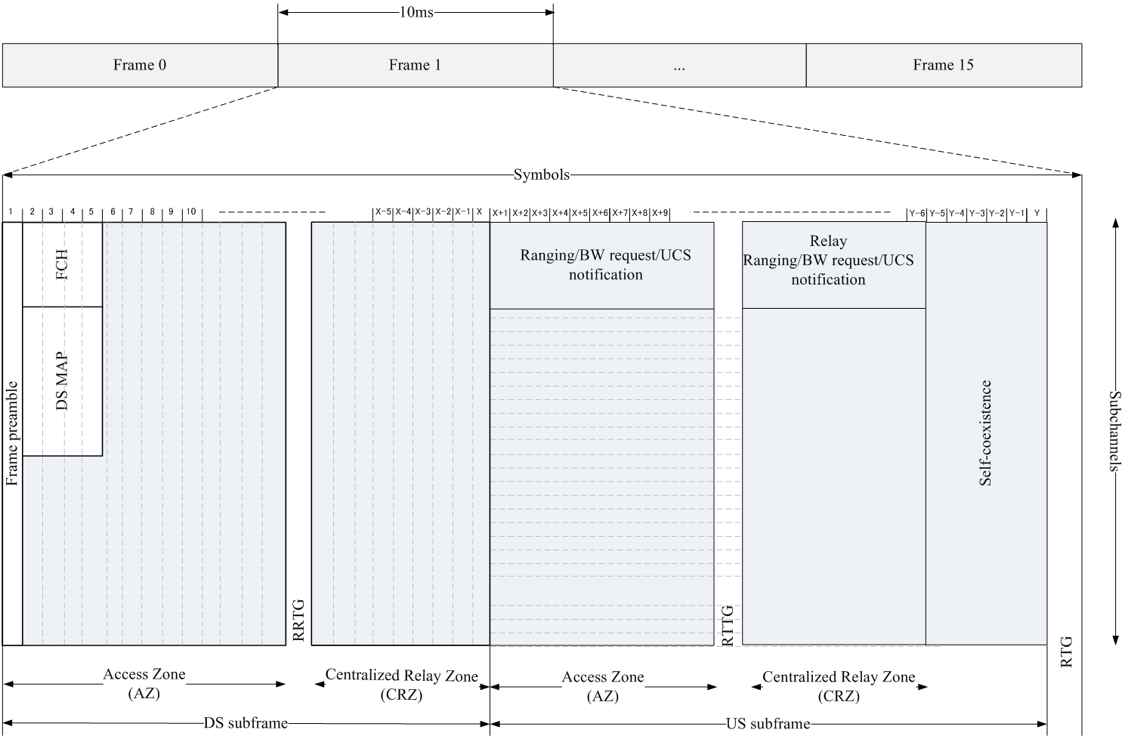
Figure C1 is updated as follows

Slide 32
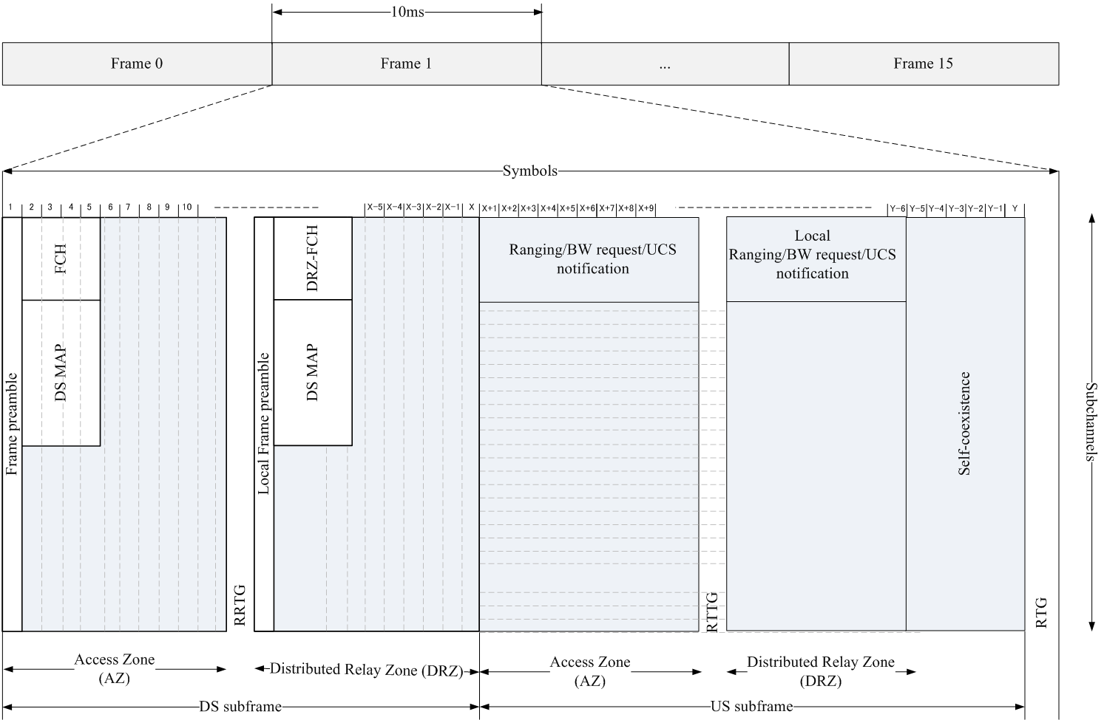
Figure D1 is revised as follows

Slide 33
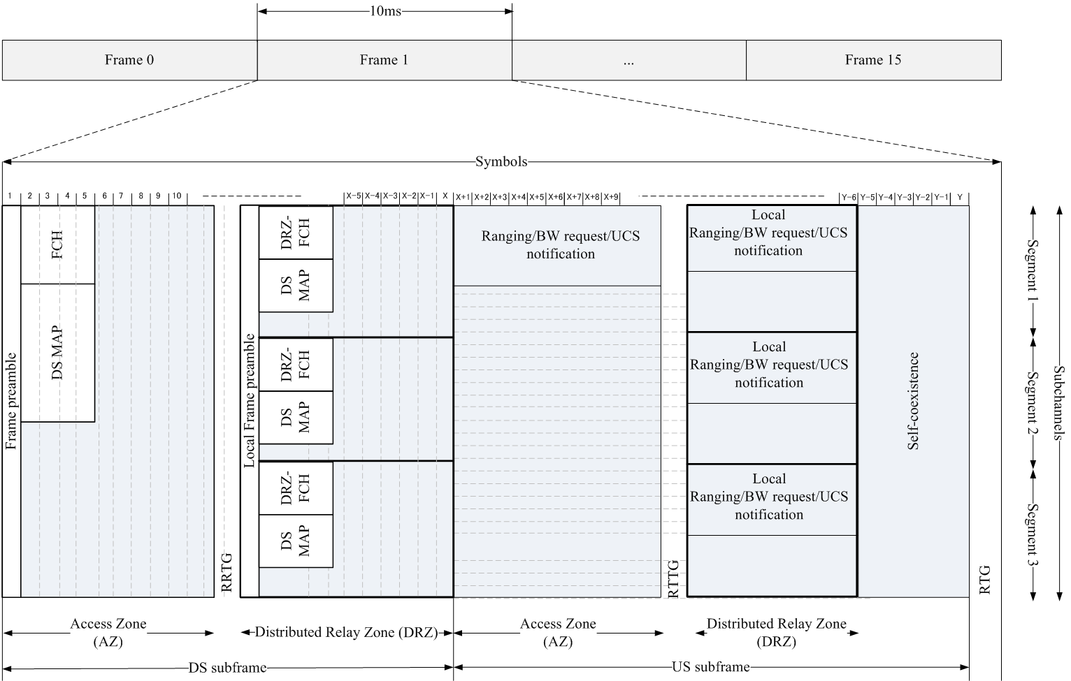
Figure E1 is revised as follows

Slide 34
Proposed Text Modifications
7.4b.1 General frame structure for a centralized relay mode
For a centralized scheduling mode, both of AZs and CRZs in the downstream and upstream subframes are managed by an MR-BS. The AZ of the downstream subframe shall appear earlier than other zones of the AZ of the upstream subframe or the CRZs of the downstream and upstream subframes. Except for the AZ of the downstream, the order of the AZ of the upstream subframe, the CRZ of the downstream subframe, and the CRZ of the upstream subframe in the frame may be changed during the operations.

Slide 35
7.4b.2 General frame structure for a distributed relay mode
The both of AZs and DRZs in the downstream and upstream subframes are scheduled by an MR-BS. For a distributed relay mode, the AZs in the downstream and upstream subframes are managed by an MR-BS, while the DRZs in the downstream and upstream subframes are controlled by a distributed scheduling R-CPE, which is capable of configuring and maintaining a local cell within an 802.22b MR-WRAN cell. The AZ of the downstream subframe shall appear earlier than other zones of the AZ of the upstream subframe or the DRZs of the downstream and upstream subframes. In addition, the DRZ of the downstream subframe shall appear earlier than the DRZ of the upstream subframe since the DRZ of the downstream subframe may contains the management and upstream MAP information of a local cell. Except for the AZ of the downstream, the order of the AZ of the upstream subframe, the CRZ of the downstream subframe, and the CRZ of the upstream subframe in the frame may be changed during the operations.

