Slide 1
IEEE 802.22 - WhiteSpace Enabled Rural Broadband to Cognitive M2M
Dr. Apurva N. Mody,
Chair, IEEE 802.22 Working Group
apurva.mody@ieee.org,
+1-404-819-0314
Dr. Chang-woo Pyo
Vice Chair, IEEE 802.22 WG
www.ieee802.org/22

Slide 2

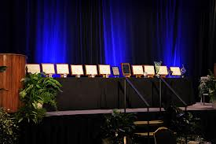
IEEE 802.22 WG on Cognitive Radio Based Wireless Regional Area Networks
IEEE 802.22 WG is the recipient of the IEEE SA Emerging Technology Award
IEEE 802.22 Standard – Wireless Regional Area Networks: Cognitive Radio based Access in TVWS:
Published in July 2011
IEEE SA awards ceremony
802.22.1 – Std for Enhanced Interference Protection using beaconing: Published in Nov. 2010
802.22.2 – Std for Recommended Practice for Deployment of 802.22 Systems: Expected completion - Dec 2012
802.22a – Enhanced Management Information Base and Management Plane Procedures: Expected Completion - Dec. 2013
802.22b Enhancement for Broadband Services and Monitoring Applications
802.22.1a – Advanced Beaconing
www.ieee802.org/22

Slide 3
Providing cost-effective RURAL broadband is a significant opportunity
Today, 73% of the people in the world (5.1 Billion people) do not have access to internet. More than half the population in the world live in rural areas with hardly any access to broadband.
It is expensive to lay fiber / cable in rural and remote areas with low population density.
Wireless broadband powered by license exempt or lightly licensed spectrum can help.
Backhaul / backbone internet access for rural areas is very expensive (50% of the cost). Hence long distance communications technologies are very useful as well.
This has created a DIGITAL DIVIDE / OPPORTUNITY

Slide 4
Relative Cost and Complexity of Various Technologies for Rural and Regional Area Broadband Service
Mobile
broadband
2.4 M
Relative Complexity and Cost (%)
2.0 M
1.6 M
1.2 M
Fixed broadband
at lower frequency
USA
(scaled x0.1066)
Population per density bin (Million)
Canada
0.8 M
0.4 M
0.0 M
4 W Base Station
Satellite
WRAN
100 W Base Station
4 W User terminal
ADSL, Cable, ISM and UNII Wireless and Optical Fiber
FCC Definition of ‘Rural’
Courtesy: Gerald Chouinard: gerald.chouinard@crc.ca
Notes:
Comparison of different Broadband Access technologies with respect to their relative complexity/cost of implementation as a function of the density of population to be served over the territory. Wired technologies (ADSL, cable, fiber) are more suited for areas with a population density of about 60 person/km^2 and above. Wireless microwave technology (Wi-Fi, Wi-MAX, HSPA, LTE) can extend the coverage to areas with somewhat lower population density. However, only wireless technologies operating in the VHF and UHF bands such as the Wireless Regional Area Network technology which is expected to operate on a non-interfering basis in the TV broadcast bands, can extend broadband access in a cost-effective way to rural areas with population density ranging between 1.5 to 60 person per km^2 because of the better RF signal propagation in this frequency range. An industry standard has been developed especially for extending broadband access to rural areas by the IEEE 802.22 Working Group (http://www.ieee802.org/22/). Satellite transmission technology is the only attractive solution for bringing broadband access to areas with population density below about 1.5 person per km^2. However, because of the extent of the propagation path to a geo-stationary satellite on the geo-stationary orbit, all transmissions will have to suffer propagation delays of about 1/3 second.
Based on Canadian population census 2000 using a grid of 3 km radius hexagons.
Based on USA population census of 2000: http://www.census.gov/geo/www/gazetteer/places2k.html
Rural as defined in FCC WT Docket No. 02-381: 100 persons/mile^2 or 38.6 persons/km^2

Slide 5
Spectrum: Optimum frequency range
for large area Non-Line-of-sight Broadband Access
Optimum frequency range for large area Non Line of Sight (NLoS) operation falls within the TV Band spectrum.
Antenna
aperture
Phase
noise
Relative Complexity and Cost (%)
Filter
selectivity
Noise
Figure
Courtesy: Gerald Chouinard: gerald.chouinard@crc.ca

Slide 6
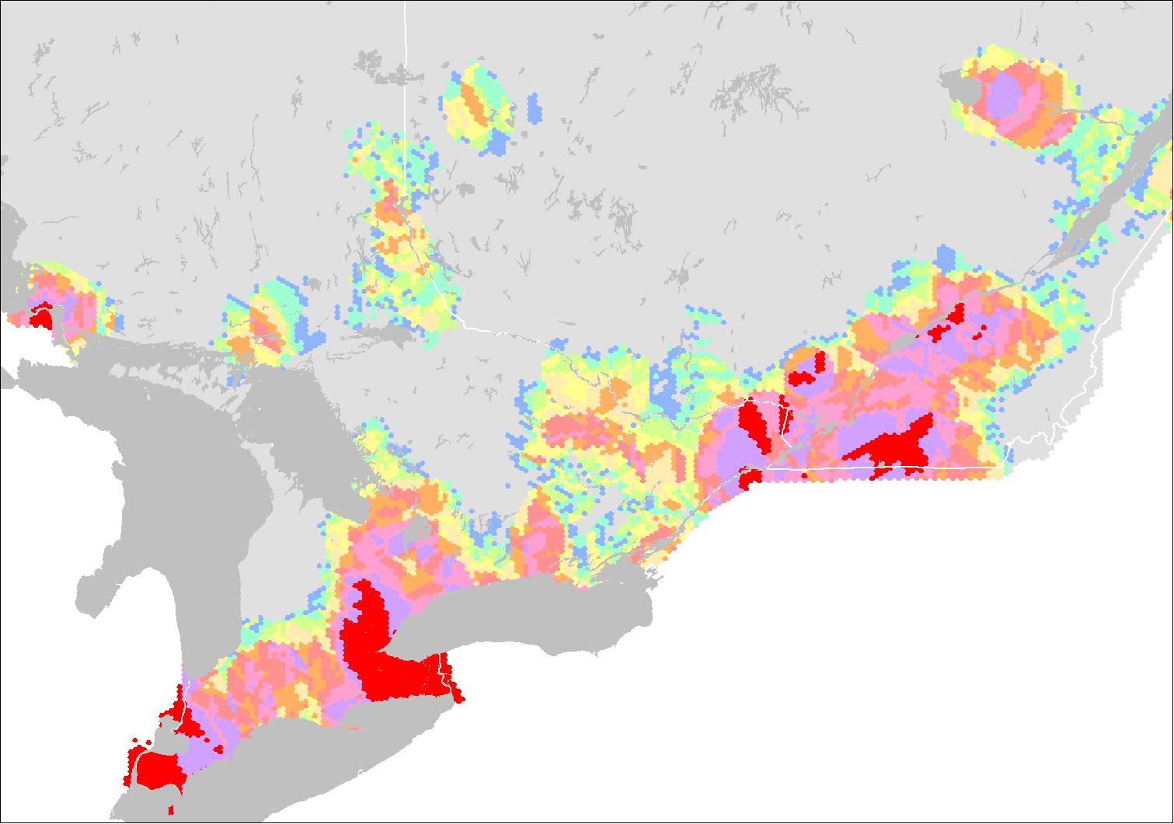

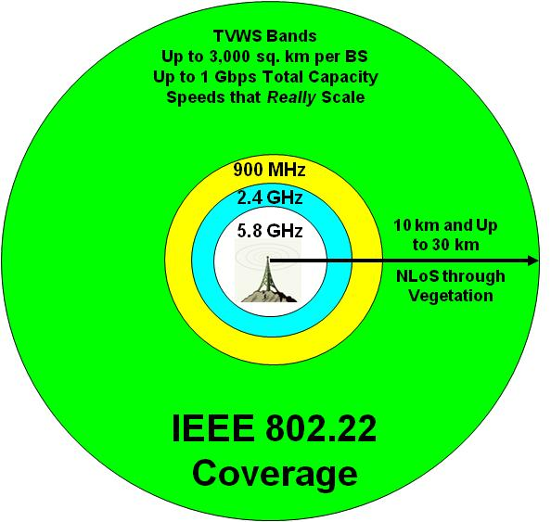
IEEE 802.22 Cognitive Radio based Wireless Regional Area Networks for Broadband over Long Distances
Southern Ontario Canada
Legend
Available TV channels
None
1
2
3
4
5
6
7
8
9
10 and +
Many Channels Available in Rural Areas
Rural Areas
Urban Areas
TV Channel Availability for Broadband
Source: Gerald Chouinard, CRC and Industry Canada
VHF / UHF bands traditionally have highly favorable propagation characteristics. Penetrating through foliage and structures, they reach far and wide
IEEE 802.22 Cognitive radio based Wireless Regional Area Networks provide broadband solutions for large areas and long range

Slide 7
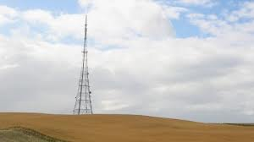
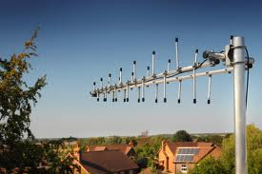

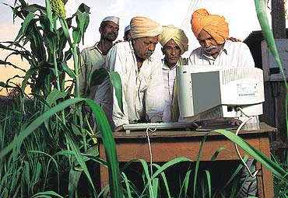
IEEE 802.22 (Wi-FAR) WhiteSpace Applications
BEFORE
Now
Rural Broadband and Backhaul

Slide 8
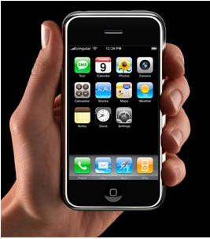
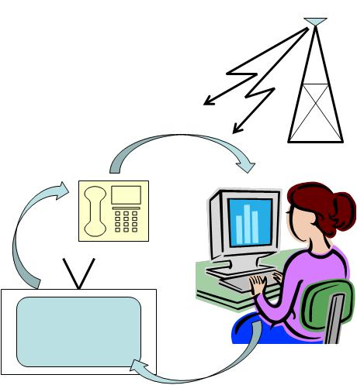

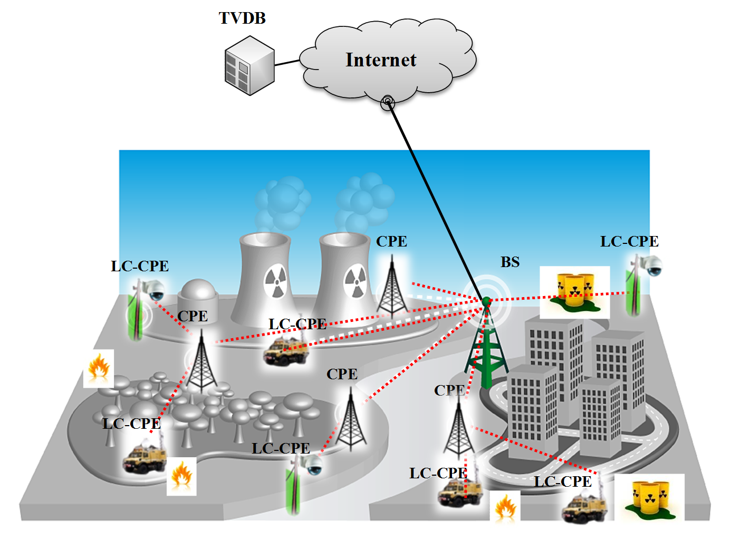

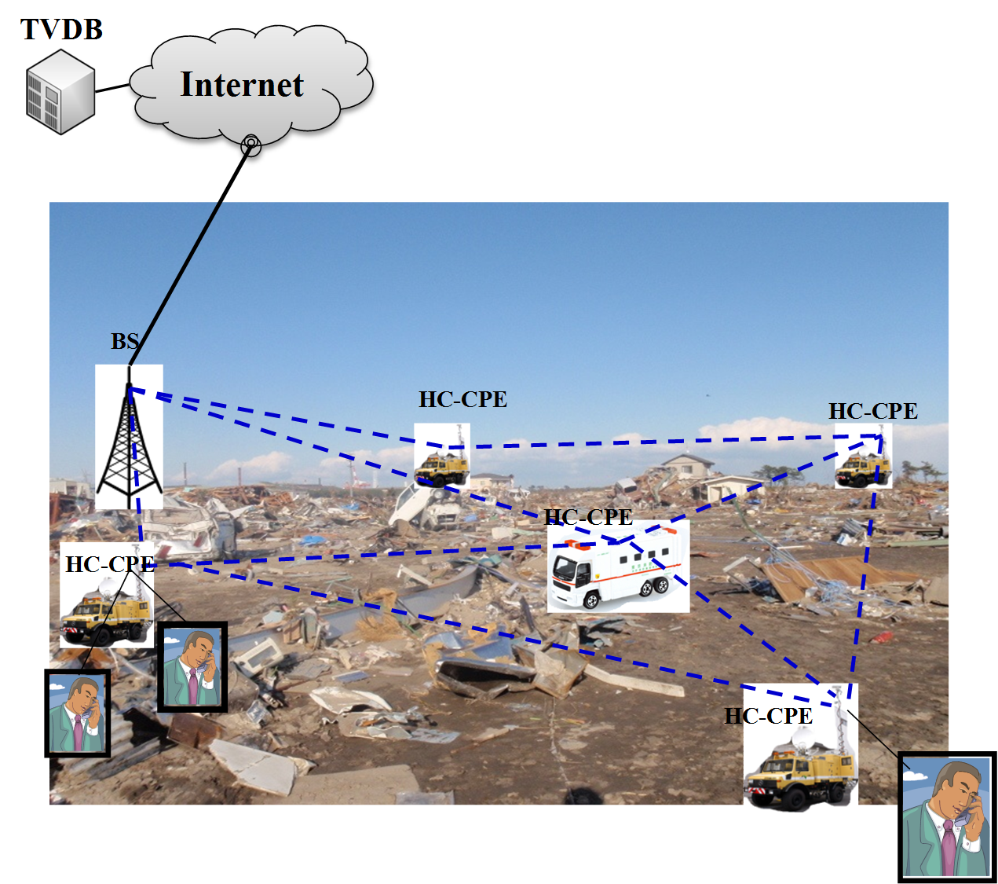
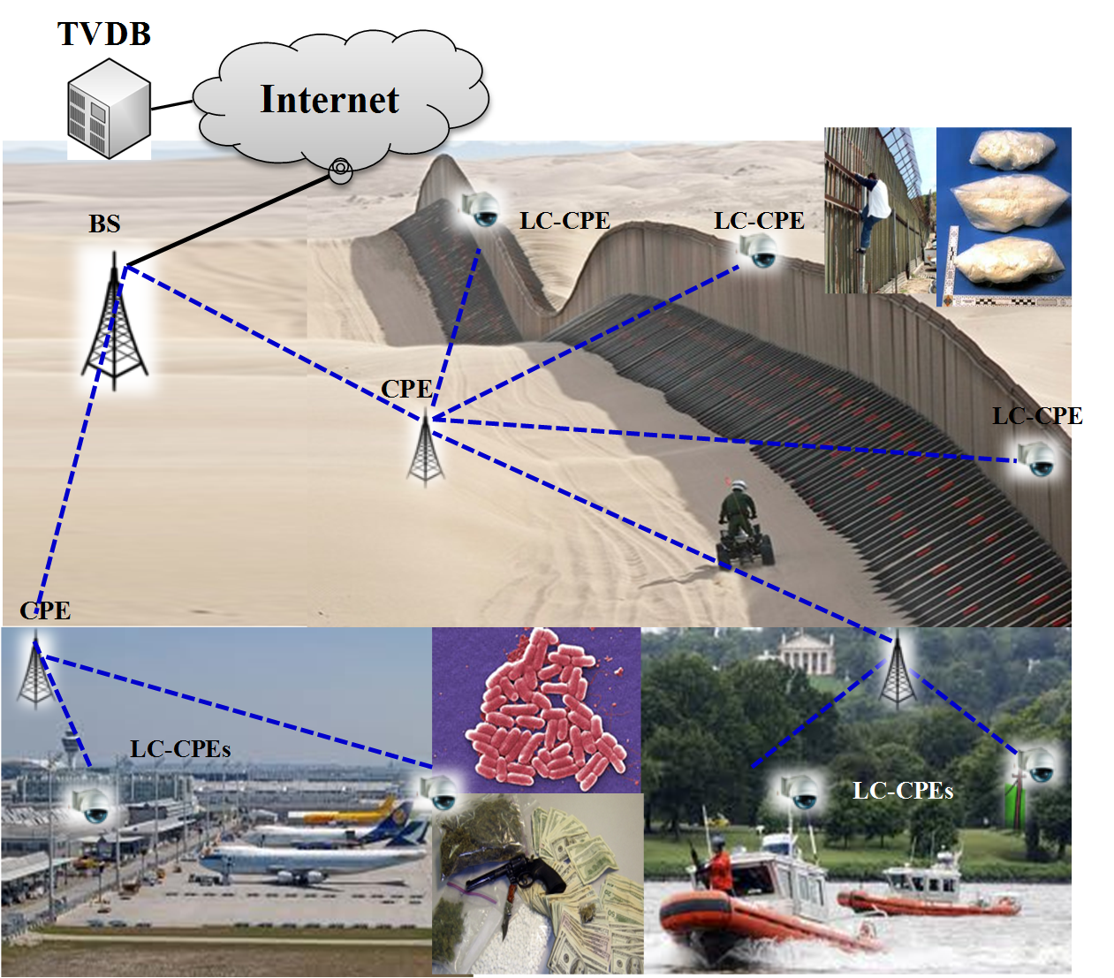
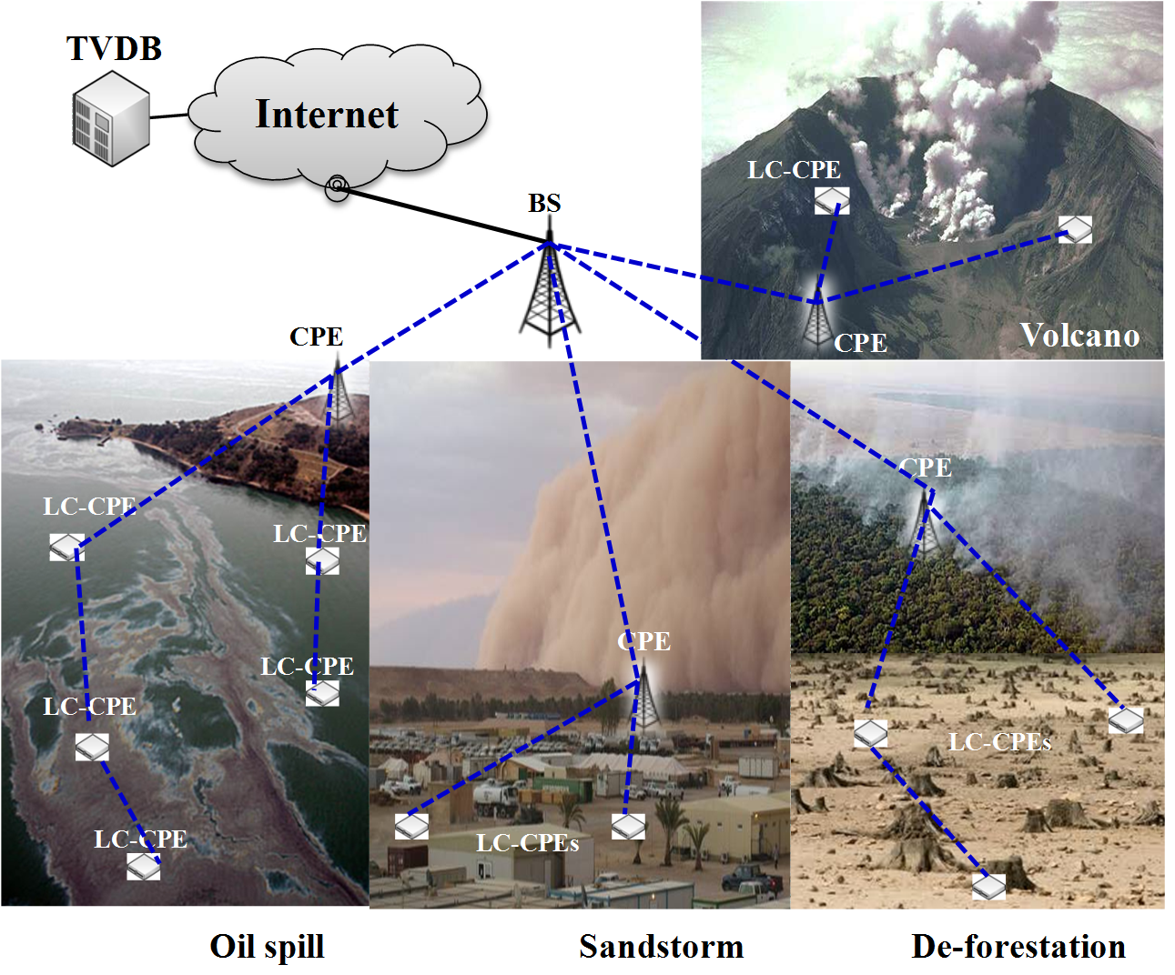
IEEE 802.22 WhiteSpace Applications
Tripple play
Cellular offload
Critical infrastructure monitoring
Border protection
Environment monitoring
Emergency broadband infrastructure

Slide 9
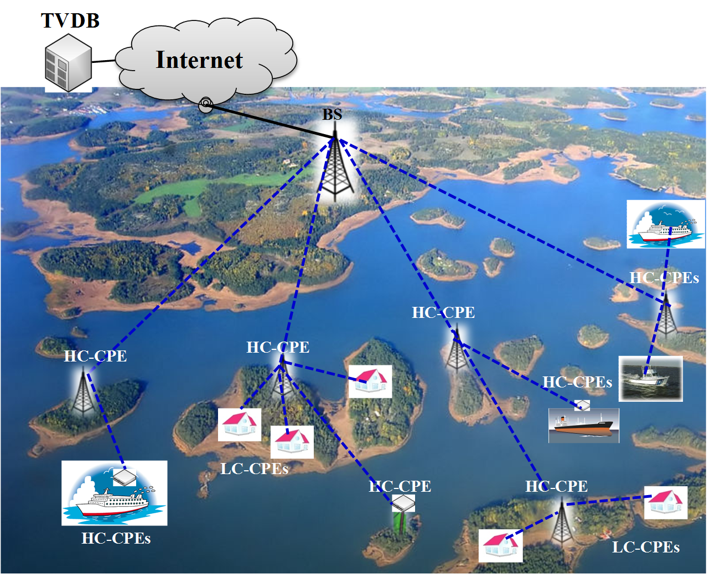
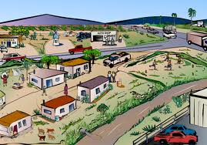
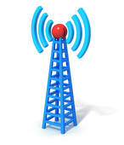

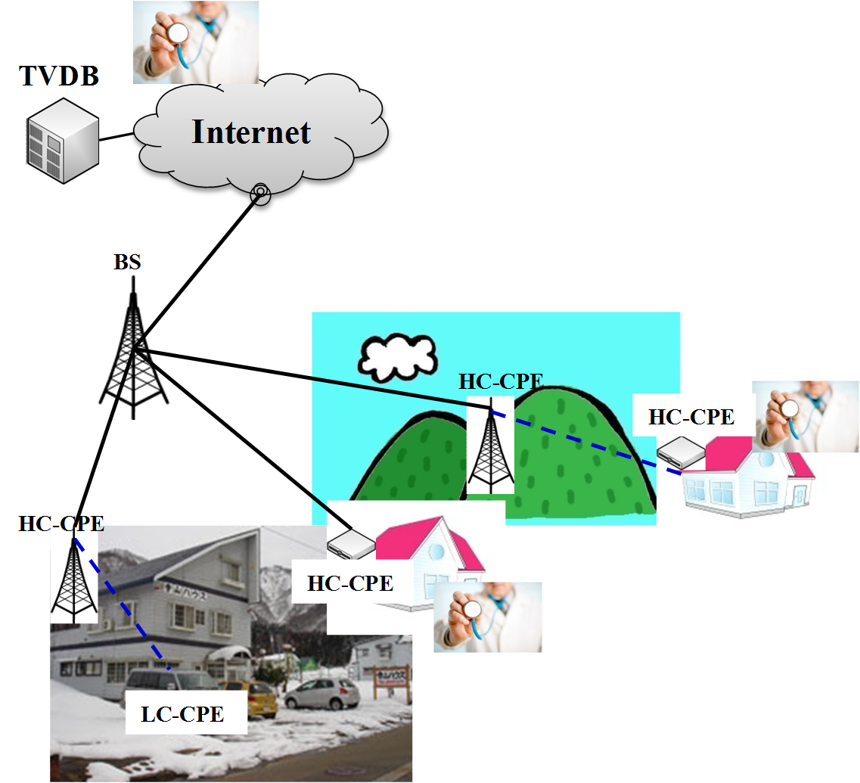
IEEE 802.22 WhiteSpace Applications
IEEE 802.11
IEEE 802.11
Backhaul
IEEE 802.22
Rural Area
Archipelago and marine broadband service. Servicing oil rigs
Urban Area
IEEE 802.22 used for Backhaul
Remote medical service
C. W. Pyo, A. Mody et al. Use Cases for IEEE 802.22 (Wi-FAR(TM)) Smart Grid and Critical Infrastructure Monitoring

Slide 10
TV Channel Modeling – IEEE 802.22 (Wi-FAR™ supports large multi-path delay absorption
Long distance communication in the VHF/ UHF Band needs to deal with severe multipath and delay spread conditions
Frequency selective with large excessive delay
  Excessive delay (measurements in US, Germany, France*)
    Longest delay: >60 μsec
    85% test location with delay spread ~35 μsec
  Low frequency (54~862 MHz)
  Long range (up to 100 km)
  Slow fading
    Small Doppler spread
    (up to a few Hz)
* WRAN Channel Modeling, IEEE802.22-05/0055r7, Aug 05
Information provided by TV Broadcasters

Slide 11
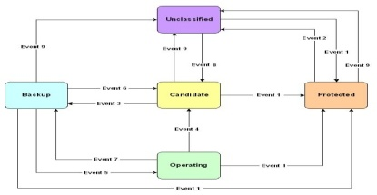
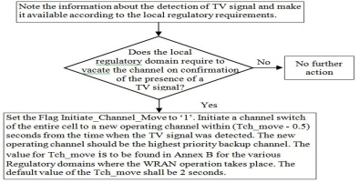
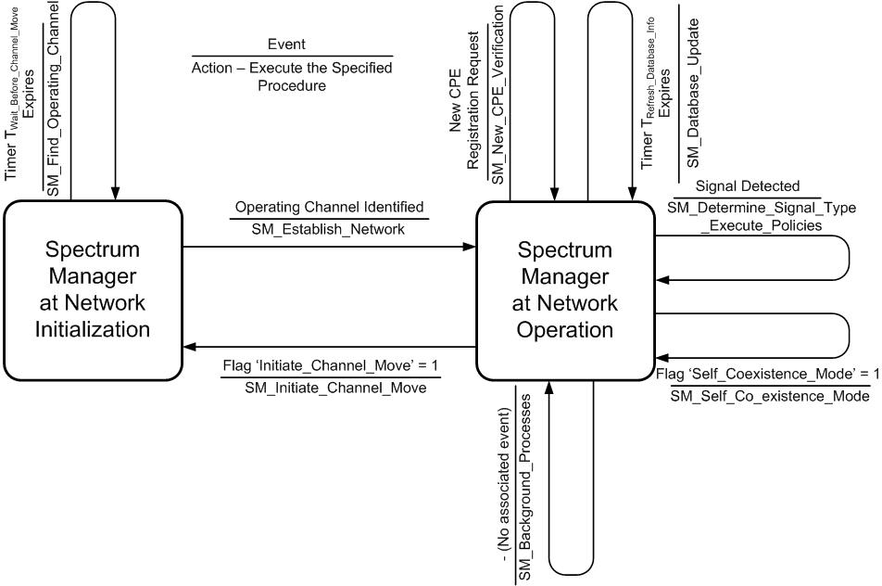
IEEE 802.22 (Wi-FAR™) – Cognitive Radio Capability
Channel Set Management
Subscriber Station Registration and Tracking
Policies
Spectrum Manager
Geo-location
Self Co-existence
Incumbent Database Service
Spectrum Sensing
Incumbent
Database

Slide 12
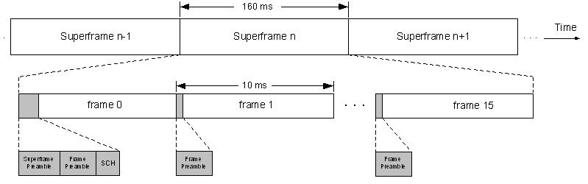
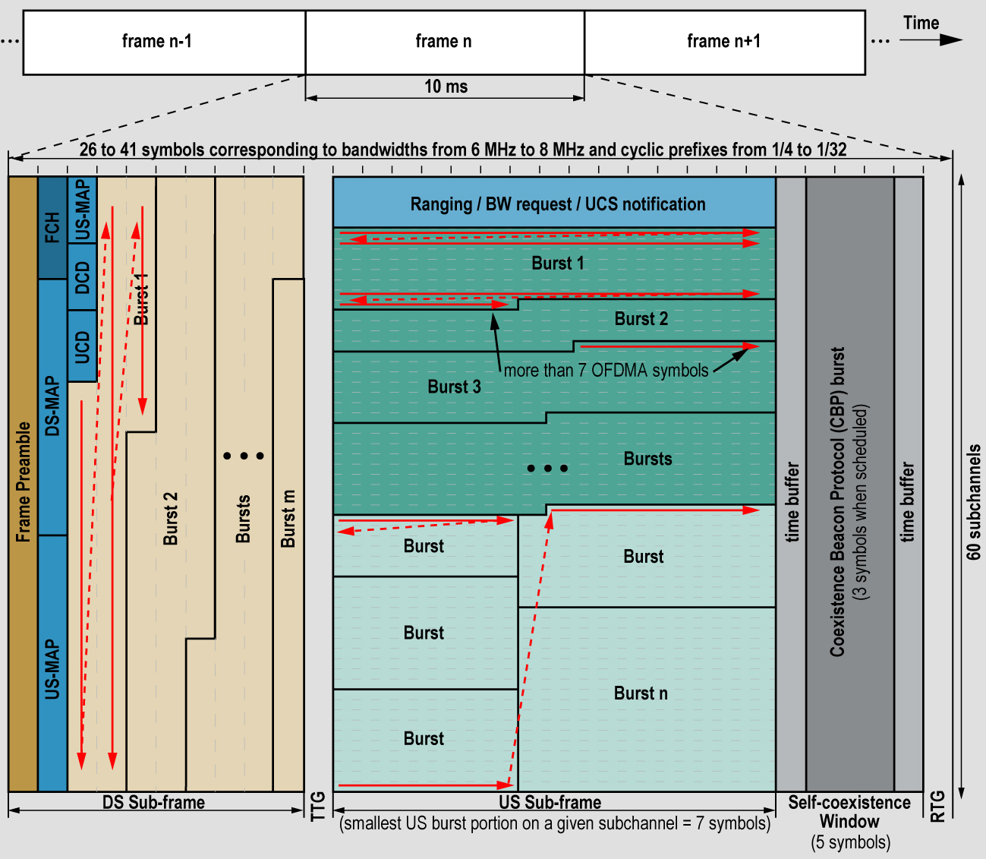
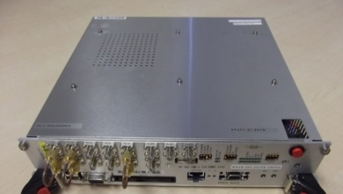
IEEE 802.22 (Wi-FAR™) – Frame Structure
Time Division Duplex (TDD) frame structure Super-frame: 160 ms, Frame: 10 ms
OFDM/ OFDMA Transport
QPSK up to 64 QAM modulation supported
Convolutional codes and other advanced codes supported
Throughput: 22-29 Mbps per TV channel WITH NO MIMO. MIMO and channel bonding increase the throughput
Spectral Efficiency: 0.624 – 3.12 bits / sec / Hz
Distance: 10 km minimum. Upto 30 km and even 100 kms
MAC supports Cognitive Radio features
Self-coexistence Window (SCW): BS commands subscribers to send out CBPs for 802.22
IEEE 802.22 prototypes are being announced
Co-existence Beacon Protocol (CBP) burst used for 802.22 self co-existence and terrestrial geo-location

Slide 13

Cognitive Machine to Machine (CM2M)
50 Billion machine to machine devices will be deployed by 2020

Slide 14
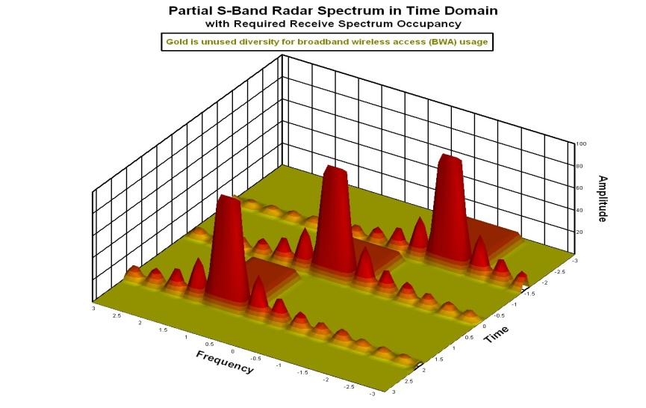

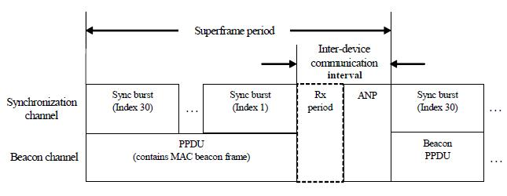
IEEE 802.22.1 Advanced Beaconing: Radar and Commercial Comms Spectrum Sharing in 3550-3650 bands
How will it Work: The designed beacon will contain Peace Time temporal patterns of the radars which when combined with some universal time clock such as GPS can help commercial communications systems to use the empty time slots for their operation.
During Emergency Situations, the beacon will send Urgent Co-existence request, to ask all the commercial systems to shut down immediately. Security features for such beacons are very important. IEEE Std, 802.22.1-2010 has incorporated many such security mechanisms that may be applied to the 3550-3650 band relatively readily.
IEEE 802.22.1 Like Beacon may operate in the same band or even UHF Band
Current IEEE 802.22.1 beacon protocol contains many security Features already
Radar Pulses
This approach can open as much as 600 MHz of Spectrum in the S-Band

Slide 15
IEEE 802.22 (Wi-FAR™) Unique Proposition
First IEEE Standard for operation in Television Whitespaces
First IEEE Standard that is specifically designed for rural and regional area broadband access aimed at removing the digital divide
First IEEE Standard that has all the Cognitive Radio features
IEEE 802.22 (Wi-FAR™) provides Broadband Wireless Access to Regional, Rural and Remote Areas Under Line of Sight (LoS) and Non Line of Sight (NLoS) Conditions using Cognitive Radio Technology (without causing harmful interference to the incumbents).
Cognitive Radio technology added to a simple and optimized OFDMA waveform (similar to the OFDMA technology used in other broadband standards
Each IEEE 802.22 (Wi-FAR™) cell can provide 22 to 29 Mbps per TV Channel and provide support for 512 devices.
Enhancements to the IEEE 802.22 are currently under way in several amendments.

Slide 16
References
IEEE 802.22 Working Group Website – www.ieee802.org/22, IEEE Std. 802.22-2011
Apurva Mody, Gerald Chouinard, “Overview of the IEEE 802.22 Standard on Wireless Regional Area Networks (WRAN) and Core Technologies” http://www.ieee802.org/22/Technology/22-10-0073-03-0000-802-22-overview-and-core-technologies.pdf
PCAST Report – Report to the President – Realizing Full Potential of the Govt. held Spectrum to Spur Economic Growth http://www.whitehouse.gov/sites/default/files/microsites/ostp/pcast_spectrum_report_final_july_20_2012.pdf
Richard Thanki, Economic Significance of License-exempt Spectrum.
United States Federal Communications Commission – www.fcc.gov
United Kingdom Office of Communications (OfCom) - www.ofcom.org.uk
UK OfCom presentation on Geolocation issues - https://mentor.ieee.org/802.18/dcn/10/18-10-0042-00-0000-ofcom-presentation-on-gelocation-issues.pptx
UK OfCom update on TVWS issues https://mentor.ieee.org/802.18/dcn/09/18-09-0118-00-0000-ofcom-update-on-the-tv-white-space-issues.ppt
Ministry of Internal Affairs and Communications, Japan, http://www.soumu.go.jp/main_sosiki/joho_tsusin/eng/Releases/Telecommunications/110408_b.html

Slide 17
Backups

Slide 18
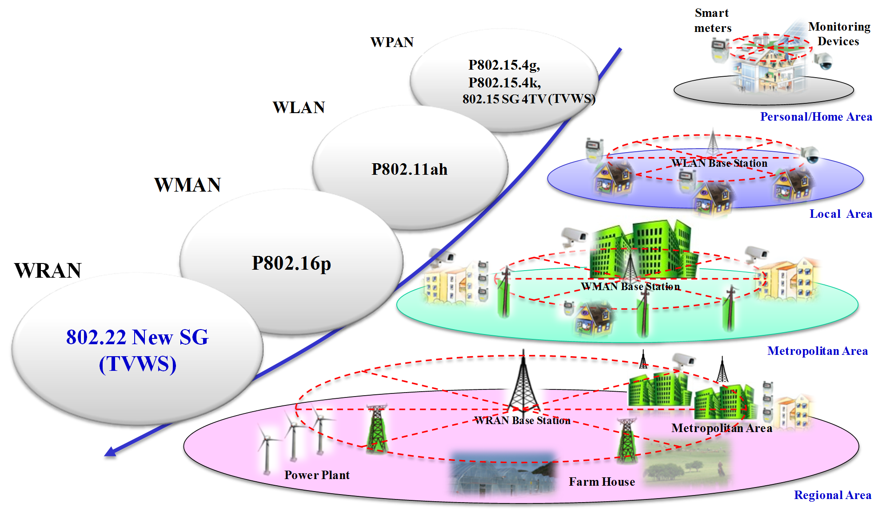
IEEE 802 Standardization Activities in Television White Spaces
More than $125M invested in creating TV WhiteSpace Standards
IETF Standardization on Database Access (IETF PAWS)
COEXISTENCE
802.19.1
(On going)
802.15.4m
802.11AF
802.16h Applicable to TVWS
(Completed)
802.22
EEE
802

Slide 19
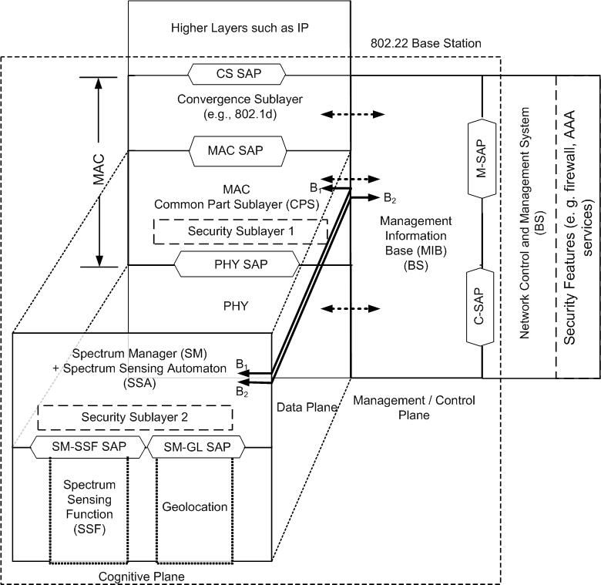
IEEE 802.22 (Wi-FAR™)
Cognitive Node: Reference Architecture
IEEE 802.22 (Wi-FAR™) Provides Three Mechanisms for Incumbent Protection
Sensing
Database Access
Specially Designed Beacon
Security Sub-layers are introduced to protect non-cognitive as well as cognitive functions
Cognitive Plane is used to control the Cognitive Radio Operation. Security Sublayer 2 is introduced for protection against Cognitive Threats

Slide 20
IEEE 802.22 (Wi-FAR™) Standard – a solution for rural broadband and cognitive M2M applications
IEEE 802.22 (Wi-FAR™) provides Broadband Wireless Access to Regional, Rural and Remote Areas Under Line of Sight (LoS) and Non Line of Sight (NLoS) Conditions using Cognitive Radio Technology (without causing harmful interference to the incumbents).
Cognitive Radio technology added to a simple and optimized OFDMA waveform (similar to the OFDMA technology used in other broadband standards
Meets all the regulatory requirements such as protection of incumbents, access to the database, accurate geolocation, spectrum mask, control of the EIRP etc.
Large regional area foot print can allow placement of the Base Station closer to the area with cheaper internet backhaul / backbone.

Slide 21
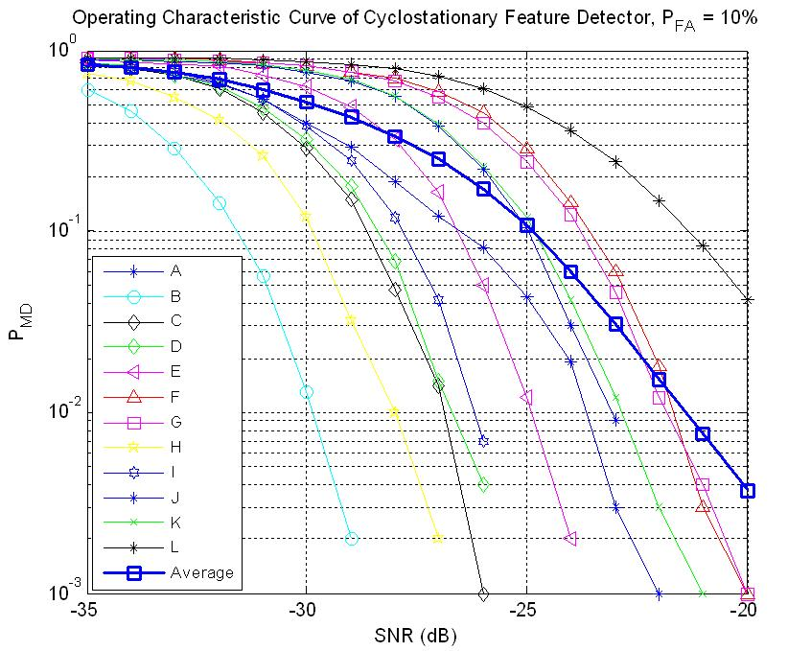
IEEE 802.22 (Wi-FAR™) – Spectrum Sensing
TV and Wireless Microphone Protection Using Spectrum Sensing- Several blind and signal specific feature-based sensing schemes have been proposed and thoroughly evaluated using TV Broadcaster supplied over-the-air collected signals
  Spectral correlation based sensing,
  Time domain cyclostationarity,
  Eigen value based sensing,
  FFT – based pilot sensing,
  Higher order statistics based sensing, etc.
Pd = >99%, Pfa = 10%, -20dB
Wireless Microphone Protection Using Beacon
Many studies have suggested that FCC R&O target for wireless microphones is not sufficient to protect wearable microphones (where body attenuation of as much as 27dB is possible according to the manufacturers)
802.22 has designed a beacon signal which will be transmitted from wireless microphone operations with up to 250 mW (as compared to 10 mW for microphones). These beacon signals consist of repeated pseudo-noise (PN) sequences and occupy a bandwidth of 78 kHz.
Security features are provided for beacon authentication
DTV Detection Results based Cyclostationary Feature Detection
-114 dBm
Wireless Microphone Beacon Sensing Results

