Slide 1
802.22b Network Configuration and Definitions
IEEE P802.22 Wireless RANs Date: 2013-3-07
Authors:
Notice: This document has been prepared to assist IEEE 802.22. It is offered as a basis for discussion and is not binding on the contributing individual(s) or organization(s). The material in this document is subject to change in form and content after further study. The contributor(s) reserve(s) the right to add, amend or withdraw material contained herein.
Release: The contributor grants a free, irrevocable license to the IEEE to incorporate material contained in this contribution, and any modifications thereof, in the creation of an IEEE Standards publication; to copyright in the IEEE’s name any IEEE Standards publication even though it may include portions of this contribution; and at the IEEE’s sole discretion to permit others to reproduce in whole or in part the resulting IEEE Standards publication. The contributor also acknowledges and accepts that this contribution may be made public by IEEE 802.22.
Patent Policy and Procedures: The contributor is familiar with the IEEE 802 Patent Policy and Procedures
<http://standards.ieee.org/guides/bylaws/sb-bylaws.pdf>, including the statement "IEEE standards may include the known use of patent(s), including patent applications, provided the IEEE receives assurance from the patent holder or applicant with respect to patents essential for compliance with both mandatory and optional portions of the standard." Early disclosure to the Working Group of patent information that might be relevant to the standard is essential to reduce the possibility for delays in the development process and increase the likelihood that the draft publication will be approved for publication. Please notify the Chair Apurva Mody <apurva.mody@ieee.org> as early as possible, in written or electronic form, if patented technology (or technology under patent application) might be incorporated into a draft standard being developed within the IEEE 802.22 Working Group. If you have questions, contact the IEEE Patent Committee Administrator at <patcom@ieee.org>.

Slide 2
Abstract
This document provides the 802.22b network configuration and definitions related with the network

Slide 3
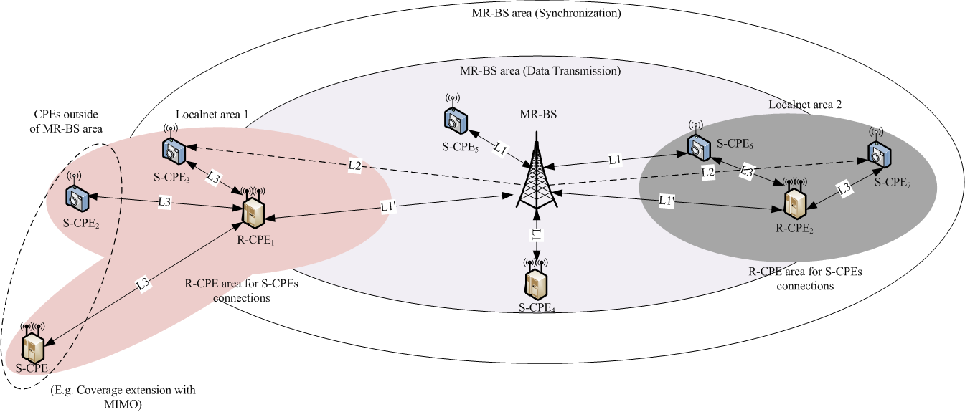
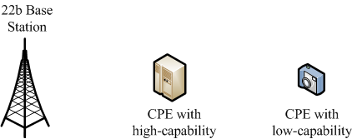
802.22b Network Configuration

Slide 4
Definitions
3.4 base station (BS): Generalized equipment set providing connectivity, management and control of the customer premise equipment (CPE). The functionalities attributed to the BS, in the context of this standard, may be implemented by a device or a collection of devices.
3.4a multihop relay base station (MR-BS): Generalized equipment set providing connectivity, management and control of the relay customer premise equipments (R-CPEs) and subscriber CPEs (S-CPEs). See also: base station (BS), relay customer premise equipment (R-CPE). The functionalities attributed to the MR-BS, in the context of this standard, may be implemented by a device or a collection of devices.
3.16 customer premise or portable equipment (CPE): A generalized equipment set providing connectivity between a BS and a subscriber premise.
3.16a relay customer premise or portable equipment (R-CPE): A generalized equipment set, dependent on a multihop relay base station (MR-BS) providing connectivity, to subscriber customer premise equipments (S-CPEs). An R-CPE may also provide management and control of subordinate S-CPEs. The air interface between an R-CPE and an S-CPE is identical to the air interface between a BS and a CPE.
3.16a.1 centralized scheduling: A mode of operation applicable to multihop relay where a multihop relay BS (MR-BS) determines the bandwidth allocations and generates the corresponding MAPs [or dictates the information used by relay CPEs (R-CPEs) to generate their MAPs] for all access and relay links in the WRAN cell.
3.16a.2 distributed scheduling: A mode of operation applicable to multihop relay where each R-CPE in the WRAN cell (with or without information from the MR-BS) determines the bandwidth allocations and generate the corresponding MAPs for the access link to/from its S-CPEs
3.16a subscribe customer premise or portable equipment (S-CPE): A generalized equipment set providing connectivity between a subscriber premise and an MR-BS or an R-CPE.
3.x relay link (R-link): A radio link between an MR-BS and an R-CPE. This can be a relay uplink or downlink.

Slide 5
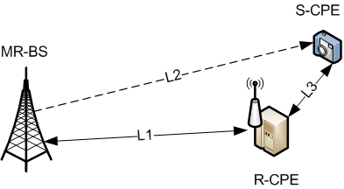
Centralized Scheduling
Centralized scheduling mode
All frame scheduling for the connections of L1, L2 and L3 are performed by MR-BS
R-CPE on centralized scheduling mode is performed as a relay node
1. Scheduling Info.
2. Data
1. Scheduling Info.
(Centralized scheduling mode)
2. Data

Slide 6
Distributed Scheduling
Distributed scheduling mode
Frame scheduling for the connection of L3 is performed by R-CPE
R-CPE on distributed scheduling mode is performed as a local BS
1. Scheduling Info.
2. Data
(Distributed scheduling mode)

Slide 7
802.22b Node Capability
Nodes | Supported Capabilities
High-capability node may have all or some of following capabilities | Network management functionality Relay operation functionality MIMO High power Geolocation etc.
Low-capability node | Subscriber only No-relay SISO Low power No geolocation etc.

Slide 8
802.22b Nodes on Capability
 | MR-BS | R-CPE |  | S-CPE
 |  | Centralized Scheduling | Distributed Scheduling
Network Mgmt. | 〇 | ✖ | 〇 | ✖
Relaying | - | 〇 | 〇 | ✖
MIMO | 〇 | 〇 | 〇 | △
Power | Higher | High | High | Low/High
Geolocation | 〇 | 〇 | 〇 | ✖
Etc.
802.22b Nodes on Capability | High-capability node (Specific product designed for MR-BS) | High-capability node with relay | High-capability node with relay and net. mgmt | High-capability node with MIMO or Low-capacity node
 | 22b BS | H-CPE | H-CPE | L-CPE/H-CPE

Slide 9
Communication Links
Link 1 (L1)
Bi-directional link
Available uplink and downlink between MR-BS and R-CPE/S-CPE
E.g., MR-BS <-> R-CPE, MR-BS <-> S-CPE
L1’ : Relay link (MR-BS <-> R-CPE)
Link 2 (L2)
Uni-directional link
Available downlink only from MR-BS to S-CPEs
Link 3 (L3)
Bi-directional link within a local network
Available uplink and downlink between R-CPE and S-CPEs within a local network

Slide 10
Supported links inside of a MR-BS area
May support all links of L1(L1’), L2 and L3
Supported links outside of a MR-BS area
Support L3 only

Slide 11
Supported MAC Operations on Links
Link 1 (L1/L1’)
All MAC operations
Synchronization
Initial ranging, periodic ranging
Registration
Downstream and Upstream
Link 2 (L2)
PHY Synchronization (preamble synchronization)
MAC Synchronization (MAP detection)
Downstream from MR-BS
Link 3 (L3)
All MAC operations within a local network
Local Synchronization
Local initial ranging, periodic ranging
Local registration
Local downstream and upstream

Slide 12
Possible Communications
L1 only communications (CC1)
Same as a legacy 802.22
L2 only communications
Not available since there is no uplink
L3 only communications
Not available since there is no down/uplink to MR-BS
L1 and L2 only communications
Include CC1
L2 and L3 only communications
Not available since there is no uplink to MR-BS

Slide 13
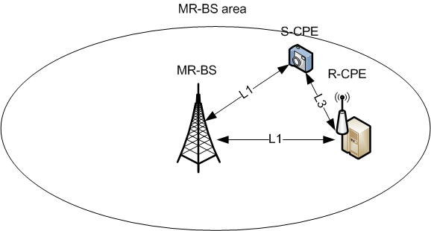
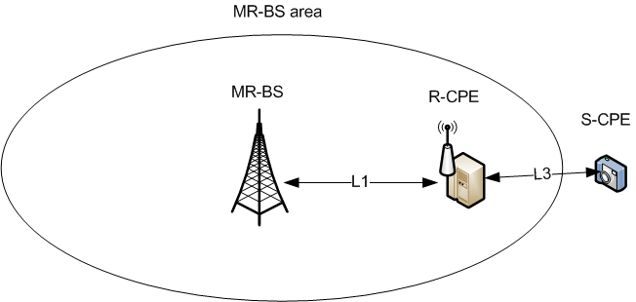
L1 and L3 only communications
When S-CPE is located inside of MR-BS area
Centralized scheduling or distributed scheduling mode is available depending on network conditions
Centralized scheduling mode (CC2)
Distributed scheduling (CC3)
When S-CPE is located outside of MR-BS area (CC4)
Distributed scheduling mode is only available since S-CPE can not synchronize to MR-BS
R-CPE shall perform as a local BS
Example of CC2 or CC3
Example of CC4

Slide 14
L1, L2 and L3 communications
Is only available for S-CPE to locate inside of MR-BS
Centralized scheduling or distributed scheduling mode is available depending on network conditions
Centralized scheduling mode (CC5)
Distributed scheduling (CC6)
Relay uplink is only available from S-CPE to MR-BS
Example of CC5 or CC6

Slide 15
Communication Cases | Scheduling mode | Links | Locations | R-CPE | Note
CC1 | Centralized mode | L1 | Inside of MR-BS area | No R-CPE | Legacy 22
CC2 | Centralized mode | L1 and L3 | Inside of MR-BS area | Relay R-CPE | 22b
CC3 | Distributed mode | L1 and L3 | Inside of MR-BS area | R-CPE as Local BS | 22b
CC4 | Distributed mode | L1 and L3 | Outside of MR-BS area | R-CPE as Local BS | 22b
CC5 | Centralized mode | L1, L2 and L3 | Inside of MR-BS area | Relay R-CPE | 22b
CC6 | Distributed mode | L1, L2 and L3 | Inside of MR-BS area | R-CPE as Local BS | 22b

