Slide 1
802.22b Network Configuration and Definitions
IEEE P802.22 Wireless RANs Date: 2013-3-07
Authors:
Notice: This document has been prepared to assist IEEE 802.22. It is offered as a basis for discussion and is not binding on the contributing individual(s) or organization(s). The material in this document is subject to change in form and content after further study. The contributor(s) reserve(s) the right to add, amend or withdraw material contained herein.
Release: The contributor grants a free, irrevocable license to the IEEE to incorporate material contained in this contribution, and any modifications thereof, in the creation of an IEEE Standards publication; to copyright in the IEEE’s name any IEEE Standards publication even though it may include portions of this contribution; and at the IEEE’s sole discretion to permit others to reproduce in whole or in part the resulting IEEE Standards publication. The contributor also acknowledges and accepts that this contribution may be made public by IEEE 802.22.
Patent Policy and Procedures: The contributor is familiar with the IEEE 802 Patent Policy and Procedures
<http://standards.ieee.org/guides/bylaws/sb-bylaws.pdf>, including the statement "IEEE standards may include the known use of patent(s), including patent applications, provided the IEEE receives assurance from the patent holder or applicant with respect to patents essential for compliance with both mandatory and optional portions of the standard." Early disclosure to the Working Group of patent information that might be relevant to the standard is essential to reduce the possibility for delays in the development process and increase the likelihood that the draft publication will be approved for publication. Please notify the Chair Apurva Mody <apurva.mody@ieee.org> as early as possible, in written or electronic form, if patented technology (or technology under patent application) might be incorporated into a draft standard being developed within the IEEE 802.22 Working Group. If you have questions, contact the IEEE Patent Committee Administrator at <patcom@ieee.org>.

Slide 2
Abstract
This document provides the 802.22b network configuration and definitions related with the network

Slide 3
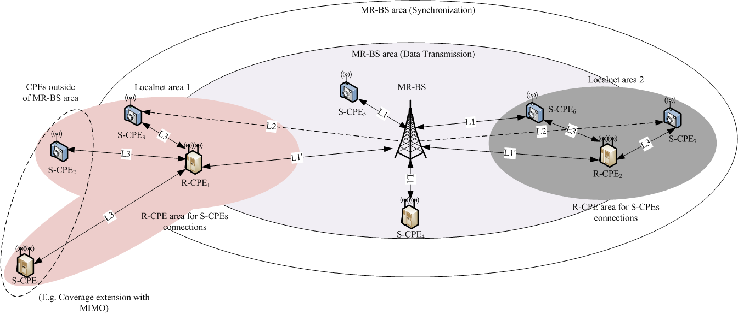
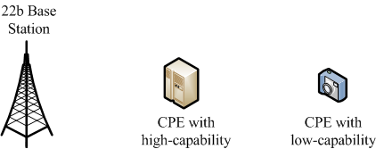
802.22b Network Configuration

Slide 4
Definitions
3.4 base station (BS): Generalized equipment set providing connectivity, management and control of the customer premise equipment (CPE). The functionalities attributed to the BS, in the context of this standard, may be implemented by a device or a collection of devices.
3.4a multihop relay base station (MR-BS): Generalized equipment set providing connectivity, management and control of the relay customer premise equipments (R-CPEs) and subscriber CPEs (S-CPEs). See also: base station (BS), relay customer premise equipment (R-CPE). The functionalities attributed to the MR-BS, in the context of this standard, may be implemented by a device or a collection of devices.
3.16 customer premise or portable equipment (CPE): A generalized equipment set providing connectivity between a BS and a subscriber premise.
3.16a relay customer premise or portable equipment (R-CPE): A generalized equipment set, dependent on a multihop relay base station (MR-BS) providing connectivity, to subscriber customer premise equipments (S-CPEs). An R-CPE may also provide management and control of subordinate S-CPEs. The air interface between an R-CPE and an S-CPE is identical to the air interface between a BS and a CPE.
3.16a subscribe customer premise or portable equipment (S-CPE): A generalized equipment set providing connectivity between a subscriber premise and an MR-BS or an R-CPE.
3.x relay link (R-link): A radio link between an MR-BS and an R-CPE. This can be a relay uplink or downlink.

Slide 5
802.22b Nodes on Capability
Nodes | Supported Capabilities
High-capability node may have all or some of following capabilities | Network management functionality Relay operation functionality MIMO High power etc.
Low-capability node | Subscriber only No-relay SISO Low power etc.
802.22b Nodes on Capability
 | MR-BS | R-CPE | S-CPE
Capability | High-capability node only (Specific product designed for MR-BS) | High-capability node with relay | High-capability node
 |  |  | Low-capability node

Slide 6
Communication Links
Link 1 (L1)
Bi-directional link
Available uplink and downlink between MR-BS and R-CPE/S-CPE
E.g., MR-BS <-> R-CPE, MR-BS <-> S-CPE
L1’ : Relay link (MR-BS <-> R-CPE)
Link 2 (L2)
Uni-directional link
Available downlink only from MR-BS to S-CPEs
Link 3 (L3)
Bi-directional link within a local network
Available uplink and downlink between R-CPE and S-CPEs within a local network

Slide 7
Supported links inside of a MR-BS area
May support all links of L1(L1’), L2 and L3
Supported links outside of a MR-BS area
Support L3 only

Slide 8
Supported MAC Operations on Links
Link 1 (L1/L1’)
All MAC operations
Synchronization
Initial ranging, periodic ranging
Registration
Downstream and Upstream
Link 2 (L2)
PHY Synchronization (preamble synchronization)
MAC Synchronization (MAP detection)
Downstream from MR-BS
Link 3 (L3)
All MAC operations within a local network
Local Synchronization
Local Initial ranging, periodic ranging
Local Registration
Local Downstream and Upstream

