Slide 1
Link Budget Calculation for NICT proposal (22-12-0090-03-000b)
IEEE P802.22b Wireless RANs Date: 2012-12-05
Authors:
Notice: This document has been prepared to assist IEEE 802.22. It is offered as a basis for discussion and is not binding on the contributing individual(s) or organization(s). The material in this document is subject to change in form and content after further study. The contributor(s) reserve(s) the right to add, amend or withdraw material contained herein.
Release: The contributor grants a free, irrevocable license to the IEEE to incorporate material contained in this contribution, and any modifications thereof, in the creation of an IEEE Standards publication; to copyright in the IEEE’s name any IEEE Standards publication even though it may include portions of this contribution; and at the IEEE’s sole discretion to permit others to reproduce in whole or in part the resulting IEEE Standards publication. The contributor also acknowledges and accepts that this contribution may be made public by IEEE 802.22.
Patent Policy and Procedures: The contributor is familiar with the IEEE 802 Patent Policy and Procedures http://standards.ieee.org/guides/bylaws/sb-bylaws.pdf including the statement "IEEE standards may include the known use of patent(s), including patent applications, provided the IEEE receives assurance from the patent holder or applicant with respect to patents essential for compliance with both mandatory and optional portions of the standard." Early disclosure to the Working Group of patent information that might be relevant to the standard is essential to reduce the possibility for delays in the development process and increase the likelihood that the draft publication will be approved for publication. Please notify the Chair
Wendong Hu as early as possible, in written or electronic form, if patented technology (or technology under patent application) might be incorporated into a draft standard being developed within the IEEE 802.22 Working Group. If you have questions, contact the IEEE Patent Committee Administrator at patcom@iee.org.

Slide 2
Abstract
This contribution presents a link budget calculation specifically tailored for NICT proposal (22-12-0090-03-000b) for IEEE 802.22b task group for an estimation of maximum communication range provided by the proposal.
In practice, a 802.22b system should be designed to cover an area by around 10 km in direct communication. While, a 802.22b can support a regional area as it can be supported by a legacy 802.22 system

Slide 3
Assumption
LOS propagation model (ITU-R Rec. P.1546-1 model) is considered [1]. (Location probability= 50%, time probability = 99.9% )
Transmitter PSD emission limit follows FCC Third MO&O
H-CPE, L-CPE and base station follow the following settings.
Assume there is a penetration loss (approx 10 dB) when signal is travelled from indoor to outdoor or vice versa.
Assume fade margin to be 20 dB [2], which allows for a more robust transmission.
 | H-CPE | L-CPE | Base Station
Max EIRP (dBm) | 30 | 30 | 36
Antenna Height AGL (m) | 1~30 | 1~30 | 30
Mode | fixed | portable | fixed
Location | outdoor | indoor | outdoor

Slide 4
Downstream
The table below calculates the path loss for different cases [3].
These values are used later for the calculation of communication range.
Parameter | BS to H-CPE | BS to L-CPE | H-CPE to L-CPE | H-CPE to H-CPE
Bandwidth | 6 MHz | 6 MHz | 6 MHz | 6 MHz
Average EIRP power (dBm) | 36 | 36 | 30 | 30
Penetration loss (dB) |  | 10 | 10
Required Rx power at d km (dBm) | -77.3 | -77.3 | -77.3 | -77.3
Path loss at d km (dB) | 113.3 | 103.3 | 97.3 | 107.3

Slide 5
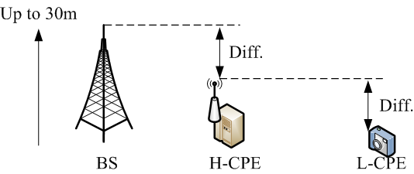
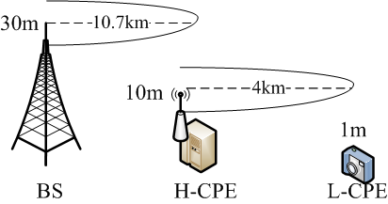
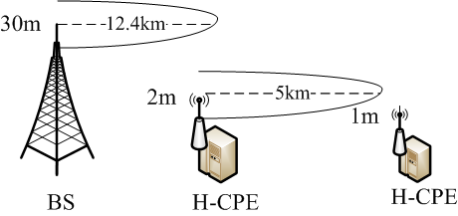
Downstream
Diff in height bet 2 entities (m) | BS to H-CPE (km) | H-CPE to L-CPE (km) | H-CPE to H-CPE (km)
0 | 6.3316 | 3.0971 | 4.8357
2 | 6.7700 | 3.2806 | 5.1995
4 | 7.2522 | 3.4751 | 5.5621
6 | 7.7767 | 3.6818 | 5.9351
8 | 8.3475 | 3.9018 | 6.3725
10 | 8.9529 | 4.1681 | 6.8304
12 | 9.2777 | 4.2875 | 7.0422
14 | 9.6136 | 4.4106 | 7.2956
16 | 9.9554 | 4.5379 | 7.5491
18 | 10.3312 | 4.6693 | 7.8088
20 | 10.7167 | 4.8053 | 8.0834
22 | 11.1172 | 4.9459 | 8.3866
24 | 11.5481 | 5.1081 | 8.6964
26 | 11.9842 | 5.2862 | 9.0130
28 | 12.394 | 5.4438 | 9.3208
29 | 12.6252 | 5.5135 | 9.3601
This table gives a complete view for 3 cases when the heights between 2 entities varied from 0 m to 29 m
Example
-Typical case (around 15km)
  - Maximum case (around 18km)
Typical case
Maximum case

Slide 6
Upstream
The table below calculates the path loss for different cases.
These values are used later for the calculation of communication range.
Parameter | H-CPE to BS | L-CPE to BS | L-CPE to H-CPE | H-CPE to H-CPE
Bandwidth | 6 MHz | 6 MHz | 6 MHz | 6 MHz
Average EIRP power (dBm) | 30 | 30 | 30 | 30
Penetration loss (dB) |  | 10 | 10
Required Rx power at d km (dBm) | -80.5 | -80.5 | -77.3 | -77.3
Path loss at d km (dB) | 110.5 | 100.5 | 97.3 | 107.3

Slide 7
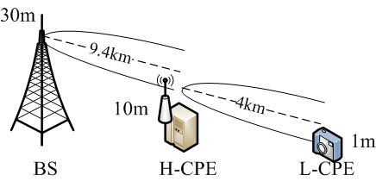
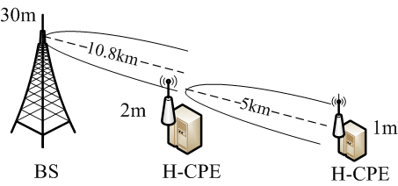
Upstream
Diff in height bet 2 entities (m) | H-CPE to BS (km) | L-CPE to H-CPE (km) | H-CPE to H-CPE (km)
0 | 5.5922 | 3.0971 | 4.8357
2 | 5.9508 | 3.2806 | 5.1995
4 | 6.3815 | 3.4751 | 5.5621
6 | 6.8302 | 3.6818 | 5.9351
8 | 7.3300 | 3.9018 | 6.3725
10 | 7.8627 | 4.1681 | 6.8304
12 | 8.1311 | 4.2875 | 7.0422
14 | 8.4222 | 4.4106 | 7.2956
16 | 8.7194 | 4.5379 | 7.5491
18 | 9.0254 | 4.6693 | 7.8088
20 | 9.3680 | 4.8053 | 8.0834
22 | 9.7168 | 4.9459 | 8.3866
24 | 10.0782 | 5.1081 | 8.6964
26 | 10.4704 | 5.2862 | 9.0130
28 | 10.8153 | 5.4438 | 9.3208
29 | 10.9692 | 5.5135 | 9.3601
This table gives a complete view for 3 cases when the heights between 2 entities varied from 0 m to 29 m
Example
-Typical case (around 14km)
  - Maximum case (around 16km)
Typical case
Maximum case

Slide 8
Conclusion
We made a very conservative calculation here by assuming
  Penetration loss (~ 10 dB)
  Fade margin (~20 dB)
From calculations, we find out that:
In practice, a 802.22b system is desired to design to cover an area by around 10 km in direct communication
While, a 802.22b can support a regional area as it can be supported by a legacy 802.22 system
 | Direct comm. | 2-hop comm.
Downstream | around 12 km | Max: around18 km Typical: around16 km
Upstream | around 11 km | Max: around 16 km Typical: around 14 km

Slide 9
Reference
[1] Recommendation ITU-R P 1546-1 “Method for point-to-area predictions for terrestrial services in the frequency range 30 MHz to 3000 MHz”
[2] Seiichi Sampei, “Applications of Digital Wireless Technologies to Global Wireless Communication” Prentice Hall PTR, Upper Saddle River, NJ 07458
[3] “Preliminary Link Budget Analysis for 802.22b” document no: 22-12-0055-03-000b

Slide 10
Appendix

Slide 11
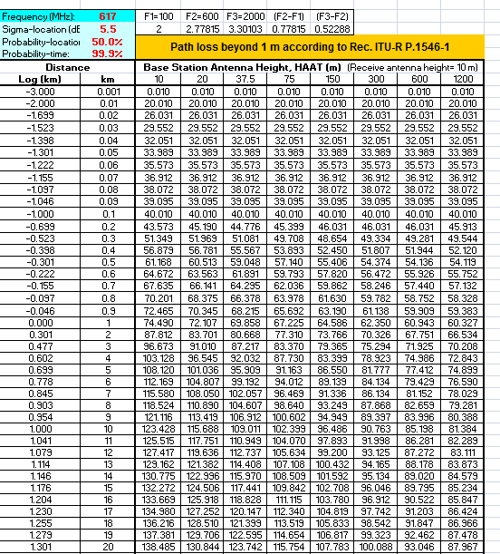
ITU-R P.1546-1
The curves were prepared from data obtained mainly from temperate climates as encountered in Europe and North America [1].
The following linear interpolation equation in dB is used for calculation of antenna height and communication distance.

Slide 12
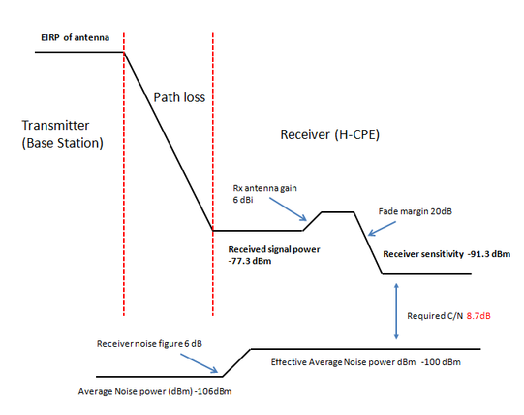
Case 1: BS to H-CPE

Slide 13
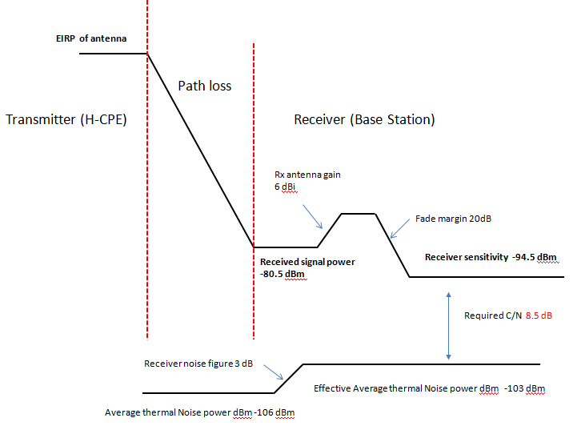
Case 2: H-CPE to BS

