Slide 1
Meeting P802.22b Requirements through PHY, MAC and Cognitive Enhancements
IEEE P802.22 Wireless RANs Date: 2012-10-28
Authors:
Notice: This document has been prepared to assist IEEE 802.22. It is offered as a basis for discussion and is not binding on the contributing individual(s) or organization(s). The material in this document is subject to change in form and content after further study. The contributor(s) reserve(s) the right to add, amend or withdraw material contained herein.
Release: The contributor grants a free, irrevocable license to the IEEE to incorporate material contained in this contribution, and any modifications thereof, in the creation of an IEEE Standards publication; to copyright in the IEEE’s name any IEEE Standards publication even though it may include portions of this contribution; and at the IEEE’s sole discretion to permit others to reproduce in whole or in part the resulting IEEE Standards publication. The contributor also acknowledges and accepts that this contribution may be made public by IEEE 802.22.
Patent Policy and Procedures: The contributor is familiar with the IEEE 802 Patent Policy and Procedures http://standards.ieee.org/guides/bylaws/sb-bylaws.pdf including the statement "IEEE standards may include the known use of patent(s), including patent applications, provided the IEEE receives assurance from the patent holder or applicant with respect to patents essential for compliance with both mandatory and optional portions of the standard." Early disclosure to the Working Group of patent information that might be relevant to the standard is essential to reduce the possibility for delays in the development process and increase the likelihood that the draft publication will be approved for publication. Please notify the Chair
Apurva Mody <apurva.mody@ieee.org> as early as possible, in written or electronic form, if patented technology (or technology under patent application) might be incorporated into a draft standard being developed within the IEEE 802.22 Working Group. If you have questions, contact the IEEE Patent Committee Administrator at patcom@iee.org.

Slide 2
Abstract
P802.22b requires enhancements to PHY, MAC and Cognitive functions.
Here we describe some concepts that will help to meet those requirements.

Slide 3
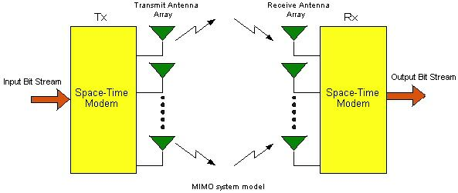
A Multi Input Multi Output (MIMO) OFDM System
Q
L
A MIMO system uses Q Transmit antennas and L Receive Antennas to provide multiple copies of the transmitted signal at the receiver. The Q X L channels should be ideally uncorrelated in time and frequency.
A MIMO channel can provide a diversity gain of order L.
Or the net capacity of the system in terms of bits/sec/Hz can can be increased by a factor of Q.
7

Slide 4
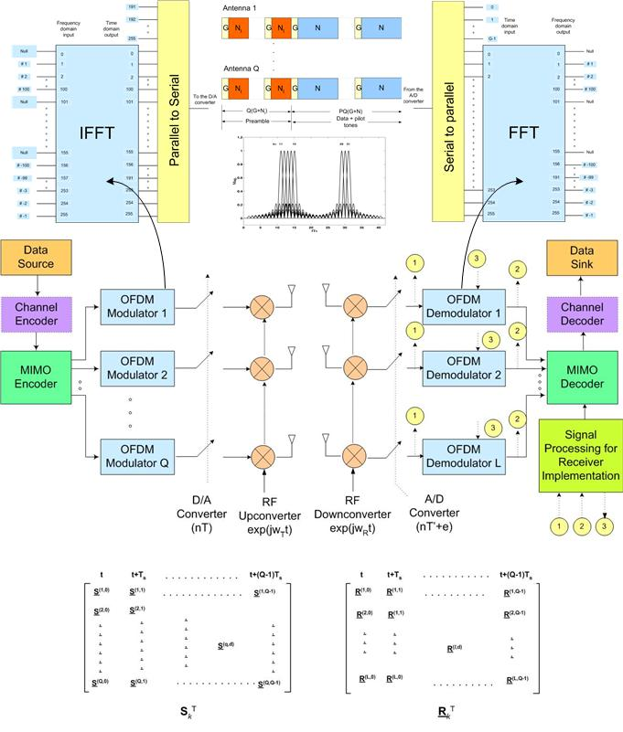
Q-Transmit L-Receive MIMO OFDM System
8

Slide 5
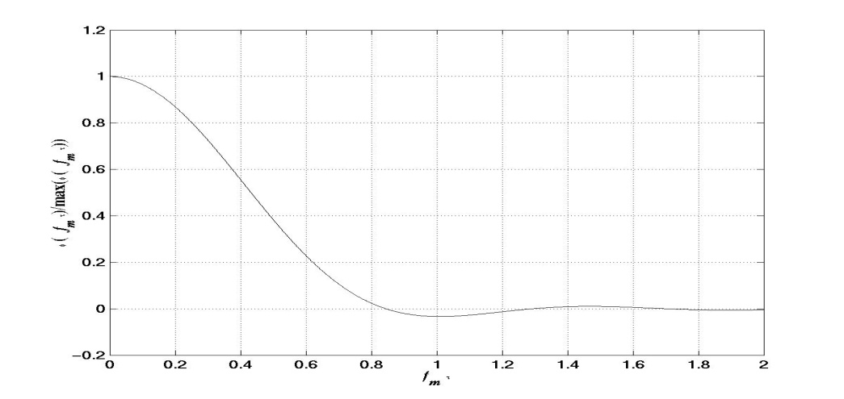
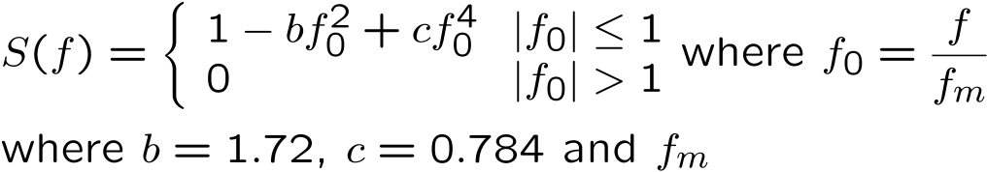
Broadband Fixed Wireless Access (BFWA) Channel
The fixed wireless access channel is characterized by the Stanford University Interim (SUI) models.
SUI-4 Channel Model for moderate to heavy tree densities is given by:
 | Tap1 | Tap2 | Tap3 | Units
Delay | 0 | 1.5 | 4 | μS
Power | 0 | -4 | -8 | dB
f_{m} | 0.2 | 0.15 | 0.25 | Hz
The Doppler power spectrum and autocorrelation functions for the SUI channel are
9

Slide 6
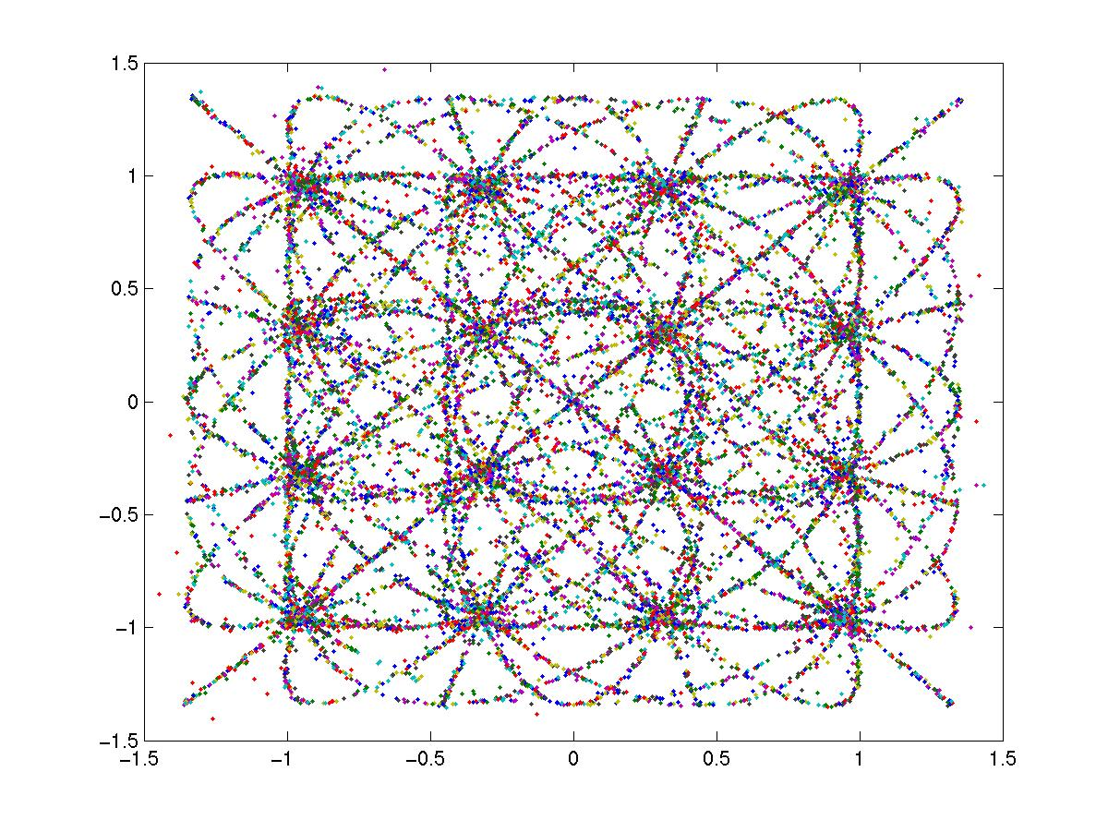
MIMO-OFDM System Impairments
1
Improper time synchronization – causes ISI and ICI,
Improper channel estimation – results in error-prone decoding of data in coherent MIMO communication systems,
Sampling frequency offsets, RF oscillator frequency offset and RF oscillator phase noise produce
  BER performance degradation,
  Loss of effective signal energy
  ISI and ICI.
Additive white Gaussian noise
2
3
4
5
6
16-QAM constellation with a sampling frequency offset of 10 parts per million (ppm) and a free running clock. channel = δ(n)
11

Slide 7
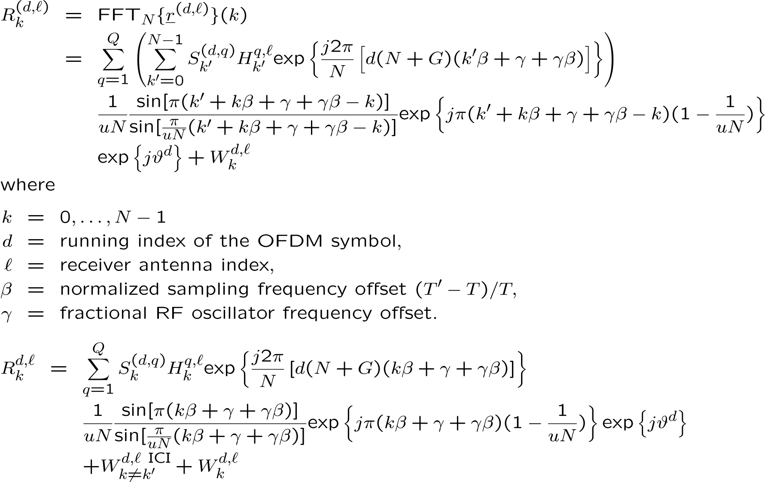
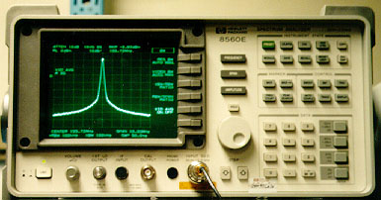
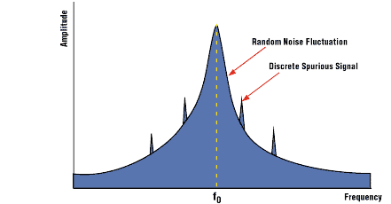
System Equation
A. N. Mody, G. L. Stüber, "Signal Acquisition and Tracking for Fixed Wireless Access MIMO OFDM," Submitted to the IEEE Transactions on Wireless Communications.
13

Slide 8
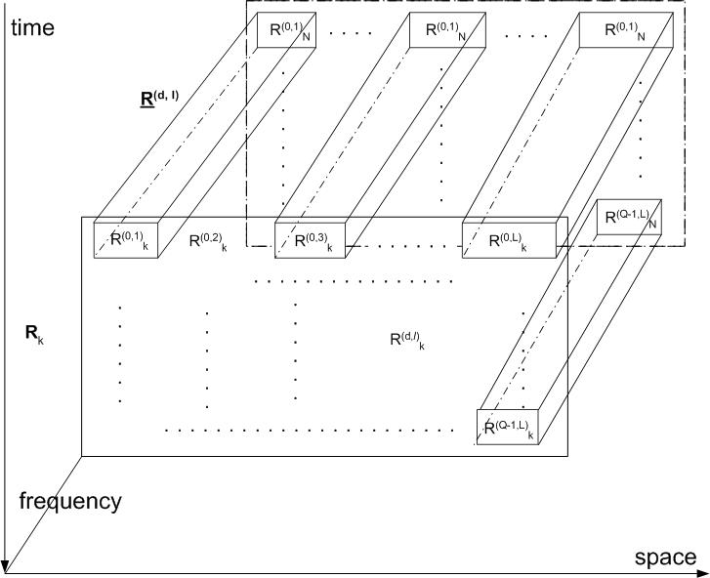
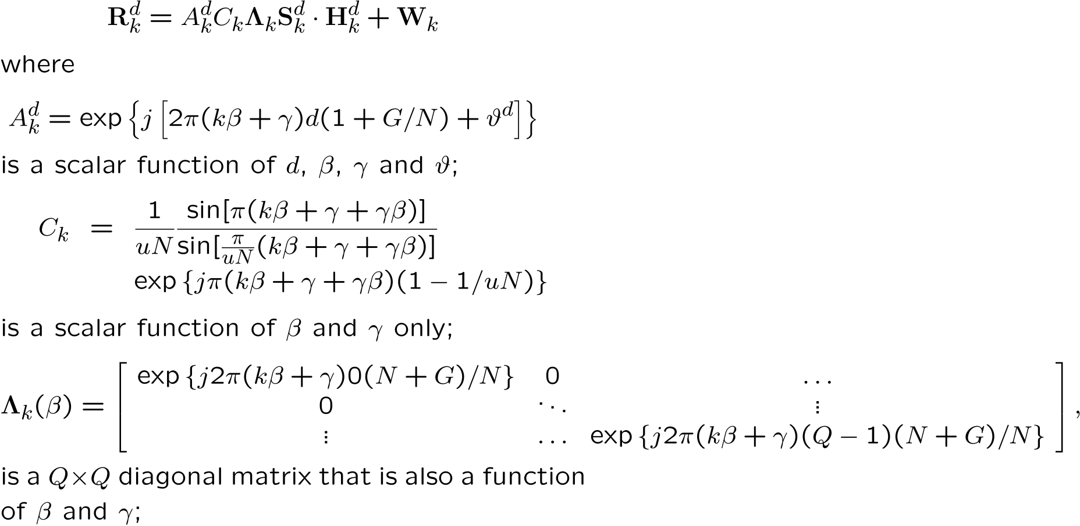
System Equation – Matrix Representation
14

Slide 9
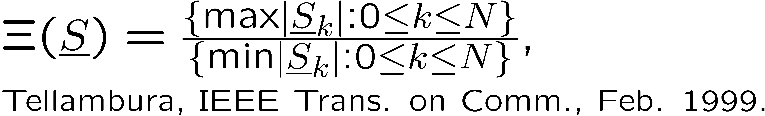
Generalized Preamble Design
Desired characteristics of sequences constituting the preamble
Low peak to average power ratio (PAPR) for undistorted signal reception,
Good correlation properties for time synchronization,
Suitable for RF oscillator frequency offset estimation over a wide range,
Suitable for channel parameter estimation,
  For optimum channel estimation, the training sequences must have a flat spectrum, where the spectral flatness is measured in terms of spectral max to min ratio (SMMR) given by
Low computational complexity, low overhead but high accuracy.
18

Slide 10
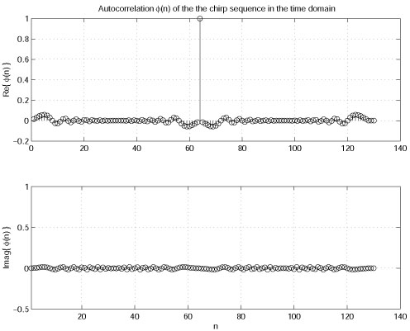
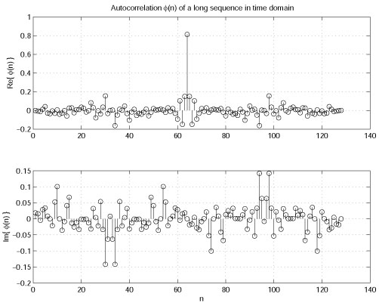
Training Sequences for the Preamble
Examples of good training sequences are
chirp sequence
Chirp like sequences – e.g. Milewski' s sequences, Suehiro' s polyphase sequences, Frank and Zadoff' s sequences, sequences proposed by Ng, Chu' s polyphase sequences etc.
19

Slide 11
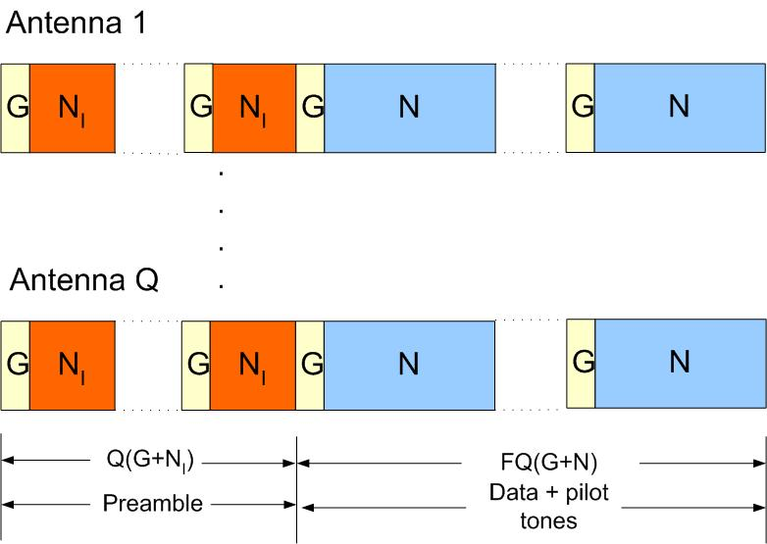
Frame Structure
Preamble consists of Q OFDM symbols of a generalized length N_{I} , where N_{I}=N/I, I=1,2,4 etc.
Data symbols consist of F blocks of Q OFDM symbols having length N
Each symbol is preceded by a cyclic prefix of G samples.
The preamble sequences of length N_{I} can be constructed by
  exciting every Ith subcarrier of an N point sequence in the frequency domain using some known alphabet,
20

Slide 12
Frame Structure
Freq. dom. rep. of the sequence used for the IEEE 802.16a Standard, I = 2,
S₁=sqrt(2)*[0 0 -1 0 -1 0 1 0 -1 0 -1 0 1 0 1 0 1 0 -1 0 1 0 1 0 1 0 -1 0 -1 0 -1 0 -1 0 -1 0 -1 0 1 0 -1 0 -1 0 -1 0 -1 0 -1 0 -1 0 1 0 1 0 1 0 -1 0 1 0 -1 0 1 0 1 0 -1 0 1 0 1 0 1 0 -1 0 -1 0 -1 0 -1 0 -1 0 1 0 -1 0 -1 0 1 0 -1 0 -1 0 1 0 -1 {55 0’s} -1 0 1 0 1 0 1 0 1 0 -1 0 -1 0 1 0 -1 0 1 0 -1 0 -1 0 1 0 1 0 -1 0 1 0 -1 0 1 0 -1 0 1 0 -1 0 1 0 1 0 -1 0 1 0 -1 0 -1 0 1 0 -1 0 -1 0 -1 0 1 0 1 0 -1 0 1 0 1 0 1 0 -1 0 1 0 1 0 -1 0 -1 0 -1 0 1 0 1 0 1 0 1 0 1 0 1 0 1 0] – PAPR 4.31 dB
G
N_{I}
N_{I}
21

Slide 13
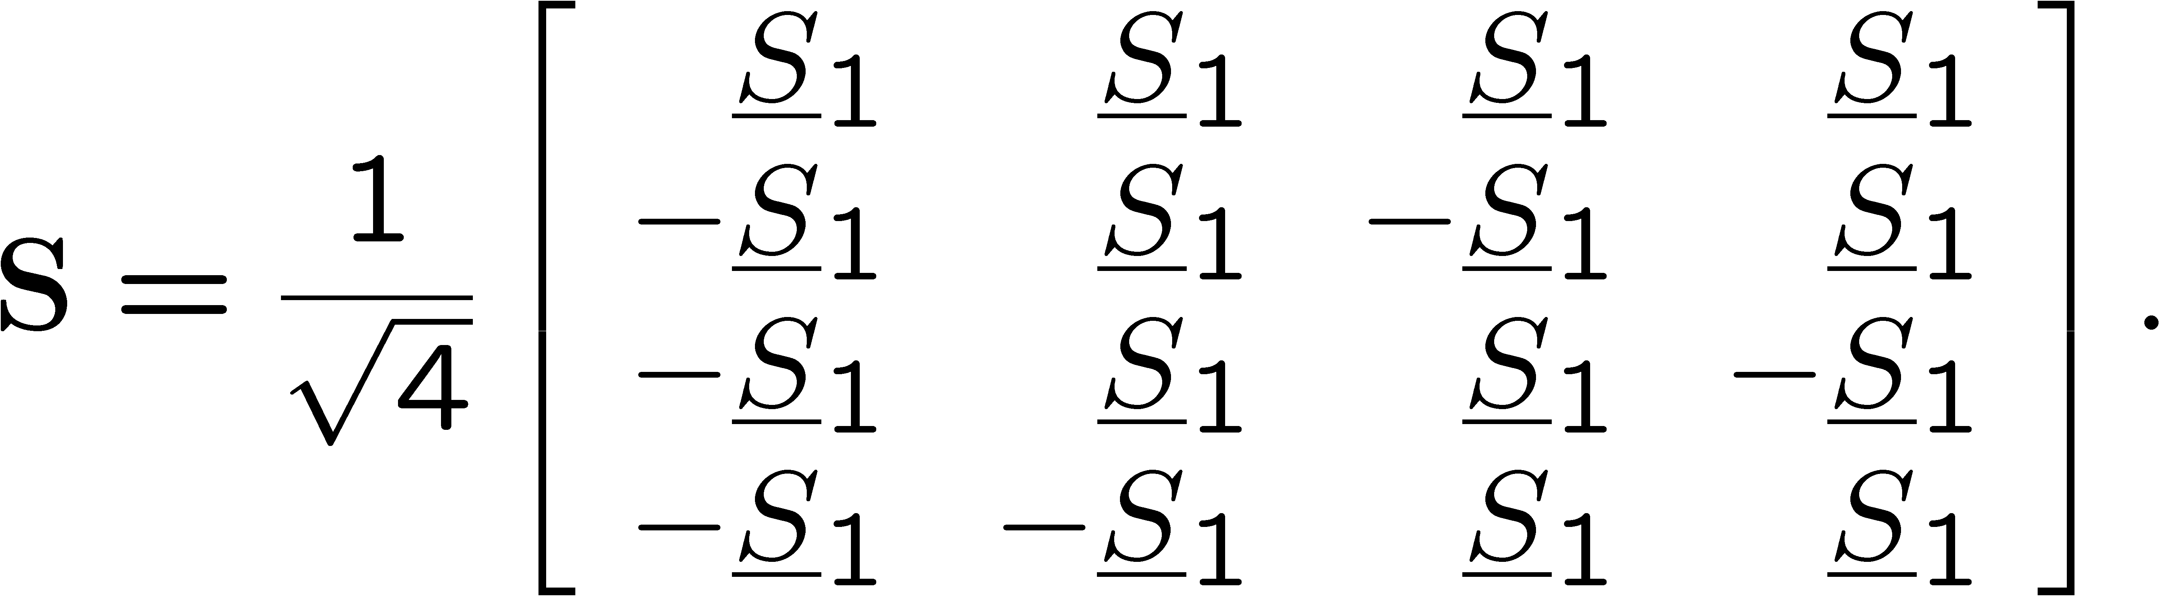
Efficient Signal Transmission Matrix Structures for MIMO Channel Estimation
If the channel is sufficiently static, then the MIMO channel can be estimated over a number of OFDM symbols, e.g. IEEE 802.11a, IEEE 802.16a.
The signal transmission matrix must have at least a rank of Q for least squares (LS) channel estimation to be possible,
When the number of transmit antennas Q is 2, 4, 8 etc., then orthogonal signal structures may be used to form Sk, e.g. for Q = 4,
A. N. Mody, G. L. Stuber, "Efficient Training and Synchronization Sequence Structures for MIMO OFDM," 6th International OFDM Workshop, Hamburg, Germany, Sept. 2001.
22

Slide 14
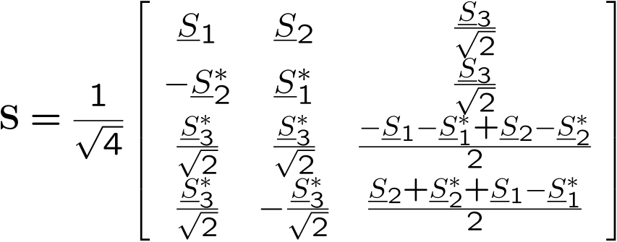
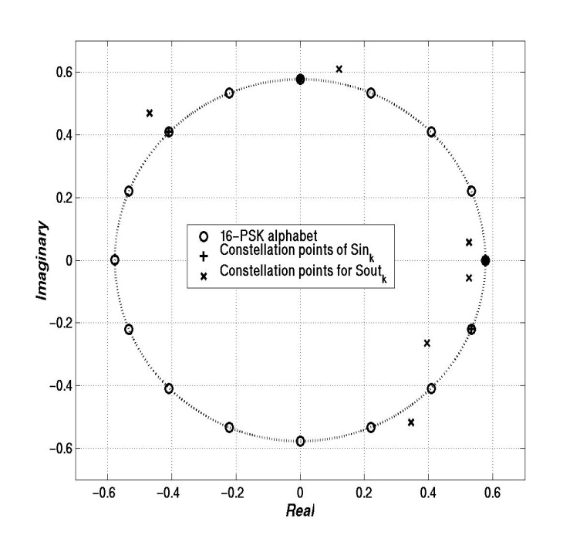
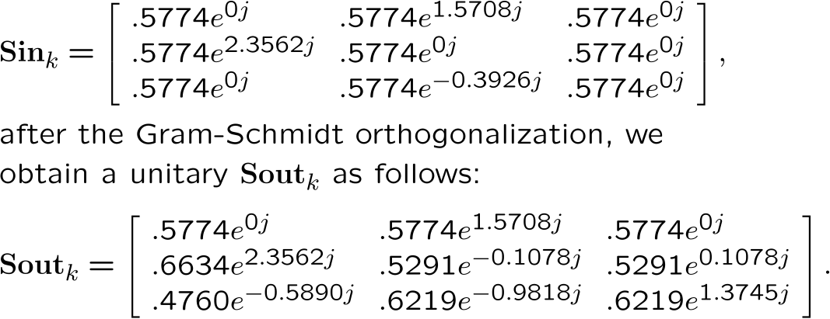
Efficient Signal Transmission Matrix Structures for MIMO Channel Estimation
For Q ≠ 2, 4, 8 etc. some other forms of signal transmission matrices are needed. For example for Q = 3,
Or Gram-Schmidt orthogonalization procedure may be used to create a unitary matrix of dimensions Q X Q. For example
This method provided a 3X3 signal structure with a PAPR of 5 dB.
A. N. Mody, G. L. Stuber, "Efficient Training and Synchronization Sequence Structures for MIMO OFDM," 6th International OFDM Workshop, Hamburg, Germany, Sept. 2001.
23

Slide 15
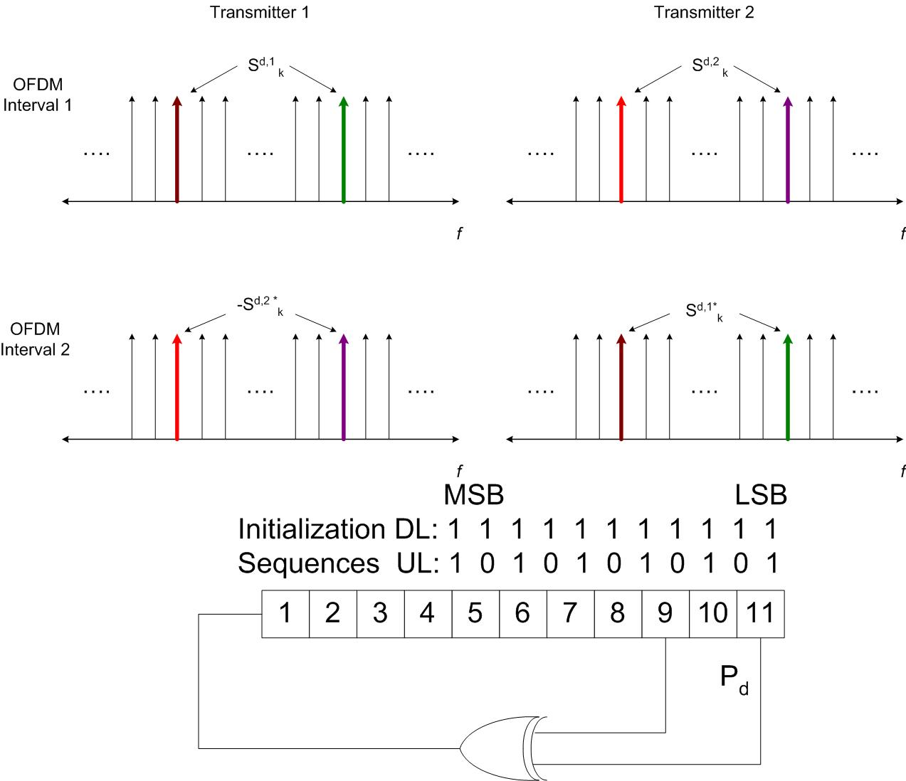
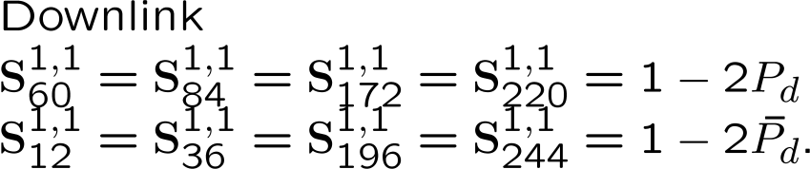
Pilot Symbol Matrices and their Generation for Parameter Tracking
For MIMO OFDM systems, pilot symbols are inserted in form of pilot tone matrices.
For Q = 2, 4, and 8, P_{d} determines the entire pilot tone matrix which is chosen to have an orthogonal structure.
For Q ≠ 2, 4, 8 etc. a diagonal pilot tone matrix is used.
The IEEE 802.16a Standard for N=256 recommends the insertion of 8 pilot tones at fixed positions of [12 36 60 84 172 196 220 244]
24

Slide 16
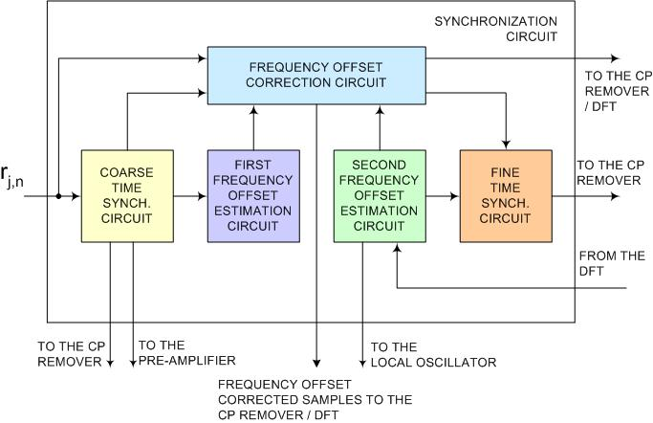
Signal Acquisition Phase
Signal Acquisition
  Sampling frequency offset estimation – Step VA
  Channel and noise variance estimation – Step VIA
IA
IIA
IIIA
IVA
26

Slide 17
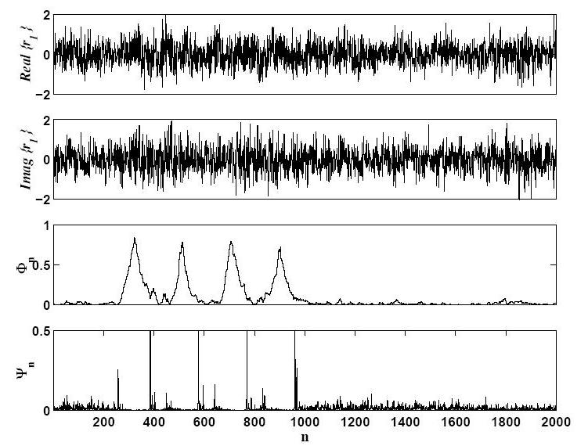
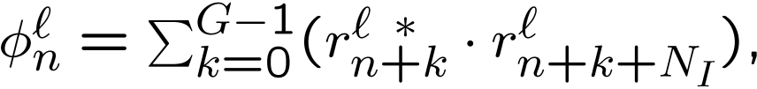
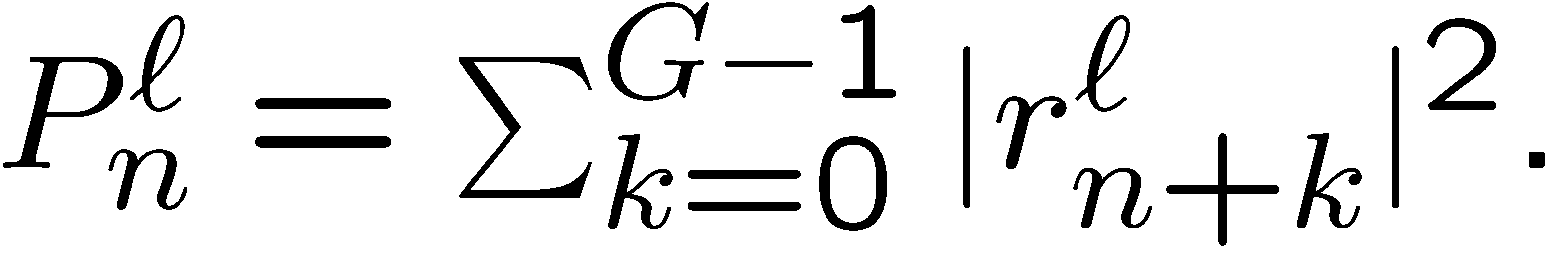
Signal Acquisition Phase
Step IA – Coarse time synchronization
Exploiting repeated samples in the frame due to the presence of the cyclic prefix
where
G
N_{I}
G
J. J. van de Beek et al. ML Estimation of Time and Frequency Offsets in OFDM – IEEE Trans. On Signal Proc., July 1997
S. H. Müller-Weinfurtner – Optimality of metrics for coarse frame synchronization in OFDM, IEEE PIMRC ‘98.
27

Slide 18
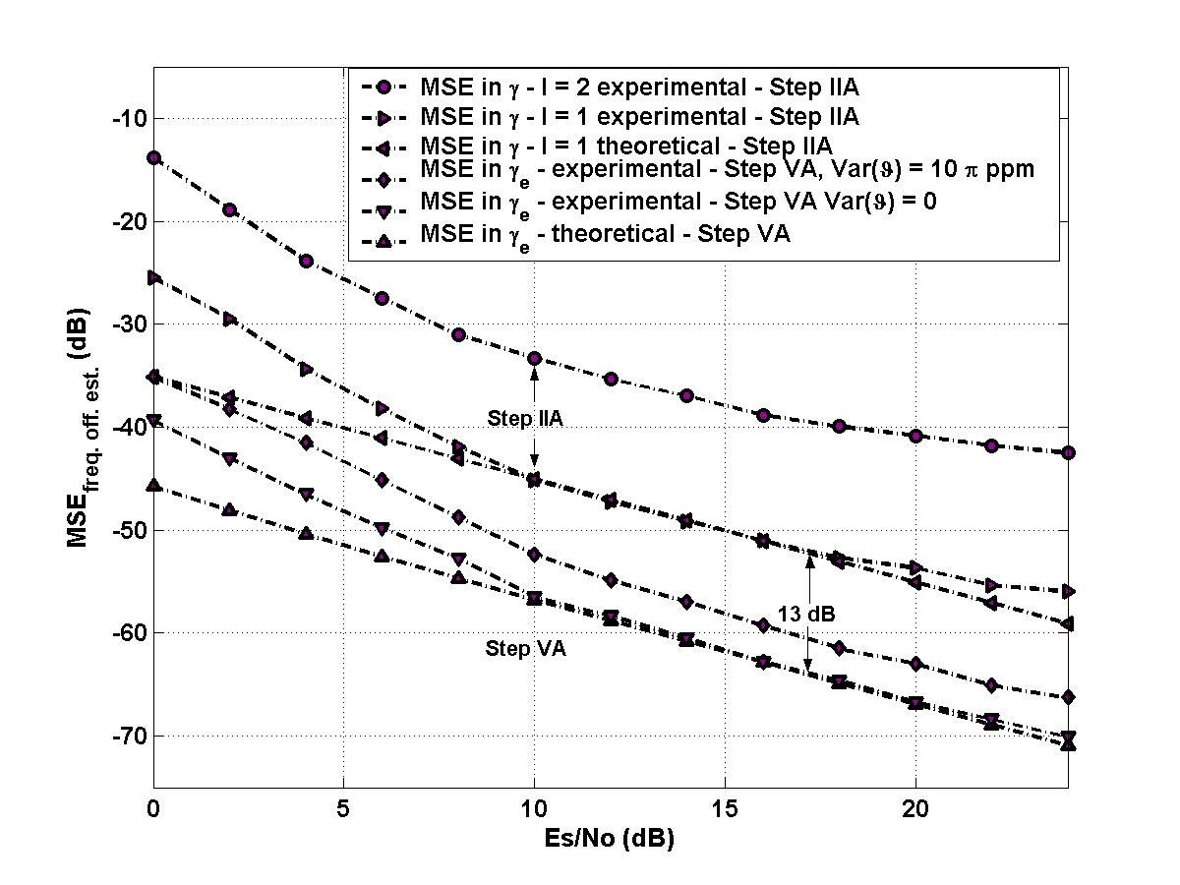
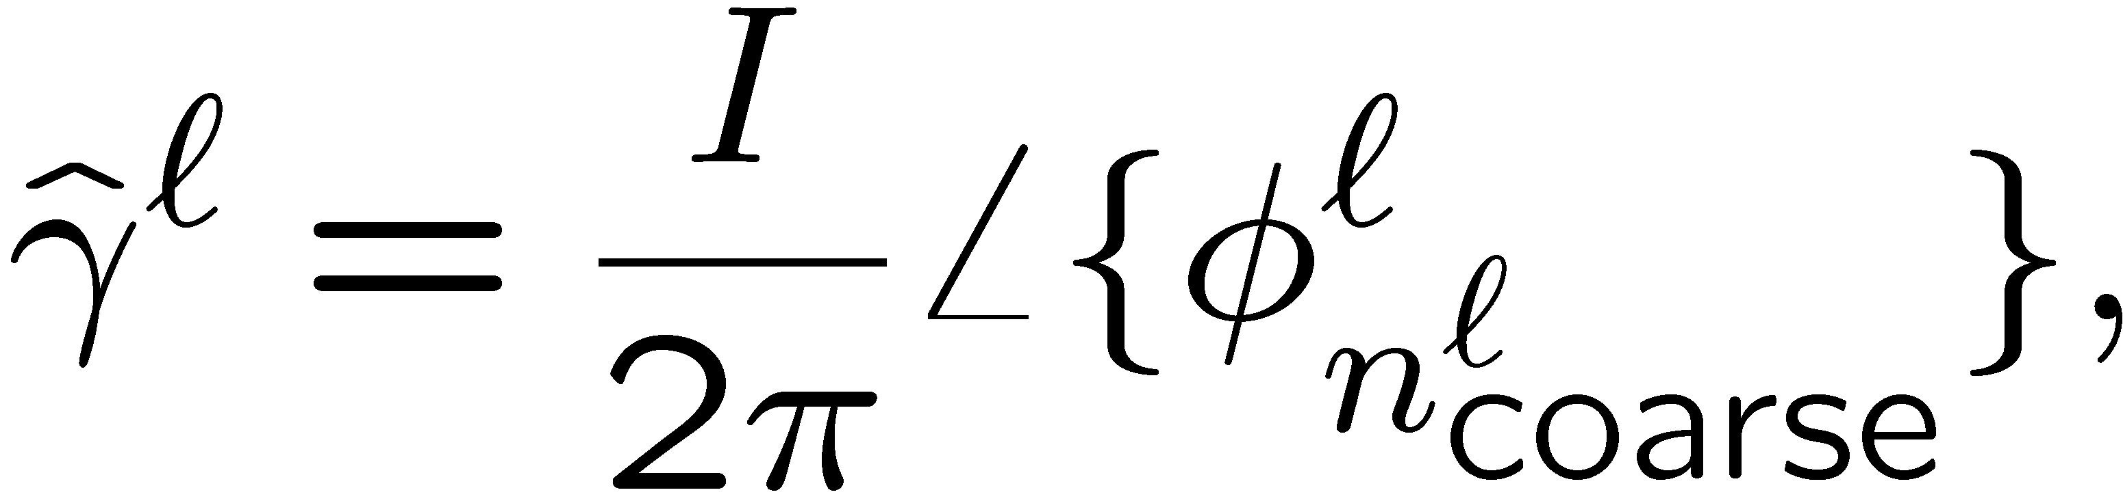
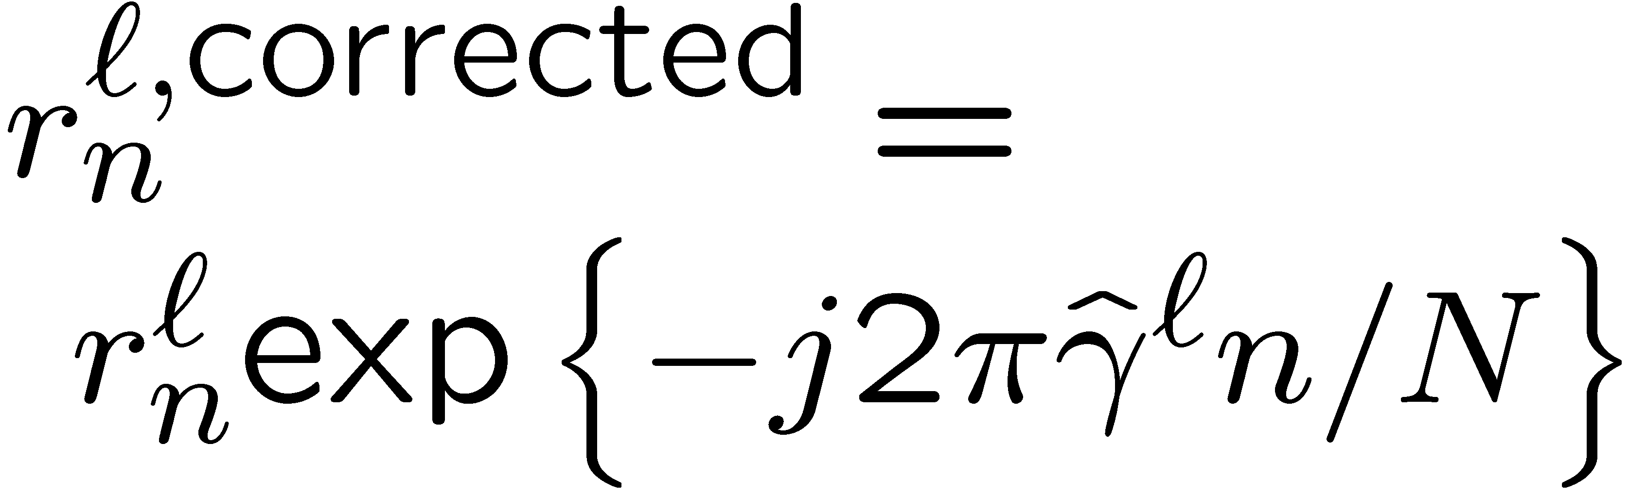
Signal Acquisition Phase
Step IIA – Fractional frequency offset estimation
Frequency offset of up to ±I/2 subcarrier spacings is reflected in the cyclic prefix and the posterior part of the OFDM symbol as a proportional phase shift.
G
N_{I}
G
P. H. Moose, A Technique for OFDM Frequency Offset Correction, IEEE Trans. on Comm., Oct. 1994
28

Slide 19
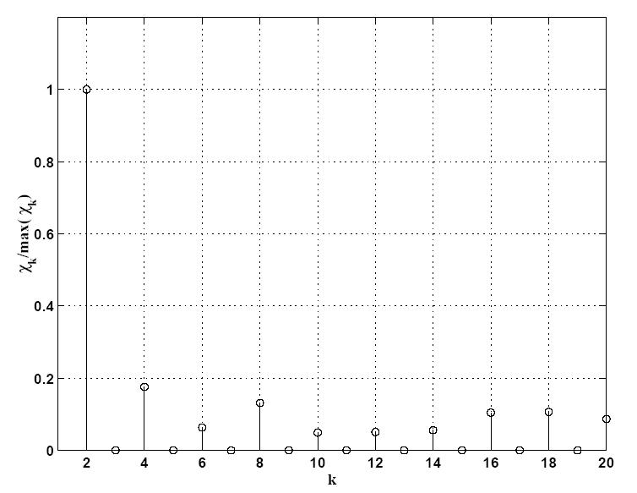
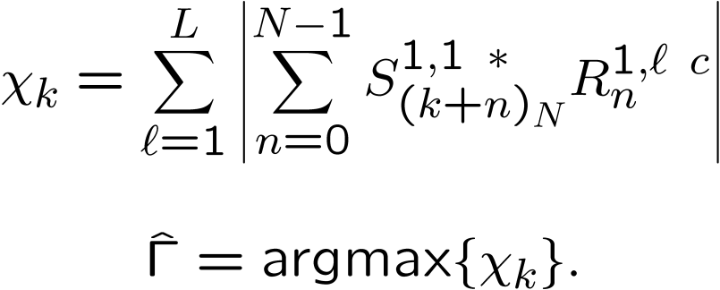
Signal Acquisition Phase
Step IIIA – Integer frequency offset estimation
If same sequences are transmitted from all the antennas for d = 1, then cyclic cross-correlation of the demodulated OFDM symbol with the original sequence can be performed to estimate the residual frequency offset
S₁
S₁
S₁
S₁
H. Zou et al., Receiver implementation for high speed mobile OFDM system, IEEE GLOBECOM 2001.
A. N. Mody, G. L. Stüber, "Receiver Implementation for a MIMO OFDM System," IEEE Global Communications Conference, Taipei, Taiwan, Nov. 2002.
29

Slide 20
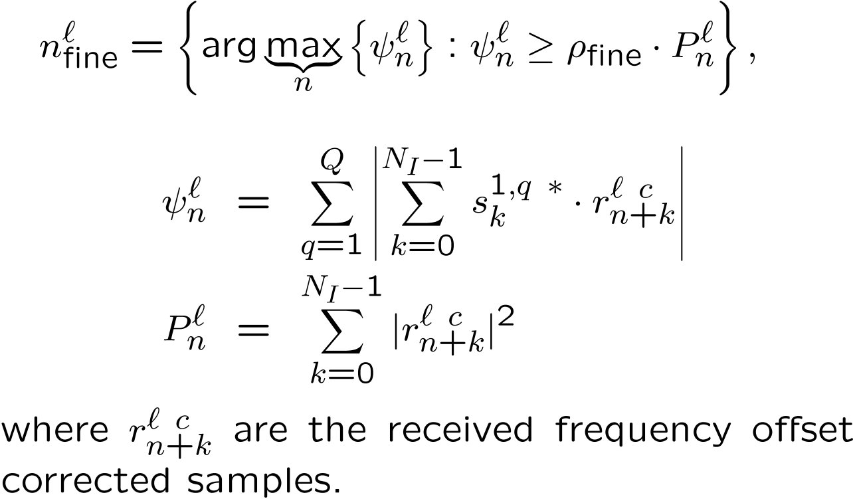
Signal Acquisition Phase
Step IVA – Fine time synchronization
Fine time synchronization can be performed by cross-correlating the frequency compensated received samples of the complex envelope with the transmitted time domain preamble sequences.
A. N. Mody and G. L. Stüber, Synchronization for MIMO OFDM Systems, IEEE GLOBECOM 2001.
30

Slide 21
Receiver Architecture – Time and Frequency Synchronization
31

Slide 22
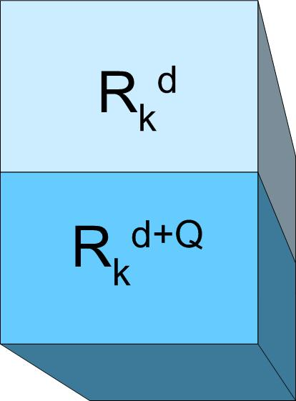
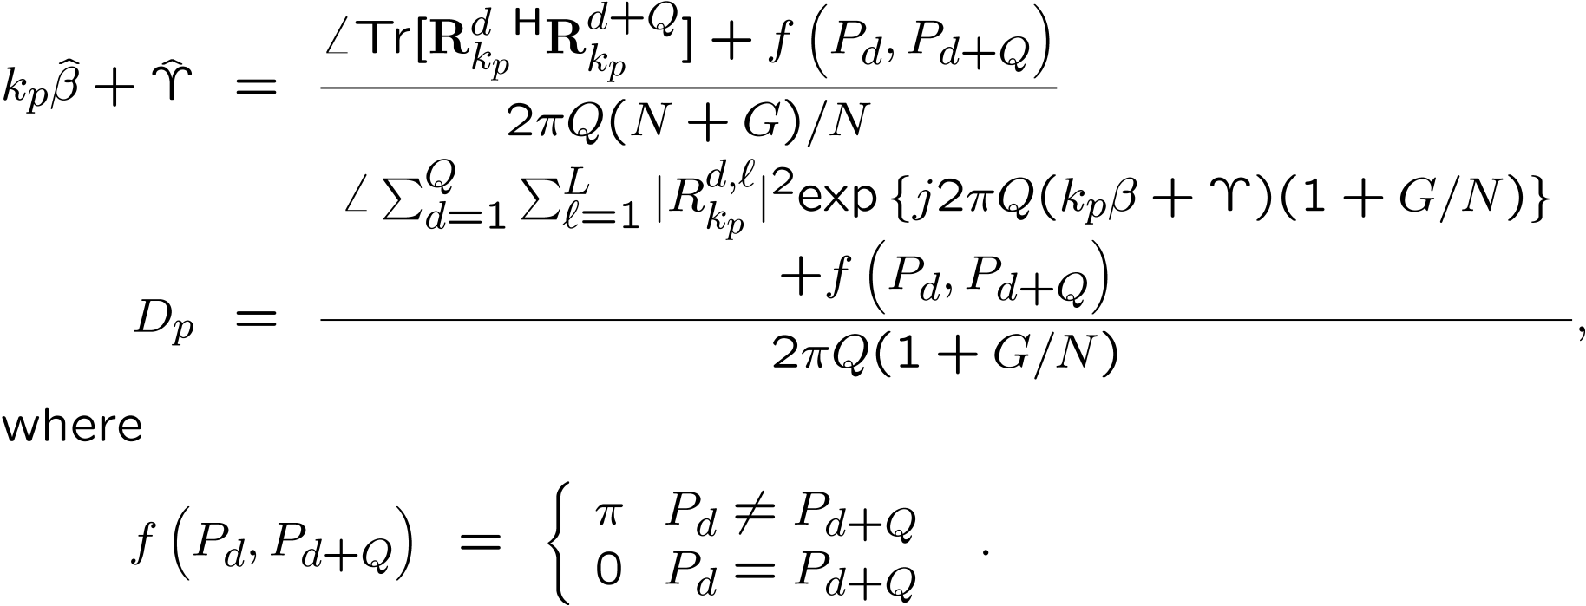
Signal Acquisition Phase
Step VA – Sampling, residual frequency offset, phase noise estimation If the channel remains sufficiently static for 2Q OFDM symbols then the sampling and the residual RF frequency offset/ phase noise difference may be determined by correlating the received demodulated sample matrices Rk for every new mod(d, Q) OFDM symbol as
A. N. Mody and G. L. Stüber, "Open Loop Timing Recovery and Channel Estimation for MIMO OFDM Systems," 8th International OFDM Workshop, Harburg, Germany, Sept. 2003.
32

Slide 23
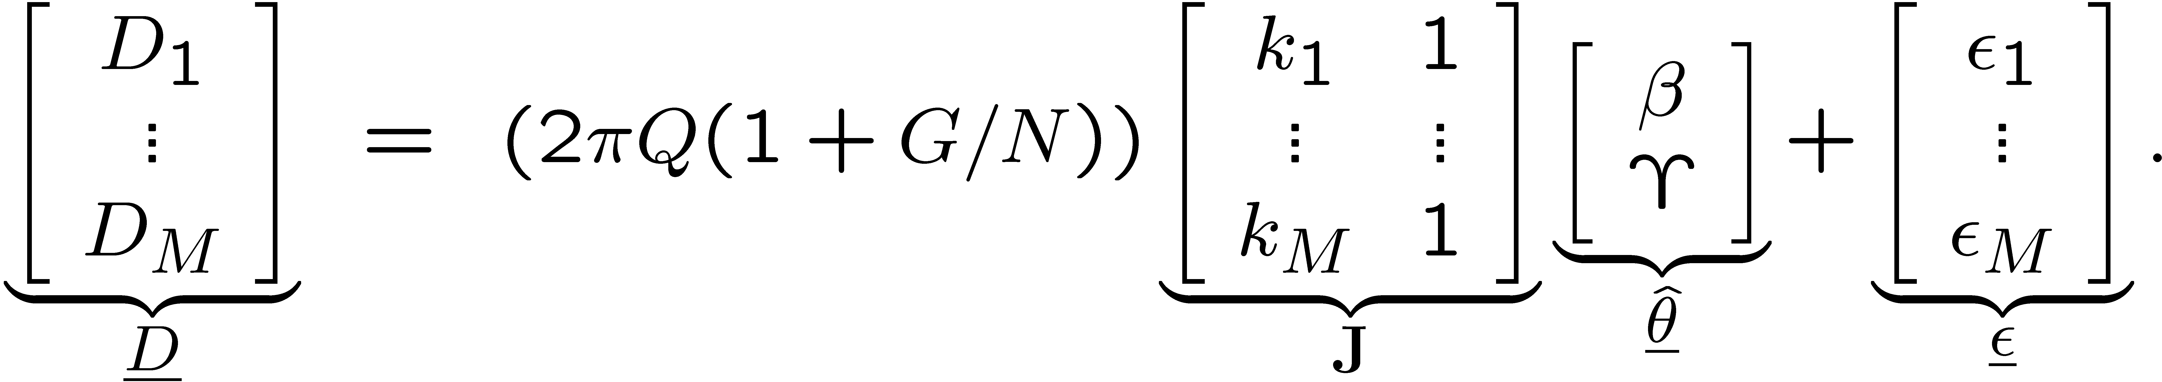
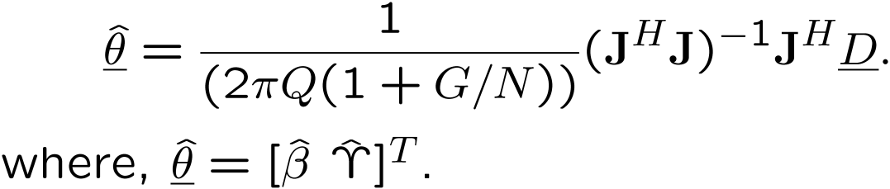
Signal Acquisition Phase
Step VA – Sampling, residual frequency offset, phase noise estimation
The estimate of β and γ are obtained using least squares estimation as
A. N. Mody and G. L. Stüber, "Open Loop Timing Recovery and Channel Estimation for MIMO OFDM Systems," 8th International OFDM Workshop, Harburg, Germany, Sept. 2003.
33

Slide 24
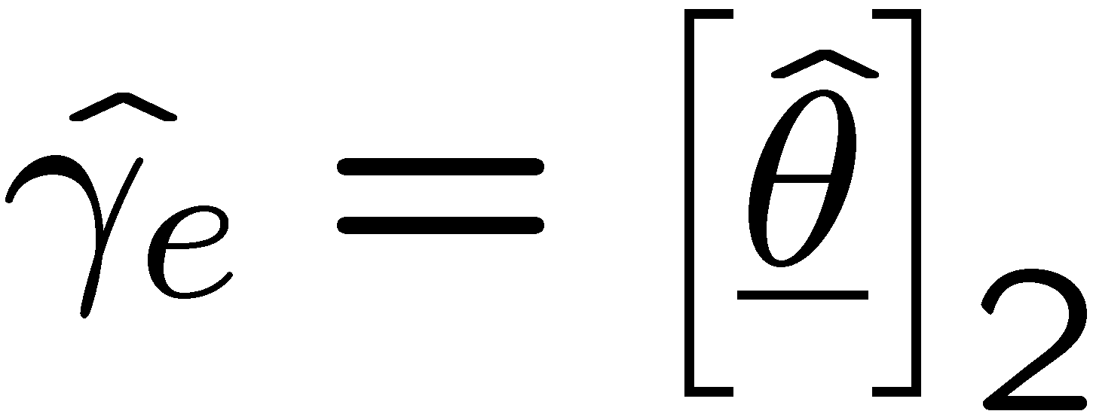
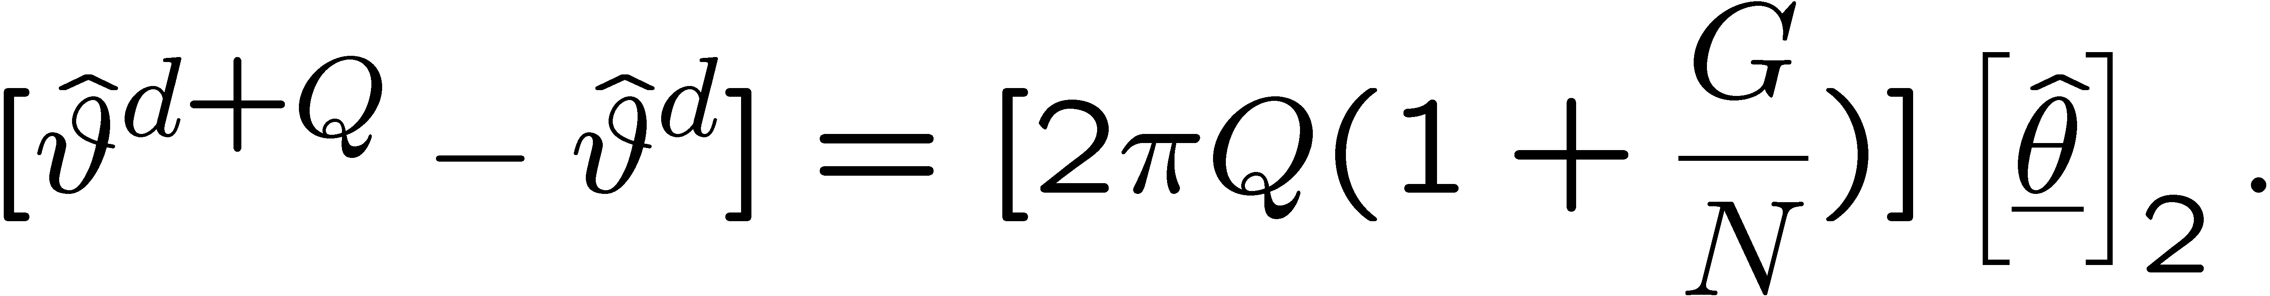
Signal Acquisition Phase
Step VA – Sampling, residual frequency offset, phase noise estimation
One can estimate the residual RF oscillator frequency offset or the phase noise difference but NOT both.
If the frame size is large, then any residual frequency offset causes a linear increase in the phase of the received symbols with time, which results in a BER floor.
On the other hand, for short frame sizes, large fluctuations in the phase noise can not be ignored.
Hence, for long frame sizes, ignore the phase noise;
For short frame sizes, ignore the residual frequency offset. The estimate of the phase noise difference is given by
A. N. Mody and G. L. Stüber, "Open Loop Timing Recovery and Channel Estimation for MIMO OFDM Systems," 8th International OFDM Workshop, Harburg, Germany, Sept. 2003.
34

Slide 25
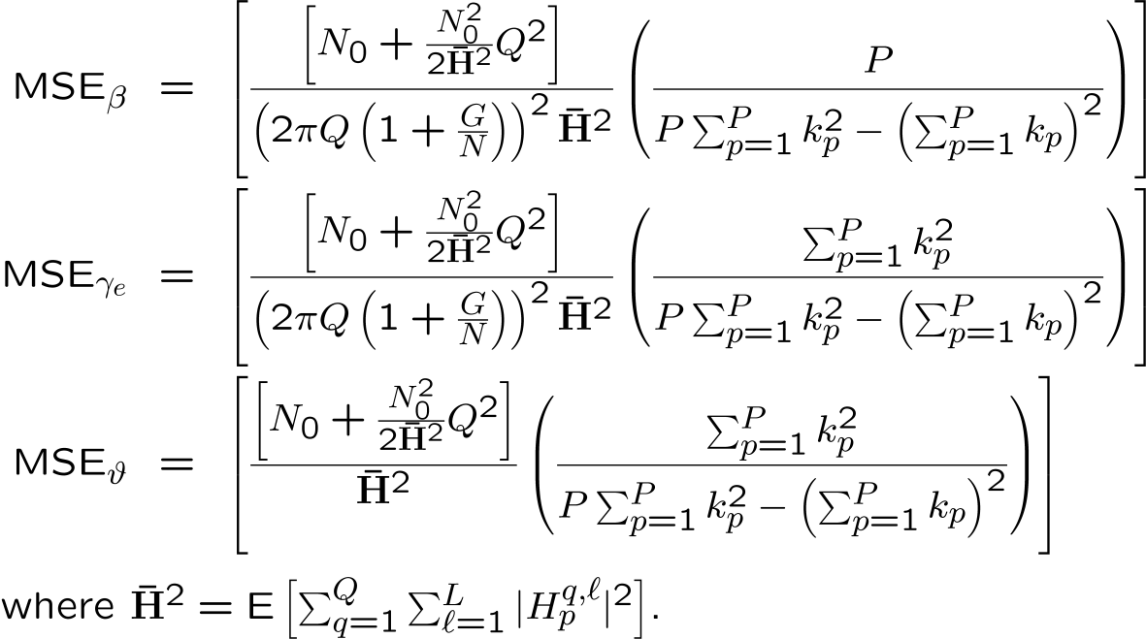
Signal Acquisition Phase
MSE in the estimates of SF offset, residual RF oscillator frequency offset and the phase noise are given by
35

Slide 26
Signal Acquisition Phase
Step IIA, VA – Factional and Residual RF Oscillator Frequency Offset Estimation Mean squared error (MSE) as a function of signal energy to noise ratio E_{s}/N₀
A. N. Mody, G. L. Stüber, "Signal Acquisition and Tracking for Fixed Wireless Access MIMO OFDM," Submitted to the IEEE Transactions on Wireless Communications.
36

Slide 27
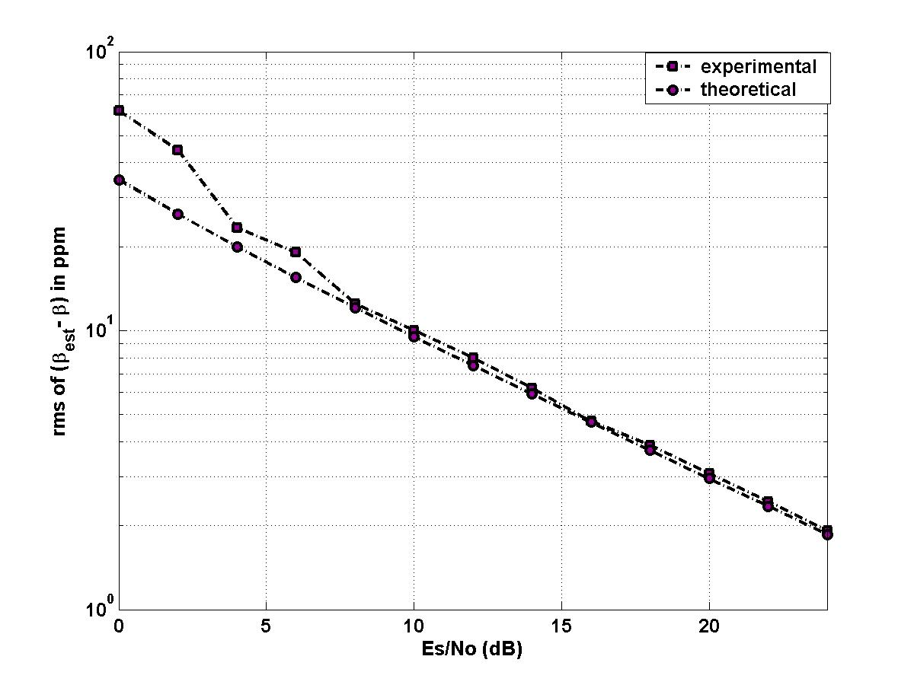
Signal Acquisition Phase
Step VA – Sampling frequency offset estimation
Mean squared error (MSE) as a function of signal energy to noise ratio E_{s}/N₀
A. N. Mody, G. L. Stüber, "Signal Acquisition and Tracking for Fixed Wireless Access MIMO OFDM," Submitted to the IEEE Transactions on Wireless Communications.
37

Slide 28
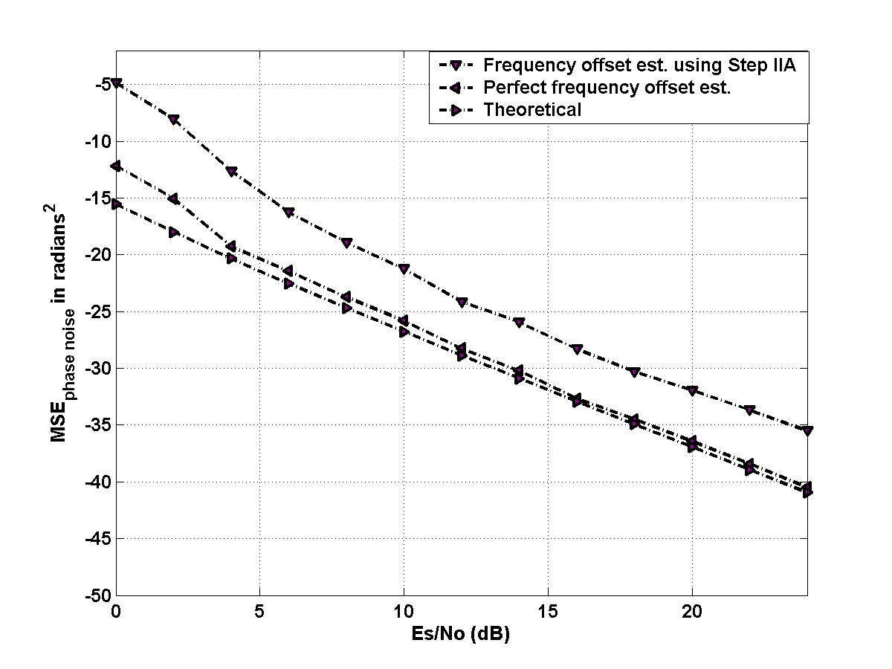
Signal Acquisition Phase
Step VA – RF Oscillator Phase Noise Estimation
Mean squared error (MSE) as a function of signal energy to noise ratio E_{s}/N₀
A. N. Mody, G. L. Stüber, "Signal Acquisition and Tracking for Fixed Wireless Access MIMO OFDM," Submitted to the IEEE Transactions on Wireless Communications.
38

Slide 29
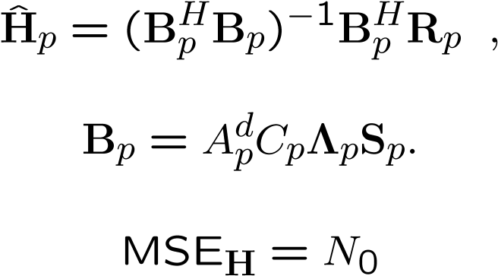
Signal Acquisition Phase
Step VIA – Channel estimation
In case the statistics of the channel and noise are not available then the least squares (LS) channel estimate at each subcarrier is given by
If the statistics of noise and the channel over space, time and frequency are available at the receiver then that information may be exploited to reduce the MSE in channel estimates.
Ye Li et al. – Channel Estimation for OFDM with Transmit Receive Diversity – IEEE JSAC March 1999.
A. N. Mody, G. L. Stüber, "Parameter Estimation for MIMO OFDM Systems," IEEE Vehicular Technology Conference, Rhodes, Greece, May 2001.
Ye Li et al. – MIMO OFDM Wireless: Signal Det. with Enhanced Ch. Est. – IEEE Trans. On Comm. Sept. 2002
J. H. Kotecha, A. M. Sayeed, Optimal Signal Design for Estimation of Correlated MIMO Channels, IEEE ICC 2003.
39

Slide 30
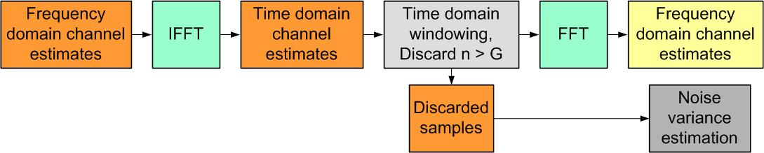
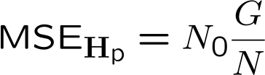
Signal Acquisition Phase
Step VIA – Reducing the MSE of the channel estimates
A. N. Mody, G. L. Stüber, "Parameter Estimation for MIMO OFDM Systems," IEEE Vehicular Technology Conference, Rhodes, Greece, May 2001.
40

Slide 31
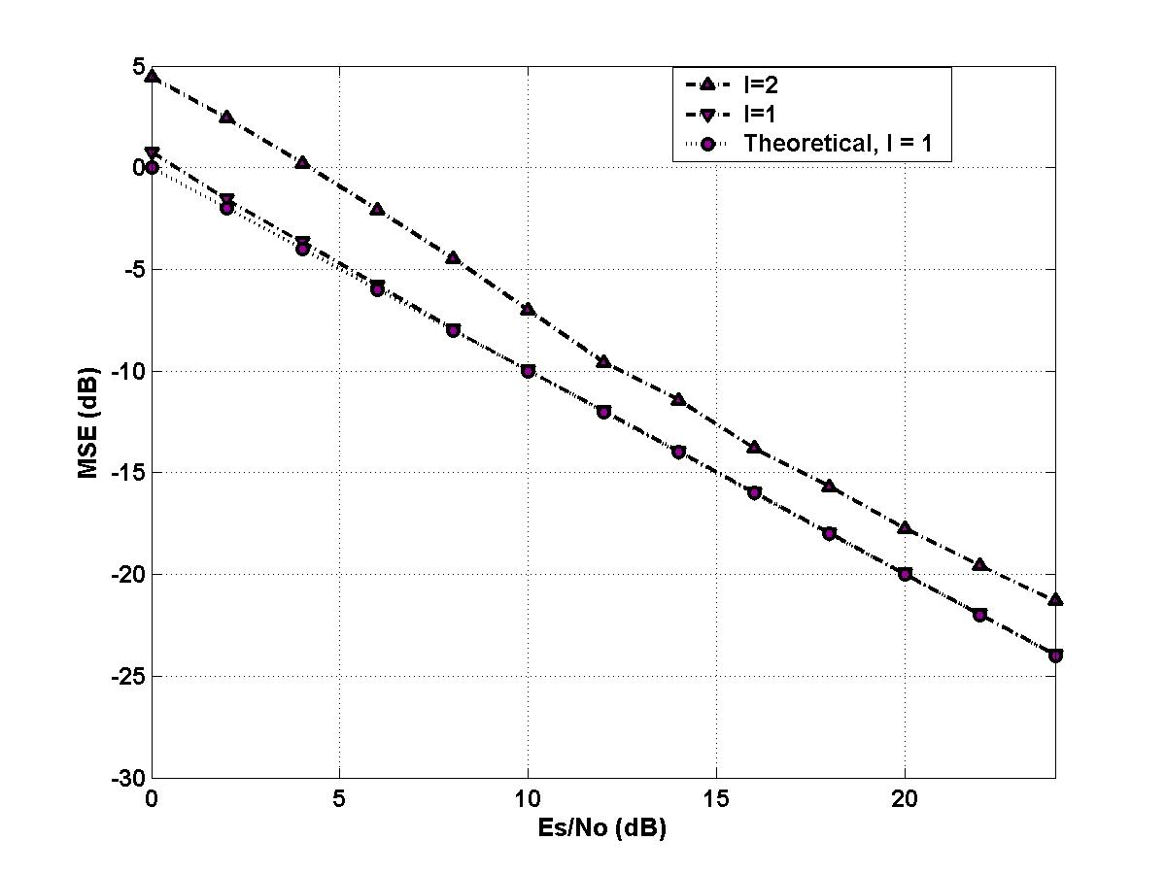
Signal Acquisition Phase
Step VIA – Channel estimation
Mean squared error (MSE) as a function of signal energy to noise ratio E_{s}/N₀
A. N. Mody, G. L. Stüber, "Parameter Estimation for MIMO OFDM Systems," IEEE Vehicular Technology Conference, Rhodes, Greece, May 2001.
41

Slide 32
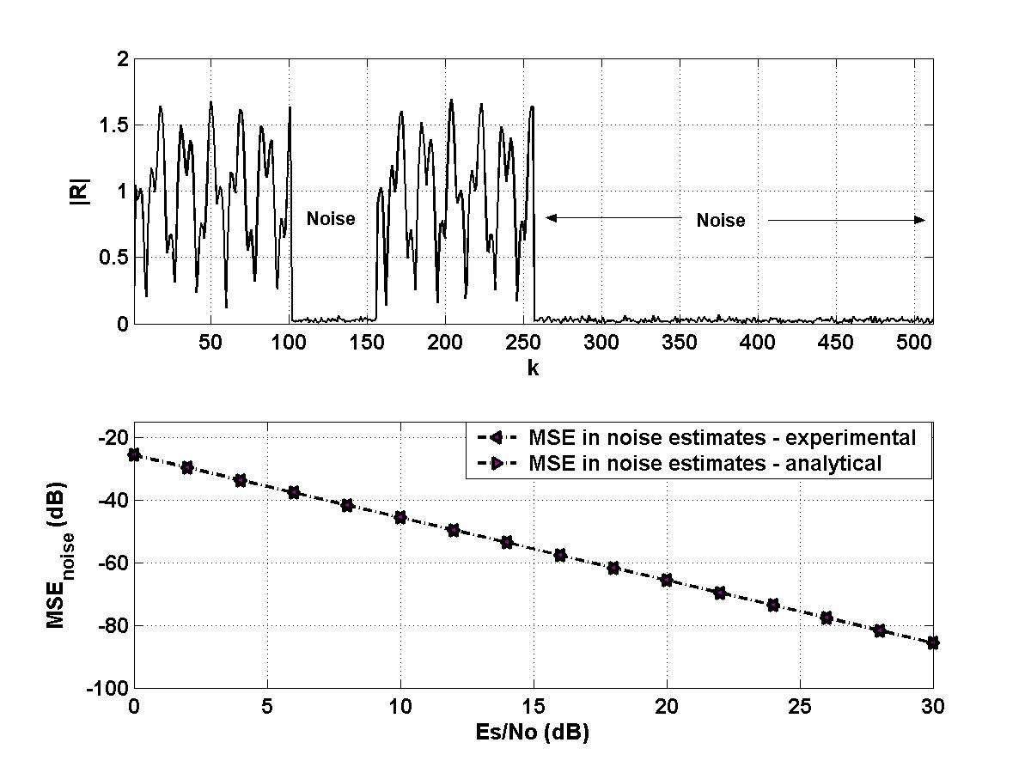
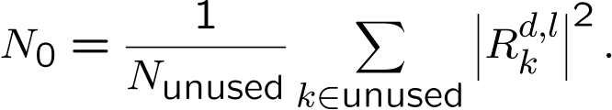
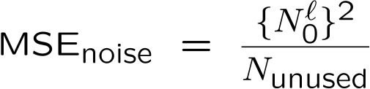
Signal Acquisition Phase
Step VIA – Noise variance estimation - Time Domain
Frequency Domain
A. N. Mody, G. L. Stüber, "Parameter Estimation for MIMO OFDM Systems," IEEE Vehicular Technology Conference, Rhodes, Greece, May 2001.
42

Slide 33
Signal Tracking Phase
Signal Tracking
  Sampling frequency offset tracking / timing recovery
  Channel parameter tracking
Step IB – Sampling frequency offset tracking
If the system has a low Doppler and the sampling frequency jitters every Q OFDM symbols, then fixed pilot tones may be used to estimate the new sampling frequency offset, β^{d}. The net sampling frequency offset estimate is given by
44

Slide 34
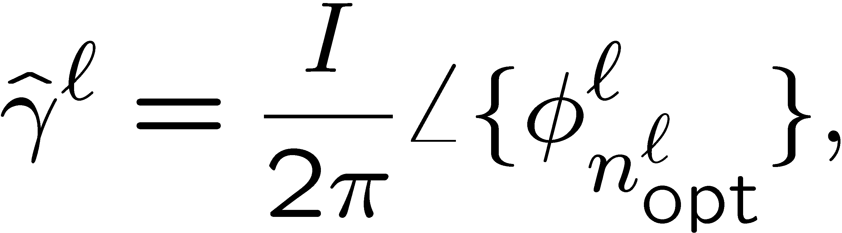
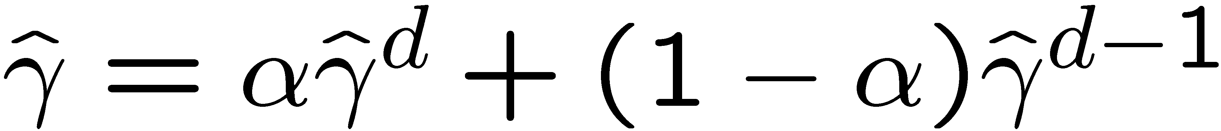
Signal Tracking Phase
Step IIB – RF oscillator frequency offset tracking
Assuming that the integral frequency offset does not change with time, the new fractional RF oscillator frequency offset is obtained using the fine time synchronization instant for each incoming OFDM symbol as
The new estimate is is then subjected to a first order frequency lock loop (FLL) to obtain the RF oscillator frequency offset as
A. N. Mody, G. L. Stüber, "Signal Acquisition and Tracking for MIMO OFDM," Submitted to the IEEE Transactions on Wireless Communications.
45

Slide 35
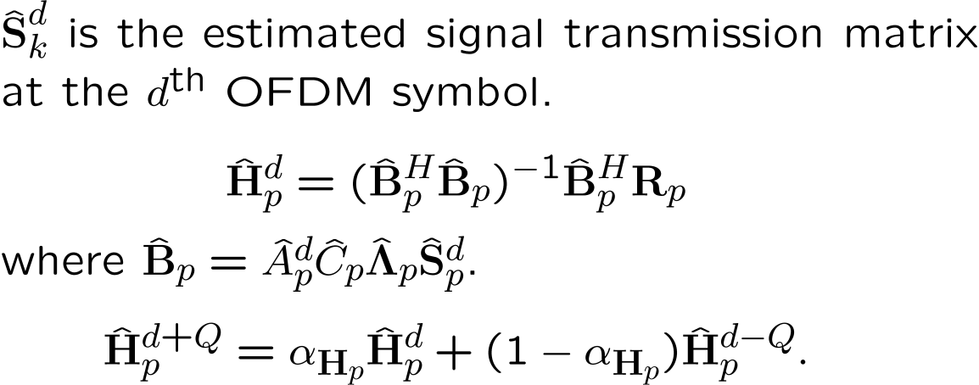
Signal Tracking Phase
Channel Tracking
  Even though, for WLAN and WMAN applications, the channel changes little from frame to frame, it needs to be updated since the effective channel is constantly changing due to the accumulation in the parameter estimation errors.
  In this research we use decision directed channel tracking (DDC) as follows
46

Slide 36
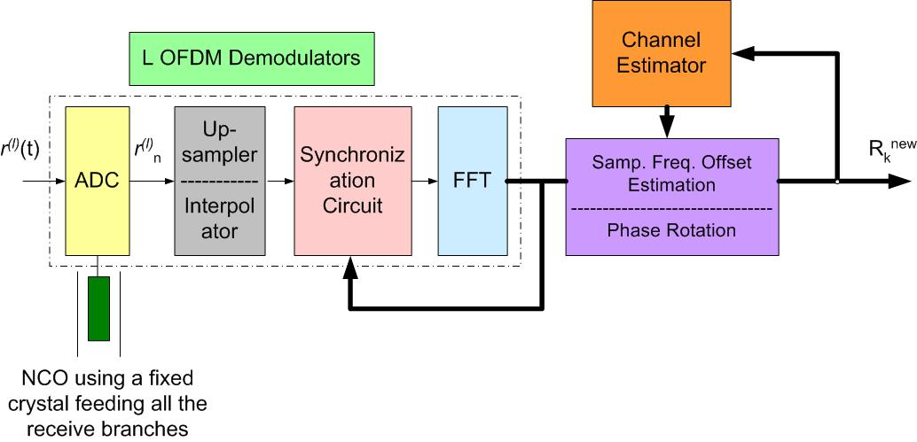
Complete Receiver Architecture
48

Slide 37
Simulation Parameters
The sampling frequency offset is 10 parts per million and varies every Q OFDM symbols in a random walk as
The RF oscillator frequency offset Γ+γ is 1.2 subcarrier spacings and γ assumes a new value for every frame
49

Slide 38
Simulation Parameters
Bandwidth = 4 MHz,
Blocksize N = 256,
Guard G = 64,
Modulation type – 16-QAM,
F = Number of space-time blocks per frame = 20,
No channel coding employed,
Rate 1 space-time block code (STBC) used for a 2X2 system and rate ¾ STBC used for a 4X4 system.
Total frequency offset Γ+γ = 1+0.2 subcarrier spacings,
Number of tones used, N_{u}=200,
50

Slide 39

Simulation Results for Signal Acquisition
Uncoded BER as a function of bit energy to noise ratio E_{b}/N₀ for a 4X4 system using 16-QAM modulation and after synchronization and channel estimation. β = 0. Sampling frequency offset estimation and correction not performed.
51

Slide 40


Simulation Results
Overall BER performance for a 4 X 4 system in the presence and absence of the phase noise. β = 10 ppm, frame
length F = 80 OFDM symbols, frequency offset Γ+γ = 1.2
subcarrier spacings, I=1, N=256 and Nu=200.
Overall BER performance for a 4 X 4 system in the presence of the phase noise. β = 10 ppm, frame
length F = 40 OFDM symbols, frequency offset Γ+γ = 1.2
subcarrier spacings, Var{θ}= 50 π ppm, Ι=1, N=256 and Nu=200.
52

Slide 41

Joint Work - LDPC Coded OFDM with Alamouti / SVD Diversity Technique
65

Slide 42

Joint Work - LDPC Coded OFDM with Alamouti / SVD Diversity Technique
J. Ha, A. N. Mody, J. H. Sung, J. Barry, S. Mclaughlin and G. L. Stüber, "LDPC Coded OFDM with Alamouti/SVD Diversity Technique," Kluwer Journal on Wireless Personal Communications, 23(1):183-194, October 2002.
66

Slide 43

Alternate Space-Time Strategies
Use of alternate space-time strategies such as Bell labs layered space time (BLAST),
http://www-out.bell-labs.com/project/blast/high-level-overview.html
70

Slide 44

Incorporating Channel Coding
Use of alternate coding schemes such as low density parity check codes (LDPC), turbo codes into the MIMO-OFDM system to enhance the system performance and improve the parameter estimation
71

Slide 45
MIMO-OFDM For Mobile Broadband Wireless Access
The channel can be tracked by either using the embedded pilot tones or re-using the data in the decision-directed mode.
Use of pilot tones produces more accurate channel estimates but reduces the overall throughput of the system.
Pilot tones must obey the Nyquist sampling theorem in both the time and the frequency domains.
Estimation of new channel estimates must be followed by an appropriate channel interpolation scheme both in the time and the frequency domains.
For a fast varying channel it is necessary to overlay variable pilot tones on top of the fixed pilot tones.
Since a BFWA system deals with very low values of Doppler (0.5 Hz) channel variations are essentially due to due to the frequency offsets, so channel re-estimation is not necessary
72

Slide 46





MIMO-OFDM For Mobile Broadband Wireless Access
Ye Li, et al. – Channel Est. for OFDM Syst. with Diversity in Mobile Wireless – IEEE JSAC March 1999
Ye Li – Pilot Aided Channel Estimation for OFDM – IEEE Trans. on Vehic. Tech. July 2000
73

Slide 47
Conclusions
We presented some ideas on how to meet the P802.22b requirements through MIMO techniques based on prior research.
This presentation is by no means complete, and other ideas will be presented in the future.

Slide 48
References
A. N. Mody, G. L. Stuber, "Signal Acquisition and Tracking for Fixed Wireless Access MIMO OFDM," Submitted to the IEEE Transactions on Wireless Communications.
A. N . Mody, R. Raich and G. L. Stuber “Cramer-Rao Bounds and Maximum Likelihood Estimation of the Parameters Associated with SISO-OFDM Systems” under preparation to be submitted to IEEE Trans. on Signal Processing.
J. Ha, A. N. Mody, J. H. Sung, J. Barry, S. Mclaughlin and G. L. Stuber, "LDPC Coded OFDM with Alamouti/SVD Diversity Technique," Kluwer Journal on Wireless Personal Communicatins, 23(1):183-194, October 2002.
A. N. Mody, G. L. Stuber, "Open Loop Timing Recovery and Channel Estimation for MIMO OFDM Systems," 8th International OFDM Workshop, Harburg, Germany, Sept. 2003.
A. N. Mody, G. L. Stuber, "Receiver Implementation for a MIMO OFDM System," IEEE Global Communications Conference, Taipei, Taiwan, Nov. 2002.
A. N. Mody, G. L. Stuber, "Synchronization for MIMO OFDM Systems," IEEE Global Communications Conference, San Antonio, Texas, Nov. 2001.
A. N. Mody, G. L. Stuber, "Parameter Estimation for MIMO OFDM Systems," IEEE Vehicular Technology Conference, Rhodes, Greece, May 2001.
77

