Slide 1
[MAC Proposal for IEEE 802.22b by Hitachi Kokusai Electric]
IEEE P802.22b Wireless RANs Date: 2013-1-16
Authors:
Notice: This document has been prepared to assist IEEE 802.22. It is offered as a basis for discussion and is not binding on the contributing individual(s) or organization(s). The material in this document is subject to change in form and content after further study. The contributor(s) reserve(s) the right to add, amend or withdraw material contained herein.
Release: The contributor grants a free, irrevocable license to the IEEE to incorporate material contained in this contribution, and any modifications thereof, in the creation of an IEEE Standards publication; to copyright in the IEEE’s name any IEEE Standards publication even though it may include portions of this contribution; and at the IEEE’s sole discretion to permit others to reproduce in whole or in part the resulting IEEE Standards publication. The contributor also acknowledges and accepts that this contribution may be made public by IEEE 802.22.
Patent Policy and Procedures: The contributor is familiar with the IEEE 802 Patent Policy and Procedures http://standards.ieee.org/guides/bylaws/sb-bylaws.pdf including the statement "IEEE standards may include the known use of patent(s), including patent applications, provided the IEEE receives assurance from the patent holder or applicant with respect to patents essential for compliance with both mandatory and optional portions of the standard." Early disclosure to the Working Group of patent information that might be relevant to the standard is essential to reduce the possibility for delays in the development process and increase the likelihood that the draft publication will be approved for publication. Please notify the Chair
Apurva Mody <apurva.mody@ieee.org> as early as possible, in written or electronic form, if patented technology (or technology under patent application) might be incorporated into a draft standard being developed within the IEEE 802.22 Working Group. If you have questions, contact the IEEE Patent Committee Administrator at patcom@iee.org.

Slide 2
Abstract
This contribution presents a partial MAC proposal for IEEE 802.22b which is the amendment in the IEEE Std. 802.22-2011[1] to support enhanced broadband services and monitoring applications.
This partial MAC proposal consists of
Multi Channel MAC
Multi Channel Sharing Scheme

Slide 3
Functional Requirements [2]
This contribution comply with the following functional requirement.
[Req02] provide a means of achieving throughput at least 2 times higher than the maximum throughput supported by the IEEE Std. 802.22-2011.

Slide 4
Multi Channel MAC

Slide 5
Outline
Motivation
Changes to current IEEE Std. 802.22-2011
Channel Allocation Manager (CAM)
Operation Flow for Adding New Operating Channel
Operation Flow for Stopping Operating Channel
Operation Flow for Switching Operating Channel
Changes on BS initialization procedure
Commence multichannel operation at BS
Changes on CPE initialization procedure
Commence multichannel operation at CPE

Slide 6
Motivation
802.22b needs to support enhanced broadband services and monitoring applications which require high data throughput.
minor changes to current IEEE Std. 802.22-2011 for enabling the multi channel allocation instead of single channel allocation in the current IEEE Std. 802.22-2011 to achieve high data throughput and also minimize the cost of the device.

Slide 7
Changes to current IEEE Std. 802.22-2011
New entity
Channel Allocation Manager (CAM)
New functions
Add New Operating Channel
Stop Operating Channel
Switch Operating Channel

Slide 8
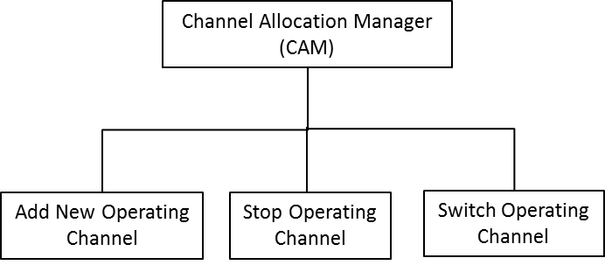
Channel Allocation Manager

Slide 9
Channel Allocation Manager (cont.)
Add New Operating Channel
allocate new operating channel to each available channel transceiver unit (CHU)
Stop Operating Channel
stop the operating channel of the specific CHU
Switch Operating Channel
switch the operating channel of the specific CHU
CHU: A transceiver unit for a specific channel operation which is consists of a MAC Layer and a Physical Layer.

Slide 10
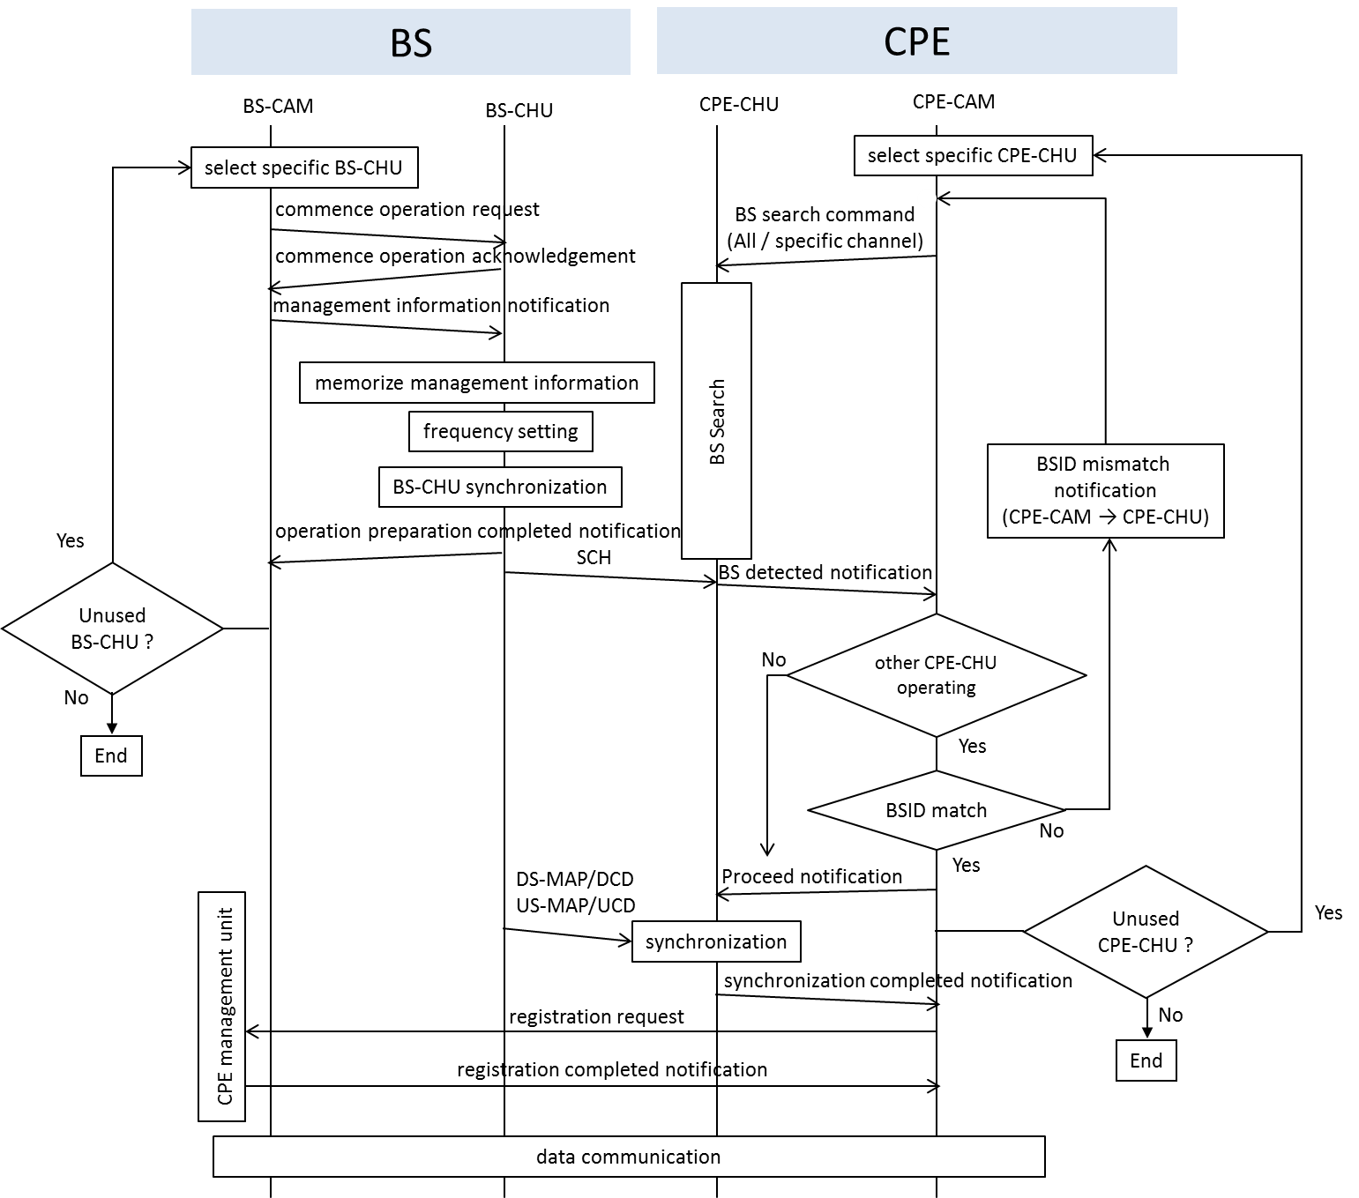
Operation Flow for Adding New
Operating Channel

Slide 11
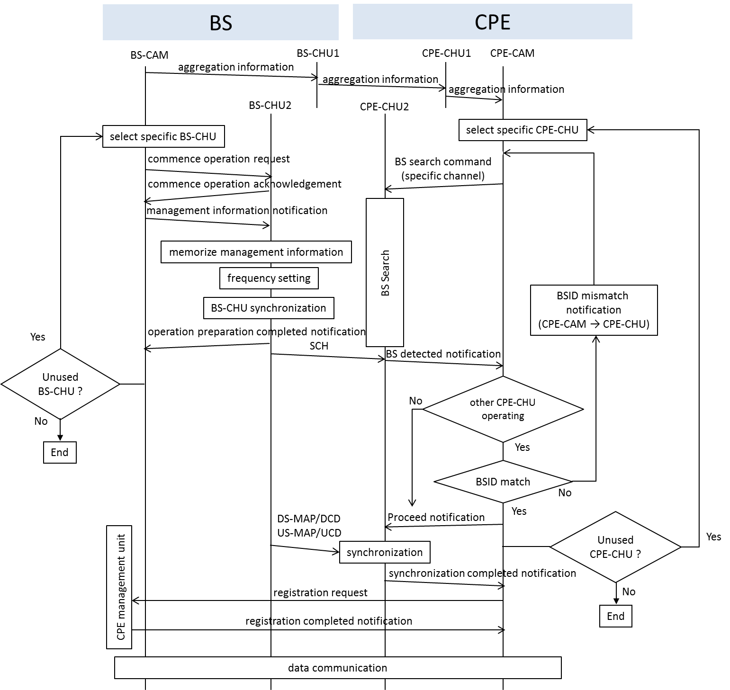
Operation Flow for BS search command (specific channel)

Slide 12
Message for Aggregation Information
Parameters | Length | Notes
Message Type | 8 bits
Aggregation Information | 1 bit | 0: Aggregation on 1: Aggregation off
Aggregation number | 3 bits | Number of maximum aggregation channel allowed in CPE
Aggregation Channel | 8 bits x n | The channel information that available for channel aggregation

Slide 13
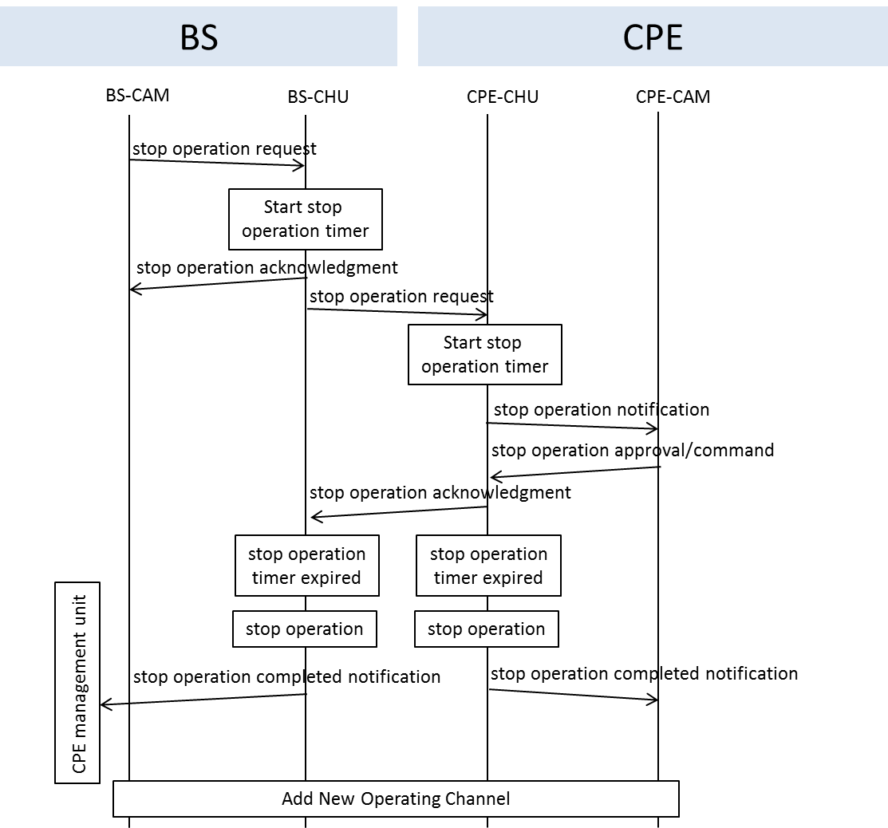
Operation Flow for Stopping
Operating Channel

Slide 14
Message for Stop Operation Request
Parameters | Length | Notes
Message Type | 8 bits
Transaction ID | 16 bits
Confirmation Needed | 1 bit | 0: No confirmation needed 1: Confirmation needed
Specified Channel Stop | 8 bits | Specified destination for channel stop operation request

Slide 15
Message for Stop Operation Acknowledgement
Parameters | Length | Notes
Message Type | 8 bits
Transaction ID | 16 bits
Confirmation Code | 8 bits | Using the same confirmation code as in IEEE Std. 802.22-2011

Slide 16
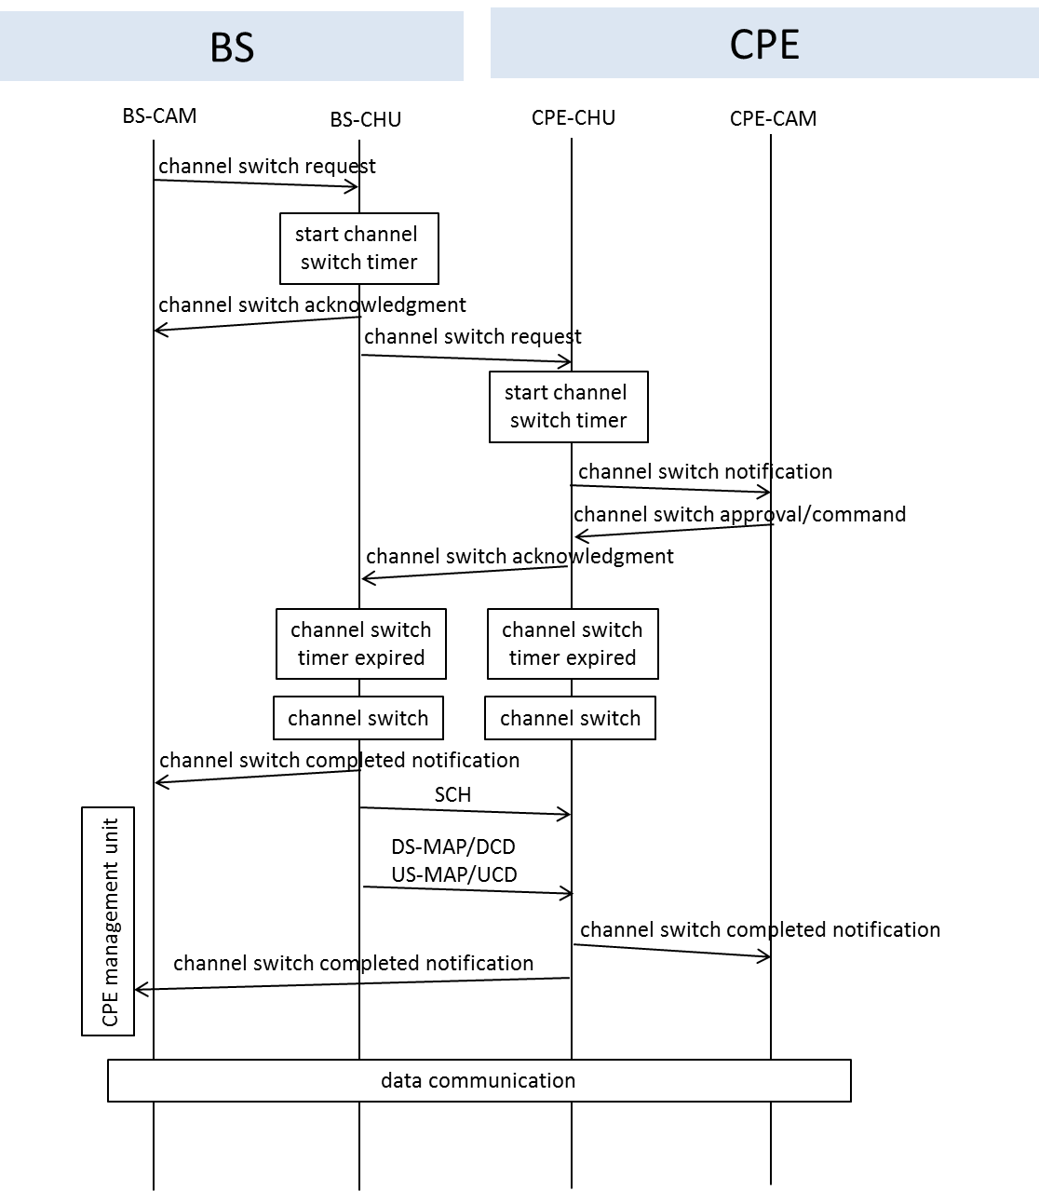
Operation Flow for Switching
Operating Channel

Slide 17
Message for Channel Switch Request
Parameters | Length | Notes
Message Type | 8 bits
Transaction ID | 16 bits
Confirmation Needed | 1 bit | 0: No confirmation needed 1: Confirmation needed
Switch Mode | 1 bit | 0: no restriction on transmission until the scheduled channel switch 1: addressed CPE shall transmit no further frames until the schedules channel switch
Switch Count | 8 bits | The number of frames until the BS sending the switching operating channel message switches to the new operating channel
Specified Channel Switch | 8 bits | Specified destination for channel switch request

Slide 18
Message for Channel Switch Acknowledgement
Parameters | Length | Notes
Message Type | 8 bits
Transaction ID | 16 bits
Confirmation Code | 8 bits | Using the same confirmation code as in IEEE Std. 802.22-2011

Slide 19
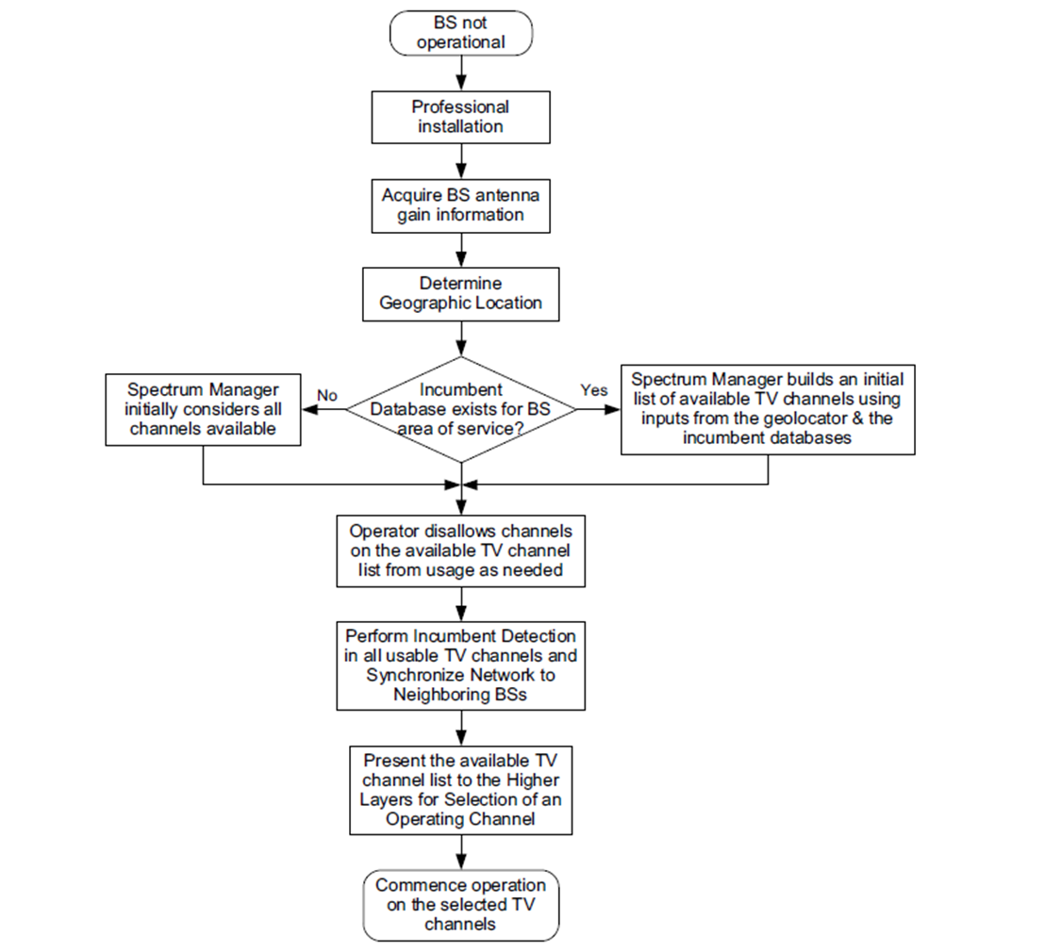
Changes on BS initialization procedure
Present the available TV channel
list to the Higher Layers for Selection of operating channels
Commence multichannel operation on the selected TV channels
Changes to IEEE Std. 802.22-2011

Slide 20
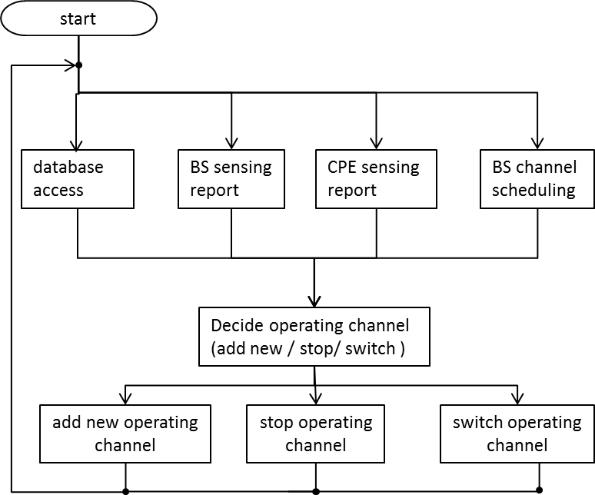
Commence multichannel operation at BS

Slide 21
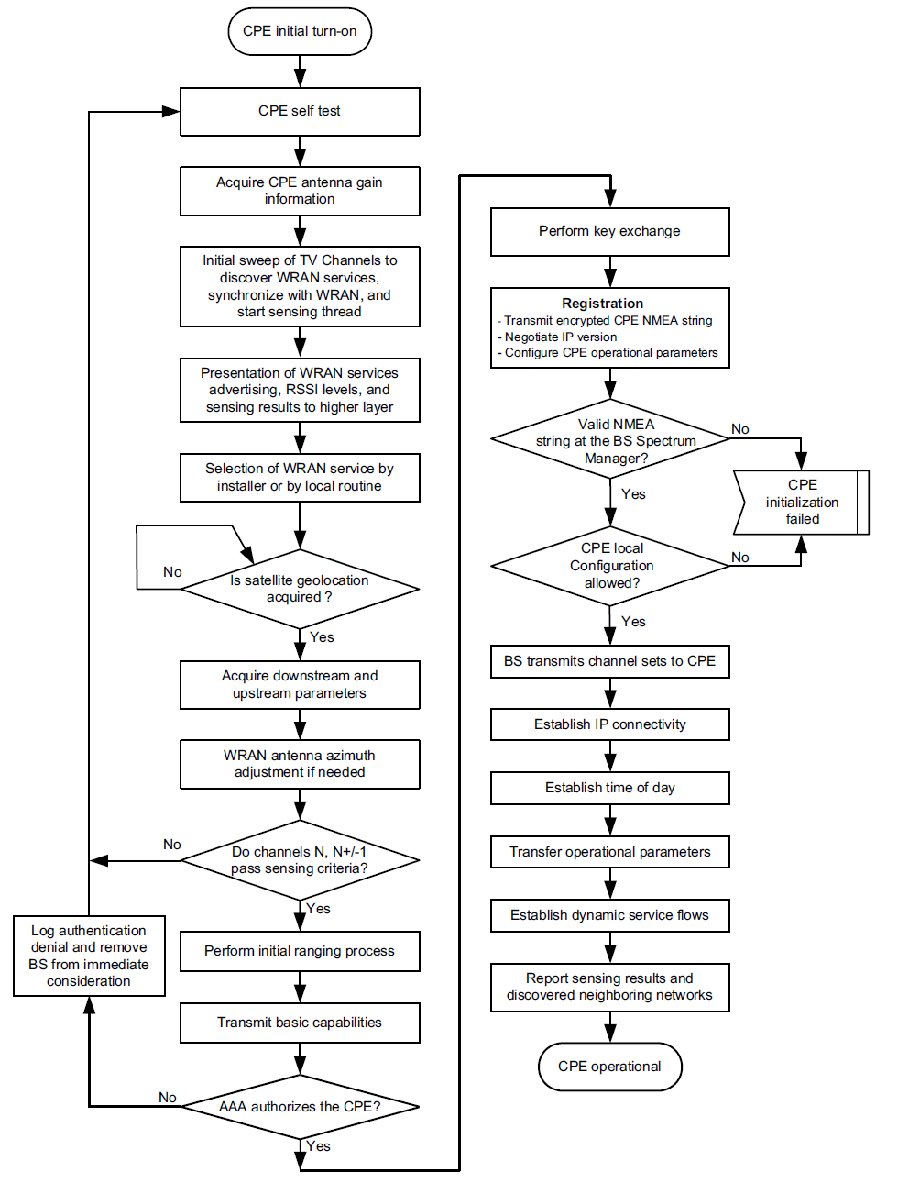
Changes on CPE initialization procedure
Selection of WRAN service by Installer or by local routine for multichannel operation
Changes to IEEE Std. 802.22-2011

Slide 22
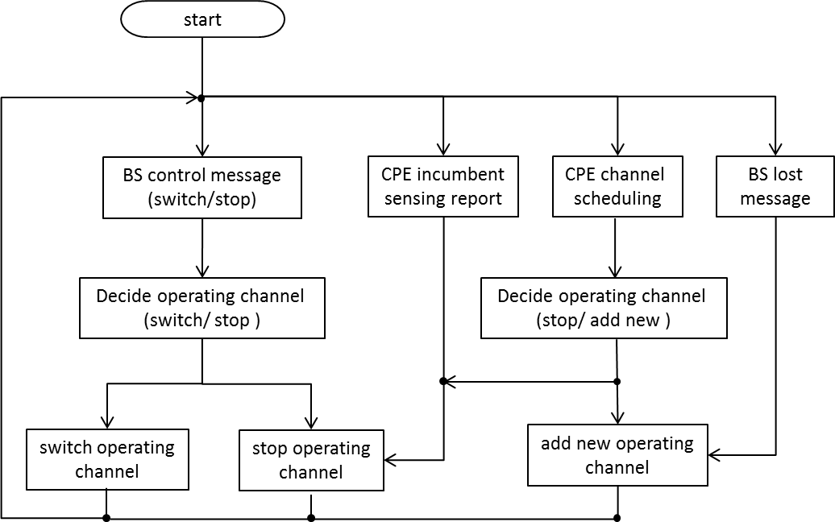
Commence multichannel operation at CPE

Slide 23
Multichannel Sharing Scheme

Slide 24
Outline
Motivation
Changes to current IEEE Std. 802.22-2011
Operation Flow for Multi Channel Sharing Scheme (MCSS)
Message Flow of the MCSS

Slide 25
Motivation [3]
Autonomous channel sharing scheme in IEEE 802.22-2011
  Spectrum Etiquette and Self-Coexistence
Spectrum Etiquette
  Use channels that are not selected as operating or backup of the discovered neighboring cell
Self-Coexistence
  Neighboring cells share a common transmission channel
  Realization using Coexistence Beacon Protocol
  Time division sharing scheme in frame based（On-demand Frame Contention: ODFC）
→ no limitation on the channel number used per cell
channel may be occupied by early registered cell
→ cannot share the resources in channel based
Only can content through frame based even though unfair
in resource allocation exist
We propose a scheme that can manage multichannel sharing efficiently and flexibly to support enhanced broadband services and monitoring applications.

Slide 26
Changes to current IEEE Std. 802.22-2011
New function
Channel Negotiation (CHN)
New messages
Channel Release Request (CHN-REQ)
Channel Release Time Notice (CHN-RSP)
Channel Release Time Acknowledgement (CHN-ACK)
Channel Release Completed (CHN-REL)

Slide 27
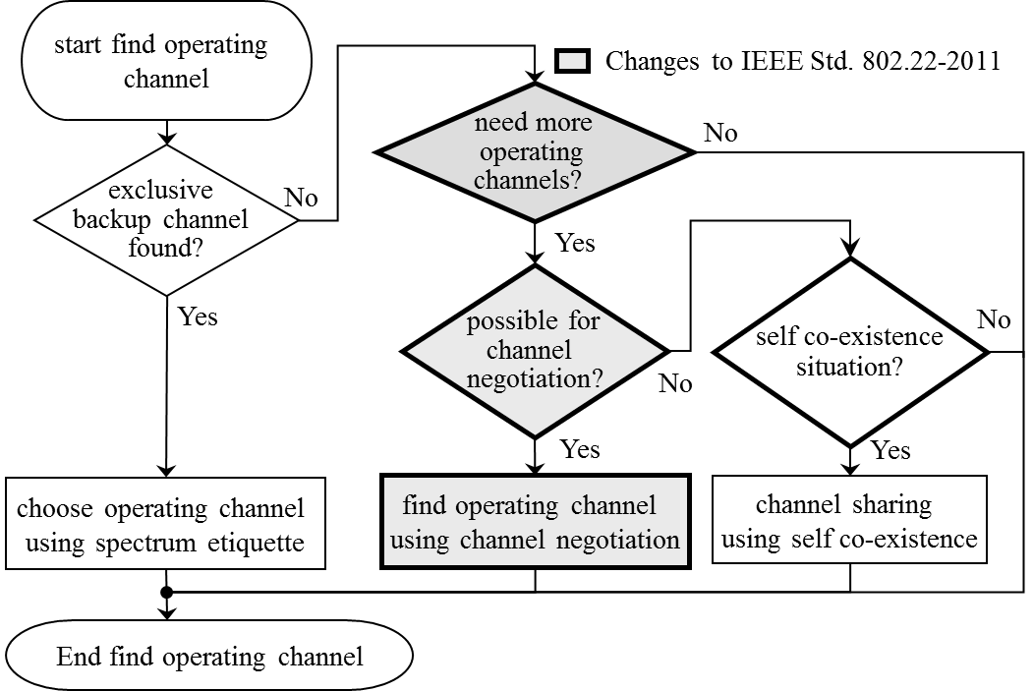
Operation Flow for Multi Channel Sharing Scheme (MCSS) [3]

Slide 28
Message Flow of the MCSS [3]
Source (BS)
Destination (BS)
channel release request (CHN-REQ)
release time notice (CHN-RSP)
time
confirm receive notice (CHN-ACK)
release completed notice (CHN-REL)

Slide 29
Conclusion
Proposed a partial MAC proposal for IEEE 802.22b.
The proposed partial MAC proposal consists of
Multi Channel MAC which enabling multi channel allocation in the 802.22b system instead of single channel allocation in the IEEE Std. 802.22-2011.
Multi Channel Sharing Scheme (MCSS) which can manage multichannel sharing efficiently and flexibly to support enhanced broadband services and monitoring applications.

Slide 30
References
IEEE Std. 802.22-2011, July 2011
Functional Requirements for IEEE 802.22b amendment : IEEE 802.22-12/0012r03-000b
Keigo Hasegawa, Masayuki Takekawa, Keat-Beng Toh, Kei Yanagisawa, Seishi Sasaki, Masahiro Asano, “Multichannel Sharing Scheme in IEEE802.22 WRAN Systems”, IEICE General Conference 2012, pp.615, B-17-17, 20-23 March 2012.

Slide 31
Appendix

Slide 32
Appendix: MCSS (1/5) [3]
Channel Sharing Scheme | IEEE 802.22 | Proposed Scheme
 | Spectrum Etiquette | Spectrum Etiquette
 | Self-coexistence （frame contention） | channel negotiation & frame contention
1 frame
preamble
SCH
FCH, MAP
DS burst
US burst
Coexistence
Window
Send channel negotiation information
during this period（define a new message）

Slide 33
Appendix: MCSS (2/5) [3]
Example of condition “need more operating channels” in MCSS
(1) cell Service Satisfaction Ratio is not satisfied
Service Satisfaction Ratio (SSR) : ratio of CPE that (transmission rate > weight traffic)
: number of operation channel in cell j
: total number of CPEs in cell j
i : i-th CPE in cell j
: weight of i-th CPE in cell j
: transmission rate of i-th CPE in cell j
: traffic rate of i-th CPE in cell j
Example of condition “possible for channel negotiation” in MCSS
(2) Cell Service Availability value is the smallest among neighboring cells
Cell Service Availability (CSA ) : Indicator for summation of each CPE traffic processing time
: Cell Service Availability of cell j
CSA value and operating channel information will be exchange within neighboring cells in advance
Cell that possess the largest CSA value and the CSA value of destination cell will not overturn by negotiation
with the source cell

Slide 34
Appendix: MCSS Simulation Result (3/5) [3]
Allocate 19 cells
（same operating channel for neighboring cells is not allowed）
Cell radius = 11 km
Randomly allocate 100 CPEs
with average traffic =1 Mbps
ITU-R P.1546 propagation model is
used for CINR calculation with MCS

Slide 35
Appendix: MCSS Simulation Result (4/5) [3]
Proposed scheme improve the average SSR by 1.2 times compare to IEEE 802.22
1
W_{i} = 1
0.9
0.8
0.7
0.6
W_{i} random（1~4）
Average SSR
0.5
0.4
0.3
Proposed
Fair
0.2
Random
0.1
IEEE802.22
0
0
5
10
15
20
Number of available channels

Slide 36
Appendix: MCSS Simulation Result (5/5) [3]
1
It shows that the CCDF=0.9 of proposed scheme improve 1.2 times compare to IEEE 802.22
0.9
0.8
Random scheme (no negotiation)
performance deteriorated compare
to IEEE 802.22
(larger variance value of SSR)
0.7
0.6
W_{i} random
CCDF
0.5
0.4
W_{i} = 1
0.3
Proposed
Fair
0.2
Random
WS Available Channel = 5 channels
0.1
IEEE802.22
0
0
0.2
0.4
0.6
0.8
1
SSR

