Slide 1
Proposed Frame Structure for
IEEE 802.22b Systems
IEEE P802.22 Wireless RANs Date: 2012-10-25
Authors:
Notice: This document has been prepared to assist IEEE 802.22. It is offered as a basis for discussion and is not binding on the contributing individual(s) or organization(s). The material in this document is subject to change in form and content after further study. The contributor(s) reserve(s) the right to add, amend or withdraw material contained herein.
Release: The contributor grants a free, irrevocable license to the IEEE to incorporate material contained in this contribution, and any modifications thereof, in the creation of an IEEE Standards publication; to copyright in the IEEE’s name any IEEE Standards publication even though it may include portions of this contribution; and at the IEEE’s sole discretion to permit others to reproduce in whole or in part the resulting IEEE Standards publication. The contributor also acknowledges and accepts that this contribution may be made public by IEEE 802.22.
Patent Policy and Procedures: The contributor is familiar with the IEEE 802 Patent Policy and Procedures http://standards.ieee.org/guides/bylaws/sb-bylaws.pdf including the statement "IEEE standards may include the known use of patent(s), including patent applications, provided the IEEE receives assurance from the patent holder or applicant with respect to patents essential for compliance with both mandatory and optional portions of the standard." Early disclosure to the Working Group of patent information that might be relevant to the standard is essential to reduce the possibility for delays in the development process and increase the likelihood that the draft publication will be approved for publication. Please notify the Chair
Apurva Mody <apurva.mody@ieee.org> as early as possible, in written or electronic form, if patented technology (or technology under patent application) might be incorporated into a draft standard being developed within the IEEE 802.22 Working Group. If you have questions, contact the IEEE Patent Committee Administrator at patcom@iee.org.

Slide 2
Abstract
Based on simple modification of the 802.22-2011 frame structure, this presentation proposes amendment of the frame structure of 802.22b standard
Proposed frame structure supports Smart Grid & Monitoring, Broadband Service Extension and Combined Services which are defined in Selection Criteria for IEEE 802.22b amendment[1]
Also, proposed frame structure supports both 802.22b SG applications and 802.22-2011 application

Slide 3
Contents
Operation Requirements for 802.22b
  IEEE 802.22b Network Entities
  Topology simplification
  Frame Structure Design Assumptions
  IEEE 802.22 Frame Structure Review
  Proposed IEEE 802.22b Frame Structure
  Design Direction
  Proposed Structure
  SGS Structure
  Reservation vs Contention
  Conclusions
  References

Slide 4
Operation Requirements for 802.22b
IEEE 802.22b Network Entities
  BS(802.22b BS)
  HCPE
  LCPE

Slide 5
Operation Requirements for 802.22b
IEEE 802.22b Network Entities
  Base Station (BS):
    802.22b BS is generalized equipment set providing connectivity, management and control of the customer premise equipment (CPE).
  High-capability CPE (H-CPE):
    802.22b H-CPE is enhanced 802.22-2011 CPE that is able to manage a local network consisting of a number of L-CPEs and to provide multi-hop connections between L-CPEs and 802.22b BS.
  Low-capability CPE (L-CPE):
    802.22b L-CPE is a device mainly for metering and monitoring, which will be installed at home, office, or on infrastructure, etc.
    A group of L-CPEs served by an H-CPE
    H-CPE may have different wireless access availabilities for the communication with BS and L-CPEs.

Slide 6
Operation Requirements for 802.22b
Topology simplification
  Coverage Extension
    Do not support data relay between LCPEs
    Required more HCPE installation
  LCPEs close to BS
    Disabling direct connection to BS
    Required another HCPE
    Connectivity of LCPE

Slide 7
Operation Requirements for 802.22b
Frame Structure Design Assumptions
  Note:
    Proposed frame structure will be adapted by changing of below considerations
  Tree Topology
    Direct connection between HCPE and BS
    Direct connection between HCPE and LCPE
  Operation Bands
    Same band operation over BS-HCPE-LCPE
    Same radio access technology
  Supporting 802.22-2011
    Supporting coexistence between 802.22-2011 and 802.22b

Slide 8
IEEE 802.22 Frame Structure Review[2]
(Logical View)
Super frame Structure
Frame Structure

Slide 9
IEEE 802.22 Frame Structure Review[2]
(Physical View)

Slide 10
IEEE 802.22 Frame Structure Review[2]
(Operation Concept)
The allocation of burst could be based on distance of CPE from BS in order to compensate the propagation delay under overlapping cells
Contention for all CBP transmitters
The propagation time for CPEs beyond 30km will be accommodated by scheduling of late upstream bursts

Slide 11
Proposed IEEE 802.22b Frame Structure
: Design Direction
HCPE-BS links
  Use existing 802.22-2011 standard
  Add high capacity supporting features
LCPE-HCPE links
  Newly defined LCPE-HCPE time slot called SGS(Smart Grid Slot)
  SGS slot can be used both reservation and contention access
    When 802.22b WG decide access mechanism, remaining structure will be modified additionally

Slide 12
Proposed IEEE 802.22b Frame Structure
: Simplest Change with Current Standard

Slide 13
Proposed IEEE 802.22b Frame Structure
: Pros and Cons
Pros
  Smallest change for current 802.22-2011 standard
  Supporting for coexistence with 802.22-2011
  Supporting for independent operation time slot of 802.22b between LCPE and HCPE
    Independent for 802.22b LCPE PHY features
    Independent for 802.22b LCPE MAC features
Cons
  Capacity degradation as much as supporting of 802.22-2011 features
  Required new HCPE features in order to support connection between HCPE and LCPE → essential requirements of 802.22b

Slide 14
Proposed IEEE 802.22b Frame Structure
: SGW used cases

Slide 15
Proposed IEEE 802.22b Frame Structure
: SGW used cases

Slide 16
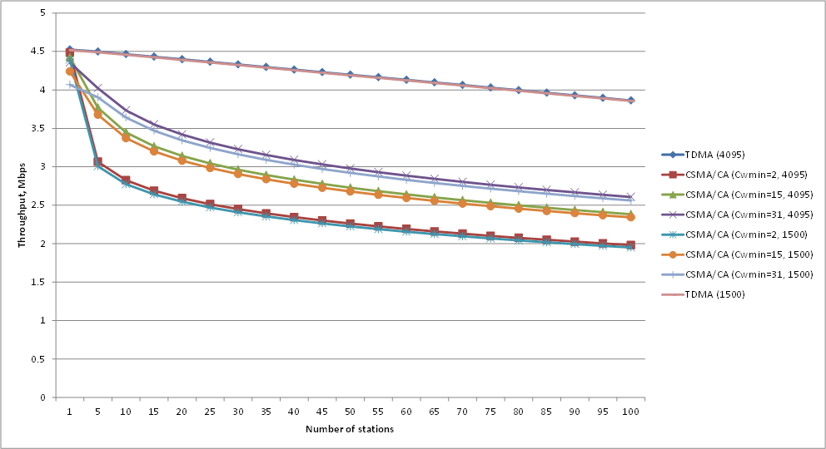
Proposed IEEE 802.22b Frame Structure
: Reservation vs Contention
Reservation
  TDMA(used all frequency band)
  Simple Polling Allocation
    UL-MAP size=(34+N*67+pad)bits
      34(UL-MAP header)
      N #of LCPE
      67(average UL-MAP IE size)
  About 15% overhead @100users
Contention
  CSMA/CA with ACK
  About 40% overhead @ 100users
  Throughput varies depends on CW size
Parameter | TDMA | CSMA/CA
MAC header size (bytes) | 4bytes | 4bytes
Data size = MSDU size (bytes) | 4095, 1500 bytes | 4095,1500 bytes
PHY data rate (Mbit/s) | 4.54Mbps (1/2 QPSK) | 4.54 Mbps
PHY header size (bytes) | Not include | Not include
PHY header transmission rate (Mbit/s) | Not include | Not include
PHY slot time (usec) | N/A | 15u
ACK scheme | N/A | Normal ACK
ACK size (bytes) | N/A | 14bytes
ACK PHY rate (Mbit/s) | N/A | 4.54Mbps
SIFS time | N/A | 10u
CWmin | N/A | variables
CWmax | N/A | 1024
Number of STA | 1 – 100 | 1 – 100

Slide 17
Conclusions
Proposed frame structure is a design example, it will be modified according to 802.22b WG specific design decision
Proposed frame structure supports 802.22b features with smallest change of the 802.22-2011 standard
Proposed frame structure supports compatibility between 802.22b and 802.22-2011 standard
Reservation method is more efficient for access scheme of LCPE-HCPE

Slide 18
References
[1] “Selection Criteria for IEEE 802.22b amendment,” 22-07-0136-00-0000, July, 2012.
[2] “Introduction to IEEE Std. 802.22-2011 and its Amendment PAR for P802.22b: Broadband Extension and Monitoring,” 22-11-0132-03-0000, Nov., 2011.

