Slide 1
[PAPR Evaluation on SCH in IEEE 802.22]
IEEE P802.22 Wireless RANs Date: 2012-09-19
Authors:
Notice: This document has been prepared to assist IEEE 802.22. It is offered as a basis for discussion and is not binding on the contributing individual(s) or organization(s). The material in this document is subject to change in form and content after further study. The contributor(s) reserve(s) the right to add, amend or withdraw material contained herein.
Release: The contributor grants a free, irrevocable license to the IEEE to incorporate material contained in this contribution, and any modifications thereof, in the creation of an IEEE Standards publication; to copyright in the IEEE’s name any IEEE Standards publication even though it may include portions of this contribution; and at the IEEE’s sole discretion to permit others to reproduce in whole or in part the resulting IEEE Standards publication. The contributor also acknowledges and accepts that this contribution may be made public by IEEE 802.22.
Patent Policy and Procedures: The contributor is familiar with the IEEE 802 Patent Policy and Procedures http://standards.ieee.org/guides/bylaws/sb-bylaws.pdf including the statement "IEEE standards may include the known use of patent(s), including patent applications, provided the IEEE receives assurance from the patent holder or applicant with respect to patents essential for compliance with both mandatory and optional portions of the standard." Early disclosure to the Working Group of patent information that might be relevant to the standard is essential to reduce the possibility for delays in the development process and increase the likelihood that the draft publication will be approved for publication. Please notify the Chair
Apurva Mody <apurva.mody@ieee.org> as early as possible, in written or electronic form, if patented technology (or technology under patent application) might be incorporated into a draft standard being developed within the IEEE 802.22 Working Group. If you have questions, contact the IEEE Patent Committee Administrator at patcom@iee.org.

Slide 2
Abstract
This contribution presents some information on the Peak-to-Average Power Ratio (PAPR) evaluation on the Superframe Control Header (SCH ) in the IEEE Std. 802.22-2011.

Slide 3
Superframe structure in IEEE 802.22
SCH Symbol
Normal Symbol
Superframe control header (SCH)

Slide 4
SCH Symbol in IEEE 802.22
The detail definitions of the SCH symbol are provided in 9.4.2.1 of the IEEE Std. 802.22-2011.
The length of SCH symbol = 1 OFDM symbol.
The SCH symbol is transmitted using QPSK modulation scheme , coding rate = 1/2 , repetition number = 4, and length of Cyclic Prefix = 1/4 .
The length of the SCH is 45 bytes and is encoded by a rate: 1/2 convolutional coder to give 720 coded bits.
The 720 coded bits are mapped to 360 QPSK symbols.
The QPSK 360 symbols with repetition = 4 are then mapped to the 1440 data carriers.

Slide 5
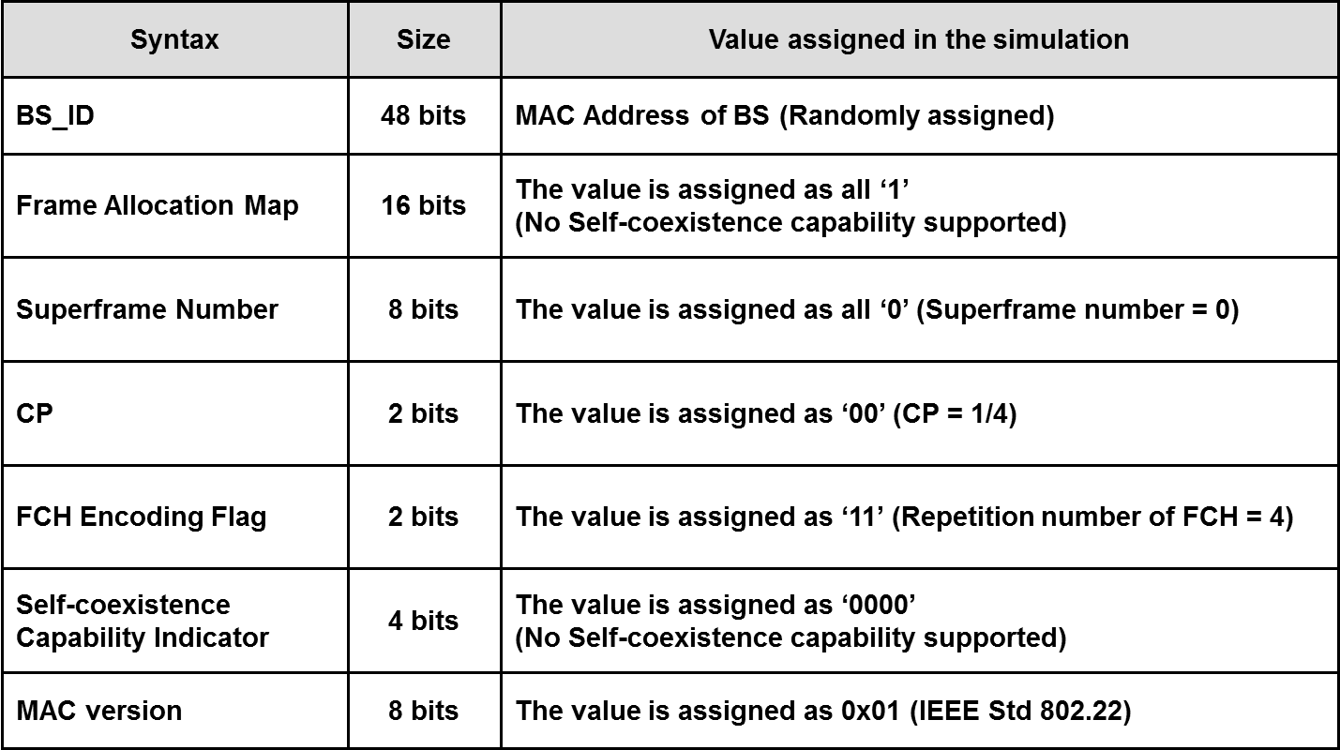
SCH Format in IEEE 802.22 (1)

Slide 6
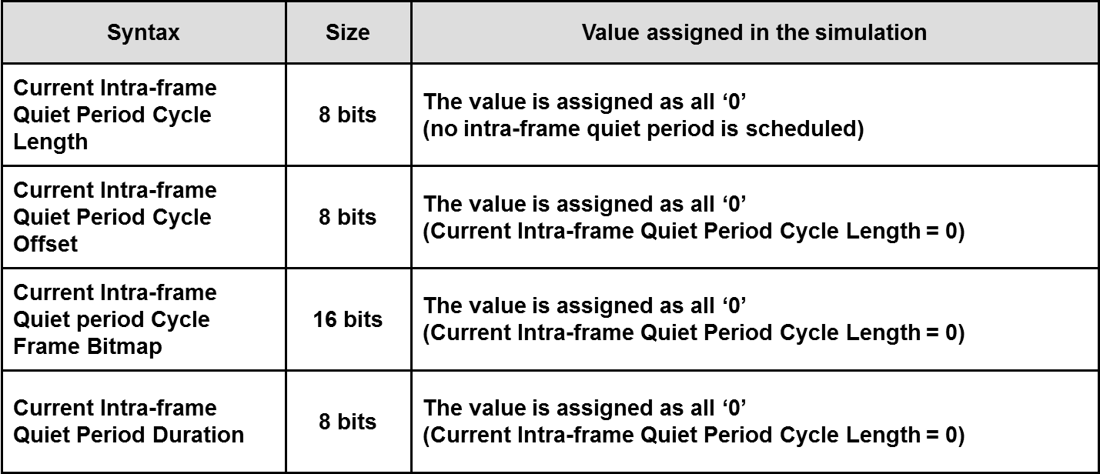
SCH Format in IEEE 802.22 (2)

Slide 7
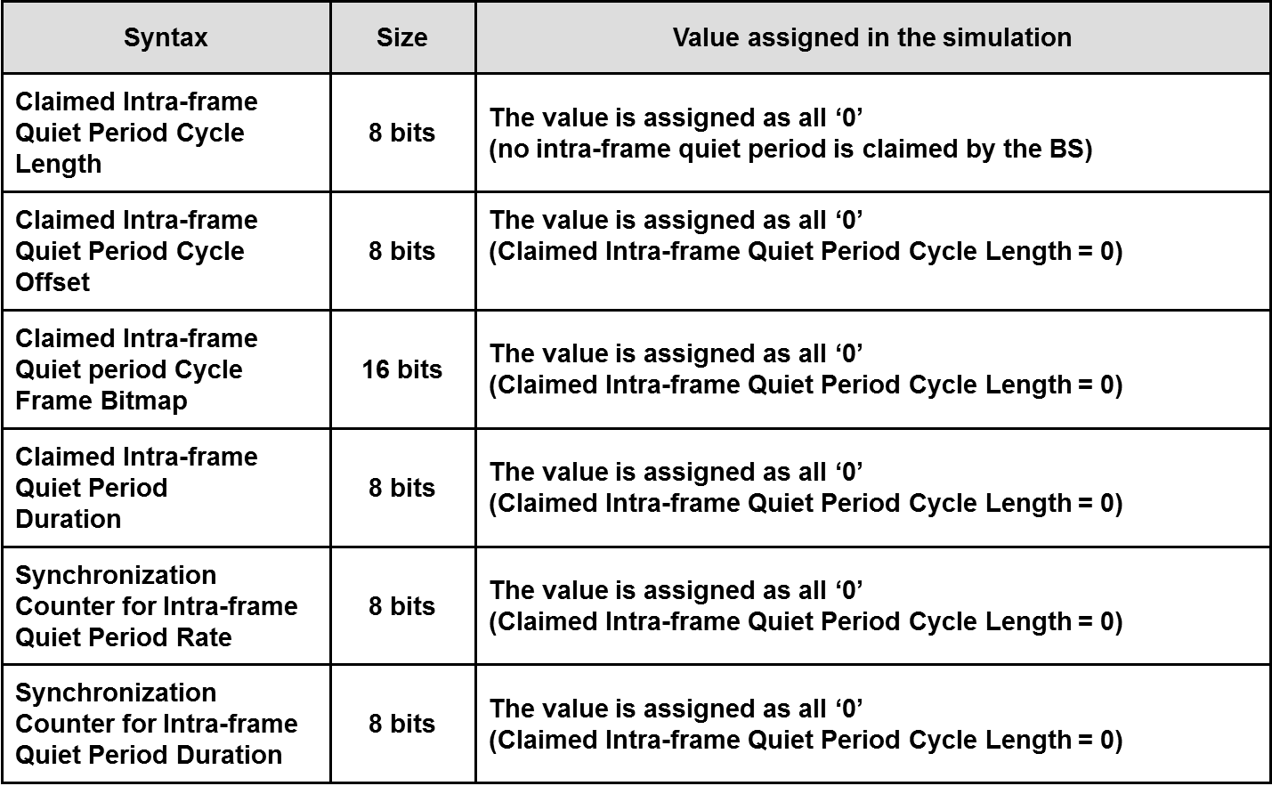
SCH Format in IEEE 802.22 (3)

Slide 8
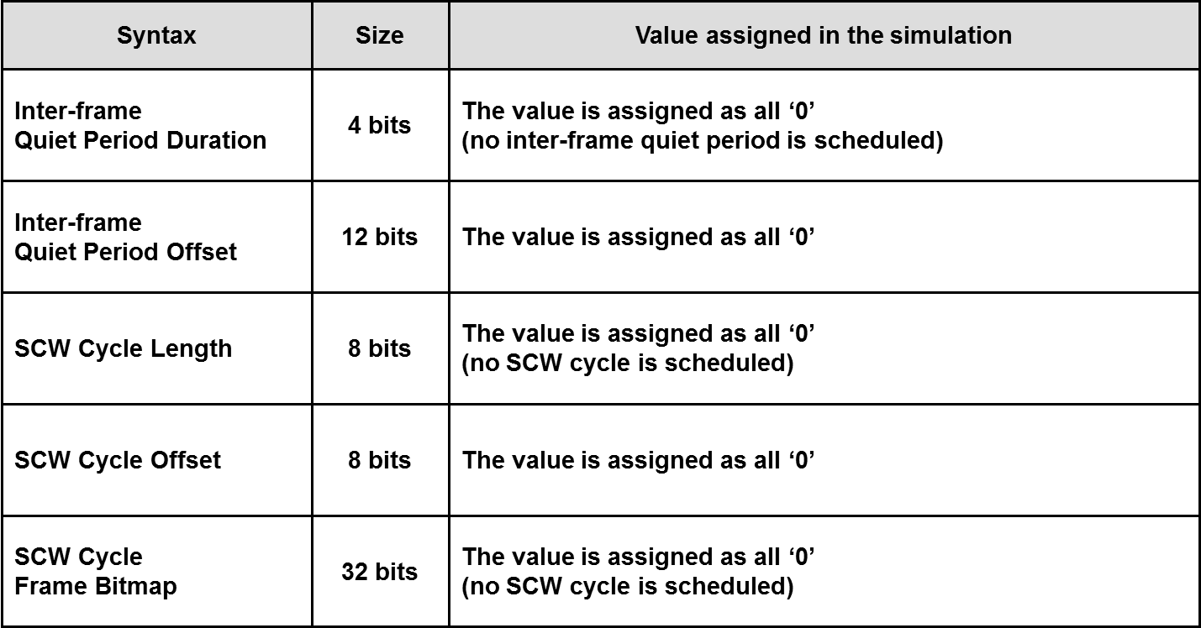
SCH Format in IEEE 802.22 (4)

Slide 9
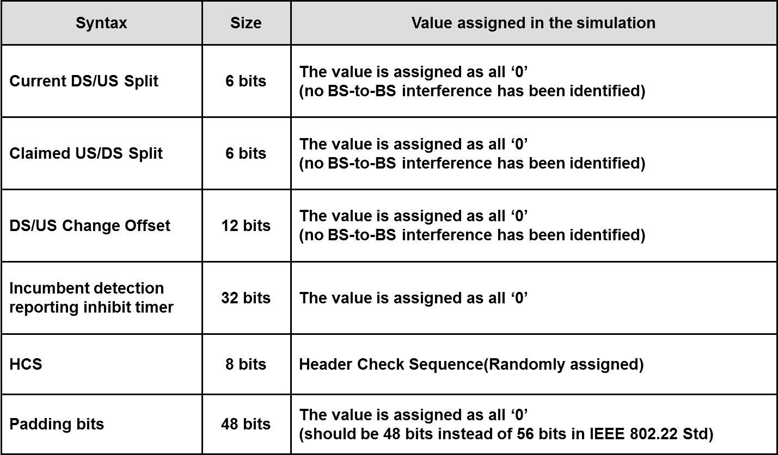
SCH Format in IEEE 802.22 (5)

Slide 10
Simulation Model (Normal Symbol)
Random Bit
Generator
Convolutional
Coding
Bit
Interleaver
Symbol
Mapping
Subcarrier
Mapping
Pilot
Modulation
And Insertion
IFFT
PAPR
Calculation
802.22 PHY
IEEE std. 802.22-2011 (PHY Mode = 5, QPSK, CC = 1/2)
Others
Block needed for Simulation Evaluation

Slide 11
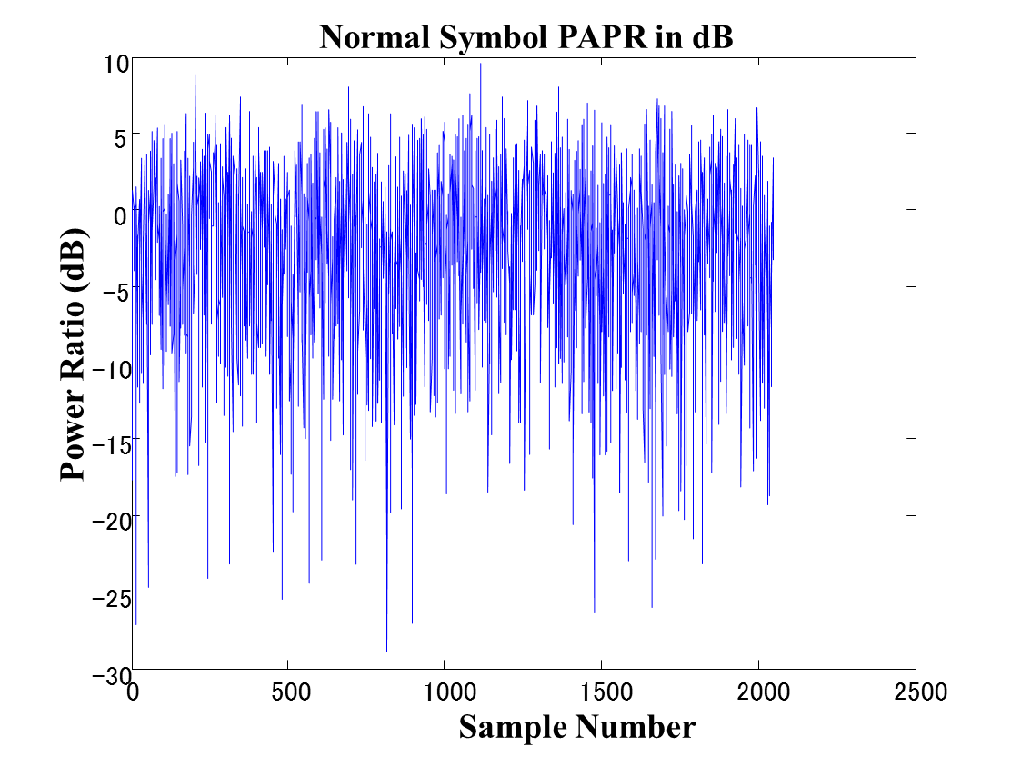
Simulation Result (Normal Symbol)
Normal Symbol Power Ratio
PAPR = 9.6 dB
In the case of
Average Power = 0 dB

Slide 12

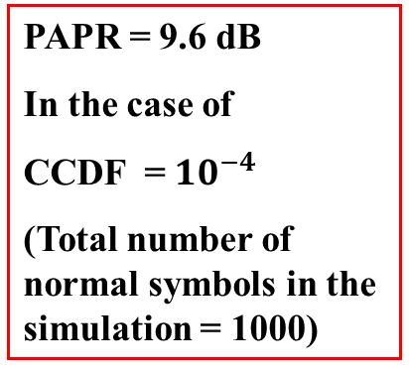
Simulation Result (CCDF of Normal Symbol)
CCDF of Normal Symbol Power Ratio
10
0
Normal
10
-1
PAPR = 9.6 dB
In the case of
CCDF = ${10}^{−4}$
(Total number of normal symbols in the simulation = 1000)
10
-2
10
-3
CCDF
$${10}^{−4}$$
10
-4
10
-5
10
-6
10
-7
-60
-50
-40
-30
-20
-10
0
10
20
Power Ratio [dB]
9.6 dB

Slide 13
Simulation Model (SCH Symbol)
SCH Format
Generator
Convolutional
Coding
Bit
Interleaver
Symbol
Mapping
Subcarrier
Mapping
Pilot
Modulation
And Insertion
IFFT
PAPR
Calculation
802.22 PHY
IEEE std. 802.22-2011 Chapter 9.4.2.1 SCH
802.22 MAC
IEEE std. 802.22-2011 Chapter 7.5.1 SCH
Others
Block needed for Simulation Evaluation

Slide 14
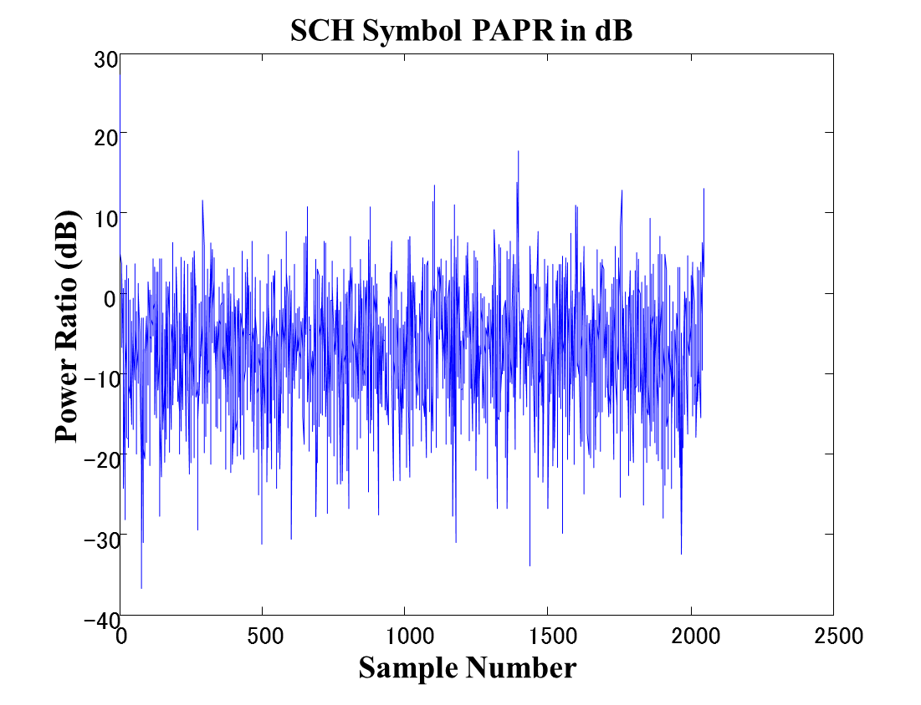
Simulation Result (SCH Symbol)
SCH symbol Power Ratio
PAPR = 27 dB
In the case of
Average Power = 0 dB

Slide 15

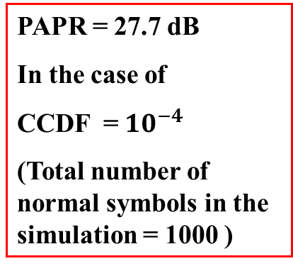
Simulation Result (CCDF of SCH Symbol)
CCDF of SCH symbol Power Ratio
10
0
10
-1
Normal
SCH
PAPR = 27.7 dB
In the case of
CCDF = ${10}^{−4}$
(Total number of normal symbols in the simulation = 1000 )
10
-2
10
-3
CCDF
$${10}^{−4}$$
10
-4
10
-5
10
-6
10
-7
-80
-60
-40
-20
0
20
40
Power Ratio [dB]
27.7dB

Slide 16
Simulation Model
(SCH Symbol with Data Scrambler)
SCH Format
Generator
Data
Scrambler
Convolutional
Coding
Bit
Interleaver
Symbol
Mapping
Subcarrier
Mapping
Pilot
Modulation
And Insertion
IFFT
PAPR
Calculation
802.22 PHY
IEEE std. 802.22-2011 Chapter 9.4.2.1 SCH
802.22 MAC
IEEE std. 802.22-2011 Chapter 7.5.1 SCH
Others
Block needed for Simulation Evaluation

Slide 17
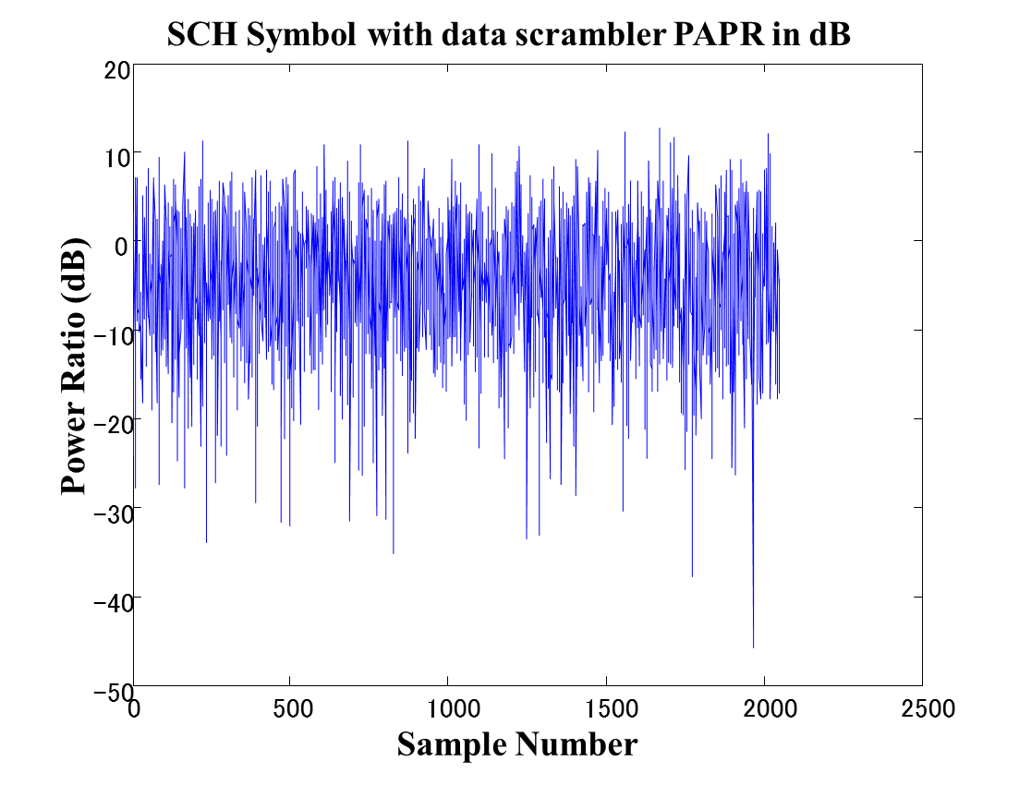
Simulation Result (SCH Symbol with Data Scrambler)
SCH symbol with Data Scrambler Power Ratio
PAPR = 13 dB
In the case of
Average Power = 0 dB

Slide 18
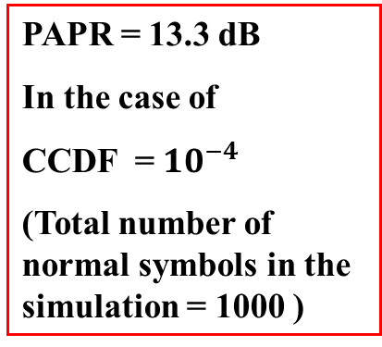
Simulation Result (CCDF of SCH Symbol with Data Scrambler)
CCDF of SCH symbol with Data Scrambler Power Ratio
10
0
Normal
10
-1
SCH
SCH with Data Scrambler
PAPR = 13.3 dB
In the case of
CCDF = ${10}^{−4}$
(Total number of normal symbols in the simulation = 1000 )
10
-2
10
-3
CCDF
$${10}^{−4}$$
10
-4
10
-5
10
-6
10
-7
-80
-60
-40
-20
0
13.3dB
20
40
Power Ratio [dB]

Slide 19
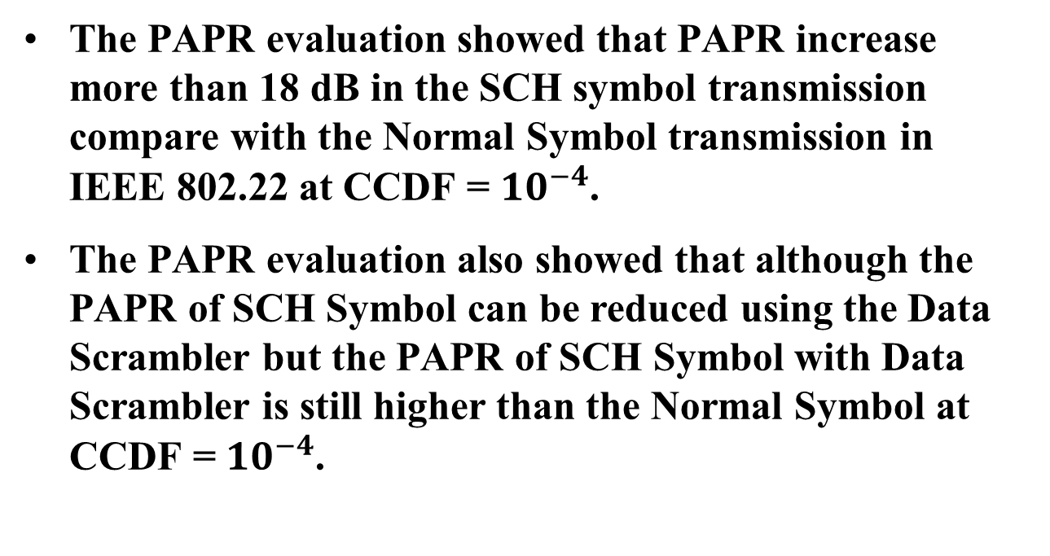
Conclusion
The PAPR evaluation showed that PAPR increase more than 18 dB in the SCH symbol transmission compare with the Normal Symbol transmission in IEEE 802.22 at CCDF = ${10}^{−4}$.
The PAPR evaluation also showed that although the PAPR of SCH Symbol can be reduced using the Data Scrambler but the PAPR of SCH Symbol with Data Scrambler is still higher than the Normal Symbol at CCDF = ${10}^{−4}$.

Slide 20
References
IEEE Std. 802.22-2011, July 2011

