Slide 1
Preliminary Link Budget Analysis for 802.22b
IEEE P802.22b Wireless RANs Date: 2012-05-15
Authors:
Notice: This document has been prepared to assist IEEE 802.22. It is offered as a basis for discussion and is not binding on the contributing individual(s) or organization(s). The material in this document is subject to change in form and content after further study. The contributor(s) reserve(s) the right to add, amend or withdraw material contained herein.
Release: The contributor grants a free, irrevocable license to the IEEE to incorporate material contained in this contribution, and any modifications thereof, in the creation of an IEEE Standards publication; to copyright in the IEEE’s name any IEEE Standards publication even though it may include portions of this contribution; and at the IEEE’s sole discretion to permit others to reproduce in whole or in part the resulting IEEE Standards publication. The contributor also acknowledges and accepts that this contribution may be made public by IEEE 802.22.
Patent Policy and Procedures: The contributor is familiar with the IEEE 802 Patent Policy and Procedures http://standards.ieee.org/guides/bylaws/sb-bylaws.pdf including the statement "IEEE standards may include the known use of patent(s), including patent applications, provided the IEEE receives assurance from the patent holder or applicant with respect to patents essential for compliance with both mandatory and optional portions of the standard." Early disclosure to the Working Group of patent information that might be relevant to the standard is essential to reduce the possibility for delays in the development process and increase the likelihood that the draft publication will be approved for publication. Please notify the Chair
Wendong Hu as early as possible, in written or electronic form, if patented technology (or technology under patent application) might be incorporated into a draft standard being developed within the IEEE 802.22 Working Group. If you have questions, contact the IEEE Patent Committee Administrator at patcom@iee.org.

Slide 2
Abstract
This contribution presents a preliminary link budget analysis for 802.22b task group based on the use cases proposed and CPE definitions.

Slide 3
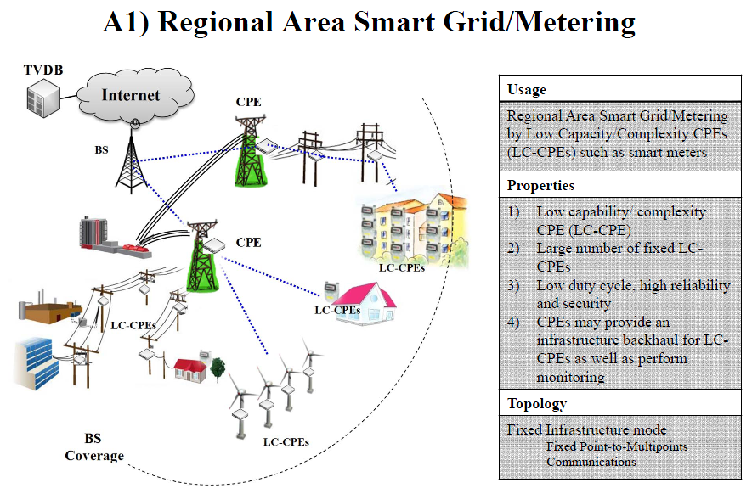
[1] “Usage Cases in 802.22 Smart Grid and Critical Infrastructure Monitoring”, doc: IEEE 802.22-11/73r1

Slide 4
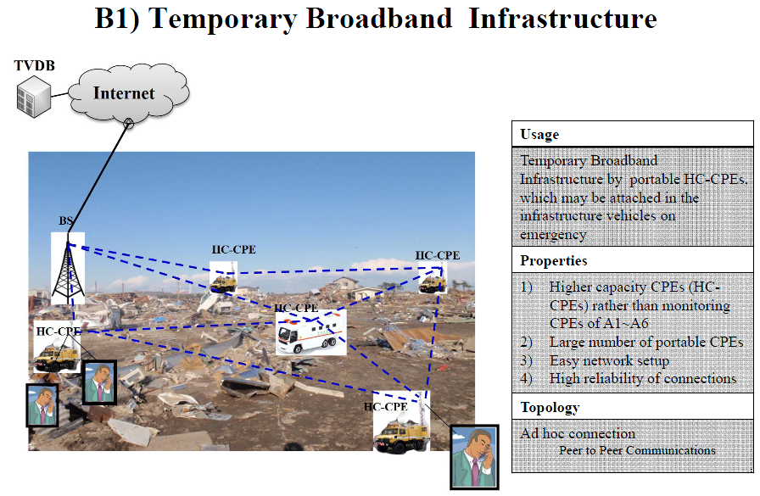
[1] “Usage Cases in 802.22 Smart Grid and Critical Infrastructure Monitoring”, doc: IEEE 802.22-11/73r1

Slide 5
CPE Definitions [2]
 |  | A1/A2 | A3/A4/A5/A6 | B1 | B2/B3
Feature (L-CPE) |  | Non real-time event sensing/monitoring Lower data rate Low duty cycle, Power applied/Battery power Very large numbers, Fixed/portable | Real-time video monitoring Higher data rate Power applied/Battery power Large numbers Fixed/portable | N/A | Real-time video conferencing Higher data rate High-speed internet service Power applied Large numbers Fixed
Feature (H-CPE) |  | Supporting BS access for L-CPEs Multi-hop/Relaying Asynchronous connections | Supporting BS access for L-CPEs Multi-hop/Relaying Asynchronous/Synchronous connections | Multi-hop/Relaying among H-CPEs Internet service Portable Synchronous connections | Supporting access for L-CPEs Multi-hop/Relaying Asynchronous/Synchronous connections
PHY | L-CPE | - Support part of 60 channels support (single carrier or sub-carrier), Less 2048FFT | - Support part of 60 channels support or full channels, Less or equal to 2048FFT | N/A | Same as A3~A6
 | H-CPE | - 2048FFT | - 2048FFT | - 2048 FFT | - 2048 FFT
Radio | L-CPE | SISO less than several Km range (~1Km) | SISO/MIMO (less 2x2) less than several Km range (~1Km) | N/A | Same as A3~A6
 | H-CPE | MIMO (over 2x2) Channel bonding (over 2 channels) less than several Km range for L-CPE (~1Km) larger than several Km range for H-CPE (10~20Km) | MIMO (over 2x2) Channel bonding (over 2 channels) less than several Km range for L-CPE (~1Km), larger than several Km range for L-CPRE or H-CPE (10~20Km) | MIMO less than several Km range (10~20Km) | Same as A3~A6

Slide 6
Spectrum Mask in TVWS
Type of TV bands device | Power Limit (6 MHz) | PSD Limit (100 kHz) | Adjacent Channel Limit (100 kHz)
Fixed | 30 dBm (1 Watt) | 12.6 dBm | -42.8 dBm
Personal/Portable | 20 dBm (100 mW) | 2.6 dBm | -56.8 dBm
Sensing only | 17 dBm (50 mW) | -0.4 dBm | -55.8 dBm

Slide 7
Link Budget Analysis Assumption
LOS propagation model (ITU-R Rec. P.1546-1 model) is considered [3]. (Location probability= 50%, time probability = 99.9% / 10%)
H-CPE and L-CPE receiver sensitivity level= -91.3 dBm for 6 MHz bandwidth [4].
Base Station receiver sensitivity level= -94.5 dBm for 6 MHz bandwidth [4].
Transmitter PSD emission limit follows FCC Third MO&O
H-CPE, L-CPE and base station follow the following settings.
Assume there is a penetration loss (approx 10 dB) when signal is travelled from indoor to outdoor or vice versa.
 | H-CPE | L-CPE | Base Station
Antenna Gain (dBi) | 6 | 0 | 6
Antenna Height (m) | 10 | 2 | 30
Mode | fixed | portable | fixed
Location | outdoor | indoor | outdoor

Slide 8
Term definition
Penetration loss
  is the loss incurred when signal are transmitted from outdoor to indoor. It takes typical values from 10-20 dB.
  In this presentation, 10 dB is assumed, so that the distance calculated is the maximum range.
Implementation loss
  accounts for coupling loss, pre-amplification filter loss, interference allowance and decoder implementation margin.
  According to 802.22 base standard, Receiver Implementation Margin = 1.9 dB and 2.1 dB for BS and CPE respectively and Interference Allowance = 1 dB for either BS or CPE, and decoder implementation margins for QPSK is 1.1 dB
 | BS | CPE
Implementation loss (dB) | 4 | 4.2

Slide 9
Full Channel
Link Budget Calculation

Slide 10
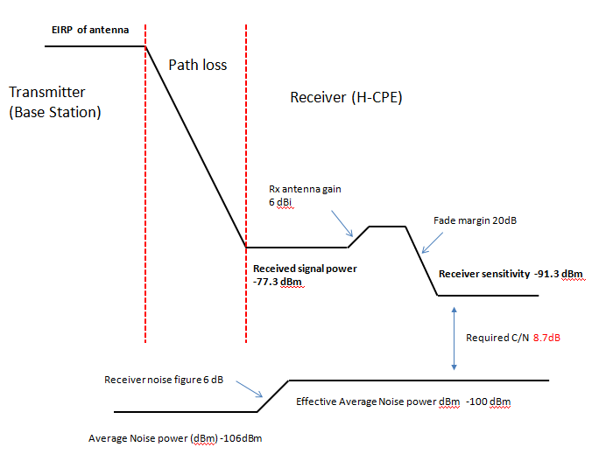
Case 1: BS to H-CPE

Slide 11
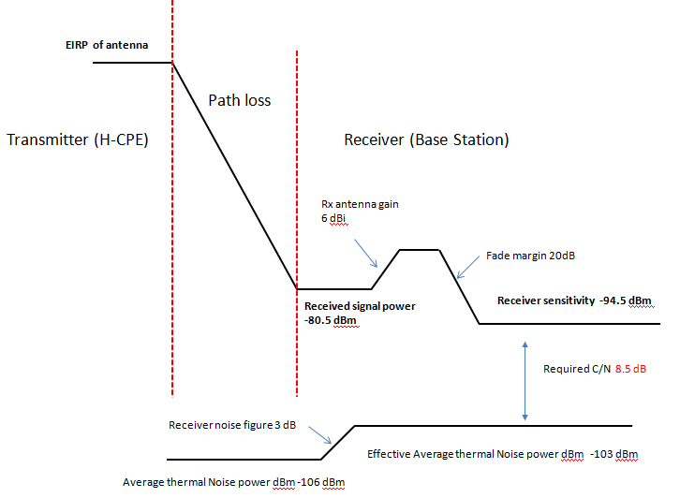
Case 2: H-CPE to BS

Slide 12
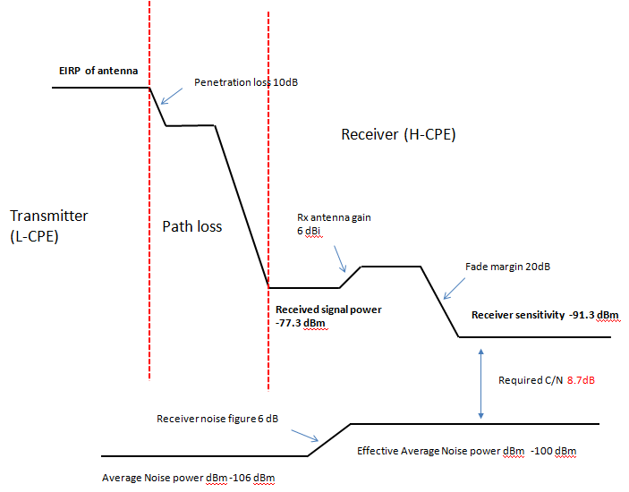
Case 3: L-CPE to H-CPE

Slide 13
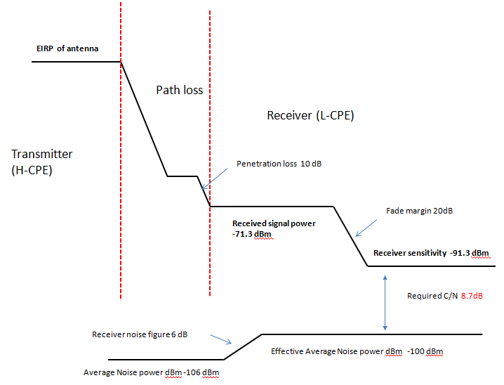
Case 4: H-CPE to L-CPE

Slide 14
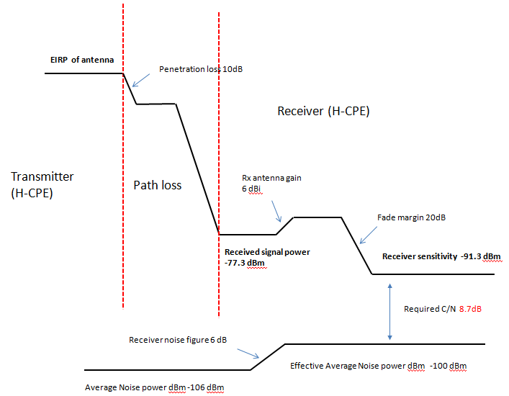
Case 5: H-CPE to H-CPE

Slide 15
Link Budget Examples
Height of the base station: 30m
Parameter | Case 1 | Case 2 | Case 3 | Case 4 | Case 5
Signal bandwidth | 6 MHz | 6 MHz | 6 MHz | 6 MHz | 6 MHz
Average EIRP power (dBm) | 36 | 36 | 20 | 36 | 36
Penetration loss (dB) |  |  | 10 | 10
Required Rx power at d km (dBm) | -77.3 | -80.5 | -77.3 | -71.3 | -77.3
Path loss at d km (dB) | 113.3 | 116.5 | 87.3 | 97.3 | 113.3
d (km) (50%, 99.9%) | 12.64 | 14.7 | 2.36 | 3.9 | 5.33
Case 1: Broadband service downlink (BS to H-CPE) Case 4: H-CPE to L-CPE
Case 2: Broadband service uplink (H-CPE to BS) Case 5: H-CPE to H-CPE
Case 3: L-CPE to H-CPE

Slide 16
ITU-R P-1546 Propagation model
Time probability
The time probability is related to the probability of the signal being at a given level due to short term (car passing by, tree leaves moving in the wind, etc.) and long term (seasonal) variations.
Location Probability
The location parameter means the percentage of terminal sites at the edge of coverage that would still be able to receive the service.

Slide 17
Summary
Based on our preliminary calculation, we adopt (10%, 99.9%) for channel model parameters:
Scenarios | Maximum Communication range (km)
Height of the base station | 30 m
BS to H-CPE | 12.64
H-CPE to BS | 14.7
L-CPE to H-CPE | 2.36
H-CPE to L-CPE | 3.90
H-CPE to H-CPE | 5.50

Slide 18
Partial Channel
Link Budget Calculation

Slide 19
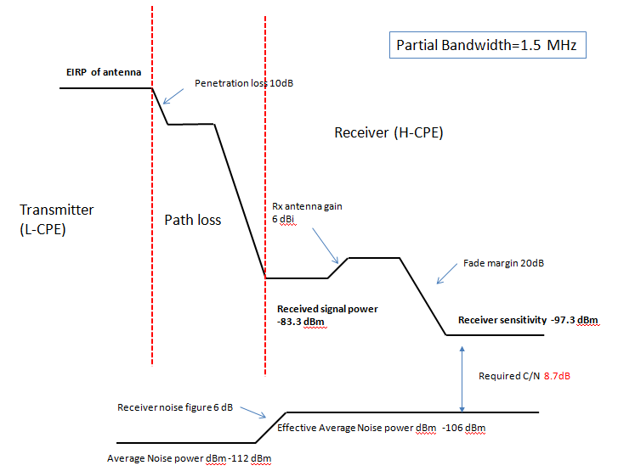
Case 3: L-CPE to H-CPE

Slide 20
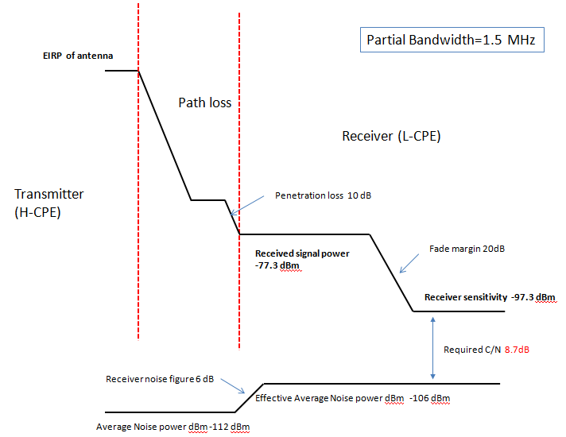
Case 4: H-CPE to L-CPE

Slide 21
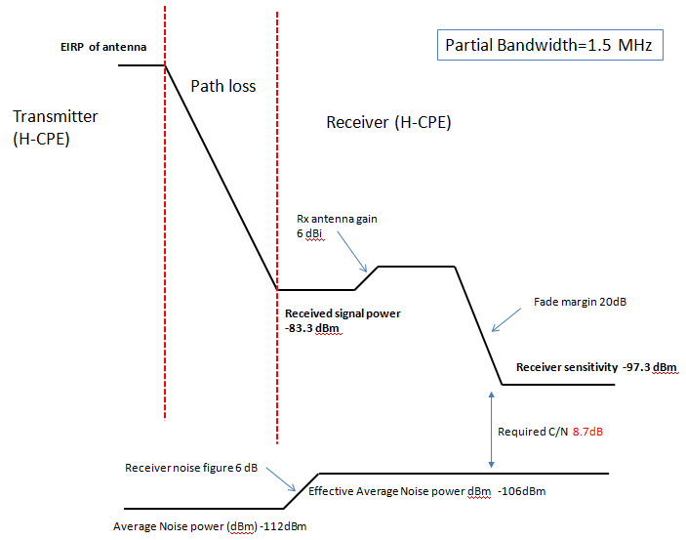
Case 5: H-CPE to H-CPE

Slide 22
Link Budget Examples
Parameter | Case 3 | Case 4 | Case 5
Signal bandwidth | 1.5 MHz | 1.5 MHz | 1.5 MHz
Number of sub-channel | 15 | 15 | 15
Average EIRP power (dBm) | 14.4 | 24.4+6 | 24.4+6
Penetration loss (dB) | 10 | 10
Required Rx power at d km (dBm) | -83.3 | -77.3 | -83.3
Path loss at d km (dB) | 87.7 | 97.7 | 113.7
d (km, (50%, 99.9%)) (full channel) | 2.36 (2.36) | 3.96 (3.9) | 5.45 (5.33)
Case 1: Broadband service downlink (BS to H-CPE) Case 4: H-CPE to L-CPE
Case 2: Broadband service uplink (H-CPE to BS) Case 5: H-CPE to H-CPE
Case 3: L-CPE to H-CPE

Slide 23
Link Budget Examples
Parameter | Case 3 | Case 4 | Case 5
Signal bandwidth | 1 MHz | 1 MHz | 1 MHz
Number of sub-channel | 10 | 10 | 10
Average EIRP power (dBm) | 12.6 | 22.6+6 | 22.6+6
Penetration loss (dB) | 10 | 10
Required Rx power at d km (dBm) | -85.1 | -79.1 | -85.1
Path loss at d km (dB) | 87.7 | 97.7 | 113.7
d (km) (50%, 99.9%) | 2.36 (2.36) | 3.96 (3.96) | 5.45 (5.45)
Case 1: Broadband service downlink (BS to H-CPE) Case 4: H-CPE to L-CPE
Case 2: Broadband service uplink (H-CPE to BS) Case 5: H-CPE to H-CPE
Case 3: L-CPE to H-CPE

Slide 24
Link Budget Examples
Parameter | Case 3 | Case 4 | Case 3 | Case 4
Signal bandwidth | 500 KHz | 500 KHz | 200 KHz | 200 KHz
Number of sub-channel | 5 | 5 | 2 | 2
Average EIRP power (dBm) | 9.6 | 19.6+6 | 5.6 | 15.6+6
Penetration loss (dB) | 10 | 10 | 10 | 10
Required Rx power at d km (dBm) | -88.1 | -82.1 | -92.1 | -86.1
Path loss at d km (dB) | 87.7 | 97.7 | 87.7 | 97.7
d (m) (50%, 99.9%) | 2.36 (2.36) | 3.96 (3.96) | 2.4 (2.36) | 3.96 (3.96)
Case 3: L-CPE to H-CPE Case 4: H-CPE to L-CPE

Slide 25
Summary
Based on our preliminary calculation, we find that:
Scenarios | Maximum Communication range (km) (50%, 99.9%)
Bandwidth (MHz) | 1.5 | 1 | 0.5 | 0.2
Number of sub-channel | 15 | 10 | 5 | 2
L-CPE to H-CPE (case 3) | 2.40 | 2.40 | 2.40 | 2.40
H-CPE to L-CPE (case 4) | 3.93 | 3.93 | 3.93 | 3.93
H-CPE to H-CPE (case 5) | 5.45 | 5.45

Slide 26
Reference
[1] “Usage Cases in 802.22 Smart Grid and Critical Infrastructure Monitoring”, doc: IEEE 802.22-11/73r1
[2] “802.22b CPE Clarifications and Capabilities”, Doc: IEEE22-12-0018-00-000b
[3] 802.22 channel model, doc: 22-04-0002-18-0000-wran-reference-model
[4] Std IEEE802.22-2011

