Slide 1
Review of 802.16j Traffic Models
IEEE P802.22b Wireless RANs Date: 2012-04-24
Authors:
Notice: This document has been prepared to assist IEEE 802.22. It is offered as a basis for discussion and is not binding on the contributing individual(s) or organization(s). The material in this document is subject to change in form and content after further study. The contributor(s) reserve(s) the right to add, amend or withdraw material contained herein.
Release: The contributor grants a free, irrevocable license to the IEEE to incorporate material contained in this contribution, and any modifications thereof, in the creation of an IEEE Standards publication; to copyright in the IEEE’s name any IEEE Standards publication even though it may include portions of this contribution; and at the IEEE’s sole discretion to permit others to reproduce in whole or in part the resulting IEEE Standards publication. The contributor also acknowledges and accepts that this contribution may be made public by IEEE 802.22.
Patent Policy and Procedures: The contributor is familiar with the IEEE 802 Patent Policy and Procedures http://standards.ieee.org/guides/bylaws/sb-bylaws.pdf including the statement "IEEE standards may include the known use of patent(s), including patent applications, provided the IEEE receives assurance from the patent holder or applicant with respect to patents essential for compliance with both mandatory and optional portions of the standard." Early disclosure to the Working Group of patent information that might be relevant to the standard is essential to reduce the possibility for delays in the development process and increase the likelihood that the draft publication will be approved for publication. Please notify the Chair
Wendong Hu as early as possible, in written or electronic form, if patented technology (or technology under patent application) might be incorporated into a draft standard being developed within the IEEE 802.22 Working Group. If you have questions, contact the IEEE Patent Committee Administrator at patcom@iee.org.

Slide 2
Abstract
This document summarizes the traffic models used in 802.16j system, that serve as reference to our 802.22b system.

Slide 3
Overview of use case applications in 802.22b
Network model | Smart Grid and Monitoring | Broadband Service extension | 802.16j
Entities | BS, H-CPE, L-CPE | BS, H-CPE
Topology | Tree Topology | Tree Topology or Mesh Topology
Applications | Metering application; Video monitoring application | Internet; VoIP | Internet; VoIP; Video Streaming; Gaming; FTP
Channel model | Basic 802.22 channel model; Proposed 802.22 channel model | Basic 802.22 channel model;
Performance Criteria | Throughput; Delay; Packet loss | Throughput; Delay; Packet loss

Slide 4
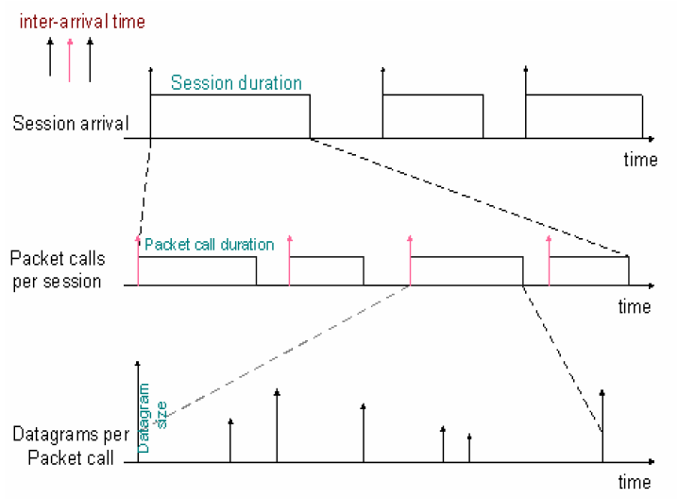
Bursty Traffic generation Model
Most of the above use cases can be modeled by bursty traffic generation model.
Assumption: one single user who maintain a session with transmission activity

Slide 5
Broadband Service Extension
Http browsing
Each session is divided into ON/OFF period
ON: Packet time, user request information.
OFF: Reading time.

Slide 6
Broadband Service Extension
Http browsing
Within each packet call, there are ON and OFF periods as well.
ON: indicated by red lines, (initial HTML page and embedded object such as graphic and buttons).
OFF: spaces between red lines, (parsing time and protocol overhead)

Slide 7
HTTP traffic model parameters

Slide 8
VoIP Traffic Model
Two state Markov process

Slide 9
VoIP traffic model parameters

Slide 10
Near Real Time Video Streaming
Packet call
ON
OFF

Slide 11
Near Real Time traffic model parameters
 | Distribution | Distribution parameters
Inter-Arrival time between the beginning of each frame | Deterministic (based on 10fps) | 100ms
Number of packets (slices) in a frame | Deterministic | 8
Packet (Slice) Size | Truncated Pareto | Mean=50 bytes Max=125 bytes K=20 Bytes = 1.2
Inter-arrival time between packets (slices) in a frame | Truncated Pareto | Mean=6 ms Max= 12.5 ms K=2.5ms =1.2

Slide 12
Summary
This document mainly summarized the traffic model used in 802.16j.
Because there are similarity in use case, this models can serve as good reference for our 802.22b system.

Slide 13
Reference
IEEE 802.16j-06/013r3
High-Level Smart Meter Data Traffic Analysis

