Slide 1
Proposed Geo-Location Amendment
IEEE P802.22 Wireless RANs Date: 2011-05-04
Authors:
Notice: This document has been prepared to assist IEEE 802.22. It is offered as a basis for discussion and is not binding on the contributing individual(s) or organization(s). The material in this document is subject to change in form and content after further study. The contributor(s) reserve(s) the right to add, amend or withdraw material contained herein.
Release: The contributor grants a free, irrevocable license to the IEEE to incorporate material contained in this contribution, and any modifications thereof, in the creation of an IEEE Standards publication; to copyright in the IEEE’s name any IEEE Standards publication even though it may include portions of this contribution; and at the IEEE’s sole discretion to permit others to reproduce in whole or in part the resulting IEEE Standards publication. The contributor also acknowledges and accepts that this contribution may be made public by IEEE 802.22.
Patent Policy and Procedures: The contributor is familiar with the IEEE 802 Patent Policy and Procedures http://standards.ieee.org/guides/bylaws/sb-bylaws.pdf including the statement "IEEE standards may include the known use of patent(s), including patent applications, provided the IEEE receives assurance from the patent holder or applicant with respect to patents essential for compliance with both mandatory and optional portions of the standard." Early disclosure to the Working Group of patent information that might be relevant to the standard is essential to reduce the possibility for delays in the development process and increase the likelihood that the draft publication will be approved for publication. Please notify the Chair
Apurva Mody <apurva.mody@ieee.org> as early as possible, in written or electronic form, if patented technology (or technology under patent application) might be incorporated into a draft standard being developed within the IEEE 802.22 Working Group. If you have questions, contact the IEEE Patent Committee Administrator at patcom@iee.org.

Slide 2
Abstract
This presentation describes proposed enhancements to the most recently approved version of the IEEE 802.22 standards. The presentation will also demonstrate how the proposed enhancements can support advanced geo-location techniques for determining location in difficult indoor environments.

Slide 3
Precision Indoor Location:
The InvisiTrack Solution
Presented to 802.22 Group
May 5, 2011

Slide 4
InvisiTrack Solution Overview
Developed for indoor and challenging outdoor environments
  Dense multipath environment
Low computational intensity multipath mitigation algorithms
  Can be executed in software by a nomadic CPE/ mobile terminal
Developed for mobile environment
  Allows simultaneous tracking of several hundred terminals
Supports one-way and transponder distance measurements
Same multipath mitigation can be used for determining DLOS distance and DOA/ AOA (direction/ angle of arrival)
  Supports geo-location by a single position reference (e.g. BS or CPE)
Compatible with the existing IEEE 802.22 Standard protocols/ infrastructure
  No changes in HW required
  No changes in PHY

Slide 5
Suggested Amendment:
Transponder Mode Option

Slide 6

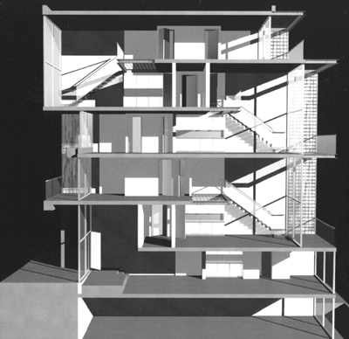
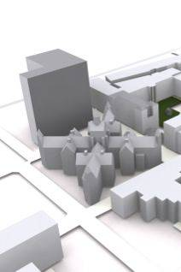

Existing 802.22 Geo-Location Capability
Geo-Locate over long distances
  Needs Base Station
  Relies on one way OFDM coherency
    (Coherency affected by multipath)

Slide 7

Addendum 802.22 Geo-Location capability
(Transponder Mode)
Improved Indoor closer range Accuracy
  Does not rely on OFDM system coherency.
  Either a terminal or base station/ fixed CPE will originate the ranging signal (fully compatible with the 802.22 signaling, e.g. OFDM)
  The receiving terminal will then store the DFT output (samples) and, will re-transmit (repeat) the ranging signal from the stored DFT samples.

Slide 8
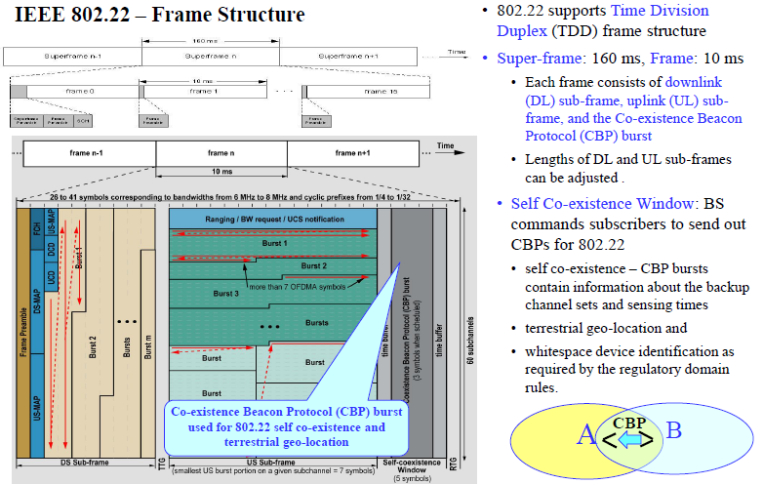
Transponder Mode, continued

Slide 9
The InvisiTrack Approach to Terrestrial Geo-Location

Slide 10
Indoor Location - Unique Challenges
Obstructed/Non-Line-of-Sight Environment
  DLOS (Direct Line Of Site) Blockage
    Structures, walls, floors, etc.
    Requires signals that penetrate dielectrics
    DLOS signal is severely attenuated relative to reflected signals
Dispersive Propagation Environment
  Multipath Interference
    DLOS and reflections are closely spaced
    Requires signal structure to minimize effect

Slide 11
Signal Propagation - Background
Signal penetration in dielectric
  Loss varies as square root of wavelength
    Lower frequencies penetrate better than higher
    Example: with the same loss, 240 MHz penetrates 3.2 times further than 2.4 GHz or, at same distance, loss at 2.4 GHz is 10 dB greater.
  Dispersion (multipath): inversely proportional to wavelength
    Objects smaller than the wavelength don’t reflect;
    Objects larger than the wavelength, reflect and generate multipath dispersion.

Slide 12
InvisiTrack Solution Integration
InvisiTrack’s geolocation ranging signal is < 5 MHz BW (ie, does not require channel bonding).
The ranging signal consists of:
  Pilot signals or subcarrier signals; or
  A combination of pilots and subcarriers;
  The total number of signals is 100 or less.
The ranging signal subcarriers do not need to be modulated; the modulation may also be applied, for example QPSK, as long as the modulation signal is known beforehand.

Slide 13
InvisiTrack Multipath Processor
Uses highly optimized and improved high-resolution spectrum estimation analysis methods and techniques as applicable to multipath mitigation;
  Able to separate direct path for accurate range estimation
  Performance
    No “picket fence” effect
Methods and techniques support frequency estimations that approach the Cramer-Rao Bound (CRB).

Slide 14
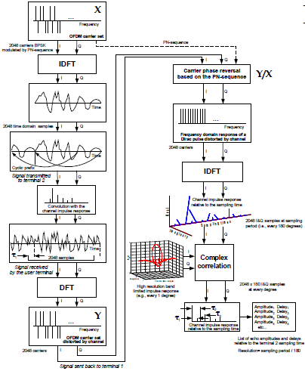
InvisiTrack Solution Integration
Can be seamlessly integrated into the current 802.22 geolocation model – uses complex channel impulse response in the frequency domain
Current 802.22 Geo-location model
Optional, not required by the Invisitrack
Invisitrack 802.22 Geo-location model
InvisiTrack’s Multipath Processor
Signal
Noise

Slide 15
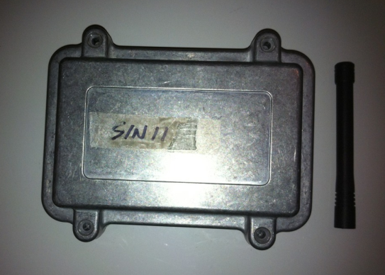
InvisiTrack Geo-location Results
Developed mobile, battery-operated proof of concept:
  Dimensions: 3x4x2 inches
  Operating frequencies: VHF (High-band)
  Operating bandwidth: 5 MHz
In all tests TX and RX antennas heights were between 0.5 meters to 1.5 meters from the ground .

Slide 16
InvisiTrack Geolocation Results
Environment | Range (m) | Accuracy (m), >=67% confidence | Accuracy (m), >=95% confidence | Comments
Coaxial cables | 500 (equiv) | N/A | 0.5 | With multipath simulator
Analog Proof of Concept Devices
Outdoor | 350 | 2 | 3 | Suburban setting
Difficult Indoor | 125 | 4 | 8 | Multiple floor buildings
Extreme, Indoor parking | 125 | 4 | 8 | Reinforced Concrete structure
Digital Production Devices
Outdoor | 350 | 1 | 2 | Suburban setting
Difficult Indoor | 125 | 2 | 3 | Multiple floor buildings
Extreme, Indoor parking | 125 | 2 | 3 | Reinforced Concrete structure

Slide 17
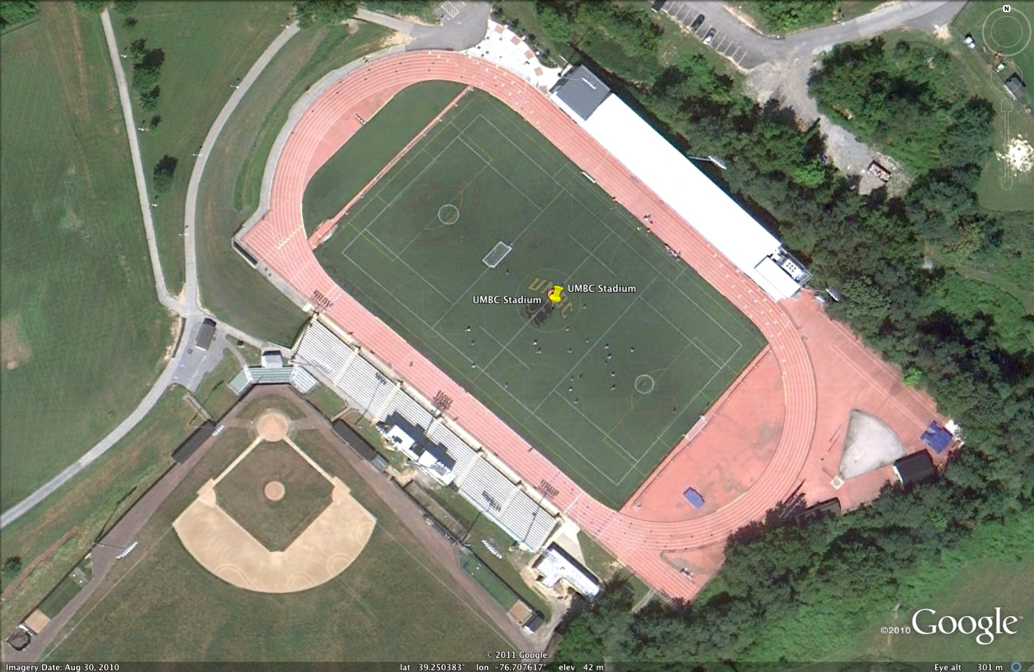
UMBC Field

Slide 18
Conversion to Distance

Slide 19
UMBC Field

Slide 20

UMBC Engineering

Slide 21
Conversion to Distance

Slide 22
Results

Slide 23
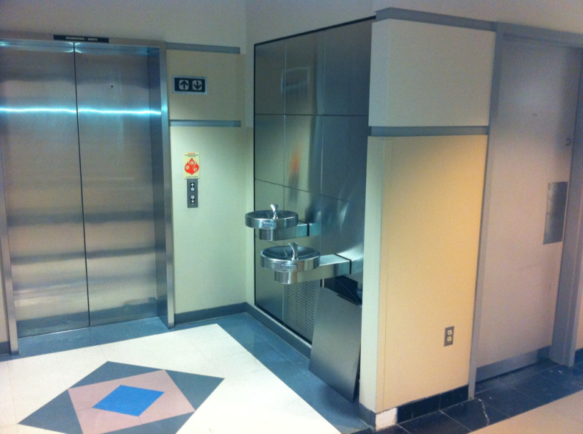
UMBC Engineering (Example 2)

Slide 24
Conversion to Distance

Slide 25
Result

Slide 26
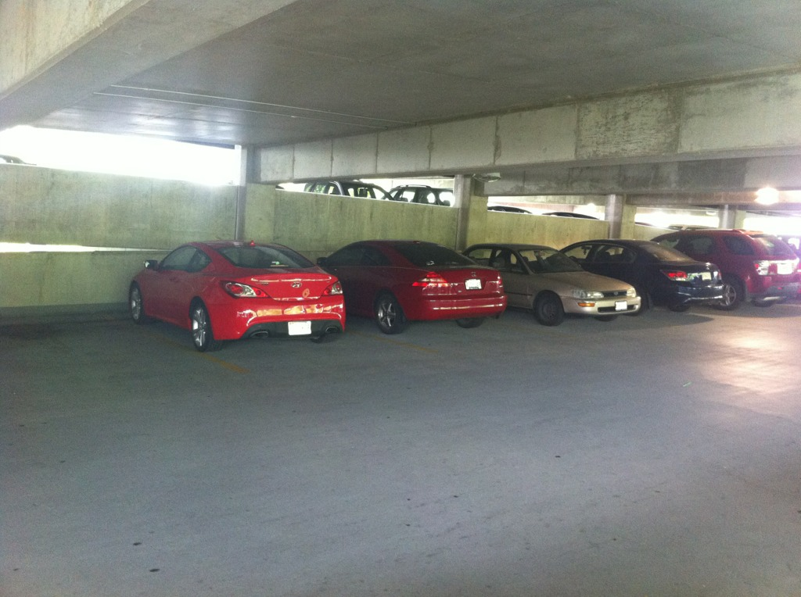
UMBC Parking Garage

Slide 27
Conversion To Distance

Slide 28
Result

Slide 29
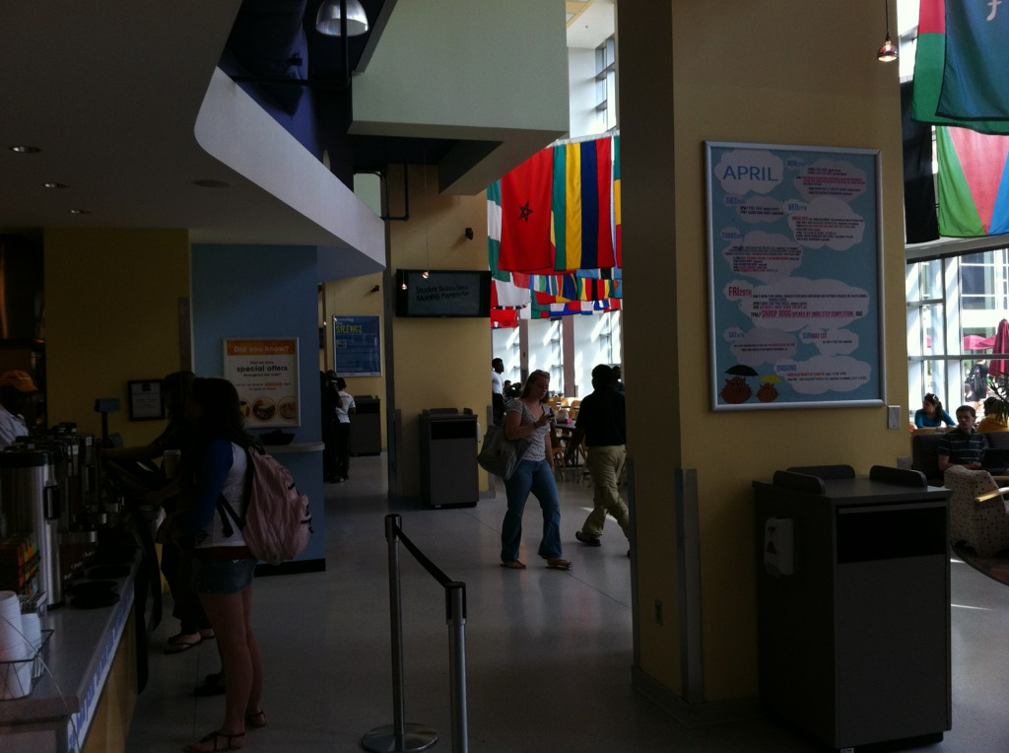
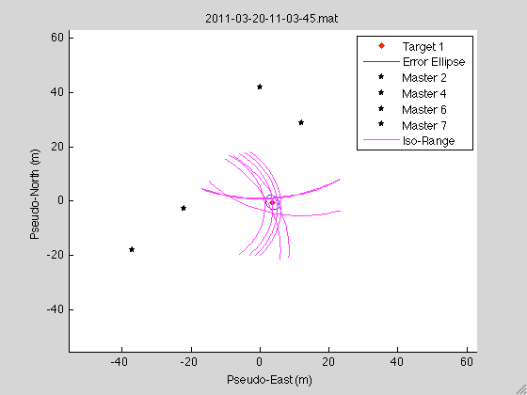
UMBC Commons

Slide 30
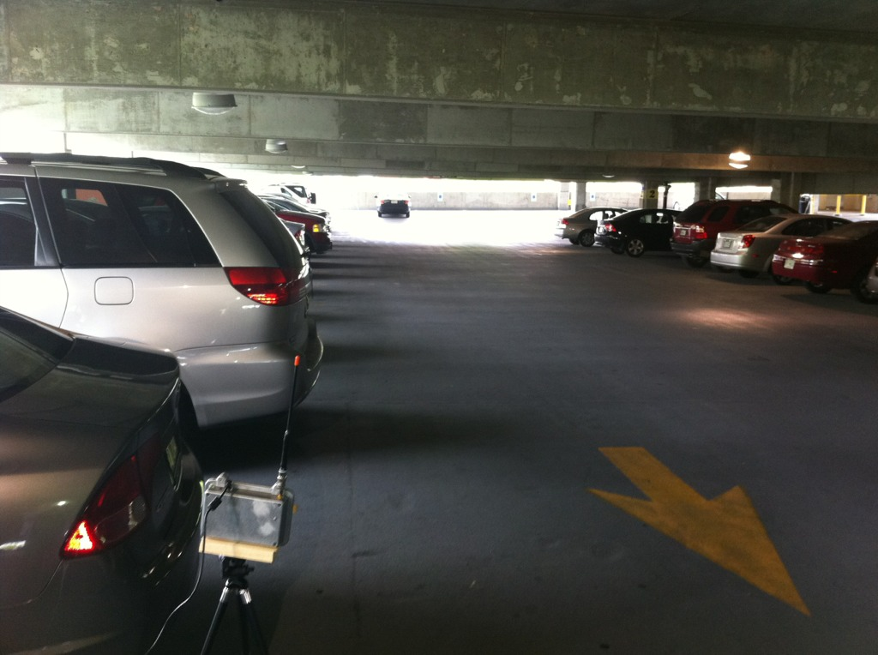
UMBC Parking Garage (Example 2)

Slide 31
Conversion to Distance

Slide 32
Result

