Slide 1
IEEE 802.21 MEDIA INDEPENDENT SRVICES
DCN: 21-19-0037-00-0000
Title: Project Proposal on Interworking between IEEE 802.11 WLAN and 3GPP 5G Core Network
Date Submitted: May 09, 2019
Presented at IEEE 802.21 Session #91 in Atlanta, GA, USA
Authors or Source(s): Hyun Seo Oh, Han Berg Cho (ETRI), Se Hoon Kim (allRadio Co. Ltd), Si Young Heo (KT), Hyeong Ho Lee (Netvision Telecom Inc., Korea Univ.)
Abstract: This document is to describe the interworking between IEEE 802.11 WLAN and 3GPP 5G core network to improve data throughput rate for increasing data traffic need and provide QoS management for time sensitive services, and to support mobility function for seamless services.

Slide 2
  IEEE 802.21 presentation release statements
This document has been prepared to assist the IEEE 802.21 Working Group. It is offered as a basis for discussion and is not binding on the contributing individual(s) or organization(s). The material in this document is subject to change in form and content after further study. The contributor(s) reserve(s) the right to add, amend or withdraw material contained herein.
The contributor grants a free, irrevocable license to the IEEE to incorporate material contained in this contribution, and any modifications thereof, in the creation of an IEEE Standards publication; to copyright in the IEEE’s name any IEEE Standards publication even though it may include portions of this contribution; and at the IEEE’s sole discretion to permit others to reproduce in whole or in part the resulting IEEE Standards publication. The contributor also acknowledges and accepts that this contribution may be made public by IEEE 802.21.
The contributor is familiar with IEEE patent policy, as stated in Section 6 of the IEEE-SA Standards Board bylaws <http://standards.ieee.org/guides/bylaws/sect6-7.html#6> and in Understanding Patent Issues During IEEE Standards Development http://standards.ieee.org/board/pat/faq.pdf>
  IEEE 802.21 presentation release statements
This document has been prepared to assist the IEEE 802.21 Working Group. It is offered as a basis for discussion and is not binding on the contributing individual(s) or organization(s). The material in this document is subject to change in form and content after further study. The contributor(s) reserve(s) the right to add, amend or withdraw material contained herein.
The contributor grants a free, irrevocable license to the IEEE to incorporate material contained in this contribution, and any modifications thereof, in the creation of an IEEE Standards publication; to copyright in the IEEE’s name any IEEE Standards publication even though it may include portions of this contribution; and at the IEEE’s sole discretion to permit others to reproduce in whole or in part the resulting IEEE Standards publication. The contributor also acknowledges and accepts that this contribution may be made public by IEEE 802.21.
The contributor is familiar with IEEE patent policy, as outlined in Section 6.3 of the IEEE-SA Standards Board Operations Manual <http://standards.ieee.org/guides/opman/sect6.html#6.3> and in Understanding Patent Issues During IEEE Standards Development http://standards.ieee.org/board/pat/guide.html>

Slide 3
Introduction
3GPP 5G communication network will support multi-RAT including non-3GPP access techniques.
3GPP already have released 5G core architecture to have multiple interfaces with 3GPP access type or non-3GPP access type.
- 3GPP TS 23.501 Technical Specification Group Services and System Aspects; System Architecture for the 5G System; Stage 2(Release 15), 2018
- 3GPP TS 23.502 Technical Specification Group Services and System Aspects; Procedures for the 5G System; Stage 2(Release 15), 2018
IEEE 802.11 access techniques should provide interface and communication protocols to be interworked with 5G core network.

Slide 4
Objectives
WLAN and 5G access in UE will improve data throughput for increasing data traffic demand.
IEEE 802.11 WLAN interworking with 3GPP core network will provide QoS(Quality of Service) management for time sensitive service types.
Mobility function between IEEE 802.11 WLAN and 5G communication will provide seamless services.

Slide 5
WLAN(non-3GPP access) to 5G Core Network
Converged core network with a common AN - CN interface
AMF: Access & Mobility Management
UPF: User Plane Function
N3IWF: N3 Inter-Working Function
NWu: IPsec Tunnel

Slide 6
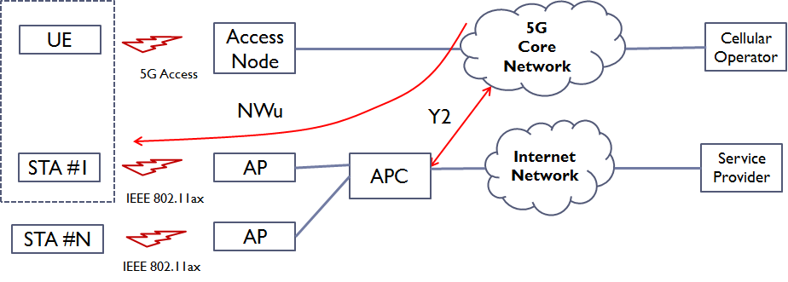
WLAN Access Reference Points
Y2 interface shall be defined
  Connection procedure between APC of WLAN and N3IWF of 5G Core Network
  CAPWAP from IETF may be adapted for Y2 interface standard
NWu interface shall be applied for WLAN
  STA shall support Data or Signaling plane of 5G core network
  NWu interface shall be processed on the upper layer of IEEE 802.11 PHY/MAC

Slide 7
Thank you for attention

