Slide 1
IEEE 802.21 MEDIA INDEPENDENT SERVICES
DCN: 21-18-0078-00-0000
Title: Application Level Bandwidth Requirements for 3DoF+/6DoF Virtual Reality Services (Simply HEVC-encoded Bitrates)
Date Submitted: April 18, 2019
Presented at IEEE 802.21 Teleconference
Authors or Source(s): Peter Jeong, Dillon Seo (JoyFun)
Eun-Seok Ryu, Dongmin Jang, Jong-Beom Jeong, Soonbin Lee, Il-Woong Ryu(Gachon University)
Abstract: The purpose of this document is LAB data for 3DOF+/6DOF VR Services.

Slide 2
  IEEE 802.21 presentation release statements
This document has been prepared to assist the IEEE 802.21 Working Group. It is offered as a basis for discussion and is not binding on the contributing individual(s) or organization(s). The material in this document is subject to change in form and content after further study. The contributor(s) reserve(s) the right to add, amend or withdraw material contained herein.
The contributor grants a free, irrevocable license to the IEEE to incorporate material contained in this contribution, and any modifications thereof, in the creation of an IEEE Standards publication; to copyright in the IEEE’s name any IEEE Standards publication even though it may include portions of this contribution; and at the IEEE’s sole discretion to permit others to reproduce in whole or in part the resulting IEEE Standards publication. The contributor also acknowledges and accepts that this contribution may be made public by IEEE 802.21.
The contributor is familiar with IEEE patent policy, as stated in Section 6 of the IEEE-SA Standards Board bylaws <http://standards.ieee.org/guides/bylaws/sect6-7.html#6> and in Understanding Patent Issues During IEEE Standards Development http://standards.ieee.org/board/pat/faq.pdf>
  IEEE 802.21 presentation release statements
This document has been prepared to assist the IEEE 802.21 Working Group. It is offered as a basis for discussion and is not binding on the contributing individual(s) or organization(s). The material in this document is subject to change in form and content after further study. The contributor(s) reserve(s) the right to add, amend or withdraw material contained herein.
The contributor grants a free, irrevocable license to the IEEE to incorporate material contained in this contribution, and any modifications thereof, in the creation of an IEEE Standards publication; to copyright in the IEEE’s name any IEEE Standards publication even though it may include portions of this contribution; and at the IEEE’s sole discretion to permit others to reproduce in whole or in part the resulting IEEE Standards publication. The contributor also acknowledges and accepts that this contribution may be made public by IEEE 802.21.
The contributor is familiar with IEEE patent policy, as outlined in Section 6.3 of the IEEE-SA Standards Board Operations Manual <http://standards.ieee.org/guides/opman/sect6.html#6.3> and in Understanding Patent Issues During IEEE Standards Development http://standards.ieee.org/board/pat/guide.html>

Slide 3
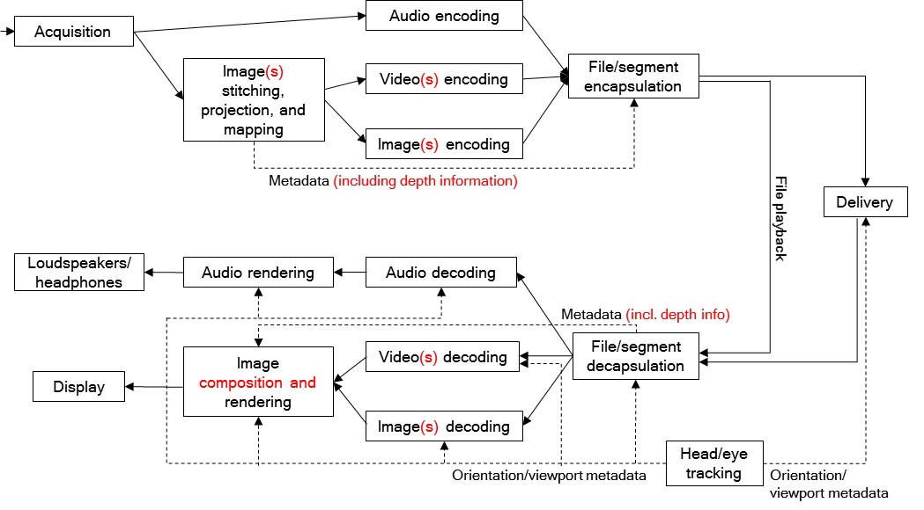
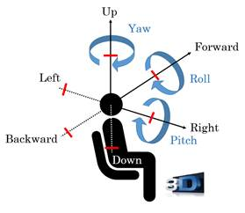
3 Degree of Freedom+ (3DoF+)
Background
  MPEG defined degree of freedom of VR as 3DoF, 3DoF+, and 6DoF
  Limited movements for user sitting in a chair is available for 3DoF+
Requirements
  Solution will be built on HEVC with 3DoF+ metadata(included in MPEG-I part 7)
  Both objective and subjective quality evaluation will be performed
Use case for 3DoF+

Slide 4
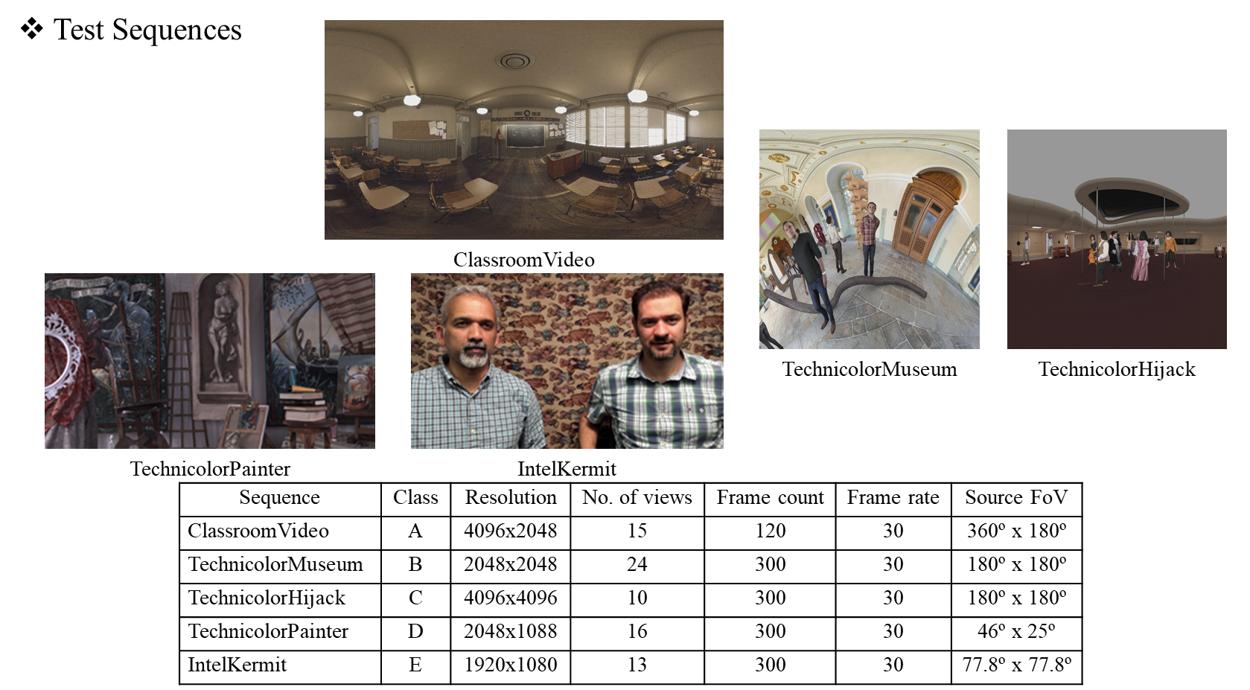
3DoF+ Common Test Condition (Defined by MPEG-I Standard)

Slide 5
Test Condition
Test Sequences
  ClassroomVideo
    15 Views (15 texture views, 15 depth views)
  TechnicolorMusium
    24 Views (24 texture views, 24 depth views)
Quantization Parameters
  Texture: 20, 22, 24
  Depth: 15, 17, 19
FPS : 30
Encoder/Decoder: HEVC/H.265 Reference SW

Slide 6
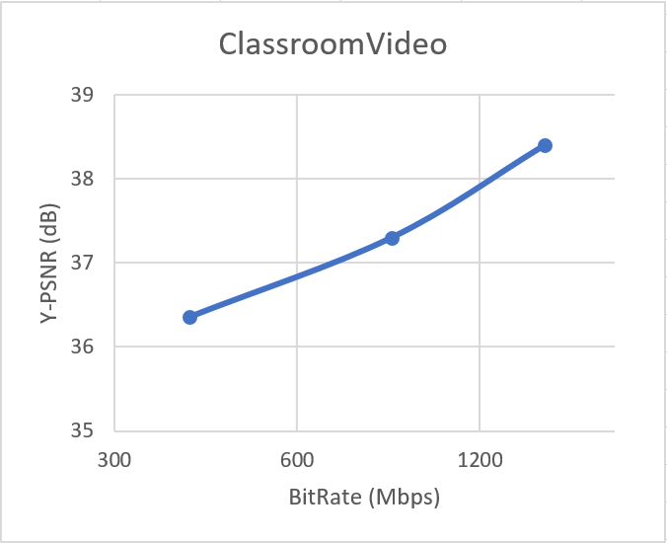
Test Results: Needed App-level BW for MPEG 3DoF+ (Simply encoded by HEVC)
ClassroomVideo
Bitrate (Kbps)
Y-PSNR (dB)
Quantization Parameter: 20 (texture) / 15 (depth)
Classroom Video | View Number | v0 | v1 | v2 | v3 | v4 | v5 | v6 | v7 | v8 | v9 | v10 | v11 | v12 | v13 | v14 | Sum
 | Bitrate | 123804.31 | 78540.76 | 89108.78 | 104979.48 | 108331.32 | 105593.24 | 107231.57 | 107295.30 | 105868.23 | 107016.50 | 103289.94 | 109515.16 | 104011.35 | 108973.46 | 106246.77 | 1569806.16
 | Y-PSNR | 38.19 | 38.78 | 38.64 | 38.38 | 38.34 | 38.37 | 38.35 | 38.36 | 38.36 | 38.36 | 38.41 | 38.33 | 38.39 | 38.33 | 38.36
Quantization Parameter: 22 (texture) / 17 (depth)
Classroom Video | View Number | v0 | v1 | v2 | v3 | v4 | v5 | v6 | v7 | v8 | v9 | v10 | v11 | v12 | v13 | v14 | Sum
 | Bitrate | 69974.80 | 43359.65 | 49557.52 | 58707.68 | 60769.33 | 58968.30 | 60068.07 | 59425.47 | 59165.21 | 59991.79 | 57896.38 | 61570.66 | 58113.91 | 61223.86 | 59477.61 | 878270.23
 | Y-PSNR | 36.96 | 37.86 | 37.66 | 37.28 | 37.21 | 37.26 | 37.23 | 37.24 | 37.25 | 37.24 | 37.32 | 37.20 | 37.29 | 37.20 | 37.24
Quantization Parameter: 24 (texture) / 19 (depth)
Classroom Video | View Number | v0 | v1 | v2 | v3 | v4 | v5 | v6 | v7 | v8 | v9 | v10 | v11 | v12 | v13 | v14 | Sum
 | Bitrate | 32557.76 | 20111.78 | 22783.72 | 27335.23 | 28292.41 | 27447.04 | 27958.97 | 28028.63 | 27504.70 | 28086.86 | 27102.26 | 28727.24 | 27020.59 | 28439.11 | 27651.08 | 409047.33
 | Y-PSNR | 35.92 | 37.04 | 36.79 | 36.33 | 36.26 | 36.32 | 36.28 | 36.28 | 36.31 | 36.29 | 36.39 | 36.23 | 36.35 | 36.24 | 36.30

Slide 7
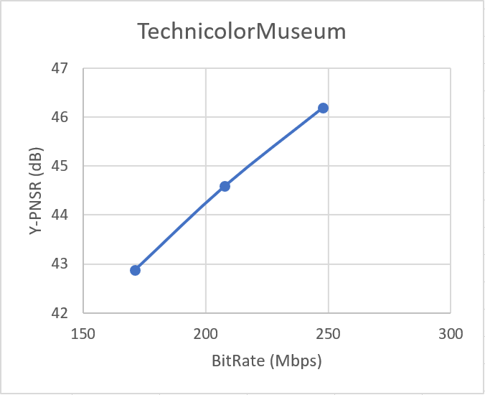
Test Results: Needed App-level BW for MPEG 3DoF+ (Simply encoded by HEVC)
TechnicolorMuseum
Bitrate (Kbps)
Y-PSNR (dB)
Quantization Parameter: 20 (texture) / 15 (depth)
TechnicolorMuseum | View Number | v0 | v1 | v2 | v3 | v4 | v5 | v6 | v7 | v8 | v9 | v10 | v11 | v12 | v13 | v14
 | Bitrate | 13174.82 | 10135.52 | 11063.30 | 12080.60 | 8956.87 | 13713.36 | 13424.78 | 11384.72 | 12379.98 | 11028.56 | 10109.51 | 11691.59 | 8334.93 | 8081.27 | 9540.86
 | Y-PSNR | 45.63 | 46.23 | 45.76 | 45.79 | 46.42 | 45.41 | 45.55 | 46.08 | 45.65 | 45.69 | 46.07 | 45.59 | 46.83 | 46.76 | 46.41
 | View Number | V15 | v16 | v17 | v18 | v19 | v20 | v21 | v22 | v23 |  |  |  |  |  |  | Total
 | Bitrate | 10946.60 | 10250.81 | 9980.81 | 8700.74 | 10157.93 | 10961.91 | 8691.04 | 7571.21 | 11309.82 |  |  |  |  |  |  | 253674.53
 | Y-PSNR | 46.32 | 46.49 | 46.50 | 46.75 | 46.50 | 46.21 | 46.81 | 47.00 | 46.07
Quantization Parameter: 22 (texture) / 17 (depth)
TechnicolorMuseum | View Number | v0 | v1 | v2 | v3 | v4 | v5 | v6 | v7 | v8 | v9 | v10 | v11 | v12 | v13 | v14
 | Bitrate | 11018.63 | 8481.74 | 9037.91 | 10104.11 | 7400.06 | 11392.20 | 11213.69 | 9607.66 | 10307.19 | 8895.48 | 8357.27 | 9571.51 | 7046.12 | 6740.48 | 8015.21
 | Y-PSNR | 44.04 | 44.64 | 44.24 | 44.22 | 44.88 | 43.86 | 44.00 | 44.50 | 44.12 | 44.23 | 44.50 | 44.09 | 45.11 | 45.13 | 44.75
 | View Number | v15 | v16 | v17 | v18 | v19 | v20 | v21 | v22 | v23 |  |  |  |  |  |  | Total
 | Bitrate | 9368.55 | 8813.16 | 8532.99 | 7357.01 | 8719.14 | 9382.02 | 7403.66 | 6390.32 | 9546.20 |  |  |  |  |  |  | 212702.31
 | Y-PSNR | 44.69 | 44.82 | 44.89 | 45.11 | 44.83 | 44.54 | 45.12 | 45.34 | 44.44
Quantization Parameter: 24 (texture) / 19 (depth)
TechnicolorMuseum | View Number | v0 | v1 | v2 | v3 | v4 | v5 | v6 | v7 | v8 | v9 | v10 | v11 | v12 | v13 | v14
 | Bitrate | 9064.16 | 6977.36 | 7232.31 | 8292.22 | 6013.42 | 9282.80 | 9183.43 | 7981.35 | 8424.79 | 6979.59 | 6754.68 | 7683.67 | 5867.93 | 5519.08 | 6623.04
 | Y-PSNR | 42.32 | 42.95 | 42.63 | 42.52 | 43.25 | 42.17 | 42.29 | 42.79 | 42.46 | 42.63 | 42.83 | 42.46 | 43.33 | 43.42 | 42.99
 | View Number | v15 | v16 | v17 | v18 | v19 | v20 | v21 | v22 | v23 |  |  |  |  |  |  | Total
 | Bitrate | 7892.36 | 7478.71 | 7187.95 | 6121.22 | 7374.17 | 7918.01 | 6222.73 | 5311.53 | 7926.65 |  |  |  |  |  |  | 175313.04
 | Y-PSNR | 42.92 | 43.04 | 43.14 | 43.37 | 43.05 | 42.76 | 43.35 | 43.62 | 42.71

Slide 8
Conclusion
Bitrates with good video quality vary from 150Mbps to 1.5Gbps according to video content features.
Required application layer bandwidth is too high, even the target bitrate proposed by MPEG-Immersive standardization is as shown in the following table.
Because of the bandwidth problem, better solutions are needed.
 | Target bitrates [Mbit/s]
Sequence | Rate 1 | Rate 2 | Rate 3 | Rate 4 | Rate 5 | Rate 6
ClassroomVideo | 6.5 | 10 | 15 | 25 | 40 | 65
TechnicolorMuseum | 10 | 15 | 25 | 40 | 65 | 100
TechnicolorHijack | 6.5 | 10 | 15 | 25 | 40 | 65
TechnicolorPainter | 6.5 | 10 | 15 | 25 | 40 | 65
IntelKermit | 4 | 6.5 | 10 | 15 | 25 | 40
MPEG-I 3DoF+ Call for Proposal Objective Evaluation

