Slide 1
IEEE 802.21 MEDIA INDEPENDENT HANDOVER
DCN: 21-19-0026-00-0000
Title: Network Considerations for Light Communication based Interactive VR Game Services
Date Submitted: March 14, 2019
Presented at IEEE 802.21 Session #90 in Vancouver, BC, Canada
Authors or Source(s): Jaesang Cha (SNUST), Vinayagam Mariappan (SNUST), Minwoo Lee (SNUST), Hyeong Ho Lee (Netvision Telecom Inc., Korea Univ.), Soo Young Chang (SYCA)
Abstract: This document is to describe the network (NW) considerations for Light Communication (LC) based Interactive Virtual Reality (VR) Game Services

Slide 2
  IEEE 802.21 presentation release statements
This document has been prepared to assist the IEEE 802.21 Working Group. It is offered as a basis for discussion and is not binding on the contributing individual(s) or organization(s). The material in this document is subject to change in form and content after further study. The contributor(s) reserve(s) the right to add, amend or withdraw material contained herein.
The contributor grants a free, irrevocable license to the IEEE to incorporate material contained in this contribution, and any modifications thereof, in the creation of an IEEE Standards publication; to copyright in the IEEE’s name any IEEE Standards publication even though it may include portions of this contribution; and at the IEEE’s sole discretion to permit others to reproduce in whole or in part the resulting IEEE Standards publication. The contributor also acknowledges and accepts that this contribution may be made public by IEEE 802.21.
The contributor is familiar with IEEE patent policy, as stated in Section 6 of the IEEE-SA Standards Board bylaws <http://standards.ieee.org/guides/bylaws/sect6-7.html#6> and in Understanding Patent Issues During IEEE Standards Development http://standards.ieee.org/board/pat/faq.pdf>
  IEEE 802.21 presentation release statements
This document has been prepared to assist the IEEE 802.21 Working Group. It is offered as a basis for discussion and is not binding on the contributing individual(s) or organization(s). The material in this document is subject to change in form and content after further study. The contributor(s) reserve(s) the right to add, amend or withdraw material contained herein.
The contributor grants a free, irrevocable license to the IEEE to incorporate material contained in this contribution, and any modifications thereof, in the creation of an IEEE Standards publication; to copyright in the IEEE’s name any IEEE Standards publication even though it may include portions of this contribution; and at the IEEE’s sole discretion to permit others to reproduce in whole or in part the resulting IEEE Standards publication. The contributor also acknowledges and accepts that this contribution may be made public by IEEE 802.21.
The contributor is familiar with IEEE patent policy, as outlined in Section 6.3 of the IEEE-SA Standards Board Operations Manual <http://standards.ieee.org/guides/opman/sect6.html#6.3> and in Understanding Patent Issues During IEEE Standards Development http://standards.ieee.org/board/pat/guide.html>

Slide 3
Table of Contents
Ⅰ
Interactive VR Game Services NW Requirements
Ⅱ
LC based VR Game Services NW Considerations
Ⅲ
Conclusions

Slide 4

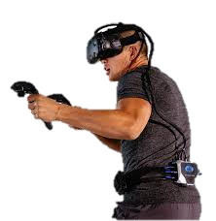
Interactive VR Game Services Requirements
Number of User to the services is one or more but not too many
VR Link Throughput Requirement of VR Game with Wireless Transmission
  Vary based on Immersion Level ( Partial , Deep, Ultimate) depends on the resolution per eye from 640x480 @60Hz to 9000x7800 @120Hz, HDR
    842 Mbps to 470 Gbps for Raw Stream
    210 Mbps to 120 Gbps for Low-latency compression (1:4)
  Raw Stream or lightly compressed stream is preferred Typical PHY Link Throughput > 30Gbps
Latency and Jitter is 5 msec
VR Game Server
T(Compression)=10ms
T_trans(Control)
T_trans(Data)
T(Decompression)=10ms
T(Rendering) ~= 3ms
T(Display) ~= 5ms
  < Interactive VR Game System >

Slide 5
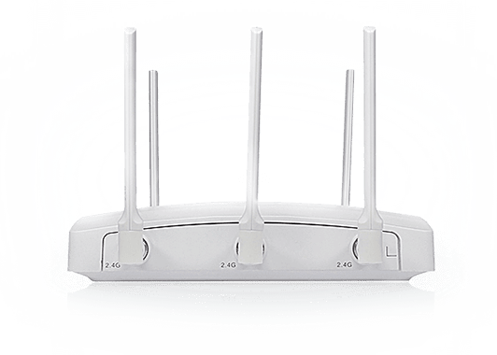
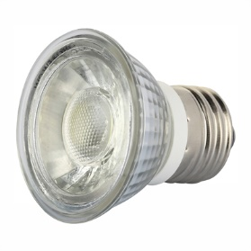
LC based VR Game Services NW Considerations
VR Game Server
IEEE802.11 TGbb Industrial Optical Wireless Scenario PHY/MAC suits VR Game Service
IEEE802.11 TGbb Bandwidth
  IEEE 802.11bb provides minimum single-link throughput of 10 Mb/s and single-link throughput of at least 5 Gb/s, as measured at the Medium Access Control (MAC) data service access point (SAP).
  Typical VR bandwidth requirement 30Gbps is achievable by next generation PHY/MAC
Jitter and Latency not discussed part of specification.
  VR Game required 5msec Jitter and latency is achievable in LC
  < LC based Interactive VR Game System >

Slide 6
Conclusions
Proposed the Network Considerations for Light Communication based Interactive VR Game Services
Using the LC, VR game system can resolve bad experience like insufficient image clarity, Image smearing, dizziness by achieving required VR required data throughput, Latency, and Jitters
LC based interactive VR game service can provide different level Immersive gaming experiences to the VR game user's and creates potential market space for VR games.

Slide 7
Reference
[1] 11-18-0846-02-0wng-802-11-for-sub-7ghz-next-generation-phy-mac
[2] 21-1-0073-00-0000-hmd-based-vr-applications-issues-and-challenges
[3] 11-18-1954-02-0eht-eht-use-case-discussion-vr-requirement-follow-up.pptx
[4] 11-18-1309-00-00bb-802-11bb-functional-requirements.docx
[5] 11-18-1423-08-00bb-tgbb-simulation-scenarios.docx

