Slide 1
IEEE 802.21 MEDIA INDEPENDENT HANDOVER
DCN: 21-19-0023-00-0000
Title: The Network Relevance in VR
Date Submitted: March 11, 2019
Presented at IEEE 802.1 session #90 Vancouver, BC, Canada
Authors or Source(s): Seo, Dong-Il Dillon (VoleR Creative)
Jeong, Sangkwon Peter (JoyFun)
Subir Das (Perspecta Labs)
Abstract: This document is to identify the industry problems for VR and to discuss the network relevance that will help to solve these problems.

Slide 2
IEEE 802.21 presentation release statements
This document has been prepared to assist the IEEE 802.21 Working Group. It is offered as a basis for discussion and is not binding on the contributing individual(s) or organization(s). The material in this document is subject to change in form and content after further study. The contributor(s) reserve(s) the right to add, amend or withdraw material contained herein.
The contributor grants a free, irrevocable license to the IEEE to incorporate material contained in this contribution, and any modifications thereof, in the creation of an IEEE Standards publication; to copyright in the IEEE’s name any IEEE Standards publication even though it may include portions of this contribution; and at the IEEE’s sole discretion to permit others to reproduce in whole or in part the resulting IEEE Standards publication. The contributor also acknowledges and accepts that this contribution may be made public by IEEE 802.21.
The contributor is familiar with IEEE patent policy, as stated in Section 6 of the IEEE-SA Standards Board bylaws <http://standards.ieee.org/guides/bylaws/sect6-7.html#6> and in Understanding Patent Issues During IEEE Standards Development http://standards.ieee.org/board/pat/faq.pdf>
IEEE 802.21 presentation release statements
This document has been prepared to assist the IEEE 802.21 Working Group. It is offered as a basis for discussion and is not binding on the contributing individual(s) or organization(s). The material in this document is subject to change in form and content after further study. The contributor(s) reserve(s) the right to add, amend or withdraw material contained herein.
The contributor grants a free, irrevocable license to the IEEE to incorporate material contained in this contribution, and any modifications thereof, in the creation of an IEEE Standards publication; to copyright in the IEEE’s name any IEEE Standards publication even though it may include portions of this contribution; and at the IEEE’s sole discretion to permit others to reproduce in whole or in part the resulting IEEE Standards publication. The contributor also acknowledges and accepts that this contribution may be made public by IEEE 802.21.
The contributor is familiar with IEEE patent policy, as outlined in Section 6.3 of the IEEE-SA Standards Board Operations Manual <http://standards.ieee.org/guides/opman/sect6.html#6.3> and in Understanding Patent Issues During IEEE Standards Development http://standards.ieee.org/board/pat/guide.html>

Slide 3
Table of Contents
Ⅰ
Industry Problems
Ⅱ
Industry Relevance
Ⅲ
Technical Challenges
Ⅳ
Goals & Objectives

Slide 4
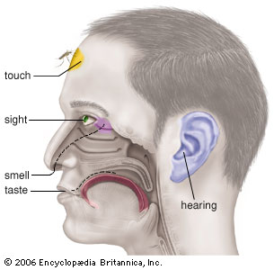
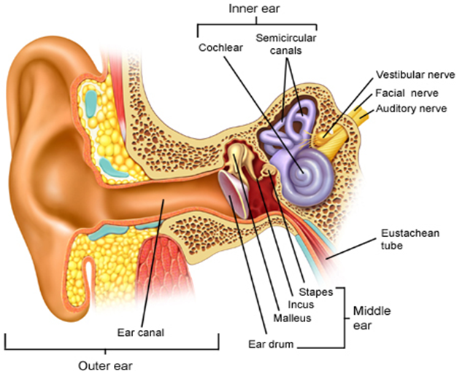
Industry Problems (VR Sickness)
Motion Sickness
Simulator Sickness
Sea Sickness
Cybersickness
Car Sickness
Air Sickness
VR Sickness
Space Sickness
Six Senses
VR sickness is a part of Motion Sickness and it is caused by the mismatch of information between the visually received information and the vestibular system.

Slide 5
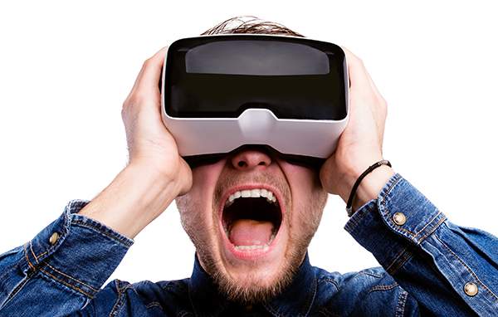
Industry Problems (QoE vs QoS)
VR HMD delivers S3D images directly to human eyes within 5 cm distance between the display and the eyes and this directly affects human sensory system.
VR content provides fully immersive experience where the user feels he/she is actually in the VR world, bad quality of experience can cause VR sickness easier than the normal flat screen (Hence, QoE is more important than QoS)
VS
Top-down Process
Bottom-up Process
Motion Sickness

Slide 6
Industry Relevance
Industry Beneficiaries for Network Standards
Mobile Network Infrastructure Providers
Immediate killer app for 5G is immersive media (VR & AR) for Telecom Companies
Need to have good VR QoE to grab more users to their 5G network
HMD Manufacturers
Stand-alone also known as all-in-one devices are designed to create a better QoE as it eliminates the cord that was attached to the device
Added processor and batteries in a limited physical case space increase the weight and the heat; hence network solution is required to for cloud VR service
Content Creators
Creating more compelling visual experience comparable to the modern PCs and gaming consoles for VR using the stand-alone device is very challenging
Current wired system limits the QoE of VR content; hence, needs a cloud VR
Platform Holders
Want to aggregate compelling VR content to grow their VR content ecosystem

Slide 7
Goals & Technical Challenges
Goals
Replace the last mile cable (e.g. ,HDMI cable connecting the HMD with the content server) with a wireless link for optimal QoE . However, the backbone connection will be a cable (e.g., Ethernet) which would require to satisfy the same QoE and deterministic delivery.
Increase the mobility with link hand-over optimization
Technical Challenges
Network requirements are directly related to MTP latency
For VR HMD based VR Content Service, the network should provide the following features:
Link Layer Issues: Jitter, Latency
High Layer Issue: QoS, QoE & Mobility
Tracker
CPU
GPU
Display
Photons
Optics
Head motion
Under 20 milliseconds of latency for comfortability
User’s retina

Slide 8
Conclusion
Various other Standard Organizations such as Khronos Group, ISO/IEC JTC1/SC24, SC29 WG11(MPEG), IEEE 3079, IEEE 2048 are developing technical standards for VR
MTP Latency is directly related to the network issues that IEEE 802 should consider when developing network standards for VR.
Link layer requirements need to be addressed by PHY & MAC
QoS, QoE and Mobility need to be addressed by above layer 2 (e,g., 2.5 layer)
SG is currently discussing
additional use cases
link layer requirements
scope for PAR/CSD
Looking forward to your participation

