Slide 1
IEEE 802.21 MEDIA INDEPENDENT HANDOVER
DCN: 21-19-0022-01-0000
Title: Why you should care about VR network requirements
Date Submitted: March 11, 2019
Presented at IEEE 802.21 session #90 Vancouver, BC, Canada
Authors or Source(s): Seo, Dong-Il Dillon (VoleR Creative)
Jeong, Sangkwon Peter (JoyFun)
Subir Das (Perspecta Labs)
Abstract: This document is to identify the industry problems for VR and to discuss the network relevance that will help to solve these problems.

Slide 2
  IEEE 802.21 presentation release statements
This document has been prepared to assist the IEEE 802.21 Working Group. It is offered as a basis for discussion and is not binding on the contributing individual(s) or organization(s). The material in this document is subject to change in form and content after further study. The contributor(s) reserve(s) the right to add, amend or withdraw material contained herein.
The contributor grants a free, irrevocable license to the IEEE to incorporate material contained in this contribution, and any modifications thereof, in the creation of an IEEE Standards publication; to copyright in the IEEE’s name any IEEE Standards publication even though it may include portions of this contribution; and at the IEEE’s sole discretion to permit others to reproduce in whole or in part the resulting IEEE Standards publication. The contributor also acknowledges and accepts that this contribution may be made public by IEEE 802.21.
The contributor is familiar with IEEE patent policy, as stated in Section 6 of the IEEE-SA Standards Board bylaws <http://standards.ieee.org/guides/bylaws/sect6-7.html#6> and in Understanding Patent Issues During IEEE Standards Development http://standards.ieee.org/board/pat/faq.pdf>
  IEEE 802.21 presentation release statements
This document has been prepared to assist the IEEE 802.21 Working Group. It is offered as a basis for discussion and is not binding on the contributing individual(s) or organization(s). The material in this document is subject to change in form and content after further study. The contributor(s) reserve(s) the right to add, amend or withdraw material contained herein.
The contributor grants a free, irrevocable license to the IEEE to incorporate material contained in this contribution, and any modifications thereof, in the creation of an IEEE Standards publication; to copyright in the IEEE’s name any IEEE Standards publication even though it may include portions of this contribution; and at the IEEE’s sole discretion to permit others to reproduce in whole or in part the resulting IEEE Standards publication. The contributor also acknowledges and accepts that this contribution may be made public by IEEE 802.21.
The contributor is familiar with IEEE patent policy, as outlined in Section 6.3 of the IEEE-SA Standards Board Operations Manual <http://standards.ieee.org/guides/opman/sect6.html#6.3> and in Understanding Patent Issues During IEEE Standards Development http://standards.ieee.org/board/pat/guide.html>

Slide 3
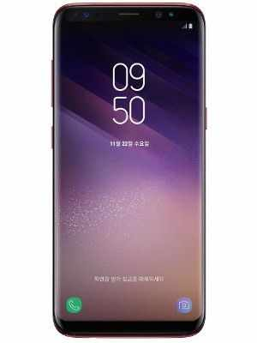
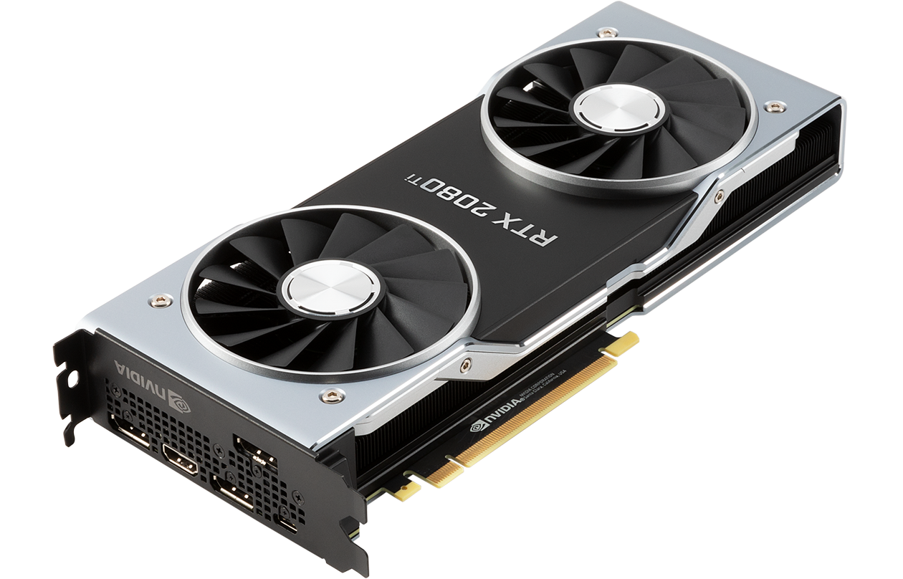

Why VR is receiving the attention
Diminishing Return: Industries need a new area to grow
Display
Microprocessor
Telecommunication

Slide 4
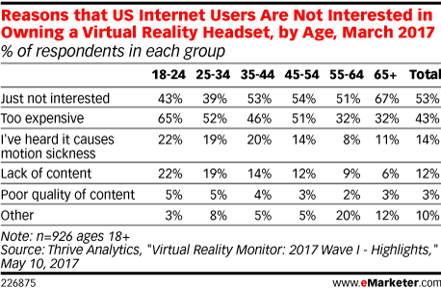
Why consumers are not interested in VR

Slide 5
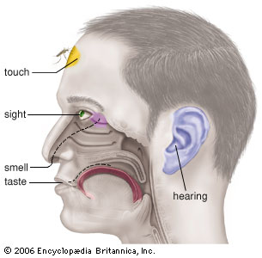
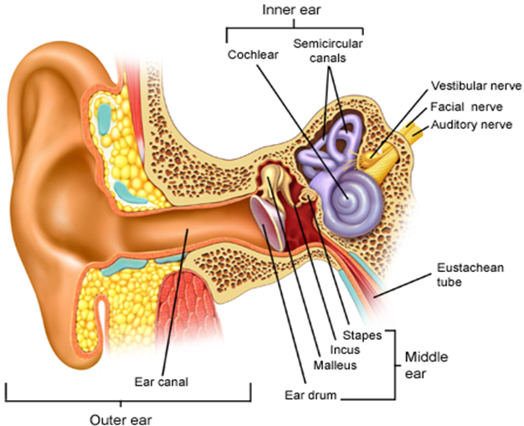
Industry Problems (VR Sickness)
Motion Sickness
Simulator Sickness
Sea Sickness
Cybersickness
Car Sickness
Air Sickness
VR Sickness
Space Sickness
Six Senses
VR sickness is a part of Motion Sickness and it is caused by the mismatch of information between the visually received information and the vestibular system.

Slide 6
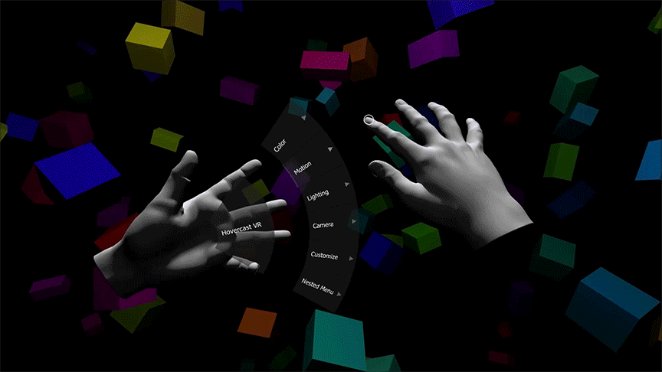
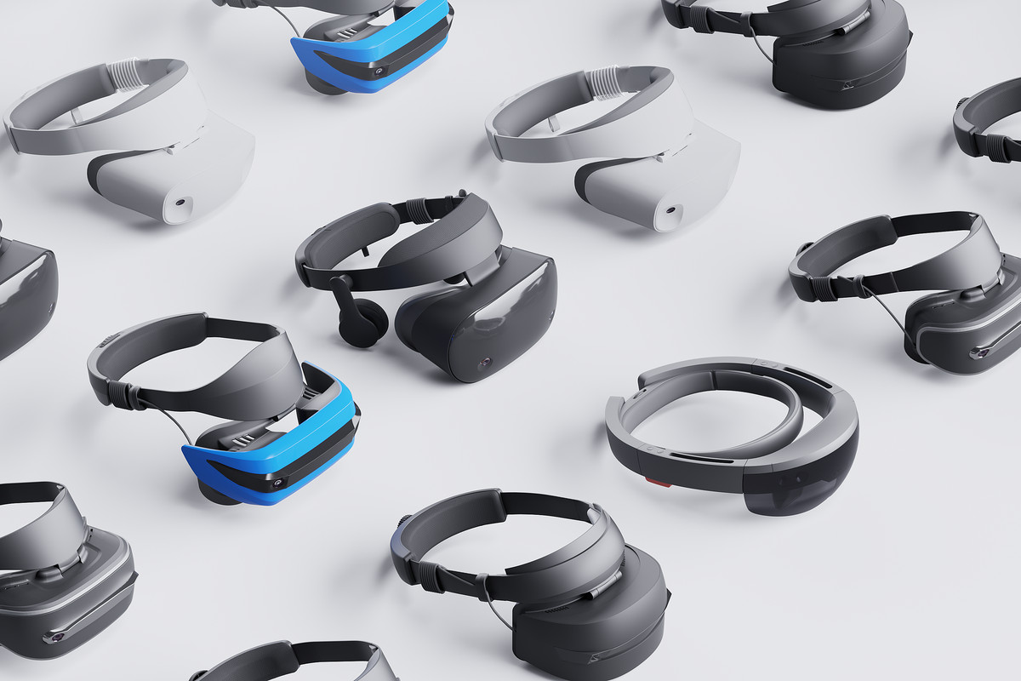
Industry Problems (VR Sickness)
VR Content Design Challenge
VR Hardware/Network Challenge

Slide 7
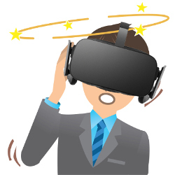
Hardware/Network Challenges (VR Sickness)
Low Display Resolution
Motion to Photon Latency
Low Frame Rate
Incorrect Spatial Sound

Slide 8
Technical Requirements for VR QoE
Technicolor, Oct. 2016 (m39532, MPEG 116th Meeting)
Requirement | Details
pixels/degree | - 40 pix/deg - no HMD is capable of displaying 40pix/deg today
video resolution | - 3 times 4K(3840x1920) vertical resolution = 11,520x6,480
framerate | - 90 FPS - a 90 FPS framerate offers a latency low enough to prevent nausea
3D Audio | - support of scene-based and/or environmental audio - 360 surround sound, object-based audio, Ambisonics
motion-to-photon latency & motion-to-audio latency | - how much time there is between the user interacts and an image / audio - maximum 20 ms
foreground & parallax | - objects in the foreground shall be far enough to prevent nausea - if objects are too close it is likely they can become an important cause of nausea - interactive parallax with background shall be present for such objects

Slide 9
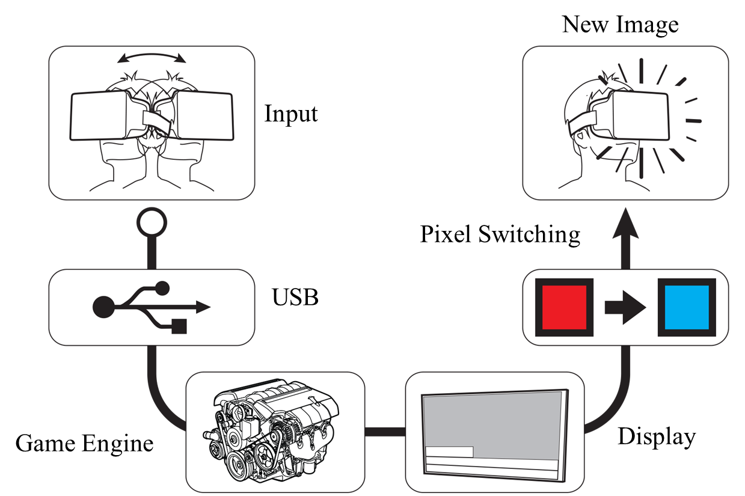


What is Motion to Photon(MTP) Latency?
According to the paper published by Held, Efsathiou, & Greene in 1966,
if the MTP (motion-to-photon latency) is too high,
it makes people to feel motion sick.
The paper published by Sheridan & Ferrel in 1963 also states
that the high MTP also cause a poor manual performance of human being.
In 2003, Bernard D. Adelstein from NASA Ames Research Center mentioned in his paper, HEAD TRACKING LATENCY IN VIRTUAL ENVIRONMENTS: PSYCHOPHYSICS AND A MODEL, the MTP needs to be less than 17 ms.
According to John Carmack, the CTO of Oculus, the MTP must be lower than 20 ms to minimized the VR sickness.
The goal is to deliver the optimal QoE with satisfying QoS
Tracker
CPU
GPU
Display
Photons
Optics
Head motion
Under 20 milliseconds of latency for comfortability
User’s retina

Slide 10
Components Contributing to MTP Latency
VR System
Total Motion-to-Photon Latency ≤20ms
HMD
Motion
Input
New Image
Output
①
1ms
⑦
Pixel
Switching
1ms
IMU
90Hz OLED Display 11ms
⑥
②
Write Display
⑤
Local Content Server
Data Processing Unit
2ms
Remote Content Server
③
④
Data Processing Unit
2ms

Slide 11
Network Components Contributing to MTP Latency
Case | Status of each node |  |  |  |  |  |  | Remarks
 | ① | ② | ③ | ④ | ⑤ | ⑥ | ⑦
1 | direct | HDMI | Wired LAN | Wired LAN | HDMI | chip | display Panel | Wired Network
2 | direct | on Board | Wireless LAN | Wireless LAN | on Board | chip | display Panel | Wireless Network
3 | direct | on Board | WAN | WAN | on Board | chip | display Panel | Backbone Network
4 | direct | LAN | n/a | n/a | LAN | chip | display Panel | Local Network
5 | direct | on Board | WAN | Wireless LAN | on Board | chip | display Panel | Network Handover

Slide 12
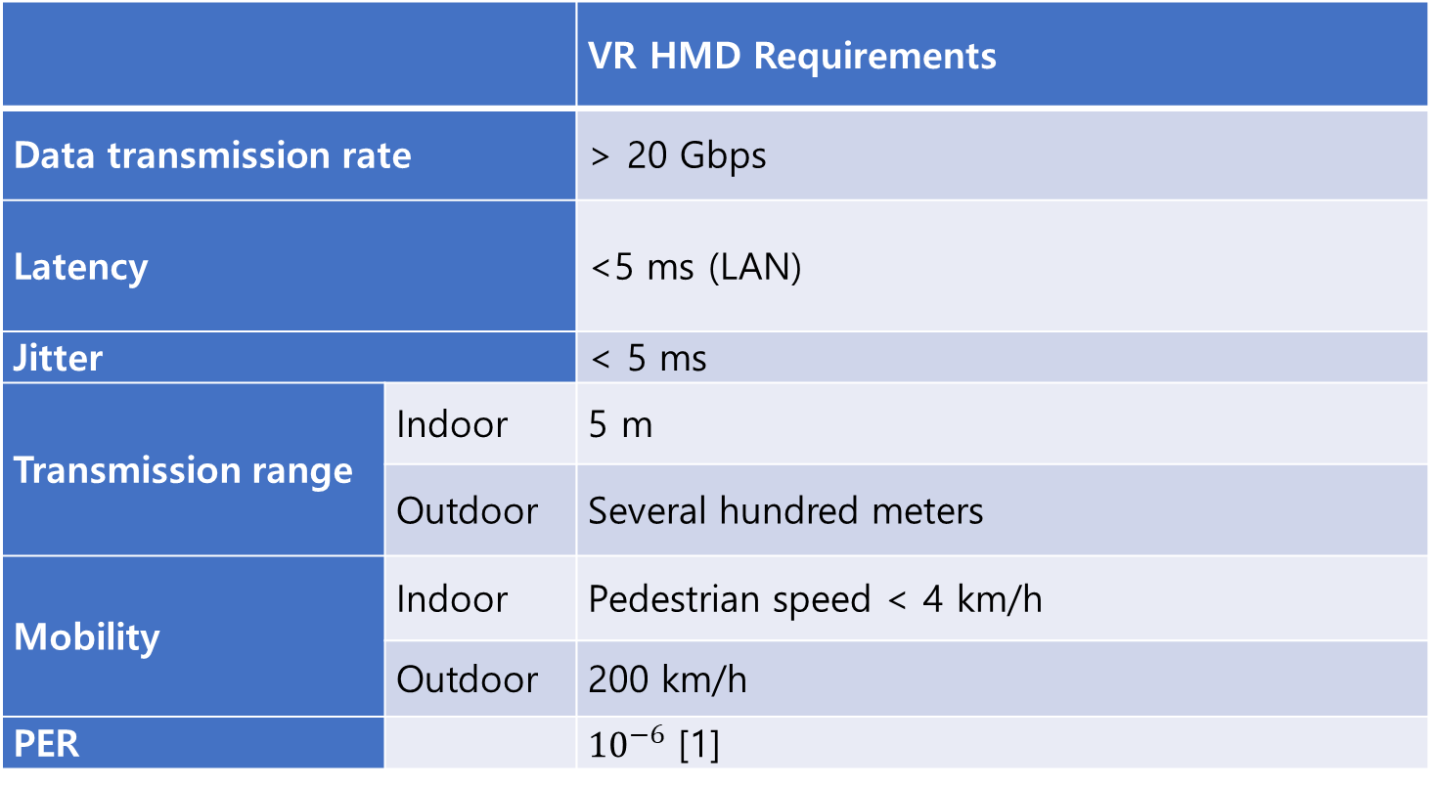
Network Requirements for VR Application
 |  | VR HMD Requirements
Data transmission rate |  | > 20 Gbps
Latency |  | <5 ms (LAN)
Jitter |  | < 5 ms
Transmission range | Indoor | 5 m
 | Outdoor | Several hundred meters
Mobility | Indoor | Pedestrian speed < 4 km/h
 | Outdoor | 200 km/h
PER |  | ${10}^{−6}$ [1]

Slide 13
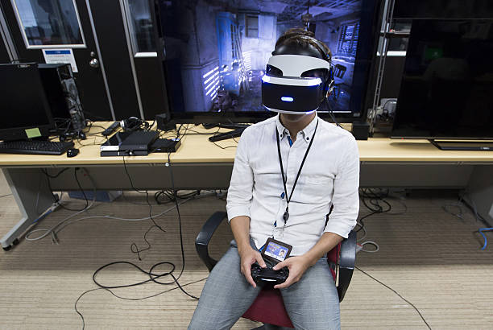
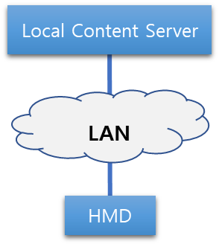
Use Case I
  Case 1: A Single VR System Connected via a LAN
In the picture below, a user is playing a VR game using a VR HMD connected to a game console system known as PlayStation 4 with HDMI (High Definition Multimedia Interface) and USB (Universal Serial Bus) cables. The HDMI cable is delivering both video and audio for the VR game that are rendered in real time by the game console (shown in figure) to the VR HMD. The USB cable is delivering the head tracking data from the VR HMD to the game console to reflect the user’s head position so that the game console can render both the video and the audio of the VR game accordingly in real time.
Goal: Replace the wired link to wireless to provide more optimal QoE
- Must support over 90 Hz of frame rate and over 2K resolution video quality with very low latency and low jitter

Slide 14
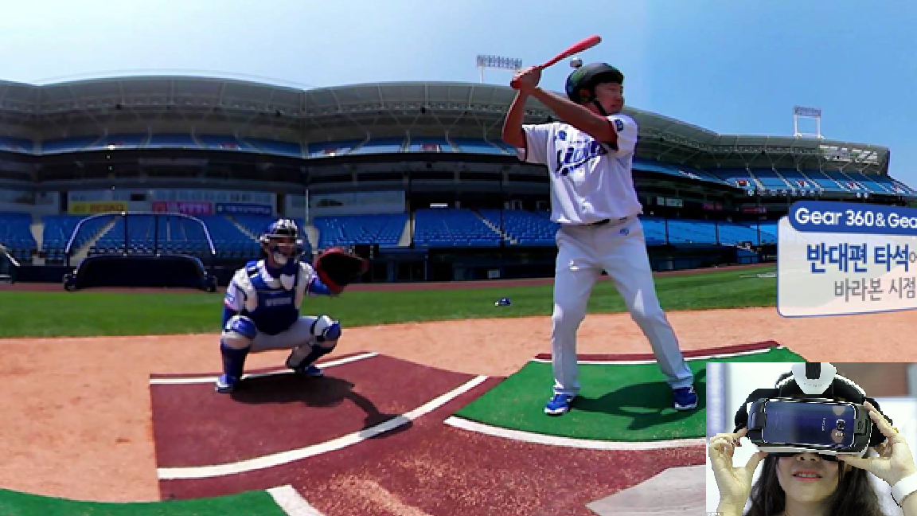
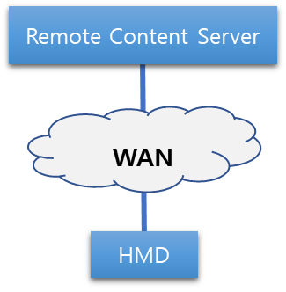
Use Case II
  Case 2: A Single VR System Connected via a WAN
  In the following picture, a user is watching a baseball game in a virtual reality environment using a mobile phone-based VR HMD system. The baseball game in this scenario is being captured with a 360-degree camera and it is being streamed to the VR HMD in real time. The head tracking data is also transferred to the camera via a mobile network to display the view where the user is looking at. In this scenario, the VR content service is rendered or decoded in the remote content server. . It is important to note that the remote content server is located outside the local network and wide area network (WAN) consists of both wired and wireless networks.
Goal: Must deliver optimal QoE via WAN
- Must support over 90 Hz of frame rate and over 2K resolution video quality with very low latency and low jitter

Slide 15
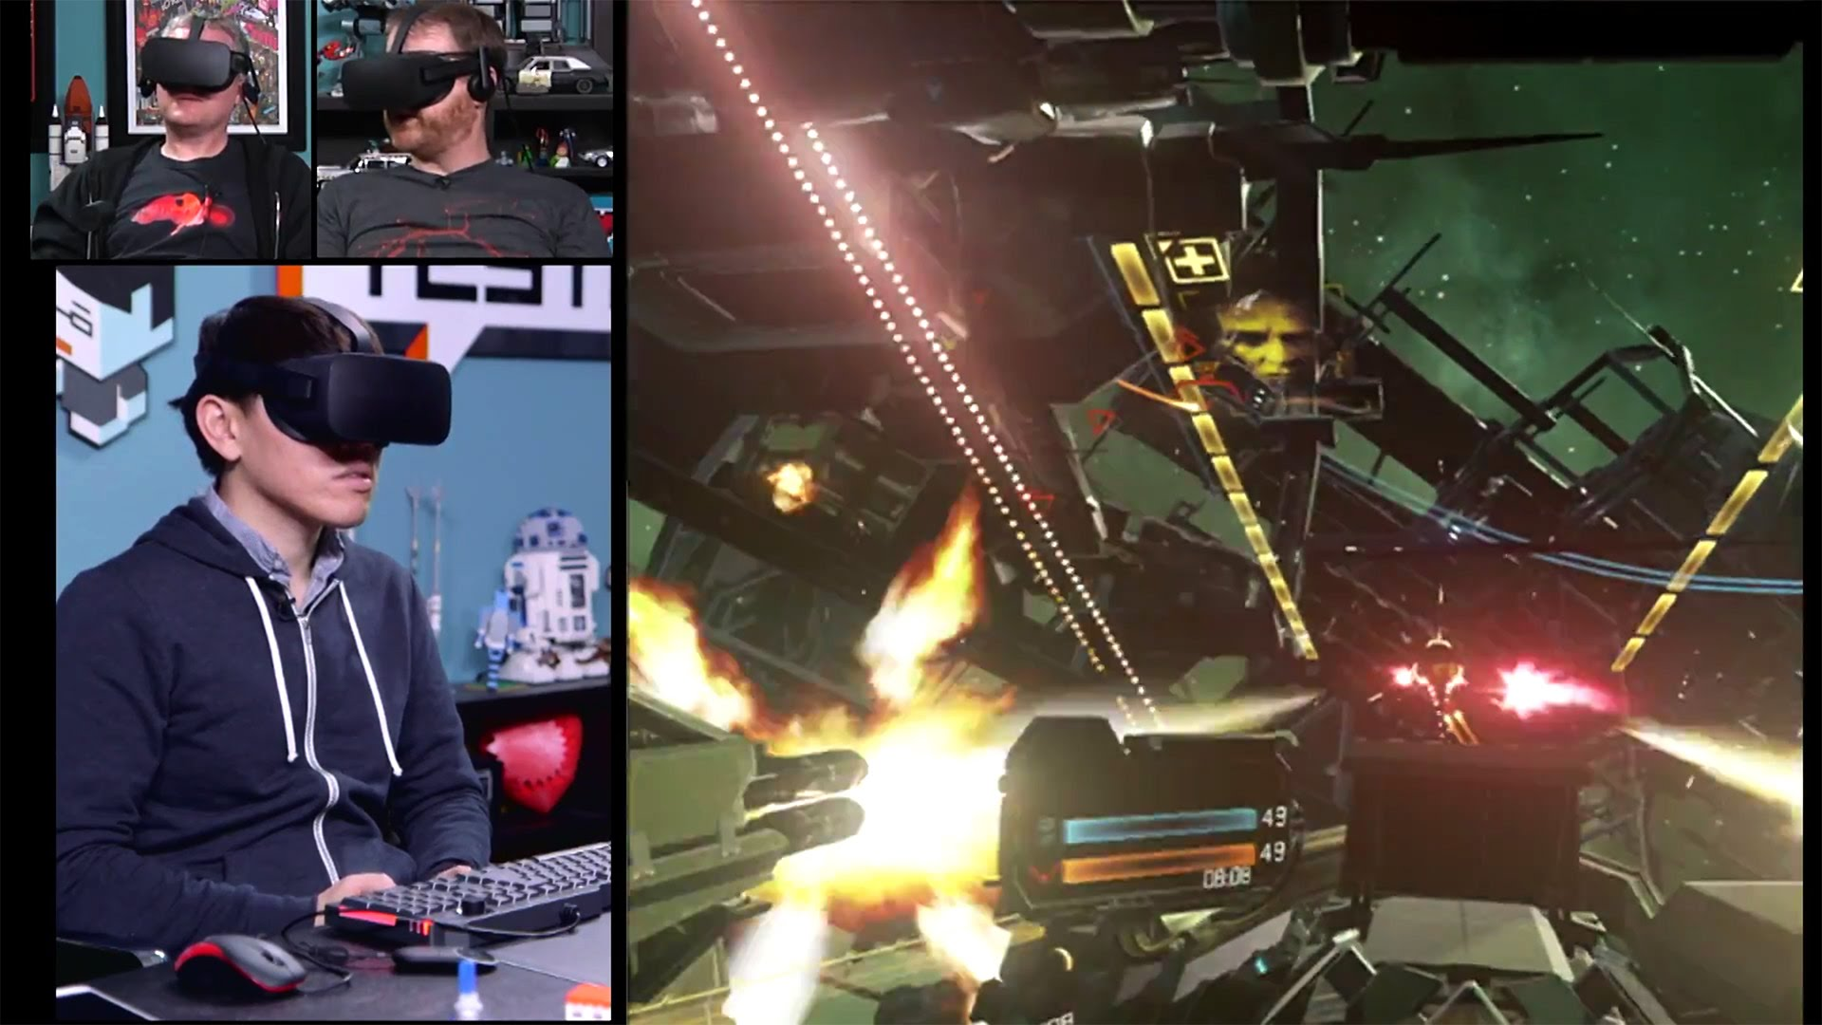
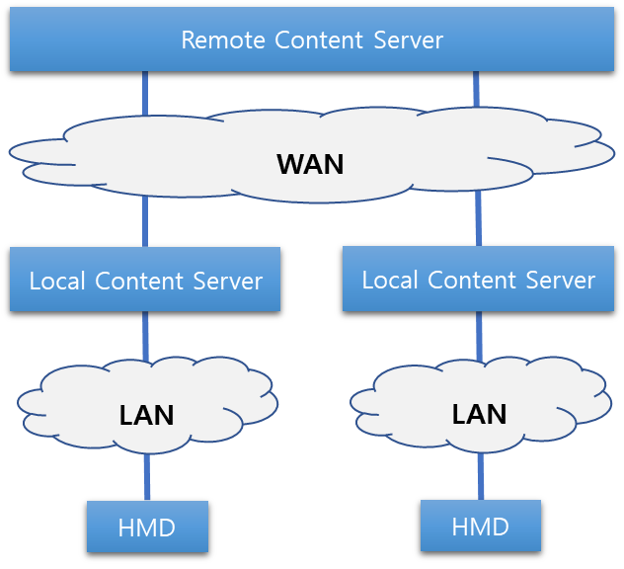
Use case III
  Case 3: Multiple VR Systems Connected via a LAN
  In the following picture, a user is playing a virtual reality game and competing against other remote players using a VR HMD system that is connected to local server (e.g., a PC or a Laptop). The HDMI cable connecting the VR HMD system and the local server is used to receive the video and the audio data of the VR game content, the service of which is being rendered real time in the local server. The USB cable connecting the VR HMD and the local server is used to exchange the head tracking data so the server can render the video and the audio data accordingly. The remote content server is calculating the scores and the consequential data caused by the remote users’ input. These data are sent to the local content server so it can render the video and the audio of the VR game content accordingly.
Goal: Must deliver optimal QoE via LAN and WAN
- Must support over 90 Hz of frame rate and over 2K resolution video quality with very low latency and low jitter

Slide 16
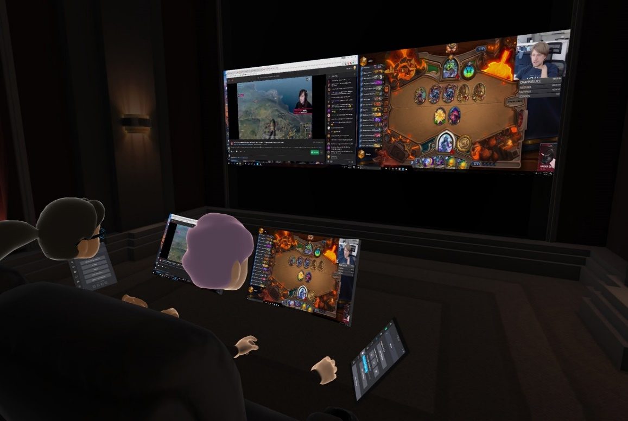
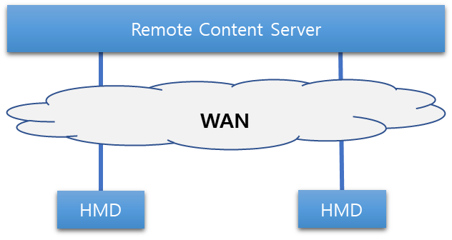
Use Cases IV
  Case 4: Multiple VR Systems Connected via a WAN
  In the following picture, two or more users are watching a live streamed video game match from their respective home using their mobile phone-based VR HMD systems. The users watching the same content in a virtual movie theater rendered in a cloud service provider and they are being represented as a form of a virtual avatar in the virtual reality theater. They are able to interact with each other and also can communicate via audio. The live-streamed video game match and the virtual reality theater are all being rendered in a remote server situated in the cloud service provider network and the VR HMD system is only running a small application for obtaining the cloud rendered VR content.
Goal: Must deliver optimal QoE via WAN with multiple nodes
- Must support over 90 Hz of frame rate and over 2K resolution video quality with very low latency and low jitter

Slide 17
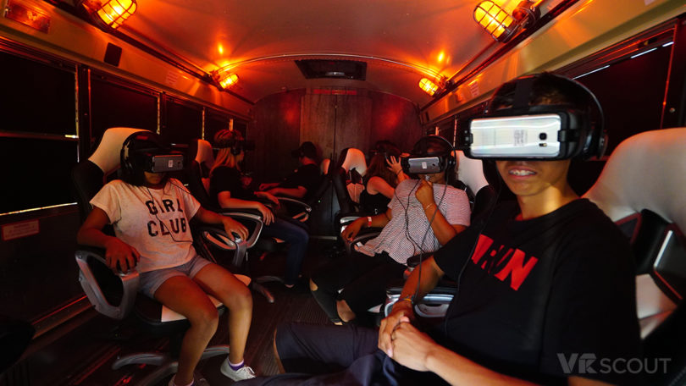
Use Cases V
  Case 5: Special Use Case – Change of Network
  In the following picture, a user is watching a streamed movie using a mobile phone-based VR HMD while travelling in a bus or a train. The movie is encoded in the remote server and sent to the VR HMD system via a wide area network. The VR HMD system is only decoding the content sent by the remote server.
Goal: Must deliver optimal QoE with network mobility
- Must support over 90 Hz of frame rate and over 2K resolution video quality with very low latency and low jitter

Slide 18
Goals & Technical Challenges
Goals
  Replace the last mile cable (e.g. ,HDMI cable connecting the HMD with the content server) with a wireless link for optimal QoE . However, the backbone connection will be a cable (e.g., Ethernet) which would require to satisfy the same QoE and deterministic delivery.
  Increase the mobility with link hand-over optimization
Technical Challenges
  Network requirements are directly related to MTP latency
  For VR HMD based VR Content Service, the network should provide the following features:
    Link Layer Issues: Jitter, Latency
    High Layer Issue: QoS, QoE & Mobility

Slide 19
Industry Relevance
Industry Beneficiaries for Network Standards
  Mobile Network Infrastructure Providers
    Immediate killer app for 5G is immersive media (VR & AR) for Telecom Companies
    Need to have good VR QoE to grab more users to their 5G network
  HMD Manufacturers
    Stand-alone also known as all-in-one devices are designed to create a better QoE as it eliminates the cord that was attached to the device
    Added processor and batteries in a limited physical case space increase the weight and the heat; hence network solution is required to for cloud VR service
  Content Creators
    Creating more compelling visual experience comparable to the modern PCs and gaming consoles for VR using the stand-alone device is very challenging
    Current wired system limits the QoE of VR content; hence, needs a cloud VR
  Platform Holders
    Want to aggregate compelling VR content to grow their VR content ecosystem

Slide 20
Conclusion
Various other Standard Organizations such as Khronos Group, ISO/IEC JTC1/SC24, SC29 WG11(MPEG), IEEE 3079, IEEE 2048 are developing technical standards for VR
MTP Latency is directly related to the network issues that IEEE 802 should consider when developing network standards for VR.
  Link layer requirements need to be addressed by PHY & MAC
  QoS, QoE and Mobility need to be addressed by above layer 2
SG is currently discussing
  additional use cases
  link layer requirements
  scope for PAR/CSD
  with all IEEE 802 WGs
Looking forward to your input & participation

