Slide 1
IEEE 802.21 MEDIA INDEPENDENT HANDOVER
DCN: 21-19-0013-00-0000
Title: Interactive Around Immersive View Experience using HMD based OCC Technology
Date Submitted: January 17, 2019
Presented at IEEE 802.21 session #89 in St. Louis, USA
Authors or Source(s): Jaesang Cha (SNUST), Vinayagam Mariappan (SNUST), Minwoo Lee (SNUST), Younggyu Kang, Daehyun Kim (Namuga Co., Ltd.), Juphil Cho (Kunsan Univ.), Byungjun Min, Jungjin Ra (Head IT Co., Ltd), Hyeong Ho Lee (Netvision Telecom Inc., Korea Univ.) , Soo Young Chang (SYCA)
Abstract: This document is to describe the 360º Interactive VR/AR view experience for historical place exhibition using HMD based LiFi / CamCom technology.

Slide 2
IEEE 802.21 presentation release statements
This document has been prepared to assist the IEEE 802.21 Working Group. It is offered as a basis for discussion and is not binding on the contributing individual(s) or organization(s). The material in this document is subject to change in form and content after further study. The contributor(s) reserve(s) the right to add, amend or withdraw material contained herein.
The contributor grants a free, irrevocable license to the IEEE to incorporate material contained in this contribution, and any modifications thereof, in the creation of an IEEE Standards publication; to copyright in the IEEE’s name any IEEE Standards publication even though it may include portions of this contribution; and at the IEEE’s sole discretion to permit others to reproduce in whole or in part the resulting IEEE Standards publication. The contributor also acknowledges and accepts that this contribution may be made public by IEEE 802.21.
The contributor is familiar with IEEE patent policy, as stated in Section 6 of the IEEE-SA Standards Board bylaws <http://standards.ieee.org/guides/bylaws/sect6-7.html#6> and in Understanding Patent Issues During IEEE Standards Development http://standards.ieee.org/board/pat/faq.pdf>
IEEE 802.21 presentation release statements
This document has been prepared to assist the IEEE 802.21 Working Group. It is offered as a basis for discussion and is not binding on the contributing individual(s) or organization(s). The material in this document is subject to change in form and content after further study. The contributor(s) reserve(s) the right to add, amend or withdraw material contained herein.
The contributor grants a free, irrevocable license to the IEEE to incorporate material contained in this contribution, and any modifications thereof, in the creation of an IEEE Standards publication; to copyright in the IEEE’s name any IEEE Standards publication even though it may include portions of this contribution; and at the IEEE’s sole discretion to permit others to reproduce in whole or in part the resulting IEEE Standards publication. The contributor also acknowledges and accepts that this contribution may be made public by IEEE 802.21.
The contributor is familiar with IEEE patent policy, as outlined in Section 6.3 of the IEEE-SA Standards Board Operations Manual <http://standards.ieee.org/guides/opman/sect6.html#6.3> and in Understanding Patent Issues During IEEE Standards Development http://standards.ieee.org/board/pat/guide.html>

Slide 3
Table of Contents
Ⅰ
Need of Around View VR/AR Experience Application
Ⅱ
Around View Interactive VR/AR Experience Using OCC Technology
Ⅲ
Conclusions

Slide 4
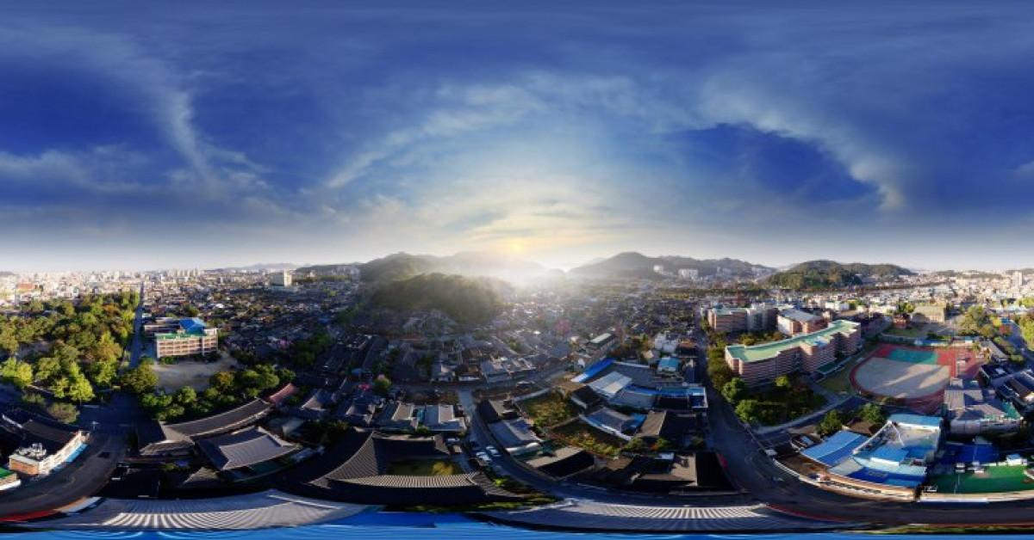
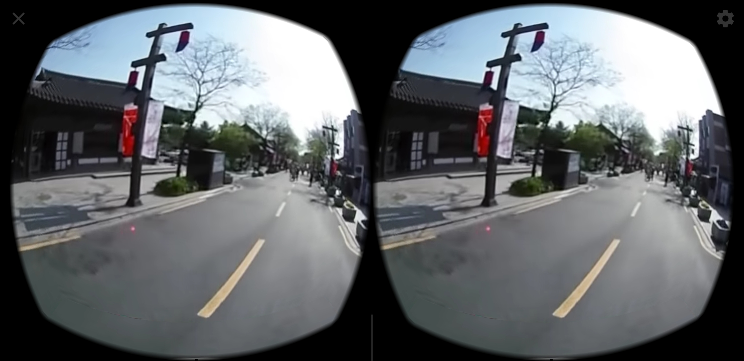
Need of Around View VR/AR Experience Application
Needs
The most of around view i.e. 360º VR/AR experience application is usually a simple playback of images shot with a 360 degree camera.
HMD AR/VR devices need the additional components such as controllers are required for interaction functions.
Basic Concept
By Using Display based OCC, we can receive Interactive around VR/AR Experience Trigger without any additional controller interface.
VR/AR Devices have a Camera as an photo detector to receive data
In VR case, VR Device can receive around view 2D Color coded Tx data from display.
In AR case, displays are installed 360º with embedded 2D Color coded Tx.
< Around View Contents Example >
< Around View Player Example >

Slide 5
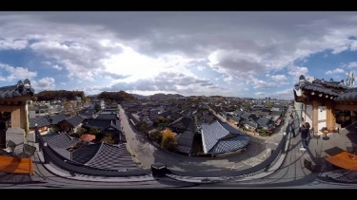
Around View Interactive VR/AR Experience Using OCC Technology
Users who are using the VR/AR Experience application can receive get interactive data from 360º installed display devices using 2D advanced color data modulation techniques.
AR/VR devices have the camera and camera support to OCC and displays embedded with 2D coded data to support OCC.
Users are able to interact with a 360º experience application without additional controllers.
Display based OCC serves as a 360º experience video playback and provides interaction functions.
OCC Data
Interactive Trigger
Create Around View(Display)
< Around View Interactive VR/AR Experience Using OCC Technology >

Slide 6
Conclusions
Proposed the 360º Interactive VR/AR Experience Application using Display based OCC Technology
Users who are using the VR/AR Experience application can receive get interactive data from 360º installed display.
Users are able to interact with a 360º experience application without additional controllers
In AR case, OCC supported display serves as a 360º experience video playback and provides interaction functions.

