Slide 1
IEEE 802.21 MEDIA INDEPENDENT HANDOVER
DCN: 21-19-0010-00-0000
Title: IoT/IoL based VR Games Interaction Service for VR System
Date Submitted: January 17, 2019
Presented at IEEE 802.21 session #89 in St. Louis, USA
Authors or Source(s): Jaesang Cha (SNUST), Vinayagam Mariappan (SNUST), Minwoo Lee (SNUST), Hyeong Ho Lee (Netvision Telecom Inc., Korea Univ.), Soo Young Chang (SYCA)
Abstract: This document is to describe the IoT/IoL based Virtual Game Interaction Service for VR System

Slide 2
  IEEE 802.21 presentation release statements
This document has been prepared to assist the IEEE 802.21 Working Group. It is offered as a basis for discussion and is not binding on the contributing individual(s) or organization(s). The material in this document is subject to change in form and content after further study. The contributor(s) reserve(s) the right to add, amend or withdraw material contained herein.
The contributor grants a free, irrevocable license to the IEEE to incorporate material contained in this contribution, and any modifications thereof, in the creation of an IEEE Standards publication; to copyright in the IEEE’s name any IEEE Standards publication even though it may include portions of this contribution; and at the IEEE’s sole discretion to permit others to reproduce in whole or in part the resulting IEEE Standards publication. The contributor also acknowledges and accepts that this contribution may be made public by IEEE 802.21.
The contributor is familiar with IEEE patent policy, as stated in Section 6 of the IEEE-SA Standards Board bylaws <http://standards.ieee.org/guides/bylaws/sect6-7.html#6> and in Understanding Patent Issues During IEEE Standards Development http://standards.ieee.org/board/pat/faq.pdf>
  IEEE 802.21 presentation release statements
This document has been prepared to assist the IEEE 802.21 Working Group. It is offered as a basis for discussion and is not binding on the contributing individual(s) or organization(s). The material in this document is subject to change in form and content after further study. The contributor(s) reserve(s) the right to add, amend or withdraw material contained herein.
The contributor grants a free, irrevocable license to the IEEE to incorporate material contained in this contribution, and any modifications thereof, in the creation of an IEEE Standards publication; to copyright in the IEEE’s name any IEEE Standards publication even though it may include portions of this contribution; and at the IEEE’s sole discretion to permit others to reproduce in whole or in part the resulting IEEE Standards publication. The contributor also acknowledges and accepts that this contribution may be made public by IEEE 802.21.
The contributor is familiar with IEEE patent policy, as outlined in Section 6.3 of the IEEE-SA Standards Board Operations Manual <http://standards.ieee.org/guides/opman/sect6.html#6.3> and in Understanding Patent Issues During IEEE Standards Development http://standards.ieee.org/board/pat/guide.html>

Slide 3
Table of Contents
Ⅰ
Need of VR Game Interaction Service for VR System
Ⅱ
IoT/IoL based VR Game Interaction Service
Ⅲ
Conclusions

Slide 4
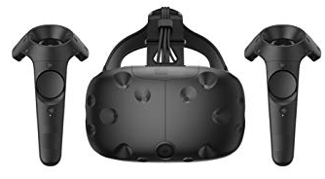
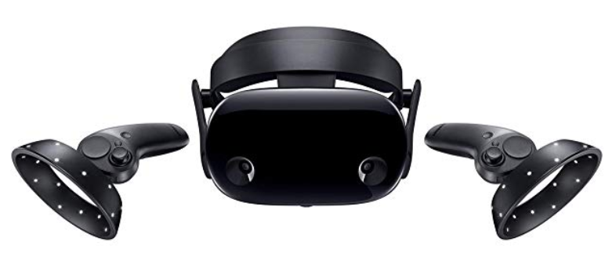
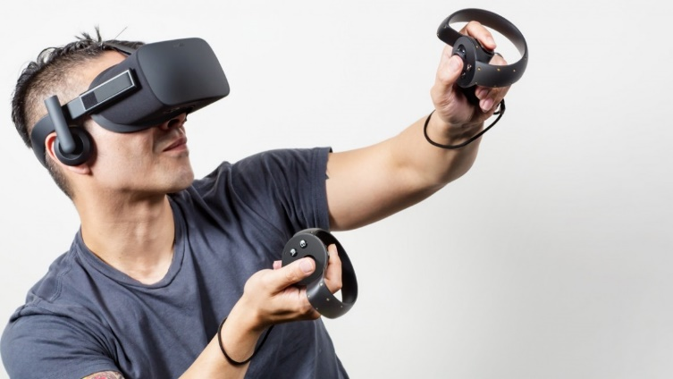
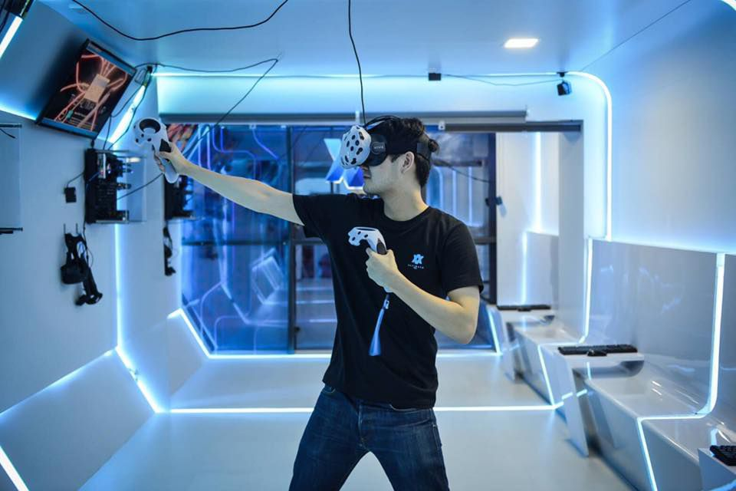
Need of VR Game Interaction Service for VR System
Needs
  In VR gaming systems, there is no other way to interact with users other than the user to make physical contact with wireless controllers
  A body-wrapped VR system has also been introduced but is incomplete.
Basic Concept
  The user mounts an HMD device coupled with a VR system or a smartphone equipped with a camera.
  LED lighting and Display’s light source used IoT/IoL connectivity with HMD devices to provide VR game engine interaction service
  < VR Game System with Interaction Interface >

Slide 5
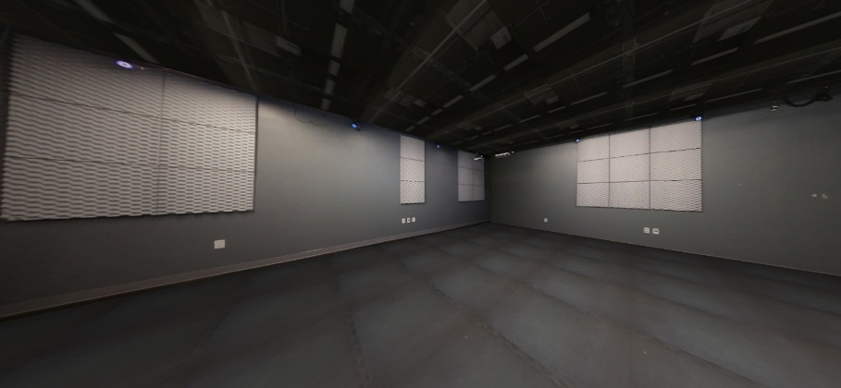




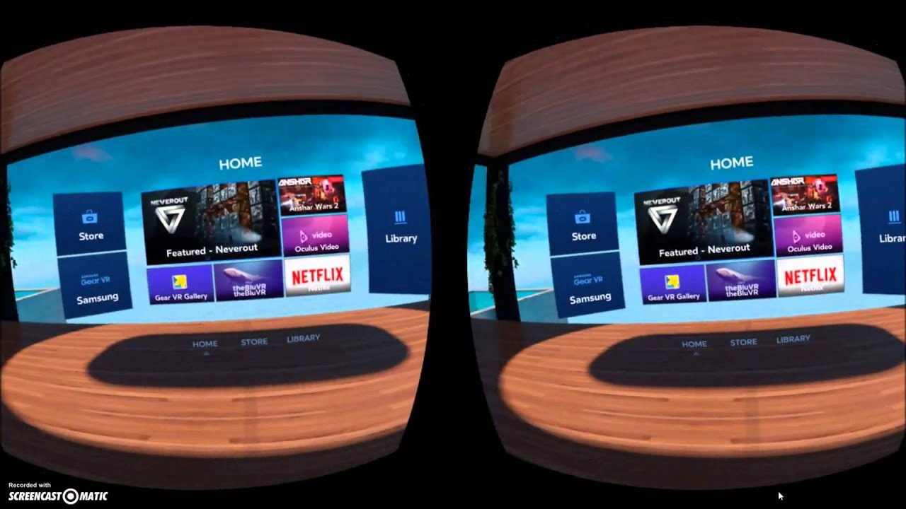
IoT/IoL based VR Game Interaction Service
Users who are using the VR system have virtually no way to receive input from outside.
An LED light or a display light source is installed in a dedicated space where the VR system is installed and is used as a transmitter for external input.
In addition, the camera mounted on the VR system can be used to acquire visible light communication-based IoL data displayed on the LED light or the display light source.
Send
IoT/IoL Data
Notice New Info.
In this IoT / IoL based Interaction service to perform interfacing with the user, notifications, additional information on the VR screen, etc.
  < IoT/IoL based User Interaction Service in VR Game System >

Slide 6
Conclusions
Proposed the IoT/IoL based VR Game interaction service for VR system
Using the proposed technology, users who use the VR system can also receive new services by utilizing the interaction system based on IoT/IoL.
Originally, the user's camera receives IoT/IoL data from illumination devices installed in the physical space where VR system installed and conversely, the HMD's built-in flash light can be used as a transmitter to interact bi-directionally.

