Slide 1
IEEE 802.21 MEDIA INDEPENDENT SERVICES
DCN: 21-18-0075-00-0000
Title: Request for Study Group Approval
Date Submitted: November 15, 2018
Presented in November, 2018 IEEE 802 EC Closing Plenary in Bangkok, Thailand
Source: Subir Das (Perspecta Labs)
Abstract: This document contains the EC motion and materials to support the Study Group proposal on Network Enablers for Seamless HMD-based VR (Virtual Reality) Content Service.

Slide 2
EC Motion
Approve the formation of IEEE 802.21 'Network Enablers for Seamless HMD-based VR (Virtual Reality) Content Service ' Study Group to consider development of a Project Authorization Request (PAR) and Criteria for Standards Development (CSD) responses for supporting HMD-VR applications.
Move: Subir Das
Second: John Rosdahl
WG Vote: 09/00/00
EC Vote:
For: Against: Abstain:
Slide 1

Slide 3
P802.21 WG Motion
Move to authorize the P802.21 WG Chair to make a motion to the
IEEE 802 Executive Committee for the formation of a Study Group
on 'Network Enablers for Seamless HMD-based VR (Virtual Reality) Content Service’.
Move: Dillon Seo
Second: Hyeong Ho Lee
For: 09
Against: 00
Abstain: 00
Motion Passes
Slide 2

Slide 4
Supporting Material
Slide 3

Slide 5
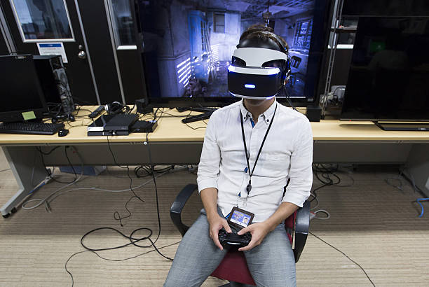
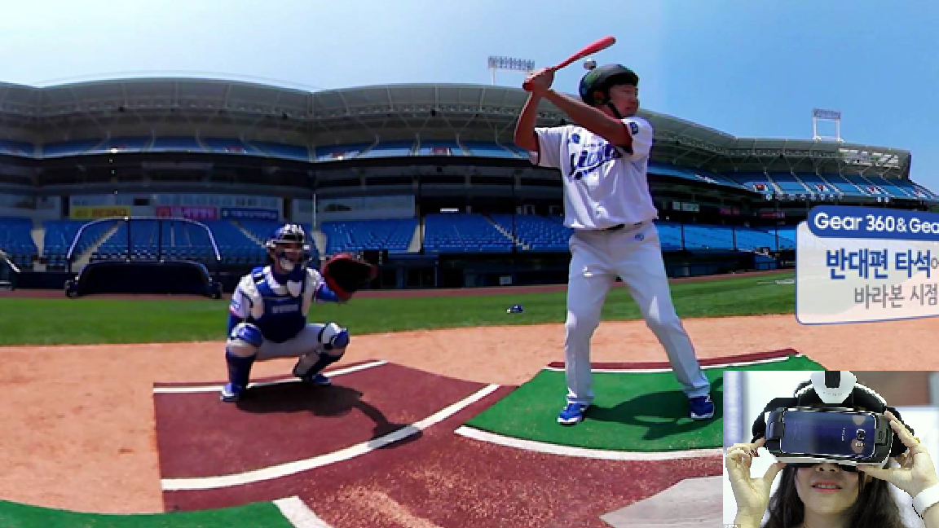
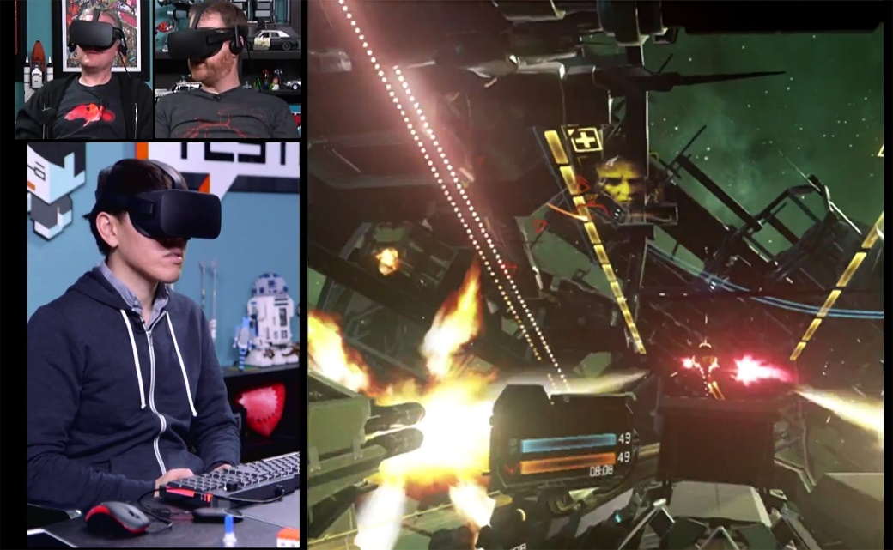
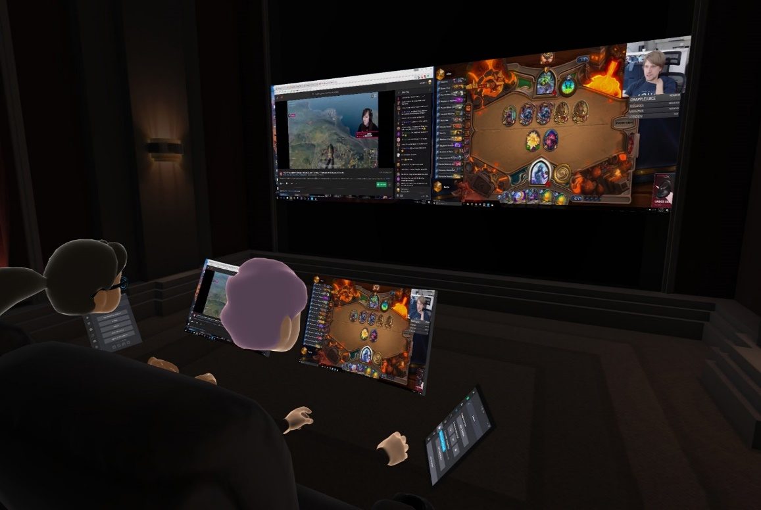
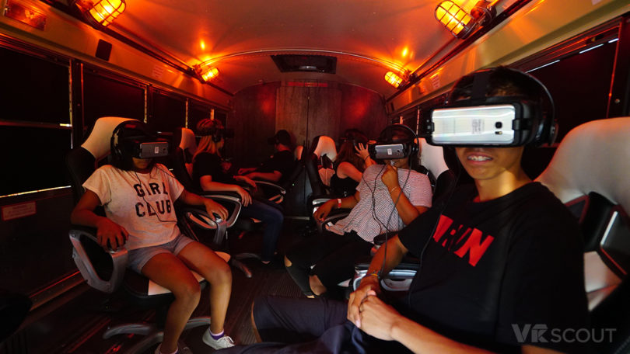
HMD-VR Use Cases
A Single VR System Connected via LAN
A Single VR System Connected via WAN
Multiple VR Systems Connected via LAN
Multiple VR Systems Connected via WAN
Multiple VR Systems connected via LAN with network mobility

Slide 6
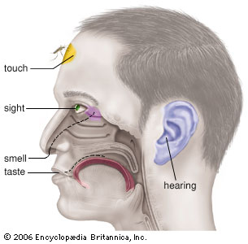
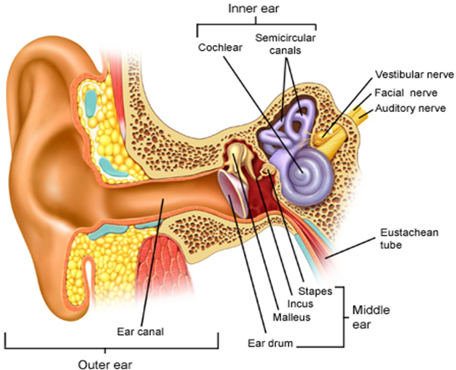
Industry Problems
VR sickness is a subset of Motion Sickness*
Our current focus is VR HMD based Sickness only
Caused by the mismatch between the visually received information and the vestibular system
Various Standard Organizations such as IEEE 3079, IEEE 2048, Khronos Group, ISO/IEC JTC1/SC24, SC29 WG11(MPEG), W3C, ITU-T SG12 are trying to address the technical issues of VR
Motion Sickness
Simulator Sickness
Sea Sickness
Cybersickness
Car Sickness
Air Sickness
VR Sickness
Space Sickness
※ VR: Virtual Reality
※ HMD: Head Mounted Display
* In 2003, Bernard D. Adelstein from NASA Ames Research Center mentioned in his paper, ‘HEAD TRACKING LATENCY IN VIRTUAL ENVIRONMENTS: PSYCHOPHYSICS AND A MODEL’, the MTP needs to be less than 17 ms.
Notes:
HMD VR sickness에 초점을 맞추어야 한다.
이 슬라이드에서 VR Sickness가 one of Cybersickness라는 것은 크게 중요한 내용이 아니다.

Slide 7
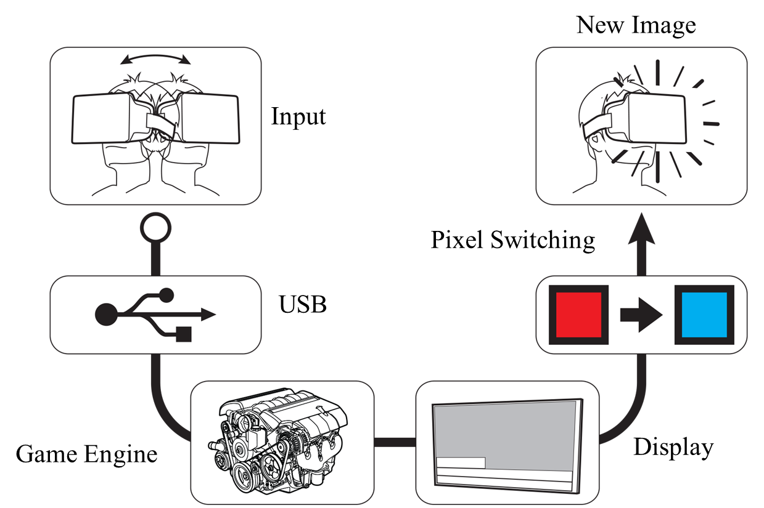


Technical Challenges
Network requirements are directly related to Motion to Photon (MTP) latency
For VR HMD based VR applications, the network should provide the following features:
  At Link Layer: very low latency and jitter
  At network and higher Layers: desired QoS, QoE and support for Mobility
Tracker
CPU
GPU
Display
Photons
Optics
Head motion
Under 20 milliseconds of latency for comfortability
User’s retina

Slide 8
Industry Relevance
Apart from link layer characteristics, securing QoE is important for the following industry participants
  Mobile Network Infrastructure Providers
    Support for immersive media (VR & AR)-based applications in 5G networks
    Ability to support more users with required QoS
  HMD Manufacturers
    Support for the desired network characteristics (QoE & QoS) will enable the HMD manufactures to move from stand-alone (which is pre-dominant at the moment) to a network based light-weight VR HMD.
  Content Creators
    Want to create compelling visual experience comparable to the modern PCs and gaming consoles for VR
    Cloud-based VR offerings are preferred
  Platform Holders
    Want to aggregate compelling VR content to grow their VR content ecosystem

Slide 9
IEEE 802.21 Interest Group Activities
For the last few months, IG produced the followings:
  Produced a White Paper on problem statement, use case and analysis of existing technologies
    https://mentor.ieee.org/802.21/dcn/18/21-18-0061-02-0000-a-white-paper-on-use-cases-and-requirements-for-supporting-hmd-based-vr-applications.docx
  Conducted a test to verify the application data throughput requirements (MPEG test procedure) in a constraint environment
  Discussions ongoing with IEEE 802.11 RTA for certain use cases
  Initiated discussion with 802.1 TSN TG

Slide 10
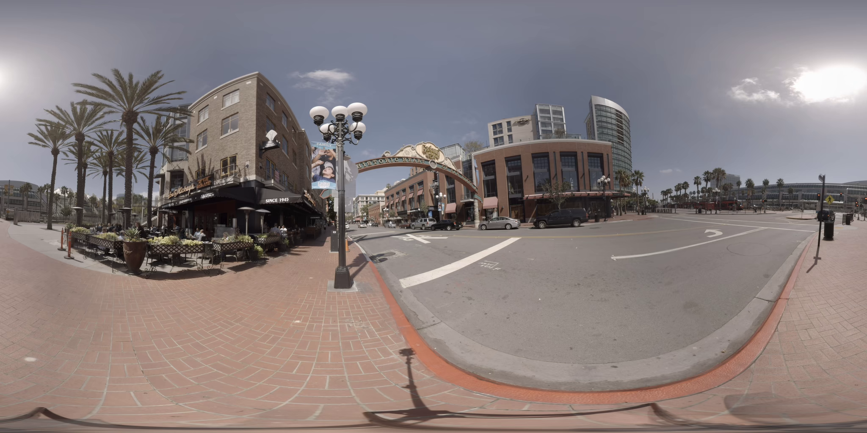
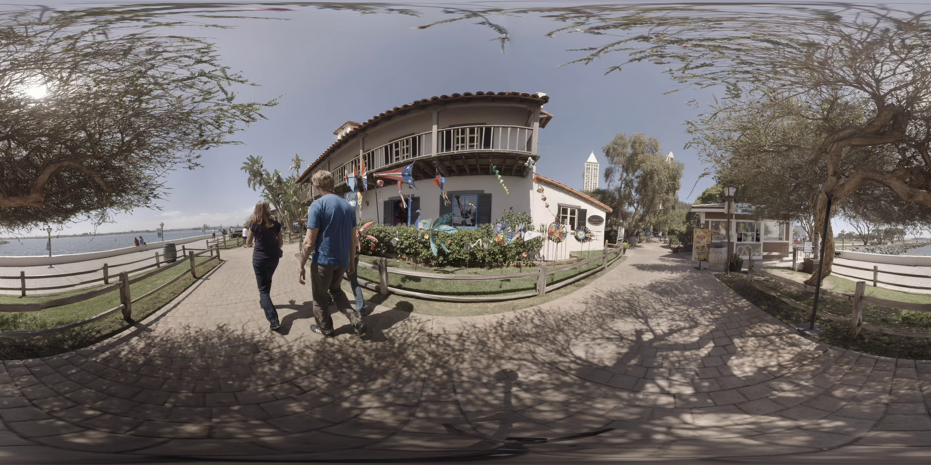
Test Sequences (Defined by ISO/IEC MPEG Standard-I)
- Gaslamp
- KiteFlite
Application throughput (8K Res & 90 FPS): 40 ~ 160 Mbps
Test is conducted on non-real time application
Future test will investigate the data throughput at the network and the link layers
※ Source: Prof. Ryu, Eunseok (Gacheon Univ.)

