Slide 1
IEEE 802.21 MEDIA INDEPENDENT SERVICES
DCN: 21-1-0073-00-0000
Title: HMD based VR Applications - Issues and Challenges
Date Submitted: November 14, 2018
Presented at IEEE 802.11 Midweek Plenary in Bangkok, Thailand
Presenter: Seo, Dong-Il Dillon (VoleR Creative)
Abstract: This document is to introduce the issues and challenges of HMD-based VR applications running over existing networks and the need for future Standardization

Slide 2
  IEEE 802.21 presentation release statements
This document has been prepared to assist the IEEE 802.21 Working Group. It is offered as a basis for discussion and is not binding on the contributing individual(s) or organization(s). The material in this document is subject to change in form and content after further study. The contributor(s) reserve(s) the right to add, amend or withdraw material contained herein.
The contributor grants a free, irrevocable license to the IEEE to incorporate material contained in this contribution, and any modifications thereof, in the creation of an IEEE Standards publication; to copyright in the IEEE’s name any IEEE Standards publication even though it may include portions of this contribution; and at the IEEE’s sole discretion to permit others to reproduce in whole or in part the resulting IEEE Standards publication. The contributor also acknowledges and accepts that this contribution may be made public by IEEE 802.21.
The contributor is familiar with IEEE patent policy, as stated in Section 6 of the IEEE-SA Standards Board bylaws <http://standards.ieee.org/guides/bylaws/sect6-7.html#6> and in Understanding Patent Issues During IEEE Standards Development http://standards.ieee.org/board/pat/faq.pdf>
  IEEE 802.21 presentation release statements
This document has been prepared to assist the IEEE 802.21 Working Group. It is offered as a basis for discussion and is not binding on the contributing individual(s) or organization(s). The material in this document is subject to change in form and content after further study. The contributor(s) reserve(s) the right to add, amend or withdraw material contained herein.
The contributor grants a free, irrevocable license to the IEEE to incorporate material contained in this contribution, and any modifications thereof, in the creation of an IEEE Standards publication; to copyright in the IEEE’s name any IEEE Standards publication even though it may include portions of this contribution; and at the IEEE’s sole discretion to permit others to reproduce in whole or in part the resulting IEEE Standards publication. The contributor also acknowledges and accepts that this contribution may be made public by IEEE 802.21.
The contributor is familiar with IEEE patent policy, as outlined in Section 6.3 of the IEEE-SA Standards Board Operations Manual <http://standards.ieee.org/guides/opman/sect6.html#6.3> and in Understanding Patent Issues During IEEE Standards Development http://standards.ieee.org/board/pat/guide.html>

Slide 3
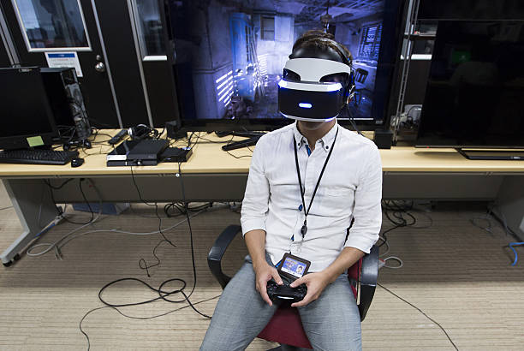
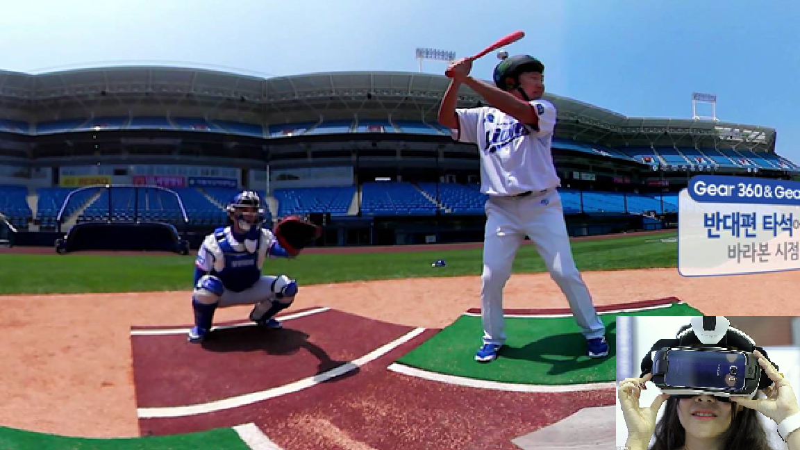
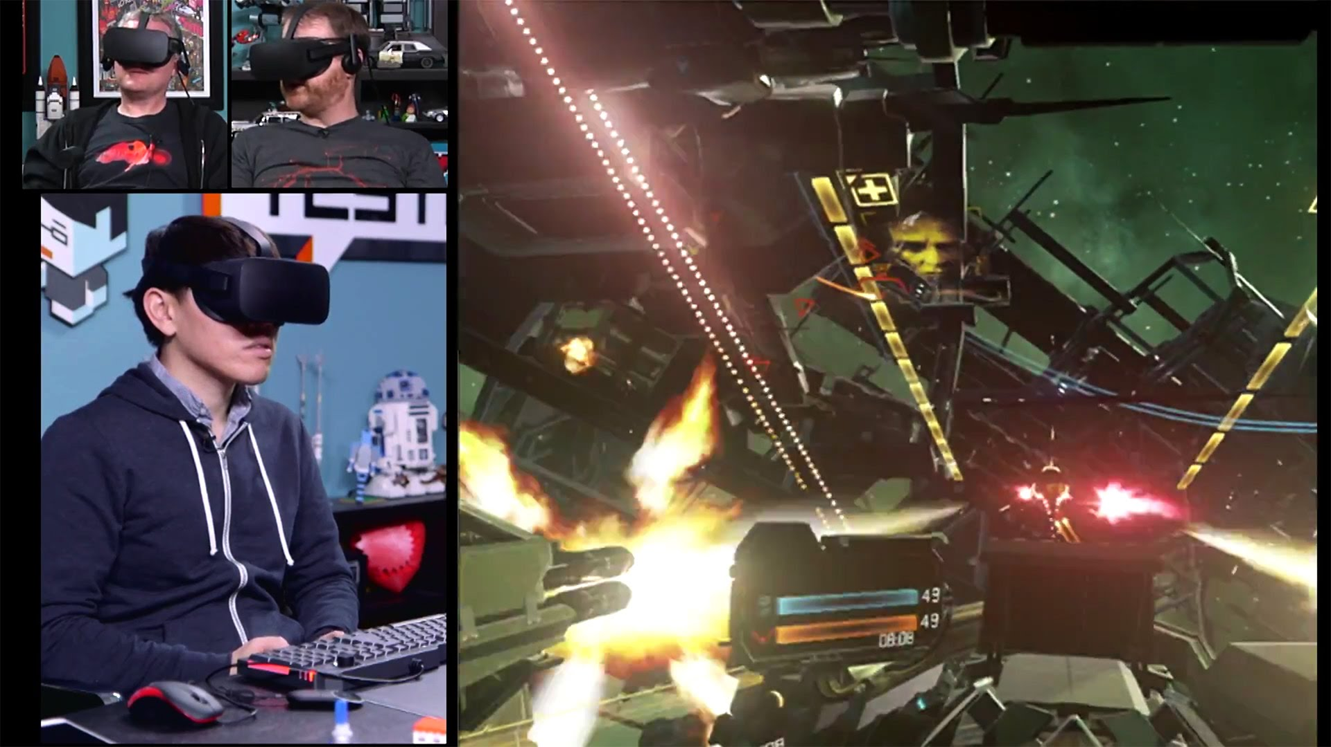
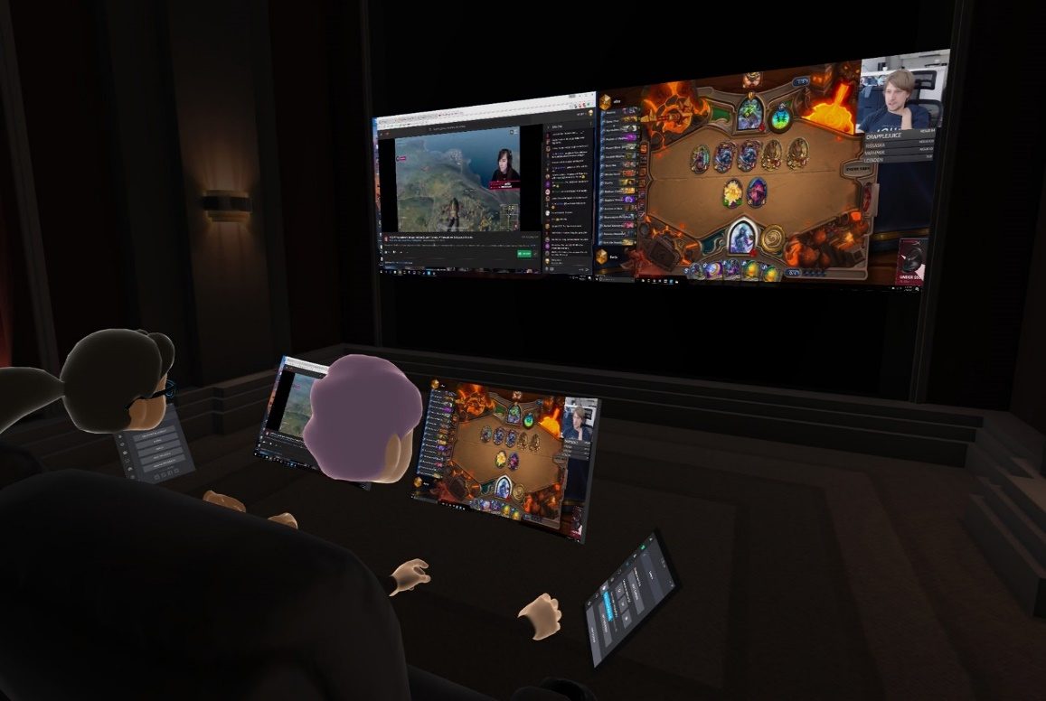
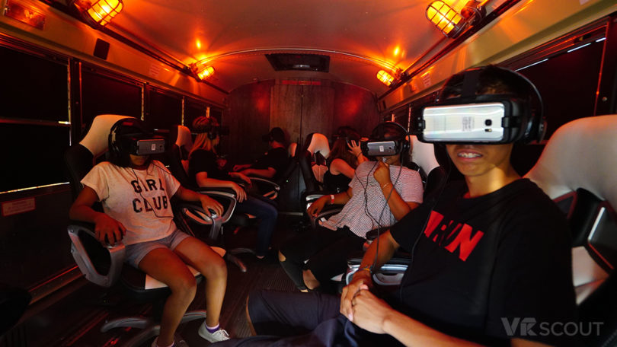
Use Cases
<A Single VR System Connected via LAN>
<A Single VR System Connected via WAN>
<Multiple VR Systems Connected via LAN>
<Multiple VR Systems Connected via WAN>
<Special Use Case – Network Mobility>

Slide 4
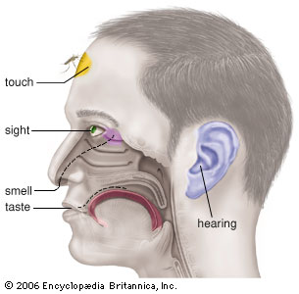
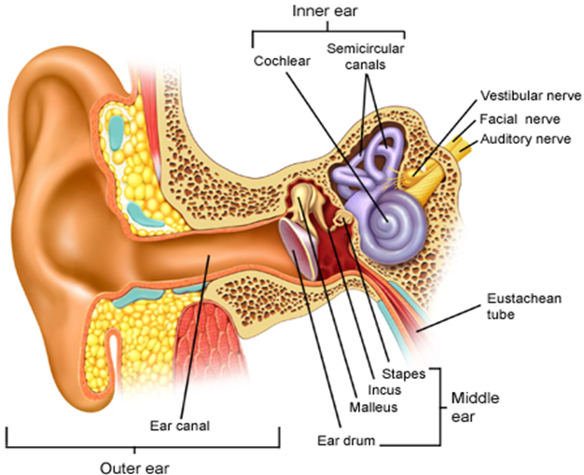
Industry Problems
VR sickness is a subset of Motion Sickness*
Our current focus is VR HMD based Sickness only
Caused by the mismatch between the visually received information and the vestibular system
Various Standard Organizations such as IEEE 3079, IEEE 2048, Khronos Group, ISO/IEC JTC1/SC24, SC29 WG11(MPEG), W3C, ITU-T SG12 are trying to address the technical issues of VR
Motion Sickness
Simulator Sickness
Sea Sickness
Cybersickness
Car Sickness
Air Sickness
VR Sickness
Space Sickness
※ VR: Virtual Reality
※ HMD: Head Mounted Display
* In 2003, Bernard D. Adelstein from NASA Ames Research Center mentioned in his paper, ‘HEAD TRACKING LATENCY IN VIRTUAL ENVIRONMENTS: PSYCHOPHYSICS AND A MODEL’, the MTP needs to be less than 17 ms.
Notes:
HMD VR sickness에 초점을 맞추어야 한다.
이 슬라이드에서 VR Sickness가 one of Cybersickness라는 것은 크게 중요한 내용이 아니다.

Slide 5
Technical Requirements for VR QoE
Technicolor, Oct. 2016 (m39532, MPEG 116th Meeting)
Requirement | details
pixels/degree | - 40 pix/deg - no HMD is capable of displaying 40pix/deg today
video resolution | - 3 times 4K(3840x1920) vertical resolution = 11520x6480
framerate | - 90 fps - a 90fps framerate offers a latency low enough to prevent nausea
3D Audio | - support of scene-based and/or environmental audio - 360 surround sound, object-based audio, Ambisonics
motion-to-photon latency & motion-to-audio latency | - how much time there is between the user interacts and an image / audio - maximum 20ms
foreground & parallax | - objects in the foreground shall be far enough to prevent nausea - if objects are too close it is likely they can become an important cause of nausea - interactive parallax with background shall be present for such objects - pic1 shows how it is possible to look behind the figure in the foreground
※ Source: Prof. Ryu, Eunseok (Gacheon Univ.); QoE- Quality of Experience

Slide 6
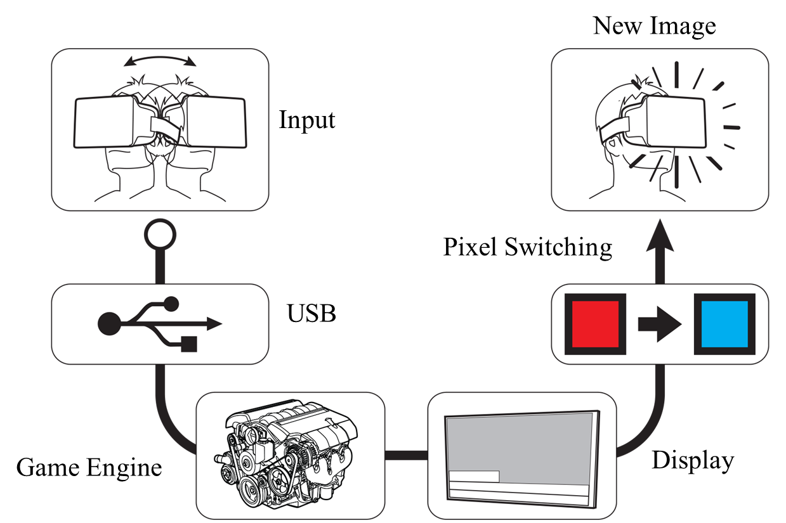


Technical Challenges
Network requirements are directly related to MTP latency
For VR HMD based VR applications, the network should provide the following features:
  At Link Layer: very low latency and jitter
  At network and higher Layers: desired QoS, QoE and support for Mobility
※ MTP: Motion to Photon
Tracker
CPU
GPU
Display
Photons
Optics
Head motion
Under 20 milliseconds of latency for comfortability
User’s retina

Slide 7
Industry Relevance
Apart from link layer characteristics, securing QoE is important for the following industry participants
  Mobile Network Infrastructure Providers
    Support for immersive media (VR & AR)-based applications in 5G networks
    Ability to support more users with required QoS
  HMD Manufacturers
    Support for the desired network characteristics (QoE & QoS) will enable the HMD manufactures to move from stand-alone (which is pre-dominant at the moment) to a network based light-weight VR HMD.
  Content Creators
    Want to create compelling visual experience comparable to the modern PCs and gaming consoles for VR
    Cloud-based VR offerings are preferred
  Platform Holders
    Want to aggregate compelling VR content to grow their VR content ecosystem

Slide 8
IEEE 802.21 Interest Group Activities
For the last few months, IG produced the followings:
  Produced a White Paper on problem statement, use case and analysis of existing technologies
  Conducted a test to verify the application data throughput requirements (MPEG test procedure) in a constraint environment
    Test Server : Linux Ubuntu
    Test Sequences : Gaslamp, KiteFlite
    Quantization Parameters : 22, 27, 32, 37
    FPS : 30, 60, 90
    Resolution : HD, UHD 4K, 8K
    Encoder/Decoder: HEVC/H.265 Reference SW

Slide 9
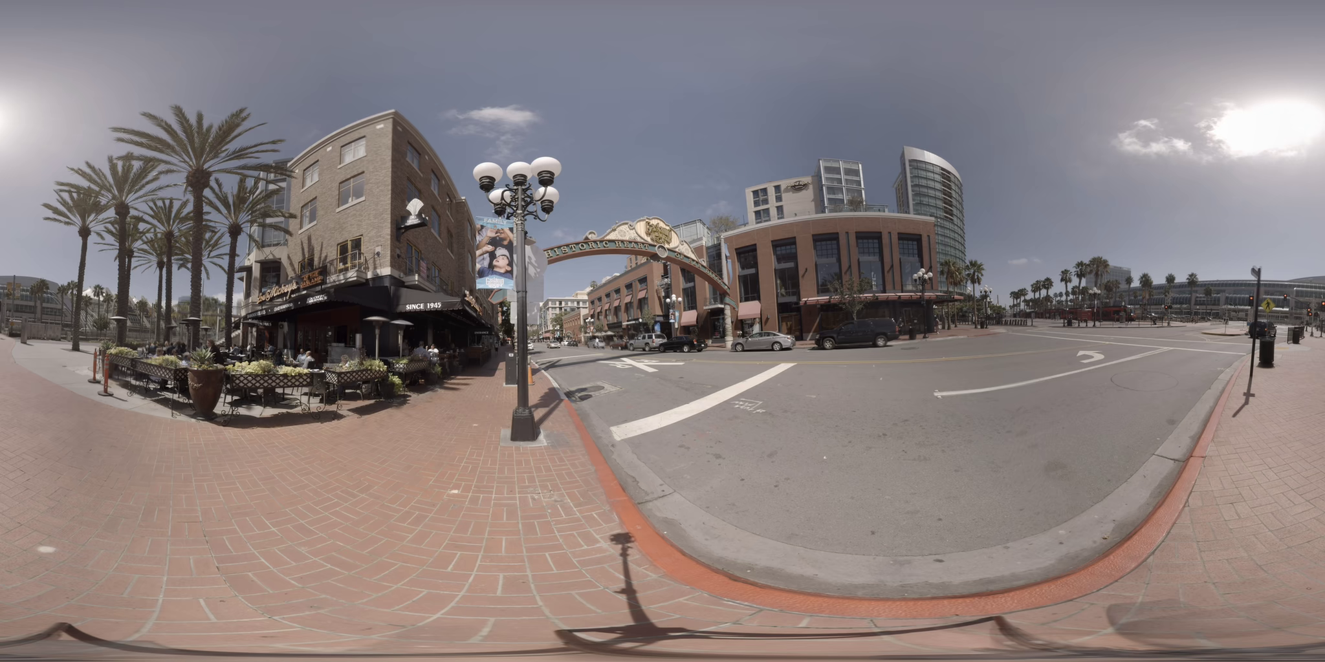
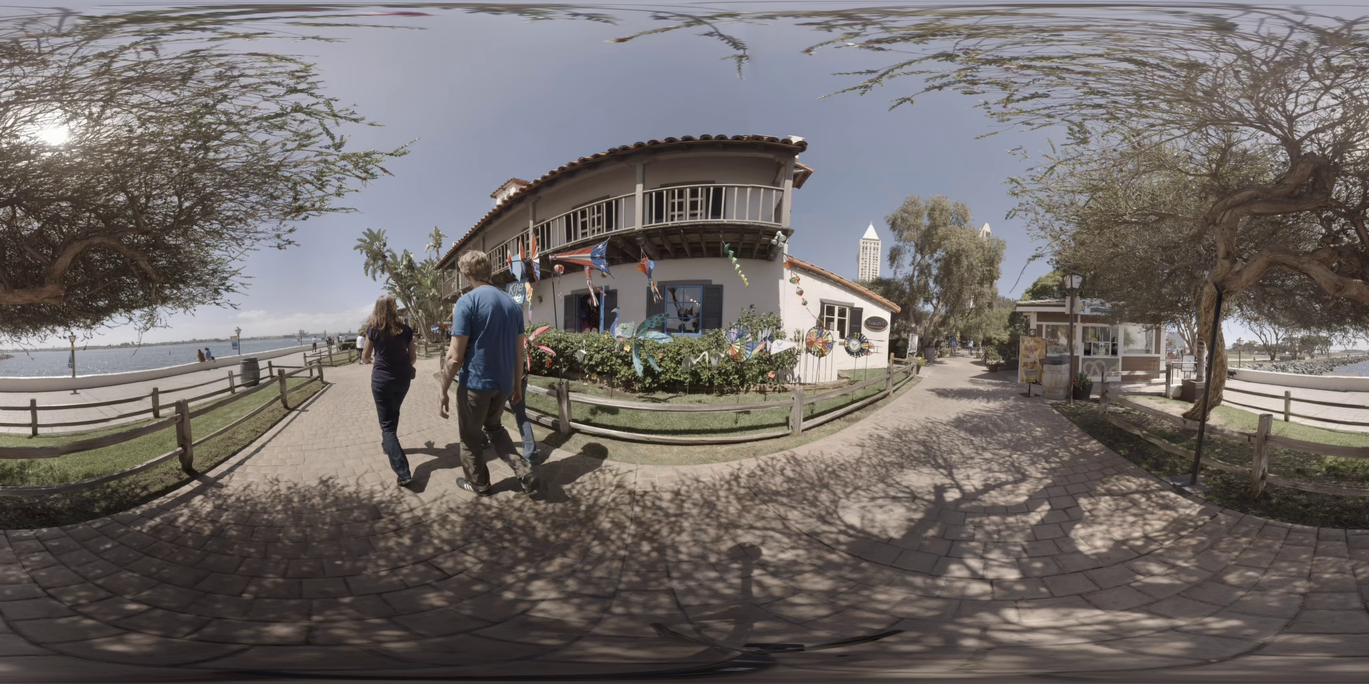
Test Sequences (Defined by ISO/IEC MPEG Standard-I)
- Gaslamp
- KiteFlite
Application throughput (8K Res & 90 FPS): 40 ~ 160 Mbps
Test is conducted on non-real time application
Future test will investigate the data throughput at the network and the link layers
※ Source: Prof. Ryu, Eunseok (Gacheon Univ.)

Slide 10
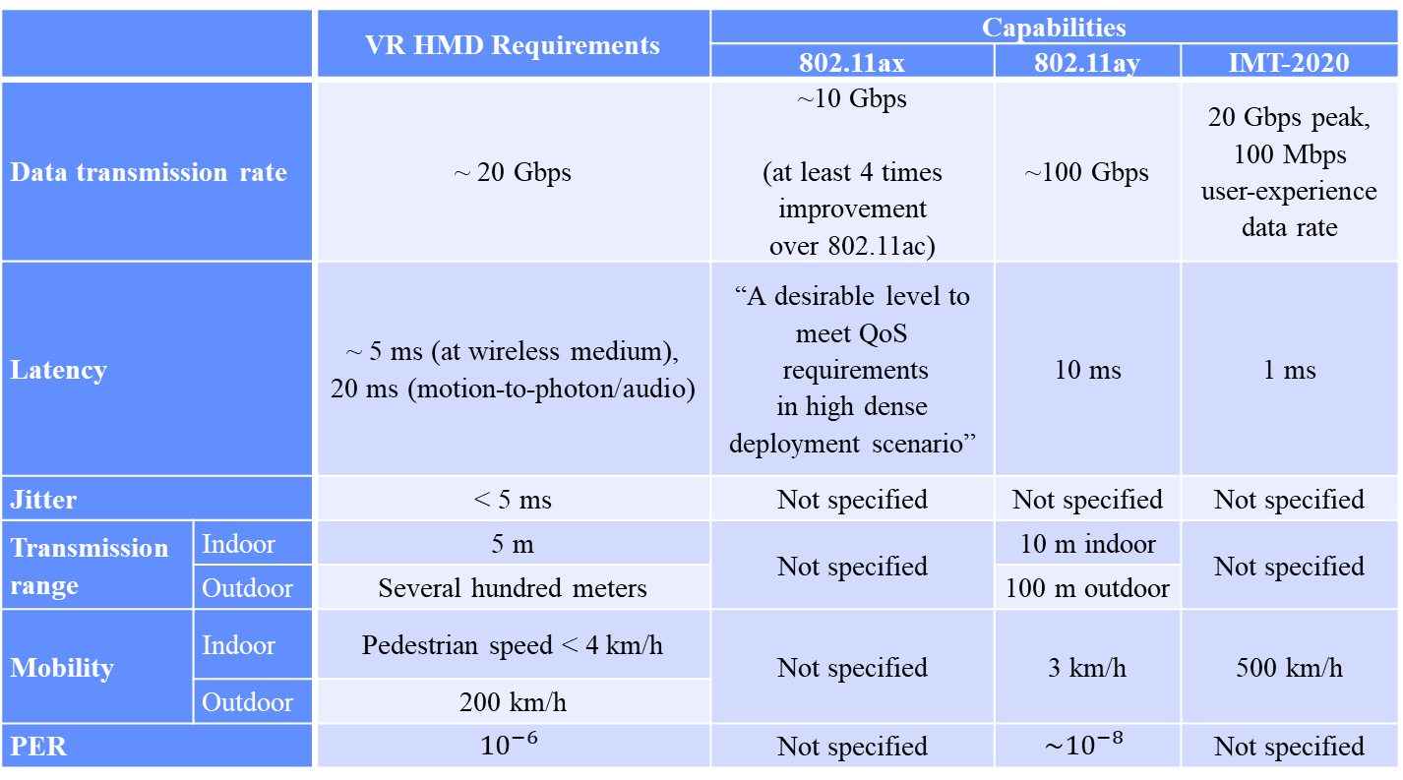
High Level Gap Analysis
 |  | VR HMD Requirements | Capabilities
 |  |  | 802.11ax | 802.11ay | IMT-2020
Data transmission rate |  | ~ 20 Gbps | ~10 Gbps (at least 4 times improvement over 802.11ac) | ~100 Gbps | 20 Gbps peak, 100 Mbps user-experience data rate
Latency |  | ~ 5 ms (at wireless medium), 20 ms (motion-to-photon/audio) | “A desirable level to meet QoS requirements in high dense deployment scenario” | 10 ms | 1 ms
Jitter |  | < 5 ms | Not specified | Not specified | Not specified
Transmission range | Indoor | 5 m | Not specified | 10 m indoor | Not specified
 | Outdoor | Several hundred meters |  | 100 m outdoor
Mobility | Indoor | Pedestrian speed < 4 km/h | Not specified | 3 km/h | 500 km/h
 | Outdoor | 200 km/h
PER |  | $${10}^{−6}$$ | Not specified | $$\sim {10}^{−8}$$ | Not specified

Slide 11
Next Steps
IEEE 802.21 is proposing a SG to study the problem further and if appropriately scoped, it will develop a PAR and a CSD
We understand that HMD-based VR problems span across multiple 802 groups and we have already started the dialogue
  Discussions ongoing with IEEE 802.11 RTA for certain use cases
  Initiated discussion with 802.1 TSN TG
We welcome more participation if SG is approved

Slide 12
Additional Documents
IEEE 802.21 IG White Paper (Download)
Other Standard Activities (Download)

