Slide 1
IEEE 802.21 MEDIA INDEPENDENT HANDOVER
DCN: 21-1-0070-00-0000
Title: 3D Sensing Camera based Facial Scanning System for Interactive 3D VR Avatar Content Commercialization
Date Submitted: November 14, 2018
Presented at IEEE 802.21 session #88 Bangkok, Thailand
Authors or Source(s): Jaesang Cha (SNUST), Vinayagam Mariappan (SNUST), MinwooLee (SNUST), Juphil Cho (Kunsan Univ.), Byungjun Min, Jungjin Ra (Head IT Co., Ltd), Junyoub Lee, Younggyu Kang, Daehyun Kim (Namuga Co., Ltd.), Hyeong Ho Lee(Netvision Telecom Inc., Korea Univ.)
Abstract: This document is to describe the VR Commercialization for Interactive 3D VR Avatar Content Commercialization using 3D Depth Camera.

Slide 2
  IEEE 802.21 presentation release statements
This document has been prepared to assist the IEEE 802.21 Working Group. It is offered as a basis for discussion and is not binding on the contributing individual(s) or organization(s). The material in this document is subject to change in form and content after further study. The contributor(s) reserve(s) the right to add, amend or withdraw material contained herein.
The contributor grants a free, irrevocable license to the IEEE to incorporate material contained in this contribution, and any modifications thereof, in the creation of an IEEE Standards publication; to copyright in the IEEE’s name any IEEE Standards publication even though it may include portions of this contribution; and at the IEEE’s sole discretion to permit others to reproduce in whole or in part the resulting IEEE Standards publication. The contributor also acknowledges and accepts that this contribution may be made public by IEEE 802.21.
The contributor is familiar with IEEE patent policy, as stated in Section 6 of the IEEE-SA Standards Board bylaws <http://standards.ieee.org/guides/bylaws/sect6-7.html#6> and in Understanding Patent Issues During IEEE Standards Development http://standards.ieee.org/board/pat/faq.pdf>
  IEEE 802.21 presentation release statements
This document has been prepared to assist the IEEE 802.21 Working Group. It is offered as a basis for discussion and is not binding on the contributing individual(s) or organization(s). The material in this document is subject to change in form and content after further study. The contributor(s) reserve(s) the right to add, amend or withdraw material contained herein.
The contributor grants a free, irrevocable license to the IEEE to incorporate material contained in this contribution, and any modifications thereof, in the creation of an IEEE Standards publication; to copyright in the IEEE’s name any IEEE Standards publication even though it may include portions of this contribution; and at the IEEE’s sole discretion to permit others to reproduce in whole or in part the resulting IEEE Standards publication. The contributor also acknowledges and accepts that this contribution may be made public by IEEE 802.21.
The contributor is familiar with IEEE patent policy, as outlined in Section 6.3 of the IEEE-SA Standards Board Operations Manual <http://standards.ieee.org/guides/opman/sect6.html#6.3> and in Understanding Patent Issues During IEEE Standards Development http://standards.ieee.org/board/pat/guide.html>

Slide 3
Table of Contents
Ⅰ
Need of Facial Scanning System in 3D Avatar
Ⅱ
3D Depth Camera in 3D Avatar Facial Scanning
Ⅲ
Conclusions

Slide 4
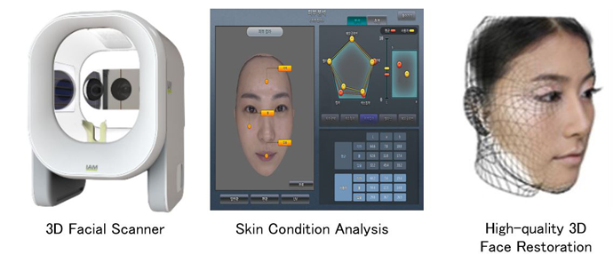
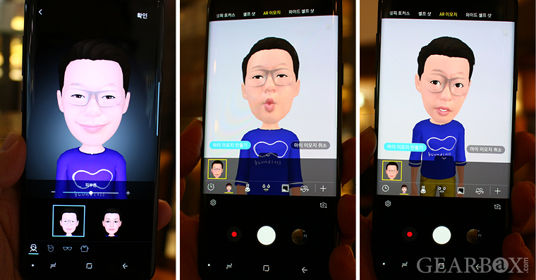
Need of Facial Scanning System in 3D Avatar
Needs
  Recently, researches on face recognition and avatar implementations are continuing, but technologies for expressing and practicing contents are insufficient.
  In case of existing face scan camera, it is difficult to extract human emotion because it is difficult to extract 3D accurately.
Basic Concept
  By attaching a 3D Sensing camera linked to the HMD on the top and bottom, you can detect the detailed emotion of the person wearing the HMD.
  And transmits the extracted emotion data to the 3D avatar.
  Then provides interlocking application services with VR content.
  < Facial Scanning Technology >

Slide 5
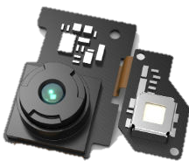
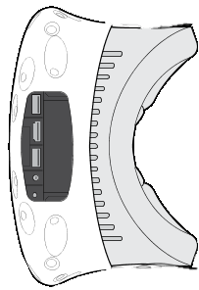
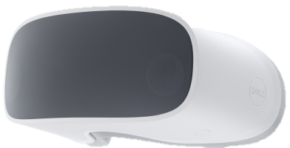


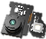

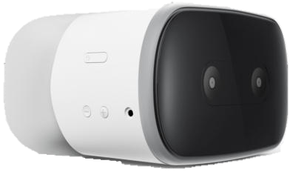

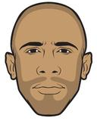


3D Depth Camera in 3D Avatar Facial Scanning
3D Depth Sensing Camera based Facial Scanning System for VR Commercialization in 3D Avatar Applications
Features of 3D Avatar technology
  Attach a 3D sensing camera to the top and bottom of the HMD.
  Extraction of human emotion through image processing.
  The emotion is displayed on the avatar by linking the HMD and the display.
  Provides application technology that is linked with avatar and VR content.
  3D Sensing Camera
  3D Avatar & VR Contents Mixing
  VR
  Contents
  HMD
  Wearing Structure
  Display
  < Facial Scanning System Concept >

Slide 6
Conclusions
Proposed the 3D Sensing Camera based Facial Scanning System for Interactive 3D VR Avatar Content Commercialization.
This technology is a technology for providing application services linked with VR contents by utilizing a 3D sensing camera attached to the HMD.
By attaching a 3D sensing camera, the avatar can be displayed by sensing the detailed emotion and shape of a person, so that it can be linked with the VR content. Also It can be applied to various technologies such as smart phone and telepresence along with display expression.

