Slide 1
IEEE 802.21 MEDIA INDEPENDENT HANDOVER
DCN: 21-1-0069-00-0000
Title: 3D Depth Sensing Camera and Signage based VR Playground for VR Commercialization in Adventure Field
Date Submitted: November 14, 2018
Presented at IEEE 802.21 session #88 Bangkok, Thailand
Authors or Source(s): Jaesang Cha (SNUST), Vinayagam Mariappan (SNUST), Minwoo Lee (SNUST), Juphil Cho (Kunsan Univ.), Byungjun Min, Jungjin Ra (Head IT Co., Ltd), Junyoub Lee, Younggyu Kang, Daehyun Kim (Namuga Co., Ltd.), Hyeong Ho Lee(Netvision Telecom Inc., Korea Univ.)
Abstract: This document is to describe the VR Commercialization for Adventure Application using 3D Depth Camera.

Slide 2
IEEE 802.21 presentation release statements
This document has been prepared to assist the IEEE 802.21 Working Group. It is offered as a basis for discussion and is not binding on the contributing individual(s) or organization(s). The material in this document is subject to change in form and content after further study. The contributor(s) reserve(s) the right to add, amend or withdraw material contained herein.
The contributor grants a free, irrevocable license to the IEEE to incorporate material contained in this contribution, and any modifications thereof, in the creation of an IEEE Standards publication; to copyright in the IEEE’s name any IEEE Standards publication even though it may include portions of this contribution; and at the IEEE’s sole discretion to permit others to reproduce in whole or in part the resulting IEEE Standards publication. The contributor also acknowledges and accepts that this contribution may be made public by IEEE 802.21.
The contributor is familiar with IEEE patent policy, as stated in Section 6 of the IEEE-SA Standards Board bylaws <http://standards.ieee.org/guides/bylaws/sect6-7.html#6> and in Understanding Patent Issues During IEEE Standards Development http://standards.ieee.org/board/pat/faq.pdf>
IEEE 802.21 presentation release statements
This document has been prepared to assist the IEEE 802.21 Working Group. It is offered as a basis for discussion and is not binding on the contributing individual(s) or organization(s). The material in this document is subject to change in form and content after further study. The contributor(s) reserve(s) the right to add, amend or withdraw material contained herein.
The contributor grants a free, irrevocable license to the IEEE to incorporate material contained in this contribution, and any modifications thereof, in the creation of an IEEE Standards publication; to copyright in the IEEE’s name any IEEE Standards publication even though it may include portions of this contribution; and at the IEEE’s sole discretion to permit others to reproduce in whole or in part the resulting IEEE Standards publication. The contributor also acknowledges and accepts that this contribution may be made public by IEEE 802.21.
The contributor is familiar with IEEE patent policy, as outlined in Section 6.3 of the IEEE-SA Standards Board Operations Manual <http://standards.ieee.org/guides/opman/sect6.html#6.3> and in Understanding Patent Issues During IEEE Standards Development http://standards.ieee.org/board/pat/guide.html>

Slide 3
Table of Contents
Ⅰ
Need of AR Playground in Adventures Field
Ⅱ
3D Depth Camera in Adventures AR Playground
Ⅲ
Conclusions

Slide 4
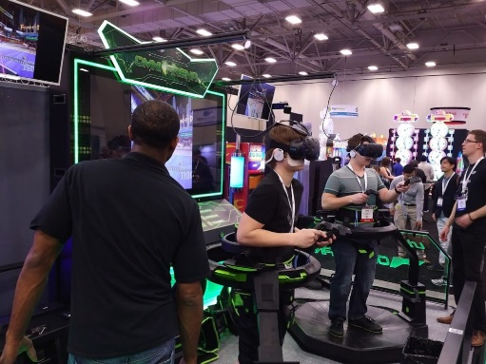
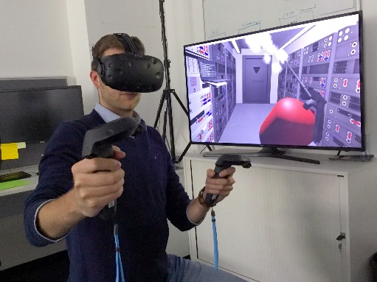
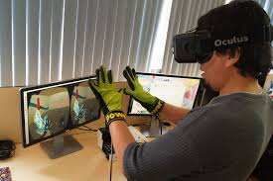
Need of AR Playground in Adventures Field
Needs
Usually a VR system requires a controller or expensive equipment to process events.
Real-time motion tracking system is required to recognize human gesture.
Basic Concept
By using 3D sensing camera and signage, it can provide VR Attraction Room
Can tracking human motion using 6 cameras
Human can interact with VR Attraction from motion tracking
< VR in Adventures >

Slide 5
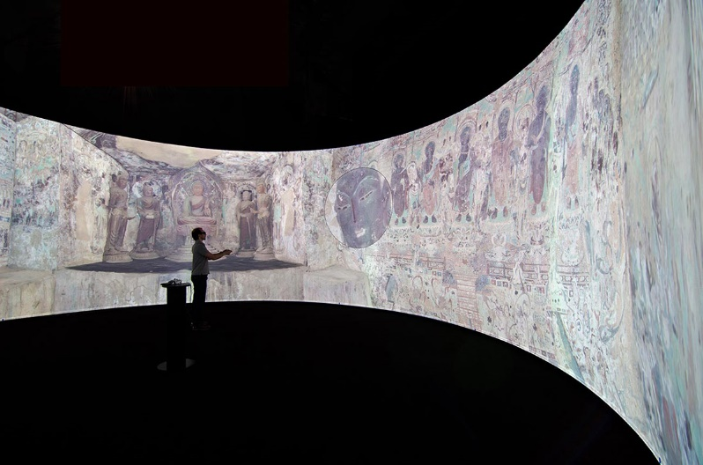
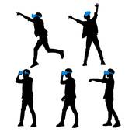
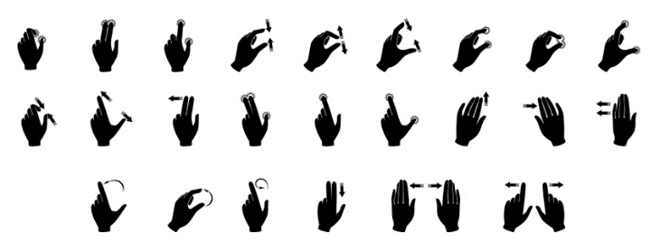
3D Depth Camera in Adventures AR Playground
3D Depth Sensing Camera and Signage based VR Playground for VR Commercialization in Adventures Field Applications
By using immersive projection display, we can support VR Attraction.
In contrast to providing VR Attraction using HMDs, controllers, or motion tracking devices, the proposed system utilizes Immersive projection display to provide VR Attraction to users.
3D Sensing camera is associated with the position of the Immersive Projection Display to recognize the user's motion or gesture in all directions.
Motion Gesture
Hand Gesture
< 3D Depth Camera based AR Adventures Playground >

Slide 6
Conclusions
Proposed the 3D Depth Sensing Camera and Signage based VR Playground for VR Commercialization in Adventure Field.
By using immersive projection display and 3D sensing camera, it can provide VR Attraction without any controller, device.
It can experience VR attraction by recognizing motion or gesture in all directions by using 3D depth camera linked with Immersive projection display.

