Slide 1
IEEE 802.21 MEDIA INDEPENDENT HANDOVER
DCN: 21-1-0065-00-0000
Title: Goal of the ‘Network Enablers for seamless HMD based VR Content Service’ SG
Date Submitted: November 09, 2018
Presented at IEEE 802 EC session #88 Bangkok, Thailand
Authors or Source(s): Subir Das (Perspecta Labs)
Seo, Dong-Il Dillon (VoleR Creative)
Jeong, Sangkwon Peter (JoyFun)
Abstract: This document is to introduce the goal of the Network Enablers for seamless HMD based VR Content Service SG.

Slide 2
IEEE 802.21 presentation release statements
This document has been prepared to assist the IEEE 802.21 Working Group. It is offered as a basis for discussion and is not binding on the contributing individual(s) or organization(s). The material in this document is subject to change in form and content after further study. The contributor(s) reserve(s) the right to add, amend or withdraw material contained herein.
The contributor grants a free, irrevocable license to the IEEE to incorporate material contained in this contribution, and any modifications thereof, in the creation of an IEEE Standards publication; to copyright in the IEEE’s name any IEEE Standards publication even though it may include portions of this contribution; and at the IEEE’s sole discretion to permit others to reproduce in whole or in part the resulting IEEE Standards publication. The contributor also acknowledges and accepts that this contribution may be made public by IEEE 802.21.
The contributor is familiar with IEEE patent policy, as stated in Section 6 of the IEEE-SA Standards Board bylaws <http://standards.ieee.org/guides/bylaws/sect6-7.html#6> and in Understanding Patent Issues During IEEE Standards Development http://standards.ieee.org/board/pat/faq.pdf>
IEEE 802.21 presentation release statements
This document has been prepared to assist the IEEE 802.21 Working Group. It is offered as a basis for discussion and is not binding on the contributing individual(s) or organization(s). The material in this document is subject to change in form and content after further study. The contributor(s) reserve(s) the right to add, amend or withdraw material contained herein.
The contributor grants a free, irrevocable license to the IEEE to incorporate material contained in this contribution, and any modifications thereof, in the creation of an IEEE Standards publication; to copyright in the IEEE’s name any IEEE Standards publication even though it may include portions of this contribution; and at the IEEE’s sole discretion to permit others to reproduce in whole or in part the resulting IEEE Standards publication. The contributor also acknowledges and accepts that this contribution may be made public by IEEE 802.21.
The contributor is familiar with IEEE patent policy, as outlined in Section 6.3 of the IEEE-SA Standards Board Operations Manual <http://standards.ieee.org/guides/opman/sect6.html#6.3> and in Understanding Patent Issues During IEEE Standards Development http://standards.ieee.org/board/pat/guide.html>

Slide 3
Why is Network important in VR?
Ⅰ
Characteristics of VR Content
Ⅱ
VR Sickness
Ⅲ
Motion-to-Photon Latency
Ⅳ
QoE is More Important than QoS

Slide 4
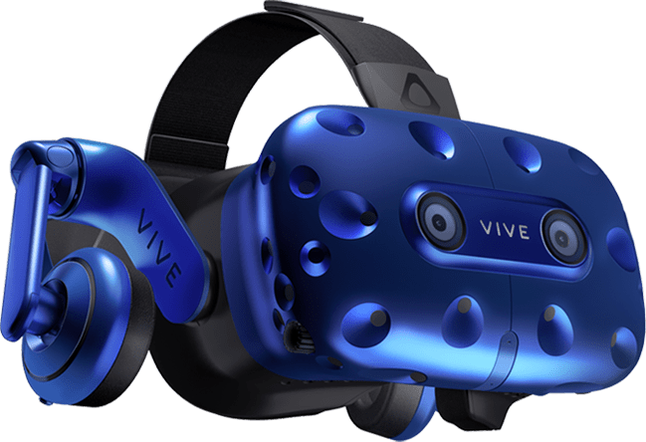
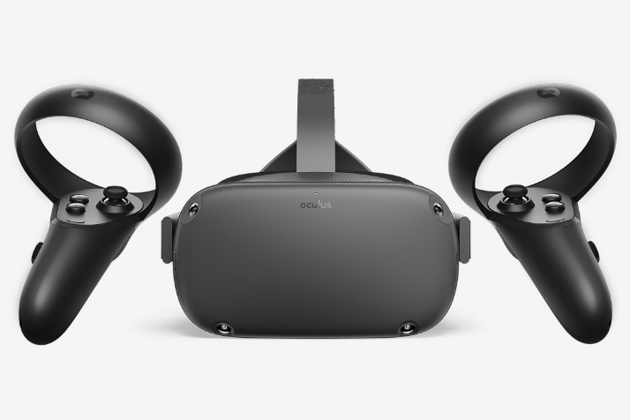
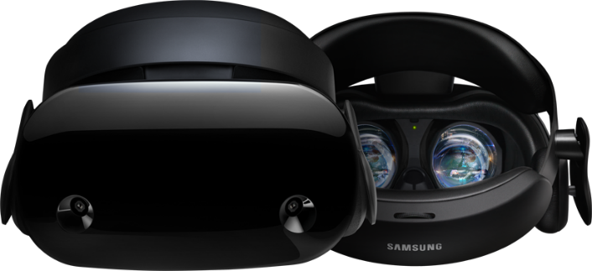
Characteristics of VR Content
Odyssey MR
Powered by Microsoft
VIVE Pro
Oculus Quest
Released on Nov. 21, 2017
Released on May 31, 2018
Announced on Sept. 27, 2018
ETA is H1, 2019
VR HMD is a See-closed Device for Full Immersive Experience

Slide 5
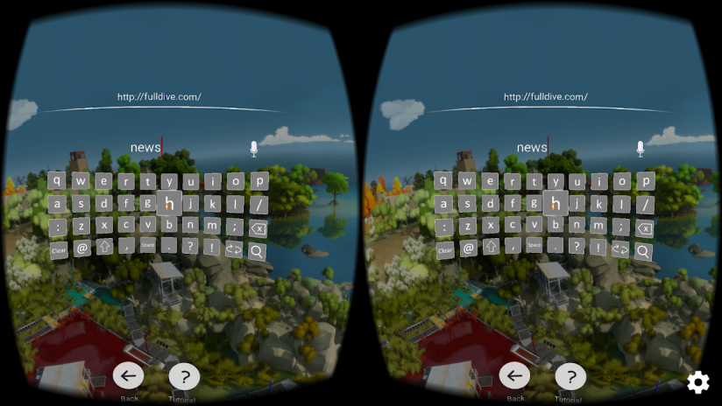
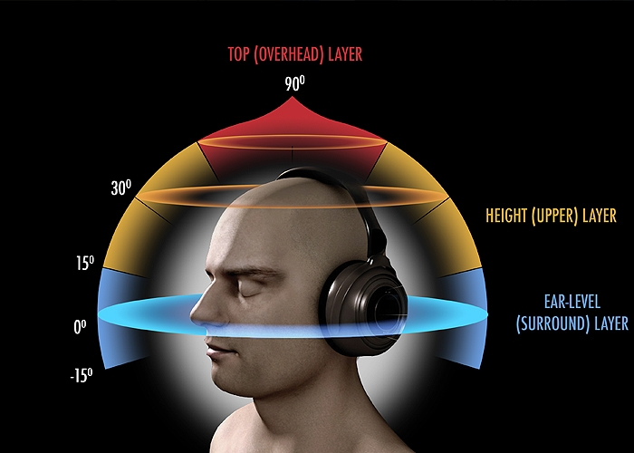
Characteristics of VR Content
Stereoscopic Images
As humans recognize the depth of the world using two eyes, the images displayed through a HMD need to be stereoscopic to understand the depth of the VR world.
All VR HMDs are designed to create stereoscopic images though binocular disparity.
Spatial Sound
As illustrated in the diagram on the left, the sound source and the distance the sound travels need to be properly reflected in order to create a proper immersion.

Slide 6
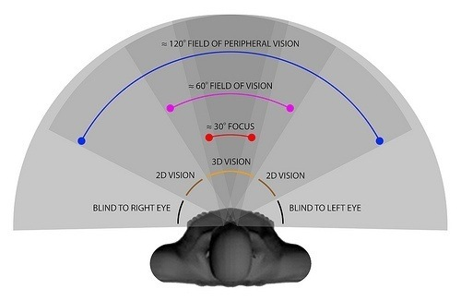
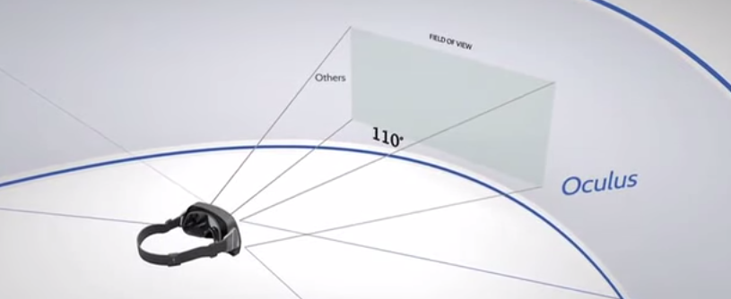
Characteristics of VR Content
Wide FoV (Field of View)
Human eyes are capable of viewing up to 120 degrees of FoV. The current VR HMD provides up to 110 degrees of FoV. Hence, the people who are experiencing VR content can be fully immersed as they do not feel like they are seeing the images through a small sized window.

Slide 7
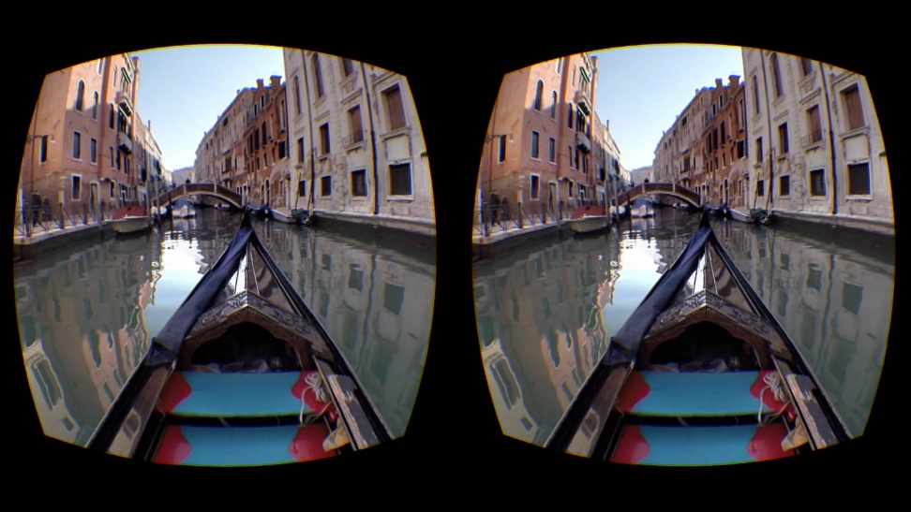
Characteristics of VR Content
Fish Eye Lens for Wide FoV
Pixel Calculation
Total Number of Pixels = 4,262,240 (Res. 2,960 X 1,440)
Pixels used for VR Images = 3,346,109
Actual Pixel Use Rate for both Eyes= 78.5%
Each side only uses 39.25% of total pixels
Both eyes perceived resolution = 39.25%
When a QHD resolution panel is used to display VR images, the actual perceived resolution is only 39.25% so the final perceived resolution quality is even less than FHD resolution
In order to provide the perceived resolution to be at least full HD or better, the recommended panel resolution is UHD or better
Higher resolution means larger data size for the VR content; hence, VR requires a faster data processing unit and faster data transfer rate

Slide 8
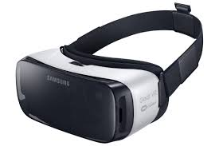
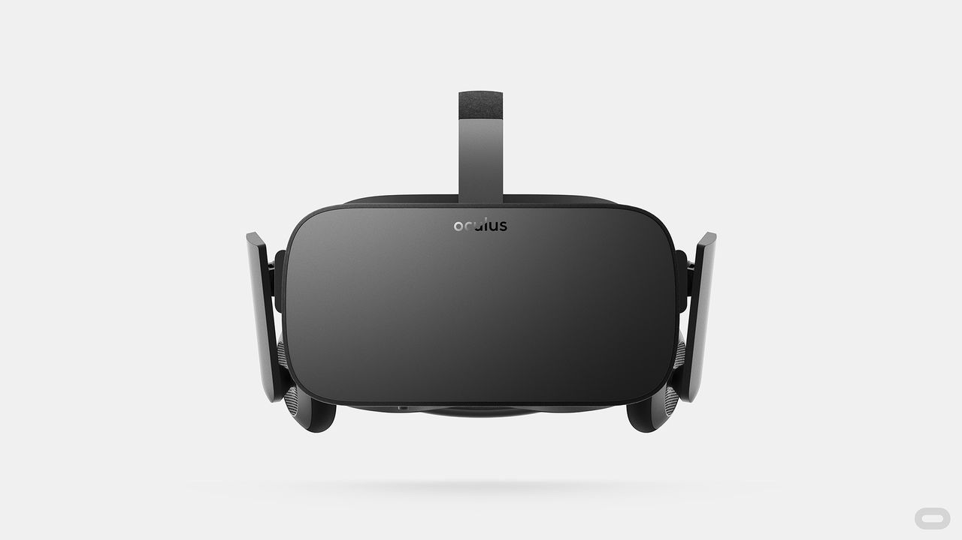
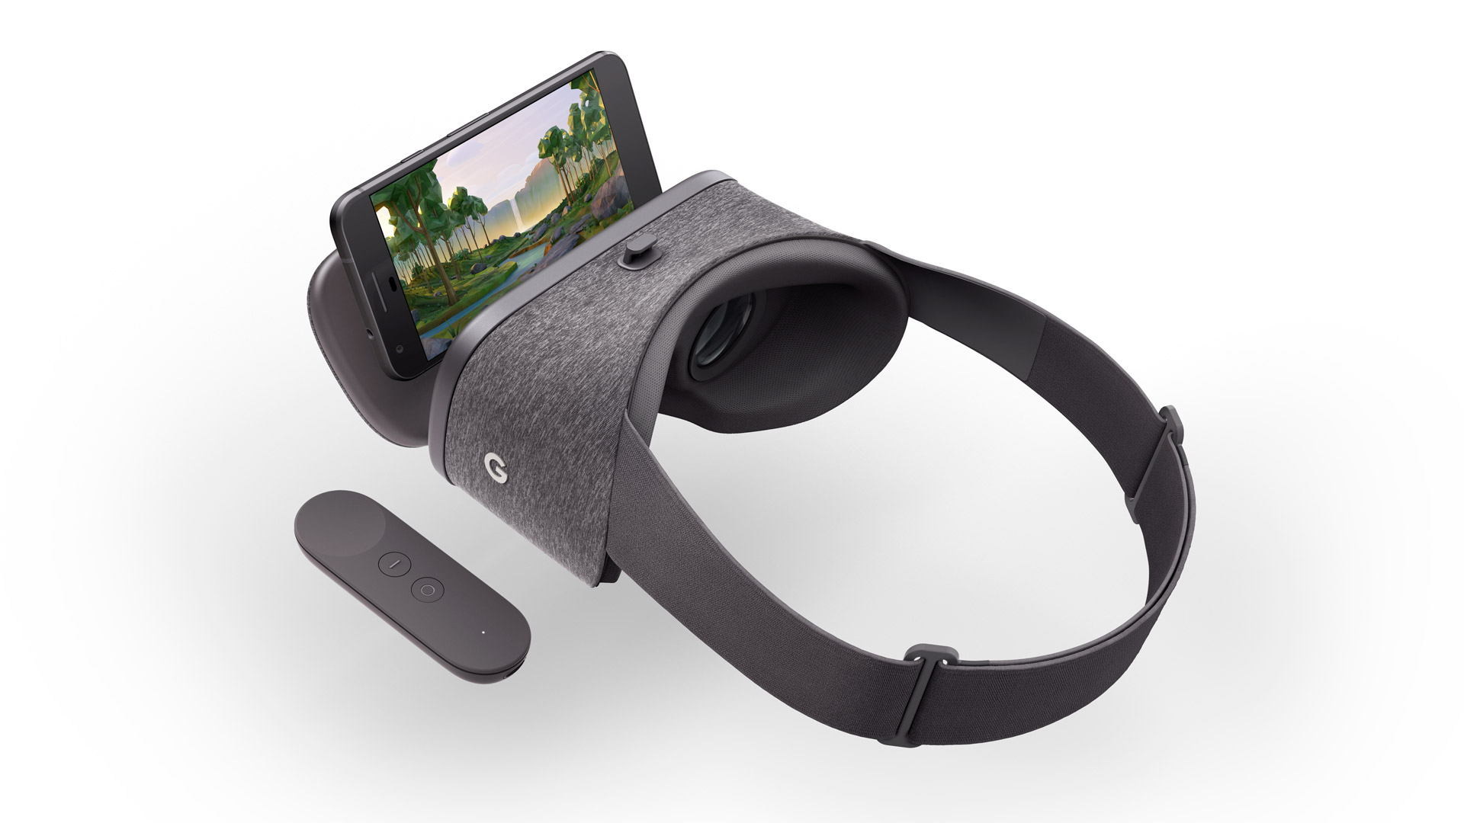
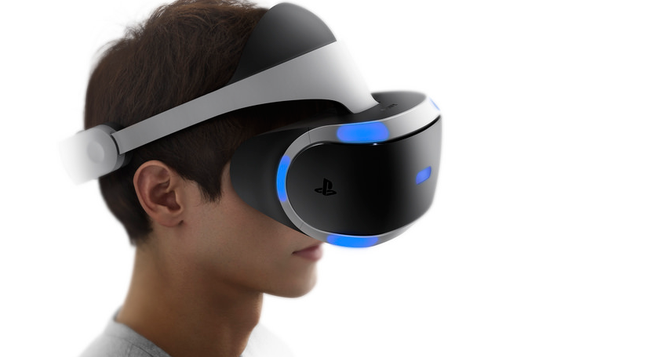
Characteristics of VR Content
High Bandwidth Requirements for VR
Recently, various HMD devices are on the market
Recommend 12K resolution for reducing nausea with high quality VR
High Bandwidth and high computational complexity are huddle
Need to reduce the required bandwidth!
Requirement | details
pixels/degree | 40 pix/deg
video resolution | 11,520 x 6,480
framerate | 90 fps
The emergence of various HMD
(Gear VR, Oculus Rift, Daydream, PlayStation VR)
Requirements for high quality VR
Source: Technicolor, Oct. 2016 (m39532, MPEG 116th Meeting)
※ Slide Source: Ryu, eun-seok, Professor of Gachon University(3079-18-0045-00-0003, IEEE 3079 7th meeting)

Slide 9
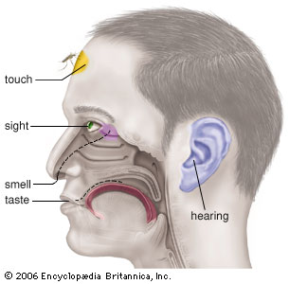
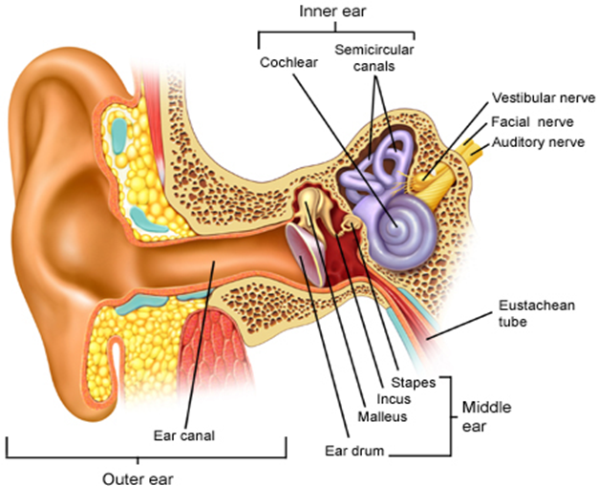
VR Sickness
Motion Sickness
Simulator Sickness
Sea Sickness
Cybersickness
Car Sickness
Air Sickness
VR Sickness
Space Sickness
Six Senses
VR sickness is a part of Motion Sickness and it is caused by the mismatch of information between the visually received information and the vestibular system.

Slide 10
Motion-to-Photon Latency
Head & Motion Tracking
Tracker
CPU
GPU
Display
Photons
Optics
Head motion
Under 20 milliseconds of latency for comfortability
User’s retina
With a help of gyro, accelerometer and magnetometer sensors, the user experiencing VR content can freely move his head around to see where he wants to see and this is called head tracking
The head tracking gives the user a freedom to look around the VR world and this quickly fools the brain that he is inside of the VR world

Slide 11
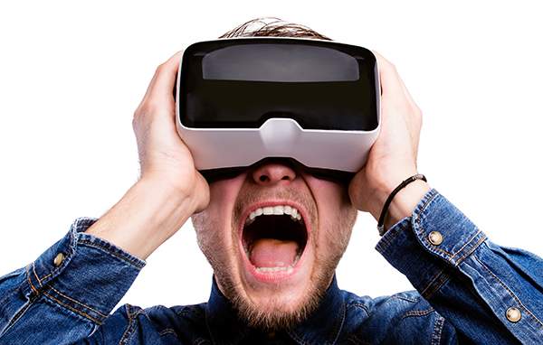
QoE is More Important than QoS
VR HMD delivers S3D images directly to human eyes within 5 cm distance between the display and the eyes and this directly affects human sensory system.
VR content provides fully immersive experience where the user feels he/she is actually in the VR world, bad quality of experience can cause VR sickness easier than the normal flat screen (Hence, QoE is more important than QoS)
VS
Top-down Process
Bottom-up Process
Motion Sickness

Slide 12
Proposals
Ⅰ
Motion-to-Photon Latency
Ⅱ
Various Network Environment for VR
Ⅲ
Use Cases
Ⅳ
Network Requirments

Slide 13
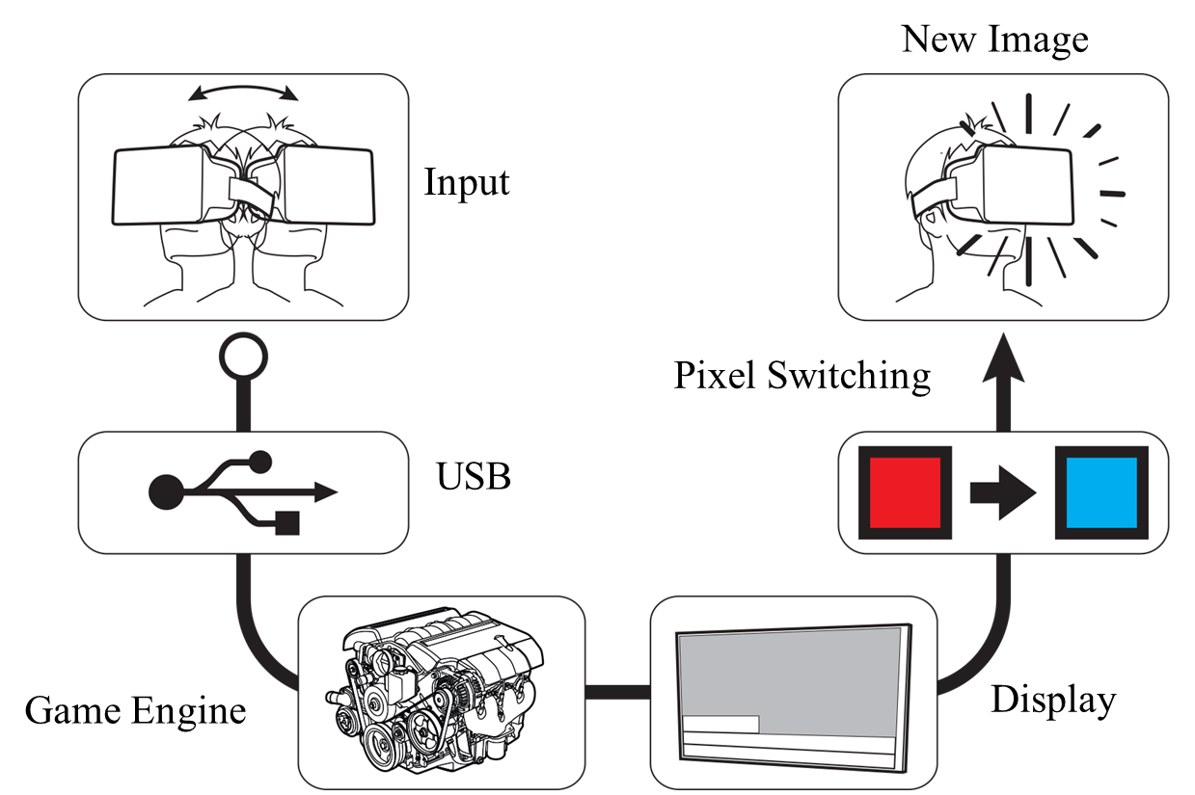
Motion-to-Photon Latency
According to the paper published by Held, Efsathiou, & Greene in 1966, if the MTP (motion-to-photon latency) is too high, it makes people to feel motion sick.
The paper published by Sheridan & Ferrel in 1963 also states that the high MTP also cause a poor manual performance of human being.
In 2003, Bernard D. Adelstein from NASA Ames Research Center mentioned in his paper, HEAD TRACKING LATENCY IN VIRTUAL ENVIRONMENTS: PSYCHOPHYSICS AND A MODEL, the MTP needs to be less than 17 ms.
According to John Carmack, the CTO of Oculus, the MTP must be lower than 20 ms to minimized the VR sickness.
Hence, the network latency needs to be satisfying this MTP latency condition.
Tracker
CPU
GPU
Display
Photons
Optics
Head motion
Under 20 milliseconds of latency for comfortability
User’s retina

Slide 14
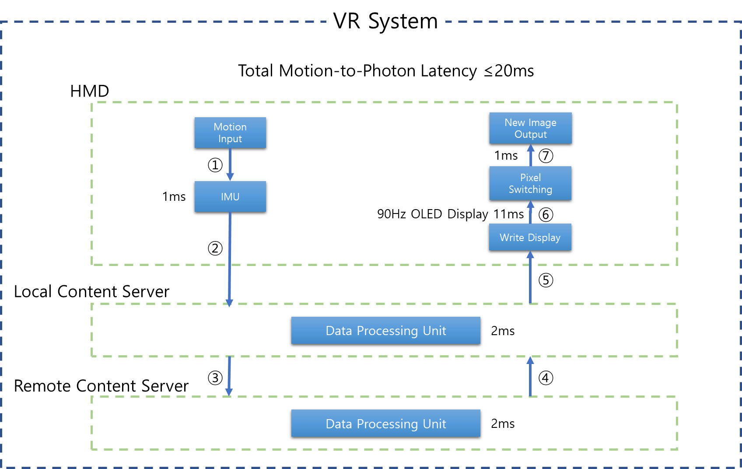
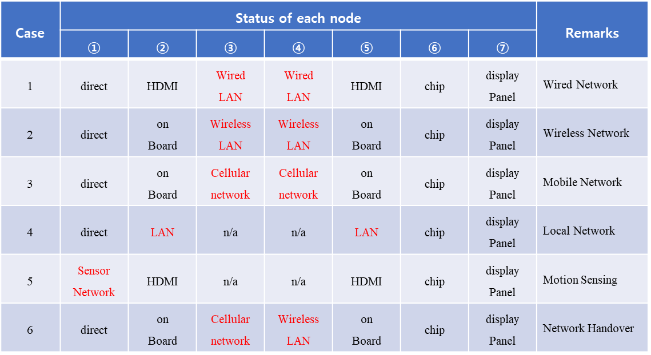
Various Network Environment for VR

Slide 15
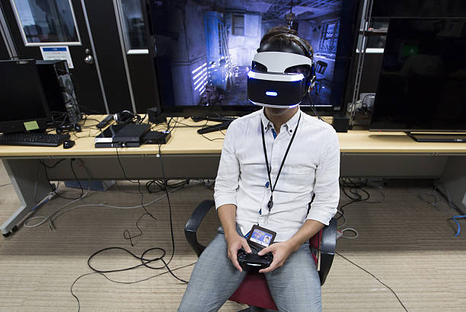
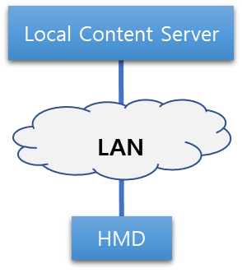
Use Case I
Case 1: A Single VR System Connected via a LAN
In the picture below, a user is playing a VR game using a VR HMD connected to a game console system known as PlayStation 4 with HDMI (High Definition Multimedia Interface) and USB (Universal Serial Bus) cables. The HDMI cable is delivering both video and audio for the VR game that are rendered in real time by the game console (shown in figure) to the VR HMD. The USB cable is delivering the head tracking data from the VR HMD to the game console to reflect the user’s head position so that the game console can render both the video and the audio of the VR game accordingly in real time.
The following is a simplified logical network connectivity diagram of the above use case scenario in which the VR HMD is communicating to a local content server (e.g., a PC or a gaming console) via a local area wired network (LAN). The VR content service is rendered or decoded in the local content server.

Slide 16
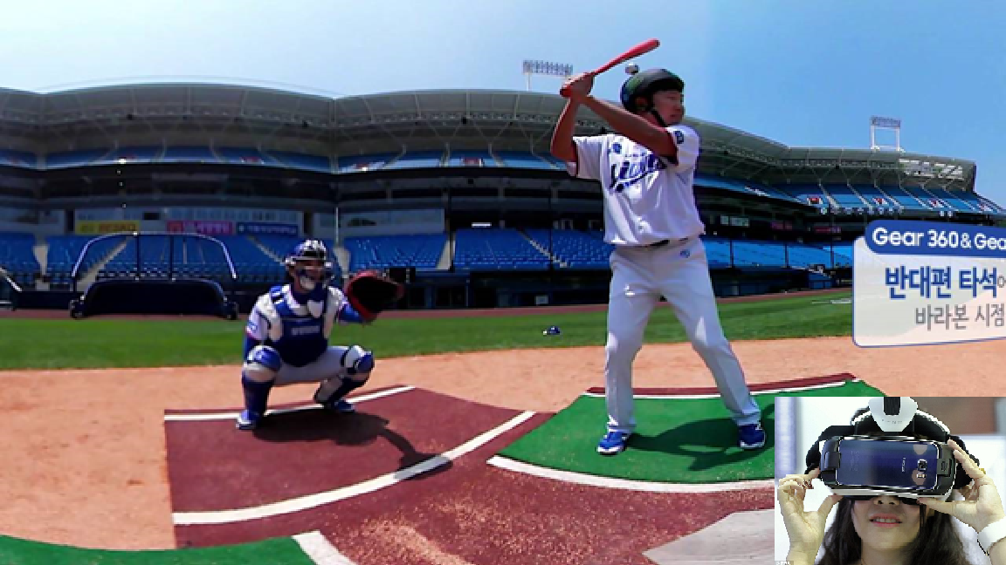
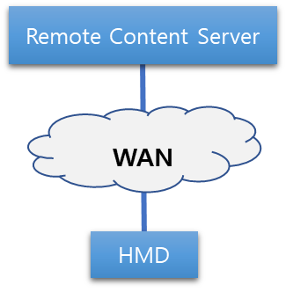
Use Case II
Case 2: A Single VR System Connected via a WAN
In the following picture, a user is watching a baseball game in a virtual reality environment using a mobile phone-based VR HMD system. The baseball game in this scenario is being captured with a 360-degree camera and it is being streamed to the VR HMD in real time. The head tracking data is also transferred to the camera via a mobile network to display the view where the user is looking at. The following is a simplified logical network connectivity diagram of the above use case scenario in which the VR HMD is communicating to a remote content server (such as to a cloud service provider) and receiving the VR content service via a wide area mobile network. In this scenario, the VR content service is rendered or decoded in the remote content server. . It is important to note that the remote content server is located outside the local network and wide area network (WAN) consists of both wired and wireless networks.

Slide 17
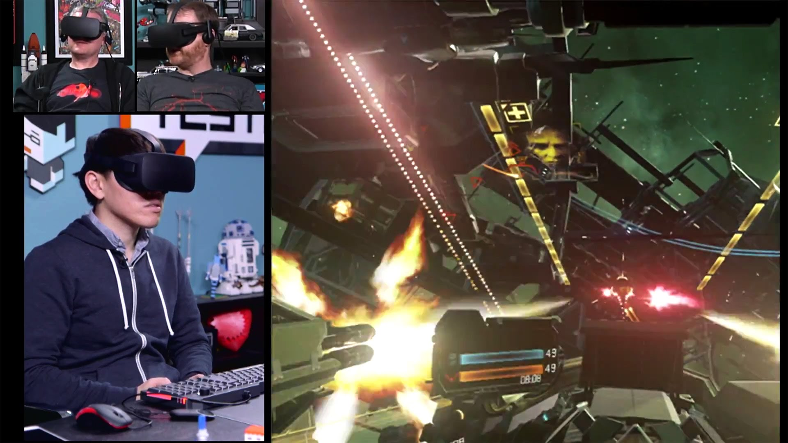
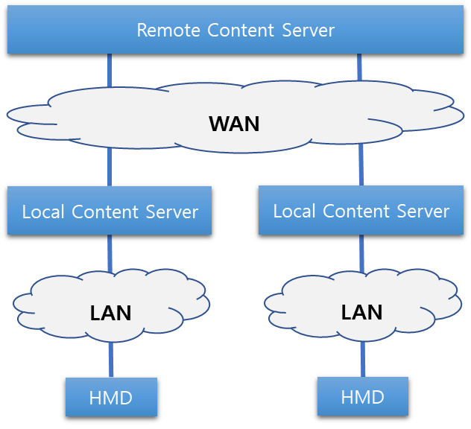
Use case III
Case 3: Multiple VR Systems Connected via a LAN
In the following picture, a user is playing a virtual reality game and competing against other remote players using a VR HMD system that is connected to local server (e.g., a PC or a Laptop). The HDMI cable connecting the VR HMD system and the local server is used to receive the video and the audio data of the VR game content, the service of which is being rendered real time in the local server. The USB cable connecting the VR HMD and the local server is used to exchange the head tracking data so the server can render the video and the audio data accordingly. The remote content server is calculating the scores and the consequential data caused by the remote users’ input. These data are sent to the local content server so it can render the video and the audio of the VR game content accordingly.
The following is a simplified logical network connectivity diagram of the above use case scenario where multiple VR systems are connected to a remote content server. The VR HMD is receiving the VR content service rendered or decoded in the local content server. The remote content server is computing the data sent by the local content servers and redistributing the calculated data back to the local content servers.

Slide 18
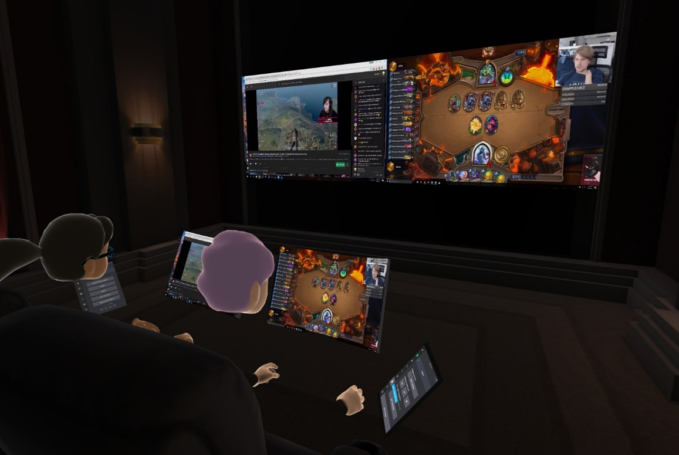
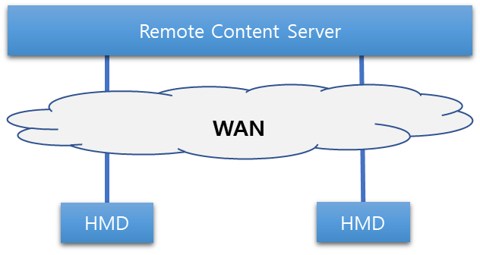
Use Cases IV
Case 4: Multiple VR Systems Connected via a WAN
In the following picture, two or more users are watching a live streamed video game match from their respective home using their mobile phone-based VR HMD systems. The users watching the same content in a virtual movie theater rendered in a cloud service provider and they are being represented as a form of a virtual avatar in the virtual reality theater. They are able to interact with each other and also can communicate via audio. The live-streamed video game match and the virtual reality theater are all being rendered in a remote server situated in the cloud service provider network and the VR HMD system is only running a small application for obtaining the cloud rendered VR content.
The following is a simplified logical network connectivity diagram of the above use case scenario where more than one VR HMD systems are communicating to the remote content server and receiving the VR content service rendered or decoded in the remote content server.

Slide 19
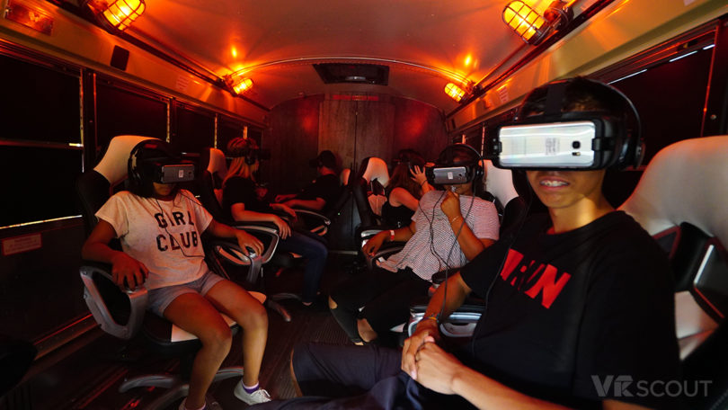
Use Cases V
Case 5: Special Use Case – Change of Network
In the following picture, a user is watching a streamed movie using a mobile phone-based VR HMD while travelling in a bus or a train. The movie is encoded in the remote server and sent to the VR HMD system via a wide area network. The VR HMD system is only decoding the content sent by the remote server.
The following is a simplified logical network connectivity diagram of the above use case scenario where the VR HMD system is connected to either the bus or train Wi-Fi networks or connected directly to the mobile network depending upon the network conditions. Therefore, the network connection is switched between two local access networks that leads to a network handover condition.

Slide 20
Network Requirements
 |  | VR HMD Requirements | Capabilities
 |  |  | 802.11ax | 802.11ay | IMT-2020
Data transmission rate |  | ~ 20 Gbps | ~10 Gbps (at least 4 times improvement over 802.11ac) | ~100 Gbps | 20 Gbps peak, 100 Mbps user-experience data rate
Latency |  | ~ 5 ms (at wireless medium), 20 ms (motion-to-photon/audio) | “A desirable level to meet QoS requirements in high dense deployment scenario” | 10 ms | 1 ms
Jitter |  | < 5 ms | Not specified | Not specified | Not specified
Transmission range | Indoor | 5 m | Not specified | 10 m indoor | Not specified
 | Outdoor | Several hundred meters |  | 100 m outdoor
Mobility | Indoor | Pedestrian speed < 4 km/h | Not specified | 3 km/h | 500 km/h
 | Outdoor | 200 km/h
PER |  | $${10}^{−6}$$ | Not specified | $$\sim {10}^{−8}$$ | Not specified

Slide 21
Conclusion
VR is a very important part of the future industries and many WGs in IEEE 802 are looking into development of standards for VR industrial needs.
Various Standard Organizations such as Khronos Group, ISO/IEC JTC1/SC24, SC29 WG11(MPEG), IEEE 3079, IEEE 2048 are developing technical standards for VR
One of the issues that is preventing the VR from the mass adoption is VR Sickness and Motion-to-Photon Latency is one of the major issues causing the VR sickness.
Motion-to-Photon Latency is directly related to the network issues that IEEE 802 should consider when developing network standards for VR.
To be more proactive to the VR industrial needs, we suggest to create a SG that will help us to create the PAR for future standard development.

