Slide 1
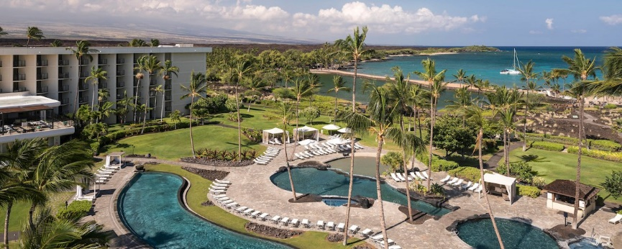
IEEE 802.21 Session #87 Big Island, HI, USA WG Closing Plenary
Subir Das
sdas at vencorelabs dot com
Subir Das, Chair 802.21 WG

Slide 2
Meeting Updates
Working Group Update
Teleconferences
Motions
Future Locations
Subir Das, Chair, IEEE 802.21

Slide 3
WG Update
Interest Group on Network Enablers for seamless HMD based VR Content Service had five sessions and the report is available at:
https://mentor.ieee.org/802.21/dcn/18/21-18-0052-01-0000-vr-ig-meeting-summary.ppt
Status update on IEEE-2017/Cor1 in ISO/JTC1/SC6 and joint meeting with IEEE 802 ISO/JTC1/SC6 ad hoc
Report on IEEE P3079
https://mentor.ieee.org/802.21/dcn/18/21-18-0048-00-0000-status-of-ieee-3079.docx
Report on 802.11 Real Time Applications TIG
https://mentor.ieee.org/802.21/dcn/18/21-18-0054-01-0000-activities-of-ieee-802-11-rta-tig.ppt
Subir Das, Chair, IEEE 802.21

Slide 4
Teleconferences
October 04, 2018, time , 8-9 am US EDT
October 25, 2018, time , 8-9 am US EDT
Subir Das, Chair, IEEE 802.21

Slide 5
WG Motions (None)

Slide 6
Future Sessions
Subir Das, Chair, IEEE 802.21

Slide 7
Future Sessions – 2018
Plenary: November 11-16, 2017, Marriott Marquis Queen’s Park, Bangkok, Thailand
Co-located with all 802 groups
Subir Das, Chair 802.21 WG

Slide 8
November 2018 Meeting Logistics
IEEE 802 Plenary Meeting: November 10-15, 2018, Bangkok, Thailand in Bangkok Marriott Marquis Queen’s Park
Event Information: http://802world.org/Plenary/
* Registration Website: https://www.regonline.com/ieee802plenaryNovember2018
Standard Registration: Before 6:00 PM PDT, Friday, September 28, 2018
* $US 600.00 for attendees at the conference hotel (>= 1 night) otherwise $US900.00
Before 6:00 PM PDT, Friday, October 27, 2018
* $US 700.00 for attendees at the conference hotel (>= 1 night) otherwise $US1000.00
Late/On-site registration: After 6:00 PM PDT, Friday, October 27, 2018
* $US 900.00 for attendees at the conference hotel (>= 1 night) otherwise $US1200.00
Hotel ROOM RATES:
SINGLE OCCUPANCY: 5100.00 THB per night*; DOUBLE OCCUPANCY: 5500.00 THB per night*
EXTRA ADULT*: 2500.00 THB per night
IEEE 802 GROUP RATE DEADLINE: Friday October 19, 2018, 5:00 PM, PDT
If visa is required, please indicate it during registration
Request Letter After Registration: Contact 802info@facetoface-events.com
Subir Das, Chair 802.21 WG

Slide 9
Future Sessions – 2019
Interim: January 13-18, 2019, Hilton St. Louis at the Ballpark
Co-located with all 802 groups
Plenary: March 10-15, 2019, Hyatt Regency Vancouver and Fairmont Hotel Vancouver, Vancouver, Canada
Co-located with all 802 groups
Interim: May 12-17, 2019, Grand Hyatt Atlanta in Buckhead , Atlanta, Georgia, USA
Co-located with all wireless groups
Plenary: July 14-19, 2019, Austria Congress Centre, Vienna, Austria
Co-located with all 802 groups
Interim: September 15-20, 2019 - Marriott Hanoi, Hanoi Vietnam (TBC)
Co-located with all 802 wireless groups
Plenary: November 10-15, 2019, Hilton Waikoloa Village, Kona, HI, USA,
Co-located with all 802 groups
Subir Das, Chair 802.21 WG

