Slide 1
IEEE 802.21 MEDIA INDEPENDENT HANDOVER SERVICES
DCN: 21-18-0003-01-0000
Title: Network Requirements for Various VR HMD Use Cases
Date Submitted: March 05, 2018
Presented at IEEE 802.21 session #84 – Chicago, Illinois, USA
Authors or Source(s): Minseok OH, Namgi KIM (Kyonggi U.)
Abstract: We list the technical requirements for VR HMD in various use cases in a table based on two contributions 3-18-0005-00-0003-use-cases-and-network-requirements [1] and 21-17-0059-02-0000-fact-check-on-standards-and-requirements-for-wireless-vr [2].

Slide 2
  IEEE 802.21 presentation release statements
This document has been prepared to assist the IEEE 802.21 Working Group. It is offered as a basis for discussion and is not binding on the contributing individual(s) or organization(s). The material in this document is subject to change in form and content after further study. The contributor(s) reserve(s) the right to add, amend or withdraw material contained herein.
The contributor grants a free, irrevocable license to the IEEE to incorporate material contained in this contribution, and any modifications thereof, in the creation of an IEEE Standards publication; to copyright in the IEEE’s name any IEEE Standards publication even though it may include portions of this contribution; and at the IEEE’s sole discretion to permit others to reproduce in whole or in part the resulting IEEE Standards publication. The contributor also acknowledges and accepts that this contribution may be made public by IEEE 802.21.
The contributor is familiar with IEEE patent policy, as outlined in Section 6.3 of the IEEE-SA Standards Board Operations Manual <http://standards.ieee.org/guides/opman/sect6.html#6.3> and in Understanding Patent Issues During IEEE Standards Development http://standards.ieee.org/board/pat/guide.html>
  IEEE 802.21 presentation release statements
This document has been prepared to assist the IEEE 802.21 Working Group. It is offered as a basis for discussion and is not binding on the contributing individual(s) or organization(s). The material in this document is subject to change in form and content after further study. The contributor(s) reserve(s) the right to add, amend or withdraw material contained herein.
The contributor grants a free, irrevocable license to the IEEE to incorporate material contained in this contribution, and any modifications thereof, in the creation of an IEEE Standards publication; to copyright in the IEEE’s name any IEEE Standards publication even though it may include portions of this contribution; and at the IEEE’s sole discretion to permit others to reproduce in whole or in part the resulting IEEE Standards publication. The contributor also acknowledges and accepts that this contribution may be made public by IEEE 802.21.
The contributor is familiar with IEEE patent policy, as stated in Section 6 of the IEEE-SA Standards Board bylaws <http://standards.ieee.org/guides/bylaws/sect6-7.html#6> and in Understanding Patent Issues During IEEE Standards Development http://standards.ieee.org/board/pat/faq.pdf>

Slide 3
Abstract
We create a table which shows the requirements in various use cases as a basis for further refinement

Slide 4
VR HMD use cases [3]
Cases | Descriptions | Remarks
1 | Remote multi-party interactive content service connected to a wired server | Direct wired connection between HMD and server
2 | Content service provided by server via mobile network outside | HMD connects to a server through mobile network
3 | Content service provided by server via Wi-Fi network inside | Wireless connection between HMD and server via AP
4 | Stand-alone content service responding to motion through sensor network | Communication between sensor/controller and server
5 | Content service where HMD and terminal (client) are connected via local network | Direct wireless connection between HMD and server
6 | Switching between heterogenous networks while using content service via wireless network | Handover from high-speed network to low-speed network in “use case 2” environment

Slide 5
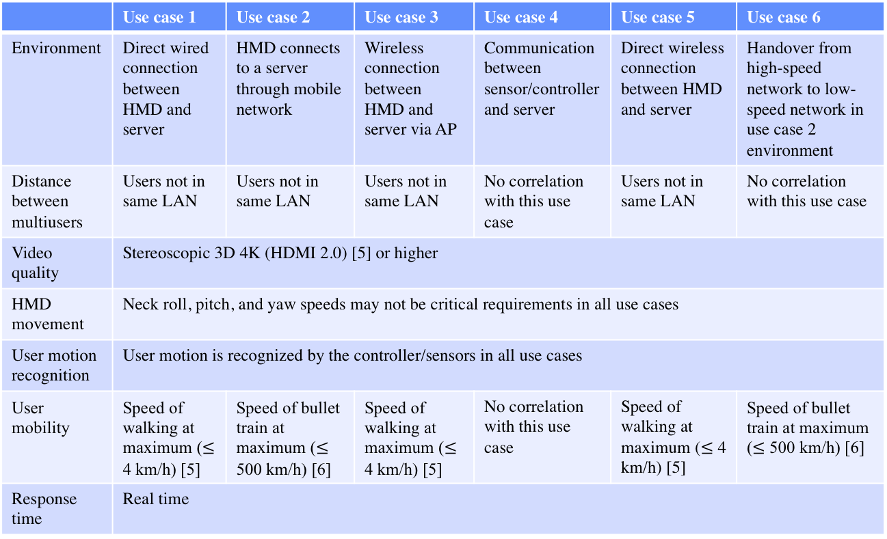
Requirements (1)
 | Use case 1 | Use case 2 | Use case 3 | Use case 4 | Use case 5 | Use case 6
Environment | Direct wired connection between HMD and server | HMD connects to a server through mobile network | Wireless connection between HMD and server via AP | Communication between sensor/controller and server | Direct wireless connection between HMD and server | Handover from high-speed network to low-speed network in use case 2 environment
Distance between multiusers | Users not in same LAN | Users not in same LAN | Users not in same LAN | No correlation with this use case | Users not in same LAN | No correlation with this use case
Video quality | Stereoscopic 3D 4K (HDMI 2.0) [5] or higher
HMD movement | Neck roll, pitch, and yaw speeds may not be critical requirements in all use cases
User motion recognition | User motion is recognized by the controller/sensors in all use cases
User mobility | Speed of walking at maximum ($≤$ 4 km/h) [5] | Speed of bullet train at maximum ($≤$ 500 km/h) [6] | Speed of walking at maximum ($≤$ 4 km/h) [5] | No correlation with this use case | Speed of walking at maximum ($≤$ 4 km/h) [5] | Speed of bullet train at maximum ($≤$ 500 km/h) [6]
Response time | Real time

Slide 6
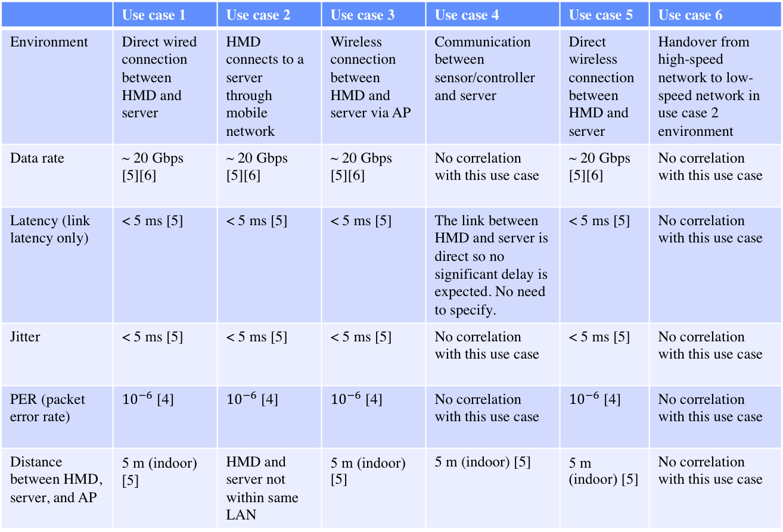
Requirements (2)
 | Use case 1 | Use case 2 | Use case 3 | Use case 4 | Use case 5 | Use case 6
Environment | Direct wired connection between HMD and server | HMD connects to a server through mobile network | Wireless connection between HMD and server via AP | Communication between sensor/controller and server | Direct wireless connection between HMD and server | Handover from high-speed network to low-speed network in use case 2 environment
Data rate | ~ 20 Gbps [5][6] | ~ 20 Gbps [5][6] | ~ 20 Gbps [5][6] | No correlation with this use case | ~ 20 Gbps [5][6] | No correlation with this use case
Latency (link latency only) | < 5 ms [5] | < 5 ms [5] | < 5 ms [5] | The link between HMD and server is direct so no significant delay is expected. No need to specify. | < 5 ms [5] | No correlation with this use case
Jitter | < 5 ms [5] | < 5 ms [5] | < 5 ms [5] | No correlation with this use case | < 5 ms [5] | No correlation with this use case
PER (packet error rate) | ${10}^{−6}$ [4] | ${10}^{−6}$ [4] | ${10}^{−6}$ [4] | No correlation with this use case | ${10}^{−6}$ [4] | No correlation with this use case
Distance between HMD, server, and AP | 5 m (indoor) [5] | HMD and server not within same LAN | 5 m (indoor) [5] | 5 m (indoor) [5] | 5 m (indoor) [5] | No correlation with this use case

Slide 7
Discussion
It is necessary to reduce or elaborate the use cases since the levels of some use cases are awkward in the aspect of network dealt
Use case 4 may not be needed since the sensor/controller connection is not an issue in a VR HMD environment since it is mostly a one-hop link and does not create a delay
Use case 6 may require to deal with a huge amount of work to address the issue
  IEEE 802.21 standard may help
If the response time is “real time” for all use cases, it better be removed

Slide 8
References
[1] https://mentor.ieee.org/3079/dcn/18/3-18-0005-00-0003-use-cases-and-network-requirements.docx
[2] https://mentor.ieee.org/802.21/dcn/17/21-17-0059-02-0000-standards-and-requirements-for-wireless-vr.ppt
[3] https://mentor.ieee.org/802.21/dcn/17/21-17-0054-05-SAUC-white-paper-for-use-cases-and-network-requirements-for-enabling-hmd-based-3d-content-motion-sickness-reducing-technology.docx
[4] DSL Forum Technical Report “Triple-play Services QoE Requirements,” https://www.broadband-forum.org/technical/download/TR-126.pdf
[5] https://mentor.ieee.org/802.11/dcn/15/11-15-0625-07-00ay-ieee-802-11-tgay-usage-scenarios.pptx
[6] Recommendation ITU-R M.2083-0, IMT Vision – Framework and overall objectives of the future development of IMT for 2020 and beyond

