Slide 1
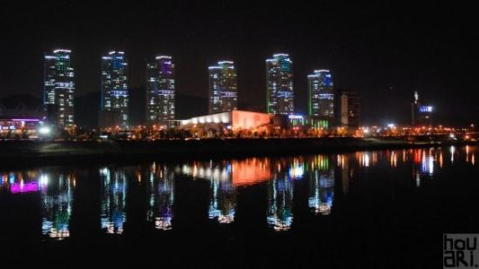
IEEE 802.21 Session #80 Daejeon, South Korea WG Closing Plenary
Subir Das
sdas at appcomsci dot com
Subir Das, Chair 802.21 WG

Slide 2
Meeting Updates
Working Group Update
Teleconferences
Motions
Future Locations
Subir Das, Chair, IEEE 802.21

Slide 3
WG Update
Discussed the IEEE 802 Workshop presentation
Discussed corrigenda text and updated draft for IEEE P802.21-2017-cor1 project
Draft is available at the private area
Discussed draft liaison letter from P3333.3
https://mentor.ieee.org/802.21/dcn/17/21-17-0021-00-0000-liaison-letter-to-ieee-802-21.docx
Discussed the submission of IEEE Std 802.21-2017 and IEEE Std 802.21.1-2017 to ISO/JTC1/SC6 for 60-day pre-ballot
Met with ISO/JTC1/SC6 ad hoc group and discussed the next steps on 60-day pre-ballot process
Report on EchoNet Lite
None
Subir Das, Chair, IEEE 802.21

Slide 4
Teleconferences
May 26, 2017, 8:00-9:00 am, US EST
June 23, 2017, 8:00-9:00am, US EST
Subir Das, Chair, IEEE 802.21

Slide 5
WG Motions

Slide 6
P802.21 WG Motion
Move to authorize the P802.21 WG Chair to initiate the WG Letter Ballot on draft IEEE P802.21-2017-cor1/D01
Move: Yoshikazu Hanatani
Second: Hyeong Ho Lee
For: 04
Against: 00
Abstain: 00
Motion passes
Slide 6

Slide 7
Future Sessions
Subir Das, Chair, IEEE 802.21

Slide 8
Future Sessions – 2017
Plenary: July 9-14, 2017, Estrel Hotel and Convention Center, Berlin, Germany
Co-located with all 802 groups
Interim: September 10-15, 2017, Hilton Waikoloa Village, Kona, HI, USA, 802 Wireless Interim Session.
Co-located with all 802 wireless groups
Plenary: November 5-10, 2017, Caribe Hotel and Convention Center, Orlando, FL, USA
Co-located with all 802 groups
May 2017
Subir Das, Chair 802.21 WG

Slide 9
July, 2017 Plenary Meeting Logistics
IEEE 802 Plenary Meeting , July 09-14, 2017
Meeting Venue: Estrel Hotel, Berlin, Germany
Event Information & Registration: http://802world.org/plenary
Early Registration and Hotel Reservation Deadline May 19, 2017
Registraion Fees and Deadlines
Early Registration • $US 450.00 for all attendees • Deadline: 6:00 PM Pacific Time, Friday, May 19, 2017
Standard Registration • $US 550.00 for all attendees • Deadline: 6:00 PM Pacific Time, Friday, June 23, 2017
Late/On-site Registration • $US 750.00 for all attendees • Applies to All Registrations AFTER: 6:00 PM Pacific Time, Friday, June 23, 2017
(Note: The IEEE 802 Plenary Session Registration Rate is not reduced for attendees staying at Estrel Hotel Berlin.)
Social Event, starting at 6:00 PM, Wednesday July 12, 2017
Cruise along the Landwehr Canal and Spree River, a Berlin city sightseeing boat trip and tour. Dinner and guided tour included in the registration fee but must indicate during registration (Note: Limited availability request during registration).
Subir Das, Chair 802.21 WG

Slide 10
Future Sessions – 2018
January 15-20, 2018, Hotel Irvine, Los Angeles, CA, USA
Co-located with all 802 groups
Plenary: March 04-09, 2018, Hyatt Regency O’Hare, Rosemont, Illinois, USA
Co-located with all 802 groups
Interim: May 06-11, 2018, Mariott, Warsaw, Poland
Co-located with all wireless groups
Plenary: July 8-13, 2018, Manchester Grand Hyatt, San Diego, CA, USA
Co-located with all 802 groups
Interim: September 09-14, 2018, Hilton Waikoloa Village, Kona, HI, USA, 802 Wireless Interim Session.
Co-located with all 802 wireless groups
Plenary: November 11-16, 2017, Suzhou, China (TBC)
Co-located with all 802 groups
May 2017
Subir Das, Chair 802.21 WG

