Slide 1
IEEE 802.21
DCN: 21-15-0102-00-SAUC
Title: Presentation of Open SLMCP use case
Date Submitted: Sep 16, 2015
IEEE 802.21 session #70 in Bangkok, Thailand
Authors or Source(s):
Sangkwon Peter Jeong, Chanyoung Kwon, Sunju Kwon (BlueCloud Co., Ltd.)
Changhwa Lyou (SeerooInformation)
Abstract: Open Social Learning Mobile Content Platform use cases for media independent handover

Slide 2
  IEEE 802.21 presentation release statements
This document has been prepared to assist the IEEE 802.21 Working Group. It is offered as a basis for discussion and is not binding on the contributing individual(s) or organization(s). The material in this document is subject to change in form and content after further study. The contributor(s) reserve(s) the right to add, amend or withdraw material contained herein.
The contributor grants a free, irrevocable license to the IEEE to incorporate material contained in this contribution, and any modifications thereof, in the creation of an IEEE Standards publication; to copyright in the IEEE’s name any IEEE Standards publication even though it may include portions of this contribution; and at the IEEE’s sole discretion to permit others to reproduce in whole or in part the resulting IEEE Standards publication. The contributor also acknowledges and accepts that this contribution may be made public by IEEE 802.21.
The contributor is familiar with IEEE patent policy, as stated in Section 6 of the IEEE-SA Standards Board bylaws <http://standards.ieee.org/guides/bylaws/sect6-7.html#6> and in Understanding Patent Issues During IEEE Standards Development http://standards.ieee.org/board/pat/faq.pdf>

Slide 3









Open SLMCP Service Model
Mobility Area
Social Learning
Platform
Service
Social Networking Service Provider
Professor
Friends
(students)
Consume
Friends
(students)
Share
&
Spread
Share
Quest
Supply
Professor
Professor
Friends
(students)
2015 BlueCloud Co., Ltd

Slide 4
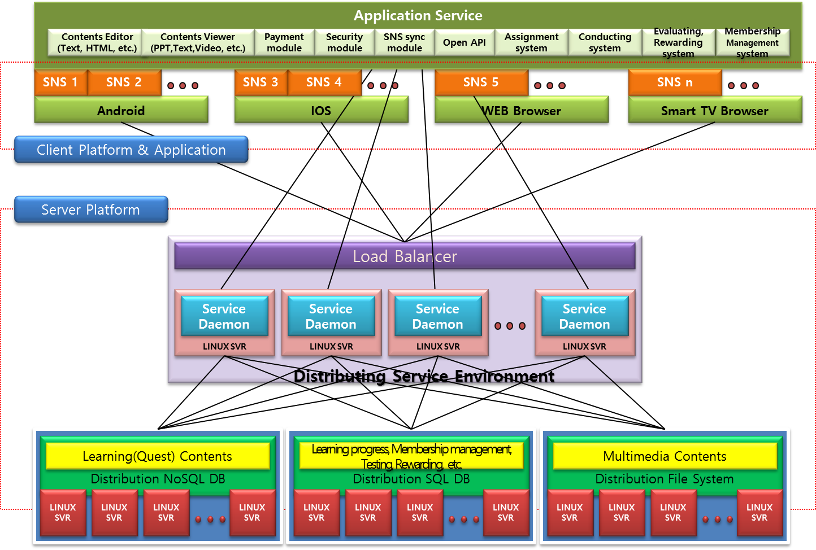
Open SLMCP Architecture
2015 BlueCloud Co., Ltd

Slide 5
MIH Services in mobile nodes facilitate seamless handovers between heterogeneous networks. MIH Services are used by MIH users such as a mobility management protocol (e.g., Mobile IP). Other mobility management protocols (in addition to Mobile IP) and even other MIH users are not precluded from making use of MIH Services.
Open SLMCP don’t use new MIH parameters and functions. It is just use to exist MIS components.
I will presentation that Open SLMCP change the using network between 802.11 and 802.16.
2015 BlueCloud Co., Ltd

Slide 6
Example handover flow chart between IEEE 802.11 and IEEE 802.16
Figure C.3 shows a handover flow chart between the IEEE 802.11 and the IEEE 802.16 network. This is an example of dual radio handover procedure wherein both the radios involved in handover can transmit and receive at the same time. The handover procedure operates as follows:
1) The Mobile Node is connected to the IEEE 802.11 network and receives the IEEE 802.11 link measurement report through the MIH_Link_Parameters_Report.indication and acquires the neighboring network information by the MIH_Get_Information.confirm.
2) When the Link_Going_Down event happens on the current IEEE 802.11 network, the Mobile Node performs the MIH_Link_Actions.request to scan the link status of the candidate networks.
The mobile node discovers the IEEE 802.16 network and can acquire the candidate IEEE 802.16 network's DL_MAP, UL_MAP, DCD and UCD parameters.
3) The Mobile Node identifies the resource availability status of the candidate network by sending the MIH_MN_HO_Candidate_Query message to the Serving PoS. When the Serving PoS receives the MIH_MN_HO_Candidate_Query request message from the Mobile Node, it retrieves resource information from target network by sending MIH_N2N_HO_Query_Resources message to the PoSs on the candidate networks.
4) Based on resource availability and other selection criteria the IEEE 802.16 network is selected as the target of the handover and the Mobile Node sends MIH_MN_HO_Commit request message to the Serving PoS to notify the decided target network information. The Serving PoS reserves the resource at the target network through MIH_N2N_HO_Commit messages.
5) The Mobile Node commits a link switch to the IEEE 802.16 interface and the new layer 2 connection for the target IEEE 802.16 network is established. The Mobile IP procedures are carried out between the Mobile Node and the IEEE 802.16 network. As a result of that, the active sessions are now shifted over to the IEEE 802.16 network.
6) The Mobile Node sends the MIH_MN_HO_Complete request message to the Serving PoS on the IEEE 802.16 network and that Serving PoS exchanges the MIH_N2N_HO_Complete messages with the previous PoS on the IEEE 802.11 network to release the resource that was reserved for the Mobile Node on that network.
2015 BlueCloud Co., Ltd

Slide 7
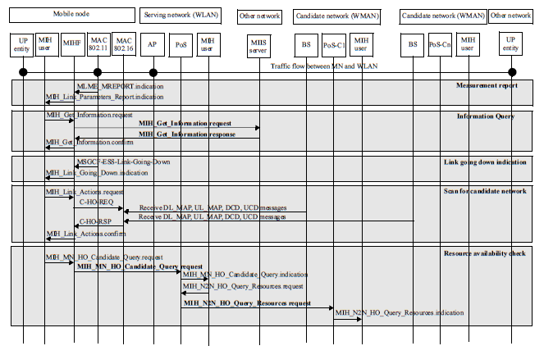
Call Flow for Handover
Figure C.3—Example handover flow chart between IEEE 802.11 and IEEE 802.16
2015 BlueCloud Co., Ltd

Slide 8

High Level Process in case of Open SLMCP
Out of Scope
Open Social Learning
Mobile Content Platform
⑥ Request for confirmation by user token
SNS(Social Networking Service)
PoS
⑦ Respond confirmation message
⑤ Request for sign in by token
⑧ Respond confirmation message
① Request for joining membership
② Check for user authentication of the SNS
③ Request
authentication token
④ Respond
authentication token
Open SLMCP Client
2015 BlueCloud Co., Ltd

Slide 9
Low Level Process in case of Registration
※ Network by Mobile IP
Open SLMCP
PoS (MIHF)
802.11
Occur to Handover
802.16
②’ Check for user authentication of the SNS
① Request for joining membership
①’ Request for joining membership
② Check for user authentication of the SNS
④’ Respond confirmation message
③ Request for sign in by token
③’ Request for sign in by token
④ Respond confirmation message
Mobile Node (MIHF)
Open SLMCP is Server. It check the connected within the MN and Open SLMCP Server. For the stable Service and prevent bad users as hackers. Therefore, Open SLMCP should using by Mobile IP.
And, MN is using for the QoS. It doesn’t make to disconnected status that is using the MIS.
2015 BlueCloud Co., Ltd

Slide 10
Low Level Process in case of Content Download
※ Network by Mobile IP
Open SLMCP
PoS (MIHF)
802.11
Occur to Handover
802.16
②’ Respond Content list
① Request for Content list
①’ Request for Content list
② Respond Content list
④’ Content download
③ Request for Content download
③’ Request for Content download
④ Content download
Mobile Node (MIHF)
Mobile node must connect for stable QoS. If disconnect between MN and Open SLMCP then user cannot download the content to his wish timing.
2015 BlueCloud Co., Ltd

Slide 11
Low Level Process in case of Content Upload
※ Network by Mobile IP
Open SLMCP
PoS
802.11
Occur to Handover
802.16
②’ Respond Ready status
① Call for Content Upload
①’ Call for Content Upload
② Respond Ready status
④’ Respond Confirm message to upload complete
③ Content Upload
③’ Content Upload
④ Respond Confirm message to upload complete
Mobile Node (MIHF)
Mobile node must connect for stable QoS. If disconnect between MN and Open SLMCP then user cannot upload the content to his wish timing.
2015 BlueCloud Co., Ltd

