Slide 1
IEEE 802.21
DCN: 21-15-0005-00
Title: Open SLMCP use case
Date Submitted: January 10, 2015
IEEE 802.21 session #66 in Atlanta, USA
Authors or Source(s):
Sangkwon Peter Jeong, Chanyoung Kwon, Sunju Kwon (BlueCloud Co., Ltd.)
Junghee Lee (NCIA)
Abstract: Open Social Learning Mobile Content Platform use cases for media independent handover

Slide 2
  IEEE 802.21 presentation release statements
This document has been prepared to assist the IEEE 802.21 Working Group. It is offered as a basis for discussion and is not binding on the contributing individual(s) or organization(s). The material in this document is subject to change in form and content after further study. The contributor(s) reserve(s) the right to add, amend or withdraw material contained herein.
The contributor grants a free, irrevocable license to the IEEE to incorporate material contained in this contribution, and any modifications thereof, in the creation of an IEEE Standards publication; to copyright in the IEEE’s name any IEEE Standards publication even though it may include portions of this contribution; and at the IEEE’s sole discretion to permit others to reproduce in whole or in part the resulting IEEE Standards publication. The contributor also acknowledges and accepts that this contribution may be made public by IEEE 802.21.
The contributor is familiar with IEEE patent policy, as stated in Section 6 of the IEEE-SA Standards Board bylaws <http://standards.ieee.org/guides/bylaws/sect6-7.html#6> and in Understanding Patent Issues During IEEE Standards Development http://standards.ieee.org/board/pat/faq.pdf>

Slide 3
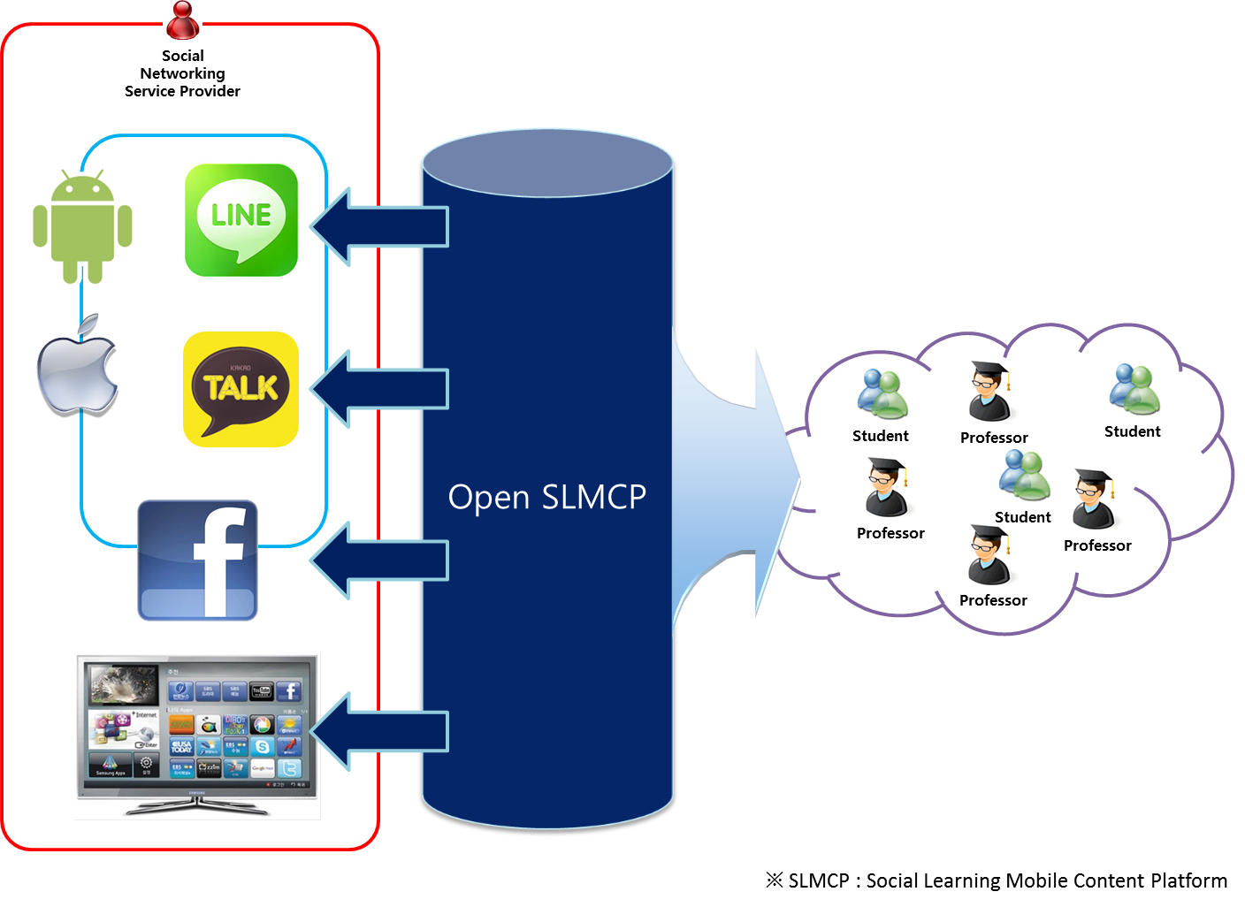
Open SLMCP
Open SLMCP is the platform which should expand influx of users and maximize the learning motivation of the learner by integration with existing social network services.
Open SLMCP is content platform and application service on mobile network environment.
2014 BlueCloud Co., Ltd. – Serious Game Portal
3

Slide 4
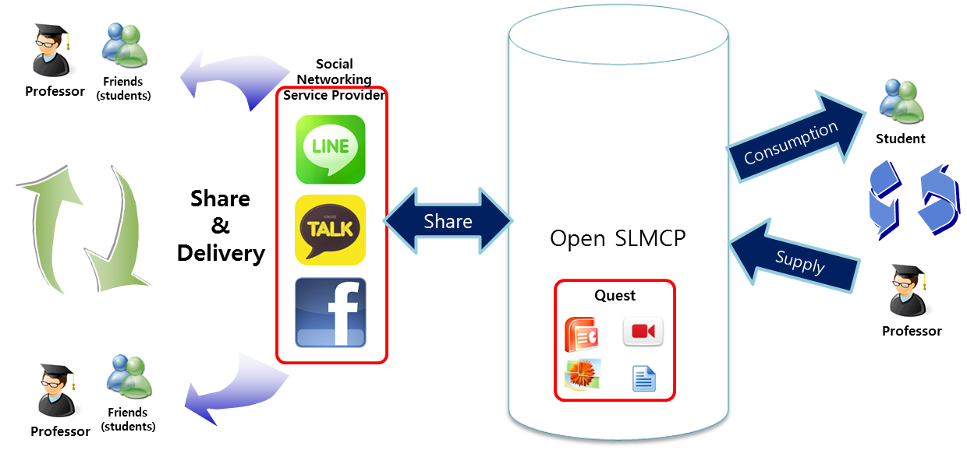
Social Learning Mobile Content Platform
Meaning of the ‘Open’ in the ‘Open SLMCP’ is the platform that is open to all users, teachers and students to be able to.
2014 BlueCloud Co., Ltd. – Serious Game Portal
4

Slide 5
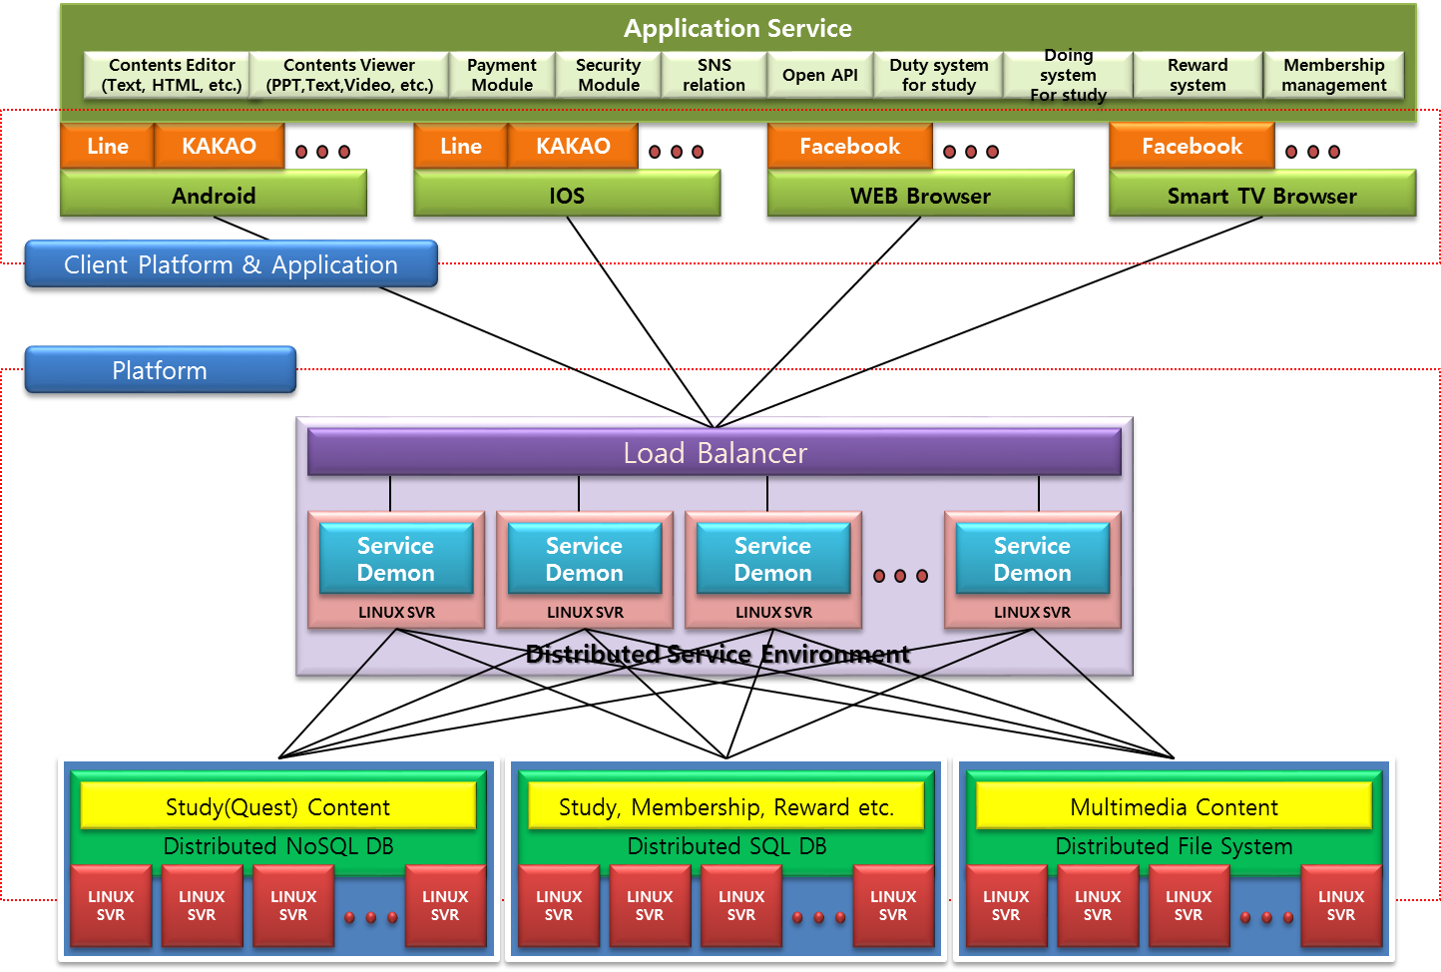
Social Learning Mobile Content Platform
This platform is configured to share the learning content through the social network service of a various friends of users.
2014 BlueCloud Co., Ltd. – Serious Game Portal
5

Slide 6
Social Learning Mobile Content Platform
Open SLMCP
Server
MIH
For stable communication between SLMCP Client and Server
MIH
3GPP
Wi-Fi
3GPP
Wi-Fi
LTE
LTE
Social Learning Mobile Content
Open SLMCP Client A
Open SLMCP Client B
※ SLMCP : Social Learning Mobile Content Platform
2014 BlueCloud Co., Ltd. – Serious Game Portal
6

Slide 7
Social Learning Mobile Content Platform
Open SLMCP Clients are moving at the using time and they are try to connecting with SLMCP Server at the same time.
At this time, Open SLMCP occurs the problem,
Therefore, Open SLMCP have to
2014 BlueCloud Co., Ltd. – Serious Game Portal
6

