Slide 1
IEEE 802.21.1 MEDIA INDEPENDENT SERVICES
DCN: 21-14-0157-01-SAUC
Title: Use cases of MIS framework to cooperate with SDN wireless access networks
Date Submitted: Nov. 4, 2014
Presented at IEEE 802.21 Session #65 in San Antonio, TX, USA
Authors or Source(s):
Jin Seek Choi (Hanyang University, Korea Ethernet Forum), Hyeong-Ho Lee (ETRI), and Hyunho Park (ETRI)
Abstract: This document presents use cases of MIS framework to cooperate with SDN (Software-Defined Networking).

Slide 2
  IEEE 802.21 presentation release statements
This document has been prepared to assist the IEEE 802.21 Working Group. It is offered as a basis for discussion and is not binding on the contributing individual(s) or organization(s). The material in this document is subject to change in form and content after further study. The contributor(s) reserve(s) the right to add, amend or withdraw material contained herein.
The contributor grants a free, irrevocable license to the IEEE to incorporate material contained in this contribution, and any modifications thereof, in the creation of an IEEE Standards publication; to copyright in the IEEE’s name any IEEE Standards publication even though it may include portions of this contribution; and at the IEEE’s sole discretion to permit others to reproduce in whole or in part the resulting IEEE Standards publication. The contributor also acknowledges and accepts that this contribution may be made public by IEEE 802.21.
The contributor is familiar with IEEE patent policy, as stated in Section 6 of the IEEE-SA Standards Board bylaws <http://standards.ieee.org/guides/bylaws/sect6-7.html#6> and in Understanding Patent Issues During IEEE Standards Development http://standards.ieee.org/board/pat/faq.pdf>

Slide 3
Definitions of
SDN and MIS Frameworks
SDN (Software-Defined Networking)* for Wireless Access networks
  Definition from ONF: The physical separation of the network control plane from the forwarding plane, and where a control plane controls several devices.
  SDN framework extended to wireless access networks (802 technology)
MIS (Media Independent Services) framework for wireless Access networks
  Framework to facilitate interworking between IEEE 802 networks for improving the user experience of mobile devices such as
    Link layer interface enabling the communication between the 802 technologies (e.g. access abstraction)
    Clearly defined interfaces, SAPs (APIs) and behaviors for mobility and handover
    Ability to modify data path based on link parameters
MIS framework needs to cooperate with SDN based wireless access networks [3]
  * https://www.opennetworking.org/sdn-resources/sdn-definition

Slide 4


MIS vs SDN
IEEE 802.21 based Access networks
Distributed MIS framework on
AP, Switch, and MN (Mobile Node)
SDN based wireless Access networks
Centralized control separating from switches
Centralized data path control and resource management
Switch/
Router
Control &
Management
SDN Controller
MISF
SDN Protocol
Switch/
Router
MISF
MISF
Agent
Agent
Agent
AP
Wireless SDN Switch
MISF
MISF
MISF
MISF
MN

Slide 5
MIS & SDN cooperated Framework
Overlay Model
Interworking Model
Integrated Model

Slide 6

Cooperation between MIS and SDN frameworks
MIS framework enables data path control and resource management for network entities (i.e., PoS and PoA for various 802 access networks) and MN [7].
  MIS Requirements of Resource management & data path control:
  SDN Switch has no ability to manage data path and network resource,
  but SDN controller has ability to manage data path and network resource.
MIS framework should cooperate with SDN framework.
  Overlay vs. Interworking vs. Integrated
Access Controller (MIS PoS)
Signalling between
MIS PoS and SDN
control entities
SDN Controller
MISF
MISF
Router/ Switch
(MIS PoS)
MISF
MISF
SDN Switch
PoA1
PoA2
MISF
MISF
MISF
MN
MISF
handover

Slide 7
(1) Overlay Solution: Mobility and MIS framework
Network entities of MIS framework may cooperate with other framework for optimizing data path control, mobility management, and resource management in both wireless and wired networks.
Requirements
  MIS function and SDN function can co-exist in the same physical network entities.
  Then, MISF are needed in SDN switches without interworking with SDN controller.
Access Controller 1 (MIS PoS)
SDN Controller 2
MISF
OpenFlow
Extended primitive
Router/ Switch
(MIS PoS)
SDN Switch
MISF
MISF
PoA1
PoA2
MISF
MISF
MISF
MISF
MISF
MN
MISF
MN
handover

Slide 8
(1) Signaling message flows (overlay)
MN
Serving
PoA1
Candidate
PoA 2
SDN
Controller 2
MIS PoS 1
MN detects
PoA2
(1) MIS_MN_Link_Detected.indication
(2) MIS_MN_HO_Candidate_Query.request
(3) MIS_N2N_HO_Query_Resources.request
(4) MIS_N2N_HO_Query_Resources.response
Handover execution
(5) MIS_MN_HO_Candidate_Query.response
(6) MIS_MN_HO_Commit.request
(7) MIS_N2N_HO_Commit.request
(8) MIS_N2N_HO_Commit.response
OpenFlow extended primitive
for Flow Set/Remove
(9) MIS_MN_HO_Commit.response
L2 Handover
(10) MIS_MN_Link_Up.indication
(11) MIS_MN_Link_Up.indication
MN connects
to PoA2
(12) MIS_MN_HO_Complete.request
(13) MIS_MN_HO_Complete.request
(14) MIS_MN_HO_Complete.response
Handover
Completed
(15) MIS_MN_HO_Commit.response

Slide 9
(2) Interworking Solution of MIS framework
MIS framework for centralized SDN control framework
  The Cooperated Framework to facilitate interworking between IEEE 802.21 based MIS PoS and SDN Controllers
    MIS PoS needs to cooperate with SDN controller (e.g., Northbound APIs)
      Clearly defined interfaces, SAPs (APIs) and behaviors for mobility and handover
      Ability to modify data path based on link layer parameters
    MIS PoS configures the network resources of SDN switches
      By enabling the communication with the centralized SDN controller (e.g. access abstraction and handover initiation)
      SDN controller enables the resource allocation through Southbound interface (e.g. resource management for handover)
  This solution means that MIS technologies can facilitate SDN control framework

Slide 10
(2-1) Interworking Solution of MIS framework
Interworking solution for handover within SDN based Wireless Access Networks
  MIS extension for SDN controller but No MIS extension for switches/APs
  Only available on MN initiated Handover
SDN Controller
MISF
SDN Switch
PoA2
handover
MISF
10

Slide 11
(2-1) Signaling message flows (Interworking)
MN
Serving
PoA1
Candidate
PoA 2
SDN
Controller
(MIS PoS)
MN detects
PoA2
(1) MIS_MN_Link_Detected.indication
(2) MIS_MN_HO_Candidate_Query.request
(3) OFPT_STATUS_REQUEST
Handover execution
(4) OFPT_STATUS_RESPONSE
5) MIS_MN_HO_Candidate_Query.response
(6) MIS_MN_HO_Commit.request
(7) OFPT_FLOW_MOD
(8) OFPT_BARRIER_REQUEST
(9) OFPT_BARRIER_REPLY
(10) MIS_MN_HO_Commit.response
L2 Handover
MN connects
to PoA2
(11) MIS_MN_Link_Up.indication
(12) MIS_MN_HO_Complete.request
(13) OFPT_FLOW_MOD
(14) OFPT_BARRIER_REQUEST
(15) OFPT_BARRIER_REPLY
Handover
Completed
(16) MIS_MN_HO_Commit.response

Slide 12
(2-2) Interworking Solution of MIS framework
Interworking solution for SDN based Wireless Access Networks
  MIS extension between SDN controllers using northbound interface to perform handover
  Only available on MN initiated Handover
SDN Controller 1 (MIS PoS)
SDN Controller
2 (MIS PoS)
MISF
Signalling between SDN controllers for delivering MIS Pos
MISF
SDN Switch
(MIS PoS)
SDN Switch
PoA1
PoA2
MISF
MN
MISF
handover
12

Slide 13
(2-2) Signaling message flows (Interworking)
MN
Serving
PoA1
Candidate
PoA 2
SDN
Controller
(MIS PoS)2
SDN
Controller
(MIS PoS) 1
MN detects
PoA2
(1) MIS_MN_Link_Detected.indication
(2) MIS_MN_HO_Candidate_Query.request
(3) OFPT_STATUS_REQUEST
(3) MIS_N2N_HO_Query_Resource.request
Handover execution
(4) OFPT_STATUS_RESPONSE
(4) MIS_N2N_HO_Query_Resource.response
5) MIS_MN_HO_Candidate_Query.response
(6) MIS_MN_HO_Commit.request
(7) MIS_N2N_HO_Commit.request
(8) OFPT_FLOW_MOD
(9) OFPT_BARRIER_REQUEST
(10) OFPT_BARRIER_REPLY
(11) MIS_N2N_HO_Commit.response
(12) MIS_MN_HO_Commit.response
L2 Handover
MN connects
to PoA2
(13) MIS_MN_Link_Up.indication
(14) MIS_MN_HO_Complete.request
(15) MIS_N2N_HO_complete.request
(16) MIS_N2N_HO_complete.response
(17) OFPT_FLOW_MOD
(18) OFPT_BARRIER_REQUEST
Handover
Completed
(19) OFPT_BARRIER_REPLY
(20) MIS_MN_HO_Commit.response

Slide 14
(2-3) Interworking Solution of MIS framework
Interworking solution for different SDN interworking solutions
  MIS extension in SDN controller to perform handover
  MIS Interworking with Overlay/Integrated Solution
Signalling between Access controller (MIS Pos) and SDN controller
SDN Controller 1 (MIS PoS)
SDN Controller 2 (MIS PoS)
MISF
MISF
Router/ Switch
(MIS PoS)
MISF
SDN Switch
PoA1
PoA2
MISF
MISF
MISF
MN
MISF
handover
14

Slide 15
(2-3) Signaling message flows (Interworking)
MN
Serving
PoA1
Candidate
PoA 2
SDN
Controller
(MIS PoS) 2
SDN
Controller
(MIS PoS) 1
MN detects
PoA2
(1) MIS_MN_Link_Detected.indication
(2) MIS_MN_HO_Candidate_Query.request
(3) OFPT_STATUS_REQUEST
(3) MIS_N2N_HO_Query_Resource.request
(4) OFPT_STATUS_RESPONSE
(4) MIS_N2N_HO_Query_Resource.response
Handover execution
5) MIS_MN_HO_Candidate_Query.response
(6) MIS_MN_HO_Commit.request
(7) MIS_N2N_HO_Commit.request
(8) OFPT_FLOW_MOD
(9) OFPT_BARRIER_REQUEST
(10) OFPT_BARRIER_REPLY
(11) MIS_N2N_HO_Commit.response
(12) MIS_MN_HO_Commit.response
L2 Handover
MN connects
to PoA2
(13) MIS_MN_Link_Up.indication
(15) MIS_MN_HO_Complete.request
(16) MIS_N2N_HO_complete.request
(17) MIS_N2N_HO_complete.response
(18) MIS_MN_HO_Complete.request
Handover
Completed
(19) MIS_MN_HO_Complete.response
(20) MIS_MN_HO_Commit.response

Slide 16
(3) Integrated Solution of MIS framework
Integrated MIS & SDN control framework for SDN based Wireless Access Networks
  extension of Northbound interface for MIS PoS
  extension of southbound interface for (OpenFlow) primitive
SDN Controller
(MIS PoS)
MISF
OpenFlow
Extended primitive
OpenFlow
Extended primitive
Router/ Switch
(MIS PoS)
MISF enabled
SDN Switch
MISF
MISF
PoA1
PoA2
MISF
MISF
MISF
MISF
MISF
MN
MISF
handover
16

Slide 17
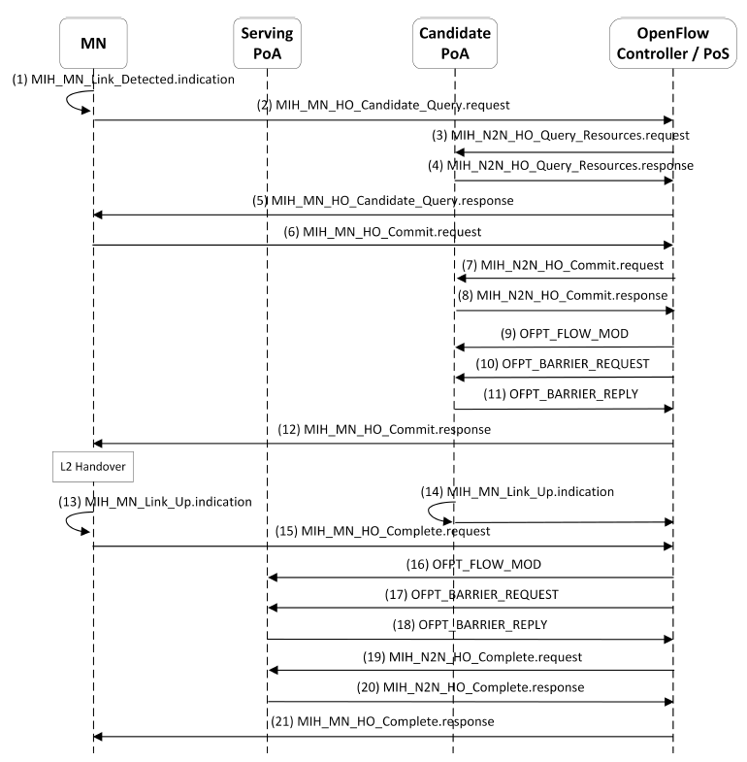
(3) Signaling message flows (Integrated[3,4,8])
MN
Serving
PoA1
Candidate
PoA 2
MIS PoS
Controller
MIS PoS
MN detects
PoA2
Handover execution
MN connects
to PoA2

Slide 18
Conclusions
SDN and MIS frameworks are open platform to control networks
  SDN usually focuses on data path control and resource management.
  MIS framework focuses on mobility and radio resource management.
Scenarios for MIS framework cooperating SDN control framework
  Overlay Model:
    Integration of MIS function with control agent in SDN Switch
  Interworking Model
    MIS PoS cooperates with SDN Controller
  Integrated Model
    Integration of MIS PoS with SDN controller and
    Integration of MIS function with control agent in SDN Switch
  Further discussions on SDN issues in IEEE 802.21.1 task group
  Cooperation between MIS framework and SDN framework will be important in future because it shows complementary relationship between them.
  For the cooperation, interfaces between MIS framework and SDN framework should be discussed in IEEE 802.21.1 task group.
  We need to make detailed description texts for the three models of MIS and SDN cooperation scenarios.

Slide 19
References
IEEE 802.21 Contribution, 21-14-0017-00, Daniel Corujo et. al., 802.21 for SDN-based flow handover in wireless environments.
IEEE 802.21 Contribution, 21-14-0029-00, Daniel Corujo et. al., 802.21+SDN integrated scenarios and new PoA-related primitives.
C. Guimarães et. al., Empowering Software Defined Wireless Networks Through Media Independent Handover Management, Globecom 2013.
C. Guimarães et. al., IEEE 802.21-enabled entity title architecture for handover optimization, WCNC 2014.
F. Buiati et. al., IEEE 802.21 information services deployment for heterogeneous mobile environments, IET Commun., 2011
IEEE 802.21 Contribution, 21-14-0060-00, Charles E. Perkins, OpenFlow PoA proposal for SDN use case
IEEE 802.21 Contribution, 21-14-0707-00, H. H. Lee et al., Consideration for MIS framework to cooperate with SDN
Carlos Guimarães et. al., Enhancing OpenFlow with Media Independent Management Capabilities, ICC 2014.
C. J. Bernardos, et al., “An architecture for software defined wireless networking, IEEE Wireless Commun. Mag., June, 2014

