Slide 1
IEEE 802.21
DCN: 21-14-0134-00
Title: Open SLMCP use cases
Date Submitted: September 13, 2014
IEEE 802.21 session #64 in Athens, Greece
Authors or Source(s):
Sangkwon Peter Jeong (BlueCloud Co., Ltd.)
Junghun Kim (TTA)
Chanyoung Kwon (BlueCloud Co., Ltd.)
Abstract: Open Social Learning Mobile Content Platform use cases for media independent handover

Slide 2
  IEEE 802.21 presentation release statements
This document has been prepared to assist the IEEE 802.21 Working Group. It is offered as a basis for discussion and is not binding on the contributing individual(s) or organization(s). The material in this document is subject to change in form and content after further study. The contributor(s) reserve(s) the right to add, amend or withdraw material contained herein.
The contributor grants a free, irrevocable license to the IEEE to incorporate material contained in this contribution, and any modifications thereof, in the creation of an IEEE Standards publication; to copyright in the IEEE’s name any IEEE Standards publication even though it may include portions of this contribution; and at the IEEE’s sole discretion to permit others to reproduce in whole or in part the resulting IEEE Standards publication. The contributor also acknowledges and accepts that this contribution may be made public by IEEE 802.21.
The contributor is familiar with IEEE patent policy, as stated in Section 6 of the IEEE-SA Standards Board bylaws <http://standards.ieee.org/guides/bylaws/sect6-7.html#6> and in Understanding Patent Issues During IEEE Standards Development http://standards.ieee.org/board/pat/faq.pdf>

Slide 3
Open SLMCP
Open SLMCP is the platform which should expand influx of users and maximize the learning motivation of the learner by integration with existing social network services.
Open SLMCP
SNS n
User n
※ SLMCP : Social Learning Mobile Content Platform
2014 BlueCloud Co., Ltd. – Serious Game Portal
3

Slide 4
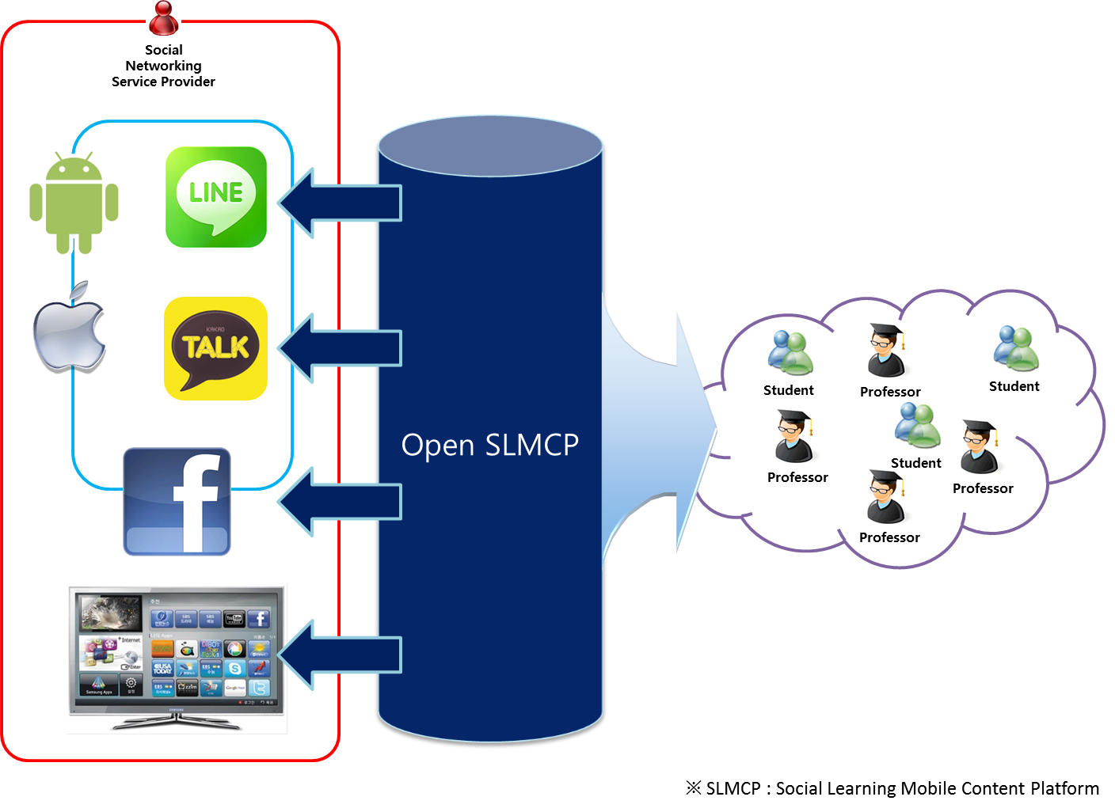
Open SLMCP
Open SLMCP is content platform and application service on mobile network environment.
2014 BlueCloud Co., Ltd. – Serious Game Portal
4

Slide 5
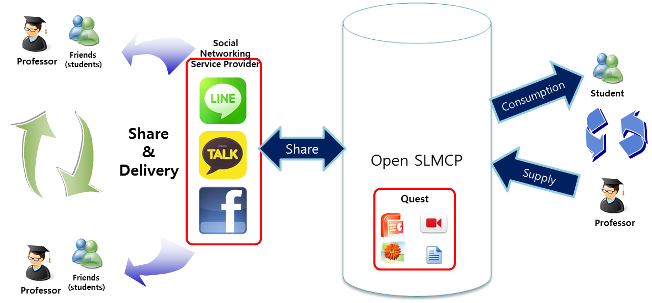
Social Learning Mobile Content Platform
Meaning of the ‘Open’ in the ‘Open SLMCP’ is the platform that is open to all users, teachers and students to be able to.
2014 BlueCloud Co., Ltd. – Serious Game Portal
5

Slide 6
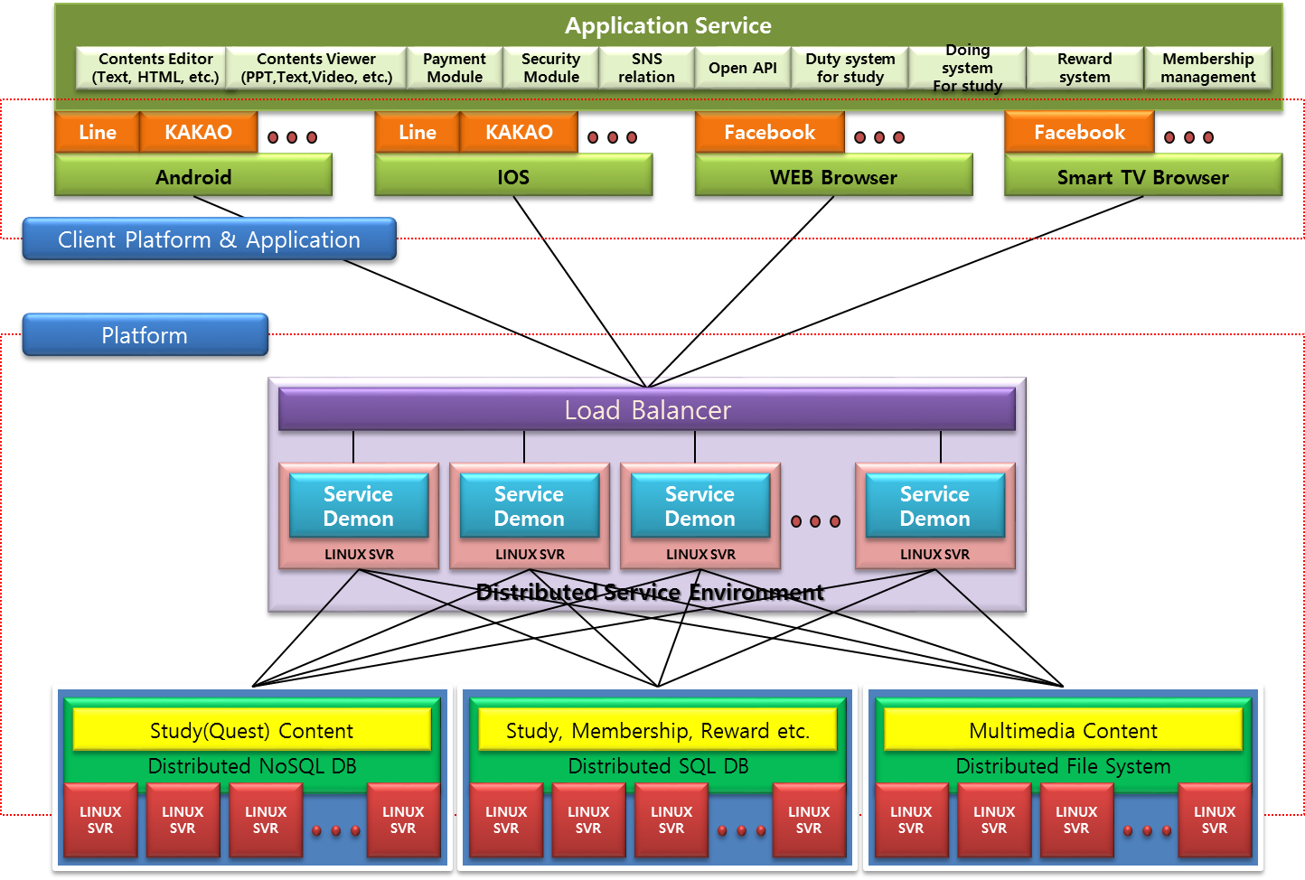
Social Learning Mobile Content Platform
This platform is configured to share the learning content through the social network service of a various friends of users.
2014 BlueCloud Co., Ltd. – Serious Game Portal
6

Slide 7
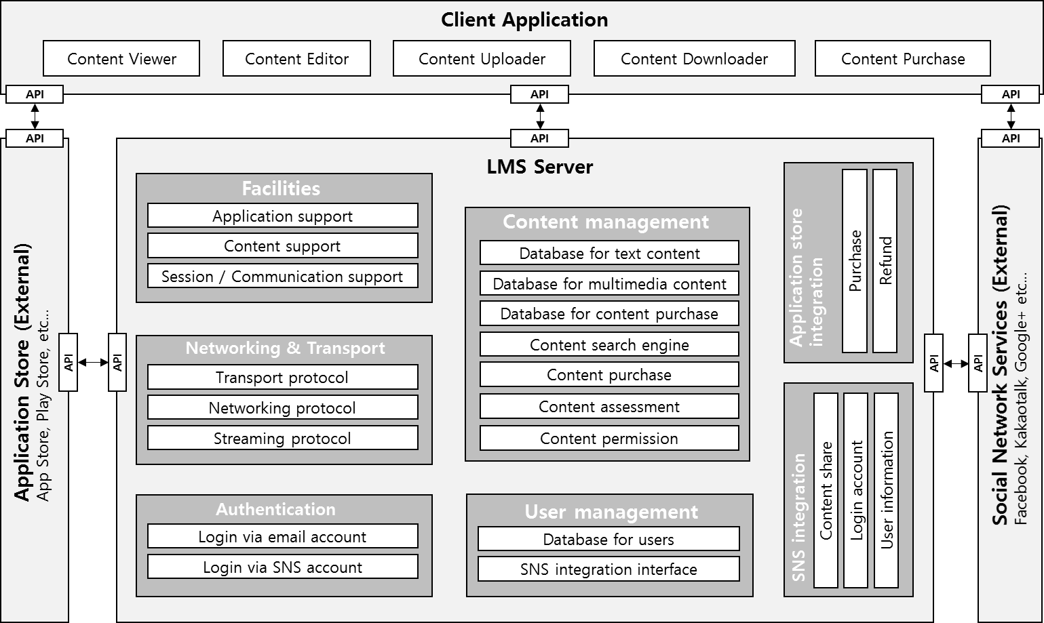
Open SLMCP System
2014 BlueCloud Co., Ltd. – Serious Game Portal

Slide 8
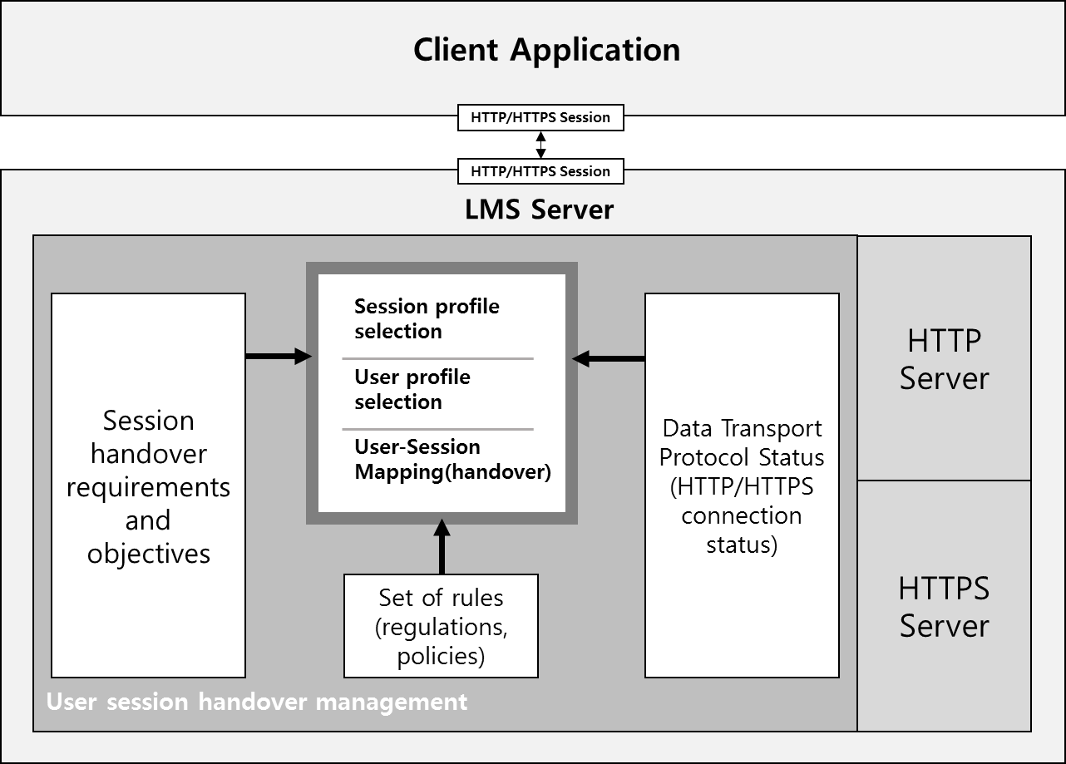
Open SLMCP System
2014 BlueCloud Co., Ltd. – Serious Game Portal

