Slide 1
IEEE 802.21
DCN: 21-14-0125-00
Title: ITS use cases for MIH
Date Submitted: July17, 2014
IEEE 802.21 session #63 in San Diego, CA, USA
Authors or Source(s):
Dick Roy (SRA)
Abstract: Intelligent transport systems use cases for media independent handover

Slide 2
  IEEE 802.21 presentation release statements
This document has been prepared to assist the IEEE 802.21 Working Group. It is offered as a basis for discussion and is not binding on the contributing individual(s) or organization(s). The material in this document is subject to change in form and content after further study. The contributor(s) reserve(s) the right to add, amend or withdraw material contained herein.
The contributor grants a free, irrevocable license to the IEEE to incorporate material contained in this contribution, and any modifications thereof, in the creation of an IEEE Standards publication; to copyright in the IEEE’s name any IEEE Standards publication even though it may include portions of this contribution; and at the IEEE’s sole discretion to permit others to reproduce in whole or in part the resulting IEEE Standards publication. The contributor also acknowledges and accepts that this contribution may be made public by IEEE 802.21.
The contributor is familiar with IEEE patent policy, as stated in Section 6 of the IEEE-SA Standards Board bylaws <http://standards.ieee.org/guides/bylaws/sect6-7.html#6> and in Understanding Patent Issues During IEEE Standards Development http://standards.ieee.org/board/pat/faq.pdf>

Slide 3
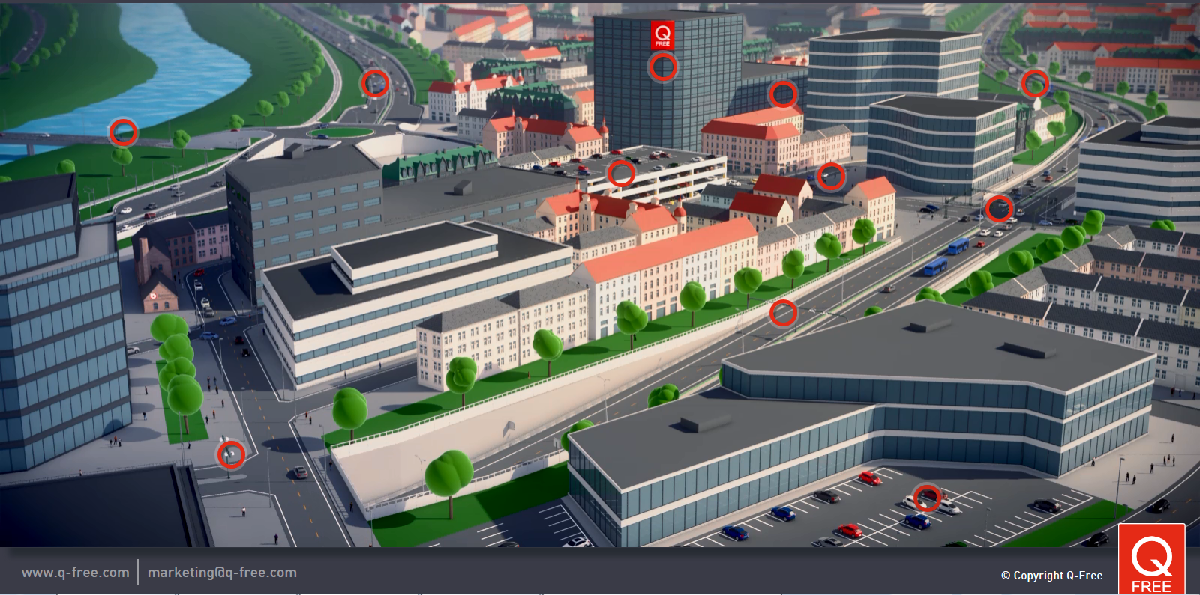
Intelligent Transportation Systems
ITS stations communicate anywhere, anytime, safely and securely
2014 SRA, Inc. – ITS consulting
3

Slide 4
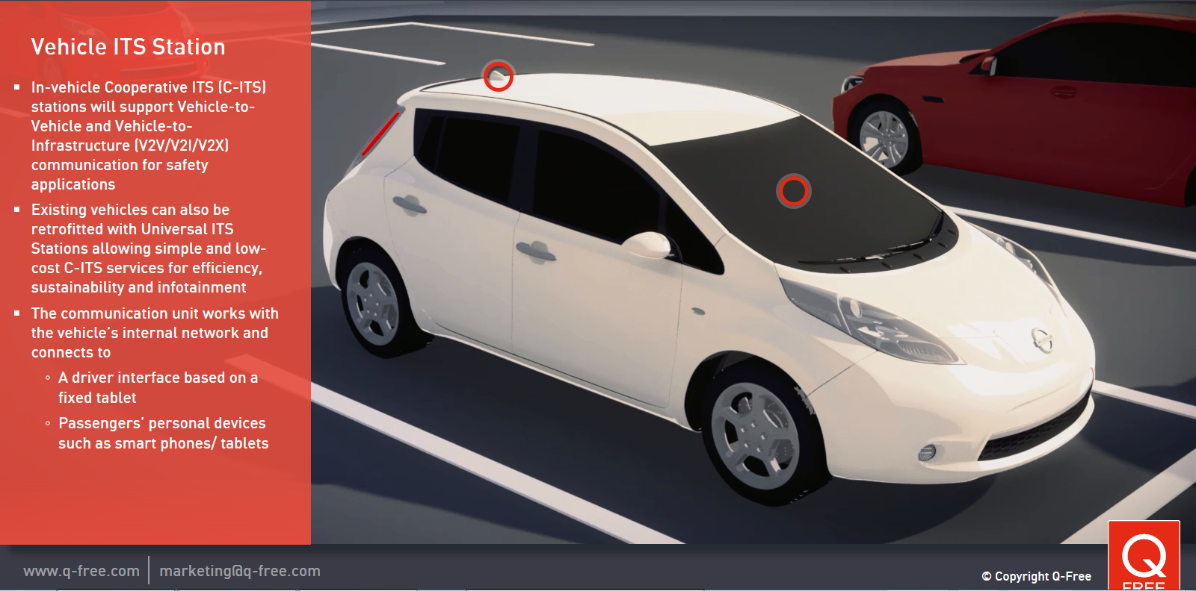
Intelligent Transportation Systems
Instrumented intersections provide valuable information to vehicles and pedestrians for collision avoidance and other applications
2014 SRA, Inc. – ITS consulting
4

Slide 5
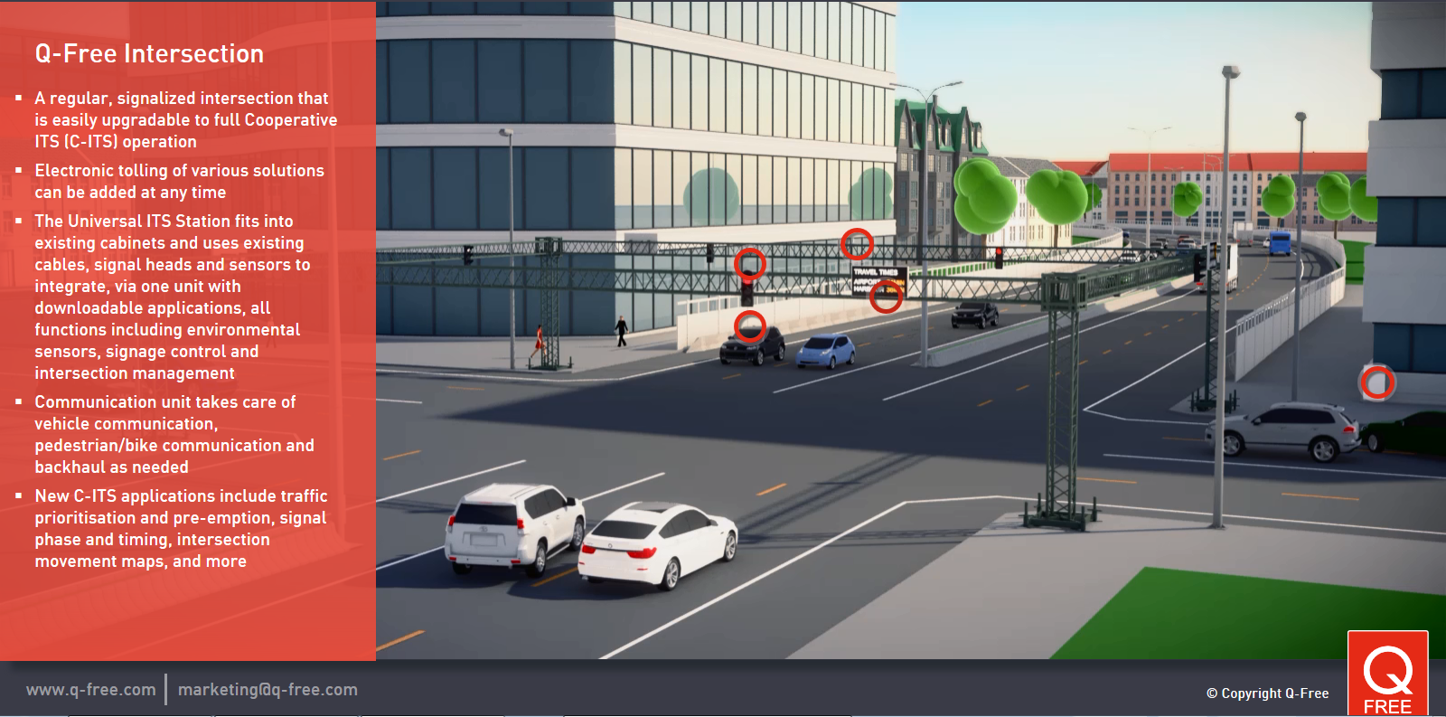
Intelligent Transportation Systems
Instrumented intersections provide valuable information to vehicles and pedestrians for collision avoidance and other applications
2014 SRA, Inc. – ITS consulting
5

Slide 6
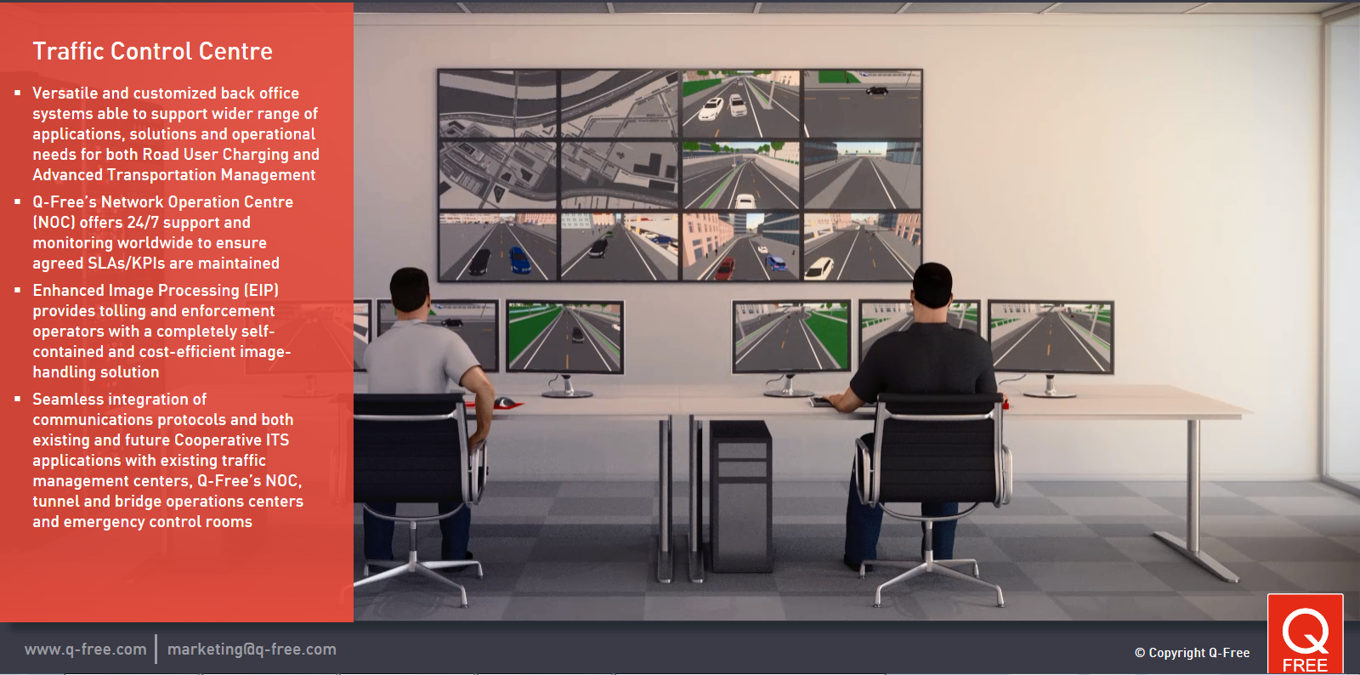
Intelligent Transportation Systems
Control centers integrate incoming information and provide value- added services
2014 SRA, Inc. – ITS consulting
6

Slide 7

“Silo” approach to multiple applications
VM Proprietary
System
EETS
system
eCall
system
Active
Safety
system
Radio box
(3G/LTE, WiFi, Bluetooth, GPS,…)
Radio box
(2G/3G, GPS, 5.8GHz,…)
Radio box
(2G/3G, GPS,…)
Radio box
(GPS, 5.9GHz,…)
Mandated and value-added applications implemented in "silos“ … duplication of equipment and no sharing of data and resources … SUBOPTIMAL & EXPENSIVE!
2014 SRA, Inc. – ITS consulting
7
Notes:
7

Slide 8
Sensible approach to multiple applications
Sharing of equipment and data … it’s OPTIMAL & CHEAPER!
and SAFER!
and FUTURE PROOF!
“Hard”
Safety
System
ITS Station
Parking
EETS
eCall
Comm System
(3G, LTE, WiFi, 5.9GHz, Bluetooth, GPS, …)
Infotainment
VM Proprietary
Firewall
Vehicle HMI
2014 SRA, Inc. – ITS consulting
8
Notes:
8

Slide 9
ITS stations
•A “Trusted” ITS station (ITS-S) is a functional entity consisting of ITS-S application processes running inside a bounded, SECURED, managed domain (cf. ISO 21217).
•SECURED means “ITS trusted/trustable”
•MANAGED means “someone is watching the store”
•The ITS-S architecture is designed around the abstraction of ITS-S application processes from the communication means used to connect to peer entities.
•Instantiations of ITS-Ss are called ITS station units (ITS-SUs).
•ITS-SUs communicate with peer entities using the “optimal” means available (cf. ISO 17419/17423/ 17429/24102-6).

Slide 10
ITS stations

Slide 11
ITS stations

Slide 12
ITS Applications / Use Cases
The US DoT has sponsored the development of the “Connected Vehicle Reference Implementation Architecture” (CVRIA)
The CVRIA has been developed based on a set of use cases documented at:
http://www.iteris.com/cvria

Slide 13
Some Relevant ISO/IEEE/SAE Standards (not exhaustive!)
2014 SRA, Inc. – ITS consulting
ISO 21217 - CALM Architecture (ITS station)
ISO 24102-x ITS station management
  (ISO 24102-5 Fast Service Advertisement Protocol)
  (ISO 24102-6 Flow and Path Management)
ISO 29281-1 - Fast Networking Protocol
ISO 17419 - ITS-S application identifiers, registries and certification (Message sets and IDs)
ISO 17423 - ITS-S application management
ISO 17429 - Generic Message Handling Services
ISO 18750 - Local Dynamic Map
IEEE 1609.2 - WAVE Security Services
SAE J2735 – DSRC Message Set Dictionary (incl. probe vehicle data)
IEEE 802.11 / 1609.3 / 1609.4 (5.9 GHz safety communications)
ISO 21215 / EN 302 665 (5.9 GHz safety communications)

