Slide 1
802.21 for SDN-based flow handover in wireless environments
Daniel Corujo <dcorujo@av.it.pt>
Carlos Guimarães <cguimaraes@av.it.pt>
Rui L. Aguiar <ruilaa@ua.pt>
http://atnog.av.it.pt

Slide 2
Outline
Objective of the work
Using IEEE 802.21 to assist SDN operations
  De-coupled approach
  Coupled approach
Conclusions

Slide 3
Objective of the Work
To identify integration synergies between 802.21 and SDN in wireless scenarios
Focus: Handover optimization and multi-technology interfacing

Slide 4
Using IEEE 802.21 to assist SDN operations
Considering that a MN<->CN communication path was established using SDN Flows…
  … and said MN moves to another PoA
  … triggering a SDN flow re-establishment
    Delay, QoE decrease, etc.
PoA #1
MN
CN
OpenFlow Switch
PoA #2
OpenFlow Controller
MN

Slide 5
Using IEEE 802.21 to assist SDN operations
By leveraging IEEE 802.21 capabilities:
  Abstraction of link layers
  Acquisition of network and link layer information
  Control and manage of link layers
... the SDN controller can be coupled with IEEE 802.21 PoS capabilities, achieving:
  IEEE 802.21-assisted mobility management and control independently of the access technology in SDN environments
  IEEE 802.21-assisted path optimization in SDN environments, based on the link conditions (both wireless and wired)

Slide 6
Using IEEE 802.21 to assist SDN operations
This work allowed to complement SDN operations with
  Media Independent Link-layer information
  Handover control and optimization
…from 802.21
Particularly, some parameters/information from 802.21 provides wireless device properties
  Which OpenFlow currently does not support

Slide 7
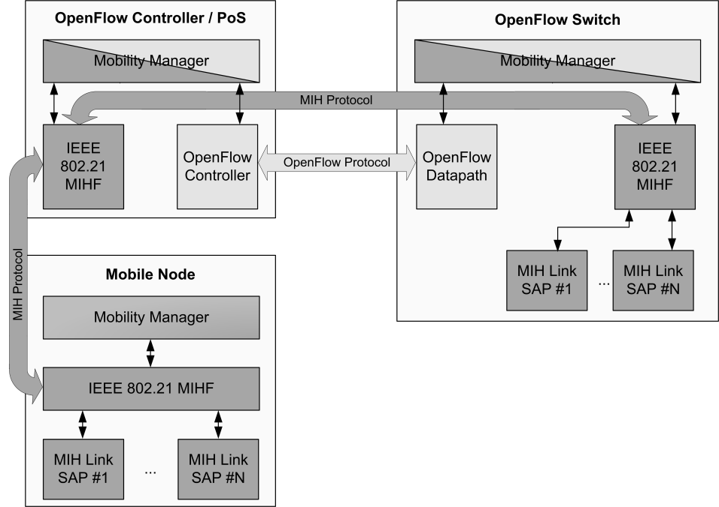
Example Deployed Architecture
OpenFlow Controller / PoS
  Perform routing related tasks, via SDN
  Handle and control mobility procedures, via IEEE 802.21
OpenFlow device
  Forwarding related tasks
  Provides interfaces to control and manage link layers, regarding handover management
Mobile Node
  Provide interfaces to control and manage link layers, via IEEE 802.21

Slide 8
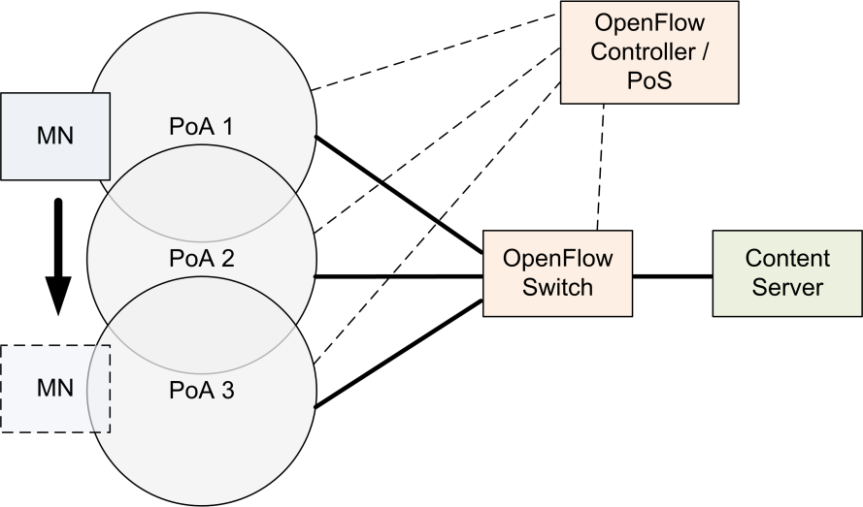
Evaluation
The Mobile Node moves through the different PoAs, while receiving a video stream from the Content Server
  The same interface was used for the handover
This scenario was compared in three different situations:
  Without any mobility-aware mechanisms
  With a deployment featureing some enhance logic on the controller (dummy mobility)
  Featuring IEEE 802.21 capabilities

Slide 9
Main Performance Conclusions
802.21 supported mobility allows for seamless handover in SDN flow environments
802.21 packet flow has a lower overhead than OpenFlow
Transporting MIH in UDP (with Ack service) has a message exchange delay comparable with OpenFlow (TCP)

Slide 10
Enhancing OpenFlow with Media Independent Management Capabilities
In addition, we studied a coupled approach
… with new OpenFlow primitives added to the protocol
… based on 802.21 primitives
  Existing and new ones

Slide 11
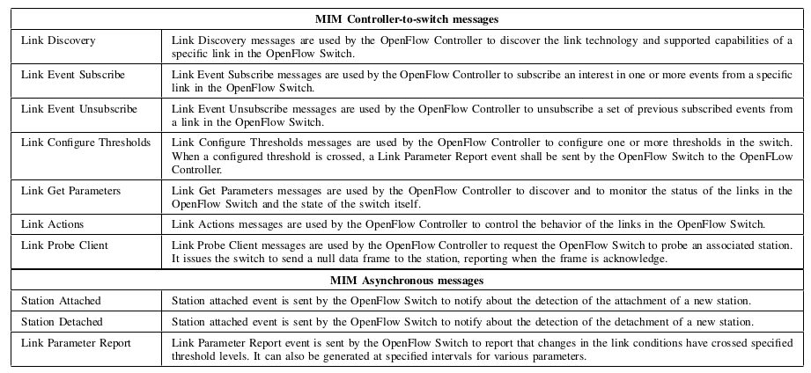
Using IEEE 802.21-like mechanisms to assist SDN operations
* Not defined in IEEE 802.21
*
*
*

Slide 12
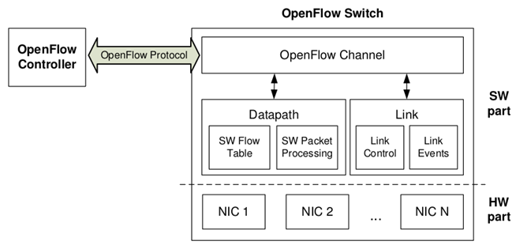
Using IEEE 802.21-like mechanisms to assist SDN operations
Datapath
  Maintains the flow table
  Processes incoming packets
Link
  Interact with the network interfaces of the OpenFlow Switch
    Leveraged by Link Media Dependent Interface (LMDI) that translates MIM OpenFlow messages into media specific commands
OpenFlow Channel
  Establishes a connection with the OpenFlow Controller via OpenFlow protocol
  Able to manage and to transmit events from the OpenFlow switch to the OpenFlow Controller

Slide 13
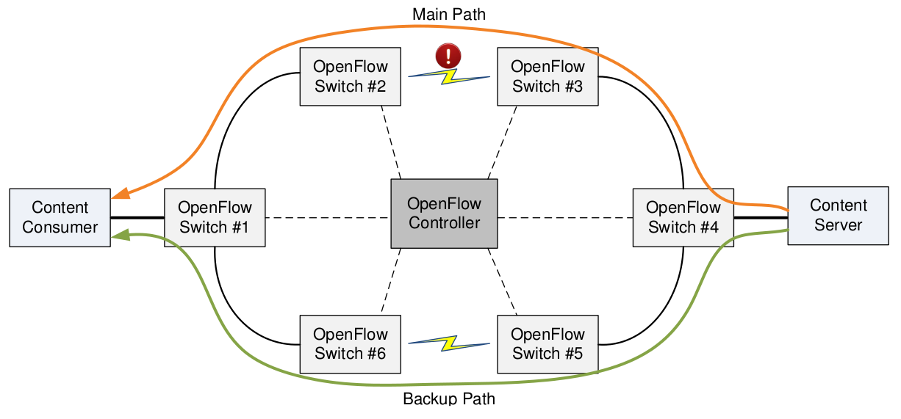
Evaluation
The content consumer is receiving a video stream from the content server
The link conditions of the wireless connections are continuously changing
The OpenFlow Controller detects that the main path is no longer optimal and reconfigures the network to use the backup path

Slide 14
Main Conclusions
OpenFlow protocol enhanced with 802.21 capabilities
  Allows for network path optimization
  … based on media independent link layer stimuli
Naturally, a larger amount of messages is used
  Due to link conditions monitoring needed
  When compared with regular OpenFlow
  … but less generated overhead overall

Slide 15
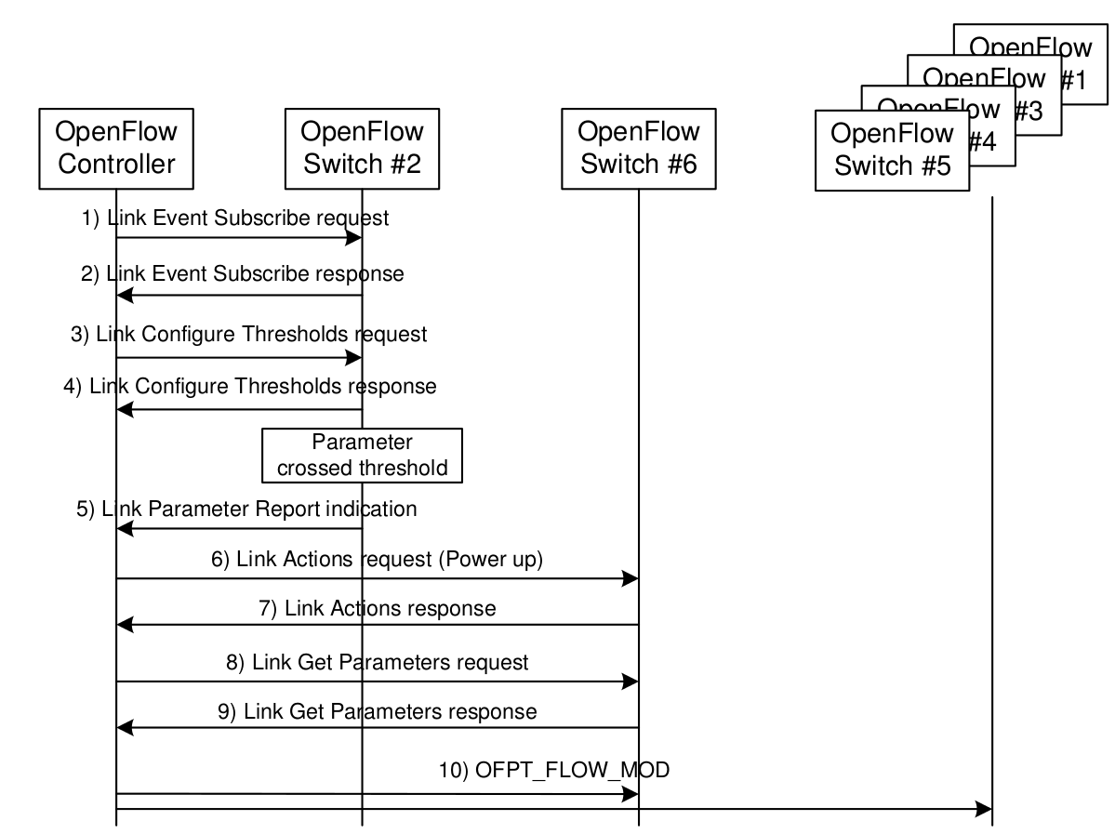
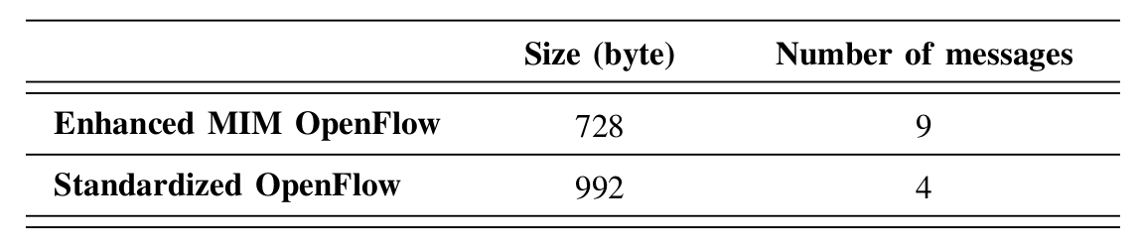
Control Signaling Overhead Analysis

Slide 16
More Details
“Empowering Software Defined Wireless Networks Through Media Independent Handover Management”, Proc. 2013 Globecom, Atlanta, USA, Dec 2013 (presented)
“Enhancing OpenFlow with Media Independent Management Capabilities”, Proc. ICC 2014 IEEE International Conference on Communications, Sydney, Australia, Jun 2014 (accepted)

Slide 17
Conclusions
When analyzed under light of 802.21 objectives
  SDN has some gaps that could be filled/complemented
802.21 can optimize SDN flow handover in wireless environments
Opens up the way for direct OpenFlow WLAN support (as well as other wireless technologies)

