Slide 1
IEEE 802.21 MEDIA INDEPENDENT HANDOVER
DCN: 21-13-0218-00-SAUC-ONF-project-desc
Title: 802.21.1 ONF project descriptions
Date Submitted: November 13th 2013
To be presented at IEEE 802.21.1 TG, Dallas Wireless Plenary
Authors or Source(s): Charlie Perkins
Abstract: This contribution presents the four use cases identified for development within the ONF Wireless & Mobility WG, and suggests some general ideas for 802.21 participation

Slide 2
  IEEE 802.21 presentation release statements
This document has been prepared to assist the IEEE 802.21 Working Group. It is offered as a basis for discussion and is not binding on the contributing individual(s) or organization(s). The material in this document is subject to change in form and content after further study. The contributor(s) reserve(s) the right to add, amend or withdraw material contained herein.
The contributor grants a free, irrevocable license to the IEEE to incorporate material contained in this contribution, and any modifications thereof, in the creation of an IEEE Standards publication; to copyright in the IEEE’s name any IEEE Standards publication even though it may include portions of this contribution; and at the IEEE’s sole discretion to permit others to reproduce in whole or in part the resulting IEEE Standards publication. The contributor also acknowledges and accepts that this contribution may be made public by IEEE 802.21.
The contributor is familiar with IEEE patent policy, as stated in Section 6 of the IEEE-SA Standards Board bylaws <http://standards.ieee.org/guides/bylaws/sect6-7.html#6> and in Understanding Patent Issues During IEEE Standards Development http://standards.ieee.org/board/pat/faq.pdf>

Slide 3
ONF Wireless & Mobility WG
OpenFlow is the focus for creation of SDNs
Charter approved prior to October Member Workday event
4 (of 17) use cases were picked for development within the WG
  Unified Enterprise Access
  Virtualized S-GW
  Mobile Backhaul
  IEEE
Project leaders identified for each project
  Regular meetings
  Mailing lists
  Progress reports
  Proof of concept strongly encouraged

Slide 4

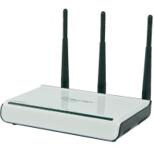

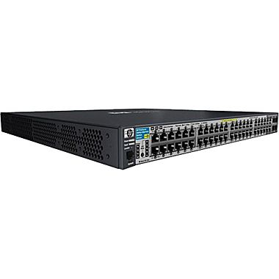

Unified Access:
How OpenFlow Can Help
Policy Enforcement across Wi-Fi and Ethernet
  Client support mandates the use of 802.1X
  RADIUS attributes used for authorization (i.e. policy enforcement)
  OpenFlow rules increase flexibility and enrich capability
  OpenFlow play a role vis-à-vis RADIUS/802.1X policy?
Today’s Environment:
Radius
Server
CAPWAP
(UDP 5246/5247)
EAPOL
(802.1X)
Wireless AC
Wireless User
RADIUS
(UDP 1812/1813)
EAPOL
(802.1X)
=
Wired User
802.1X Authenticator
Radius Client

Slide 5
Northbound API for Authentication
Scenario:
Assume CAPWAP Local-MAC model requires OpenFlow agent on AP, otherwise agent is on AC
Radius Server determines end-user authentication results
Radius Server calls Northbound API on OpenFlow Controller for deployment of rules
Potential ONF Standardization Needs:
Northbound API for user authentication
Radius
Server
CAPWAP
(UDP 5246/5247)
RADIUS
(UDP 1812/1813)
EAPOL
(802.1X)
Wireless AC
Wireless User
OpenFlow
Controller
OpenFlow
(TCP 6633/6634)
New Northbound API for User Authentication
EAPOL
(802.1X)
=
OpenFlow Agent
Wired User
=
802.1X Authenticator
Radius Client

Slide 6





SW Virtualization: Architecture
SDN based GW virtualization is realized by combination of GW (C-plane), SDN controller and multiple OFSs.
The virtualized GW can be considered as 3GPP standard GW, so that peripheral 3GPP entities, i.e. eNB, MME, do not have any impacts to interwork with the virtualized GW.
Virtualized S-GW
S11
SDN
controller
GW-C
MME
P-GW
S1-MME
S5
S1-U
Multiple OFSs
eNB

Slide 7


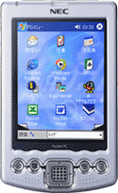
Benefit #1 - Route optimization between eNB and P-GW
Current technology w/o SDN
  S-GW could be a bottle neck for possible user traffic congestion.
P-GW
This P-GW can be any where in all over the world
Home
PDN
GRX
S-GW
P-GW
Semi-distributed
GW (SGi)
P-GW
IMS
Internet
This P-GW could be allocated per county or region.
It could be one possible IMS deployment scenario that a P-CSCF is assigned as the same way as a VLR in CS domain.
(Ex. SIPTO above RAN)
eNB
This P-GW should be allocated ex, per city basis, as it should be highly optimized.
UE

Slide 8
Benefit #1 - Route optimization between eNB and P-GW
SDN enables Efficient usage of intra operator network.
GW-C
SDN
controller
Home routed
GW (SGi)
Home
PDN
P-GW
MME
Semi-distributed
GW (SGi)
IMS
Distributed
OFSs
P-GW
Internet
Distributed
GW (SGi)
(SIPTO above RAN)
eNB
P-GW
Virtualized
S-GW
UE

Slide 9
Wireless Backhaul
For example, microwave
Energy savings, dynamic capacity, load balancing

Slide 10
Transmit Power Control
Current technology: ATPC(automatic transmit power control)
  against the deep fading in a short period of time
Optimize power consumption of network
  The SDN controller could set up a traffic distribution model and control the transmission power level
SDN Controller
Transmission power level
BTS
NE
NE
BSC
NodeB
ATM RNC
NE
NE
NodeB
/
eNB
IP RNC/S
-
Backhaul network
GW/MME

Slide 11
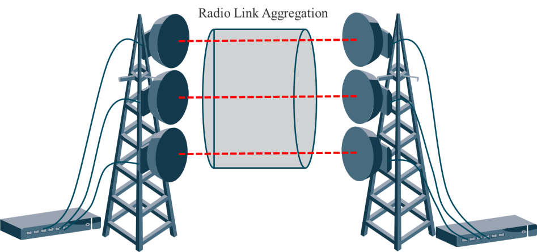
Radio Link Aggregation Control
Current technology: radio link aggregation
  multiple radio carriers are used to carry the traffic
Optimize the power consumption in a LAG group
  The SDN controller can monitor the actual utilization of the link, and turn off some of the radios within the group

Slide 12
IEEE 802 Wireless
OmniRAN
802.16r small cell backhaul
802.21
We can try to align with one of the three other ONF projects
We can make a wholly new project
We can collaborate with OmniRAN and/or 802.16r

