Slide 1
IEEE 802.21 MEDIA INDEPENDENT HANDOVER
DCN: 21-13-0197-00-SAUC
Title: MIH Service Use Cases for Dynamic Frequency Channel Allocation of IEEE 802.11 WLANs
Date Submitted: November 9th, 2013
Presented at IEEE 802.21 Session #59 –Dallas, USA
Authors or Source(s):
Hyunho Park(ETRI), Hyeong-Ho Lee(ETRI), Seung-Hwan Lee (ETRI), and Jin Seek Choi (Korea Ethernet Forum)
Abstract: This document proposes MIH Service use cases for dynamic frequency channel allocation of IEEE 802.11 WLANs.

Slide 2
  IEEE 802.21 presentation release statements
This document has been prepared to assist the IEEE 802.21 Working Group. It is offered as a basis for discussion and is not binding on the contributing individual(s) or organization(s). The material in this document is subject to change in form and content after further study. The contributor(s) reserve(s) the right to add, amend or withdraw material contained herein.
The contributor grants a free, irrevocable license to the IEEE to incorporate material contained in this contribution, and any modifications thereof, in the creation of an IEEE Standards publication; to copyright in the IEEE’s name any IEEE Standards publication even though it may include portions of this contribution; and at the IEEE’s sole discretion to permit others to reproduce in whole or in part the resulting IEEE Standards publication. The contributor also acknowledges and accepts that this contribution may be made public by IEEE 802.21.
The contributor is familiar with IEEE patent policy, as stated in Section 6 of the IEEE-SA Standards Board bylaws <http://standards.ieee.org/guides/bylaws/sect6-7.html#6> and in Understanding Patent Issues During IEEE Standards Development http://standards.ieee.org/board/pat/faq.pdf>

Slide 3
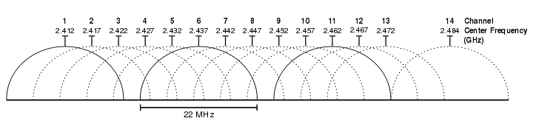
Problem of Dense WLAN Environment
WLAN access points (APs) are usually deployed by individual users without any planning for channel allocation.
In a dense WLAN environment, the signal coverage area of each AP typically has significant overlap with that of the neighboring APs.
The number of non overlapping channels for 2.4GHz WLAN (IEEE 802.11 b/g/n) are three.
Non-Overlapping Channels for 2.4 GHz WLAN

Slide 4

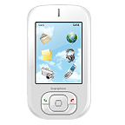
Problem of Dense WLAN Environment
Throughput of WLANs in dense environment decreases significantly due to the coverage overlap of neighboring APs.
Same Channel
AP B
that operates in the same frequency band as MN A
AP (Access Point) A
that connects to MN A
MN B
that operates in the same frequency band as MN A
MN (Mobile Node) A
Connection
Radio Interference

Slide 5
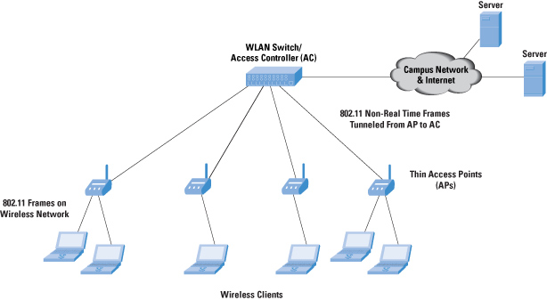
“Feasibility of Coordinated Transmission for HEW” (DCN: 11-13-1157-03)
Coordinated transmission allocation between adjacent WLAN APs
Architecture for Coordinated Transmission Allocation

Slide 6
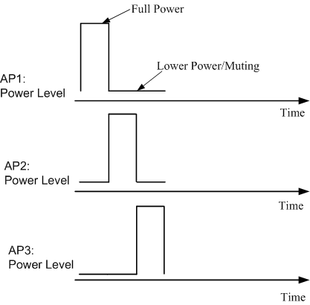
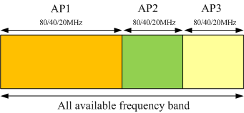
“Feasibility of Coordinated Transmission for HEW” (DCN: 11-13-1157-03) (Cont’d)
Coordinated power allocation
Coordinated frequency band allocation

Slide 7
Proposal of Dynamic Channel Allocation
Coordinated transmission allocation cannot be a solution for deployment of APs that are not controlled by the access controller (AC).
After AC allocates a channel for a WLAN AP, channel for a WLAN AP remains fixed even though link status becomes bad.
➔If channel for a coordinated or uncoordinated WLAN AP can be allocated dynamically depending on channel status, throughput of a WLAN can be improved.

Slide 8
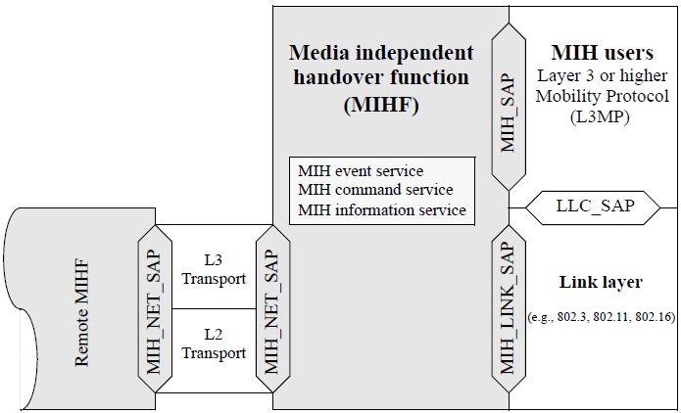
MIH Framework for Dynamic Channel Allocation of IEEE 802.11 WLANs
MIH framework is a common platform to support interworking between IEEE802 based networks.
  MIH_LINK_SAP is used to interact with link layer.
  → MIH framework provides fast control and management for link layer.
  MIH_SAP is used to interact with MIH users (Layer 3 or higher layer).
  → MIH user can manage and control link layer based on link status.
  MIH_NET_SAP is used to interact with remote MIHF.
  → MIH messages can be used to manage and control MIH-PoS(Point of Service).
  ➔MIH framework can be a good platform for dynamic channel allocation of IEEE 802.11 WLANs.

Slide 9
MIH Use Case 1: Dynamic Channel Allocation based on report of MNs (for Uncoordinated APs)
If MN reports bad link status to WLAN AP by using a proposed MIH message, the WLAN AP can change its channel allocation.
WLAN AP
Link Layer
L1/L2
Mobile Node (MN)
MIH User
Link Layer
L1/L2
MIH User
MIHF
MIHF
Primitive to report
bad link status
Primitive to report
MN’s bad link status
Message to report link status of MN
Primitive to change channel allocation
Primitive to change channel allocation
Channel allocation is changed.
Proposed MIH Primitive or MIH Message
MIH Primitive or MIH Message

Slide 10
MIH Use Case 2: Dynamic Channel Allocation based on
Link Status of WLAN APs (for Uncoordinated APs)
If link layer of AP detects a neighboring AP operating in the same channel and informs MIH User of the AP by using MIH primitive (e.g, Link_detected), the WLAN AP can change its channel allocation.
Neighboring WLAN AP
WLAN AP
Link Layer
L1/L2
MIH User
Radio interference from neighboring WLAN AP
MIHF
Link_Detected
MIH_Link_Detected
Primitive to change channel allocation
Radio interference
Primitive to change channel allocation
Proposed MIH Primitive or MIH Message
Channel allocation is changed.
MIH Primitive or MIH Message

Slide 11
MIH Use Case 3: Dynamic Channel Allocation by using a WLAN AC (for Coordinated APs)
If a WLAN AP reports its channel to its WLAN AC by using a proposed MIH message, the WLAN AC can allocate channels for its WLAN APs by using a proposed MIH message.
WLAN AP A and B operate in the same frequency channel.
WLAN AP A
WLAN AC
WLAN AP B
MIH User
MIH PoS
Link Layer
L1/L2
MIH User
MIHF
Report of frequency channel which WLAN AP A operates in
Network controller knows that WLAN AP A and B can interfere each other.
Message to change WLAN AP B’s channel ment
Primitive to change channel allocation
Channel allocation changed.

Slide 12
Conclusions
This contribution presented problem of dense WLAN environment, and possible solutions for dynamic channel allocation of WLAN APs based on MIH framework.
MIH framework is a good platform to support dynamic allocation of channels for WLAN APs that are uncoordinated or coordinated.

