Slide 1
IEEE 802.21 MEDIA INDEPENDENT HANDOVER
DCN: 21-13-0160-00-SAUC
Title: MIH Service Use Cases for Network-Assisted D2D Communication
Date Submitted: September 11th, 2013
Presented at IEEE 802.21 Session #58 –Nanjing, China
Authors or Source(s):
Hyunho Park, Hyeong-Ho Lee, and Seung-Hwan Lee (ETRI)
Abstract: This document proposes MIH service use cases for Network-Assisted D2D Communication (NADC).

Slide 2
  IEEE 802.21 presentation release statements
This document has been prepared to assist the IEEE 802.21 Working Group. It is offered as a basis for discussion and is not binding on the contributing individual(s) or organization(s). The material in this document is subject to change in form and content after further study. The contributor(s) reserve(s) the right to add, amend or withdraw material contained herein.
The contributor grants a free, irrevocable license to the IEEE to incorporate material contained in this contribution, and any modifications thereof, in the creation of an IEEE Standards publication; to copyright in the IEEE’s name any IEEE Standards publication even though it may include portions of this contribution; and at the IEEE’s sole discretion to permit others to reproduce in whole or in part the resulting IEEE Standards publication. The contributor also acknowledges and accepts that this contribution may be made public by IEEE 802.21.
The contributor is familiar with IEEE patent policy, as stated in Section 6 of the IEEE-SA Standards Board bylaws <http://standards.ieee.org/guides/bylaws/sect6-7.html#6> and in Understanding Patent Issues During IEEE Standards Development http://standards.ieee.org/board/pat/faq.pdf>

Slide 3
Network-Assisted
D2D Communication (NADC)
Device-to-Device (D2D) communications such as Wi-Fi Direct and IEEE 802.15.8 Peer Aware Communication (PAC) have problems of peer discovery and radio resource management.
Network-Assisted D2D Communication (NADC)
  We define Network-Assisted D2D Communication (NADC) as a D2D communication between two mobile nodes in proximity with the assistance of legacy networks (e.g., 3GPP network, WiMAX network, and WLAN).
    Scope of NADC: Peer discovery and radio resource management by using legacy networks
    Example of NADC: Proximity Services (ProSe) of 3GPP
  * Reference: G. Fodor, E. Dahlman, G. Mildh, S. Parkvall, N. Reider, G. Miklos, and Z. Turanyi, “Design aspects of network assisted device-to-device communications,” Communications Magazine, IEEE, vol. 50, no. 3, pp. 170 –177, march 2012.

Slide 4

Wi-Fi Direct and PAC without Network Assistance
1. Difficult peer discovery without network assistance
  Requirements for the peer
    Proximity: A mobile node (MN) and a peer node should be in proximity.
    Communication service: A peer node can provide communication service for the MN.
      E.g., If MN wants to receive some video file, the peer node must have the video file.
    Same D2D communication: A mobile node and a peer node should communicate each other by using the same D2D communication.
      E.g., MN and peer node use Wi-Fi Direct.
  Without network assistance, it is difficult for MN to discover the peer that meets the conditions.
    Example: If MN A and MN B in close proximity connect to different networks, how can they discover each other without network assistance?
Cellular Network
WLAN
MN A
MN B

Slide 5
Wi-Fi Direct and PAC without Network Assistance
2. Difficult to avoid radio interference without network assistance
  Radio interferences in Wi-Fi Direct and PAC
    Radio interference between MNs using D2D communication
      E.g., Radio interference between MNs using PAC
    Radio interference between legacy network (e.g., infrastructure WLAN) and D2D communication.
      E.g., Radio interference between infrastructure WLAN and Wi-Fi Direct.
  Without network assistance, it is difficult for MN to avoid radio interference.
Example: Interference between PAC devices
MN A
MN B
PAC Link
Interference from PAC
MN C
MN D

Slide 6
Introduction of 3GPP ProSe as NADC
Proximity Services (ProSe) communication in 3GPP TR 22.803
  A communication between two UEs in proximity by means of a E-UTRAN communication path established between the UEs.
    E.g., “direct mode” and “locally-routed” data path
3GPP ProSe documents
Stage 1 document: 3GPP TR 22.803 V12.2.0 (2013-06), “3rd Generation Partnership Project; Technical Specification Group Services and System Aspects; Feasibility study for Proximity Services (ProSe) (Release 12).”
Stage 2 document: 3GPP TR 23.703 V0.4.1 (2013-06), “3rd Generation Partnership Project; Technical Specification Group Services and System Aspects; Study on architecture enhancements to support Proximity Services (ProSe) (Release 12).”

Slide 7

  3GPP ProSe Use Cases as NADC
  Network ProSe Discovery Use Case
MNO
(2) The MNO (Mobile Network Operator) network verifies that Mary has permission to discover Peter’s UE and in proximity of Peter’s UE
(1) Request for ProSe Discovery
(3) “Mary’s and Peter’s user equipment's (UEs) are in proximity.”
(3) “Mary’s and Peter’s user equipment's (UEs) are in proximity.”
Mary
Peter
(3) Mary’s and Peter’s UEs have discovered each other.
Mary’s UE
(User Equipment)
Peter’s UE
Ref. 3GPP TR 22.803 V12.2.0 (2013-06), “3rd Generation Partnership Project; Technical Specification Group Services and System Aspects; Feasibility study for Proximity Services (ProSe) (Release 12).”

Slide 8
  3GPP ProSe Use Cases as NADC (Cont’d)
  ProSe-assisted WLAN Direct Communications Use Case
(1) 3GPP EPC (Evolved Packet Core) determines proximity of Bob’s and John’s UEs
3GPP EPC
(2) WLAN configuration information to assist with WLAN direct connection establishment
(2) WLAN configuration information to assist with WLAN direct connection establishment
Bob
John
(3) Establishment of WLAN direct communication
Bob’s UE
John’s UE
Ref. 3GPP TR 22.803 V12.2.0 (2013-06), “3rd Generation Partnership Project; Technical Specification Group Services and System Aspects; Feasibility study for Proximity Services (ProSe) (Release 12).”

Slide 9
  3GPP ProSe Use Cases as NADC (Cont’d)
  Service Management and Continuity for ProSe-assisted WLAN Direct Communications
MNO’s core network infrastructure
(1) Data session is routed over the MNO’s core network infrastructure.
3GPP system
(3) 3GPP system switches data session to the WLAN Direct communication path
Bob
Bob
John
John
(2) Move
(2) Move
(4) Data session over WLAN direct path.
Bob’s UE
Bob’s UE
John’s UE
John’s UE
Ref. 3GPP TR 22.803 V12.2.0 (2013-06), “3rd Generation Partnership Project; Technical Specification Group Services and System Aspects; Feasibility study for Proximity Services (ProSe) (Release 12).”

Slide 10
  3GPP ProSe Use Cases as NADC
  Network Offloading via WLAN ProSe Communication
(2) MNO’s core network is congested.
MNO’s core network infrastructure
(1) Data session is routed over the MNO’s core network infrastructure.
3GPP EPC
(3) Connect directly via WLAN!
Bob
John
(4) WLAN direct connection
Bob’s UE
(5) 3GPP EPC moves data session from infrastructure path to WLAN direct path.
John’s UE
Ref. 3GPP TR 22.803 V12.2.0 (2013-06), “3rd Generation Partnership Project; Technical Specification Group Services and System Aspects; Feasibility study for Proximity Services (ProSe) (Release 12).”

Slide 11
Architecture for 3GPP ProSe
  Application Server (AS): stores user’s profile for applications relying on ProSe service
  Mobility Management Entity (MME): issues and maintains the ProSe ID
  Gateway Mobile Location Centers (GMLC): stores current locations of UEs
  ProSe Server: stores subscriber’s ProSe profile and acts as a location services (LCS) client to GMLC
Ref. 3GPP TR 23.703 V0.4.1 (2013-06), “3rd Generation Partnership Project; Technical Specification Group Services and System Aspects; Study on architecture enhancements to support Proximity Services (ProSe) (Release 12).”

Slide 12
3GPP EPC-level ProSe Discovery
  Proximity Alert
Ref. 3GPP TR 23.703 V0.4.1 (2013-06), “3rd Generation Partnership Project; Technical Specification Group Services and System Aspects; Study on architecture enhancements to support Proximity Services (ProSe) (Release 12).”

Slide 13
MIH Framework for NADC
Characteristics of MIH framework
  Common platform to support interworking between networks using IEEE 802 and cellular technologies
  Network discovery and selection with network assistance
MIH framework is a good platform of NADC for Wi-Fi Direct, PAC, and ProSe Direct Communication.
Requirements of MIH Framework to support NADC
  Discovery of MN’s peer
  Interworking between D2D communication and legacy network
  Interworking between D2D communications

Slide 14

Architecture of NADC with MIH
MIH entity | Functions | Corresponding entities in 3GPP ProSe
MIH Information Server | stores MN’s current location and provide configuration information of MN’s peer | ProSe Server + GMLC
MIH PoS (Point of Service) | functions as a controller of MNs for NADC | MME
MIH
Information
Server
MIH PoS
MIH PoS
WLAN/ WPAN/WiMAX/
Cellular Network
Control Path
Data Path
PoA A
PoA B
MN A
MN B

Slide 15
  MIH Service Use Cases and Scenarios for NADC
  Peer Discovery
  The MIH information server provides information about MN’s peer.
  Scenario
WLAN/ WPAN/WiMAX/Cellular Network
MIH
Information
Server
(1) MIH Information Server determines proximity of Bob’s and John’s UEs
(2) Configuration information of D2D communication
(E.g., Wi-Fi Direct or PAC)
Bob
(2) Configuration information of D2D communication
(E.g., Wi-Fi Direct or PAC)
John
(3) Establishment of D2D communication
Bob’s MN
(Mobile Node)
John’s MN

Slide 16
  MIH Service Use Cases and Scenarios for NADC (Cont’d)
  Service Management and Continuity
  MIH Information Server provides service management and continuity.
  Scenario
WLAN/ WPAN/WiMAX/Cellular Network
MIH
Information
Server
(1) Data session is routed over the network infrastructure.
Bob
Bob
(3) Configuration information
(E.g., configuration information for Wi-Fi Direct or PAC)
John
John
(2) Move
(2) Move
(4) Data session over D2D communication path.
Bob’s UE
Bob’s UE
John’s UE
John’s UE

Slide 17
  MIH Service Use Cases and Scenarios for NADC (Cont’d)
  Network Offloading via D2D Communication
  MIH PoS and MIH Information Server provide Network Offloading via D2D Communication.
  Scenario
WLAN/ WPAN/WiMAX/Cellular Network
MIH
Information
Server
(1) Data session is routed over the network infrastructure.
(3) Request for configuration information of D2D communication (E.g., Wi-Fi Direct and PAC)
(4) Response for configuration information of D2D communication
Bob
(2) Network infrastructure is congested.
MIH PoS determines network offloading via D2D communication.
John
MIH PoS
(5) Establish D2D communication with configuration information !
(6) Establishment of D2D communication
Bob’s UE
(5) MIH PoS moves data session from infrastructure path to D2D communication path.
John’s UE

Slide 18
  3GPP ProSe Use Cases as NADC
  Radio Interference Avoidance
  MIH Information Server helps radio interference avoidance.
  Scenario
WLAN/ WPAN/WiMAX/Cellular Network
MIH
Information
Server
(3) MIH Information Server knows that Mary’s and Peter’s MNs can connect to each other via D2D communication B (E.g., PAC)
(2) Request for another
D2D communication
(4) “Mary’s and Peter’s MNs can connect via D2D communication B
(E.g., PAC).”
(4) Mary’s and Peter’s MNs can connect via D2D communication B
(E.g., PAC).”
Peter
Mary
(1) Bad link of D2D communication A (E.g., Wi-Fi Direct) due to radio interference
Mary’s MN
Peter’s MN
(5) Establishment of D2D communication B
(1) Radio interference from other MNs

Slide 19
Conclusions
Current Wi-Fi Direct and PAC without network assistance have problems of peer discovery and radio resource management.
MIH framework can provide network assistance for Wi-Fi Direct, PAC, and ProSe Direct Communication for Network-Assisted D2D Communication (NADC).
NADC use cases with MIH framework
  Peer discovery
  Service management and continuity
  Network Offloading via D2D Communication
  Radio Interference Avoidance
Standard works for ProSe already started in 3GPP, and thus IEEE 802.21 also needs to start standard works for NADC as soon as possible.

Slide 20
Appendix: Direct mode data path and Locally-routed data Path
(a) Direct mode data path
(b) Locally-routed data path

Slide 21



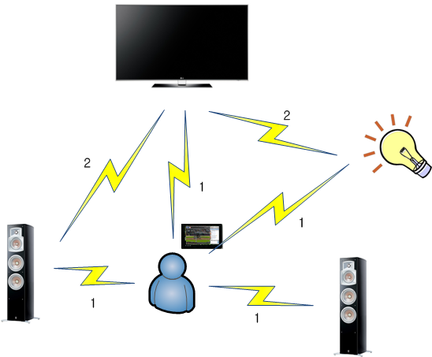



Appendix: Use Cases for D2D communications
Public safety
  E.g. Emergency Service
Advertisement
  E.g. Automatic advertisement or guide
SoS message
Advertisement
message
SoS message
Social networking
  E.g. Local group chatting/ messaging
Control of electronic devices
  Auto-control/device sync-up and easy content sharing
Control message
Friends
Ref. 15-12-0246-00-0008, “Application and Expected Technical Attributes in PAC.”

Slide 22
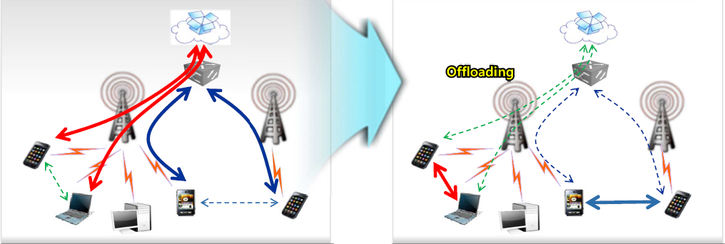
Appendix: Use Cases for D2D communications (Cont’d)
Data offload
  Data transfer and social network services can be offloaded to proximity communications
Data Transfer
Social Network
Ref. 15-12-0255-02-0008, “Response to the Call for Applications.”
22

Slide 23
Appendix: Peer discovery of Wi-Fi Direct
Search
Search
30ms
100ms~300ms
IEEE 802.11 scan
Ch. 1
Ch. 6
Ch. 11
Listen Ch. 11
Ch. 1
Ch. 6
Ch. 11
Listen
Ch. 11
Probe Request
Probe Request
Probe
Response
Probe Request
Probe Request
IEEE 802.11 scan
Ch. 1
Ch. 6
Ch. 11
Listen Ch. 1
Ch. 1
Ch. 6
Ch. 11
Search
Search
Ref. D. Camps-Mur et al., “Device to device communications with WiFi Direct: overview and experimentation.” In IEEE Wireless Communications Magazine, 2013.
Ref. 15-12-0281-00-0008, “Technical proposal of discovery for PAC.”

Slide 24
Appendix: Peer discovery of Wi-Fi Direct (Cont’d)
  IEEE 802.11 scan status
    Active or passive scan of IEEE 802.11
  Listen status
    MN selects one of the social channels (channel 1, 6, and 11 in 2.4GHz band).
    MN listens to the selected channel and responds with Probe Responses.
    Duration of Listen status: randomly distributed between 100ms and 300ms
  Search status
    MN transmits discovery signal at each channel 1, 6, 11 sequentially and wait the response during about 30ms typically.

Slide 25
  Appendix: Use Cases of ProSe
  Restricted ProSe Discovery Use Case
  Open ProSe Discovery Use Case
  Discovery Use Case with Subscribers from Different PLMNs
  Discovery Use Case with Roaming Subscribers
  Network ProSe Discovery Use Case
  Service Continuity between Infrastructure and E-UTRA ProSe Communication paths
  Operator A uses ProSe to Enhance Location and Presence Services
  ProSe for Large Numbers of UEs
  ProSe-assisted WLAN Direct Communications Use Case
  Service Management and Continuity for ProSe-assisted WLAN Direct Communications
Ref. 3GPP TR 22.803 V12.2.0 (2013-06), “3rd Generation Partnership Project; Technical Specification Group Services and System Aspects; Feasibility study for Proximity Services (ProSe) (Release 12).”

Slide 26
  Appendix: Use Cases of ProSe (Cont’d)
  Use Case for ProSe Application Provided by the Third-Party Application Developer
  Concurrent E-UTRAN Infrastructure and WLAN Proximity Communication
  Network Offloading via WLAN ProSe Communication
  ProSe Discovery Within Network Coverage
  ProSe Discovery Out of Network Coverage
  Can Discover But Not Discoverable
Ref. 3GPP TR 22.803 V12.2.0 (2013-06), “3rd Generation Partnership Project; Technical Specification Group Services and System Aspects; Feasibility study for Proximity Services (ProSe) (Release 12).”

