Slide 1
IEEE 802.21 MEDIA INDEPENDENT HANDOVER
DCN: 21-13-0015-00-MuGM
Title: Detailed explanation of the proposal made by ITAv and UC3M to IEEE 802.21d
Date Submitted: January, 2013
Authors or Source(s):
Antonio de la Oliva (UC3M), Daniel Corujo (ITAv), Carlos Guimaraes (ITAv)
Abstract: This document describes the components of the solution proposed by ITAv and UC3M to IEEE 802.21d

Slide 2
  IEEE 802.21 presentation release statements
This document has been prepared to assist the IEEE 802.21 Working Group. It is offered as a basis for discussion and is not binding on the contributing individual(s) or organization(s). The material in this document is subject to change in form and content after further study. The contributor(s) reserve(s) the right to add, amend or withdraw material contained herein.
The contributor grants a free, irrevocable license to the IEEE to incorporate material contained in this contribution, and any modifications thereof, in the creation of an IEEE Standards publication; to copyright in the IEEE’s name any IEEE Standards publication even though it may include portions of this contribution; and at the IEEE’s sole discretion to permit others to reproduce in whole or in part the resulting IEEE Standards publication. The contributor also acknowledges and accepts that this contribution may be made public by IEEE 802.21.
The contributor is familiar with IEEE patent policy, as outlined in Section 6.3 of the IEEE-SA Standards Board Operations Manual <http://standards.ieee.org/guides/opman/sect6.html#6.3> and in Understanding Patent Issues During IEEE Standards Development http://standards.ieee.org/board/pat/guide.html>
  IEEE 802.21 presentation release statements
This document has been prepared to assist the IEEE 802.21 Working Group. It is offered as a basis for discussion and is not binding on the contributing individual(s) or organization(s). The material in this document is subject to change in form and content after further study. The contributor(s) reserve(s) the right to add, amend or withdraw material contained herein.
The contributor grants a free, irrevocable license to the IEEE to incorporate material contained in this contribution, and any modifications thereof, in the creation of an IEEE Standards publication; to copyright in the IEEE’s name any IEEE Standards publication even though it may include portions of this contribution; and at the IEEE’s sole discretion to permit others to reproduce in whole or in part the resulting IEEE Standards publication. The contributor also acknowledges and accepts that this contribution may be made public by IEEE 802.21.
The contributor is familiar with IEEE patent policy, as stated in Section 6 of the IEEE-SA Standards Board bylaws <http://standards.ieee.org/guides/bylaws/sect6-7.html#6> and in Understanding Patent Issues During IEEE Standards Development http://standards.ieee.org/board/pat/faq.pdf>

Slide 3
Detailed proposal discussion https://mentor.ieee.org/802.21/dcn/13/21-13-0003-00-MuGM-tgd-detailed-proposal-oliva-corujo-1.docx https://mentor.ieee.org/802.21/dcn/13/21-13-0004-00-MuGM-tgd-detailed-proposal-oliva-corujo-2.docx
Daniel Corujo (ITAv)
Carlos Guimaraes (ITAv)
Antonio de la Oliva (UC3M)

Slide 4
Command Service flow model
Current command flow expects one response per request
Proposed modification allows multiple responses coming from different mcast clients.

Slide 5
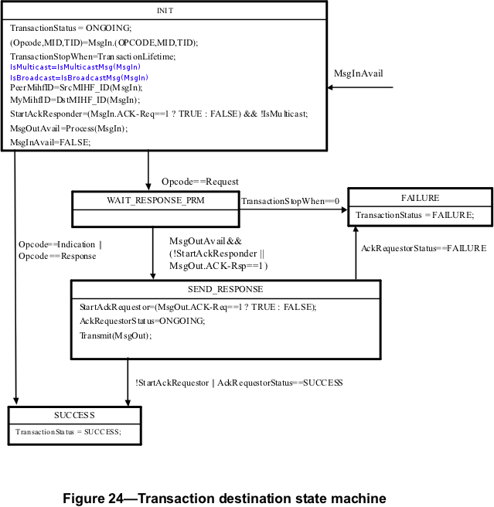
Required State Machine Modifications
Transaction destination State Machine needs to differentiate between Mcast and Bcast

Slide 6
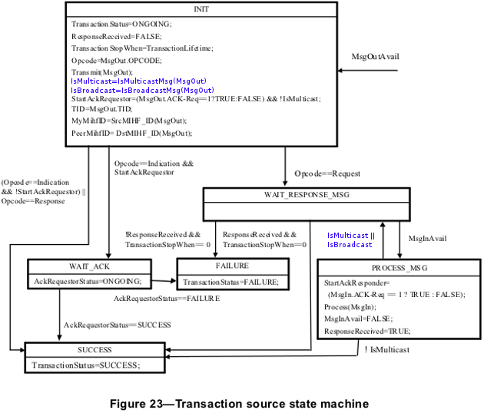
Required State Machine Modifications
Transaction source State Machine needs to differentiate between Mcast and Bcast
Also needs to keep processing response messages
Transaction lifetime timer used for controlling the waiting time

Slide 7
Group Management Primitives
MIH_Mcast_Join
  Local message used to convey information to the local MIHF
  Support multiple groups
MIH_Net_Mcast_Join
  Remote message enabling remote PoS to ask an MIHF to join a group

Slide 8
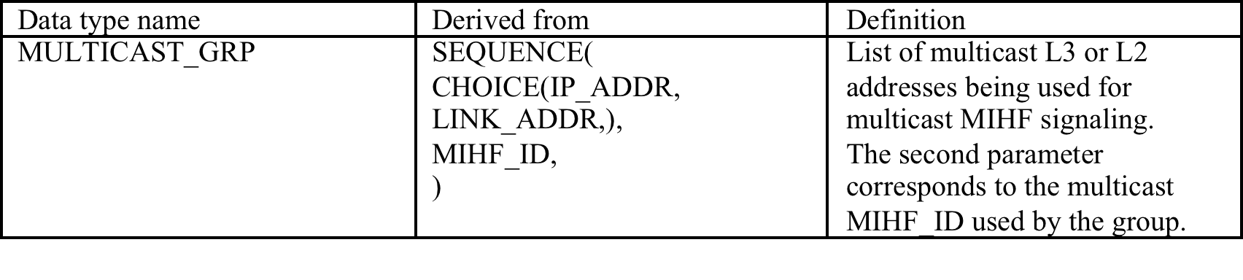
Transport addresses
Join primitives carry information about transport address to bind to

Slide 9
Joining groups while registering
We provide an extension to the registration procedure enabling the MN to obtain the list of groups while registering with the PoS.
Security aspects of this procedure TBD.
Similar approach is also proposed for the Capability Discovery mechanism.

Slide 10
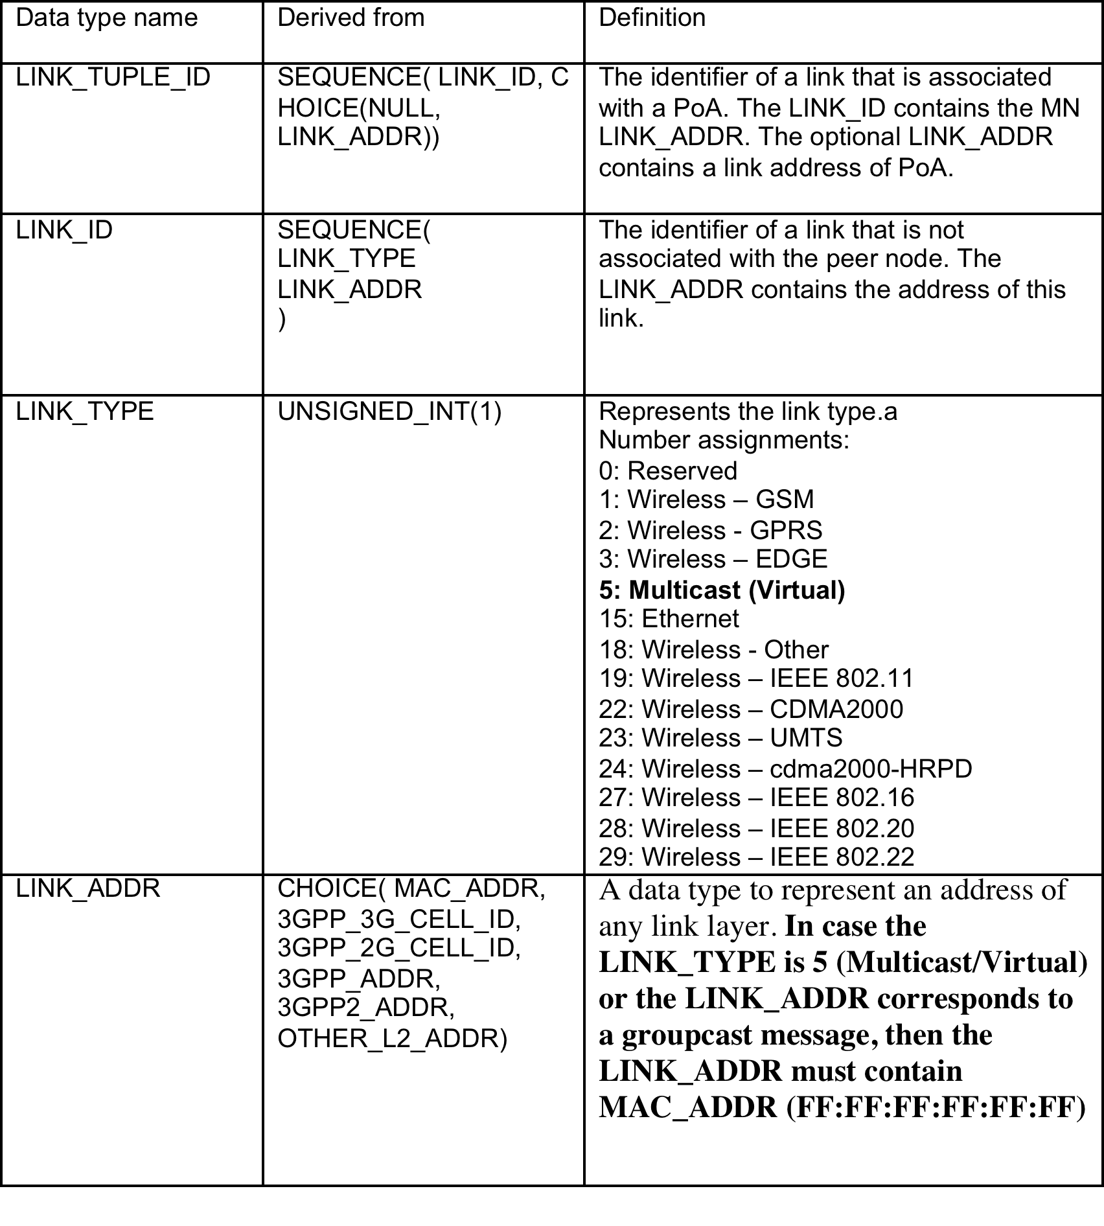
Link_Id data type
If multicast communication wants to be used in a general framework, it is needed to modify the contents of the Link_ID data type.
Through the use of the Multicast Data Type we can provide 3 different behaviours:
  Target: All links → [[5,FF:FF:FF:FF:FF:FF],NULL]
  Target: Links of a certain technology → [[19,FF:FF:FF:FF:FF:FF],NULL]
  Target: Nodes of a certain technology connected to a specific PoA→
  [[19,FF:FF:FF:FF:FF:FF],PoA]
Through this solution, multicast can be used in any primitive

Slide 11
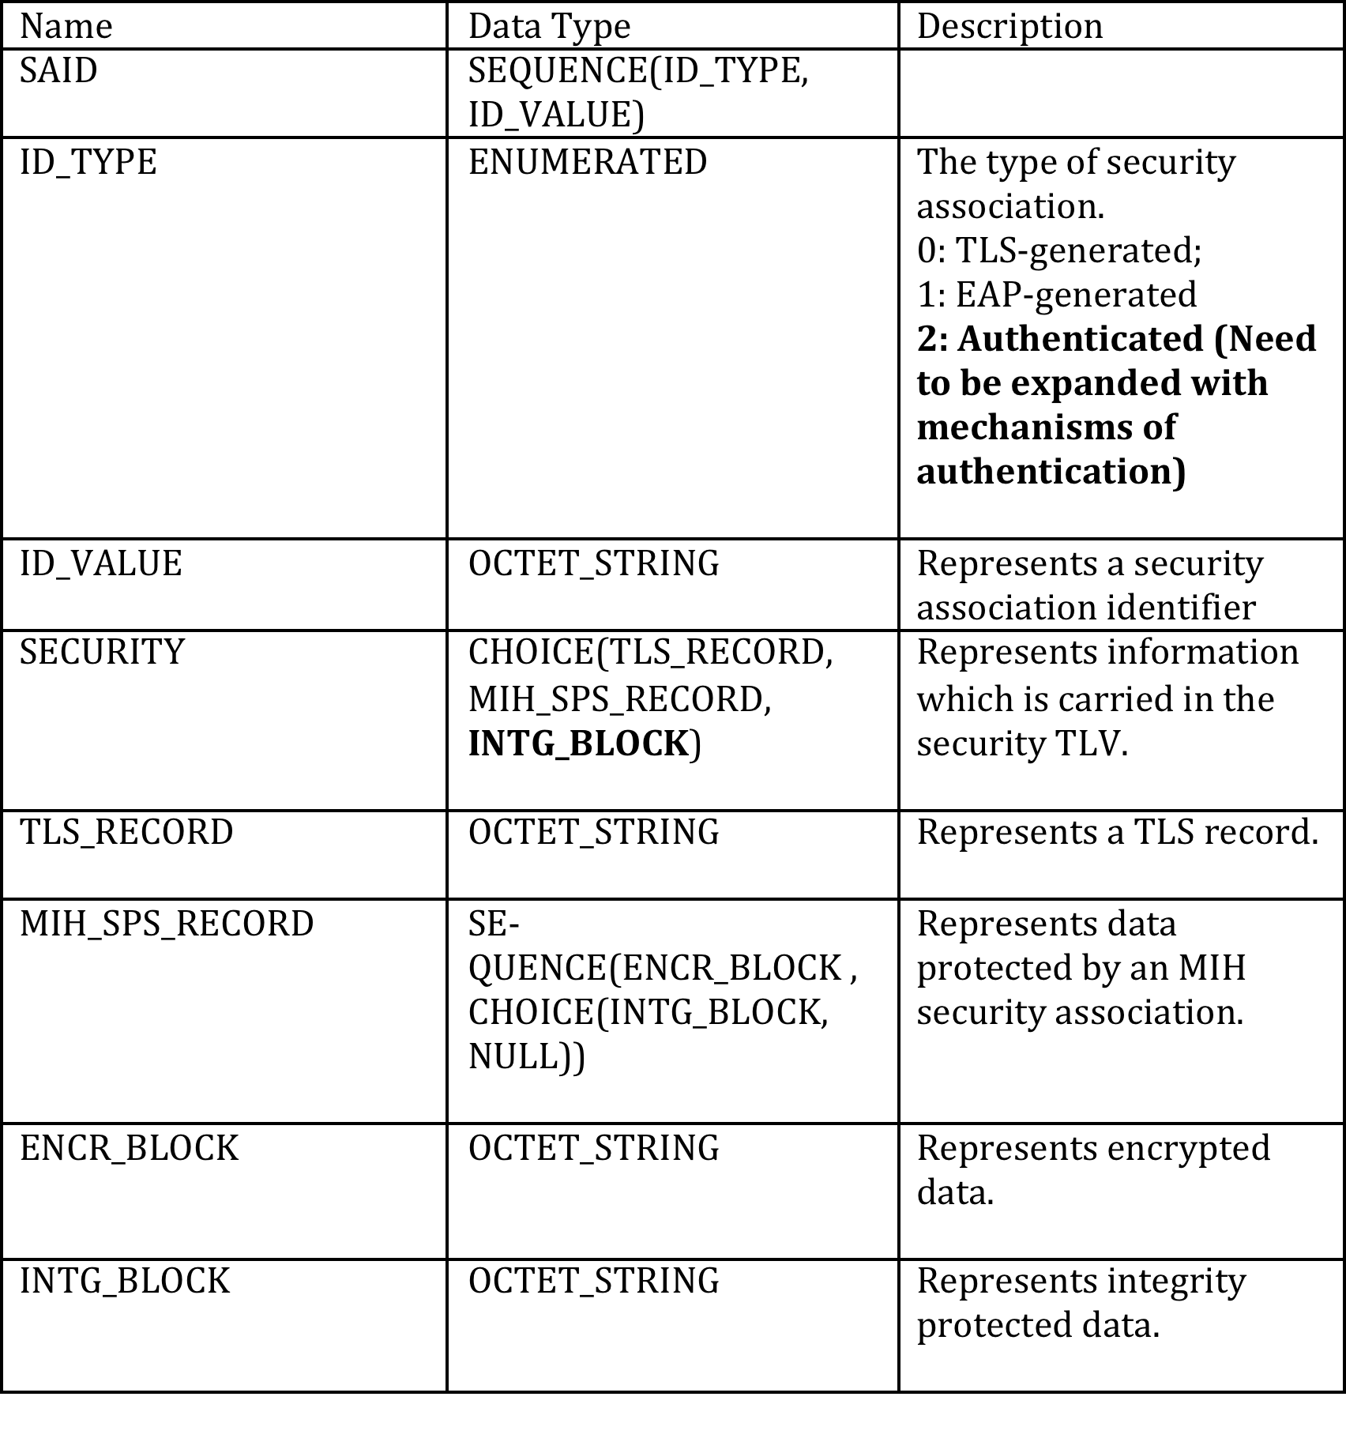
Security
Definition of a new type of security TLV
MIH header
(S=1)
Source MIHF
Identifier TLV
Destination MIHF
Identifier TLV
SAID
TLV
MIH service specific TLVs
Security TLV
(Authentication payload)

Slide 12
How can we integrate both solutions?
Transport model
  Need to define a generic way of handling the request/response in mcast
  Use of generic indication message might be an option
Link definition
  Use of GroupLinkActionList requires the modification of all the primitives to be used in mcast
  IMHO the solution of the modification of Link_ID is more flexible
Need a way of providing information regarding the transport address
  We can add a modified version of our MULTICASTGRP to your primitives
The manipulation primitives need to carry the command to execute (join, remove, etc..)
Security aspects are perfectly aligned, although some minor details such as the data type to use, require tweaking
Extra features
  Registration/Discovery mechanisms need to better explore the security aspects, we can consider inclusion in next iteration
  MIIS support

