Slide 1
IEEE 802.21 MEDIA INDEPENDENT HANDOVER
DCN: 21-12-0146-00-0000
Title: Data Offload Service through Wireless P2P Networks based on IEEE 802.21 Framework
Date Submitted: Nov. 03, 2012
Presented at IEEE 802.21 Session #53 –San Antonio, TX
Authors or Source(s):
Hyunho Park and Hyeong-Ho Lee (ETRI)
Abstract: This document describes data offload service through wireless P2P networks based on IEEE 802.21 framework.

Slide 2
IEEE 802.21 presentation release statements
This document has been prepared to assist the IEEE 802.21 Working Group. It is offered as a basis for discussion and is not binding on the contributing individual(s) or organization(s). The material in this document is subject to change in form and content after further study. The contributor(s) reserve(s) the right to add, amend or withdraw material contained herein.
The contributor grants a free, irrevocable license to the IEEE to incorporate material contained in this contribution, and any modifications thereof, in the creation of an IEEE Standards publication; to copyright in the IEEE’s name any IEEE Standards publication even though it may include portions of this contribution; and at the IEEE’s sole discretion to permit others to reproduce in whole or in part the resulting IEEE Standards publication. The contributor also acknowledges and accepts that this contribution may be made public by IEEE 802.21.
The contributor is familiar with IEEE patent policy, as stated in Section 6 of the IEEE-SA Standards Board bylaws <http://standards.ieee.org/guides/bylaws/sect6-7.html#6> and in Understanding Patent Issues During IEEE Standards Development http://standards.ieee.org/board/pat/faq.pdf>

Slide 3
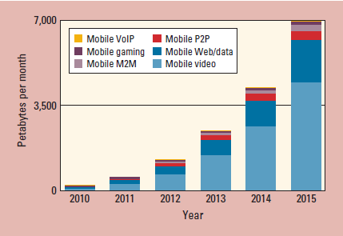
Characteristics of Video Mobile Data Traffic
Forecast of mobile data traffic
In 2015, video mobile data traffic will be 66 percent of the world’s mobile data traffic.
Reference: “Global Mobile Data Traffic Forecast, 2010.2015,” white paper, Cisco Visual Networking Index, Feb. 2012.

Slide 4
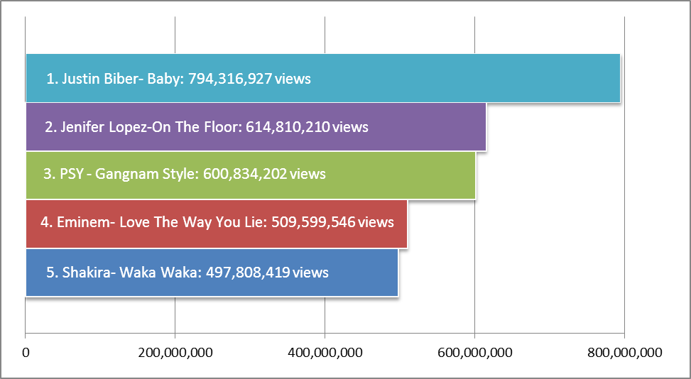
Characteristics of Video Mobile Data Traffic (Cont’d)
Number of views of video contents
Most viewed videos of YouTube charts on Oct. 31st, 2012

Slide 5
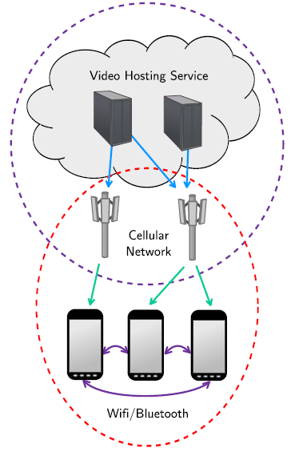
Data Offload through Wireless P2P Networks
MicroCast (A paper in Mobisys’ 12)
A group of smartphone users, within proximity of each other, are interested in watching the same video at the same time. Each smartphone connects to the video source (e.g., UStream, YouTube, or Netflix) using its cellular (3G or 4G) connection.
The base station may be the same or different for different users, depending on the provider they use.
Each smartphone can receive packets from the source as well as from other smartphones in the neighborhood through device-to-device (e.g., WiFi) links.
“Micro” indicates locality: there is a small number of users and they are all within proximity of each other.
“Cast” indicates a multicast scenario: all users in the group are interested in the same content sent by a single source, and local broadcast is used.
Reference: L. Keller, A. Le, and B. Cici,,” MicroCast: Cooperative Video Streaming on Smartphones,” MobiSys’12, pp. 57-69, June 2012.

Slide 6
Data Offload through Wireless P2P Networks (Cont’d)
Use case scenario
Jane likes Justin Biber, and thus downloaded Biber’s music video (MV) in her smart phone through a cellular network.
Jane’s school mates also want to download Biber’s MV.
However, the cellular network cannot transmit Biber’s MV in appropriate. throughput, because Jane’s school mates are so many.
Data offload through wireless P2P network is decided, and then the smartphones of the Jane’s school mates discover Jane’s smart phone, that downloaded Biber’s MV for Jane’s school mates.
Contents billing & payment, and security between mobile nodes should be considered.
Jane’s smart phone transmit Biber’s MV to her school mate.
Jane’s smart phone may multicast Biber’s MV using multicast scheme because of transmission efficiency.
Video hosting server
Cellular Networks
Justin Biber’s MV transmission through Cellular Networks
Jane’s Smartphone
Justin Biber’s MV transmission through WLAN Multicast
Classmate 2’s Smartphone
Classmate 1’s Smartphone
Classmate 2’s Smartphone

Slide 7
Data Offload through Wireless P2P Networks (Cont’d)
Advantages
Can support data offload without a point of attachment (PoA)
Can solve load balance problem for cellular networks
Can support higher quality of service (QoS) than cellular network
May support multicast of the contents to increase transmission efficiency using a wireless link

Slide 8
Consideration of Data Offload Service through Wireless P2P Networks
Decision of data offload through wireless P2P networks should be considered.
High load of cellular networks can be a reason for data offload.
Low QoS of cellular networks can be a reason for data offload.
Discovery of the donor device for contents should be considered.
Need to know which device has the contents downloaded before.
Location information of the donor device can be used to discover the closest donor device.
Security issues between donor and receiver devices should be considered.
Security for multicast user
Security for contents
Billing and payment of downloading the video contents should be considered.
Multicast group management is needed.
Multicast transmission of video contents should be considered.
Management for multicast groups should be considered for multicast transmission.

Slide 9
Proposal for Data Offload through Wireless P2P Networks based on IEEE 802.21 Frameworks
Contents server (CS)
CS provides contents.
Contents: Video data, firmware, etc.
Information repository (IR)
IR knows which device has the contents downloaded before.
IR knows location information of the mobile nodes (MNs).
Network controller (NC)
NC determines the appropriate networks (cellular networks, WiFi networks, wireless P2P networks, etc) for the MNs to download contents.
NC can be implemented by MIH-PoS.
Donor mobile node (MN)
The MN that already downloaded the contents from CS.
Donor MN provide contents for receiver MNs.
Receiver MNs
Architecture
CS
IR
The donor MN receives the contents from CS
Networks
NC
(MIH-PoS)
PoA
Multicast of contents
Receiver MNs
Donor MN

Slide 10
Proposal for Data Offload through Wireless P2P Networks based on IEEE 802.21 Frameworks(Cont’d)
Procedure
NC
(MIH-PoS)
IR
Donor MN
Receiver MNs
PoA
CS
Received contents
Request for Contents
Decision of Data Offload through Wireless P2P Networks
Request for Donor MN’s ID
Response of Donor MN’s ID
Response of Donor MN’s ID
Multicast Group Management between Donor MN and Receiver MNs
(This area can be a scope of IEEE 802.21d )
Request for Contents
Multicast of Contents

