Slide 1
IEEE 802.21 MEDIA INDEPENDENT HANDOVER
DCN: 21-12-0065-00-srho
Title: New Protocol Header for IEEE 802.21c
Date Submitted: May 16, 2012
Presented at IEEE 802 Interim meeting on May 16, 2012
Authors or Source(s):
Hyunho Park and Junghoon Jee (ETRI), H. Anthony Chan (Huawei), Dapeng Liu (China Mobile)
Abstract: This document describes the new simplified protocol header for IEEE 802.21c

Slide 2
IEEE 802.21 presentation release statements
This document has been prepared to assist the IEEE 802.21 Working Group. It is offered as a basis for discussion and is not binding on the contributing individual(s) or organization(s). The material in this document is subject to change in form and content after further study. The contributor(s) reserve(s) the right to add, amend or withdraw material contained herein.
The contributor grants a free, irrevocable license to the IEEE to incorporate material contained in this contribution, and any modifications thereof, in the creation of an IEEE Standards publication; to copyright in the IEEE’s name any IEEE Standards publication even though it may include portions of this contribution; and at the IEEE’s sole discretion to permit others to reproduce in whole or in part the resulting IEEE Standards publication. The contributor also acknowledges and accepts that this contribution may be made public by IEEE 802.21.
The contributor is familiar with IEEE patent policy, as stated in Section 6 of the IEEE-SA Standards Board bylaws <http://standards.ieee.org/guides/bylaws/sect6-7.html#6> and in Understanding Patent Issues During IEEE Standards Development http://standards.ieee.org/board/pat/faq.pdf>

Slide 3
Requirements for IEEE 802.21c Protocol
IEEE 802.21c protocol SHALL support control messages (R9, Rx, and Ry) of WiMAX for SRHO
802.21c is required to define interfaces for WiMAX<>WiFi and WiMAX <> 3GPP SRHO using Rx, Ry, and R9 protocols
Ref: Functional Requirements (IEEE 802.21c document, DCN # 21-10-0017-02-srho)
The 802.21c protocol are desirable to deliver other interworking protocols (e.g, ANQP and ANDSF message)
With the different transport and different requirements from 802.21 protocol, the 802.21c protocol needs new design

Slide 4
Control Messages of WiMAX for SRHO
Reserved (6bits) | B (1bits) | MTI (1bits)
MSID (6 bytes)
BSID (6bytes)
802.16 MAC PDU/R9 Control Message
Reserved (6bits) | B (1bits) | MTI (1bits)
MSID (6 bytes)
BSID (6bytes)
802.16MAC PDU/Rx Control Message
Reserved (7bits) | MTI (1bits)
802.11 MAC PDU/Ry Control Message
(a) R9 protocol: protocol between MS and WiMAX SFF for Interworking between Non-WiMAX and WiMAX Access Networks
(b) Rx protocol: protocol between MS and WiMAX SFF for Wi-Fi – WiMAX Interworking
(c) Ry protocol: protocol between MS and WiFi SFF for Wi-Fi – WiMAX Interworking
WiMAX Forum, “WiMAX Forum Network Architecture - Architecture, Detailed Protocols and Procedures WiFi® and WiMAX® Access Networks,” Nov. 2010.
WiMAX Forum. “WiMAX Forum Network Architecture - Architecture, detailed Protocols and Procedures Single Radio Interworking between Non-WiMAX® and WiMAX® Access Networks,” Nov. 2010.

Slide 5
Interworking Protocol of WiMAX (Cont’d)
B | indicates if the BSID field will be included in this message. “0” indicates that the BS ID is omitted in the message and “1” indicates BS ID is included.
MTI (Message Type Indicator) | This bit indicates the type of message.”0” indicates it is Control Message (for R9, Rx, or Ry) for SRHO, “1” indicates Encapsulated L2 message.
MSID | This is set to the 6-byte MAC address of MS the message pertains to. For transactions not related to any specific MS, all bits shall be set to zero.
BSID | For MS to WiMAX SFF direction, BSID is set to the 6-byte Target WiMAX BS identity from MS to WiMAX SFF. For WiMAX SFF to MS direction, BSID is set to pseudo BSID of the WiMAX SFF. If the MS has the SFF BSID, the BSID field may be omitted by setting the B bit to “0”. If the BSID is not omitted, then it SHALL be set to the BSID received from the SFF.

Slide 6
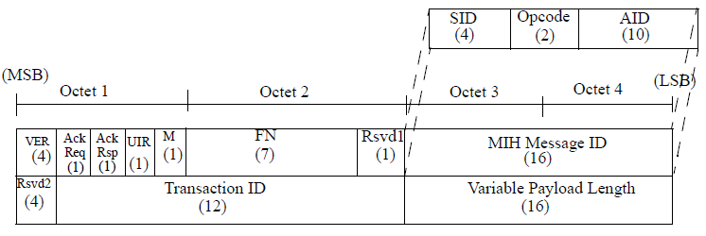
MIH Protocol Format & Header
MIH Protocol General Frame Format
MIH Protocol Header Format (Header Size: 8 Octets (=8Bytes))
Mandatory

Slide 7
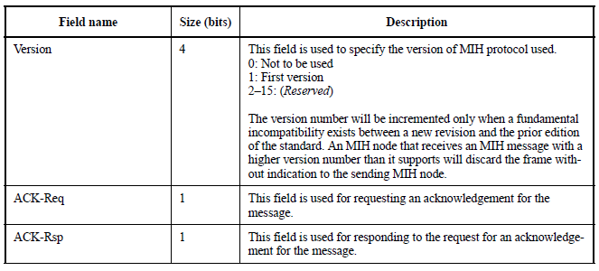
Description of MIH Header Fields

Slide 8
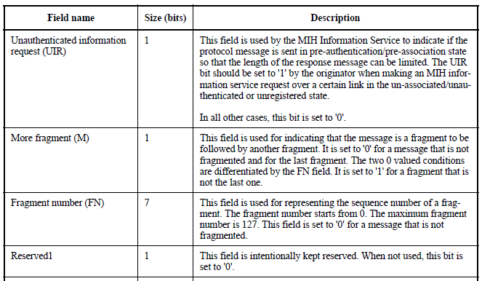
Description of MIH Header Fields (Cont’d)

Slide 9
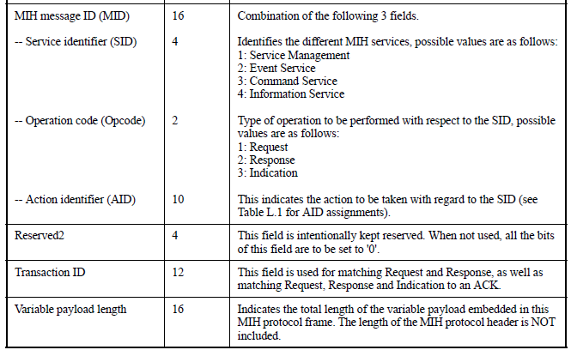
Description of MIH Header Fields (Cont’d)

Slide 10
New Simplified Protocol Design for IEEE 802.21c
Version (4) 2: IEEE 802.21c |  |  |  |  | Payload Types (2) |  | B (1) | MTI (1)
SrcID (6 bytes)
DstID (6bytes)
Ack Req (1) | Ack Rsp (1) |  | UIR (1) | M (1) | FN (4)
FN (3) |  |  |  | Rsvd (1) | SID (4)
Opcode (2) |  |  | AID (10)
Transaction ID (12)
Variable payload length (16)
Payload

Slide 11
Description of IEEE 802.21c’s New Protocol Header Fields
Version | This field is used to specify the version of MIH protocol used. 0: Not to be used 1: First version 2: IEEE 802.21c 3–15: (Reserved)
Payload Types | Indicates types of interworking protocols 0: IEEE 802.21c single radio handover content 1: ANQP of IEEE 802.11u 2: WiMAX interworking (E.g. R9 protocol) 3: ANDSF message
MTI | Indicates the type of Message 0: Control message for SRHO 1: Encapsulated target L2 message
SrcID (6 bytes) | Source MAC address, e.g., MAC address of MS MSID for WiMAX interworking protocol
DstID (6 bytes) | Destination MAC address, e.g., MAC address of M-GW BSID for WiMAX interworking protocol

Slide 12
Conclusions
The new IEEE 802.21c header
Can support interworking control message for WiMAX
Includes Interworking Protocol Type field to deliver other interworking protocols (e.g, ANQP and ANDSF message)
IEEE 802.21c can use old IEEE 802.21 protocol
Effects of IEEE 802.21c protocol
Improve network performance with short protocol header
Support compatibility with other interworking protocols
The simplified protocol raises its customization chance by supporting improved network performance and compatibility with other interworking protocol

